Slide 1

Multi-Threaded Proxy Server & Client
Presented By:
Jetty Subhash(AP23110010787)
Munagala Poorna Ravi Teja(AP23110010733)
Byraju Guna Vardhan (AP23110010744)
K Jesweer(Ap23110010054)
Oruganti Sumanth(AP23110010787)

Slide 2

Networking OS Project: Client-Server with Proxy
This project delves into the fundamentals of Operating Systems through a practical networking application. We implement a robust Client–Server model enhanced with an optional Proxy layer, showcasing essential OS concepts in action.

Slide 3
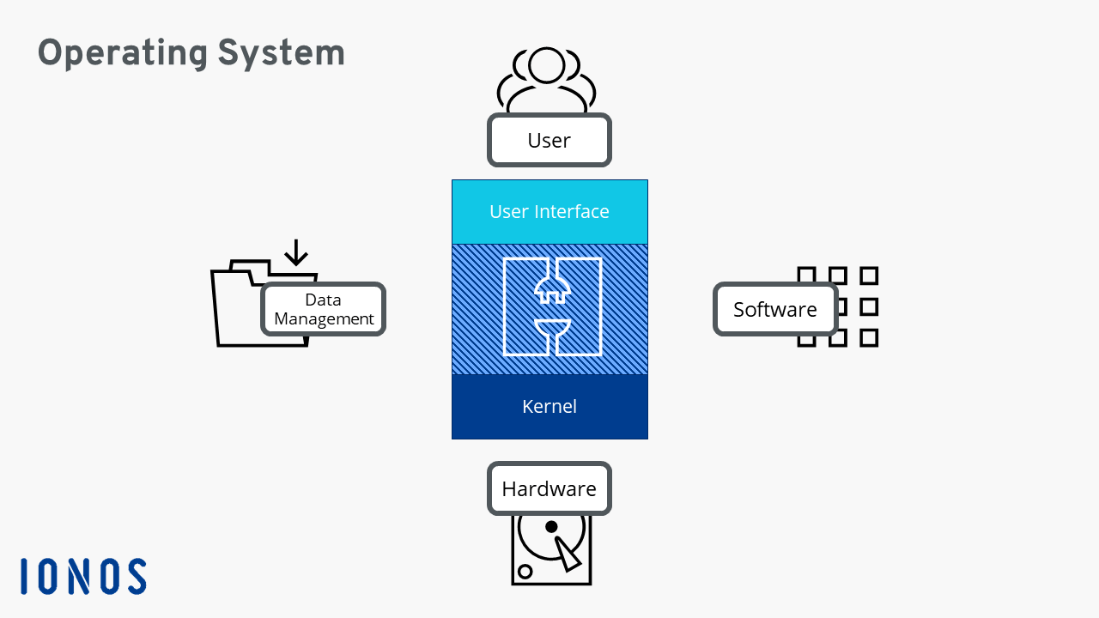
Problem Statement: Building a Reliable Communication System
Client-Server Communication
Design a system enabling reliable message exchange between a client and a server.
Optional Proxy Routing
Integrate a proxy layer for traffic monitoring, analysis, and enhanced security.
Real-Time Request Handling
Ensure the system can process and display requests and responses in real-time.
Modular Design
Maintain clear separation of concerns: GUI, backend, server, and proxy logic for scalability.

Slide 4
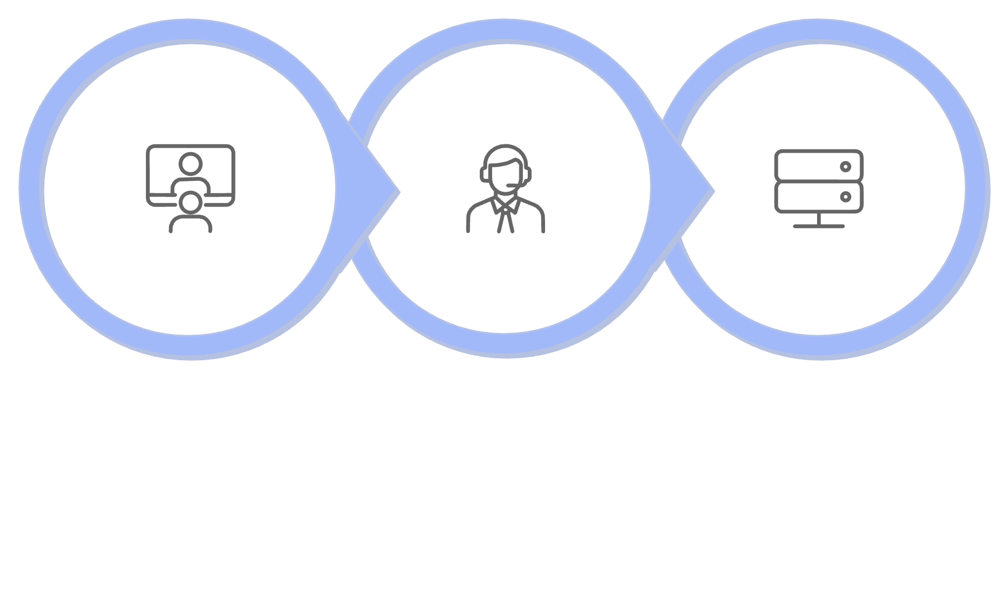



System Architecture: Three Core Components
Client
Proxy
Server
Client Module: Initiates communication, sending requests and receiving responses from the server.
Server Module: The backbone, responsible for processing all incoming requests and generating appropriate replies.
Proxy Module: An intelligent intermediary, optionally forwarding traffic and offering a layer for monitoring or manipulation.
All communication between these modules is facilitated using reliable TCP sockets, ensuring data integrity and ordered delivery.

Slide 5





Workflow Explanation: A Journey of Data
Client Sends Message
The user initiates communication via the GUI.
Proxy Interception
If enabled, the proxy captures the message for logging or modification.
Server Processing
The server receives, processes the request, and prepares a reply.
Reply via Proxy
The server's reply travels back through the proxy (if active).
GUI Displays Result
The client's interface presents the final response to the user.
This demonstrates a clear, full-duplex communication pathway.

Slide 6
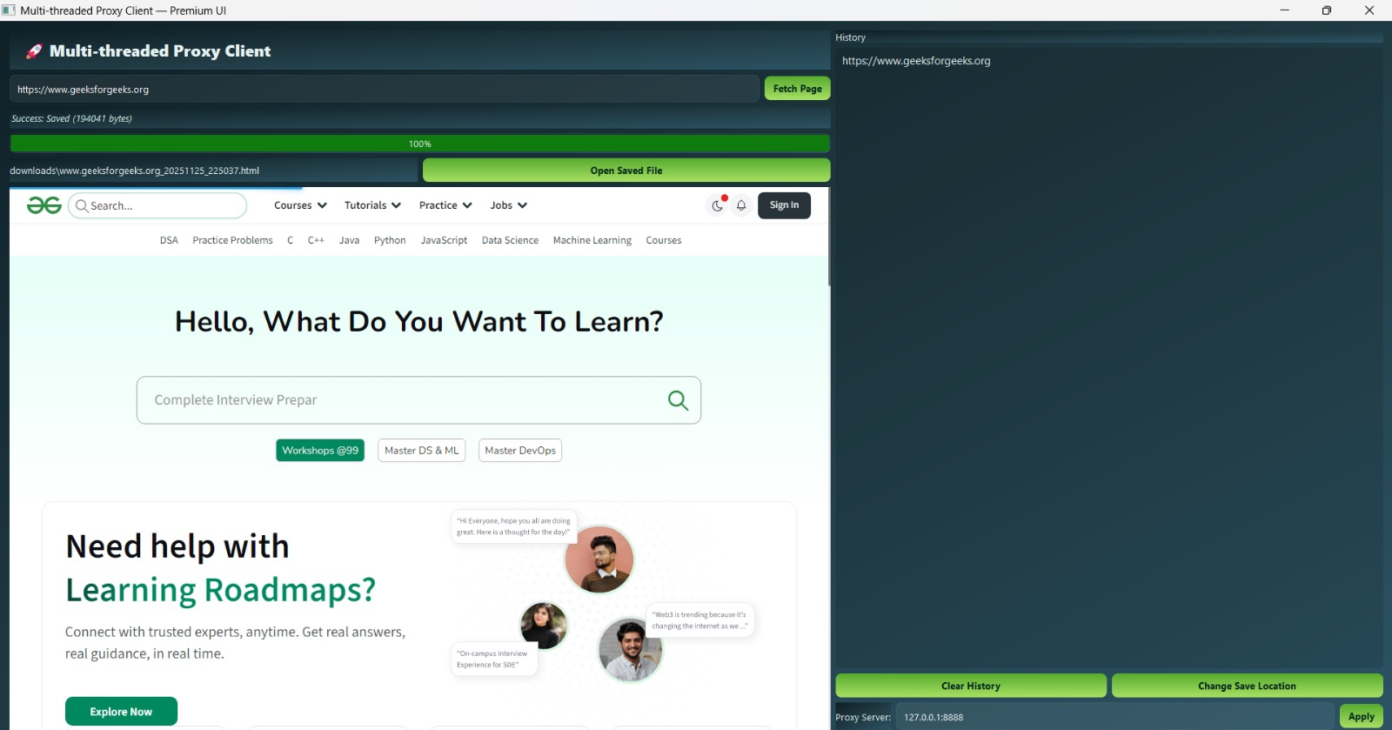
Client Module: User's Gateway to the Network
Socket Creation: Manages the establishment of network connections.
Input/Output: Sends user-generated data and receives server responses.
GUI Integration: Seamlessly connects with the graphical user interface for an intuitive experience.
Error Handling: Implements mechanisms to manage disconnections and network issues gracefully.
The client is designed to be robust and user-friendly, abstracting complex network operations.

Slide 7



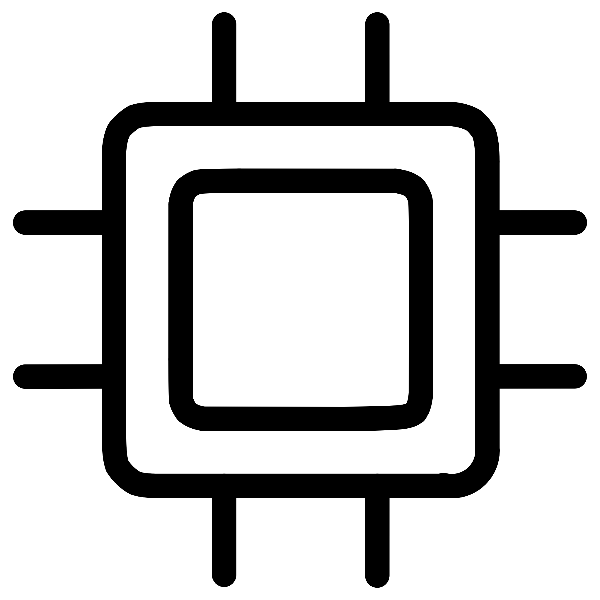

Server Module: The Processing Hub
Listening Socket
Always ready to accept incoming client connections.
Connection Handling
Efficiently manages multiple concurrent client connections.
Message Processing
Analyzes and responds to diverse incoming messages.
Acknowledgment & Response
Ensures reliable communication by sending appropriate replies.
This module demonstrates fundamental OS concepts like concurrency and robust request handling under varying loads.

Slide 8
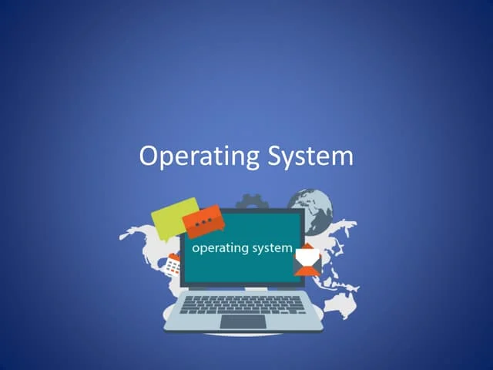
Proxy Module: The Network Intermediary
Intermediate Router: Sits between client and server, routing traffic.
Traffic Capture: Logs all data passing through for debugging and
analysis.
OS Concepts: Illustrates buffering, intelligent routing, and dynamic port management.
Network Control: Provides insights into flow control and
network behavior.
The proxy is invaluable for understanding network security, performance monitoring, and traffic management in operating systems.

Slide 9
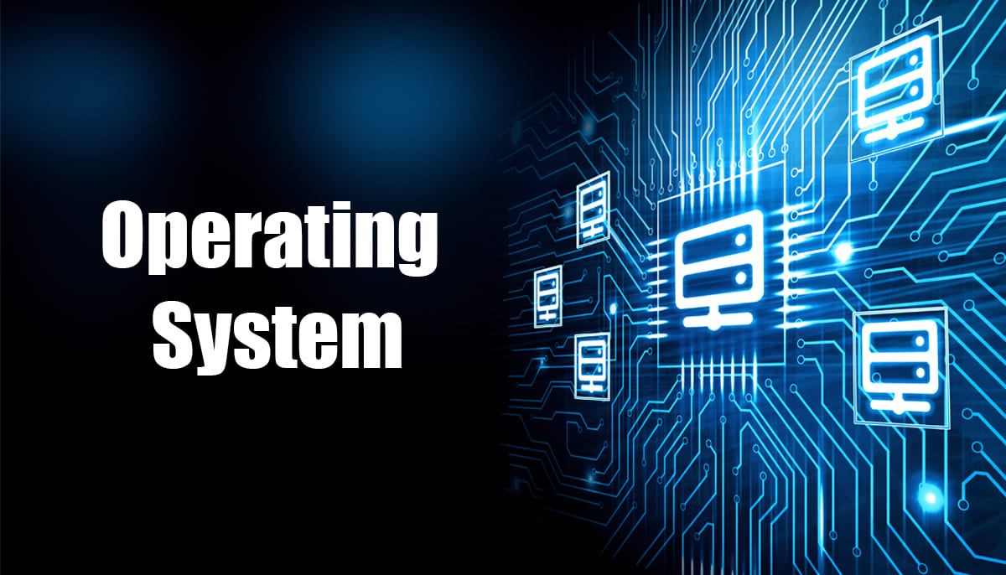
Backend Logic: The Engine of Communication
Abstracts Communication
1
Manages the intricacies of connection establishment, sending, and receiving data.
Responsive GUI
2
Ensures the user interface remains fluid and unblocked.
Modular Design
3
Enhances system maintainability and future extensibility.
Robust Error Handling
4
Includes mechanisms for reconnection attempts and exception management.
The backend (proxy_client_backend.py) is crucial for a stable and efficient system, separating complex operations from presentation.

Slide 10

Output & Demonstration: Seeing is Believing
Proxy Logs: Detailed records of all routed network traffic.
Successful Connections: Clear messages confirming established links.
Live Flow: Real-time display of message requests and responses.
Error Feedback: Informative messages for connection failures or incorrect configurations.
User-Friendly GUI: An intuitive interface simplifying interaction and visualization.
The demonstration provides visual proof of the system's functionality and robustness.

Slide 11

Applications & Future Scope
Network Simulation
Ideal for modeling and testing network behaviors and protocols.
OS Communication Demo
A practical example for teaching inter-process communication.
Proxy & Security Analysis
Exploring network vulnerabilities and implementing security measures.
Lab Exercises
A hands-on tool for students to understand client-server dynamics.
This project provides a foundational understanding that can be expanded into more complex networking and operating system research.

Slide 12
THANK YOU

