Slide 1

SMART WALL PAINTING ROBOT
PRESENTED BY GROUP G1

Slide 2

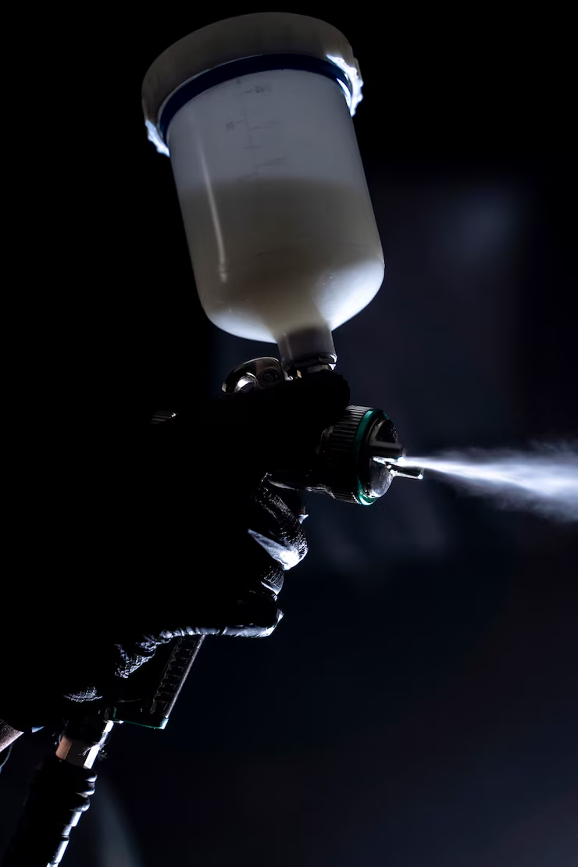
Project Overview
We are developing an automated wall painting robot that can move smoothly on vertical surfaces using omni wheels and paint walls efficiently.
Controlled by an Arduino Mega, the robot is designed to reduce manual labor, save time, and improve painting quality.
Our goal is to build a working prototype that can autonomously cover a wall surface with even paint distribution.

Slide 3
Working Concept
The robot base moves along the wall surface using 4 omni wheels powered by DC motors.
The paint spray nozzle is mounted on a sliding mechanism, moved up and down by a NEMA 17 stepper motor and a threaded rod (lead screw) for full vertical wall coverage.
Ultrasonic sensors maintain a constant distance between the robot and the wall, ensuring even and consistent paint spraying.
A load cell is used to measure the weight of the paint bucket and monitor the remaining paint level.
Two color sensors are placed near the nozzle area to check if the wall has been painted properly:
They detect whether the area is already painted or still needs paint.
This helps prevent overlapping paint and ensures full coverage.
The system is controlled by an Arduino Mega, managing motor control, sensor data processing, and spray activation.
The robot can operate in semi-automatic or automatic mode, following a planned path or based on user control.

Slide 4
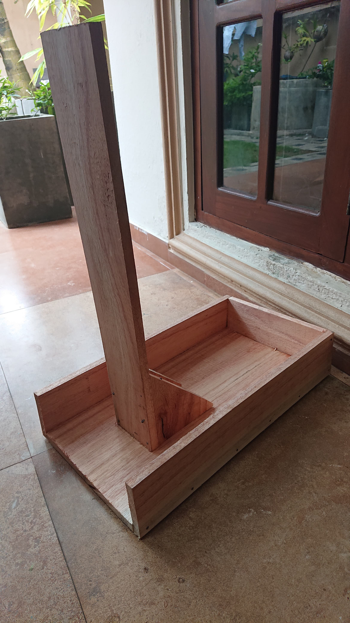
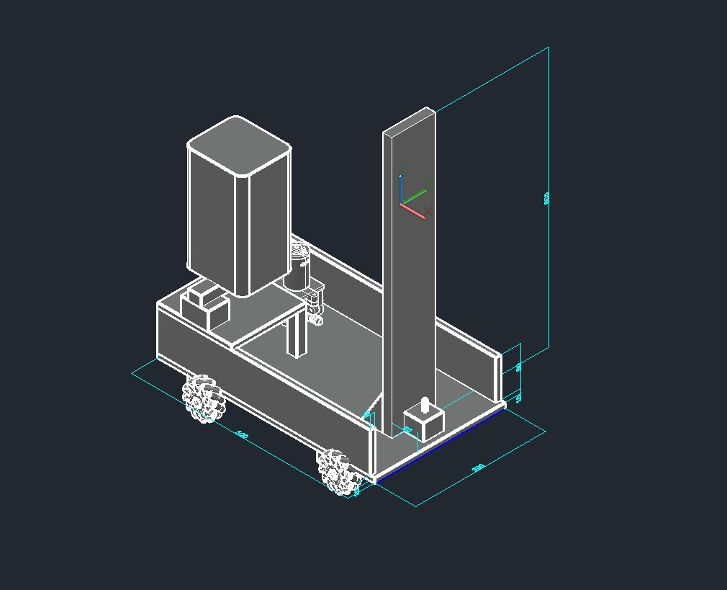
Current Progress
Fabrication Design
AutoCad Drawing
Fabricated Wood Frame

Slide 5
Nozzle Moving Mechanism
We are using a NEMA 17 stepper motor controlled by an A4988 motor driver to move the paint spray nozzle vertically along the wall using threaded rod (lead screw) mechanism .
We successfully:
Tested the current settings for the NEMA 17 motor using the A4988 driver to ensure smooth and stable motion.
Adjusted the motor current to prevent overheating and provide enough torque for vertical lifting.
Verified the linear motion of the threaded bar to ensure that the nozzle can move up and down smoothly without vibrations.

Slide 6
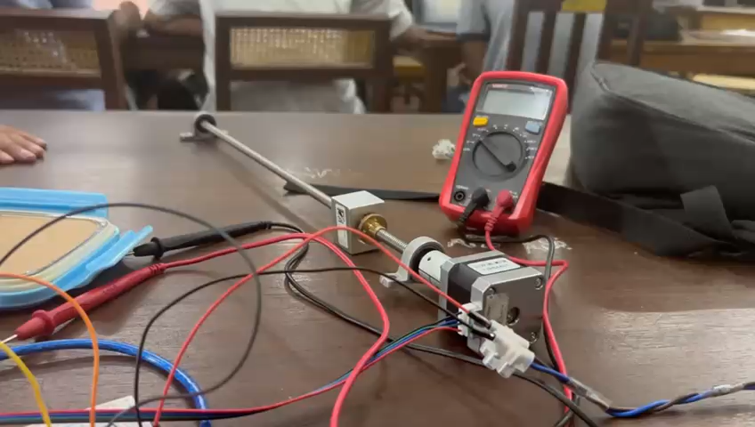

Slide 7
Mobility and Wall Distance Maintenance
The robot uses four mechanum wheels to enable smooth omnidirectional movement, allowing precise alignment and easy navigation along the wall surface.
Ultrasonic sensors are mounted on the robot to continuously monitor and maintain an optimal distance from the wall, ensuring accurate and consistent painting.

Slide 8
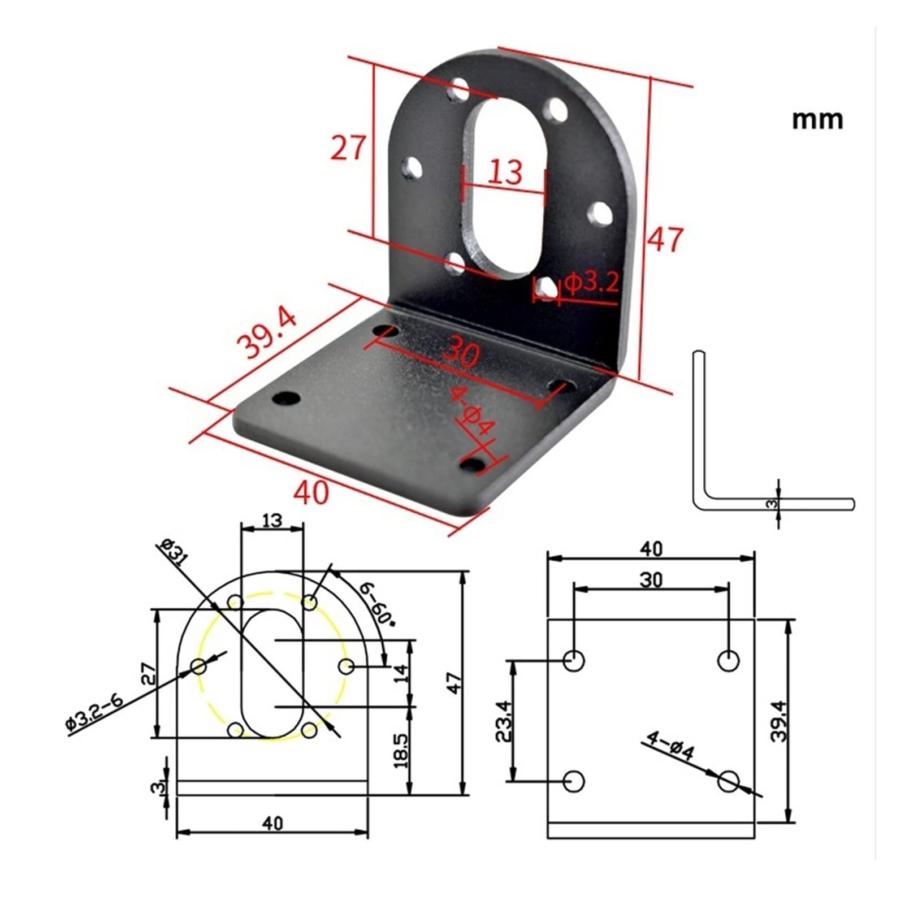
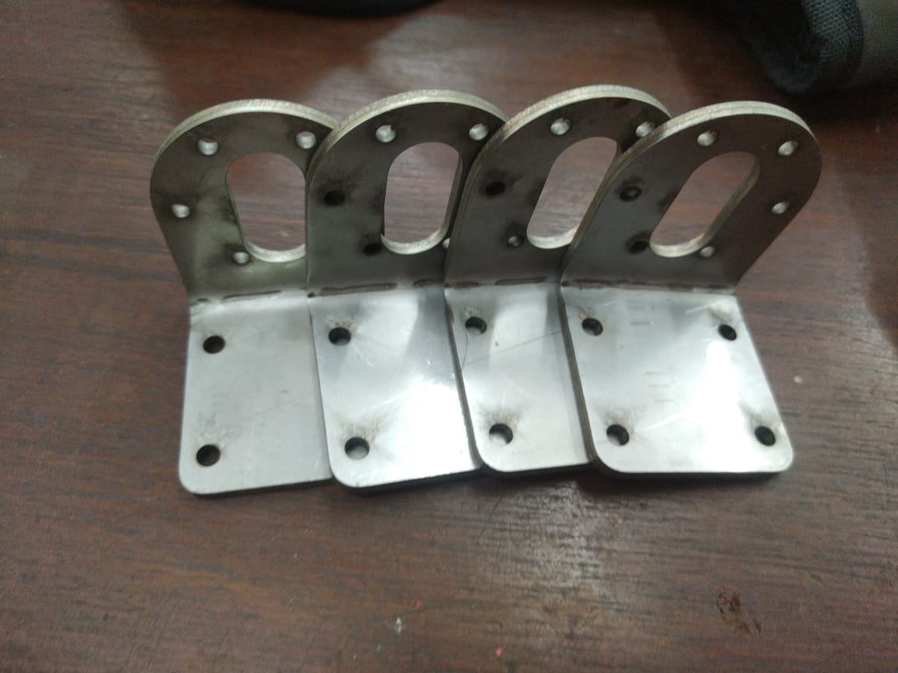
We also made motor bracket and Motor shafts
Motor bracket drawing
Crafted Motor bracket

Slide 9
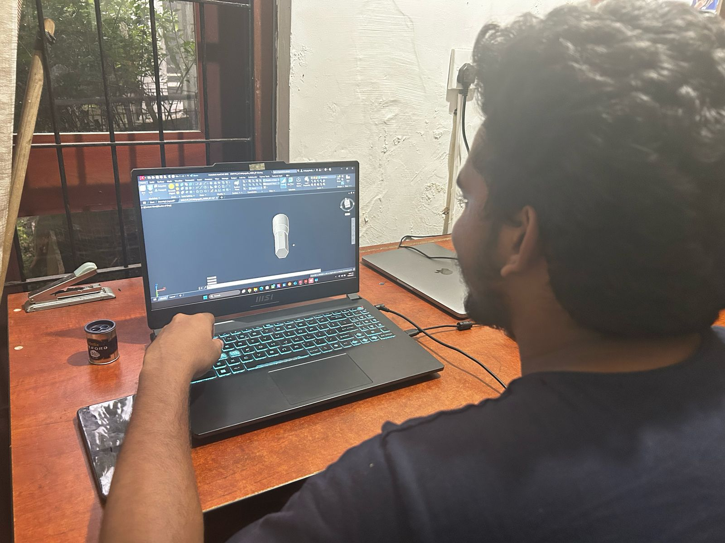
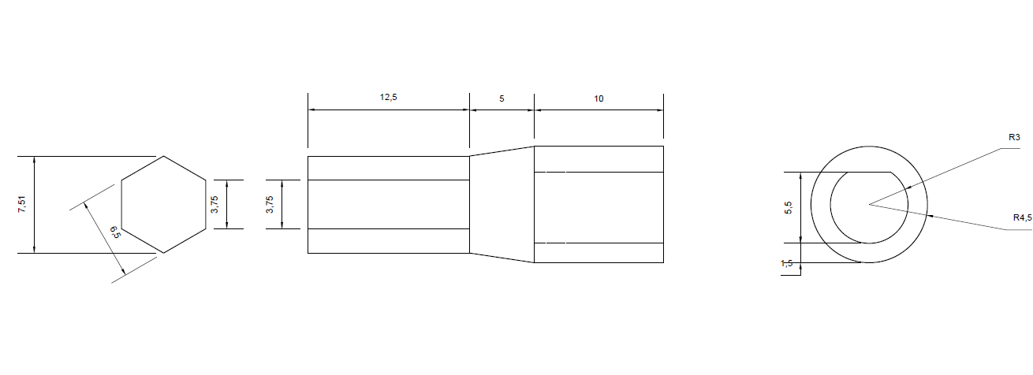
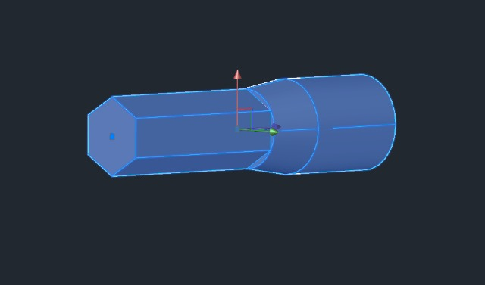
Motor Sharf 2D drawing
Motor Sharf 3D drawing

Slide 10
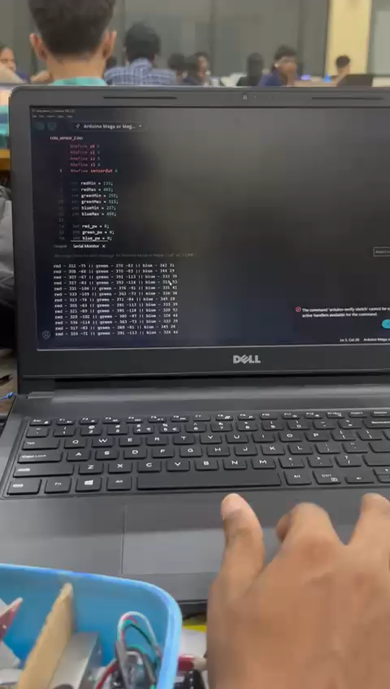
Color Detection and Wall Coverage Verification
We integrated two TCS230 color sensors to detect whether the wall surface has been painted.
We successfully calibrated the two TCS230 color sensors using black and white papers.

Slide 11
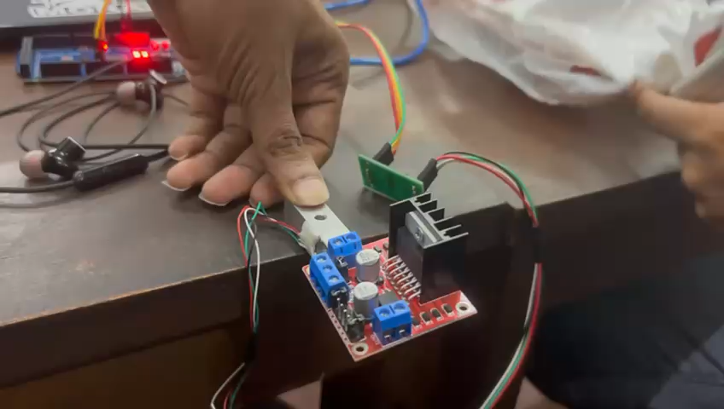
Paint Level Monitoring
A load cell combined with an HX711 amplifier is used to measure the weight of the paint bucket continuously

Slide 12
Current Progress and Next Steps
We are currently developing the basic structure, mobility system, wall distance sensing, color detection, and paint level monitoring setups.
We still have to develop the paint pumping mechanism, set up the nozzle, and test all individual components.
Each component will be programmed and tested individually to ensure correct operation.
After individual testing, we will combine all components and program the complete system for full automation.
Final stages will include full robot testing, fine-tuning, and performance improvements

Slide 13
Thank you very much!
PRESENTED BY GROUP G1

