Slide 1
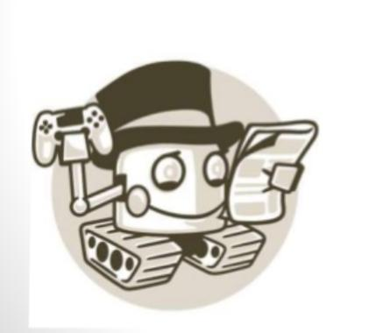
Chatbot

Slide 2
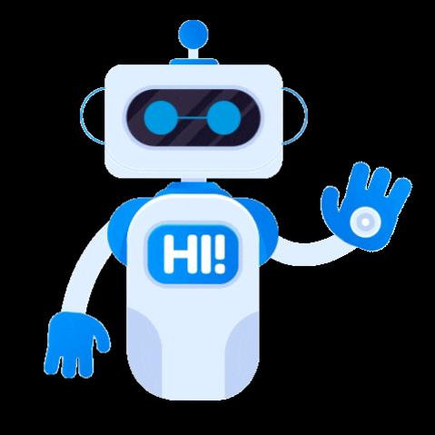
CHATHARASI SAINATH (20181CSE0850)
KARRI GUNAVARDHAN (20181CSE0831) NEHA PRASAD T (20181CSE0857) YASHAS L (20181CSE0802)
- 5CSE13

Slide 3
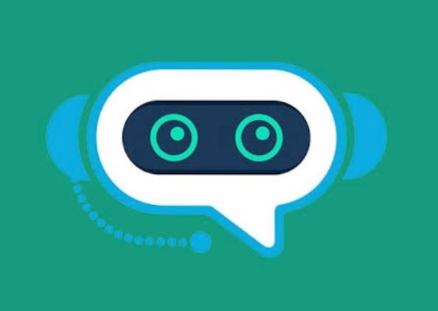
Introduction
A chatbot is a piece of technology that allows a computer program to communicate with people just like conversing through text messaging using a natural language, say English, to accomplish specific tasks. ... Text To Speech – A text-to-speech technology is simply one that converts verbal speech to text on a digital page.

Slide 4
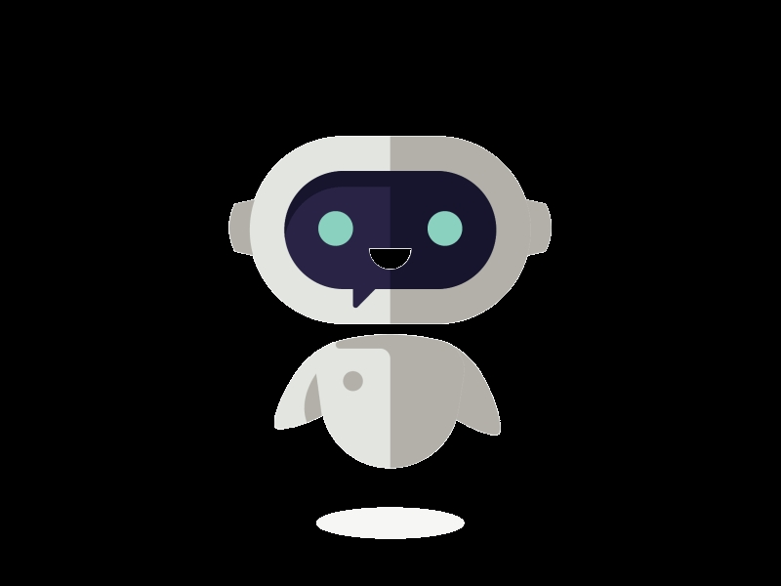
What is a chatbot?
Chat robot, a computer program that simulates human conversation, or chat, through artificial intelligence.
Typically, a chatbot will com.municate with a real person.

Slide 5
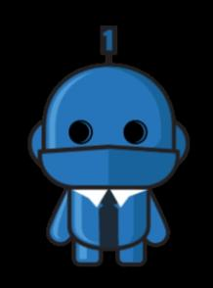
Why chatbot?
Bots are a lot easier to install than mobile apps.
Bots are easily distributed Quality mobile apps are expensive to bulid, maintain and deploy.
Moving complexity to the cloud reduces A user’s cognitive Load.

Slide 6
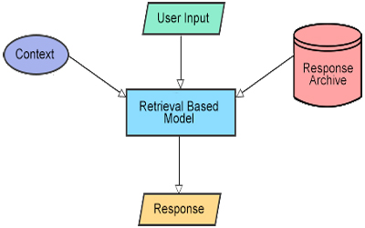
Design and architecture of chatbot

Slide 7
Tkinter programming
Tkinter is the standard GUI library for Python. Python when combined with Tkinter provides a fast and easy way to create GUI applications. Tkinter provides a powerful object-oriented interface to the Tk GUI toolKit

Slide 8
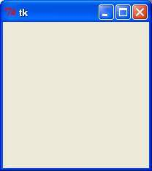
Creating a GUI application using Tkinter is an easy task.
All you need to do is perform the following steps −
Import the Tkinter module.
Create the GUI application main window.
Add one or more of the above-mentioned widgets to the GUI application.
Enter the main event loop to take action against each event triggered by the user.
Example#!/usr/bin/pythonimport Tkintertop = Tkinter.Tk()# Code to add widgets will go here...top.mainloop()
This would create a following window −TK Window
This would also help us to create button,check box,etc in the program

Slide 9
Code:CHATBOT
from tkinter import *
root = Tk()
def send():
send = "You:"+ e.get()
text.insert(END,"\n" + send)
if(e.get()=='hi'):
text.insert(END, "\n" + "Bot: hello")
elif(e.get()=='hello'):
text.insert(END, "\n" + "Bot: hi")
elif (e.get() == 'how are you?'):
text.insert(END, "\n" + "Bot: i'm fine and you?")

Slide 10
elif (e.get() == "i'm fine too"):
text.insert(END, "\n" + "Bot: nice to hear that")
elif (e.get() == "hi there "):
text.insert(END, "\n" + "Bot: i am glad talking to you there")
elif (e.get() == "what's new here "):
text.insert(END, "\n" + "Bot: nothing more interesting")
elif (e.get() == "i need some information"):
text.insert(END, "\n" + "Bot: i am always here to help you")
elif (e.get() == "bye"):
text.insert(END, "\n" + "Bot: you are welcome ")

Slide 11
else:
text.insert(END, "\n" + "Bot: Sorry I didnt get it.")
text = Text(root,bg='white')
text.grid(row=0,column=0,columnspan=2)
e = Entry(root,width=80)
send = Button(root,text='Send',bg='green',width=20,command=send).grid(row=1,column=1)
e.grid(row=1,column=0)
root.title('SIMPLE CHATBOT')
root.mainloop()

Slide 12
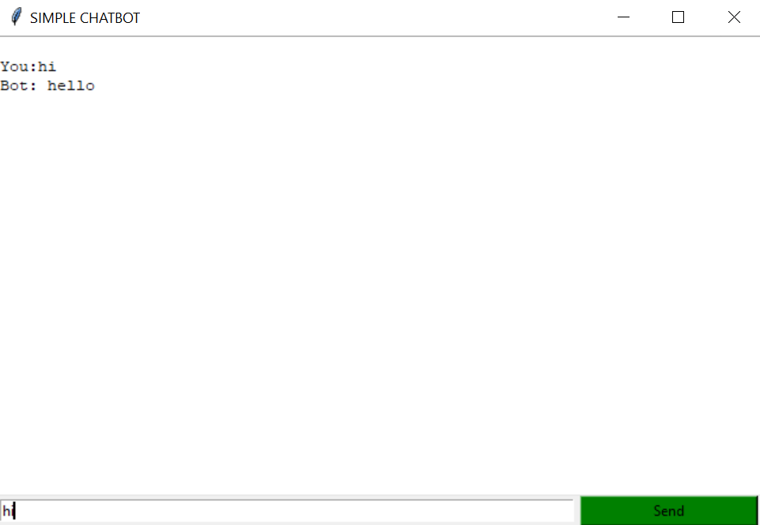
output

Slide 13
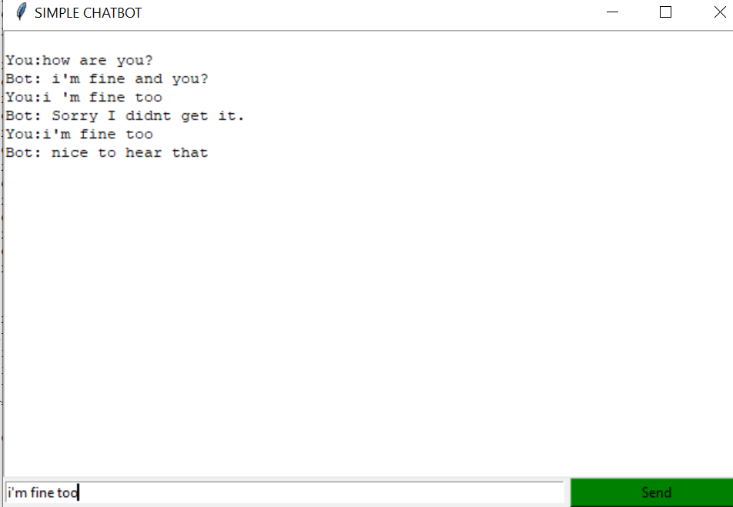
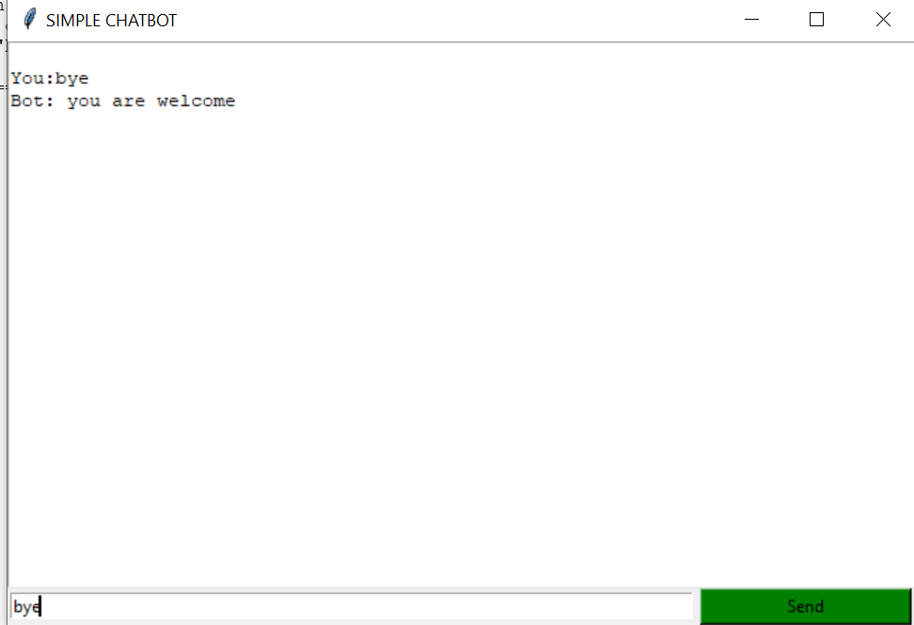

Slide 14
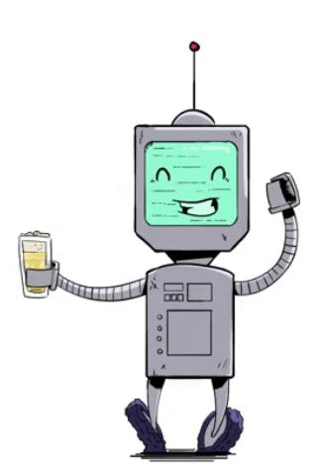
Conclusion
We conclude that the chatbots are going to play a huge role in development in the coming future with help of some development languages like python and with some artificial intelligence(AI). From gauging purchase intent to answering questions about IT issues, chatbots are on track to play a major role in the contemporary enterprise. Chatbots are fully functioning, semi-autonomous systems that can assist customer service experiences and response time. But that doesn’t mean their future in the enterprise is secure. For chatbots to withstand the rapidly increasing technological shifts and become mainstays in the enterprise, developers need to examine the issues that have popped up with increased implementation. The future scope of chatbots could include many benefits for enterprises, but experts say they will need to be gently nudged in the right direction for businesses to reap these benefits.

Slide 15
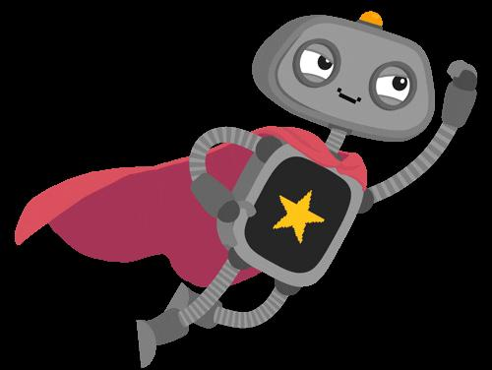
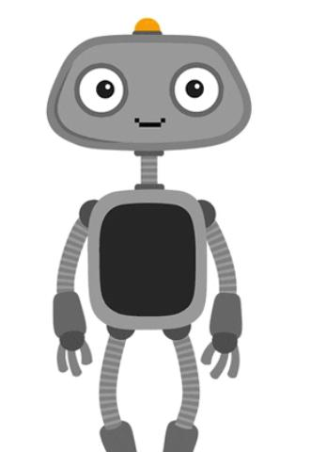
Thank you

