Slide 1
SMART HOME LIGHTING SYSTEM
Voice Control & Motion Detection
GROUP 15
9 Members | ESP32 & Blynk IoT Project
CYRIL OSAH MARTEY 7329123
CUDJOE BLESS 7321323
FRAIZER AKWASI CLEMENT 7324123
GUNAB EBENEZER 7324923
BENARD FOSU MARFO 7329023
NYAMEKYE BUSUMBRU 7321123
GRACE SIKA KONADU 7326823
MILLICENT DJABATEY 7322423
JUANITA DA PILMA 7321523

Slide 2
TABLE OF CONTENTS
INTRODUCTION | GROUP MEMBERS
PROJECT OVERVIEW
TOOLS AND COMPONENTS USED
WOKWI SIMULATION
CODE EXPLANATION | WOKWI SIMULATION
PHYSICAL IMPLEMENTATION
CODE EXPLANATION | PHYSICAL IMPLEMENTATION
HOW THE SYSTEM WORKS
CHALLENGES AND SOLUTION
RESULTS AND DEMONSTRATION
CONCLUSION

Slide 3
PROJECT OVERVIEW
An IoT-based smart lighting system that automates home lighting using motion detection and enables remote voice control through the Blynk mobile app.
🏠
👁️
🎙️
📟
Smart Control
Motion Detection
Voice Commands
LCD Display
Control lights from anywhere via Blynk app
PIR sensor auto-triggers LED on movement
Turn lights ON/OFF using Blynk voice widget
Real-time status shown on 16x2 I2C LCD
By: Cyril Osah Martey
Group 15 | Smart Home Lighting

Slide 4
TOOLS & COMPONENTS USED
HARDWARE
SOFTWARE & PLATFORMS
ESP32 DOIT DevKit V1 — Microcontroller
HC-SR501 PIR Sensor — Motion Detection
16x2 I2C LCD Display (0x27) — Status Output
LED + 1k Ohm Resistor — Light Indicator
Breadboard & Jumper Wires — Circuit Assembly
USB Cable — Power & Programming
iPhone Hotspot — WiFi Connectivity
Arduino IDE 2.3.4 — Code Development
Wokwi Simulator — Online Simulation
Blynk IoT Platform — App & Voice Control
LiquidCrystal_I2C Library — LCD Control
BlynkSimpleEsp32.h — WiFi + Blynk
WiFi.h / WiFiClient.h — Network Libraries
Wire.h — I2C Communication Protocol
Group 15 | Smart Home Lighting
By: Sika Grace & Millicent Djabatey

Slide 5
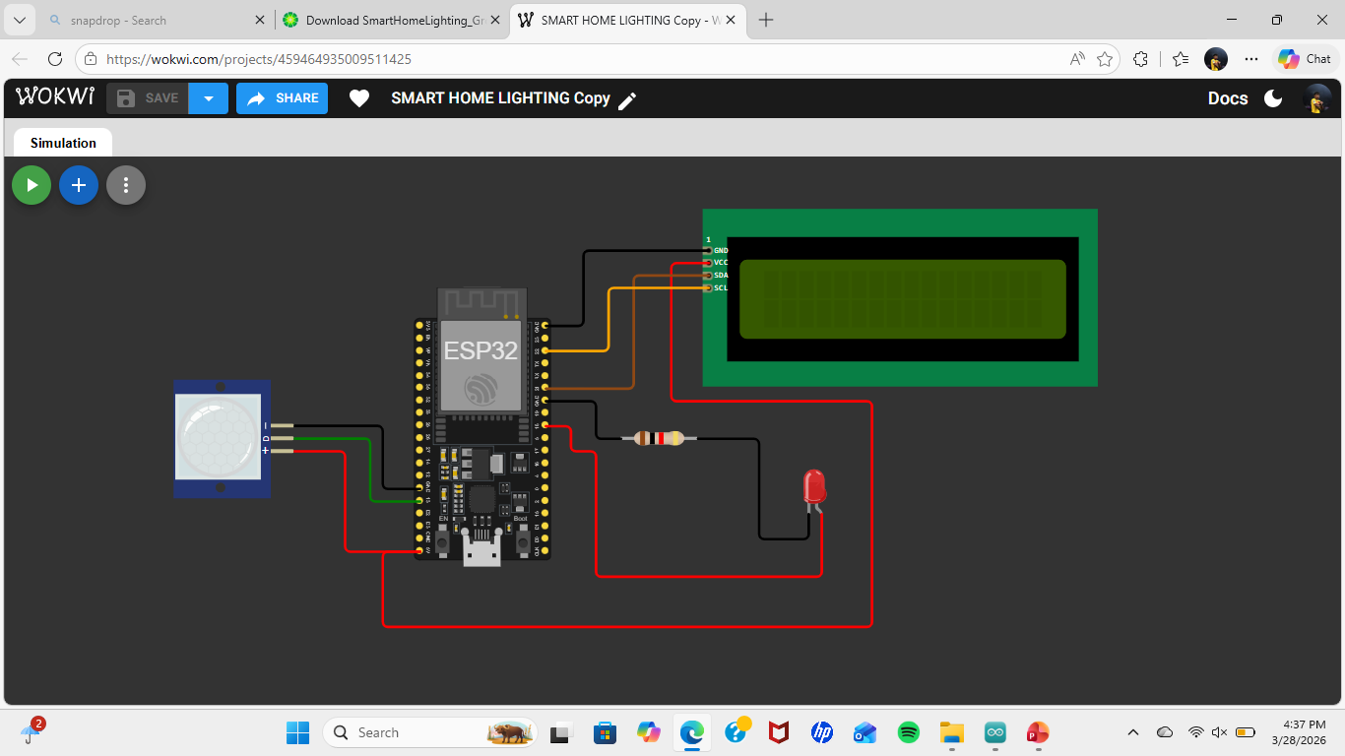
WOKWI SIMULATION
What is Wokwi?
Wokwi is a free online IoT simulator that allows microcontroller projects to be built and tested virtually before physical implementation.
Components Simulated:
ESP32 DevKit V1
HC-SR501 PIR Sensor
16x2 I2C LCD Display
LED with resistor
Blynk Virtual Pins (V1)
Simulation Result: All functions worked perfectly — Motion detection, LED control & LCD display confirmed
By: Clement Fraizer
Group 15 | Smart Home Lighting

Slide 6
CODE EXPLANATION — SIMULATION
1. Blynk Configuration (Lines 1-5)
[ #define BLYNK_TEMPLATE_ID / BLYNK_AUTH_TOKEN ]
Sets up the Blynk cloud template ID, name, and authentication token to identify the device on the Blynk server.
2. Library Imports & Pin Setup (Lines 7-26)
[ #include <LiquidCrystal_I2C.h> | ledPin=18, pirPin=13 ]
Imports WiFi, Blynk, LCD libraries. Declares LED on GPIO18, PIR sensor on GPIO13, LCD at I2C address 0x27.
3. Setup Function (Lines 29-65)
[ lcd.init() -> WiFi.begin() -> Blynk.begin() ]
Initialises LCD, connects to WiFi (Wokwi-GUEST for simulation), then connects to Blynk cloud server.
4. Voice Control Handler (Lines 68-74)
[ BLYNK_WRITE(V1) { ledState = param.asInt(); } ]
Listens to Virtual Pin V1 from Blynk app. When switch toggled, reads value and turns LED ON/OFF accordingly.
5. Motion Detection Loop (Lines 76-110)
[ digitalRead(pirPin) -> HIGH -> digitalWrite(ledPin, HIGH) ]
Reads PIR sensor every 100ms. On motion detected, turns LED ON, updates LCD, waits 10 seconds, then turns LED OFF.
By: Gunab Ebenezer
Group 15 | Smart Home Lighting

Slide 7
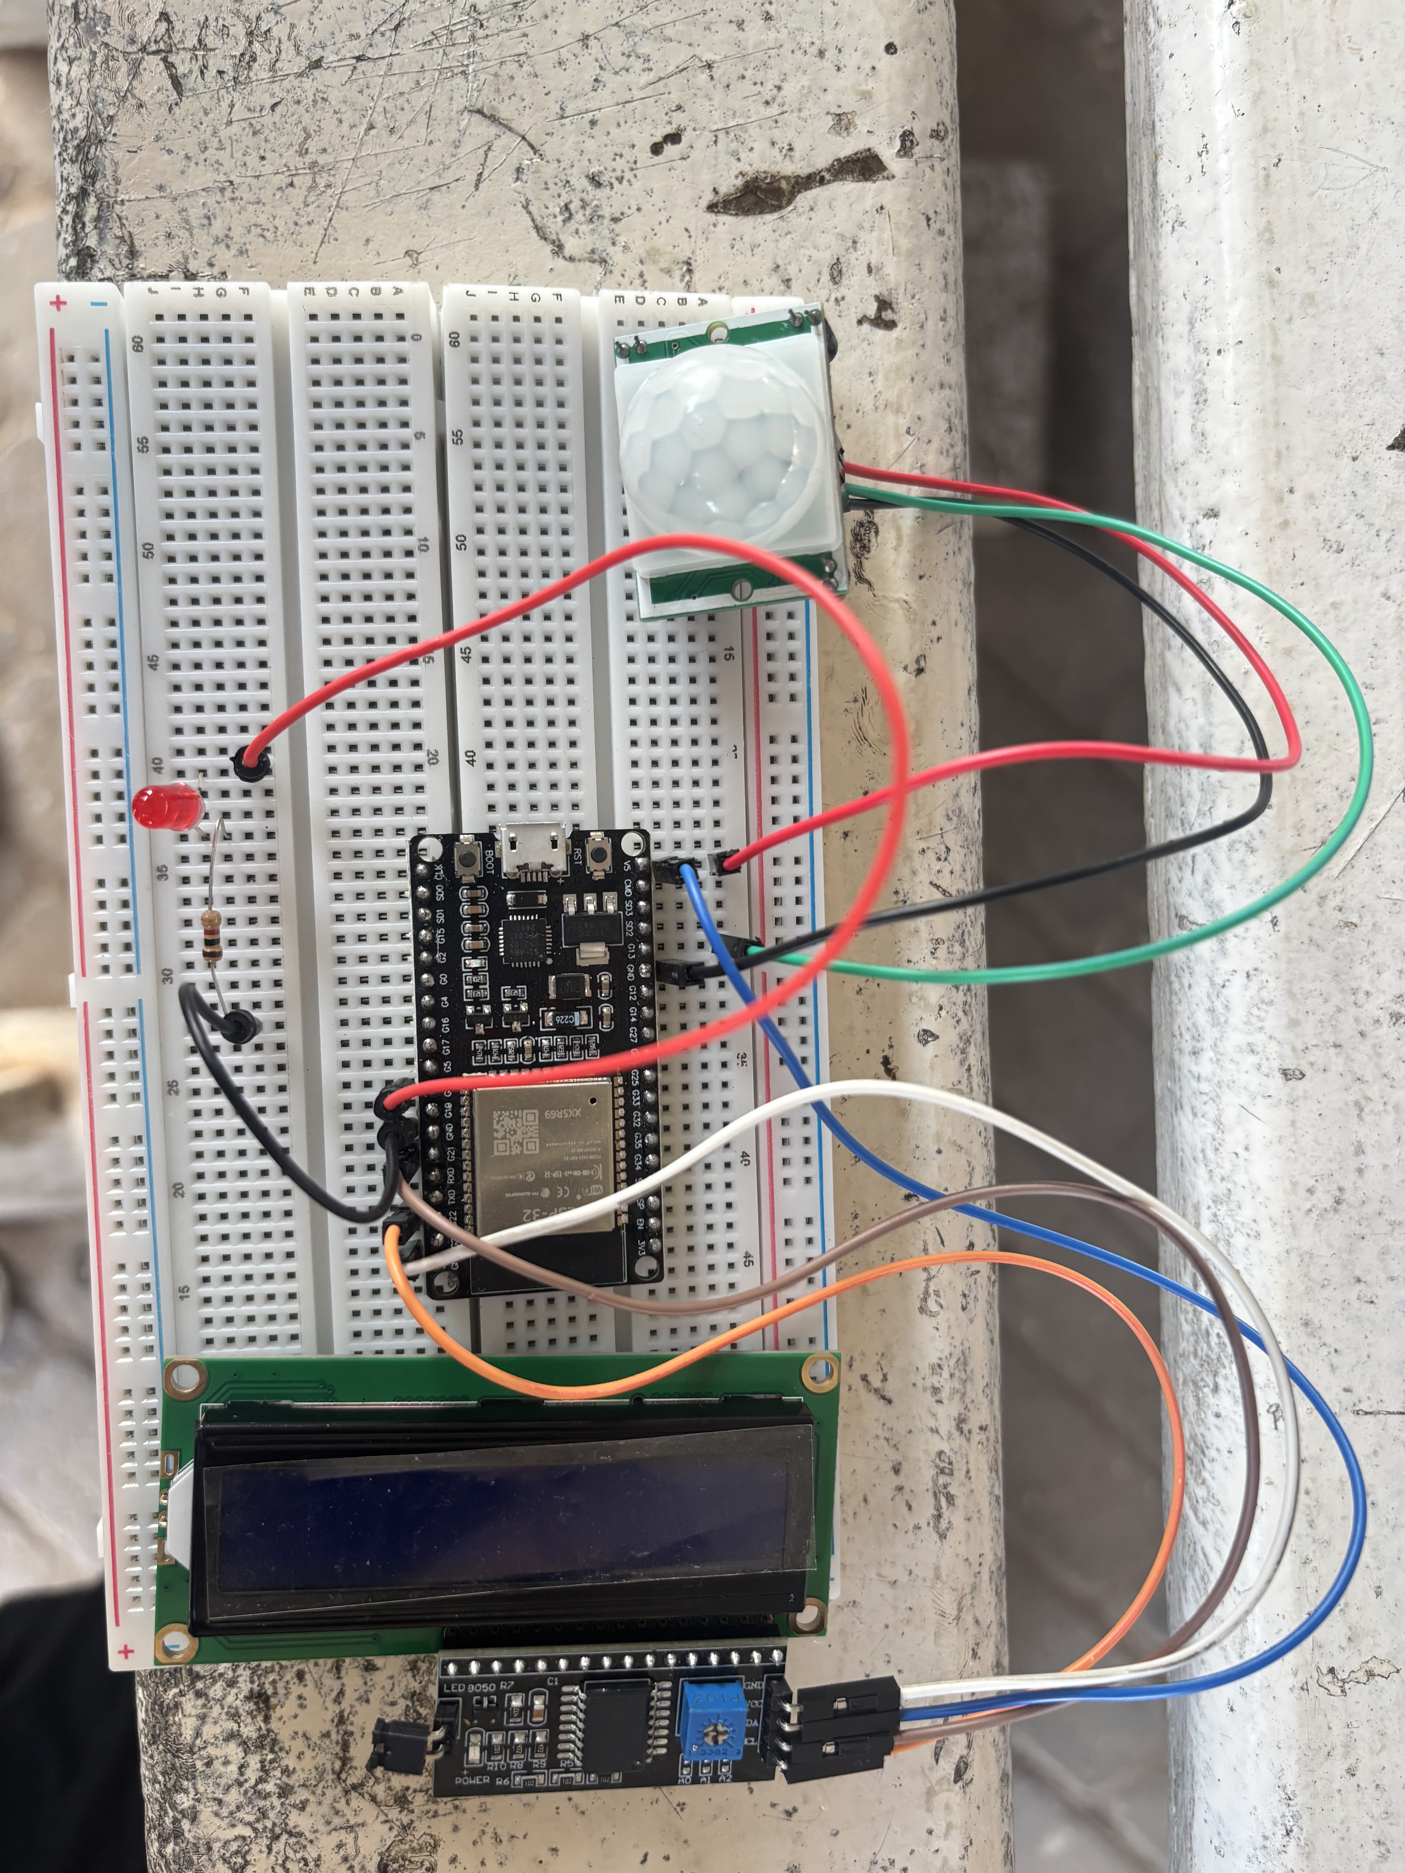
PHYSICAL IMPLEMENTATION
Circuit Connections:
LED -> GPIO 18 (via 220 Ohm resistor)
PIR Sensor OUT -> GPIO 13
PIR VCC -> 5V | PIR GND -> GND
LCD SDA -> GPIO 21
LCD SCL -> GPIO 22
LCD VCC -> V5 (5V pin)
LCD GND -> GND
Key Differences from Simulation:
WiFi: Wokwi-GUEST replaced with real hotspot
lcd.init() called twice for ESP32 stability
Wire.begin(21,22) explicitly declared
By: Benard Fosu
Group 15 | Smart Home Lighting

Slide 8
CODE EXPLANATION — PHYSICAL IMPLEMENTATION
Fix 1: WiFi Credentials
X WiFi.begin("Wokwi-GUEST", "", 6);
OK WiFi.begin(ssid, pass);
Wokwi guest network does not exist in real life. Real hotspot credentials stored in char ssid[] and pass[] are used instead.
Fix 2: LCD Double Initialisation
X lcd.init(); // called once
OK lcd.init(); lcd.init(); // called twice
ESP32 requires lcd.init() called twice to properly reset the I2C LCD and prevent garbage characters on startup.
Fix 3: Motion Logic Bug
X if (motionState == HIGH && !ledState)
OK if (motionState == HIGH && !motionDetected)
Original code used ledState (voice control variable) which blocked motion detection. Fixed to use motionDetected flag.
Fix 4: 10-Second Auto OFF Logic
X else if (motionState==LOW && motionDetected) { ... }
OK delay(10000); digitalWrite(ledPin,LOW); motionDetected=false;
Moved LED OFF inside the detection block after delay(10000) to guarantee auto shut-off after exactly 10 seconds.
By: Bless Cudjoe
Group 15 | Smart Home Lighting

Slide 9
HOW THE SYSTEM WORKS
Power ON
WiFi
PIR
LED ON
10s
OFF
ESP32
Boots Up
Connect
Blynk
Motion
Detected
Light
Turns ON
Timer
Counts
Light
Auto OFF
VOICE CONTROL PATH (Blynk App)
User opens Blynk App -> Taps Switch Widget -> Signal sent to ESP32 via WiFi -> BLYNK_WRITE(V1) triggers -> LED toggles ON/OFF instantly
By: Juanita Esinam
Group 15 | Smart Home Lighting

Slide 10
CHALLENGES & SOLUTIONS
WIFI
Problem: WiFi Connection Failure (Status Code 6)
Solution: Renamed hotspot to “Gunab” and enabled “Maximize Compatibility” on iPhone.
LCD
Problem: LCD Showing Garbage Characters
Solution: Called “lcd.init()” twice.
LED
Problem: LED Not Turning OFF After 10 Seconds
Solution: Fixed using “!motionDetected” flag and placed LED OFF inside detection block.
CODE
Problem: Compilation exit status 1 Error
Solution: Enabled verbose output to reveal hidden error. Root cause was Wokwi WiFi credentials left unchanged for real hardware upload.
By: Nyamekye Busumbru
Group 15 | Smart Home Lighting

Slide 11
RESULTS & DEMONSTRATION
SIM
HW
APP
Simulation
Physical Build
Blynk App
100% Success
Fully Working
Connected
All features verified on Wokwi: motion detection, voice control, LCD display, and auto shut-off all working perfectly.
ESP32 circuit assembled on breadboard. PIR sensor, LCD, LED all responding correctly to code after debugging.
Device visible online in Blynk. Voice/switch control on Virtual Pin V1 successfully toggles the LED remotely.
By: The whole group
Group 15 | Smart Home Lighting

Slide 12
CONCLUSION
This project successfully demonstrated a fully functional Smart Home Lighting System using an ESP32 microcontroller, combining IoT cloud control with physical sensor automation.
OK Simulated and fully verified on Wokwi before physical build
OK Blynk app enables remote voice/switch control via WiFi
OK ESP32 programmed using Arduino IDE with multiple libraries
OK LCD provides real-time system status feedback
OK PIR sensor automates lighting with precise 10-second timer
OK All bugs systematically identified and resolved
Group 15 — Thank You!
By: Cyril Osah Martey

