Slide 1
DIABETES DETECTION USING MACHINE LEARNING ALGORITHMS
By
M. Guna jaswanth reddy

Slide 2
Abstract
Diabetes is an illness caused because of high glucose level in a human body. Diabetes can be controlled if it is predicted earlier. To achieve this goal this project work will do early prediction of Diabetes in a human body or a patient for a higher accuracy through applying, Various Machine Learning Techniques on a dataset to predict diabetes. Which are K-Nearest Neighbor, Logistic Regression, Decision Tree, Extreme Gradient Boosting, Support Vector Classifier, Gaussian Naïve Bayes and Random Forest. The Project work gives the accurate or higher accuracy model shows that the model is capable of predicting diabetes effectively. The result shows that Logistic Regression achieved higher accuracy compared to other machine learning techniques.

Slide 3
Contents
Introduction
Existing Method
Architecture
Methodology
Implementation
Conclusion

Slide 4
Introduction
Diabetes is noxious diseases in the world. Diabetes caused because of obesity or high blood glucose level, and so forth. It affects the hormone insulin, resulting in abnormal metabolism of crabs and improves level of sugar in the blood. Diabetes occurs when body does not make enough insulin.
Early prediction of diabetes can be controlled and save the human life. To accomplish this, this work explores prediction of diabetes by taking various attributes related to diabetes disease. For this purpose the Pima Indian Diabetes Dataset is used and various Machine Learning classification and ensemble Techniques are applied to predict diabetes.

Slide 5
Existing Method
Artificial neural network (ANN), random forest (RF) and K-means clustering techniques were implemented for the prediction of diabetes.
In existing method, the classification and prediction accuracy is not so high.
A new diabetes prediction model is proposed for better classification of diabetes which includes few external factors responsible for diabetes along with regular factors like Glucose, BMI, Age, Insulin, etc.

Slide 6
Architecture
The proposed method uses various Machine Learning Algorithms for predicting the diabetes. The following phases are present in the architecture of proposed method.
Dataset Collection
Data Pre-processing
Clustering
Model Building
Evaluation

Slide 7
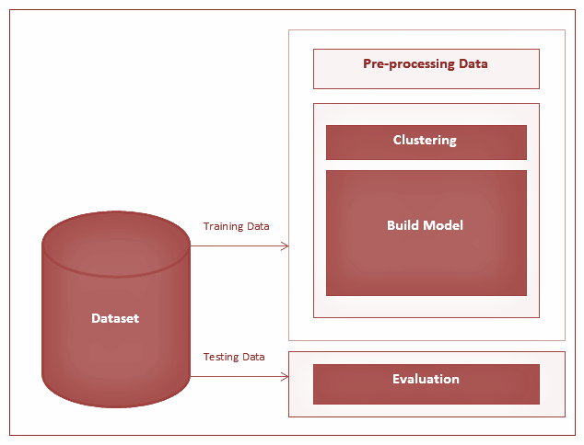
Architecture of the Proposed Method

Slide 8
Dataset Collection
This phase includes data collection and understanding the data to study the patterns and trends which helps in prediction and evaluating the results.
The dataset used in this project is Pima Indians Diabetes Dataset and it contains 769 records and 9 attributes.
Dataset Information
Attribute | Type
Pregnancies | N
Glucose | N
BloodPressure | N
SkinThickness | N
Insulin | N
BMI | N
DiabetesPredegreeFunction | N
Age | N
Outcome | C

Slide 9
Data Pre-processing
This phase of model handles inconsistent data in order to get more accurate and precise results. This dataset contains missing values. The missing values are imputed for few selected attributes like Glucose level, Blood Pressure, Skin Thickness, BMI and Age because these attributes cannot have values zero. Then the dataset is scaled to normalize all values.

Slide 10
Clustering
In this phase, K-means clustering is implemented on the dataset to classify each patient into either a diabetic or non-diabetic class. Before performing K-means clustering, highly correlated attributes were found which were, Glucose and Age. K-means clustering was performed on these two attributes. After implementation of this clustering class labels (0 or 1) for each record were obtained.

Slide 11
Model Building
This is the most important phase which includes model building for prediction of diabetes. For this purpose various machine learning algorithms for diabetes prediction. The algorithms include Logistic Regression, K-Nearest Neighbor, Gaussian Naïve Bayes, Support Vector Classifier, Decision Tree, XGBoost and Random Forest.
Evaluation
This is the final step of prediction model. Here, we evaluate the prediction results using classification accuracy.

Slide 12
Methodology
For classifying each patient into either a diabetic or non-diabetic class K-means clustering is used.
K-means Clustering
K-Means Clustering is an unsupervised learning algorithm that is used to solve the clustering problems in machine learning or data science. It groups the unlabeled dataset into different clusters. Here K defines the number of predefined clusters that need to be created in the process, as if K=2, there will be two clusters, and for K=3, there will be three clusters, and so on.

Slide 13
For predicting the diabetes the following machine learning algorithms were implemented
Support Vector Classification
SVC is a nonparametric clustering algorithm that does not make any assumption on the number or shape of the clusters in the data. In our experience it works best for low-dimensional data, so if your data is high-dimensional, a preprocessing step, e.g. using principal component analysis, is usually required.

Slide 14
K-Nearest Neighbor
KNN is also a supervised machine learning algorithm. KNN assumes that similar things are near to each other. Many times data points which are similar are very near to each other. KNN algorithm records all the records and classifies them according to their similarity measure. For finding the distance between the points uses tree like structure. To make a prediction for a new data point, the algorithm finds the closest data points in the training data set its nearest neighbors.

Slide 15


Slide 16
Gradient Boosting
Gradient Boosting is most powerful ensemble technique used for prediction and it is a classification technique. It combine week learner together to make strong learner models for prediction. It uses Decision Tree model. it classify complex data sets and it is very effective and popular method. In gradient boosting model performance improve over iterations.

Slide 17
Decision Tree
Decision tree is a basic classification method. It is supervised learning method. Decision tree is used when response variable is categorical. Decision tree has tree like structure based model which describes classification process based on input feature. Input variables are any types like graph, text, discrete, continuous etc.

Slide 18


Slide 19
Random Forest
It is type of ensemble learning method and also used for classification and regression tasks. This method can easily handle large datasets. It is popular ensemble Learning Method. Random Forest Improve Performance of Decision Tree by reducing variance. It operates by constructing a multitude of decision trees at training time and outputs the class that is the mode of the classes or classification or mean prediction (regression) of the individual trees.

Slide 20


Slide 21


Slide 22


Slide 23
Implementation
The proposed method is implemented using PyCharm and Python 3.6 interpreter.
Importing required libraries and diabetes dataset.
Pre-process data to remove missing data.
Analysis of data using various plots
Select the machine learning algorithm i.e. K- Nearest Neighbor, Support Vector Classification, Decision Tree, Logistic regression, Random Forest and Gradient boosting algorithm, Gaussian NB.
Build the classifier model for the mentioned machine learning algorithm based on training set.

Slide 24
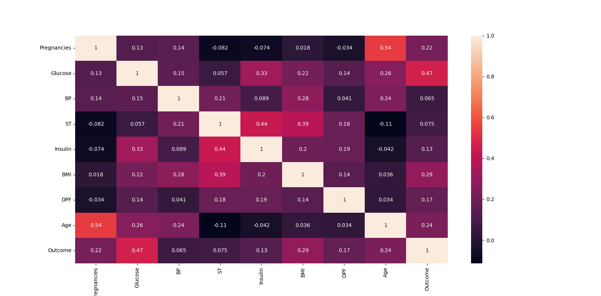
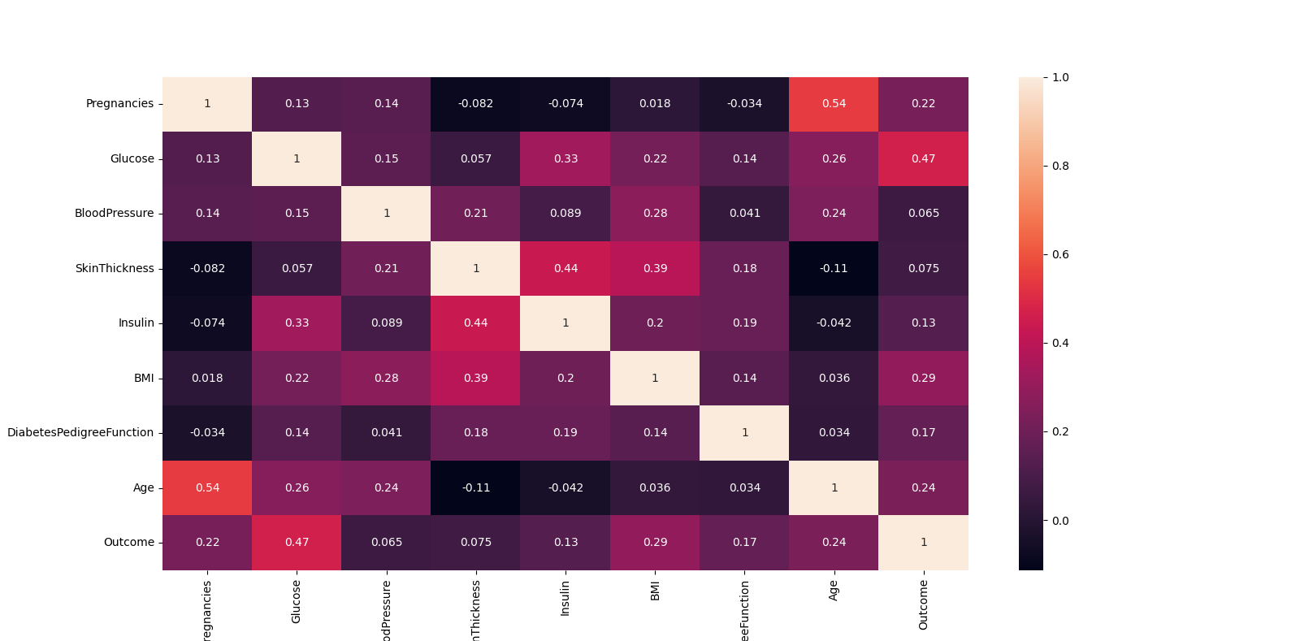
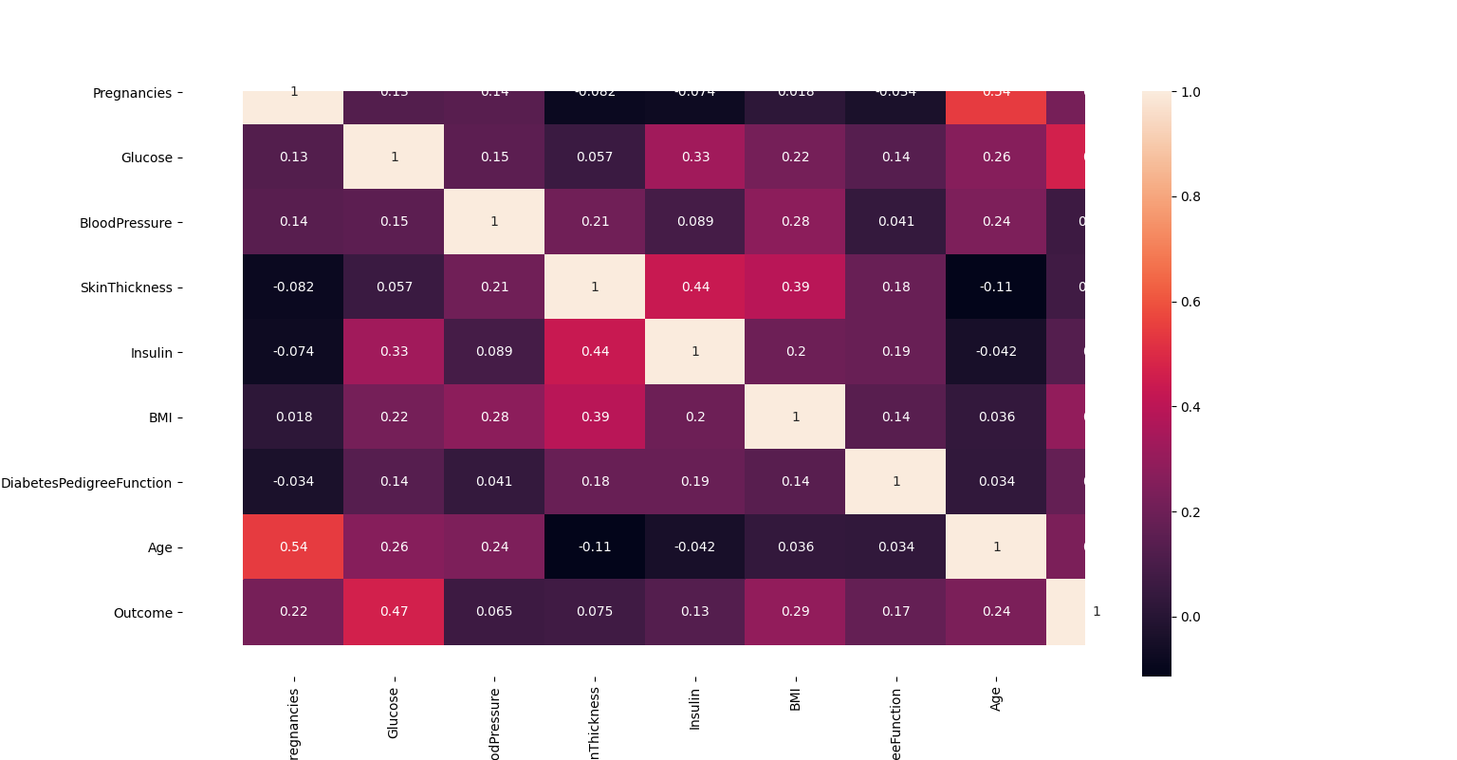
Heat map for expressing Correlation

Slide 25


Slide 26
The accuracy score is calculated using the formula by substituting the values obtained from confusion matrix.
Accuracy Scores
Score | Model
0.779 | Logistic Regression
0.753 | Random Forest
0.740 | Xgboost
0.733 | SVC
0.733 | GaussianNB
0.720 | KNN
0.681 | Decision Tree

Slide 27
After analyzing based on various measures conclude the best performing algorithm.
Here we can observe that the Logistic Regression algorithm has the highest accuracy when compared to other machine learning algorithms.
So I will use Logistic Regression algorithm for training my model.

Slide 28
Conclusion
The main aim of this project was to design and implement Diabetes Prediction Using Machine Learning Methods and Performance Analysis of that methods and it has been achieved successfully. The proposed approach uses various classification and ensemble learning method in which SVC, KNN, Random Forest, Decision Tree, Gaussian NB, Logistic Regression and Gradient Boosting classifiers are used. And 77% classification accuracy has been achieved. The Experimental results will assist health care to take early prediction and make early decision to cure diabetes and save humans life.

