Slide 1


July 2025
JOURNAL WATCH
IEEE Transactions on Communications
August 23, 2025
Nekkanti Guna Sai Kiran,
MTech ECE Student,
SPC Lab, IISC Bangalore

Slide 2
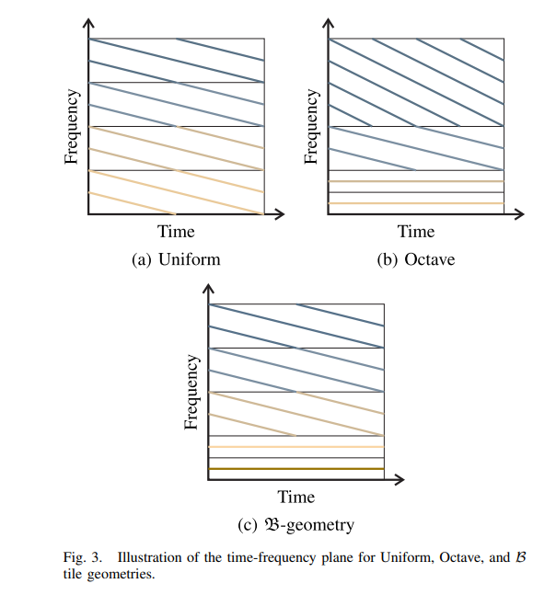
Orthogonal Chirp-Frequency Division Multiplexing
Túlio Fernandes Moreira , Mateus de Lima Filomeno , Wallace Alves Martins , and Moisés Vidal Ribeiro
Motivation:
OCDM offers robustness to interference:
Resource allocation difficult.
low average SNR, leading to lower data rates.
OFDM, efficient in resource allocation, is less robust to interference.
Goal: Design a system that combines the robustness of chirp signaling with the flexibility of frequency division, enabling resource allocation
Contribution:
Introduction of a new unitary transform: Discrete Modular Chirp Transform (DMCT).
Enables modular division of the frequency band into voices.
Unitary
Proposal of OCFDM, a hybrid technique:
Merges chirp waveform robustness (from OCDM) with frequency division flexibility (from OFDM).
Allows resource allocation across sub-bands.
Tile geometry introduces a new degree of freedom:
Enables tuning between OFDM-like and OCDM-like behavior.
Notes:
The energy of each chirp is spread across the whole spectrum and time, which can dilute the signal strength
(b) Octave Geometry
Narrow tiles at high frequencies (top of the graph) → better time resolution.
Wide tiles at low frequencies (bottom) → better frequency resolution.
©B-Geometry
Starts with small tiles (high time resolution), then switches to larger tiles (high frequency resolution).
A hybrid between uniform and octave.

Slide 3
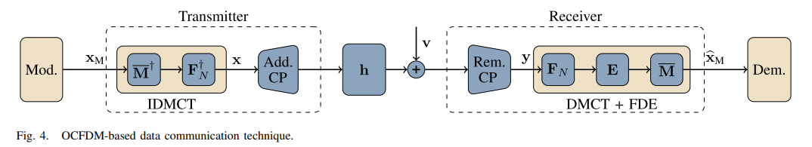
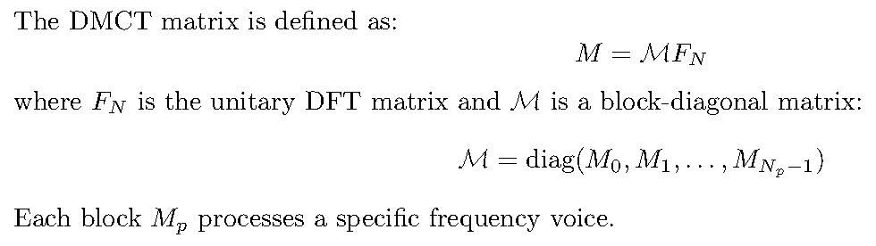
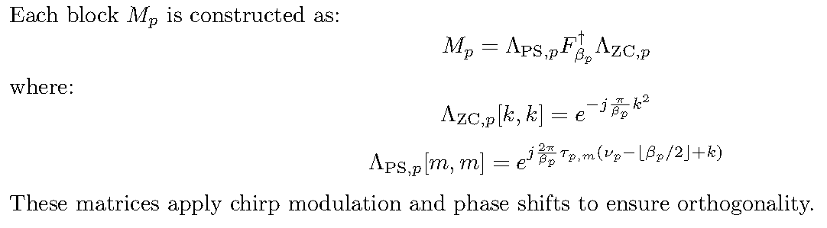
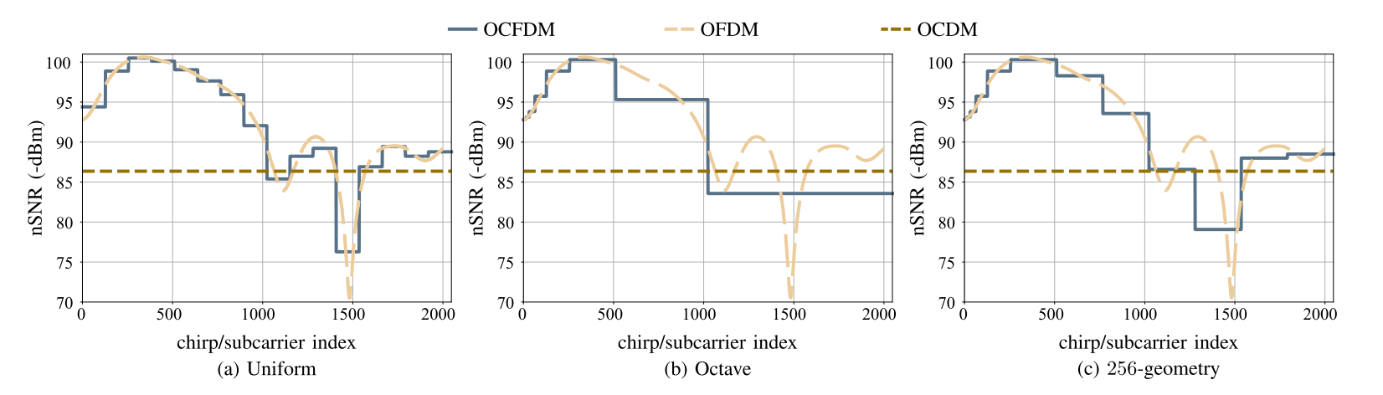
Conclusion
Flexible Power Allocation:
Tile Geometry Controls nSNR Variation:
In OCFDM, the choice of tile geometry affects how the frequency band is divided into voices
Uniform geometry (with smaller, equal-sized voices) makes the nSNR follow the channel more closely, similar to OFDM.
Notes:
OCFDM allows different normalised SNRs (nSNRs) across its voices, enabling the use of traditional resource allocation algorithms like water-filling to optimise data rate.
τp,m​: Time index for the m-th tile
νp​: Central frequency index
βp​: Number of tiles in the p-th voice
2) Since Fn, Fbeta_p are unitary and lambda ps p and lambda zsp are diagonal with unit modulous entries one can show M is a unitary Matrix so its inverse is simple Hermitian transpose.

Slide 4
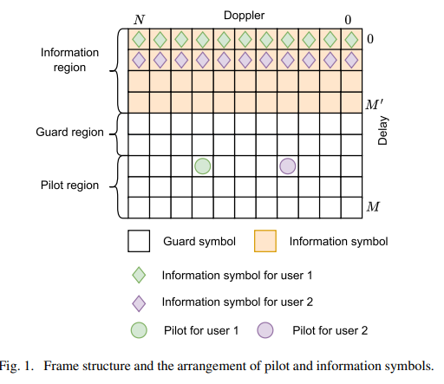
Uplink Multi-User OTFS: Transmitter Design Based on Statistical Channel Information
Mingcheng Nie, Shuangyang Li, Deepak Mishra, Jinhong Yuan, and Derrick Wing Kwan Ng
Motivation :
OTFS modulation is highly effective in high-mobility environments
In multi-user uplink OTFS systems, accurate channel estimation is critical.
Efficient power allocation strategies are needed
Goal :
To design uplink multi-user OTFS transmission schemes that:
Use only statistical CSI.
Optimize pilot and symbol power allocation.
Maximize achievable sum-rate while ensuring user fairness.
Key Contributions :
Derived the posterior Cramér-Rao Bound (PCRB) using statistical CSI.
Proposed and solved an optimization problem to minimize average PCRB, with a closed-form solution.
Formulated and solved a fairness-aware symbol power allocation problem using fractional programming.
Notes:
OTFS modulation is highly effective in high-mobility environments, where conventional schemes struggle due to rapid channel variations.
In multi-user uplink OTFS systems, accurate channel estimation is critical but challenging, especially when only statistical CSI is available.
Efficient power allocation strategies are needed to improve both channel estimation accuracy and transmission performance under practical constraints.

Slide 5
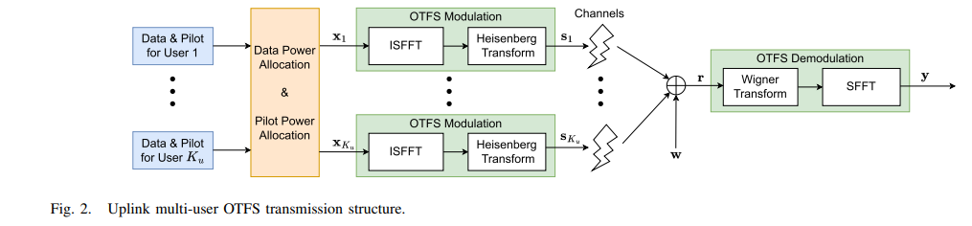
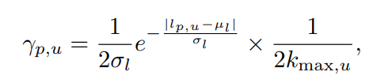
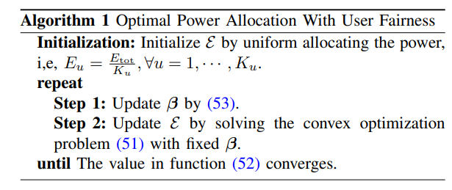
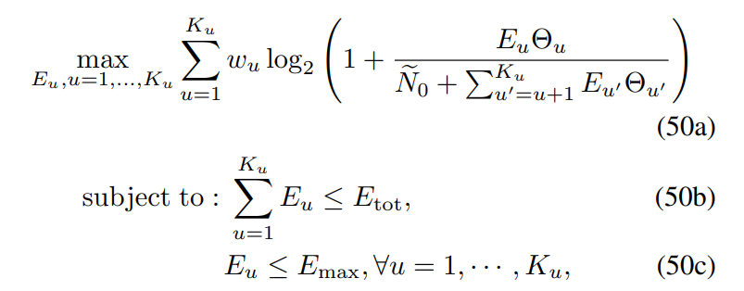
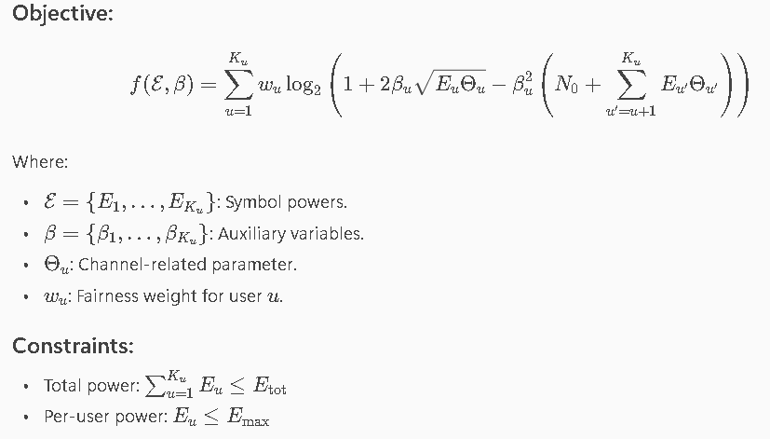
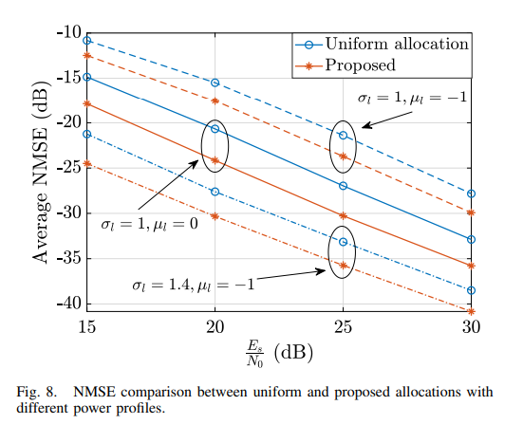
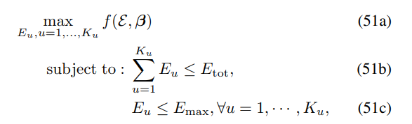

Fractional Programming :
Performance:
(52)
Notes:
Here, E denotes the collection comprising the symbol power for each user, Similarly, β represents the set of all auxiliary variables. A priori channel statistical information
Why change the objective function?
The objective contains logarithmic SINR terms, where SINR is in a ratio form, making the problem non-convex and difficult to optimize.
How do they change it?
They apply a quadratic transform to each logarithmic SINR term, converting the fractional form into an equivalent, tractable formulation, allowing optimal solution.
Mul Location Parameter and sigma l is scale Parameter in Laplace Distribution
M = 64, N = 16, P = 4, and Ku = 4

Slide 6
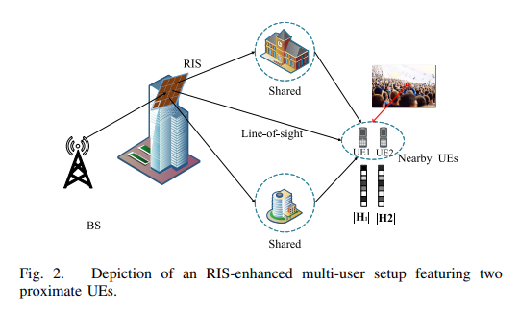
Deep Learning-Based CSI Feedback for RIS-Assisted Multi-User Systems
Jiajia Guo , Xi Yang , Chao-Kai Wen , Shi Jin, and Geoffrey Ye Li
Motivation : In RIS-assisted multi-user wireless systems, channel state information (CSI) feedback is essential for optimizing performance.
High Feedback Overhead
Inefficient Use of Spatial Correlation
Complex Phase Feedback
Goal : To develop a cooperative deep learning framework that reduces CSI feedback overhead by leveraging spatial correlation among neighboring UEs without requiring inter-UE communication.
Contributions :
RIS-CoCsiNet: A novel deep learning-based CSI feedback system that splits CSI into shared and unique parts to reduce redundancy.
Base Station-Side Cooperative Decoding: Uses an additional decoder and combination NN to reconstruct shared CSI from neighboring UEs.
Magnitude-Dependent Phase Feedback (MDPF): Introduces strategies that enhance phase feedback by incorporating CSI magnitude information.
Notes:
High Feedback Overhead: In RIS-assisted systems, nearby UEs often transmit highly correlated CSI, leading to redundant feedback and increased overhead.
Inefficient Use of Spatial Correlation: Conventional methods fail to exploit the natural correlation among neighboring UEs and antennas.
Complex Phase Feedback: RIS-UE CSI phases are not sparse, making accurate and efficient phase feedback challenging.
For UEs equipped with multiple antennas, a baseline NN architecture with long short-term memory (LSTM) modules is introduced to capture the correlation among nearby antennas

Slide 7
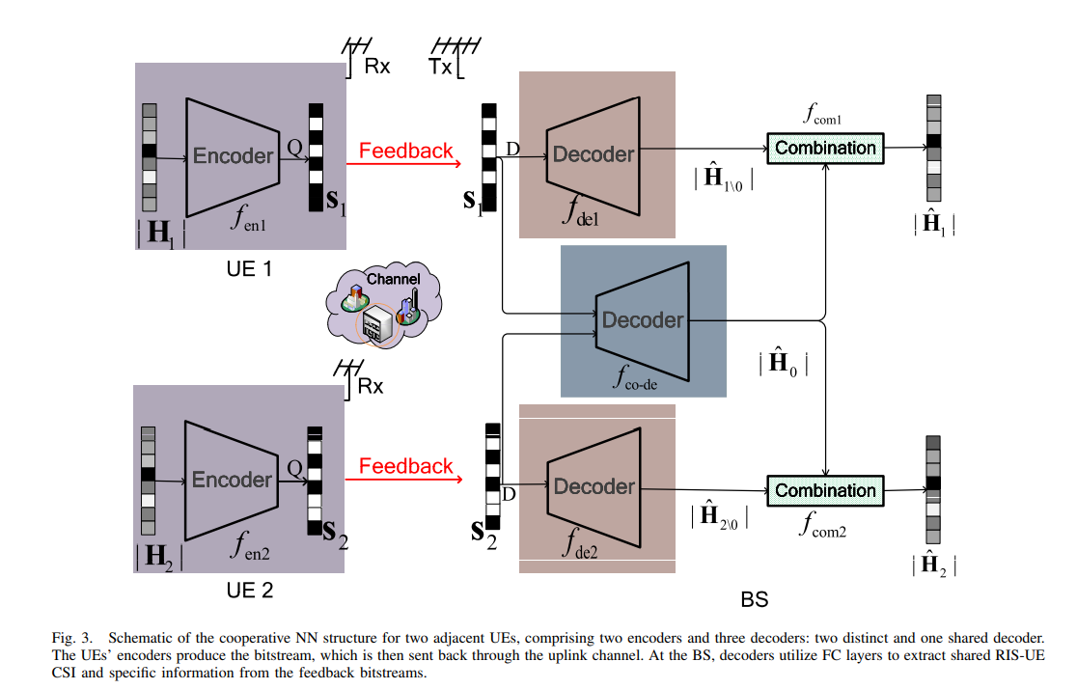
UE Side
The encoder uses fully connected (FC) layers followed by a binary or quantization layer to generate a compact bitstream.
BS Side
The BS has three decoders:
Shared decoder: Extracts common CSI (denoted as ∣H^0∣) from the feedback of both UEs.
Individual decoders: Recover unique CSI for each UE (e.g., ∣H^10∣and ∣H^20∣).
Cooperation Mechanisms
Explicit Cooperation: Happens at the BS, where the shared decoder uses feedback from multiple UEs to extract common CSI.
Implicit Cooperation: Happens at the UE encoders, which are trained to collaboratively compress shared CSI without needing direct communication between UEs.
Compared to Non-Cooperative Models
Traditional models require each UE to independently transmit all CSI, including redundant shared parts.
RIS-CoCsiNet avoids this by collaboratively encoding shared CSI, reducing feedback overhead and improving efficiency.
Notes:
Each UE (e.g., UE1 and UE2) has an encoder that processes its RIS-UE CSI.
A combination module, implemented as a simple neural network, merges the shared and unique CSI to reconstruct the full CSI magnitude matrix for each UE.
1. The encoder situated at the UE consists of a series of three FC layers, which are subsequently followed by three batch normalization (BN) layers. The activation function for the first pair of BN layers is designated as the LeakyReLU function
2. The activation function allocated to the final BN layer is the hyperbolic tangent function tanh(·)
3. In contrast, the decoder at the BS incorporates three FC layers last layer used sigmoid function

Slide 8

Other Interesting Papers
Optimizing Information Freshness in Uplink Multiuser SIMO Systems: Low-Complexity Scheduling Algorithms
Energy-Efficient Distributed Detection Through Feedback-Assisted Ordered Transmissions in the Presence of Fading and Quantization
Integration Communication and Detection Scheme Based on Superimposed Waveform
Individual Channel Estimation in RIS-Aided MIMO Systems Using Atomic Norm Minimization
RIS-Aided Integrated Communication and Positioning Systems: A Correlation Dispersion Scheme
Near-Field Wideband Beamforming for RIS Based on Fresnel Zones
IRS-Aided Multi-Cell Massive MIMO Systems With Impairments: SE Analysis and Optimization

Slide 9
Event-Triggered Communications Over AWGN Channels
Yiyu Qiu and Wei Chen
Motivation :
Traditional communication systems transmit data periodically, even when no meaningful change occurs, leading to wasted energy and bandwidth.
Most existing ETC research focuses on application-layer sampling, ignoring the physical-layer transmission behavior.
Using average transmission frequency as a cost metric is misleading; average power consumption gives a fairer comparison between ETC and periodic communication.
Goal :
To develop a physical-layer framework for Event-Triggered Communication (ETC) over AWGN channels, analyze its performance under finite and infinite block length coding, and design multi-user ETC protocols that optimize power efficiency and real-time signal estimation accuracy.
Contributions :
Channel Coding Analysis:
Shows that Shannon’s capacity holds for ETC in the infinite block length regime.
Derives coding rate and error bounds for finite block length scenarios, including fading channels.

Slide 10
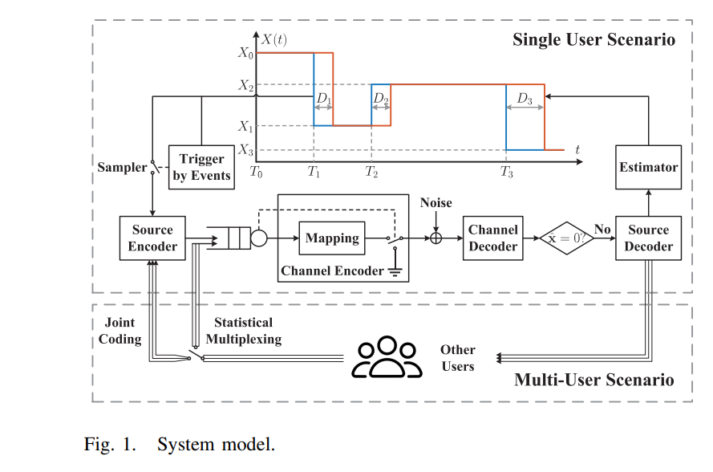


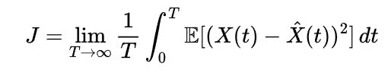
Multi-User ETC Protocols:
Proposes two strategies: statistical multiplexing and joint coding.
Model’s distortion and power tradeoffs, and optimises the number of users sharing the channel.
Distortion Metric:
Introduces misalignment time ratio as a new metric to evaluate real-time estimation distortion, enabling fair comparison with periodic communication.
System Model:
The system consists of a source generating signal X(t), a channel for transmission, and an estimator reconstructing
The source follows a semi-Markov process, and transmission is triggered only when events occur, minimizing communication cost.
Distortion Metric
Distortion is measured using Mean Square Error (MSE):
The time-averaged distortion is

Slide 11
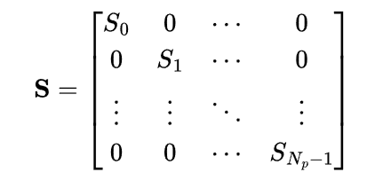
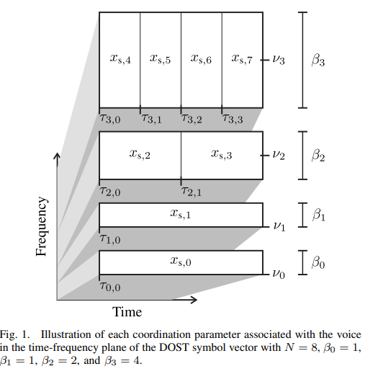

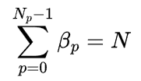
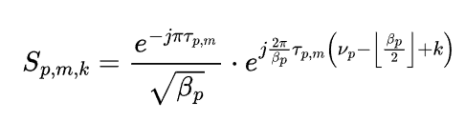
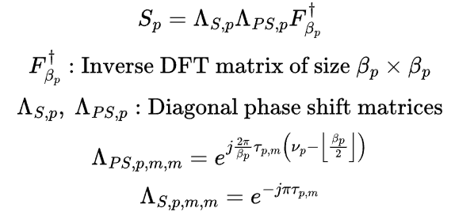
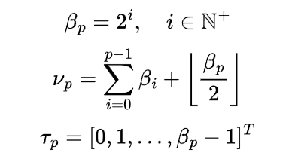
DISCRETE ORTHONORMAL S-TRANSFORM
The DOST divides the time-frequency plane into tiles (or "voices") that represent specific frequency bands over specific time intervals. Each tile is processed using a block-diagonal matrix, where each block corresponds to a different frequency band.
The DOST transform is defined as:
Where:
Np is the number of voices (frequency bands).
Each Sp is a βp × βp matrix that processes the signal in the p-th voice.
The total size of all blocks adds up to N, i.e.,
Each block Sp is defined element-wise as:
m,k ∈ [0,βp​−1]
τp,m​: Time index for the m-th tile
νp​: Central frequency index
βp​: Number of tiles in the p-th voice
Notes:
Purpose of Phase Shifts
Time Localization: Concentrates energy around specific time indices.
Tile Alignment: Places each tile correctly in the time-frequency grid.
Orthonormality: Ensures energy preservation and perfect reconstruction.

Slide 12



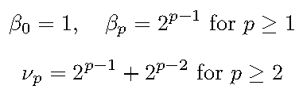
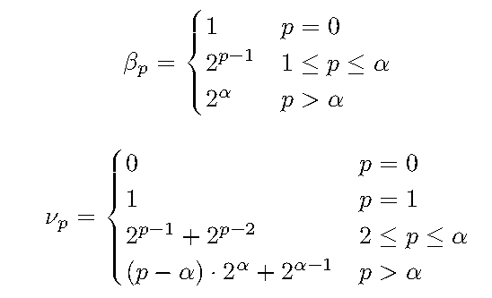
Tile Geometry
1) Uniform Geometry: It divides the frequency band into equal-sized voices
Regular Tile Geometry
A tile geometry is regular if:
This condition ensures:
2) Octave Geometry: It uses dyadic progression:
3)β-Geometry: It balances complexity and performance:
Notes:
(b) Octave Geometry
Narrow tiles at high frequencies (top of the graph) → better time resolution.
Wide tiles at low frequencies (bottom) → better frequency resolution.
©B-Geometry
Starts with small tiles (high time resolution), then switches to larger tiles (high frequency resolution).
A hybrid between uniform and octave.

Slide 13
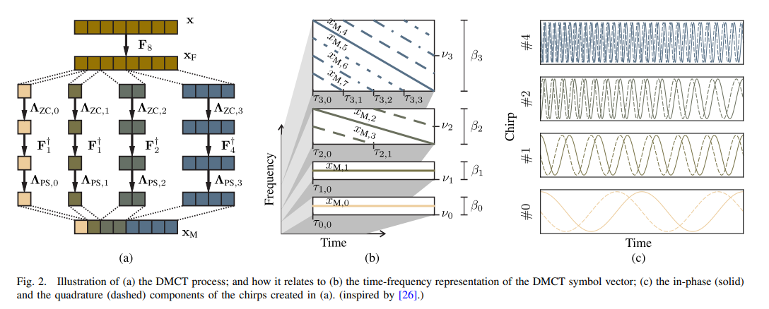
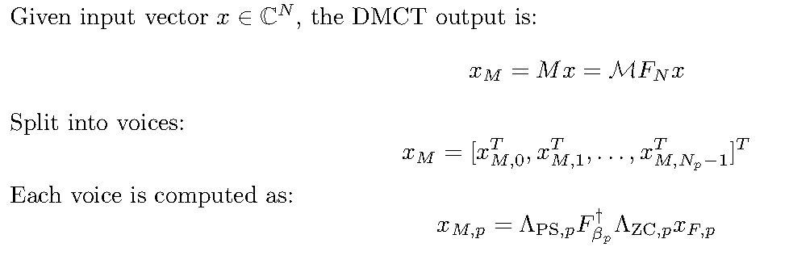
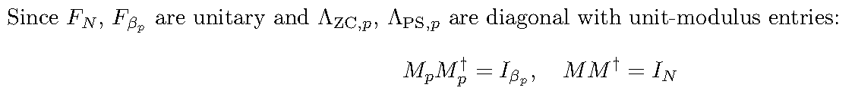
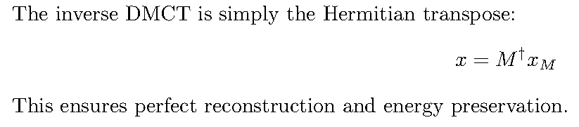
Discrete Modular Chirp Transform

Slide 14







OCFDM
This is analogous to OFDM but uses chirps instead of sinusoids.
where Ch is the circulant convolution matrix and v ∈ CN ×1 is the additive noise vector.
Using zero-forcing (ZF) equalization,
Since Ch is circulant:
OCFDM leverages chirp-based modulation and DMCT to achieve robust communication over LTI channels, with efficient equalization and demodulation strategies.
where ΛhF is a diagonal matrix derived from:

Slide 15
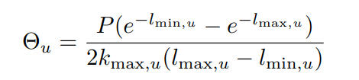
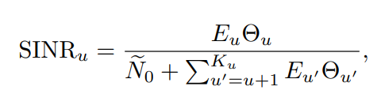
Why Change in the Objective Function
A priori channel statistical information
Where w_u denotes the weighting factor of the u-th user
E_tot denotes the total symbol power budget of the system.
E_max puts an upper limit on the transmission power of each user
Why change the objective function?
The objective contains logarithmic SINR terms, where SINR is in a ratio form, making the problem non-convex and difficult to optimize.
How do they change it?
They apply a quadratic transform to each logarithmic SINR term, converting the fractional form into an equivalent, tractable formulation, allowing optimal solution.

