Slide 1


Opportunistic scheduling in IRS-assisted communication systems
Guna Sai Kiran Nekkanti
Mid –Project Review Presentation
MTech ECE
January 27 , 2026

Slide 2
Opportunistic Multi user Communication
Opportunistic multi-user communication (MU-OC): A transmission strategy that exploits multi-user diversity, in which the user(s) with the favourable instantaneous channel conditions are scheduled for transmission in each time slot
Choices:
1. Max-rate scheduler: Schedules user with best instantaneous channel quality. In a $K$ user system, the scheduler serves user $k^{∗}$at time$t$where
$$k^{∗}\left(t\right)=\arg{{\max_{k∈\left[K\right]}\left|h_{k}\left(t\right)\right|}^{2}}$$
The total throughput of the system increases. But user fairness?
2. Round Robin scheduler: Schedules the users one after the other, in a round-robin fashion
Round: n
Round: n +1
Mechanism of RR scheduling, in a system with 4 users.
UE - 1
UE - 2
UE - 3
UE - 4
UE - 1
UE - 2
UE - 3
UE - 4
….
1 time slot
Notes:
a drawback with this approach is that a UE who is far away from the gNB always sees a weak channel and would, therefore, rarely be scheduled.
This ensures that every user gets equal resource allocation regardless of the instantaneous CQI.

Slide 3
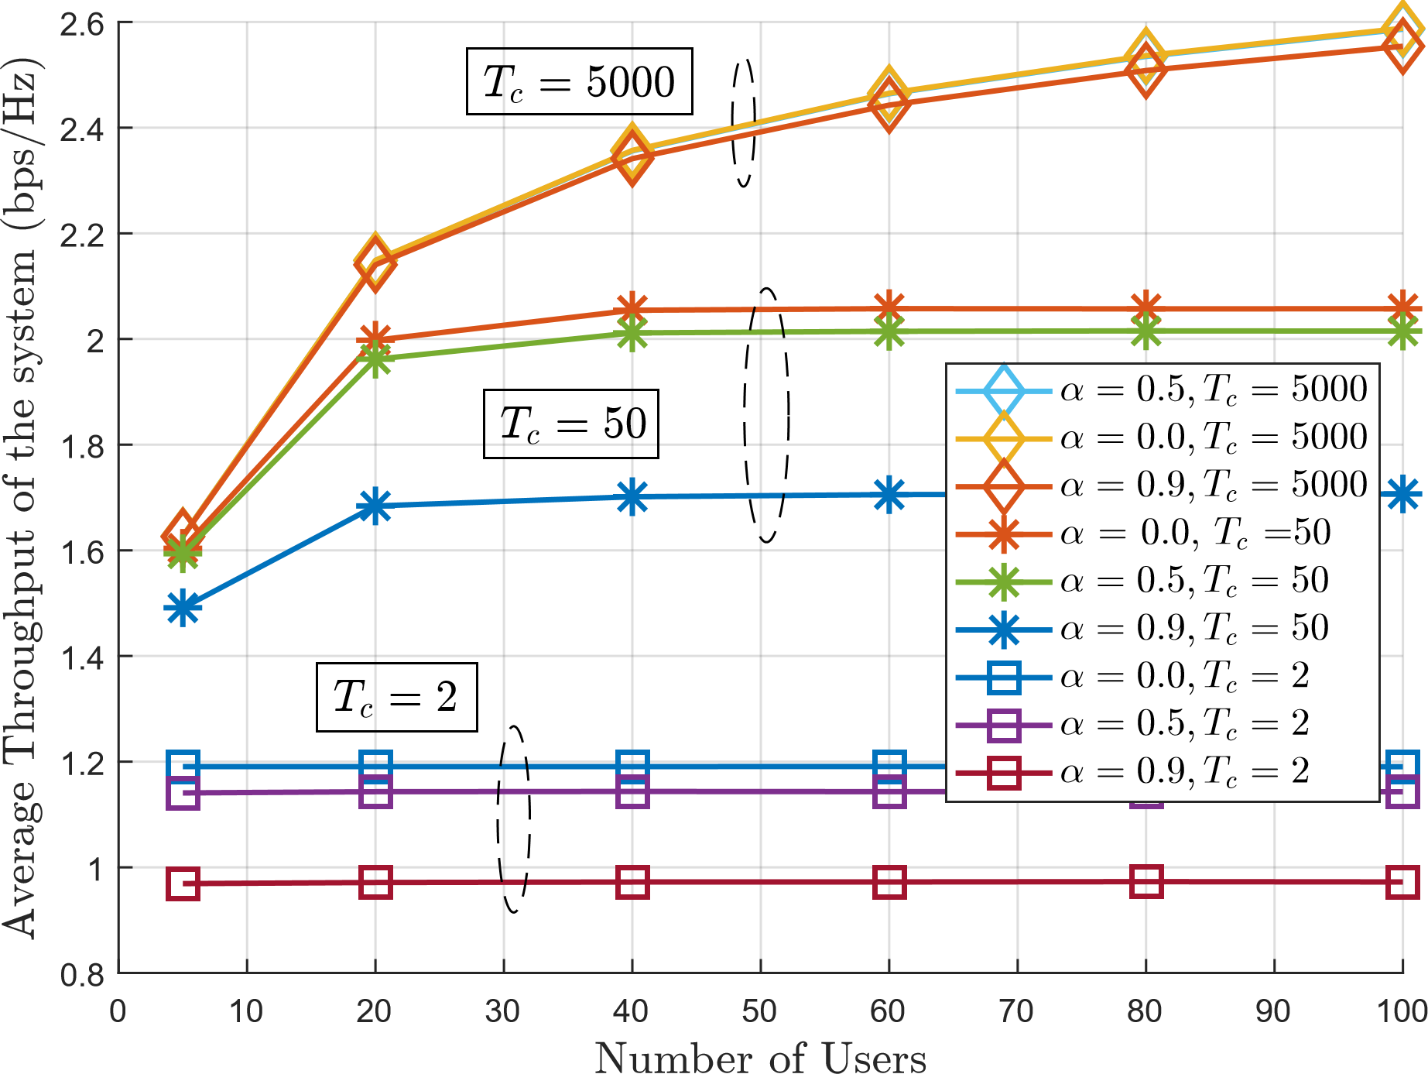
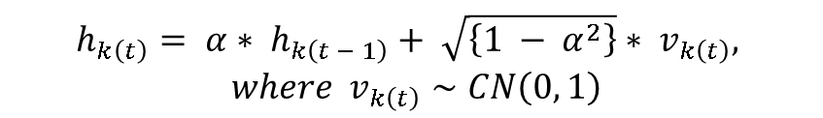

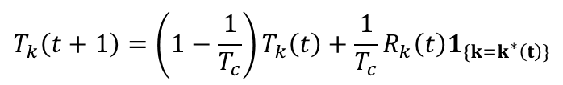
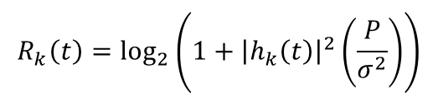

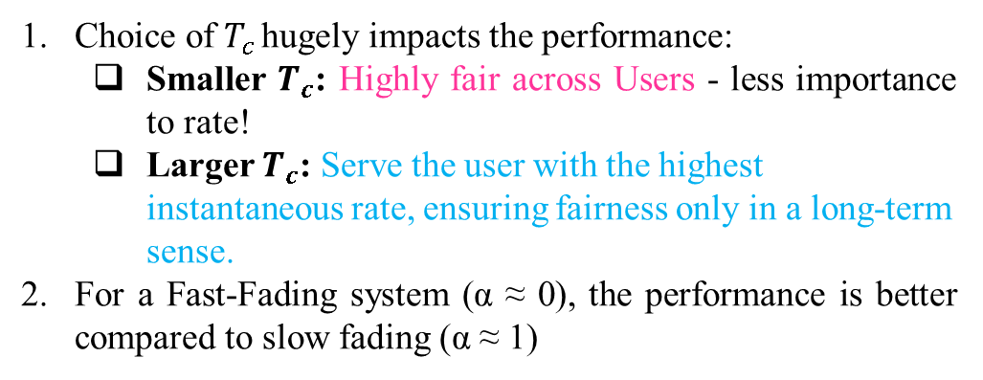
PF Scheduler Interpretation
3. Proportional Fair scheduler: In a $K$ user system, the scheduler serves user $k^{∗}$at time$t$where
$$k^{∗}\left(t\right)=\arg{\max_{k∈\{1,2,…,K\}}{\frac{R_{k}\left(t\right)}{T_{k}\left(t\right)}}}$$
$$R_{k}\left(t\right)=\log_{2}\left(1+{\left|h_{k}\left(t\right)\right|}^{2}\left(\frac{P}{σ^{2}}\right)\right)$$
where
and
$T_{C }$is averaging window
$$T_{k}\left(t+1\right)=\left(1−\frac{1}{T_{c}}\right)T_{k}\left(t\right)+\frac{1}{T_{c}}R_{k}\left(t\right)1_{\{k=k^{∗}\left(t\right)\}}$$
Illustration:
$$h_{k\left(t\right)}= α∗ h_{k\left(t − 1\right)}+ \sqrt{\left\{1 − α^{2}\right\}}∗ v_{k\left(t\right)},$$
$where v_{k\left(t\right)}∼CN\left(0, 1\right)$
Remarks:
Choice of $T_{c }$hugely impacts the performance:
Smaller $T_{c}$: Highly fair across Users - less importance to rate!
Larger $T_{c}$: Serve the user with the highest instantaneous rate, ensuring fairness only in a long-term sense.
For a Fast-Fading system (α ≈ 0), the performance is better compared to slow fading (α ≈ 1)

Slide 4
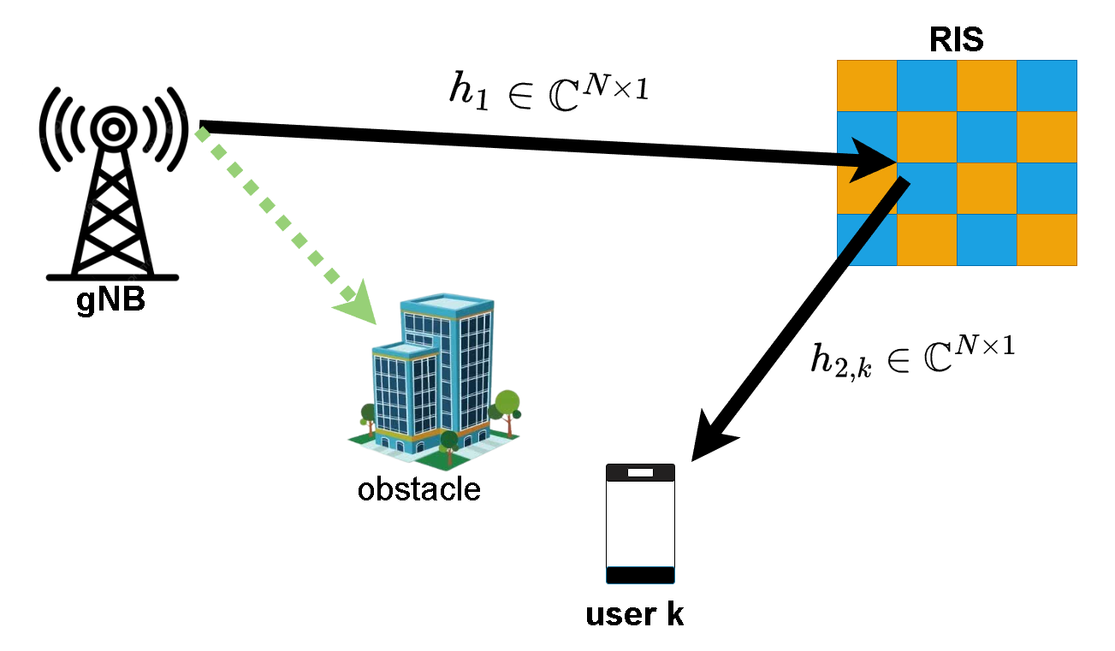





Also known as reconfigurable intelligent surfaces (RIS)
Meta-surfaces made up of passive elements
Reflect signals in required directions
Alters the wireless channel
Perks: Boosts SNR/SINR, energy efficiency, coverage, etc.
Controls the channel by modifying the reflection coefficients at the IRS
Effective channel at UE $– k$ :
Intelligent reflecting surfaces (IRS)
$$h_{k}=\sqrt{β_{k}}φ^{H}\left(t\right)h_{c,k}$$
$$φ\left(t\right)={\left[e^{−jθ_{1}\left(t\right)},e^{−jθ_{2}\left(t\right)},…,e^{−jθ_{N}\left(t\right)}\right]}^{T}$$
Path loss
$$h_{c,k}= h_{1}⊙h_{2,k}$$
Received signal at UE $– k$ :
$$y_{k}\left(t\right)=\sqrt{β_{k}}φ^{H}\left(t\right)h_{c,k}x_{k}\left(t\right)+n_{k}\left(t\right).$$
Note$:h_{1}$ is mostly a strong LOS path between base station and IRS
Notes:
For e.g, when IRS is configured as an ULA, h1 can be modeled as steering vector of ULA.

Slide 5
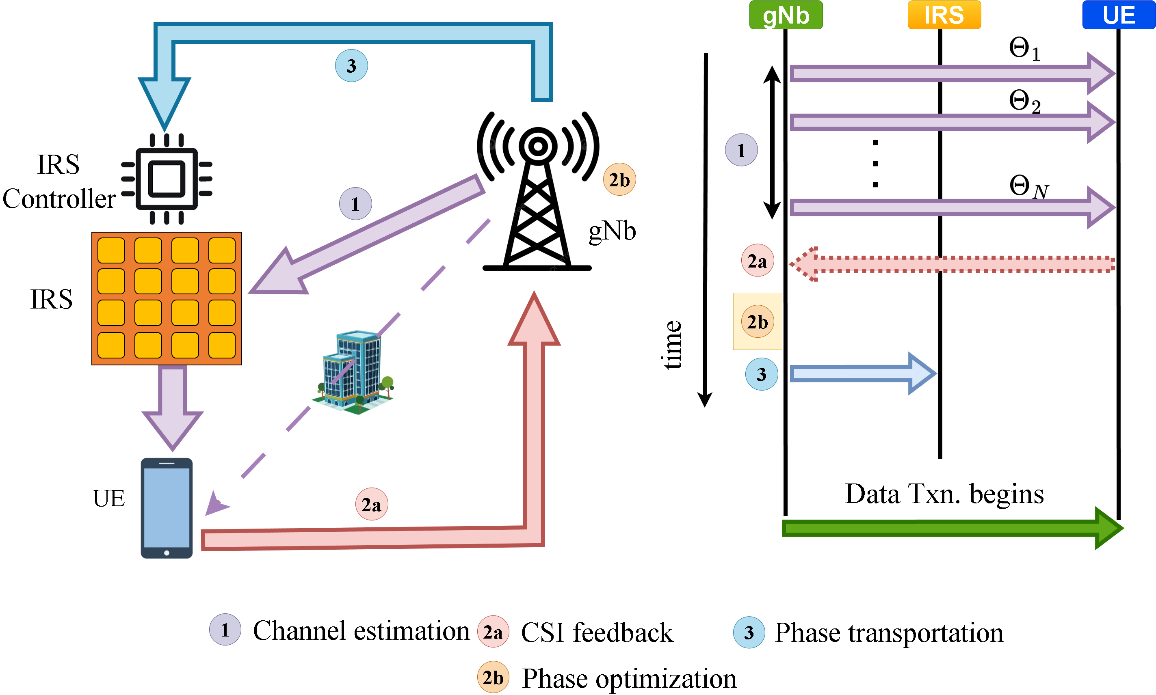
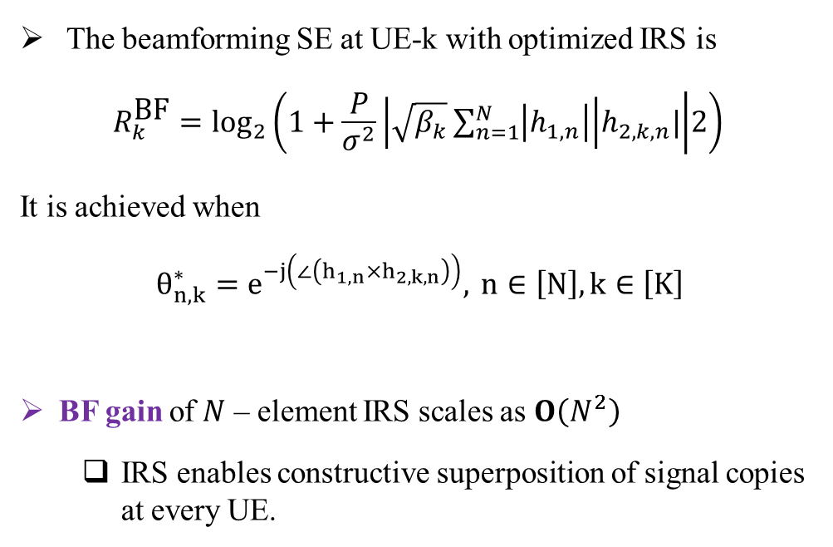
Benchmark and 3-Fold Overheads
The beamforming SE at UE-k with optimized IRS is
$$R_{k}^{\text{BF}}=\log_{2}\left(1+\frac{P}{σ^{2}}\left|\sqrt{β_{k}}\sum_{n=1}^{N}{\left|h_{1,n}\right|}\right|h_{2,k,n}| | 2\right)$$
It is achieved when
$θ_{n,k}^{∗}=e^{−j\left(∠\left(h_{1,n}×h_{2,k,n}\right)\right)}, n∈\left[N\right],k∈\left[K\right]$
BF gain of $N$ – element IRS scales as $O\left(N^{2}\right)$
IRS enables constructive superposition of signal copies at every UE.
Problem
How can we obtain optimal benefits without optimizing the IRS and avoiding the three-fold overheads
Solution
Randomized RIS + Opportunistic Communications

Slide 6
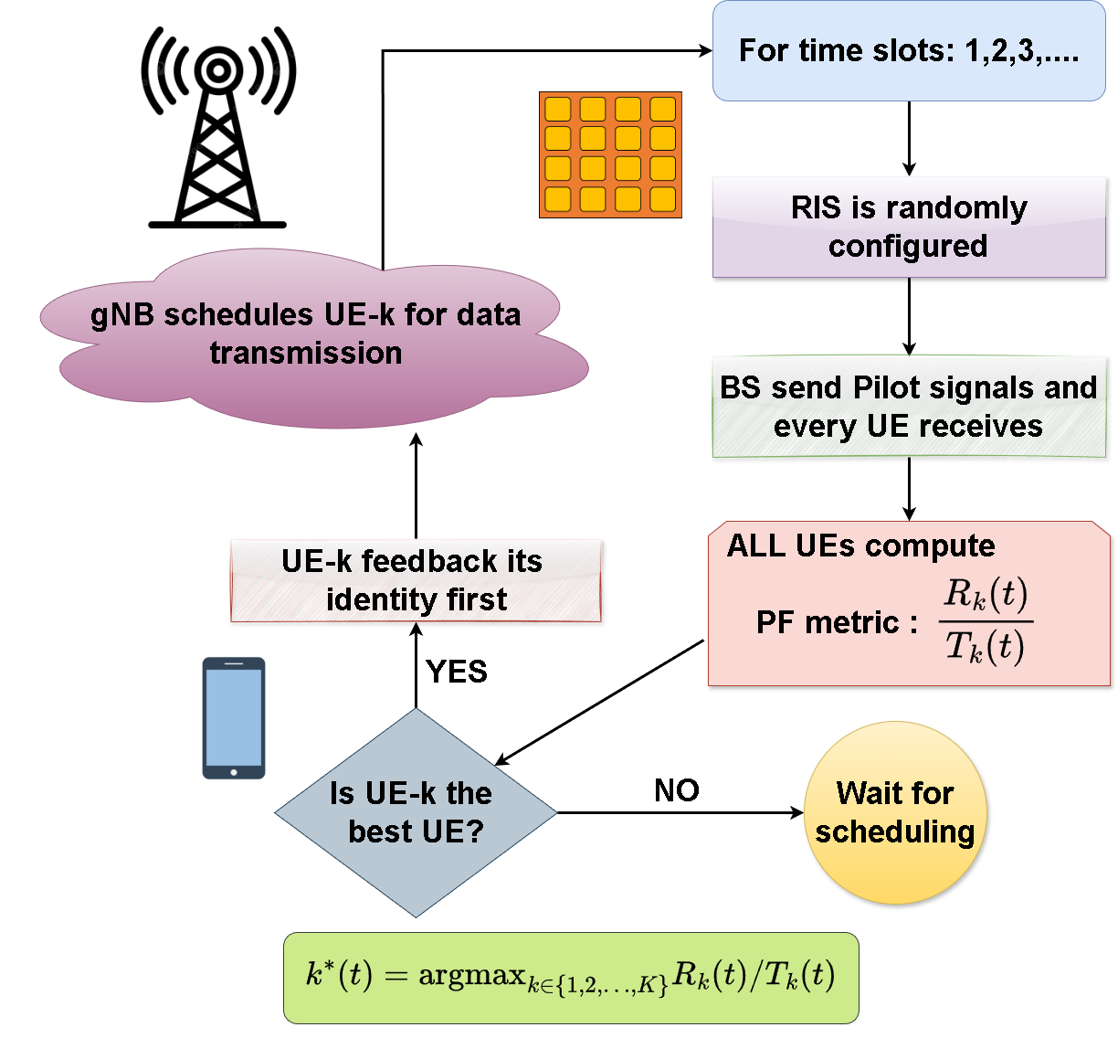
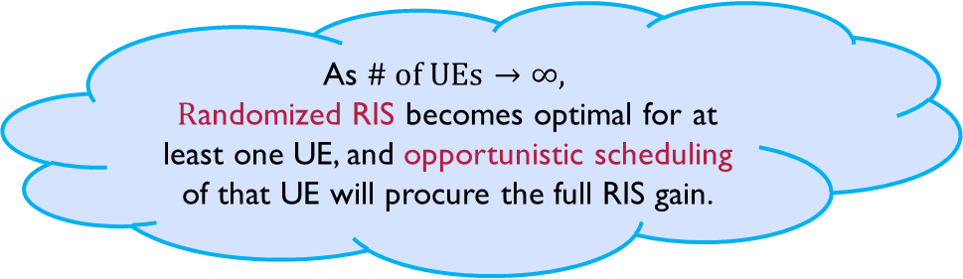
Randomized RIS + Opportunistic Communications
Idea : Randomly tune the RIS configurations and schedule one of K UEs opportunistically having the best channel in every time slot!
Explicit RIS phase optimization is unnecessary, as the gNB scheduler exploits RIS gain via UE CQI feedback.
UEs periodically report CQI (≈80 ms); the UE aligned with the RIS reports higher CQI.
The gNB scheduler uses CQI to identify and schedule the RIS-favored UE.
As $\# \text{of} \text{UEs}→∞,$
$R$andomized RIS becomes optimal for at least one UE, and opportunistic scheduling of that UE will procure the full RIS gain.

Slide 7
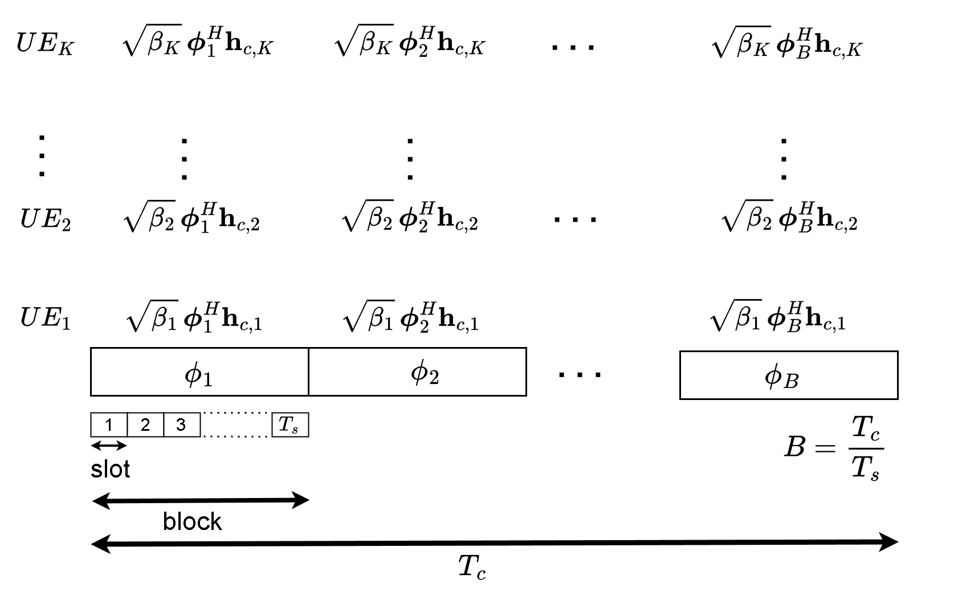
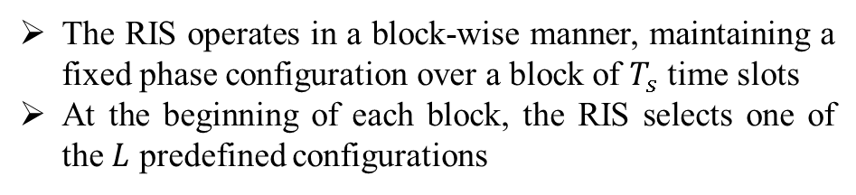
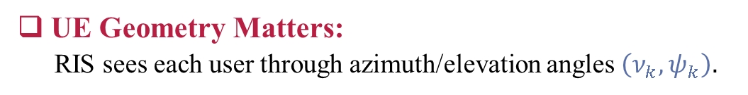

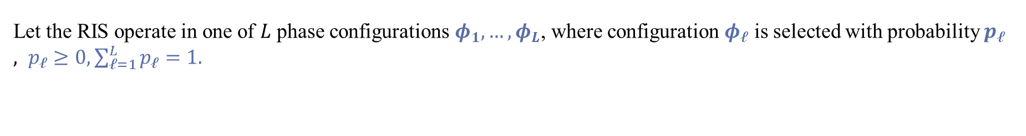
Choice of RIS states
UE Geometry Matters:
RIS sees each user through azimuth/elevation angles $\left(ν_{k},ψ_{k}​\right).$
Finite RIS Codebook :
Let the RIS operate in one of $L$ phase configurations $φ_{1},…,φ_{L}$, where configuration $φ_{ℓ}$ is selected with probability $p_{ℓ}, p_{ℓ}≥0,\sum_{ℓ=1}^{L}{p_{ℓ}}=1.$
$S=\{(φ_{1},p_{1}),…,(φ_{L}, p_{L})\}$ : sampling distribution
Sampling Distribution:
Matching the RIS phase distribution to the users’ angular statistics maximizes the system throughput.
Block wise Operation :
The RIS operates in a block-wise manner, maintaining a fixed phase configuration over a block of $T_{s}$ time slots
At the beginning of each block, the RIS selects one of the $L$ predefined configurations
$$φ\left(t\right)=φ_{ℓ}, t∈\left[nT_{s},\left(n+1\right)T_{s}−1\right],$$

Slide 8
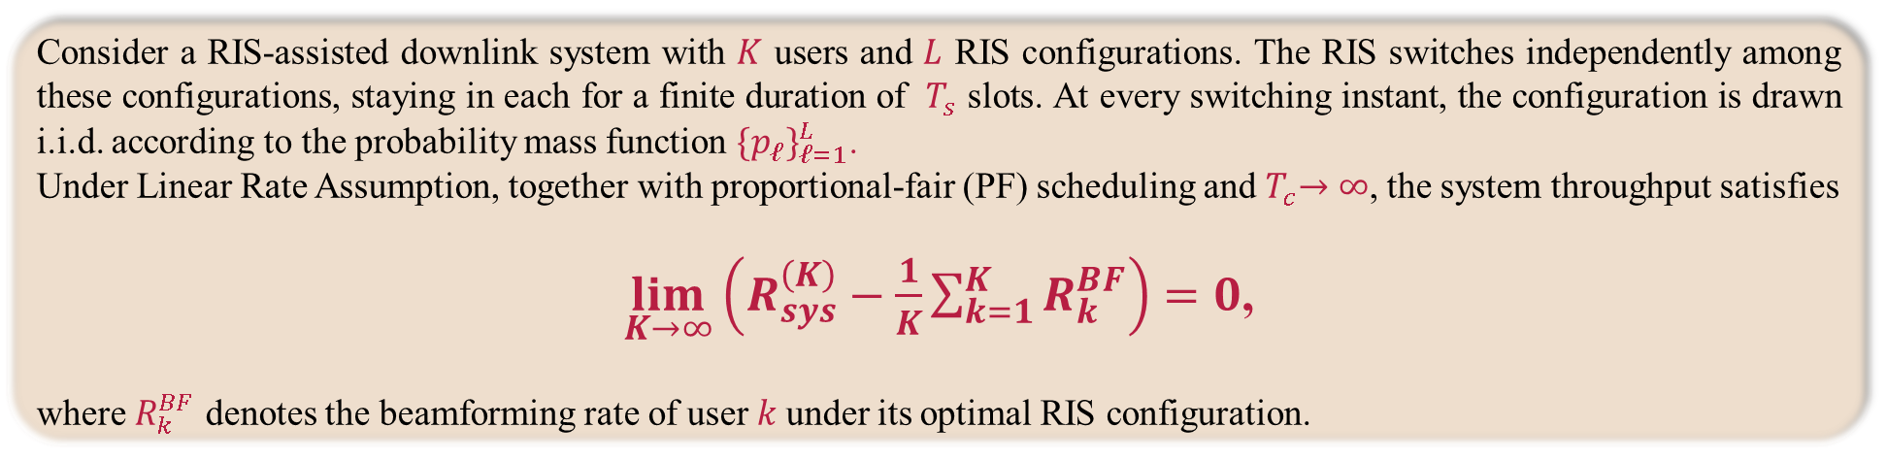
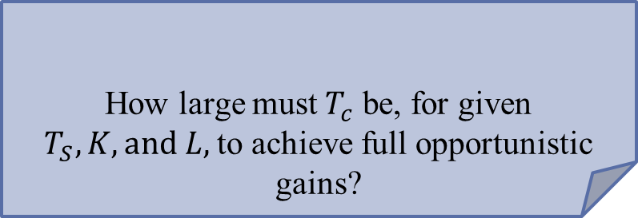
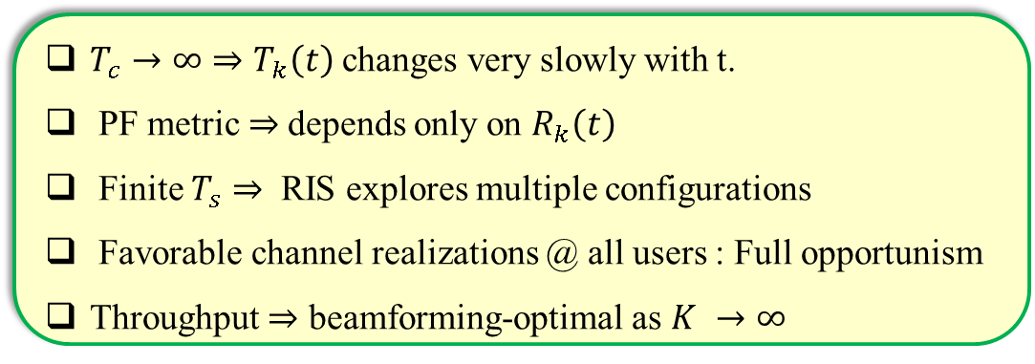
Theorem 1
Consider a RIS-assisted downlink system with $K$ users and $L$ RIS configurations. The RIS switches independently among these configurations, staying in each for a finite duration of $T_{s}$ slots. At every switching instant, the configuration is drawn i.i.d. according to the probability mass function $\{p_{ℓ}\}_{ℓ=1}^{L}$.
Under Linear Rate Assumption, together with proportional-fair (PF) scheduling and${ T}_{c}→∞$, the system throughput satisfies
$\lim_{K→∞}\left(R_{sys}^{\left(K\right)}−\frac{1}{K}\sum_{k=1}^{K}{R_{k}^{BF}}\right)=0$,
where $R_{k}^{BF}$ denotes the beamforming rate of user$k$under its optimal RIS configuration.
Interpretation:
$T_{c}→∞⇒T_{k}\left(t\right)$ changes very slowly with t.
PF metric $⇒$depends only on $R_{k}\left(t\right)$
Finite $T_{s}⇒$RIS explores multiple configurations
Favorable channel realizations @ all users : Full opportunism
Throughput $⇒$ beamforming-optimal as $K →∞$
How large must${ T}_{c}$ be, for given $T_{S},K,and L,$to achieve full opportunistic gains?
In practice : Finite $T_{C}$.

Slide 9
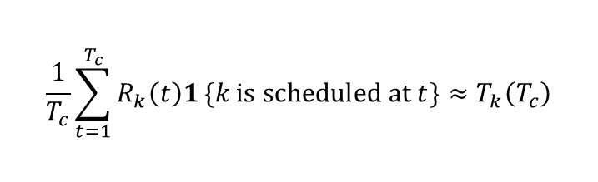


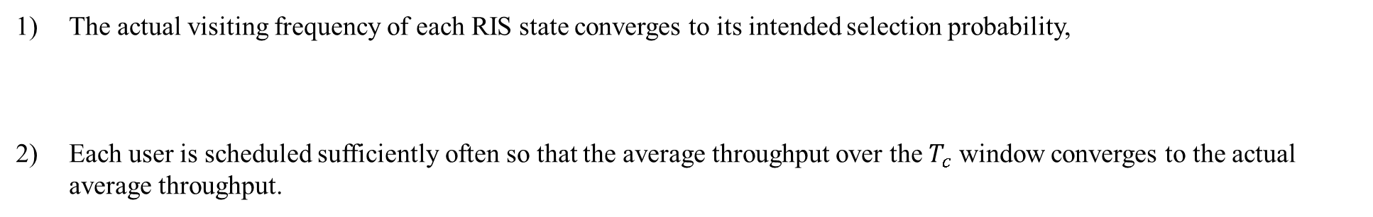
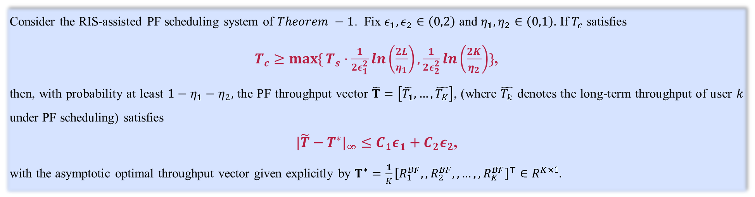
Theorem 2 (Finite $T_{c}$)
Consider the RIS-assisted PF scheduling system of $Theorem −1$. Fix $ε_{1},ε_{2}∈\left(0,2\right)$ and $η_{1},η_{2}∈\left(0,1\right).$ If $T_{c}$ satisfies
$T_{c}≥\max{\{}T_{s}⋅\frac{1}{2ε_{1}^{2}}ln\left(\frac{2L}{η_{1}}\right),\frac{1}{2ε_{2}^{2}}ln\left(\frac{2K}{η_{2}}\right)\}$,
then, with probability at least $1−η_{1}−η_{2},$ the PF throughput vector $\tilde{T}=\left[\tilde{T_{1}},…,\tilde{T_{K}}\right]$, (where $\tilde{T_{k}}$ denotes the long-term throughput of user $k$ under PF scheduling) satisfies
$|\tilde{T}−T^{∗}|_{∞}≤C_{1}ε_{1}+C_{2}ε_{2}$,
with the asymptotic optimal throughput vector given explicitly by $T^{∗}=\frac{1}{K}{\left[R_{1}^{BF},,R_{2}^{BF},,…,,R_{K}^{BF}\right]}^{⊤}∈R^{K×𝟙}.$
$T_{c}$ should be long enough :
The actual visiting frequency of each RIS state converges to its intended selection probability,
Each user is scheduled sufficiently often so that the average throughput over the $T_{c}$ window converges to the actual average throughput.
$$\frac{1}{T_{c}}\sum_{t=1}^{T_{c}}{1}\{θ\left(t\right)=θ_{m}\}≈P\left(θ=θ_{m}\right)$$
$$\frac{1}{T_{c}}\sum_{t=1}^{T_{c}}{R_{k}\left(t\right)1}\{k \text{is} \text{scheduled} \text{at} t\}≈T_{k}\left(T_{c}\right)$$

Slide 10
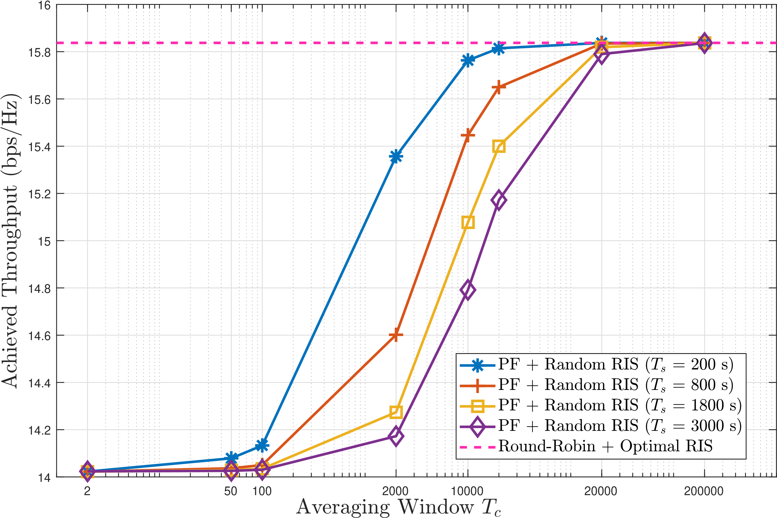
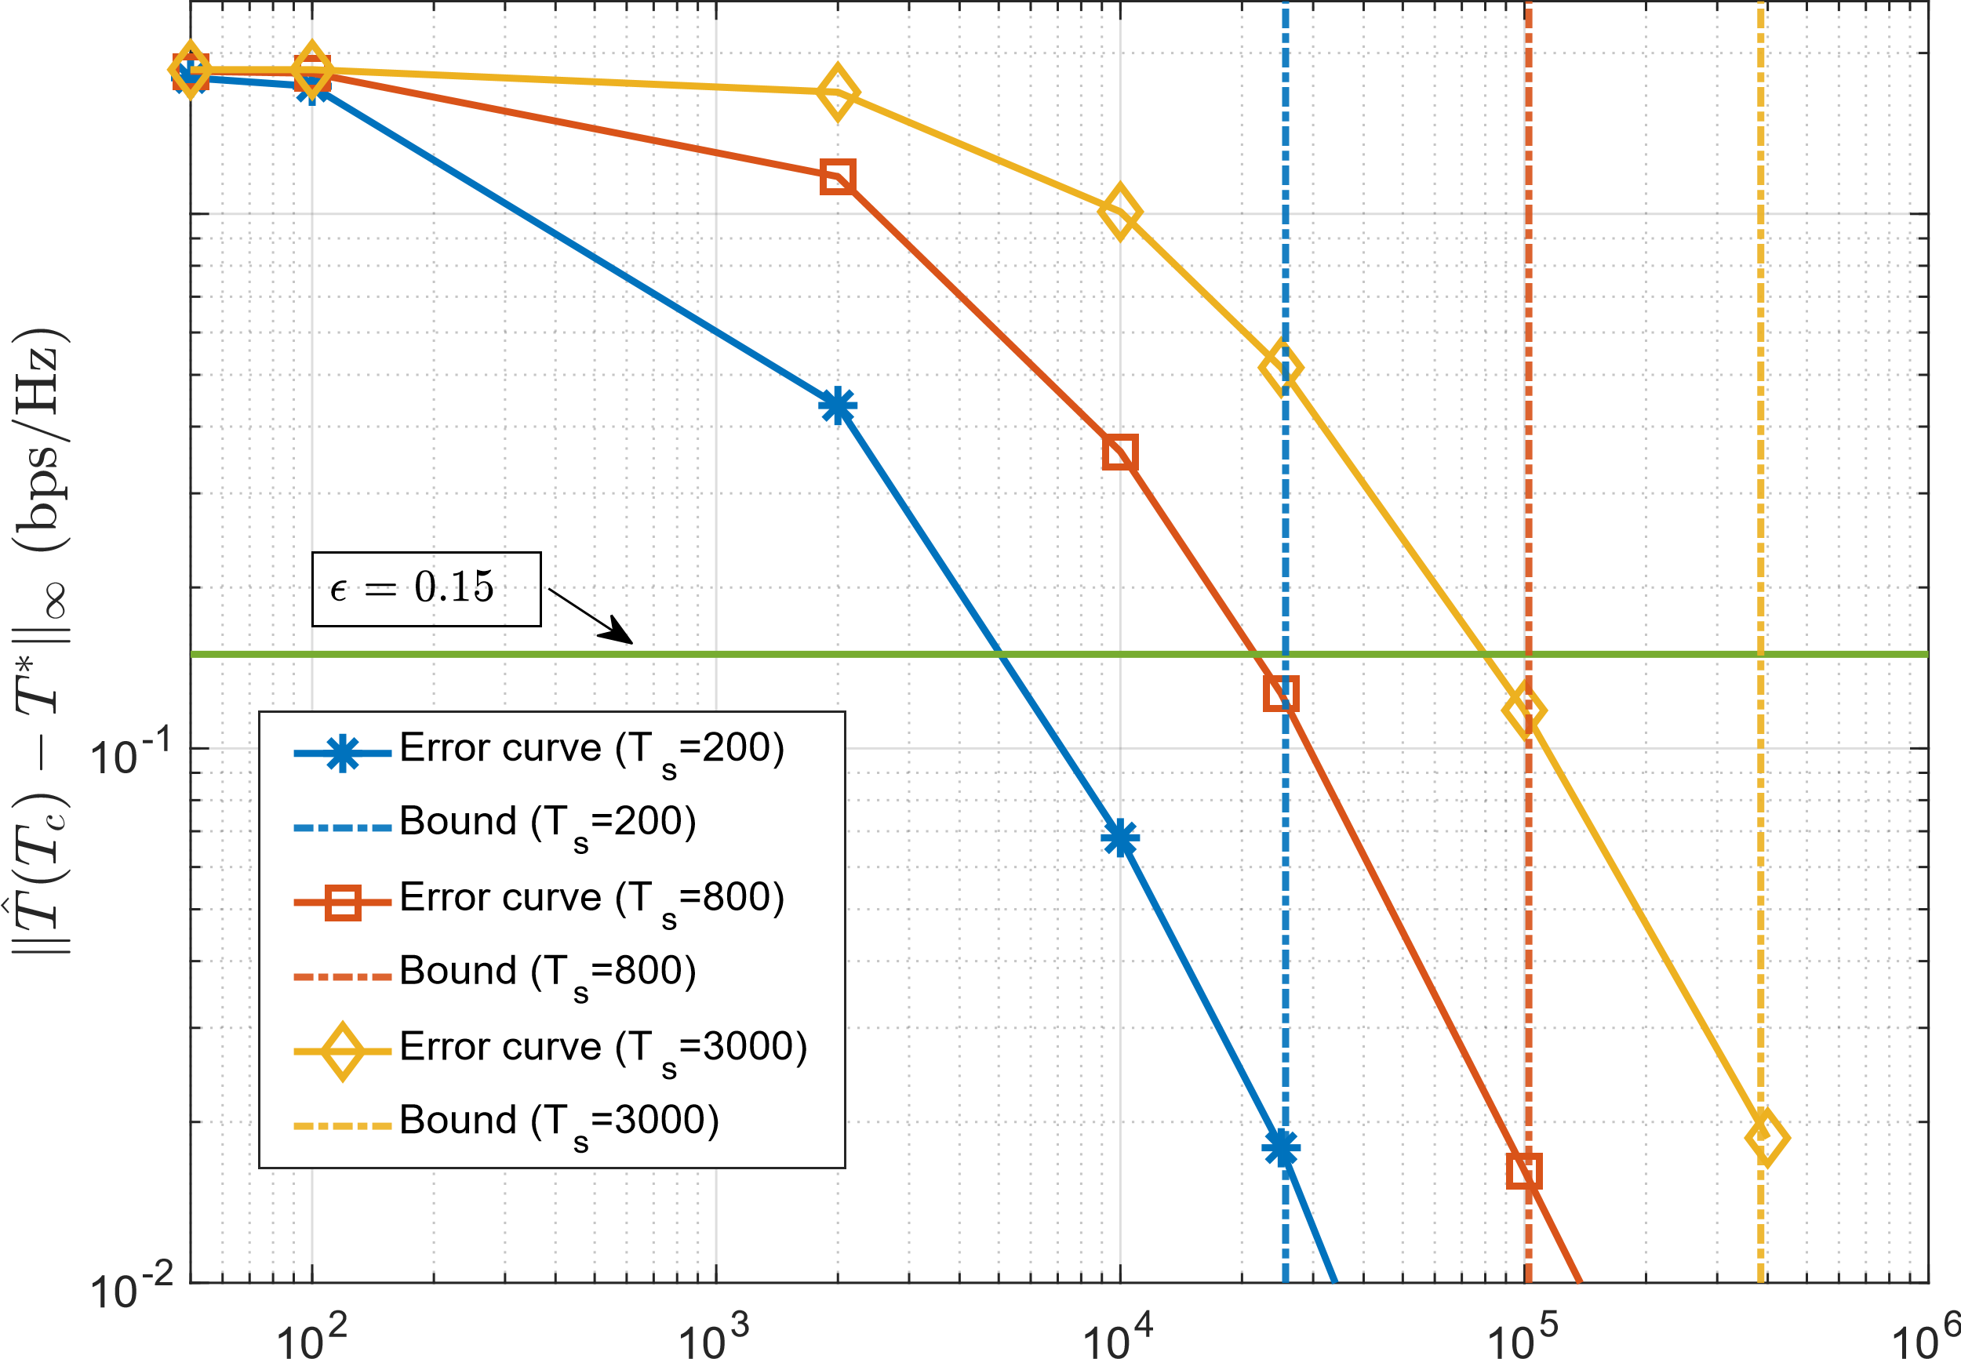
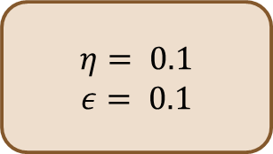
Simulation Results
Averaging Window T_{c}
N = 16
K = 2
L = 16
$$η= 0.1$$
$$ε= 0.1$$

Slide 11
Experiments: RIS Gain without the Pain via Randomization and Opportunistic Scheduling in 5G NR
Guna Sai Kiran Nekkanti
Joint work with: L. Yashvanth, Raju Malleboina, Venkatareddy Akumalla,
Prof. Debdeep Sarkar, Prof. Chandra R. Murthy

Slide 12
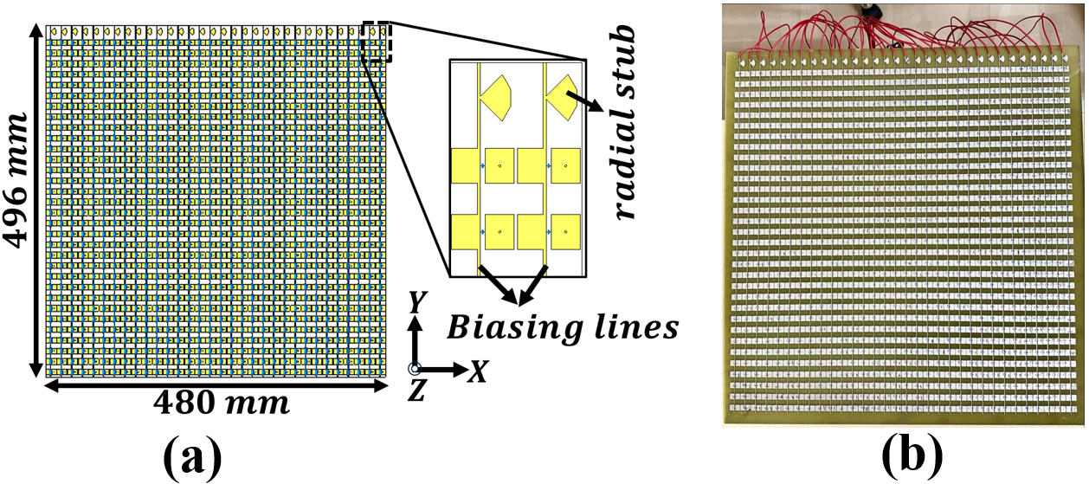
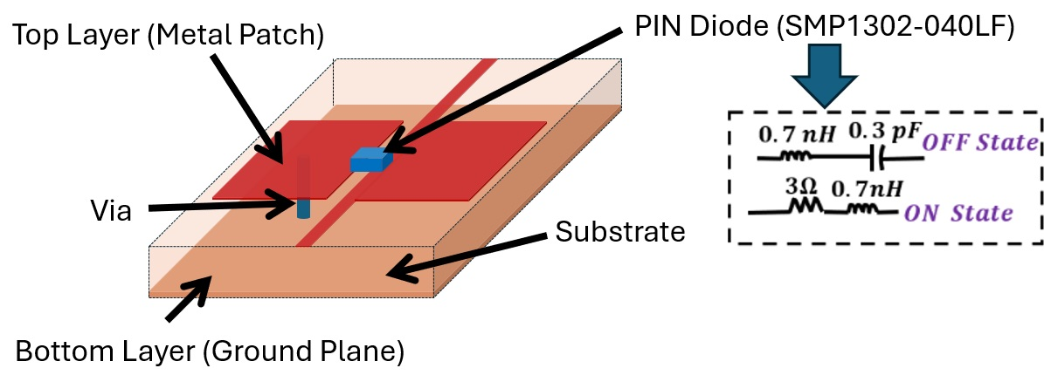
Indigenously Built RIS
Full RIS structure
RIS design using a 1-bit digitally coded metasurface at 5 GHz
Has 1024 elements; each element is configured via PIN-diode
Single-layer design with a single switch per unit cell
An FPGA controller used for programming & dynamic steering
Scan loss-free steering range from $0^{o}−{60}^{o}$
Low cost and low power consumption (<2 W) design
Suitable for sub-6 GHz wireless communications & other freq.
Unit-cell of a 1-bit
digitally coded RIS:
3D view
Equivalent circuit of PIN diode

Slide 13
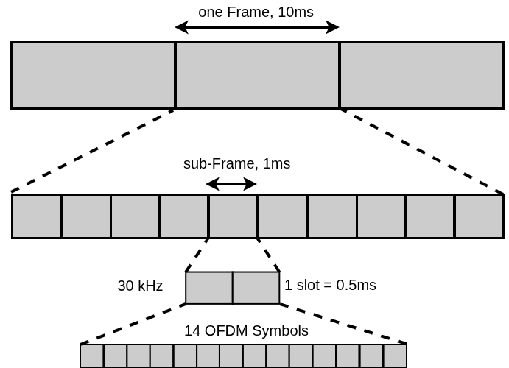
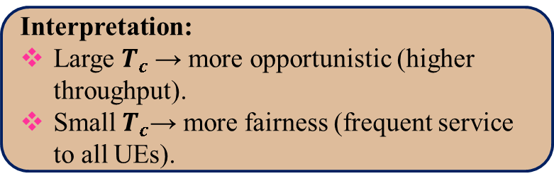

The OpenAirInterface for 5G NR
Communication Resources:
40 MHz bandwidth (5 GHz carrier), 30 kHz SCS.
0.5 ms slots with 14 OFDM symbols.
TDD frame: 10-slot periodicity
Discrete-Rate Adaptation:
Uses 3GPP MCS Table 1 (29 levels).
MCS range: 3 to CQI-dependent max (CQI every 80 ms).
HARQ adjust: ±1 MCS based on BLER (<0.05 / >0.15).
Retransmissions: Up to 3 HARQ repeats with same MCS
Resource Allocation:
1. In OAI, users are scheduled using a Proportional Fair scheduler.
Interpretation:
Large $T_{c}$→ more opportunistic (higher throughput).
Small $T_{c}$→ more fairness (frequent service to all UEs).
2. Scheduling rule:
$$k^{∗}\left(t\right)=\arg{\max_{k∈\{1,2,…,K\}}{\frac{R_{k}\left(t\right)}{T_{k}\left(t\right)}}}$$
Notes:
OpenAirInterface (OAI) is an open-source platform for 3GPP-compliant cellular systems.
Provides software implementations of 5G (New Radio).
Covers the entire protocol stack, from PHY to core network.

Slide 14
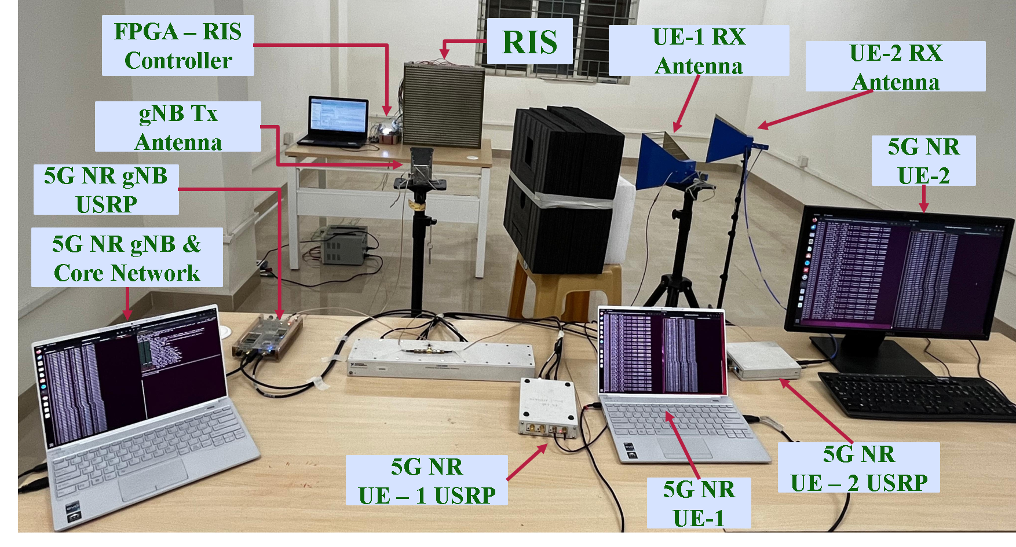
Setup of our RIS-aided 5G NR
5G NR Testbed Setup
Implemented using OpenAirInterface (OAI).
Operates: monolithic Stand-Alone (SA).
Full 5G RAN protocol stack
5G core network.
USRPs act as RUs for OTA communication.
OAI gNB and UE stacks run on:
Intel i7, 12 cores @ 4.9 GHz
32 GB RAM
Ubuntu 22.04 LTS, low-latency kernel
Notes:
Universal Software Radio Peripherals

Slide 15
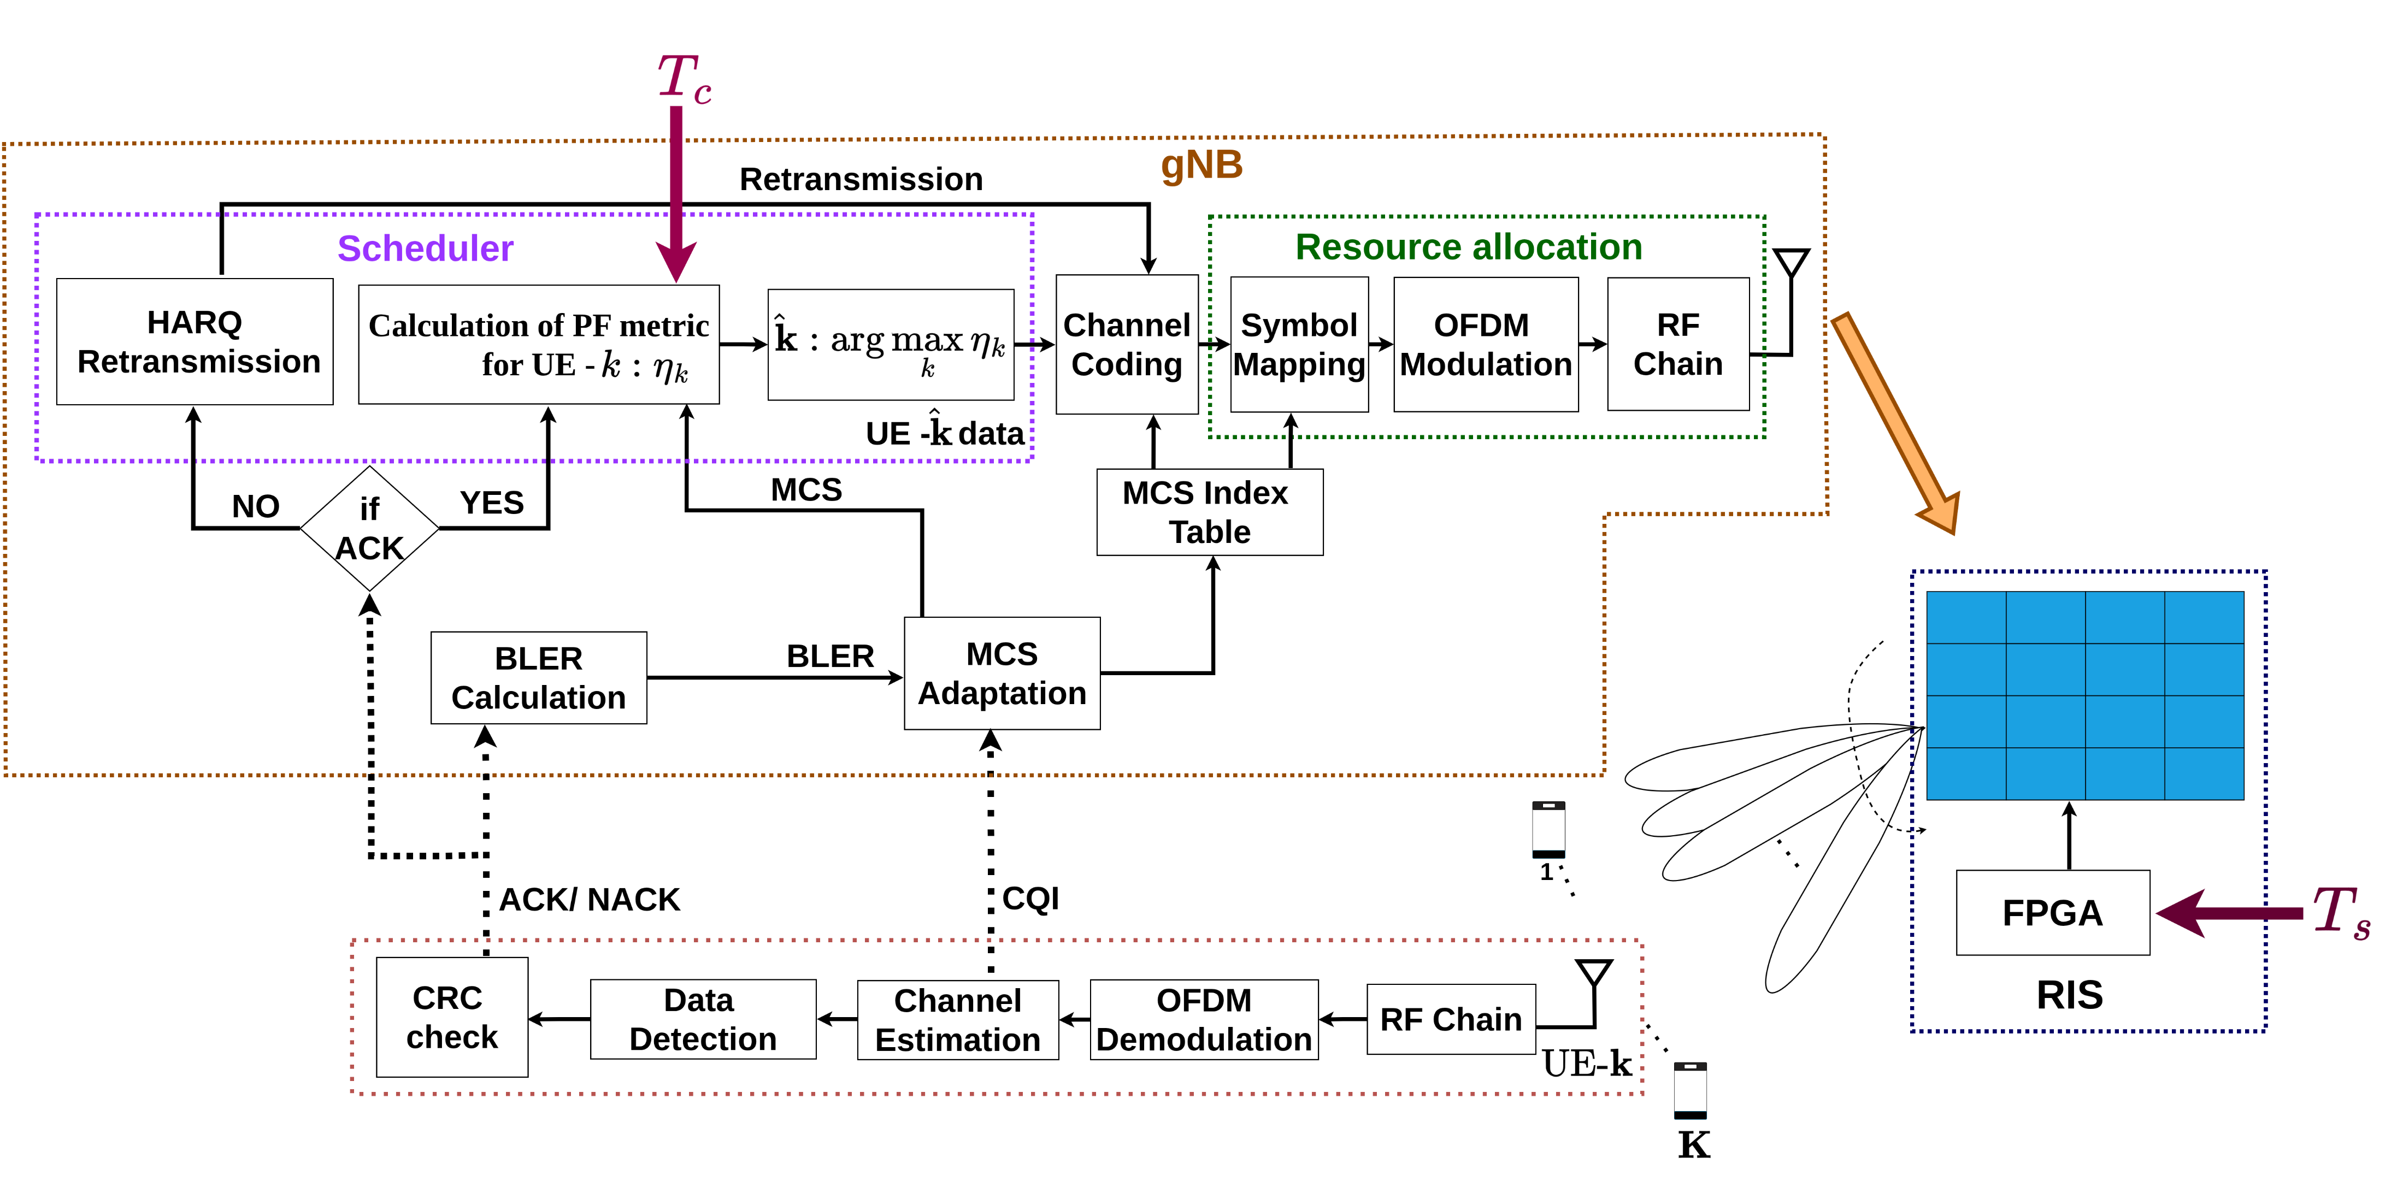
Block Diagram

Slide 16

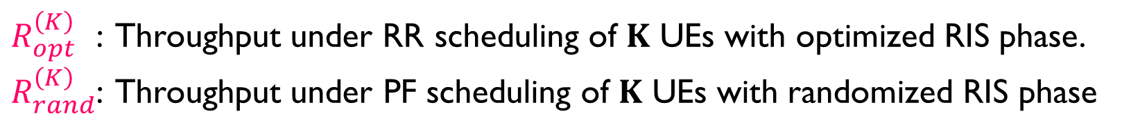

Core Idea
Randomized RIS: RIS switches between phase states with a switching time = $T_{s}$.
Proportional fair scheduler: gNB employs a PF scheduler with EWMA parameter = $T_{c}$.
A random RIS phase will be optimal to atleast one UE: Multi-user diversity
$R_{opt}^{\left(K\right) }$ : Throughput under RR scheduling of $K$ UEs with optimized RIS phase.
$R_{rand}^{\left(K\right)}$: Throughput under PF scheduling of $K$ UEs with randomized RIS phase
$$Using appropriately chosen T_{c},T_{s}.$$
$$R_{rand}^{\left(K\right)}=R_{opt}^{\left(K\right)}.$$

Slide 17

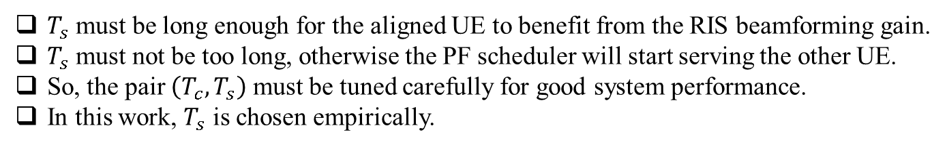
With RIS and Without RIS ( Random Switching)
With vs without RIS | RSRP (in dBm) |  | Throughput (in Mbps)
 | UE-1 | UE-2 | UE-1 | UE-2
Without RIS | -110 | -110 | 25.2 | 26.3
With RIS | -100 | -97 | 51.1 | 55.9
RSRP increment: 10-13 dB
Rate increment: 26 Mbps
Experiment Parameters:
Switching Time: $T_{s}$ = 1,3, 9, 15 sec
PF Parameters:
$T_{c}$ $= 100, 2000, 20000$.
Choice of the switching time, $T_{s}$:
$T_{s}​$ must be long enough for the aligned UE to benefit from the RIS beamforming gain.
$T_{s}$ must not be too long, otherwise the PF scheduler will start serving the other UE.
So, the pair $\left(T_{c},T_{s}\right)$ must be tuned carefully for good system performance.
In this work, $T_{s}​$ is chosen empirically.
Notes:
UE Placement & Geometry: Two UEs are located at azimuth angles ${30}^{∘}$and ${45}^{∘}$, both with elevation $0^{∘}$
RIS State Distribution: The RIS switches between the two beamforming states corresponding to these angles.

Slide 18
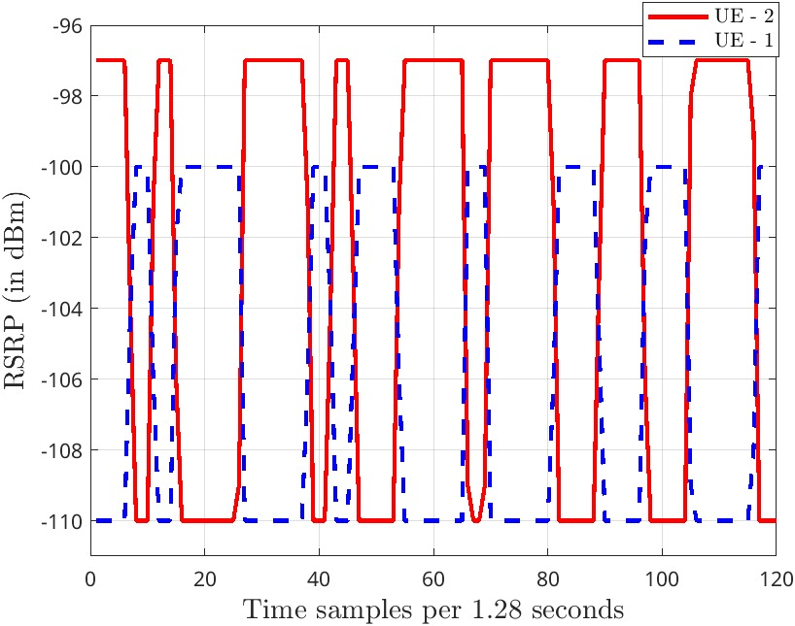
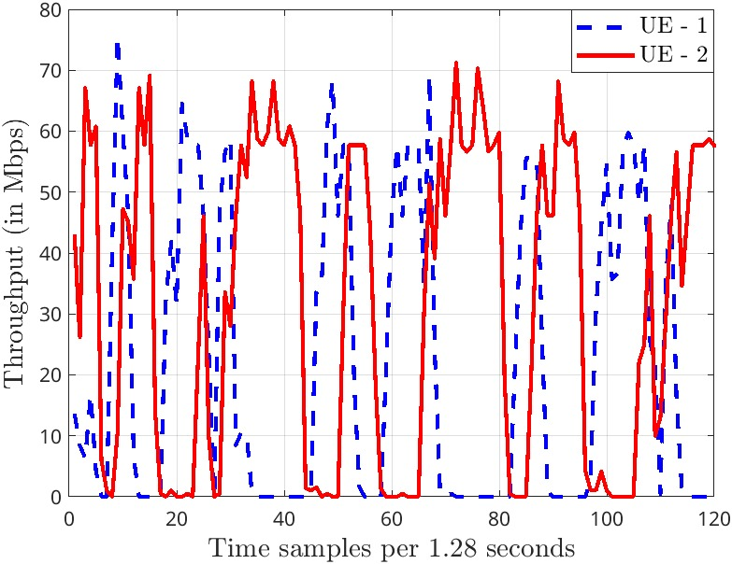
RSRP and Throughput $\left(T_{c}=20000, T_{s}= 5 sec\right)$

Slide 19
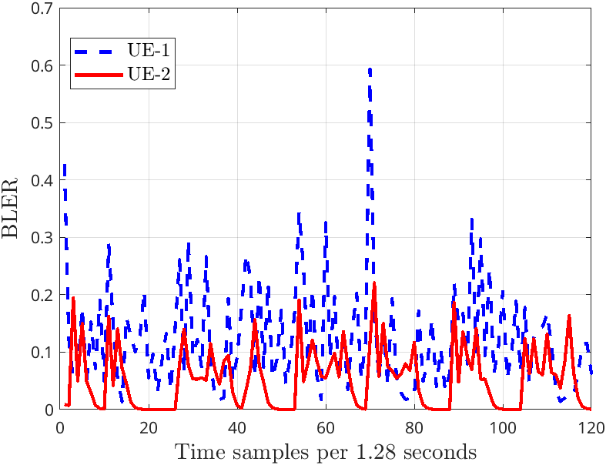
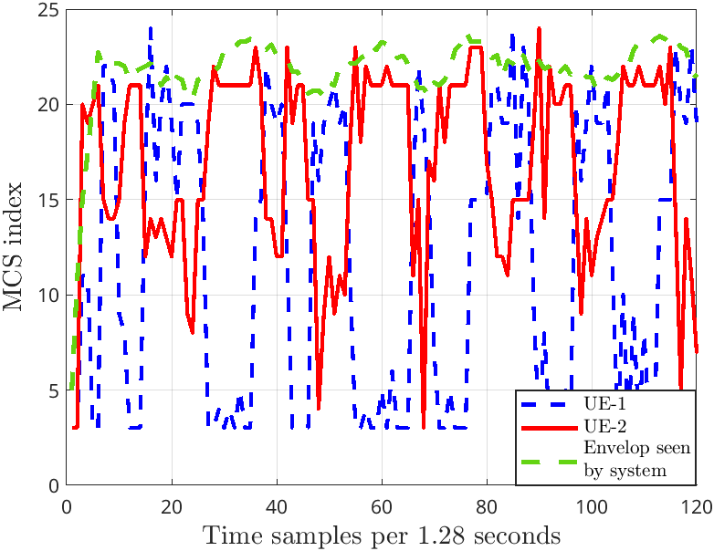
BLER and MCS

Slide 20
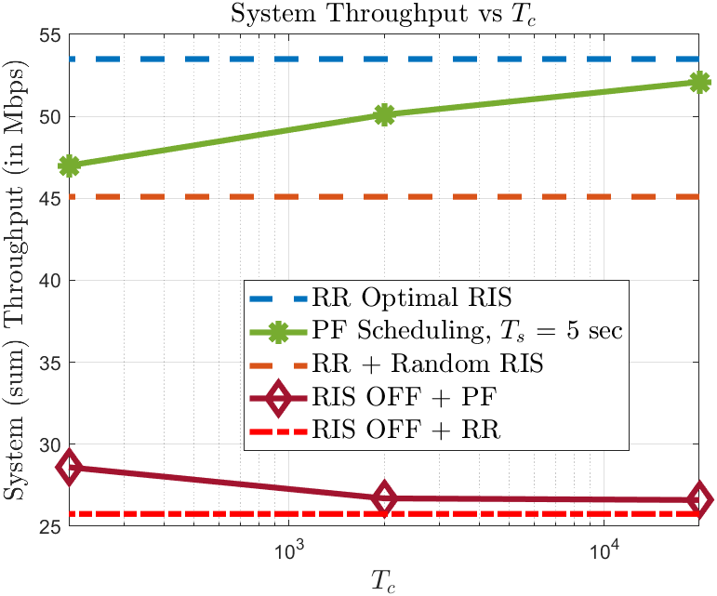
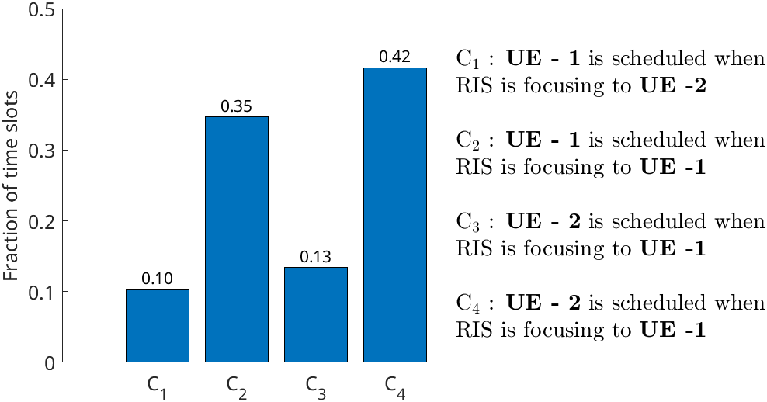
Randomized RIS Can Procure Full Benefits

Slide 21
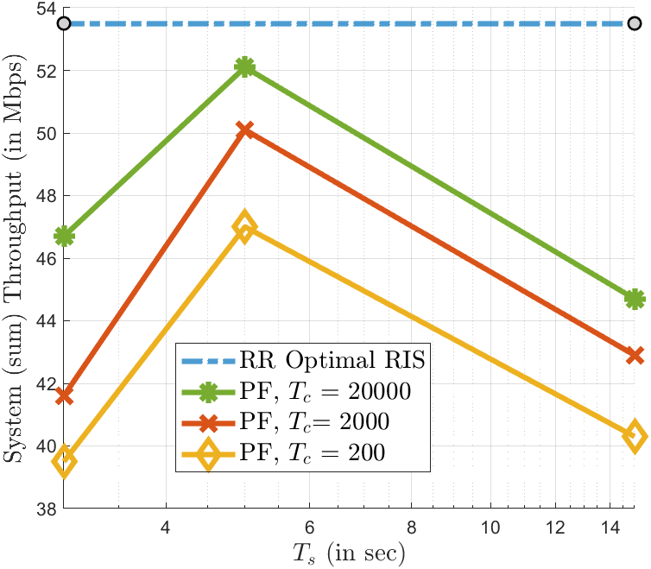
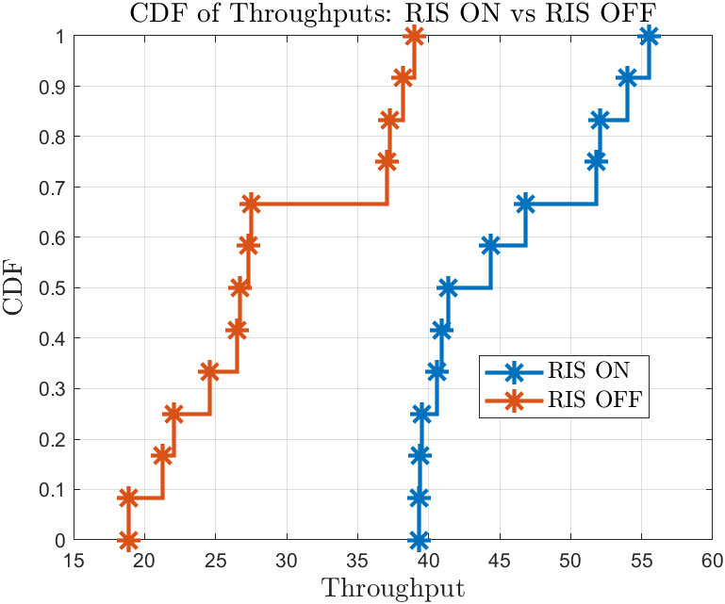
Randomized RIS always Helps

Slide 22

Conclusion
RIS integration with a real-time 5G system significantly improves performance
Random RIS configurations achieve near-optimal gains
5G NR opportunistic scheduling naturally exploits RIS benefits
Near-optimal performance without explicit RIS optimization enables low-complexity integration
Future Work :
Extend evaluation to large-scale 5G networks with more UEs
Study scalability and performance under dynamic and mobile scenarios
Publications:
IEEE ICC 2026 - Paper Accepted
L. Yashvanth, M. Raju, A. Venkata Reddy, N. Guna Sai Kiran, Chandra R. Murthy, and Debdeep Sarkar,
“Practical RIS Gain Without the Pain: Randomization and Opportunistic Scheduling in 5G NR”
IEEE ANTS 2025, IIIT Delhi - Experimental Demo Presented
ACM MobiCom 2025, Open-AI RAN Workshop, Hong Kong, China – Poster Presented

Slide 23

References
R. Malleboina and D. Sarkar, "A Digitally Coded Intelligent Reflecting Surface for 6G Wireless Communication," Proc. 19th European Conference on Antennas and Propagation (EuCAP), Stockholm, Sweden, 2025, pp. 1-5.
L. Yashvanth, C. R. Murthy and B. D. Rao, "Spatial Correlation-Aware Opportunistic Beamforming in IRS-Aided Multi-User Systems," in IEEE Wireless Communications Letters, vol. 14, no. 10, Oct. 2025.
L. Yashvanth and Chandra R. Murthy, “Performance Analysis of IRS Assisted Opportunistic Communications,” IEEE Transactions on Signal Processing, vol. 71, pp. 2056-2070, Jun. 2023

Slide 24

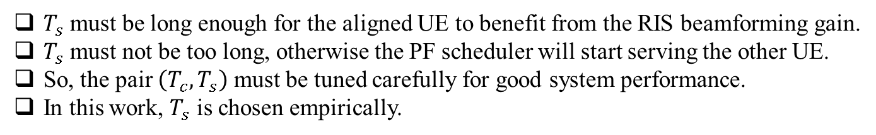
With RIS and Without RIS ( Alternate Switching)
With vs without RIS | RSRP (in dBm) |  | Throughput (in Mbps)
 | UE-1 | UE-2 | UE-1 | UE-2
Without RIS | -112 | -110 | 40.70 | 47.40
With RIS | -105 | -102 | 50.10 | 58.20
RSRP increment: 7–8 dB
Rate increment: 10 Mbps
Experiment Parameters:
Switching Time: $T_{s}$ = 9 sec
PF Parameters:
$T_{c}$ $= 100, 2000, 20000$.
Choice of the switching time, $T_{s}$:
$T_{s}​$ must be long enough for the aligned UE to benefit from the RIS beamforming gain.
$T_{s}$ must not be too long, otherwise the PF scheduler will start serving the other UE.
So, the pair $\left(T_{c},T_{s}\right)$ must be tuned carefully for good system performance.
In this work, $T_{s}​$ is chosen empirically.
Notes:
UE Placement & Geometry: Two UEs are located at azimuth angles ${30}^{∘}$and ${45}^{∘}$, both with elevation $0^{∘}$
RIS State Distribution: The RIS switches between the two beamforming states corresponding to these angles.

Slide 25
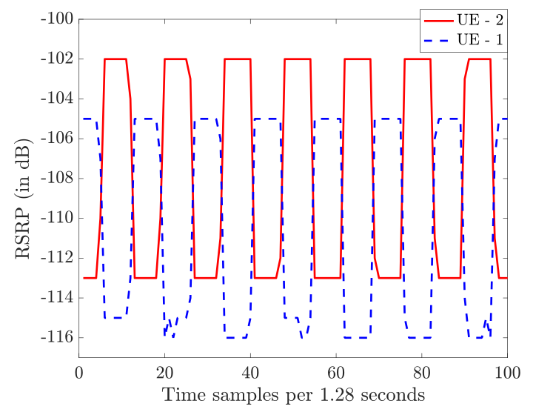
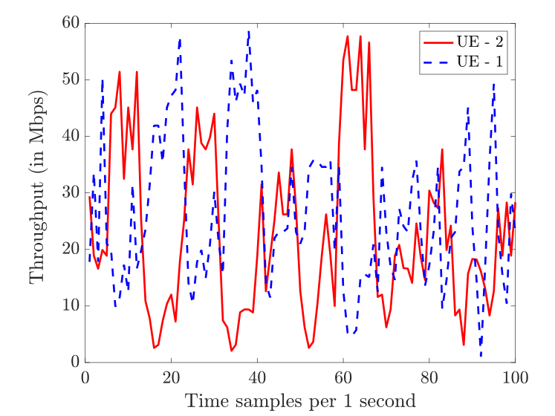
RSRP and Throughput $\left(T_{c}=20000\right)$

Slide 26
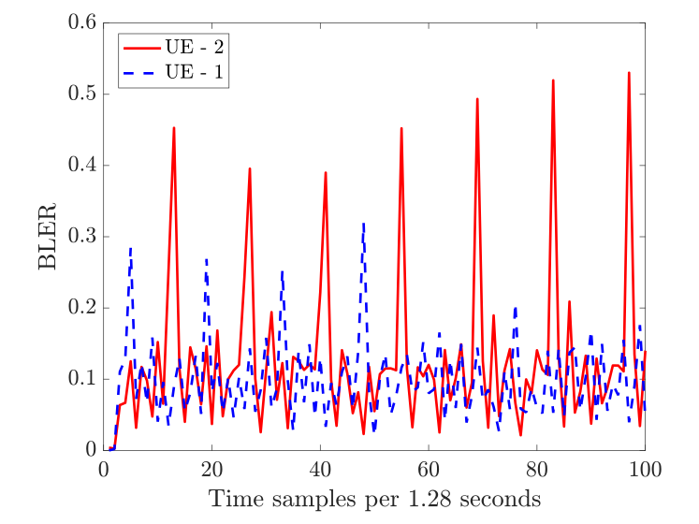
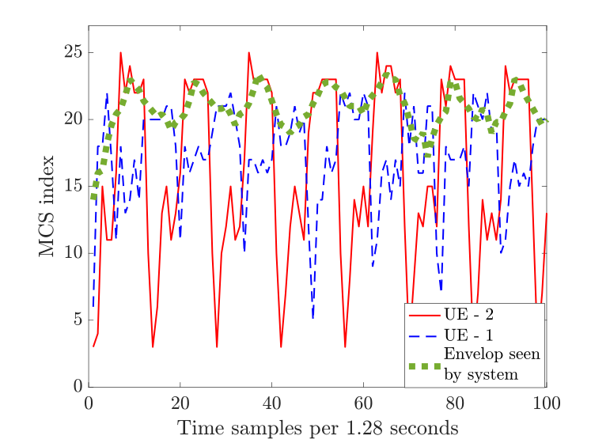
BLER and MCS

Slide 27
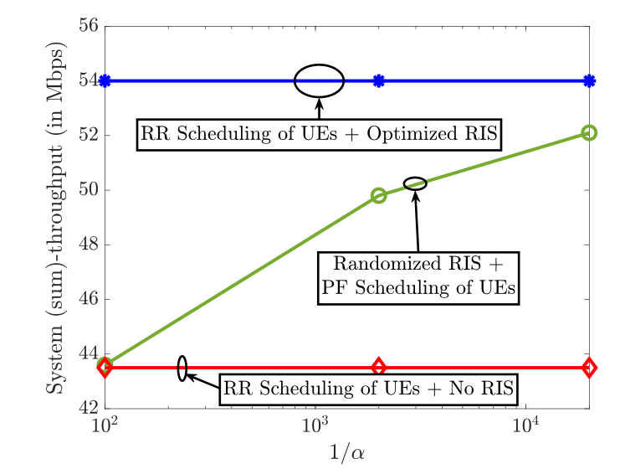
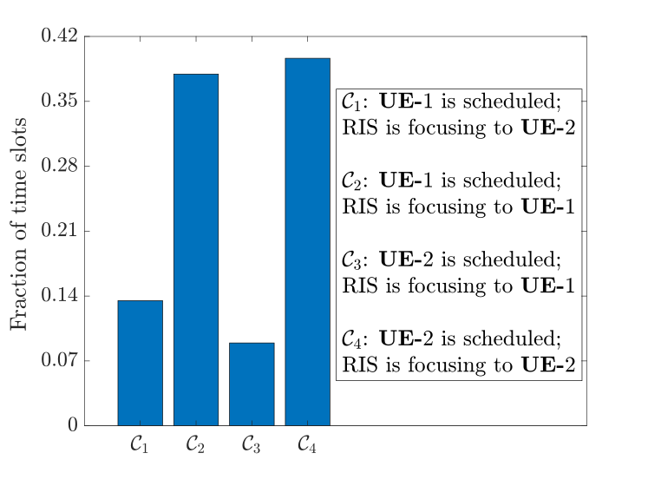
Randomized RIS Can Procure Full Benefits

