Slide 1


Opportunistic scheduling in IRS-assisted communication systems
Guna Sai Kiran Nekkanti
MTech ECE
January 27 , 2026

Slide 2
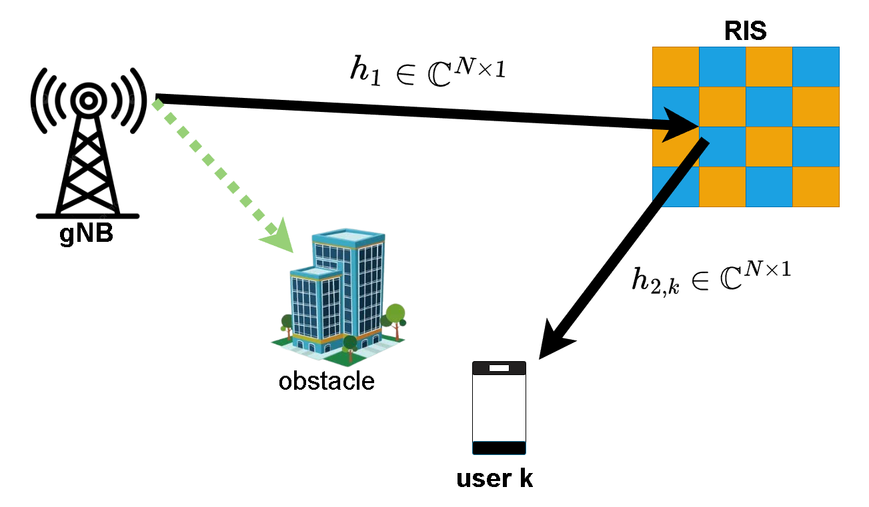





Intelligent reflecting surfaces (IRS)
Also known as reconfigurable intelligent surfaces (RIS)
Meta-surfaces made up of passive elements
Reflect signals in required directions
Alters the wireless channel
Perks: Boosts SNR/SINR, energy efficiency, coverage, etc.
Controls the channel by modifying the reflection coefficients at the IRS
Effective channel at UE $– k$ :
$$h_{k}=\sqrt{β_{k}}φ^{H}\left(t\right)h_{c,k}$$
$$φ\left(t\right)={\left[e^{−jθ_{1}\left(t\right)},e^{−jθ_{2}\left(t\right)},…,e^{−jθ_{N}\left(t\right)}\right]}^{T}$$
Path loss
$$h_{c,k}= h_{1}⊙h_{2,k}$$
Received signal at UE $– k$ :
$$y_{k}\left(t\right)=\sqrt{β_{k}}φ^{H}\left(t\right)h_{c,k}x_{k}\left(t\right)+n_{k}\left(t\right).$$
Note$:h_{1}$ is mostly a strong LOS path between base station and IRS
Notes:
For e.g, when IRS is configured as an ULA, h1 can be modeled as steering vector of ULA.

Slide 3
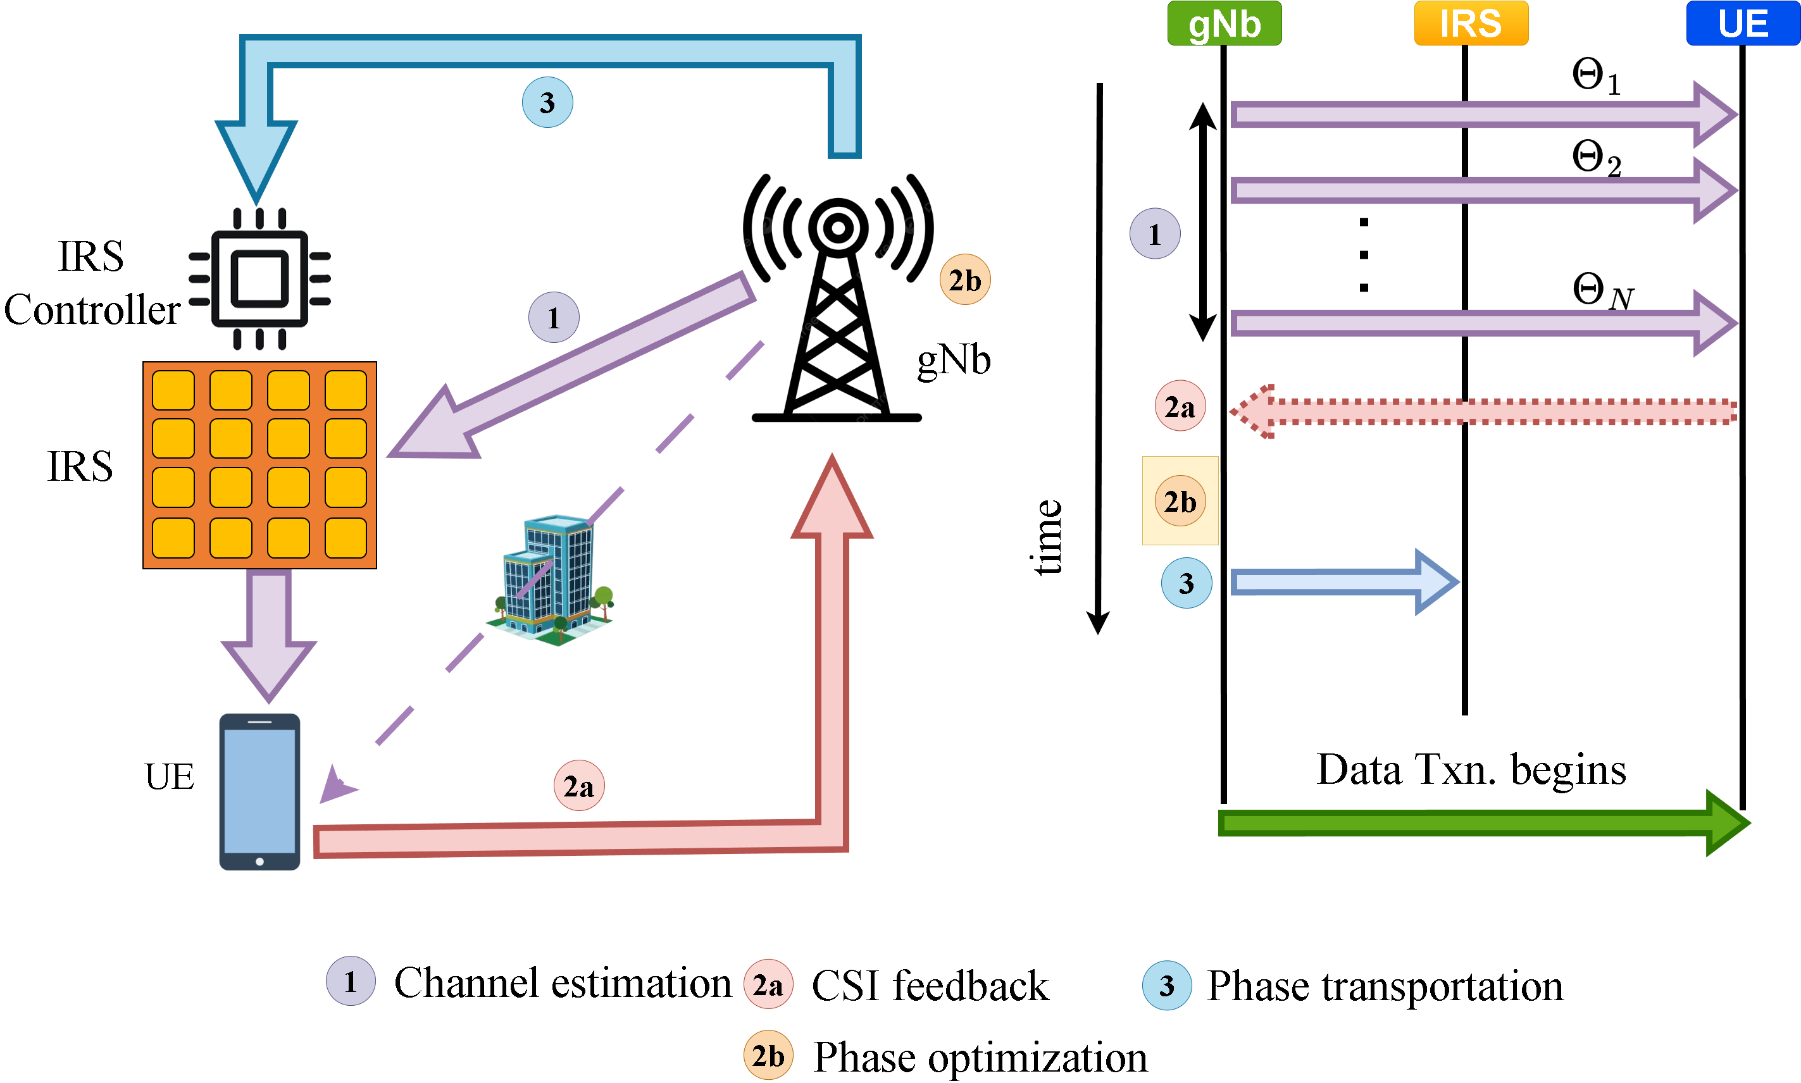
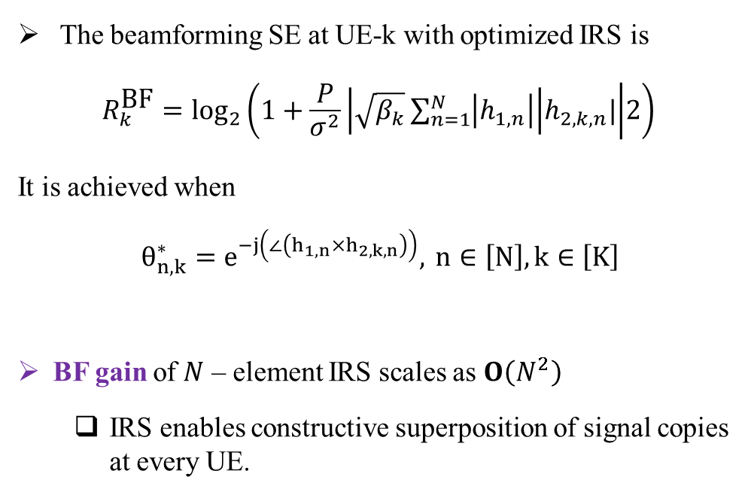
Benchmark and 3-Fold Overheads
The beamforming SE at UE-k with optimized IRS is
$$R_{k}^{\text{BF}}=\log_{2}\left(1+\frac{P}{σ^{2}}\left|\sqrt{β_{k}}\sum_{n=1}^{N}{\left|h_{1,n}\right|}\right|h_{2,k,n}| | 2\right)$$
It is achieved when
$θ_{n,k}^{∗}=e^{−j\left(∠\left(h_{1,n}×h_{2,k,n}\right)\right)}, n∈\left[N\right],k∈\left[K\right]$
BF gain of $N$ – element IRS scales as $O\left(N^{2}\right)$
IRS enables constructive superposition of signal copies at every UE.
Problem
How can we obtain optimal benefits without optimizing the IRS and avoiding the three-fold overheads
Solution
Randomized RIS + Opportunistic Communications

Slide 4
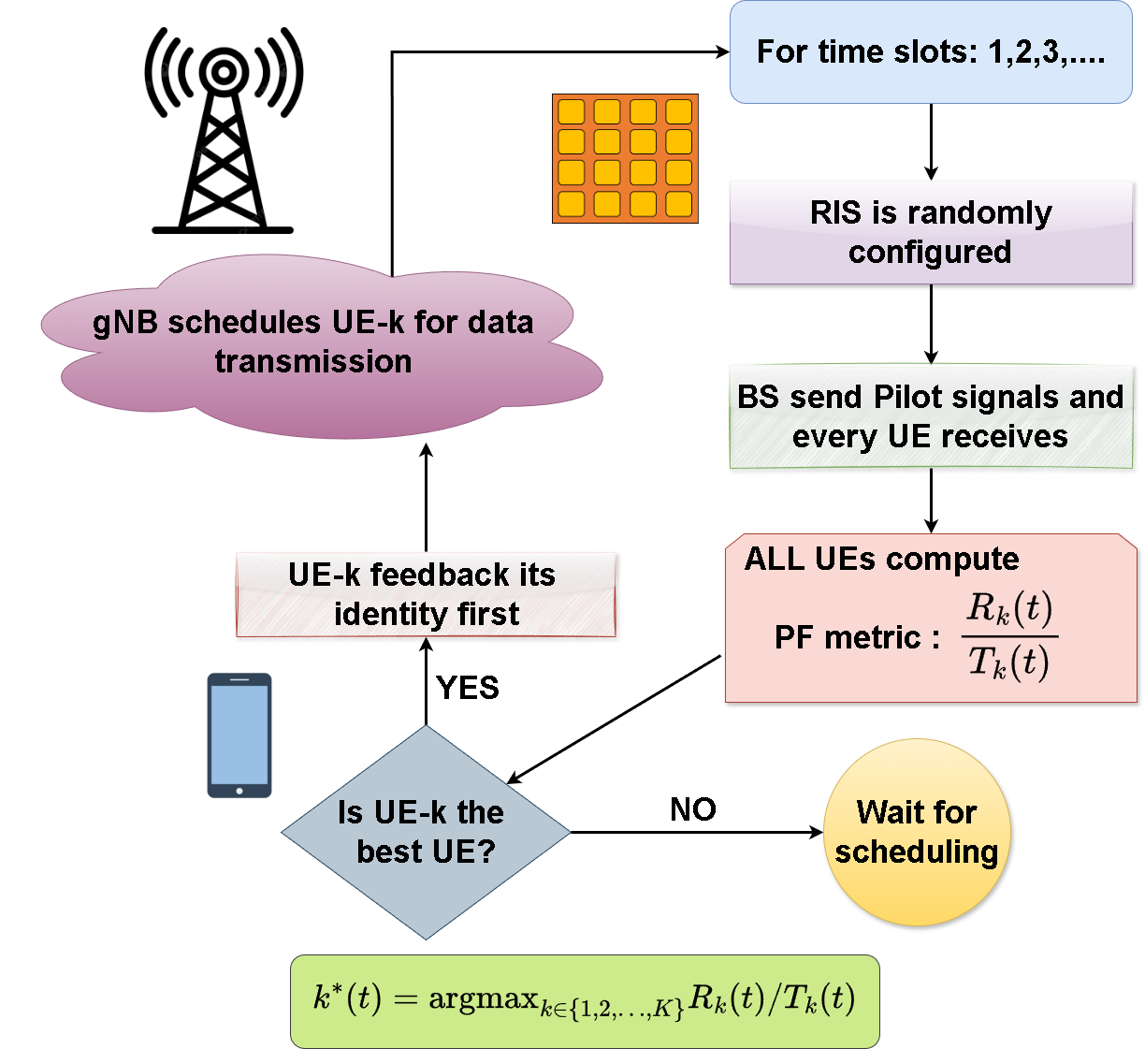
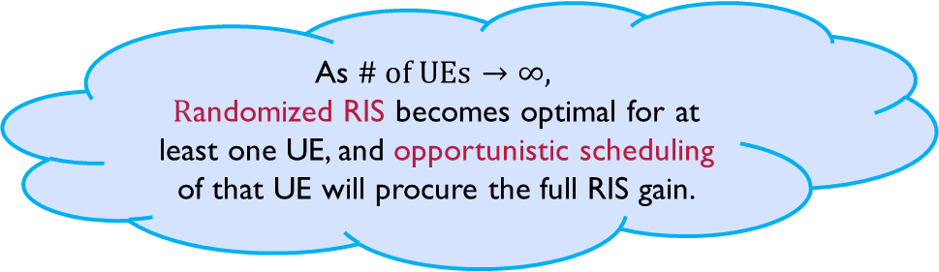
Randomized RIS + Opportunistic Communications
Idea : Randomly tune the RIS configurations and schedule one of K UEs opportunistically having the best channel in every time slot!
Explicit RIS phase optimization is unnecessary, as the gNB scheduler exploits RIS gain via UE CQI feedback.
UEs periodically report CQI (≈80 ms); the UE aligned with the RIS reports higher CQI.
The gNB scheduler uses CQI to identify and schedule the RIS-favored UE.
As $\# \text{of} \text{UEs}→∞,$
$R$andomized RIS becomes optimal for at least one UE, and opportunistic scheduling of that UE will procure the full RIS gain.

Slide 5

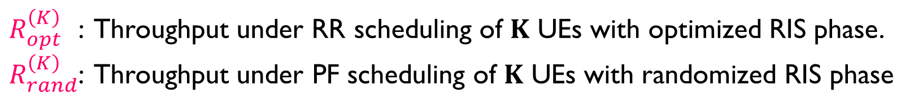

Core Idea
Randomized RIS: RIS switches between phase states with a switching time = $T_{s}$.
Proportional fair scheduler: gNB employs a PF scheduler with EWMA parameter = $T_{c}$.
A random RIS phase will be optimal to atleast one UE: Multi-user diversity
$R_{opt}^{\left(K\right) }$ : Throughput under RR scheduling of $K$ UEs with optimized RIS phase.
$R_{rand}^{\left(K\right)}$: Throughput under PF scheduling of $K$ UEs with randomized RIS phase
$$Using appropriately chosen T_{c},T_{s}.$$
$$R_{rand}^{\left(K\right)}=R_{opt}^{\left(K\right)}.$$

