Slide 1
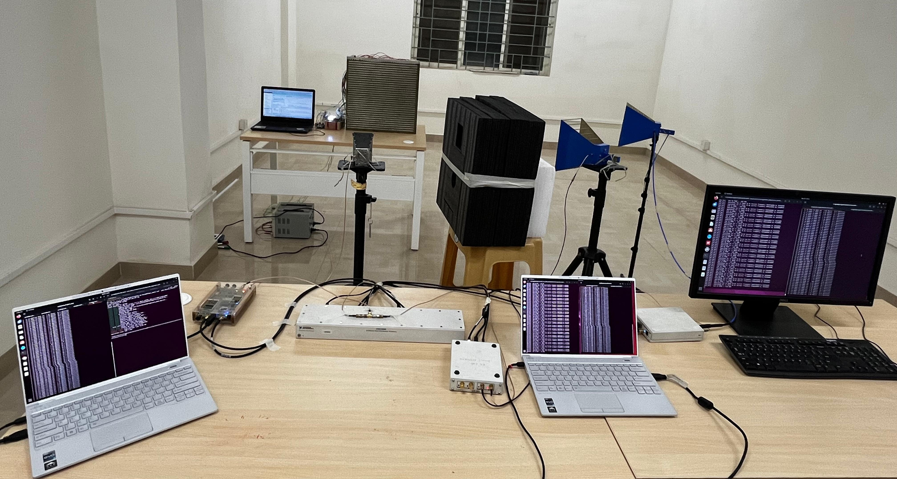
FPGA – RIS
Controller
RIS
UE-1 RX Antenna
UE-2 RX Antenna
gNB Tx Antenna
5G NR UE-2
5G NR gNB USRP
5G NR gNB &
Core Network
5G NR
UE – 1 USRP
5G NR
UE – 2 USRP
5G NR UE-1
Notes:
Universal Software Radio Peripherals

