Slide 1



DEMO: Practical RIS Gain without the Pain: Randomization and Opportunistic Scheduling in 5G NR
Guna Sai Kiran Nekkanti
Joint work with: L. Yashvanth, Raju Malleboina, Venkatareddy Akumalla,
Prof. Debdeep Sarkar, Prof. Chandra R. Murthy

Slide 2

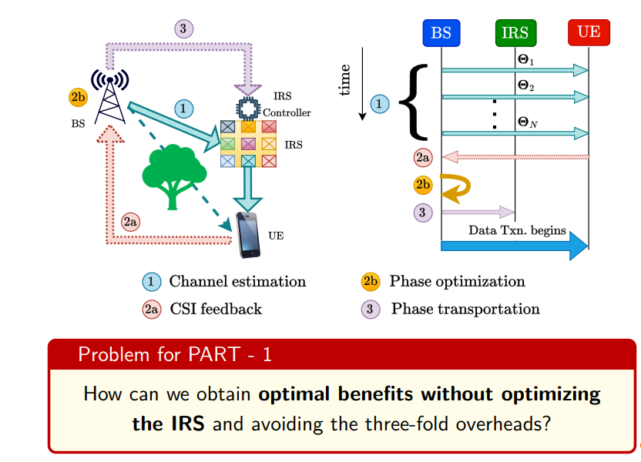
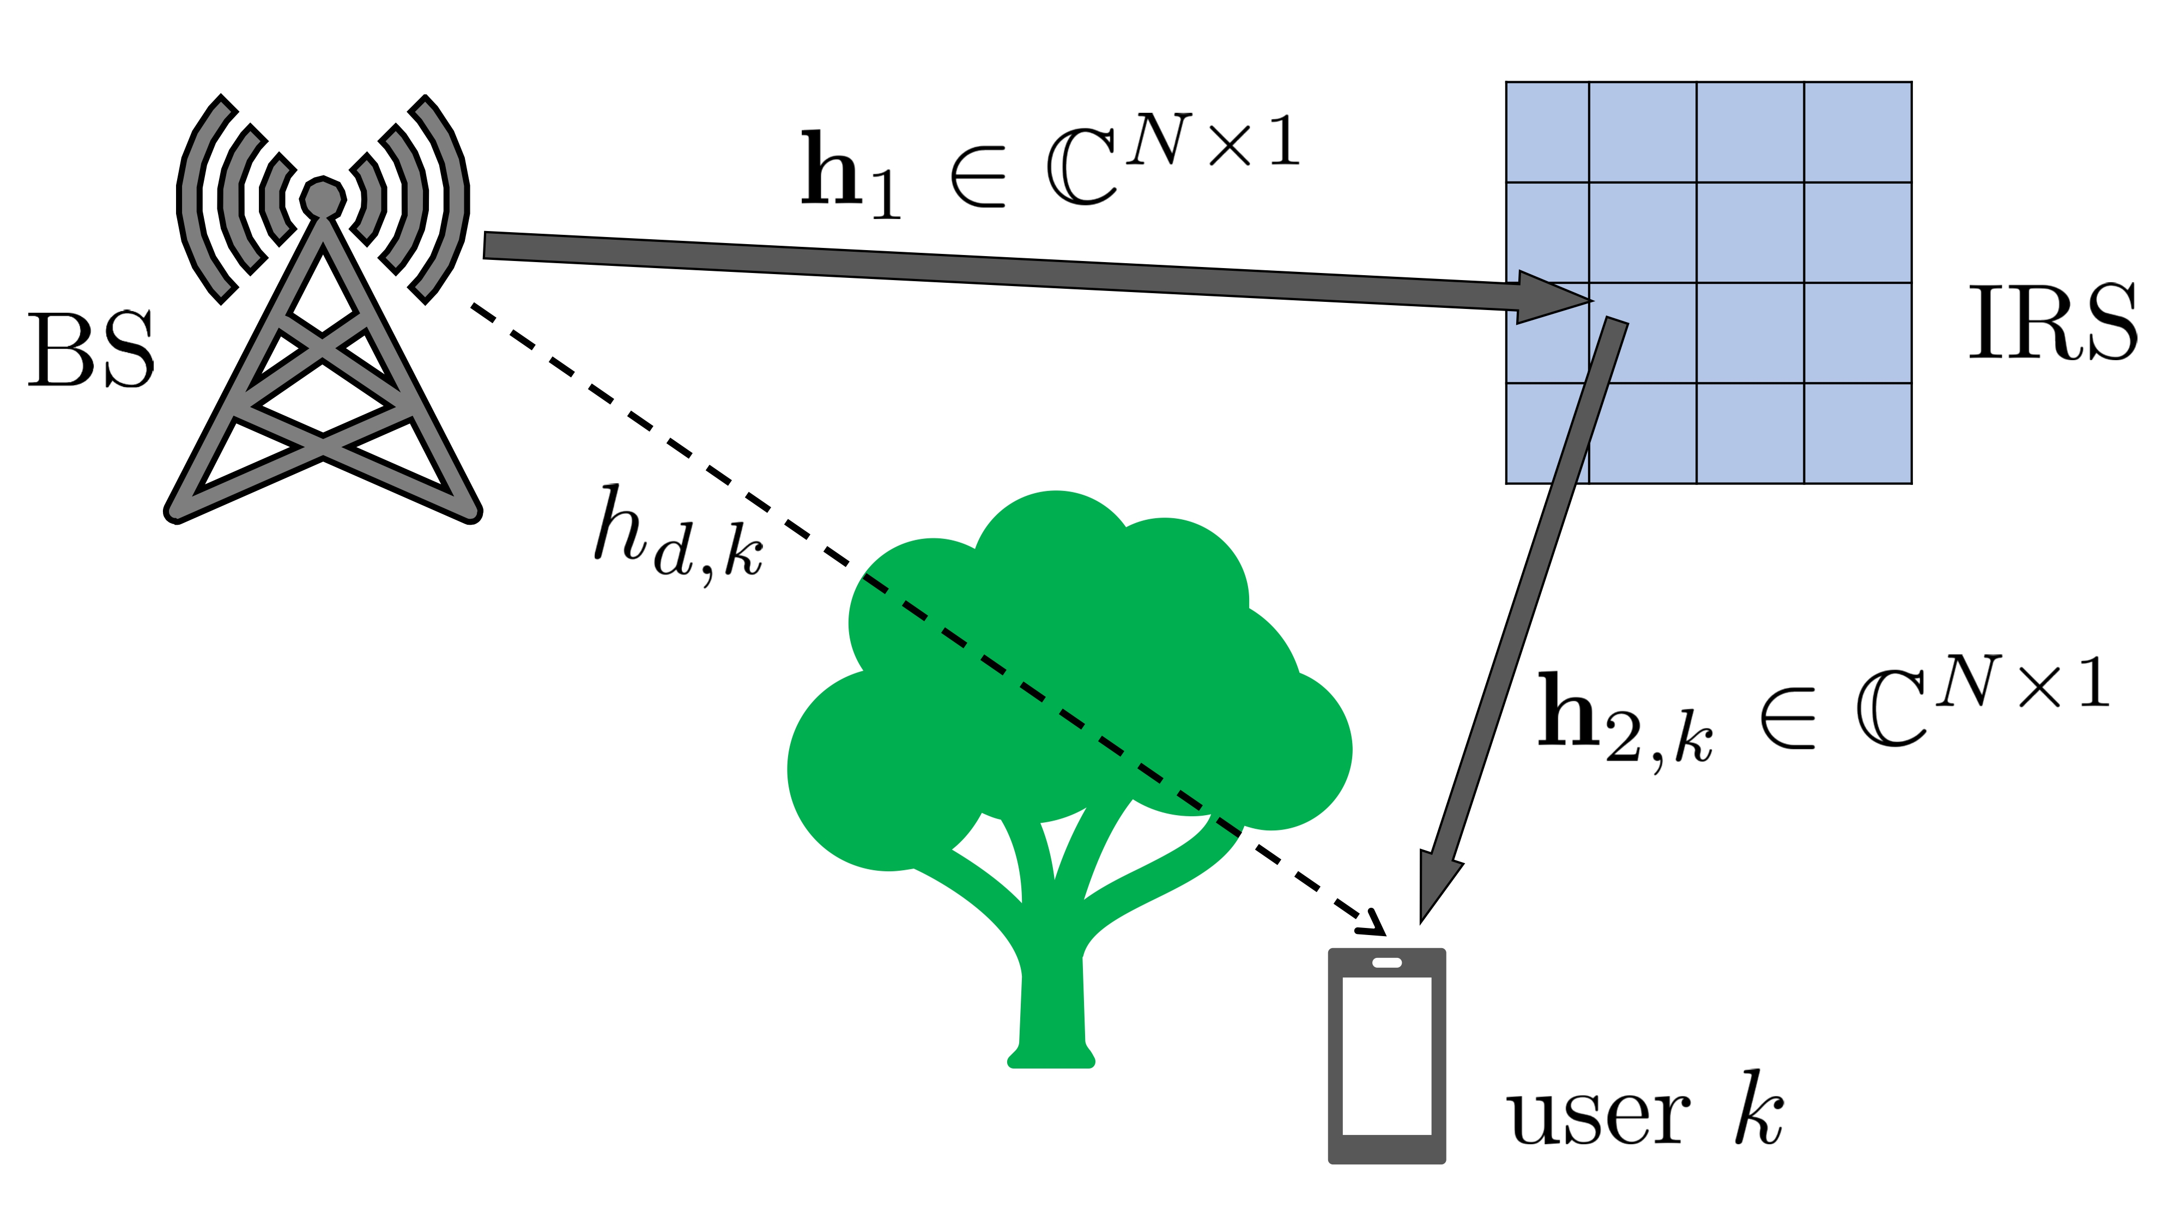
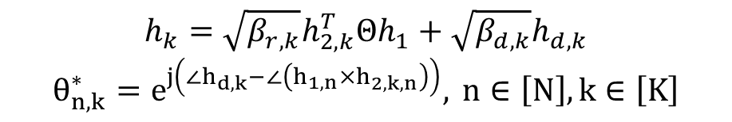
Intelligent reflecting surfaces (IRS)
Also known as reconfigurable intelligent surfaces (RIS)
Meta-surfaces made up of passive elements
Reflect signals in required directions
Alters the wireless channel
Perks: Boosts SNR/SINR, energy efficiency, coverage, etc.
Three Fold Overheads:
$$h_{k}=\sqrt{β_{r,k}}h_{2,k}^{T}Θh_{1}+\sqrt{β_{d,k}}h_{d,k}$$
$$θ_{n,k}^{∗}=e^{j\left(∠h_{d,k}−∠\left(h_{1,n}×h_{2,k,n}\right)\right)}, n∈\left[N\right],k∈\left[K\right]$$
Solution
Opportunistic Communications

Slide 3
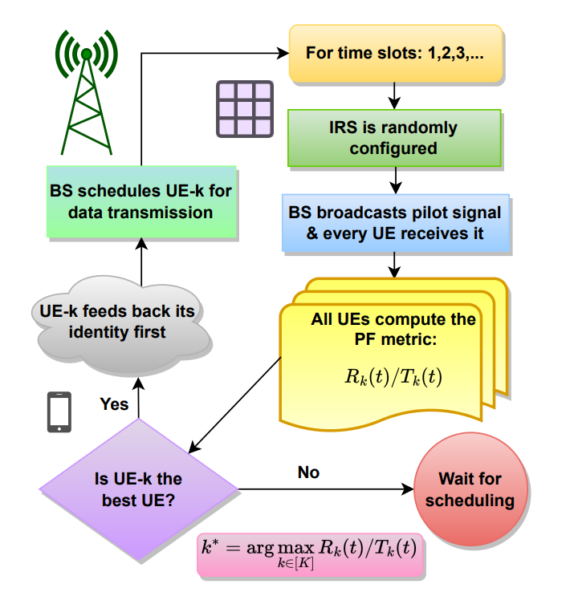
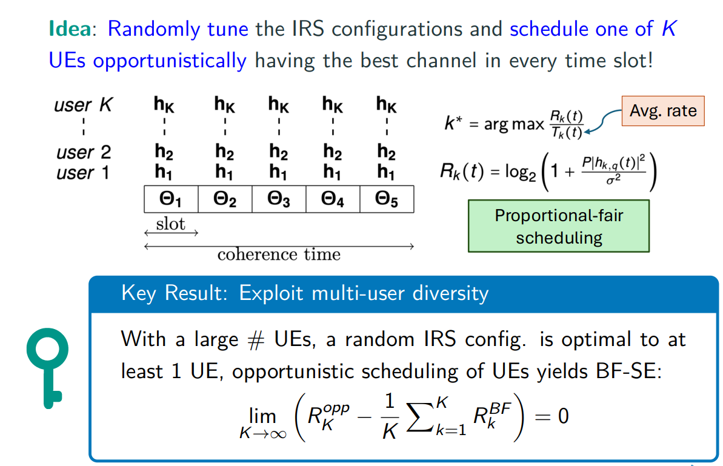
Opportunistic Communications

Slide 4
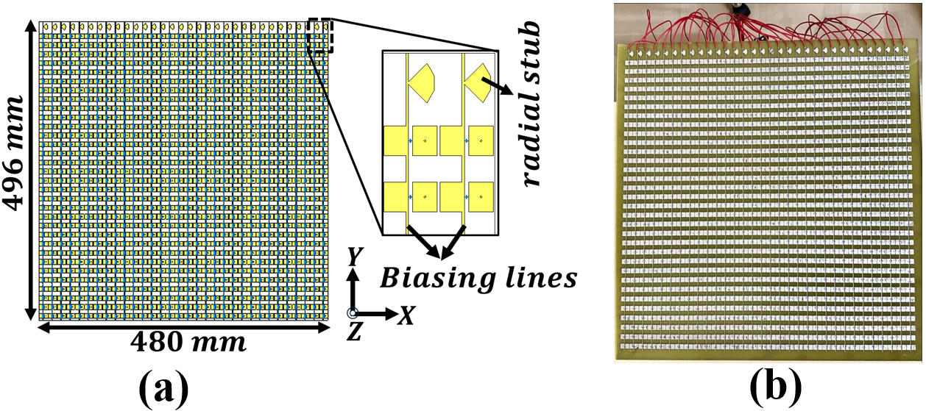
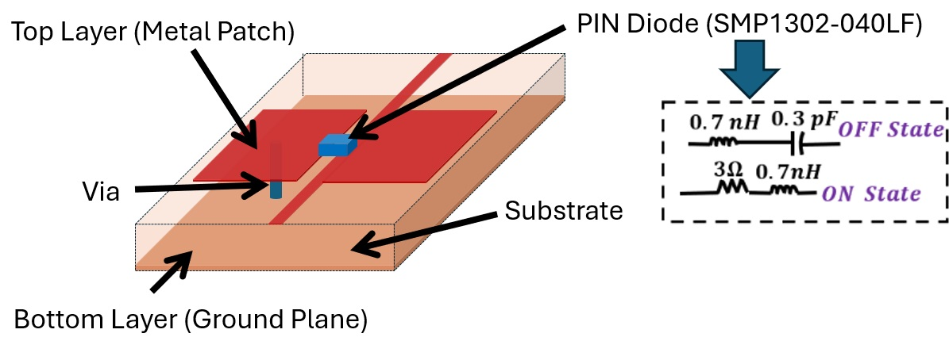
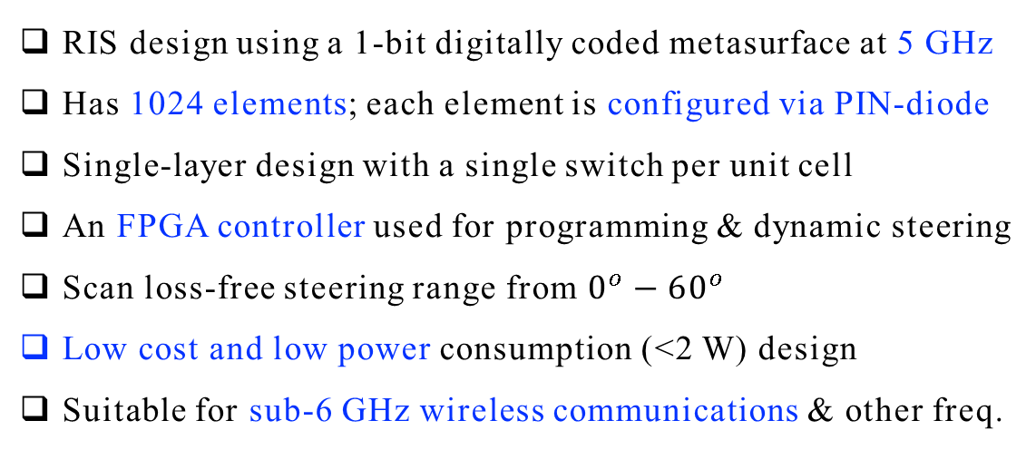
Indigenously Built RIS
Full RIS structure
RIS design using a 1-bit digitally coded metasurface at 5 GHz
Has 1024 elements; each element is configured via PIN-diode
Single-layer design with a single switch per unit cell
An FPGA controller used for programming & dynamic steering
Scan loss-free steering range from $0^{o}−{60}^{o}$
Low cost and low power consumption (<2 W) design
Suitable for sub-6 GHz wireless communications & other freq.
Unit-cell of a 1-bit
digitally coded RIS:
3D view
Equivalent circuit of PIN diode

Slide 5


The OpenAirInterface for 5G NR
Communication Resources:
Discrete-Rate Adaptation:
40 MHz bandwidth (5 GHz carrier), 30 kHz SCS.
0.5 ms slots with 14 OFDM symbols.
TDD frame: 10-slot periodicity
Uses 3GPP MCS Table 1 (29 levels).
MCS range: 3 to CQI-dependent max (CQI every 80 ms).
HARQ adjust: ±1 MCS based on BLER (<0.05 / >0.15).
Retransmissions: Up to 3 HARQ repeats with same MCS
Resource Allocation:
1. In OAI, users are scheduled using a Proportional Fair scheduler.
2. Scheduling rule:
$$k^{∗}\left(t\right)=\arg{\max_{k∈\{1,2,…,K\}}{\frac{R_{k}\left(t\right)}{T_{k}\left(t\right)}}}$$
3. Instantaneous SE :
Interpretation:
Small α → more opportunistic (higher throughput).
Large α → more fairness (frequent service to all UEs).
$$R_{k}\left(t\right)=\log_{2}\left(1+{\left|h_{k}\left(t\right)\right|}^{2}\left(\frac{P}{σ^{2}}\right)\right)$$
4. EWMA update of average SE:
$$T_{k}\left(t+1\right)=\left(1−α\right)T_{k}\left(t\right)+αR_{k}\left(t\right)1_{\{k=k^{∗}\left(t\right)\}}$$

Slide 6
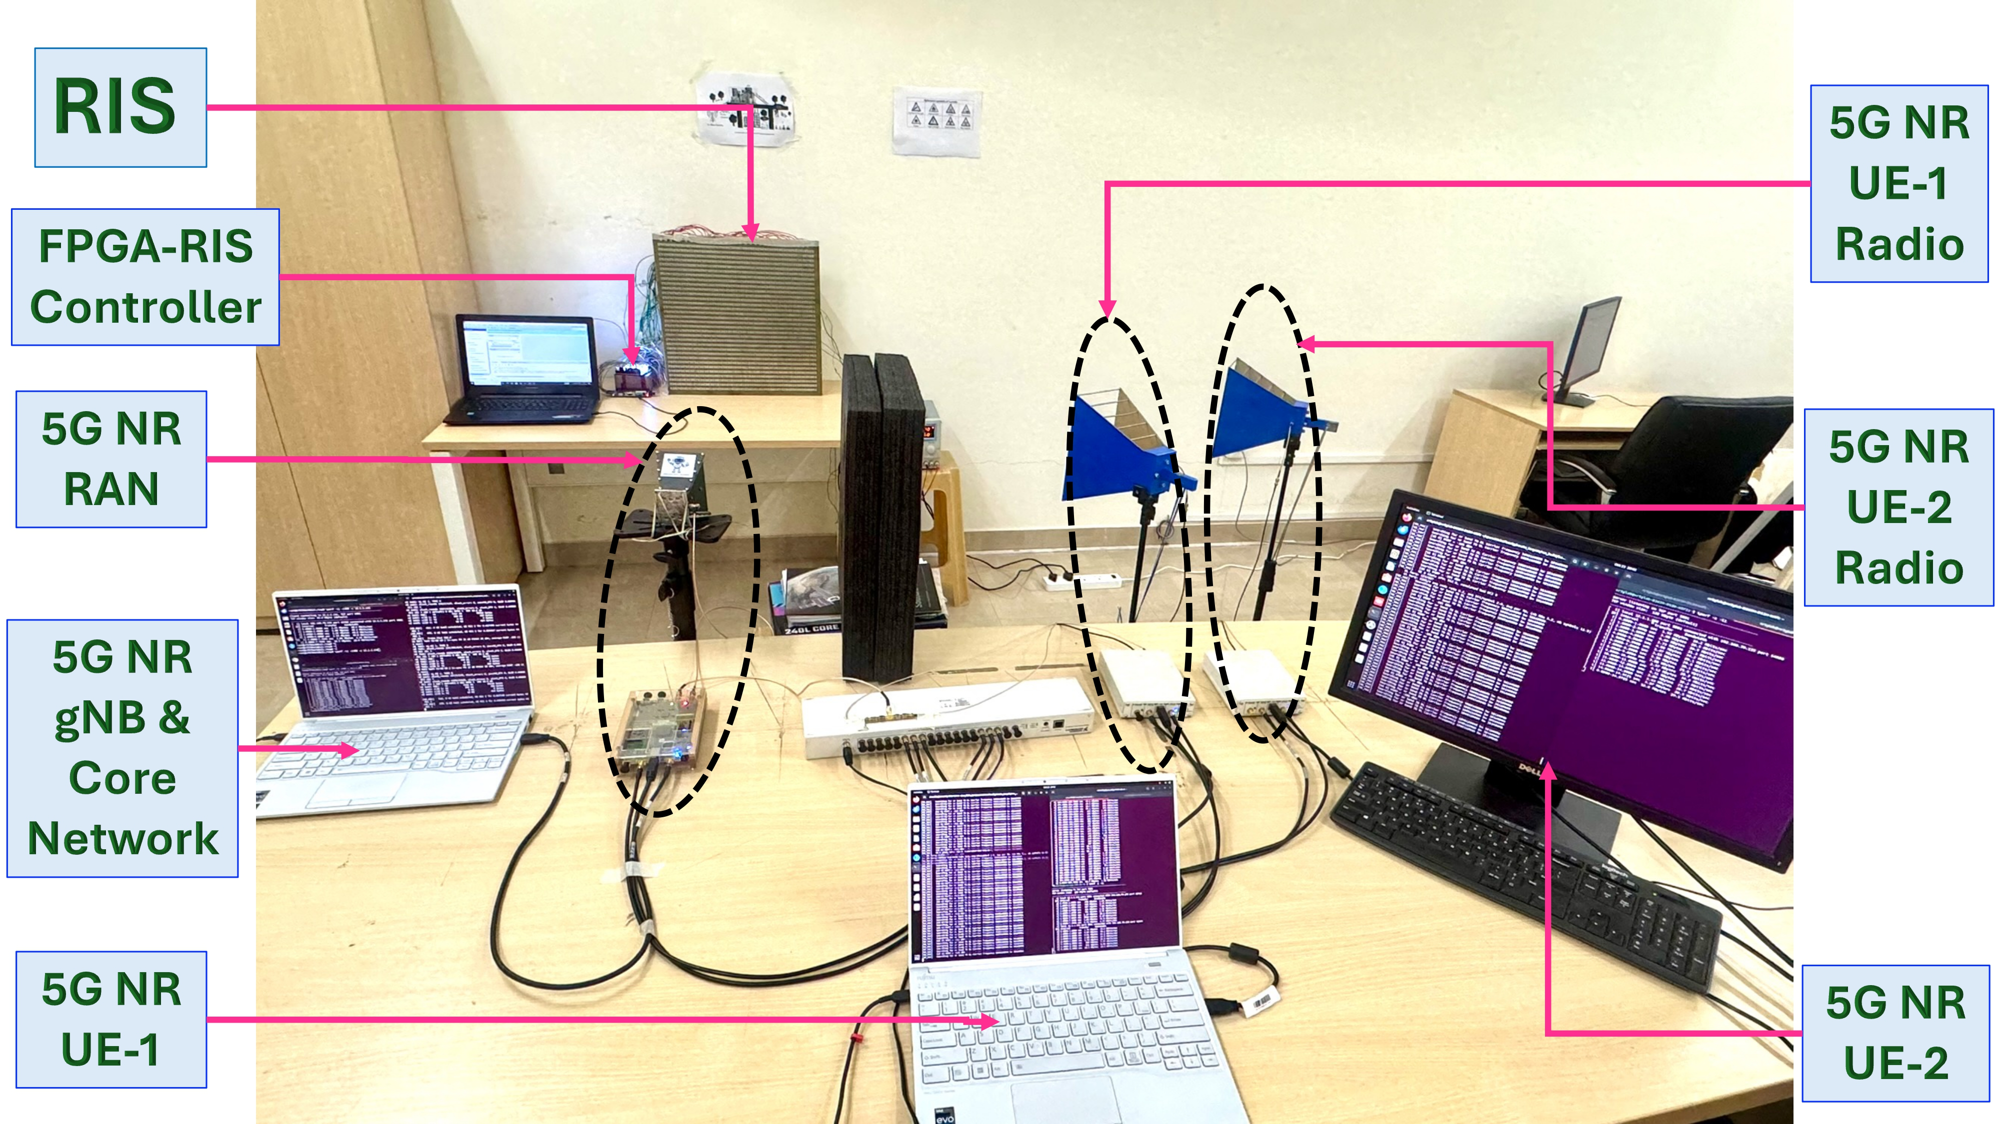
Setup of our RIS-aided 5G NR
5G NR Testbed Setup
Implemented using OpenAirInterface (OAI).
Operates: monolithic Stand-Alone (SA).
Full 5G RAN protocol stack
5G core network.
USRPs act as RUs for OTA communication.
OAI gNB and UE stacks run on:
Intel i7, 12 cores @ 4.9 GHz
32 GB RAM
Ubuntu 22.04 LTS, low-latency kernel
Notes:
Universal Software Radio Peripherals

Slide 7

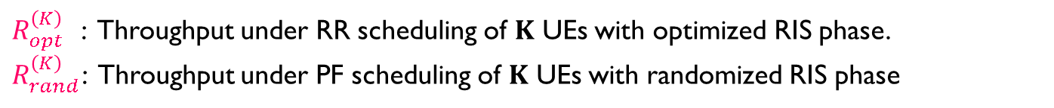
Evaluation Methodology
UE Geometry Matters: RIS sees each user through azimuth/elevation angles $\left(ν_{k},ψ_{k}​\right).$
Finite RIS Codebook: L discrete phase states $\{φ_{1},φ_{2},…,φ_{L}\}$, each chosen with probability $p_{ℓ}$​.
Sampling Distribution: Matching the RIS phase distribution to the users’ angular statistics maximizes the system throughput.
Experimental Setup:
UE Placement & Geometry: Two UEs are located at azimuth angles ${30}^{∘}$and ${45}^{∘}$, both with elevation $0^{∘}$
RIS State Distribution: The RIS switches between the two beamforming states corresponding to these angles.
Core Idea and Claim
Randomized RIS: RIS switches between phase states with a switching time = Ts.
Proportional fair scheduler: gNB employs a PF scheduler with EWMA parameter = α.
A random RIS phase will be optimal to atleast one UE: Multi-user diversity
$R_{opt}^{\left(K\right) }$ : Throughput under RR scheduling of $K$ UEs with optimized RIS phase.
$R_{rand}^{\left(K\right)}$: Throughput under PF scheduling of $K$ UEs with randomized RIS phase
$$Using appropriately chosen α,T_{s}, R_{rand}^{\left(K\right)}=R_{opt}^{\left(K\right)}.$$

Slide 8
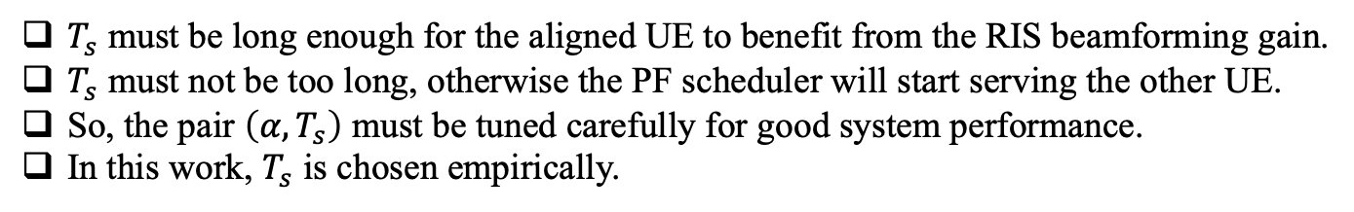

With RIS and Without RIS
With vs without RIS | RSRP (in dB) |  | Throughput (in Mbps)
 | UE-1 | UE-2 | UE-1 | UE-2
Without RIS | -112 | -110 | 40.70 | 47.40
With RIS | -105 | 102 | 50.10 | 58.20
RSRP increment: 7–8 dB
Rate increment: 10 Mbps
Experiment Parameters:
Switching Time: $T_{s}$ = 9 sec
PF Parameters:
$α= 0.01, 0.0005, 0.00005$.
Choice of the switching time, $T_{s}$:
$T_{s}​$ must be long enough for the aligned UE to benefit from the RIS beamforming gain.
$T_{s}$ must not be too long, otherwise the PF scheduler will start serving the other UE.
So, the pair $\left(α,T_{s}\right)$ must be tuned carefully for good system performance.
In this work, $T_{s}​$ is chosen empirically.

Slide 9

What Next?
Change alternate RIS switching to random switching.
Extend to multiple UEs and more RIS states.
Experiment in indoor vs. outdoor measurement setups.
Analyze feasible values of Ts based on PF scheduling parameters.

Slide 10

References
Publication: L. Yashvanth, M. Raju, A. Venkata Reddy, N. Guna Sai Kiran, Chandra R. Murthy, and Debdeep Sarkar, “Practical RIS Gain Without Pain: Randomization and Opportunistic Scheduling in 5G NR?,” submitted in Nov. 2025 for IEEE ICC 2026
Further Reading:
R. Malleboina and D. Sarkar, "A Digitally Coded Intelligent Reflecting Surface for 6G Wireless Communication," Proc. 19th European Conference on Antennas and Propagation (EuCAP), Stockholm, Sweden, 2025, pp. 1-5.
L. Yashvanth, C. R. Murthy and B. D. Rao, "Spatial Correlation-Aware Opportunistic Beamforming in IRS-Aided Multi-User Systems," in IEEE Wireless Communications Letters, vol. 14, no. 10, Oct. 2025.
L. Yashvanth and Chandra R. Murthy, “Performance Analysis of IRS Assisted Opportunistic Communications,” IEEE Transactions on Signal Processing, vol. 71, pp. 2056-2070, Jun. 2023

Slide 11
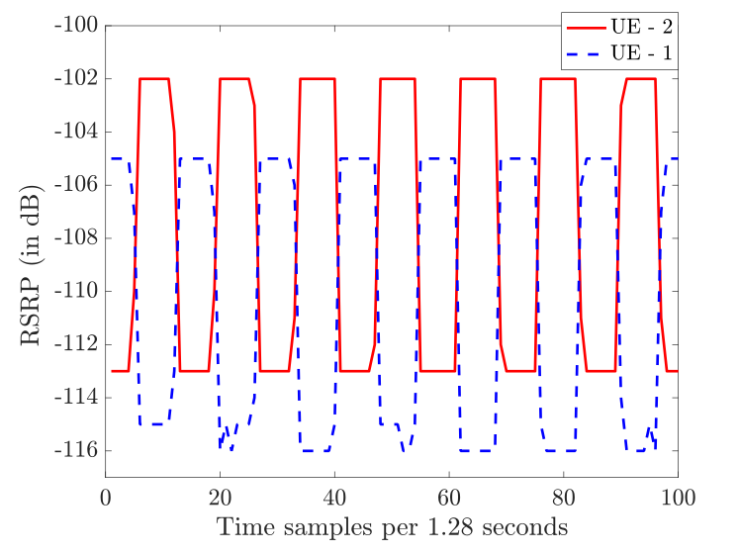
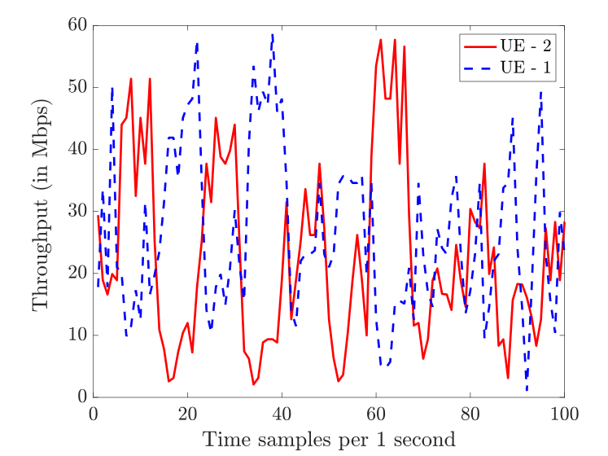
RSRP and Throughput $\left(α=0.00005\right)$

Slide 12
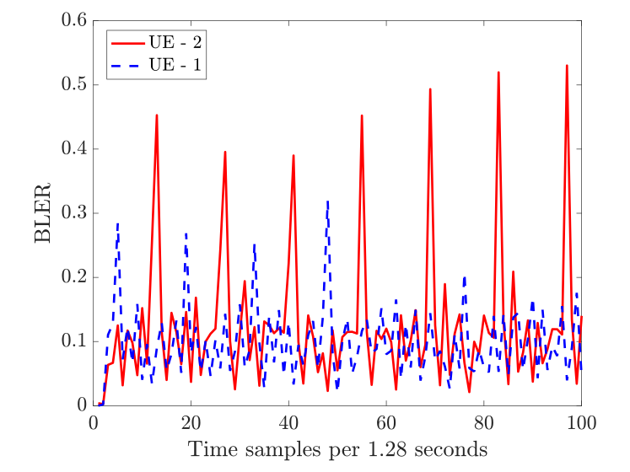
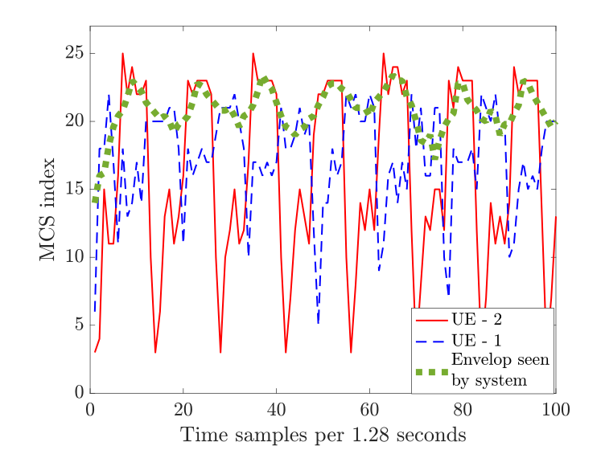
BLER and MCS

Slide 13
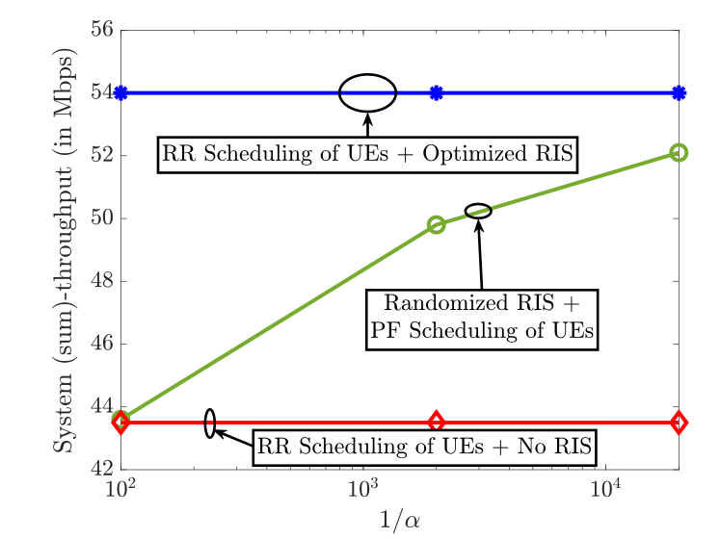
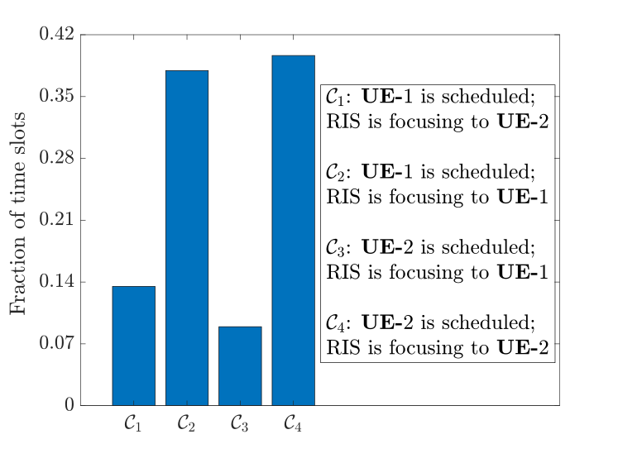
Randomized RIS Can Procure Full Benefits

