Slide 1
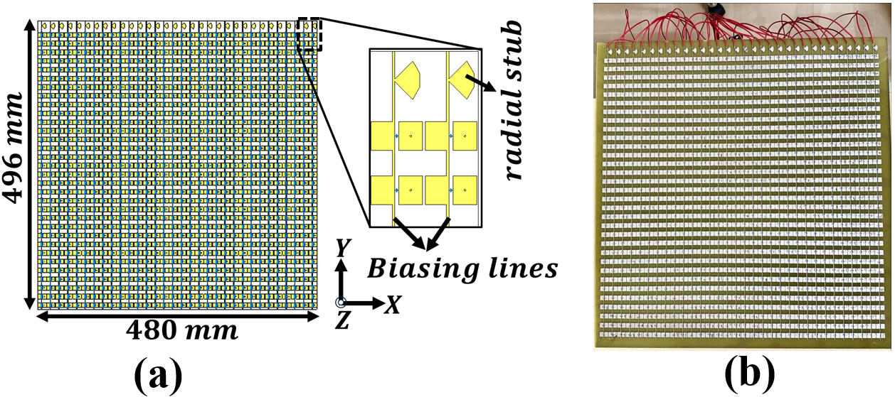
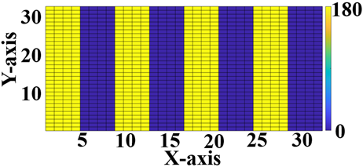
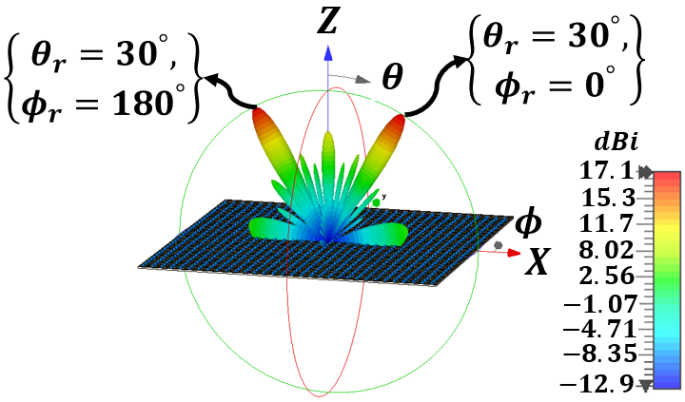

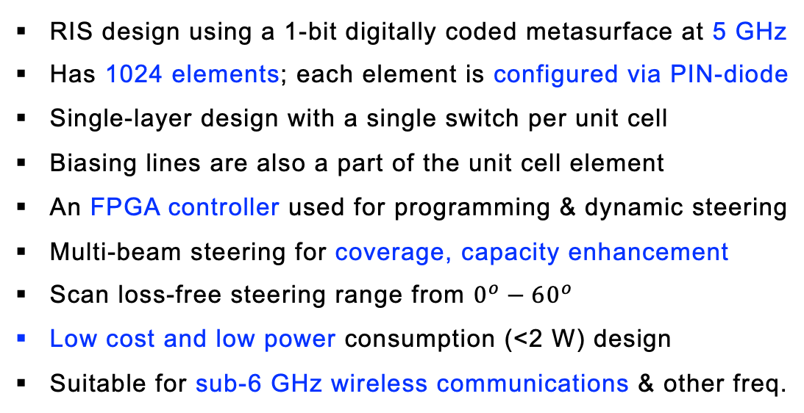
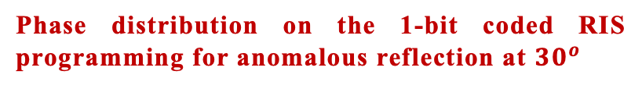
Design of our RIS/IRS
OFF state phase ${180}^{o}$ Element 0
ON state phase $0^{o}$ Element 1
Full RIS structure
RIS design using a 1-bit digitally coded metasurface at 5 GHz
Has 1024 elements; each element is configured via PIN-diode
Single-layer design with a single switch per unit cell
Biasing lines are also a part of the unit cell element
An FPGA controller used for programming & dynamic steering
Multi-beam steering for coverage, capacity enhancement
Scan loss-free steering range from $0^{o}−{60}^{o}$
Low cost and low power consumption (<2 W) design
Suitable for sub-6 GHz wireless communications & other freq.
Phase distribution on the 1-bit coded RIS programming for anomalous reflection at ${30}^{o}$
Far-field scattering pattern at 5 GHz
Reference: R. Malleboina and D. Sarkar, "A Digitally Coded Intelligent Reflecting Surface for 6G Wireless Communication," Proc. 19th European Conference on Antennas and Propagation (EuCAP), Stockholm, Sweden, 2025, pp. 1-5.

Slide 2
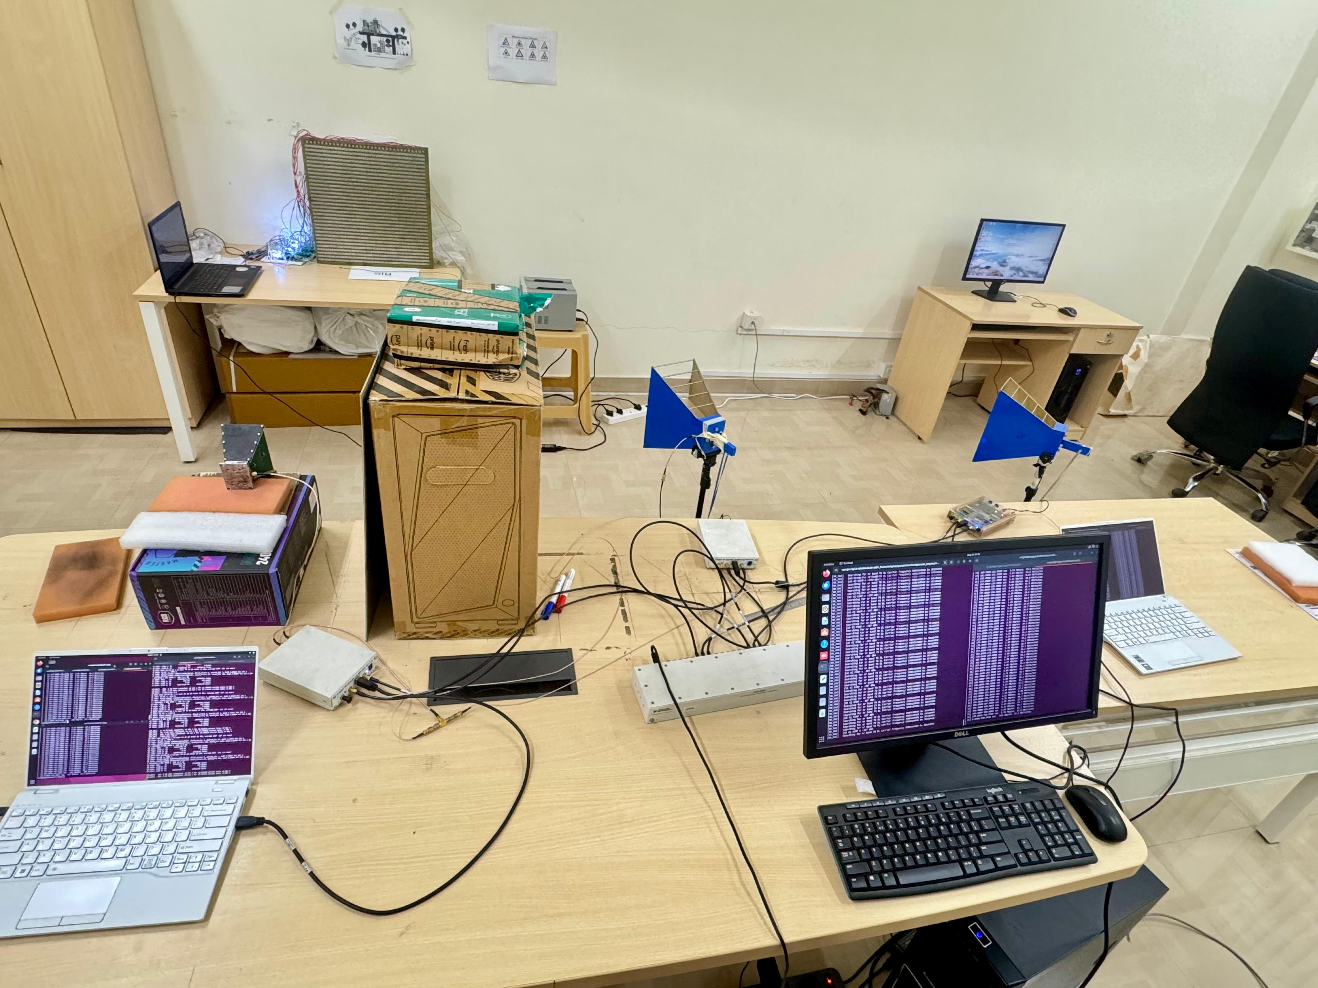
Setup of our RIS-aided 5G NR
Designed RIS
5G NR UE-1 (Rx antenna)
5G NR RAN
5G NR UE-2 (Rx antenna)
5G NR gNB
IISc Team members:
Venkat Reddy
Raju Malleboina
Guna Sai Kiran
Yashvanth L.
Prof. Chandra Murthy
Prof. Debdeep Sarkar
Prof. Anurag Kumar

Slide 3
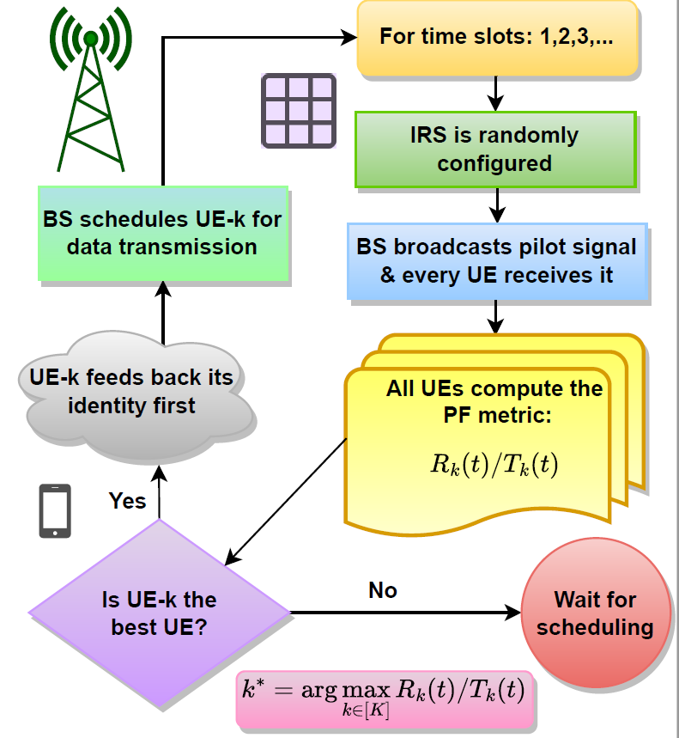
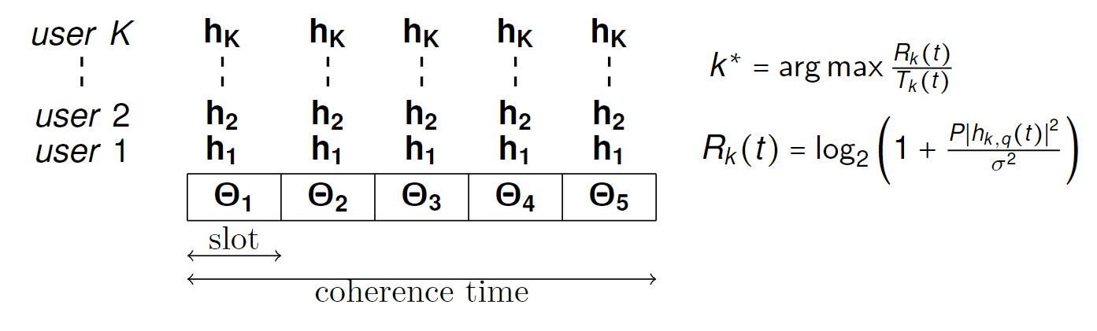
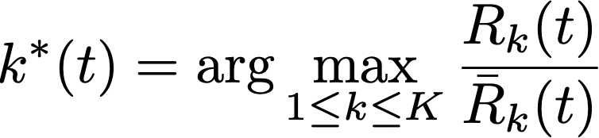
RIS-benefits without pain: Opportunistic Scheduling
Overheads: CSI estimation, phase optimization & control
Question: How to obtain optimal benefits w/o overheads?
Ans: Random IRS phase + proportional-fair (PF) scheduling
UE selection rule in PF scheduling
Idea: A random RIS config. will be optimal for at least one UE
Reference: L. Yashvanth and Chandra R. Murthy, “Performance Analysis of IRS Assisted Opportunistic Communications,” IEEE Transactions on Signal Processing, vol. 71, pp. 2056-2070, Jun. 2023

