Slide 1


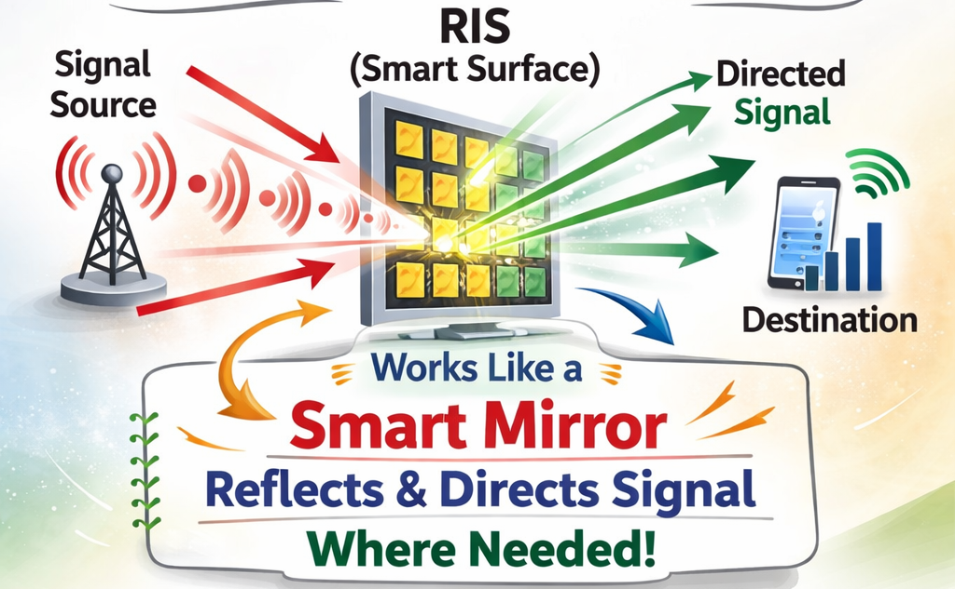
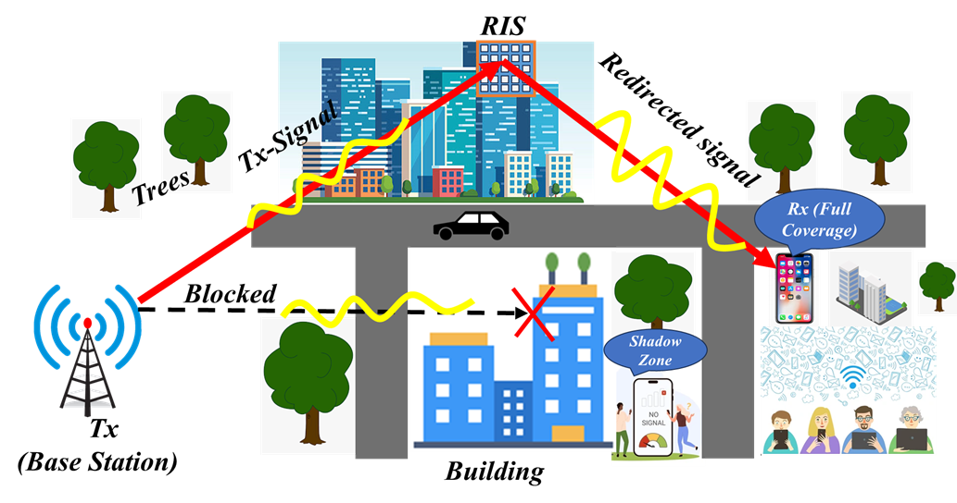
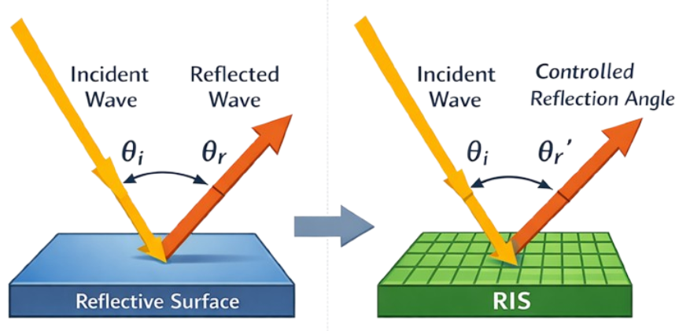
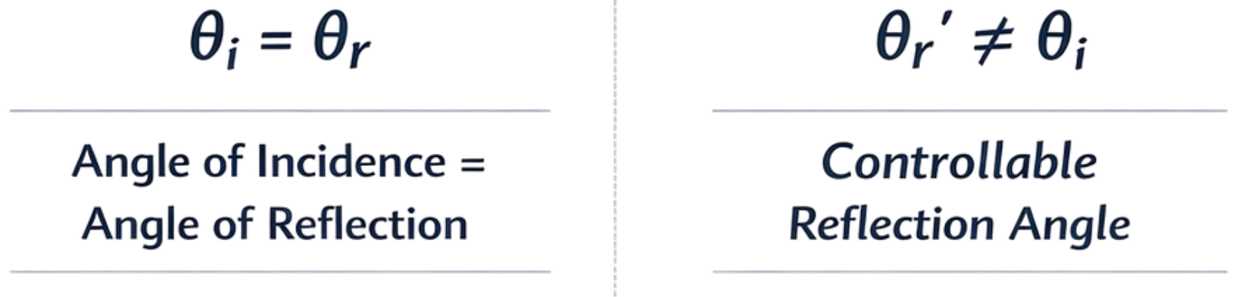

Nekkanti Guna Sai Kiran , Raju Malleboina, Venkata Reddy , Debdeep Sarkar, Chandra R Murthy
Snell’s Law
RIS

