Slide 1



IRS-aided communications
Yashvanth L., and Guna Sai Kiran
Advisor: Prof. Chandra R. Murthy
28 November 2025

Slide 2
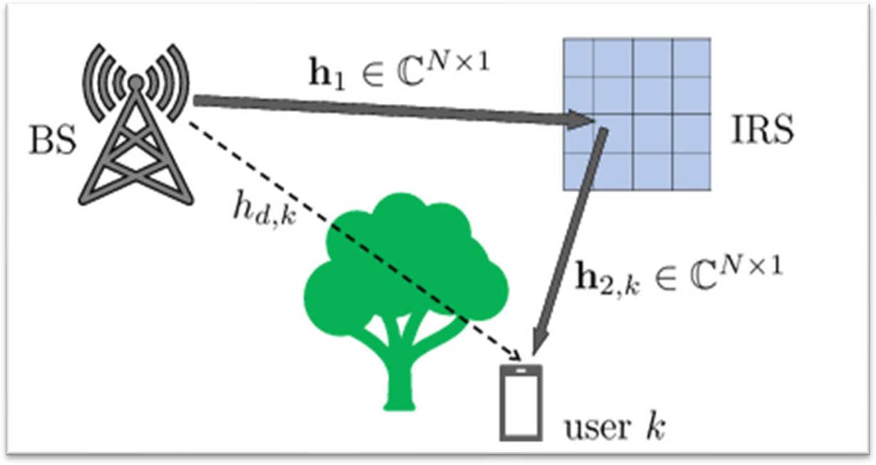
Intelligent reflecting surfaces: Past and Present
Also known as reconfigurable intelligent surfaces (RIS)
Meta-surfaces made up of passive elements
Reflect signals in required directions
Alters the wireless channel
Perks: Boosts SNR/SINR, energy efficiency, coverage, etc.
Last time: IRS-assisted opportunistic communications
Goal: How to reap the optimal benefits at low overheads?
Ans: Randomized IRS + opportunistic scheduling reaps all benefits
Narrowband communication: i.i.d. vs. spatially correlated-channels
Wideband communication: exploitation of beam-split effects
TODAY:
Multiplexing-gain of IRSs
Experimental demo of IRS-aided opportunistic comm.

Slide 3
Multiplexing gain of IRS: How many IRS(s) are needed to realize full-rank MIMO?
Yashvanth L.
Joint work with: Prof. Chandra R. Murthy, IISc and Prof. Bhaskar Rao, UC San Diego

Slide 4
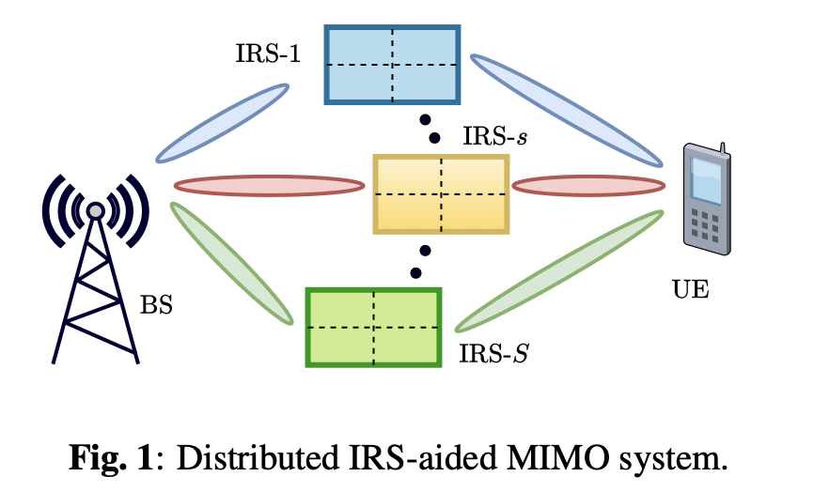
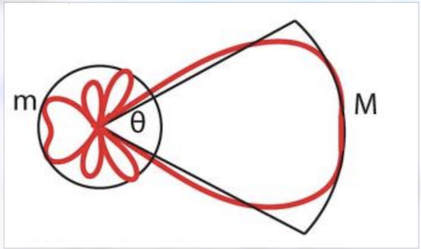
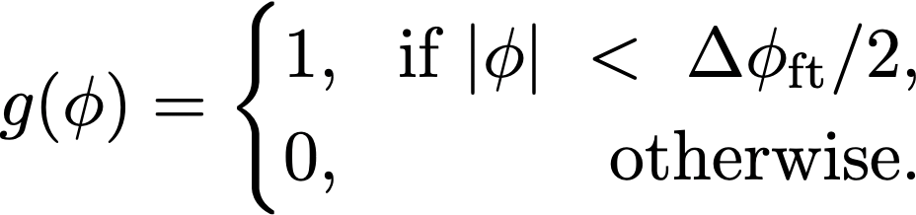
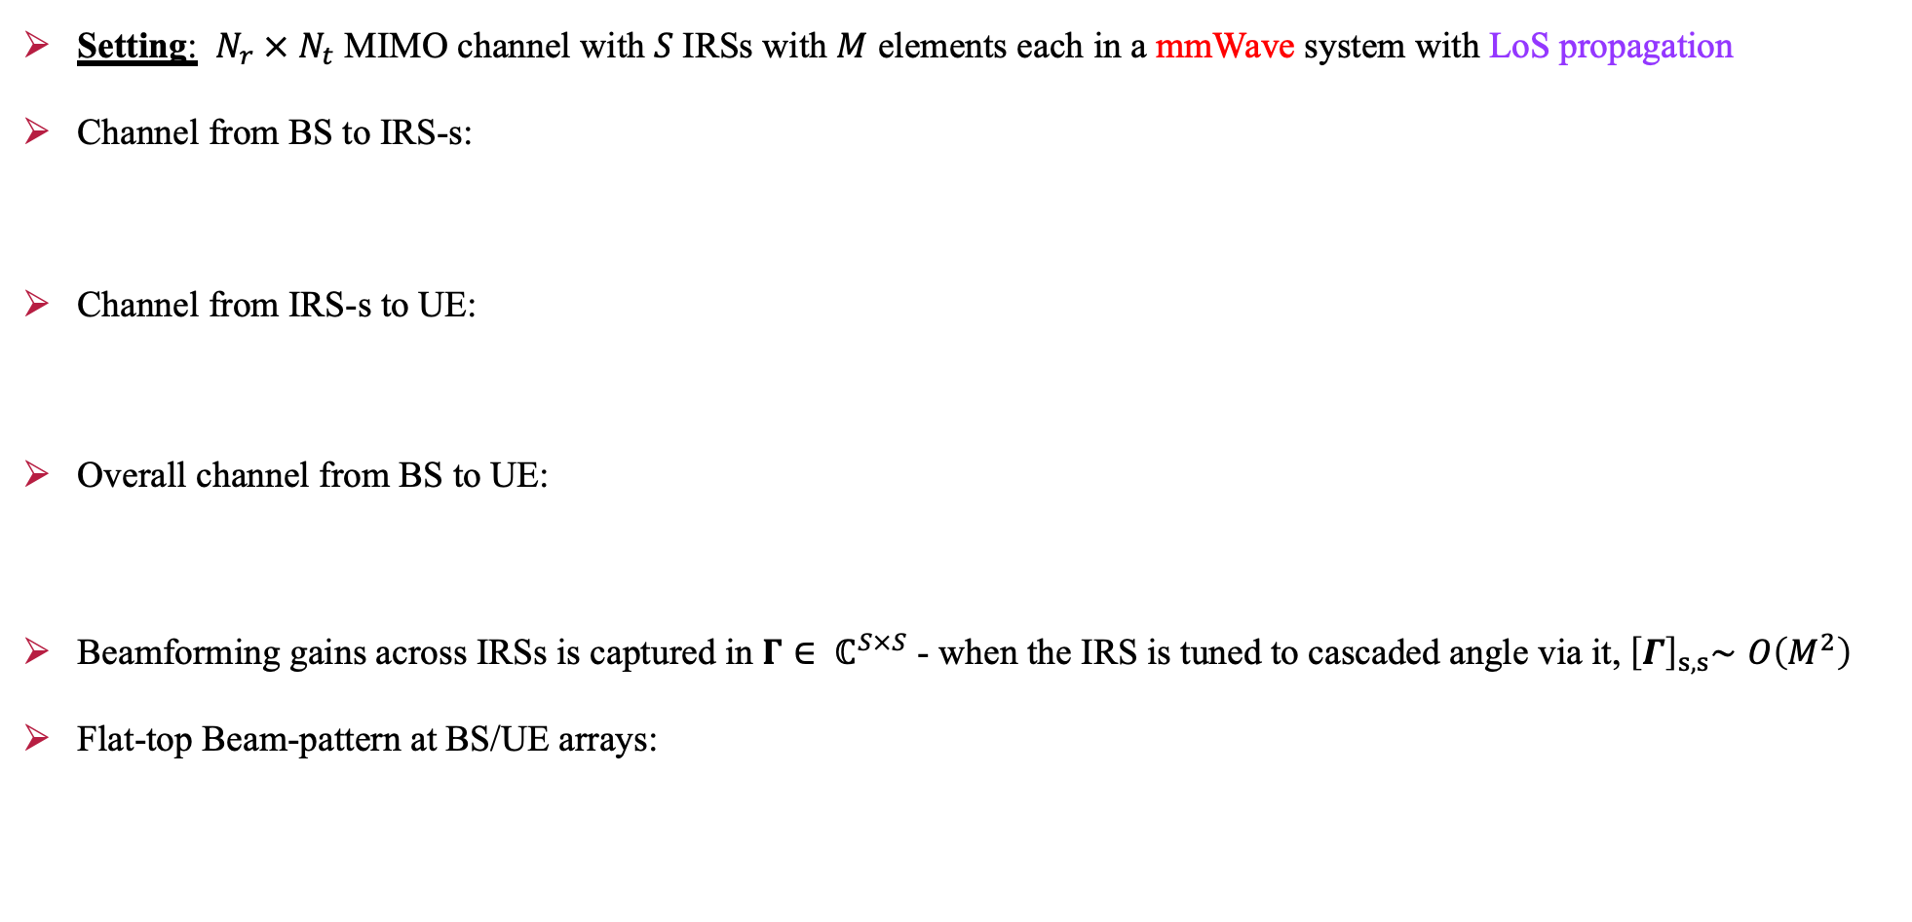
Channel Modeling
Setting: $N_{r} × N_{t}$ MIMO channel with $S$IRSs with $M$ elements each in a mmWave system with LoS propagation
Channel from BS to IRS-s:
Channel from IRS-s to UE:
Overall channel from BS to UE:
Beamforming gains across IRSs is captured in $Γ∈ ℂ^{S×S}$ - when the IRS is tuned to cascaded angle via it,${ \left[Γ\right]}_{s,s}∼Ο\left(M^{2}\right)$
Flat-top Beam-pattern at BS/UE arrays:

Slide 5
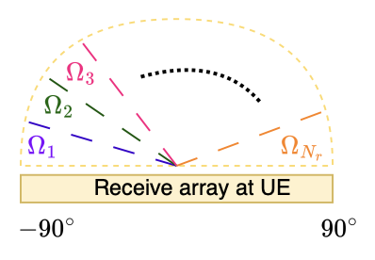
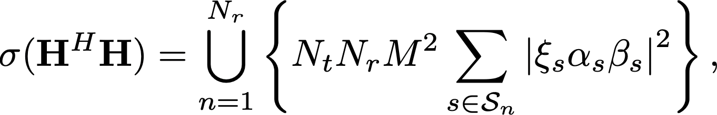



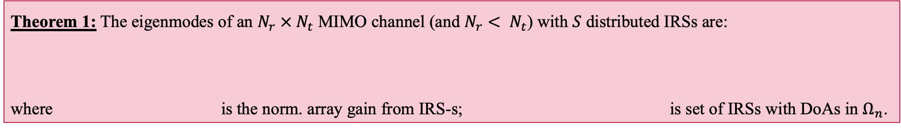
Eigen Modes of the MIMO channel
Question: How many eigen-modes does the MIMO channel have?
Angular bin partitions at UE-array:
Assumption: Each IRS is resolvable at the BS antenna array – can be easy to ensure via placement of IRSs.
Interpretations from Theorem 1:
The ability to resolve the IRSs decides the number and strength of the eigenmodes
Each resolvable IRS contributes to 1 eigen-mode; the strength of the mode depends on $ξ_{s}$: precise optimization is not needed!
All non-resolvable IRSs jointly contribute to 1 eigen mode; its strength equals the combined array gains from all these IRSs
Theorem 1: The eigenmodes of an $N_{r} × N_{t}$ MIMO channel (and $N_{r}< N_{t}$) with $S$ distributed IRSs are:
where is the norm. array gain from IRS-s; is set of IRSs with DoAs in $Ω_{n}$.

Slide 6
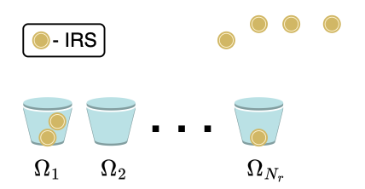
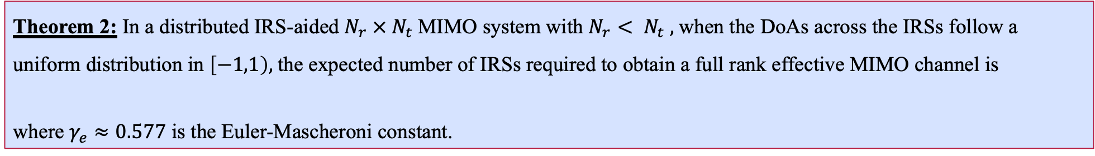

How many IRSs are needed for a full-rank Channel?
Multiplexing gain: # non-zero eigen-values of $H^{H}H,$i.e. rank of $H.$This depends on the number of resolvable IRSs seen by the UE!
Question: Multiple UEs at arbitrary locations can have different rank:
How many IRSs can deliver full-rank MIMO at any UE?
Analogy of ball-bin packing problem can be used to find the answer!
Interpretations from Theorem 2:
$N_{r}$ IRSs can provide a full-rank MIMO at a single UE; whereas $N_{r}\ln{N_{r}}$ IRSs can provide a full-rank MIMO at any UE
The scaling $N_{r}\ln{N_{r}}$ is both necessary and sufficient to attain a full rank channel at any UE!
Reminiscent of the classical coupon collector problem
Theorem 2: In a distributed IRS-aided $N_{r} × N_{t}$MIMO system with $N_{r}< N_{t} ,$when the DoAs across the IRSs follow a uniform distribution in $\left[−1,1\right),$the expected number of IRSs required to obtain a full rank effective MIMO channel is
where $γ_{e}≈0.577$ is the Euler-Mascheroni constant.

Slide 7

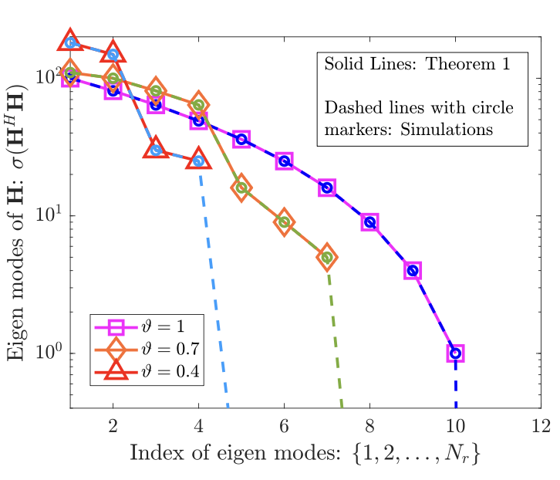
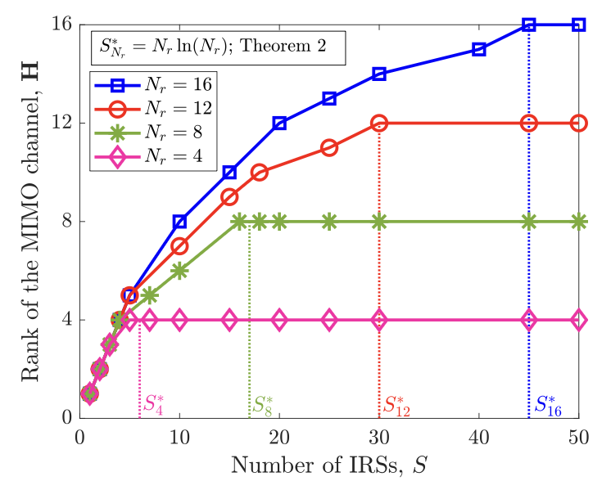
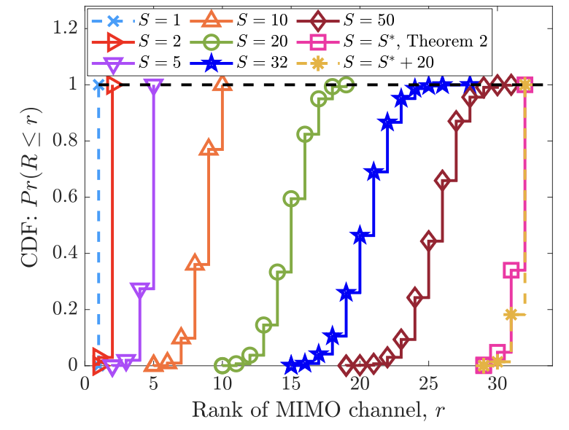



Numerical Illustrations
Fig. 1: $S=10, N_{t}=64, N_{r}=16$
Fig. 2: $N_{t}=64$
Fig. 3: $N_{t}=150, N_{r}=32$

Slide 8
The Punchline and What Next?
Multiple IRSs can improve the rank of a MIMO Channel even in the mmWave bands
Multiplexing gain can be improved in mmWave bands using multiple IRSs
Beamforming gain can be improved in mmWave bands using many elements at each IRS
Related Publication: L. Yashvanth, Chandra R. Murthy, and Bhaskar D. Rao, “How Many IRSs are Needed to Realize a Full-Rank MIMO Channel?,” submitted in Sep. 2025 for IEEE ICASSP 2026
Interesting Future Questions:
Rank of a MIMO channel is a discrete random variable: What is its probability distribution?
Can we provide analytical results to establish the tightness of this scaling?
How does the result generalize to arbitrary angular distributions, and when the IRSs are not resolvable at the BS array?
What is the implication of these results on the achievable ergodic rates of a distributed IRS-aided MIMO system?
What is the impact of frequency selectivity in the channels?

Slide 9
Practical RIS Gain without the Pain: Randomization and Opportunistic Scheduling in 5G NR
Guna Sai Kiran Nekkanti
Joint work with: L. Yashvanth, Raju Malleboina, Venkatareddy Akumalla,
Prof. Debdeep Sarkar, Prof. Chandra R. Murthy

Slide 10
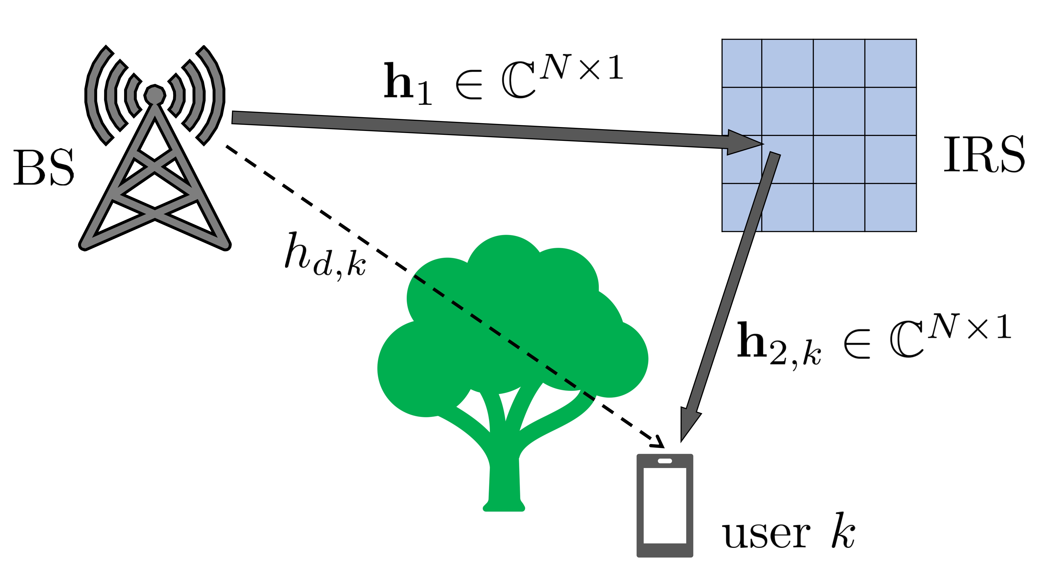
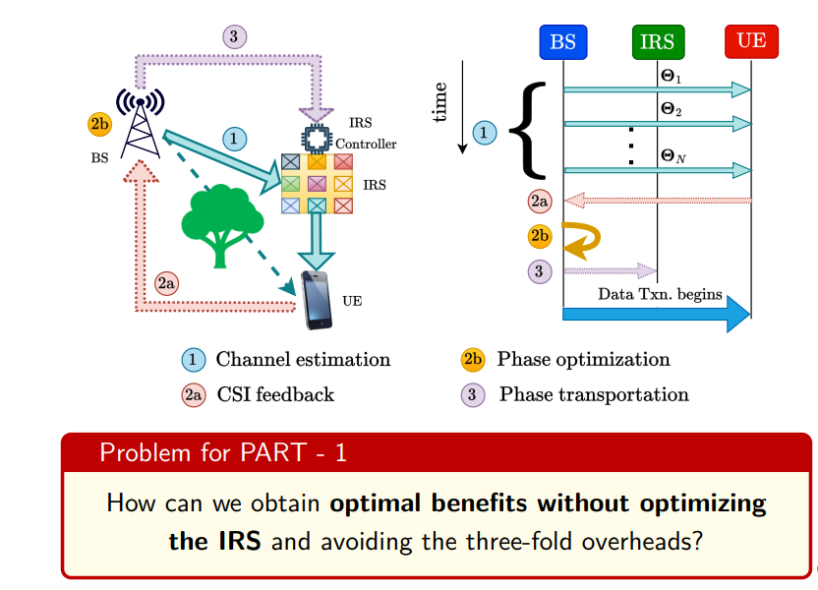
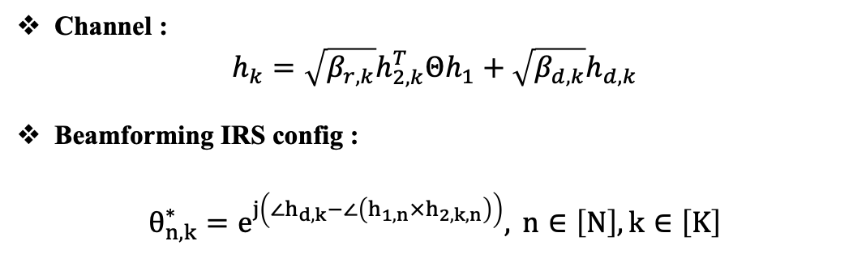
Intelligent reflecting surfaces (IRS)
IRS are used to alter the wireless channel characteristics
Controls the channel by modifying the reflection coefficients at the IRS
Channel :
$$h_{k}=\sqrt{β_{r,k}}h_{2,k}^{T}Θh_{1}+\sqrt{β_{d,k}}h_{d,k}$$
Beamforming IRS config :
$$θ_{n,k}^{∗}=e^{j\left(∠h_{d,k}−∠\left(h_{1,n}×h_{2,k,n}\right)\right)}, n∈\left[N\right],k∈\left[K\right]$$
Solution:
Goal :
Opportunistic Communications
Experimental demonstration
Idea of opportunistic Scheduling

Slide 11
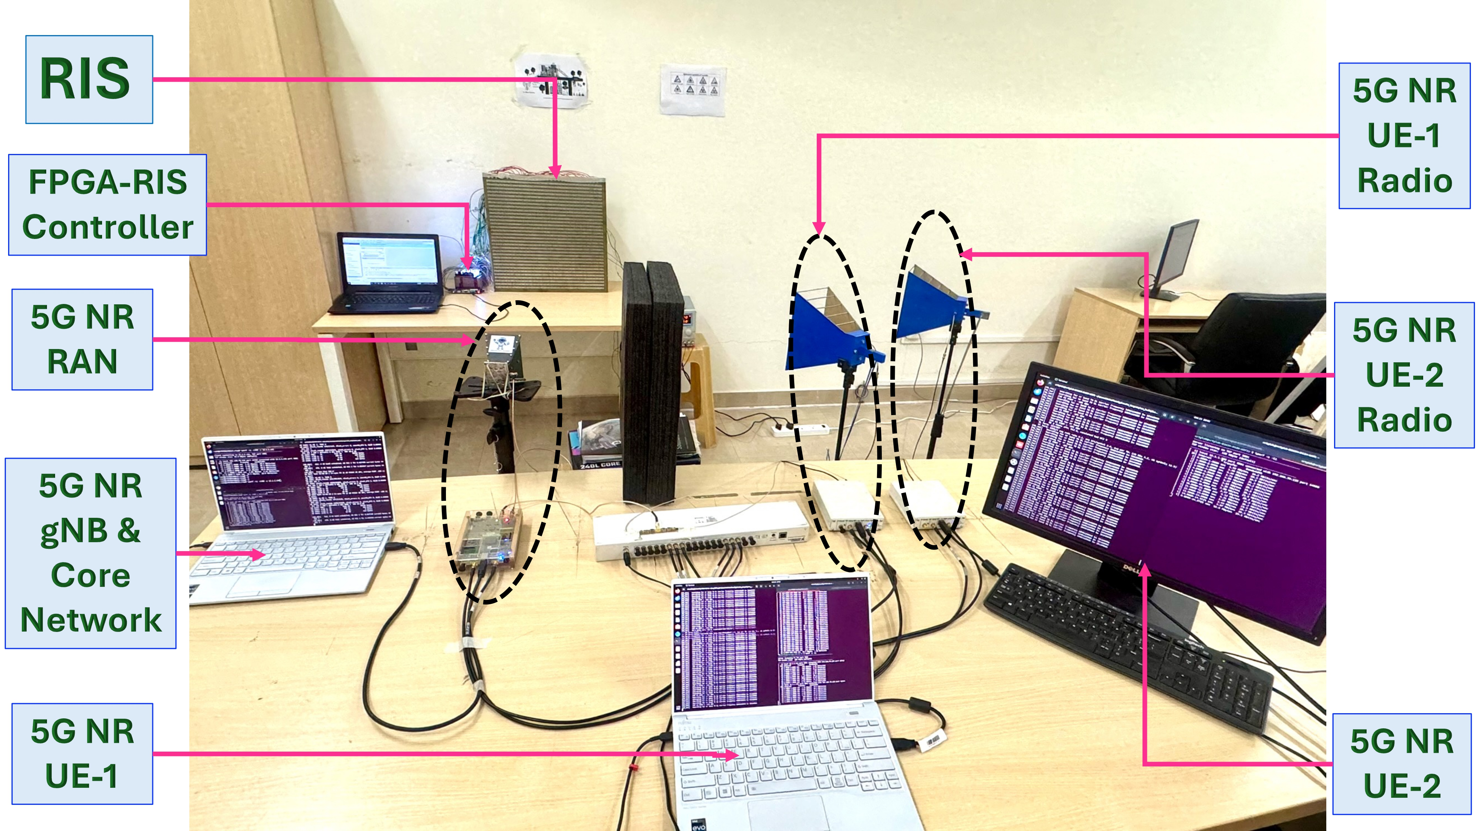
Setup of our RIS-aided 5G NR
5G NR Testbed Setup
Implemented using OpenAirInterface (OAI).
Operates: monolithic Stand-Alone (SA).
Full 5G RAN protocol stack
5G core network.
USRPs act as RUs for OTA communication.
OAI gNB and UE stacks run on:
Intel i7, 12 cores @ 4.9 GHz
32 GB RAM
Ubuntu 22.04 LTS, low-latency kernel
Notes:
Universal Software Radio Peripherals

Slide 12
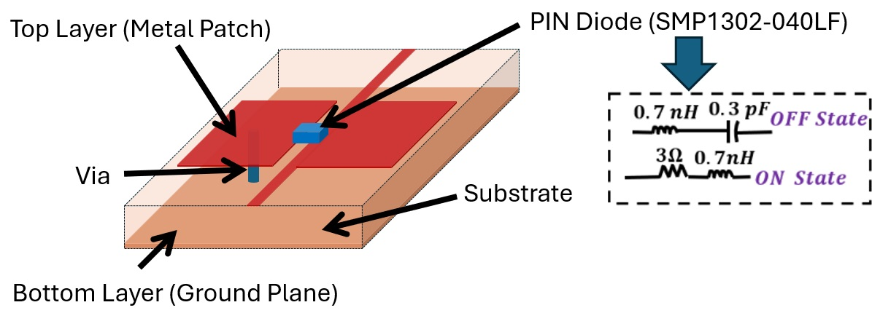
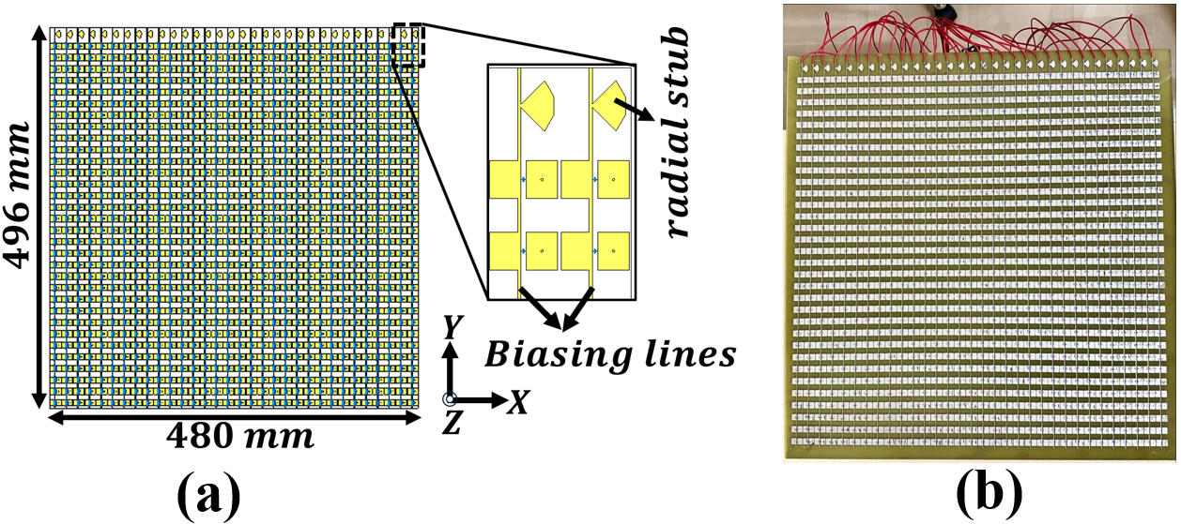
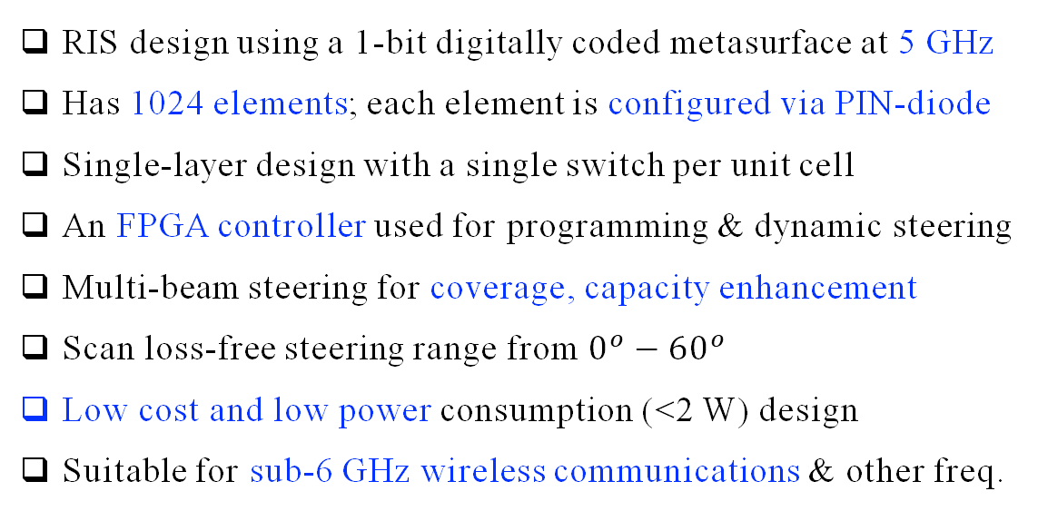
Indigenously Built RIS
Equivalent circuit of PIN diode
RIS design using a 1-bit digitally coded metasurface at 5 GHz
Has 1024 elements; each element is configured via PIN-diode
Single-layer design with a single switch per unit cell
An FPGA controller used for programming & dynamic steering
Multi-beam steering for coverage, capacity enhancement
Scan loss-free steering range from $0^{o}−{60}^{o}$
Low cost and low power consumption (<2 W) design
Suitable for sub-6 GHz wireless communications & other freq.
Unit-cell of a 1-bit digitally coded RIS: 3D view
Full RIS structure

Slide 13
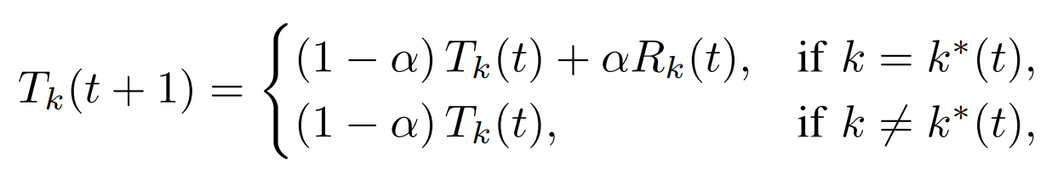
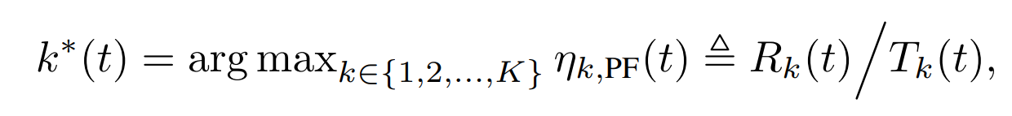
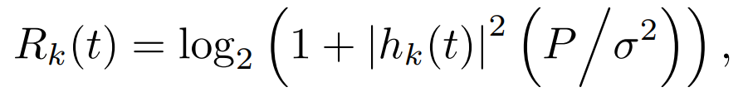
The OpenAirInterface for 5G NR
Communication Resources:
Discrete-Rate Adaptation:
40 MHz bandwidth (5 GHz carrier), 30 kHz SCS.
0.5 ms slots with 14 OFDM symbols.
TDD frame: 10-slot periodicity
Uses 3GPP MCS Table 1 (29 levels).
MCS range: 3 to CQI-dependent max (CQI every 80 ms).
HARQ adjust: ±1 MCS based on BLER (<0.05 / >0.15).
Retransmissions: Up to 3 HARQ repeats with same MCS
Resource Allocation:
4. EWMA update of average SE:
1. In OAI, users are scheduled using a Proportional Fair scheduler.
2. Scheduling rule:
Interpretation:
Small α → more opportunistic (higher throughput).
Large α → more fairness (frequent service to all UEs).
3. Instantaneous SE :
Notes:
Physical resource blocks (every 10 slots : 6 downlink, 3 are uplink,1 is a mixed slot)
(14 OFDM Symbols: 6DL,4 guard and 4 Uplink symbols

Slide 14
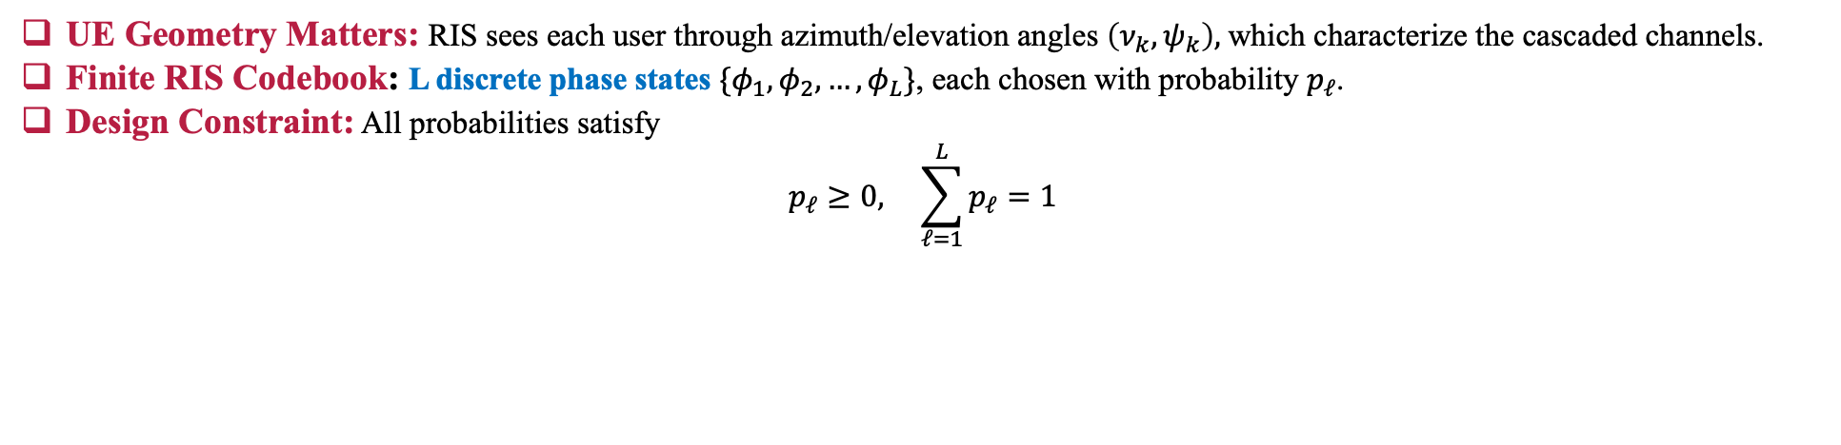
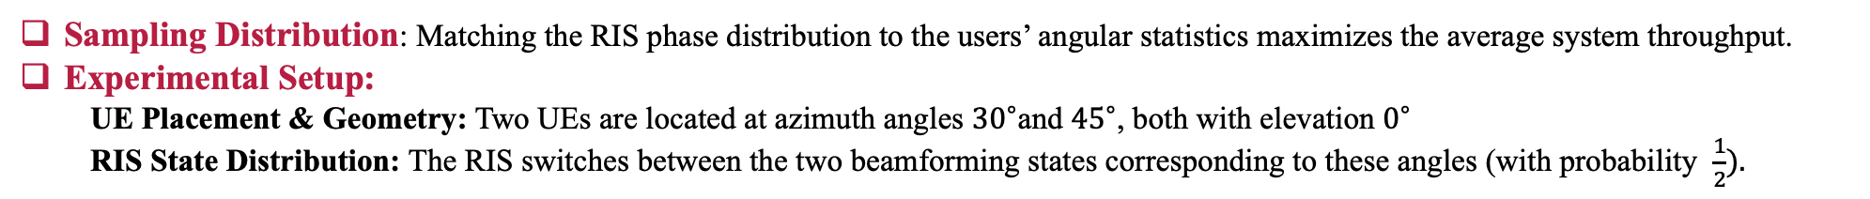
Evaluation Methodology
UE Geometry Matters: RIS sees each user through azimuth/elevation angles $\left(ν_{k},ψ_{k}​\right),$which characterize the cascaded channels.
Finite RIS Codebook: L discrete phase states $\{φ_{1},φ_{2},…,φ_{L}\}$, each chosen with probability $p_{ℓ}$​.
Design Constraint: All probabilities satisfy
$$p_{ℓ}≥0, \sum_{ℓ=1}^{L}{p_{ℓ}}=1$$
Sampling Distribution: Matching the RIS phase distribution to the users’ angular statistics maximizes the average system throughput.
Experimental Setup:
UE Placement & Geometry: Two UEs are located at azimuth angles ${30}^{∘}$and ${45}^{∘}$, both with elevation $0^{∘}$
RIS State Distribution: The RIS switches between the two beamforming states corresponding to these angles (with probability $\frac{1}{2}).$
Core Idea:
Randomized RIS: RIS switches between phase states with a switching time = Ts.
Proportional fair scheduler: gNB employs a PF scheduler with EWMA parameter = α.
$$Using appropriately chosen α,T_{s}, R_{rand}^{\left(K\right)}=R_{opt}^{\left(K\right)}.$$
Notes:
Note (Random RIS Operation): The RIS selects its state randomly every time slot—independent of which UE is scheduled—so a user gets full beamforming gain only when the randomly chosen state happens to match its direction.

Slide 15
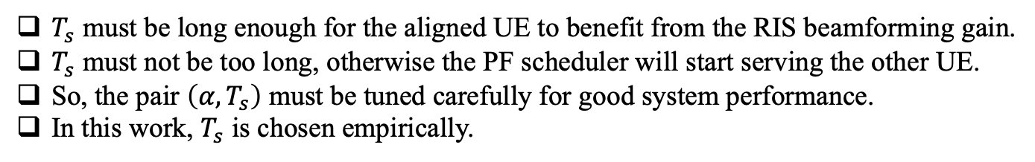

With RIS and Without RIS
With vs without RIS | RSRP (in dB) |  | Throughput (in Mbps)
 | UE-1 | UE-2 | UE-1 | UE-2
Without RIS | -112 | -110 | 40.70 | 47.40
With RIS | -105 | 102 | 50.10 | 58.20
RSRP increment: 7–8 dB
Rate increment: 10 Mbps
Experiment Parameters:
Switching Time: $T_{s}$ = 9 sec
PF Parameters:
$α= 0.01, 0.0005, 0.00005$.
Choice of the switching time, $T_{s}$:
$T_{s}​$ must be long enough for the aligned UE to benefit from the RIS beamforming gain.
$T_{s}$ must not be too long, otherwise the PF scheduler will start serving the other UE.
So, the pair $\left(α,T_{s}\right)$ must be tuned carefully for good system performance.
In this work, $T_{s}​$ is chosen empirically.

Slide 16
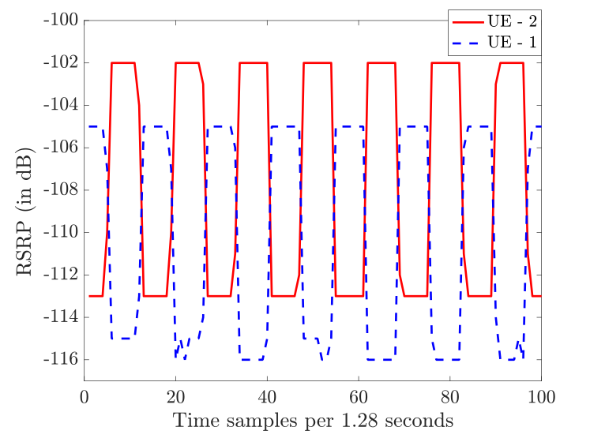
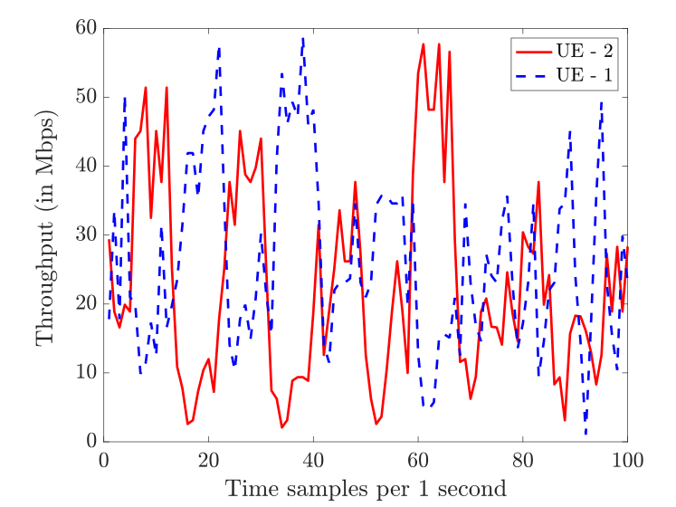
RSRP and Throughput $\left(α=0.00005\right)$

Slide 17
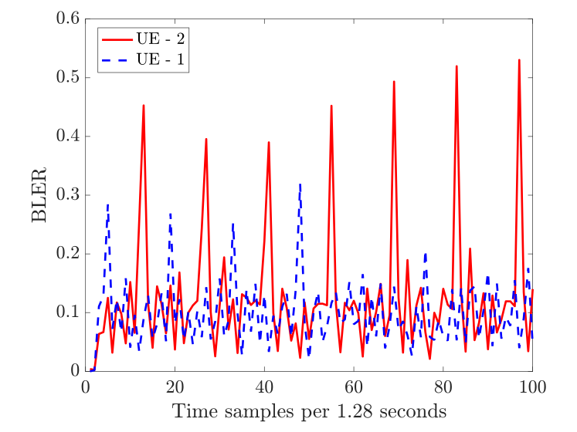
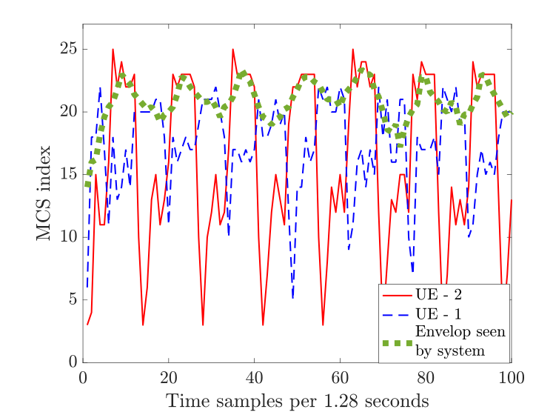
BLER and MCS

Slide 18
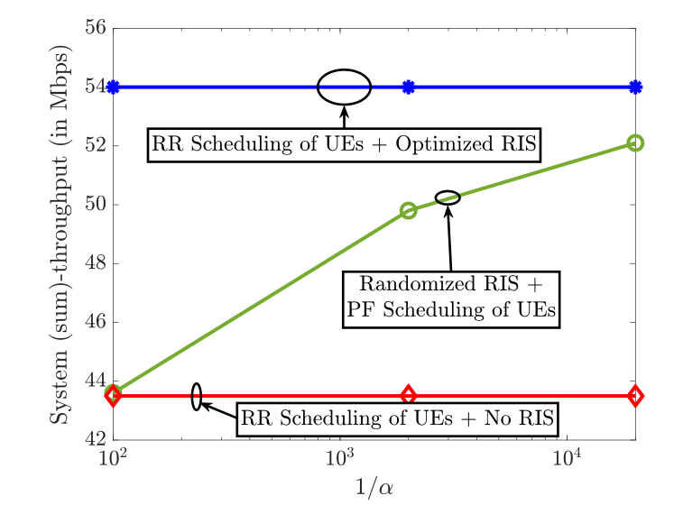
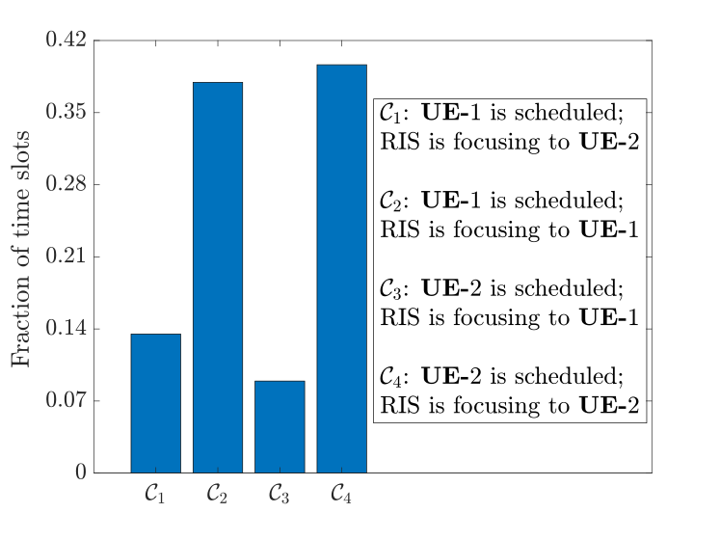
Randomized RIS Can Procure Full Benefits

Slide 19

What Next?
Change alternate RIS switching to random switching.
Extend to multiple UEs and more RIS states.
Experiment in indoor vs. outdoor measurement setups.
Analyze feasible values of Ts based on PF scheduling parameters.

Slide 20

References
Publication: L. Yashvanth, M. Raju, A. Venkata Reddy, N. Guna Sai Kiran, Chandra R. Murthy, and Debdeep Sarkar, “Practical RIS Gain Without Pain: Randomization and Opportunistic Scheduling in 5G NR?,” submitted in Nov. 2025 for IEEE ICC 2026
Further Reading:
R. Malleboina and D. Sarkar, "A Digitally Coded Intelligent Reflecting Surface for 6G Wireless Communication," Proc. 19th European Conference on Antennas and Propagation (EuCAP), Stockholm, Sweden, 2025, pp. 1-5.
L. Yashvanth, C. R. Murthy and B. D. Rao, "Spatial Correlation-Aware Opportunistic Beamforming in IRS-Aided Multi-User Systems," in IEEE Wireless Communications Letters, vol. 14, no. 10, Oct. 2025.
L. Yashvanth and Chandra R. Murthy, “Performance Analysis of IRS Assisted Opportunistic Communications,” IEEE Transactions on Signal Processing, vol. 71, pp. 2056-2070, Jun. 2023

