Slide 1
AWS
Agenda Day 1:
Basics Terminologies used In cloud computing (elasticity,scalability)
Introduction to Cloud Computing
Advantages Of Cloud Computing
Types Of Cloud Computing Environments
Why AWS?
Hands on Lab

Slide 2

Cloud Computing overview
Cloud computing is the on-demand delivery of compute, database storage, applications, and other IT resources through a cloud services platform via the Internet with pay-as-you-go pricing. Think of it as simply renting someone else computer!

Slide 3
6 Advantages of Cloud computing
Trade Capital Expense For Variable Expense - Pay only for what you use
Benefit from massive economies of scale
Stop guessing about capacity - spend too much money or too little money
Increase speed and agility - serverless architecture
Stop spending money running and maintaining data centres
Go global in minutes - Easy deploy in multiple region. Provides Low latency and better customer experience.

Slide 4
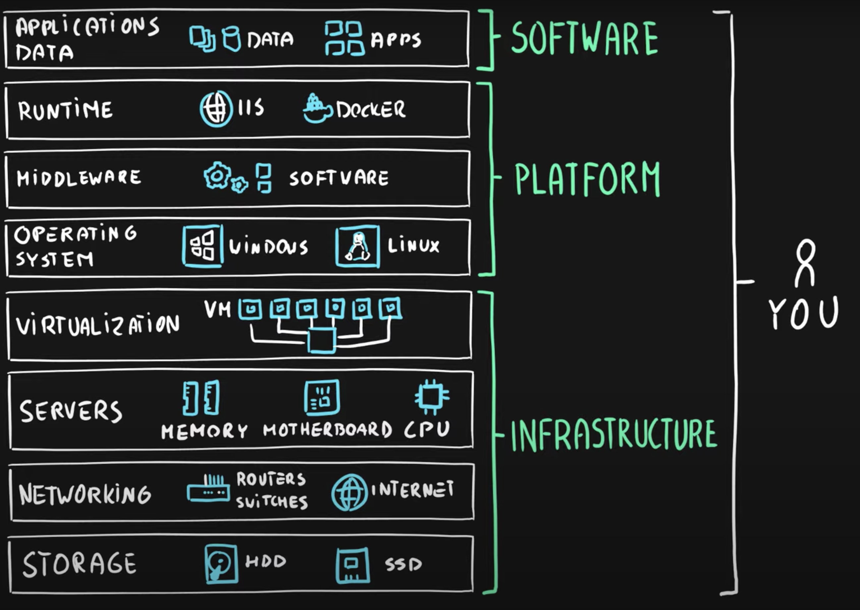

Slide 5
3 Types of Cloud Computing
Infrastructure As A Service (IAAS)
You manage the server which can be physical or virtual, as well as the operating system. Usually, Data centre provider will have no access to the server.
Platform As A Service (PAAS )
Someone else manages the underlying hardware and operating systems. You just focus on your applications.
Software As A Service (SAAS)
Think of Gmail. All you manage is your inbox (or the software provided to you by Google). Google take care of the data centers, servers, networks, storage, maintenance, patching etc.

Slide 6
Examples
SAAS :
Office 365, Salesforce User : End User
PAAS :
Heroku, Lambda, force.com, Elastic Bean stalk User: Developer
IAAS:
Amazon EC2 User: Sys Admin

Slide 7
3 Types of Cloud Computing Deployments
Public Cloud - AWS, Azure, GCP
Hybrid - Mixture of public and private
Private Cloud (Or On Premise) - You manage it, in your datacenter. Openstack or Vmware

Slide 8
Why AWS?
Amazon Web Services (AWS) is the world’s most comprehensive and broadly adopted cloud platform, offering over 200 fully featured services from data centers globally. Millions of customers—including the fastest-growing startups, largest enterprises, and leading government agencies—are using AWS to lower costs, become more agile, and innovate faster.

Slide 9
The leading cloud platform
Most functionality
Largest community of customers and partners
Most secure
Fastest pace of innovation
Most proven operational expertise

Slide 10
Hands on lab
Aws Account Creation,AWS Budget Setup(10$ max)
List of services that are available for aws-free tier account(12months)
Official Docs Link (For all AWS services)

