Slide 1
AWS
Agenda Day-02:
AWS console
AWS Global Infrastructure - Regions and Availability-zones
EC2 Instances
Hands-On Lab

Slide 2
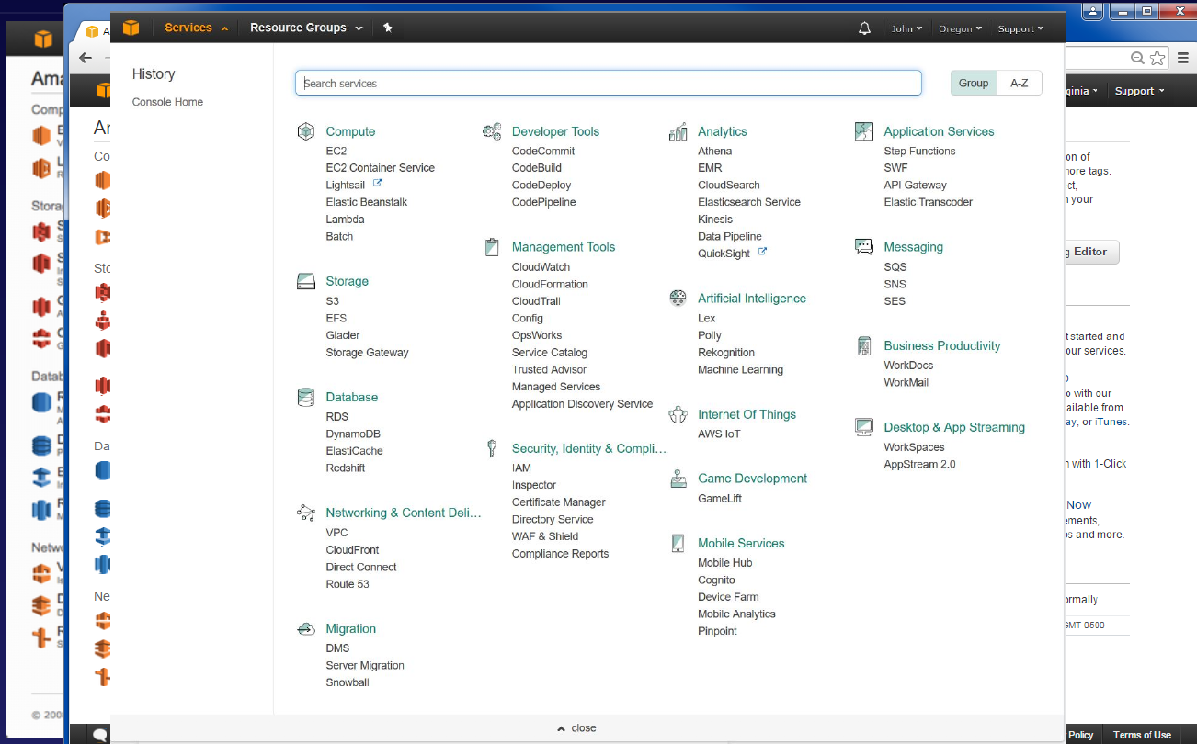
AWS Overview

Slide 3
AWS GLOBAL INFRASTRUCTURE
The AWS Global Cloud Infrastructure is the most secure, extensive, and reliable cloud platform, offering over 200 fully featured services from data centers globally
25 Regions & 80 Availability Zones
An AZ is one or more discrete data centers, each with redundant power, networking and connectivity, housed in separate facilities.
A Data Center is just a building filled with Servers
A Region is a physical location in the world which consists of two or more Availability Zones (AZ’s).
Edge Locations are endpoints for AWS which are used for caching content. Typically, this consists of CloudFront, Amazon’s Content Delivery Network (CDN)
There are many more Edge Locations than Regions. Currently there are over 200 Edge Locations.

Slide 4
Choosing the right AWS Region
Data Sovereignty Laws
Latency to end users
AWS Services

Slide 5
EC2
Amazon Elastic Compute Cloud (Amazon EC2 is just a virtual server (or servers) in the cloud. Amazon EC2 reduces the time required to obtain and boot new server instances to minutes, allowing you to quickly scale capacity, both up and down, as your computing requirements change.
Like a VM, only hosted in AWS instead of your own data center. Designed to make web-scale cloud computing easier for developers. The capacity you want when you need it. You are in complete control of your own instances.

Slide 6



Why is it so cool
Game Changer
AWS led a big change in the industry by introducing EC2.
Pay Only For What You Use EC2 changed the economics of computing.
No Wasted Capacity Select the capacity that you need right now. Grow and shrink when you need.

Slide 7

EC2 pricing Models
On Demand Allows you to pay a fixed rate by the hour (or by the second) with no commitment. Low cost and short term use.
Reserved Provides you with a capacity reservation, and offer a significant discount on the hourly charge for an instance. Contract Terms are 1 Year or 3 Year Terms.
Spot Enables you to bid whatever price you want for instance capacity, providing for even greater savings if your applications have flexible start and end. Very Low compute prices. For example, Image rendering, Genomic sequencing.
Dedicated Hosts Physical EC2 server dedicated for your use. Dedicated Hosts can help you reduce costs by allowing you to use your existing server-bound software licenses.

Slide 8

Instance type and FAMILY
Hardware: When you launch an instance, the instance type determines the hardware of the host computer used for your instance.
Capabilities: Each instance type offers different compute, memory, and storage capabilities. These types are grouped in instance families
Application Requirements: Select an instance type based on the requirements of the application that you plan to run on your instance.

Slide 9
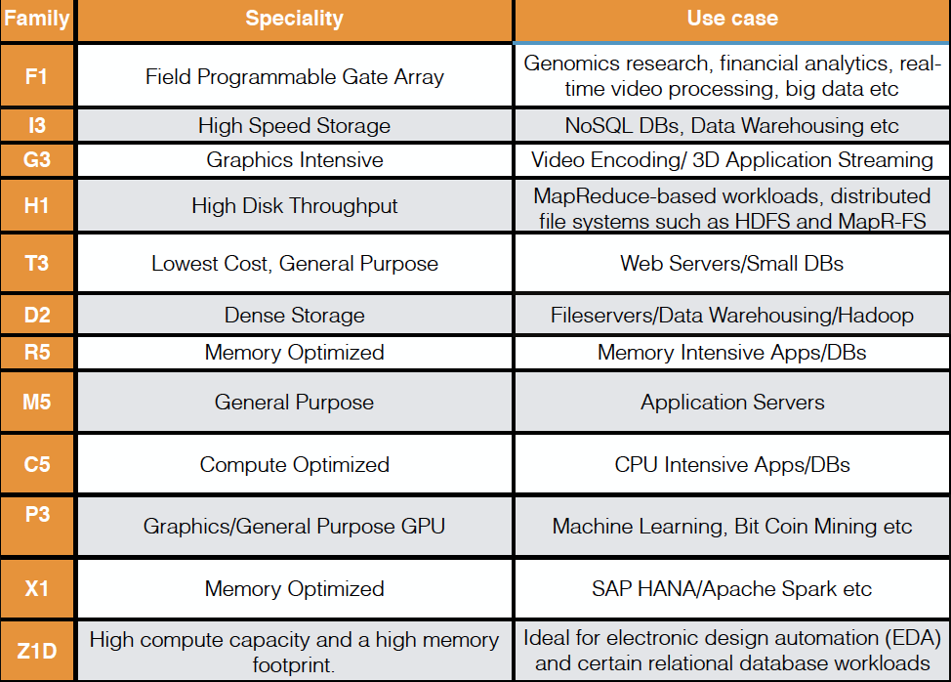

Slide 10
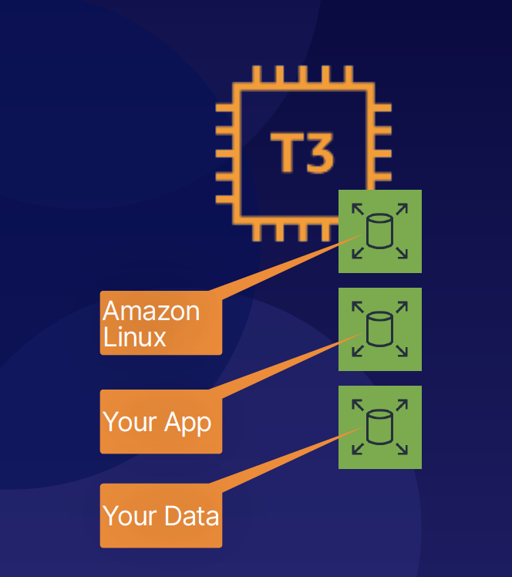
EBS (Elastic block store)
Storage volumes that you can attach to your EC2 instances.
Use them the same way you would use any system disk.
Create a file system.
Run a database.
Run an operating system.
Store data.
Install applications.
Key Benefits:
Highly Available
Scalable

Slide 11
EBS Volume type
SSD
General Purpose SSD (GP2) - balances price and performance for a wide variety of workloads.
Provisioned IOPS SSD (IO1) - Highest-performance SSD volume for mission-critical low-latency or high-throughput workloads.
Magnetic
Throughput Optimized HDD (ST1) - Low-cost HDD volume designed for frequently accessed, throughput-intensive workloads.
Cold HDD (SC1) - Lowest cost HDD volume designed for less frequently accessed workloads (File Servers).
Magnetic - Previous Generation.

Slide 12
Hands-on lab
How to launch Amazon-EC2 instances using EC2 Instance Dashboard?
SSH into EC2 Instances (using instance Connect, Putty , Windows powershell(OS windows 10)

