Slide 1
AWS
Agenda Day-04:
Introduction to S3
S3 management console
Versioning
Microservices

Slide 2
S3 (Simple storage service)
Object Storage
S3 provides secure, durable, highly-scalable object storage.
Scalable
S3 allows you to store and retrieve any amount of data from anywhere on the web at a very low cost.
Simple
Amazon S3 is easy to use, with a simple web services interface.
Notes:
Upload any file type you can think of to S3.
Examples: photos, videos, code, documents, text files.
It cannot be used to run an operating system or database.

Slide 3
Working with S3
Universal Namespace
All AWS accounts share the S3 namespace.
Each S3 bucket name is globally unique.
Example S3 URLs
https://bucket-name.s3.Region.amazonaws.com/key-name
https://fayecloudguru.s3.us-east-1.amazonaws.com/Ralphie.jpg
Uploading Files
When you upload a file to an S3 bucket, you will receive an HTTP 200 code if the upload was successful.

Slide 4
S3 types
Designed for Different Use Cases
S3 Standard – high availability and durability (99.9%)
S3 Standard-Infrequent Access (Used for data that is accessed less frequently but requires rapid access when needed)
S3 One Zone-Infrequent Access (Great for long-lived,infrequently accessed, non-critical data)
S3 Glacier

Slide 5
Glacier
Glacier is very cheap storage. •
Optimized for data that is very infrequently accessed.
You pay each time you access your data
Use only for archiving data.
Glacier standard - historical data only accessed a few times per year.
Glacier deep archive - financial records that may be accessed once or twice per year.

Slide 6


Introduc tion to microservices
Monolithic
One big thing
Difficult to change
We can’t make it any bigger
One small mistake affects the whole thing.
A microservice is a small, loosely coupled, distributed service. It is part of a broader microservices architecture, comprising a set of loosely coupled microservices that operate together to solve a common goal.
A collection of microservices can be regarded as a system.

Slide 7
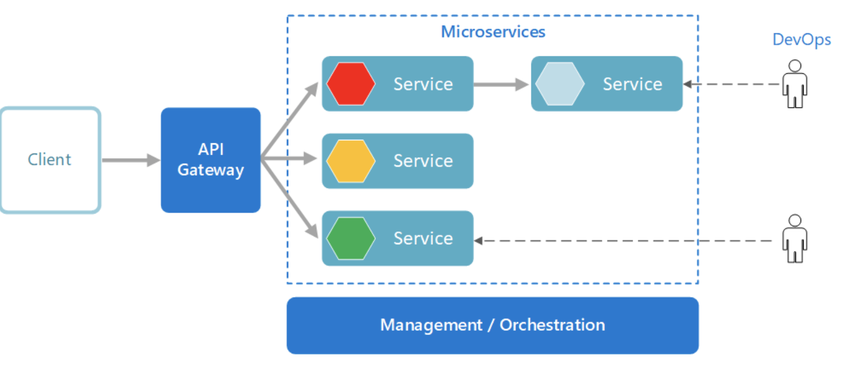
Microservice architecture

Slide 8
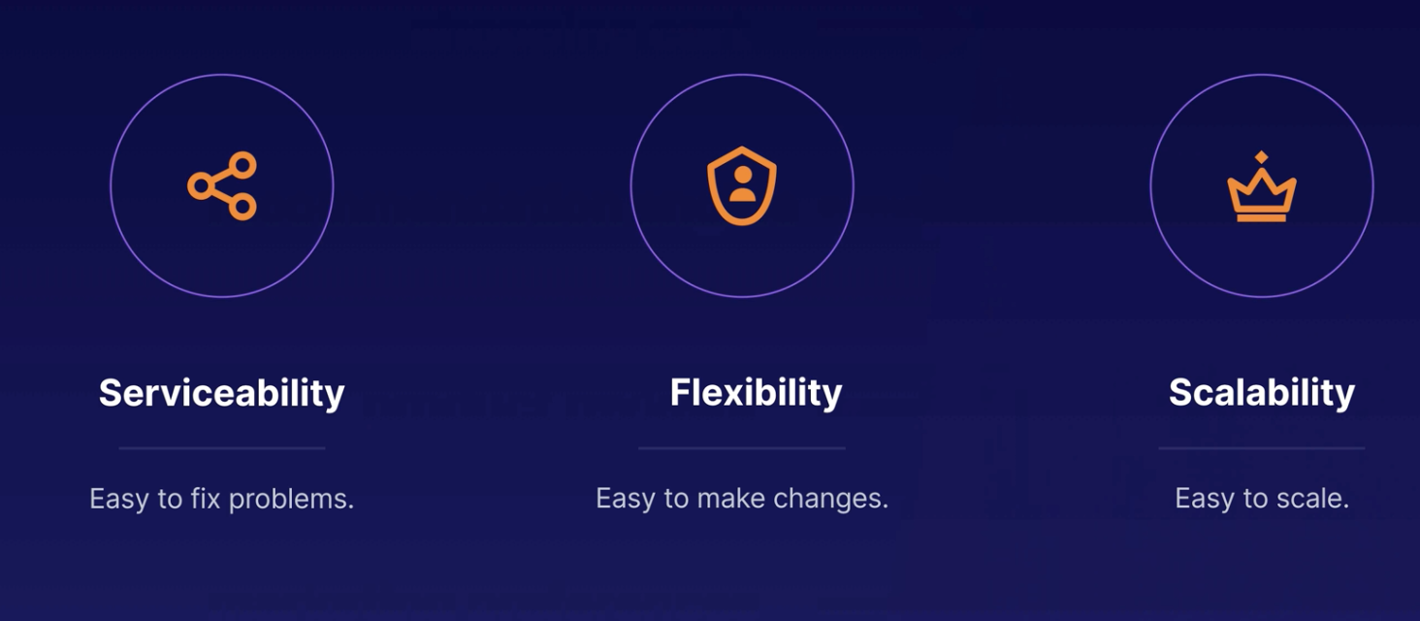
Benefits

Slide 9
Hands-on lab
How to create S3 buckets?
Uploading files to S3 buckets
Hosting a static website in Buckets Using S3

Slide 10
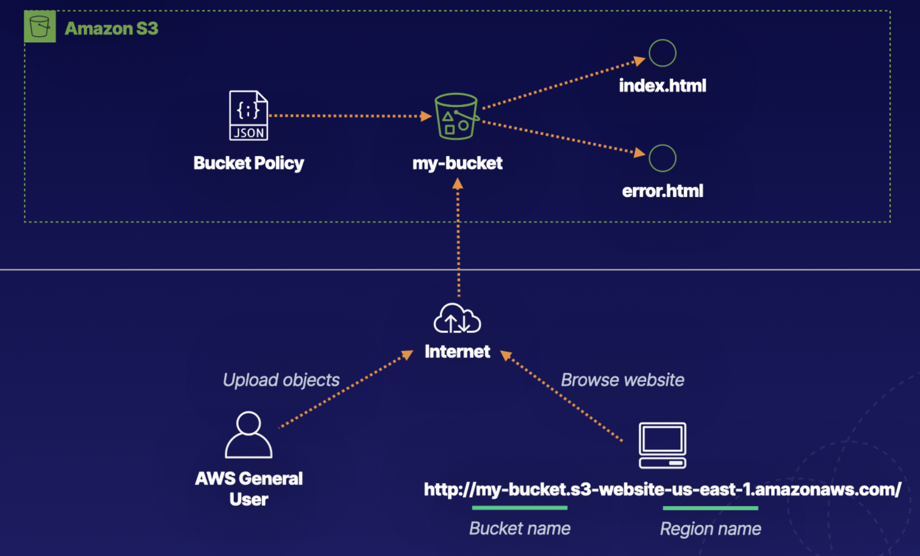
Create a Static Website Using Amazon S3
Lab
Create S3 Bucket
Enable Static Website Hosting
Apply Bucket Policy

