Slide 1
AWS
Agenda Day-05:
Introduction to VPC
Subnets, security groups
API Gateway
Industry Based Solution – Realtime examples
Deploy React App – Working session

Slide 2
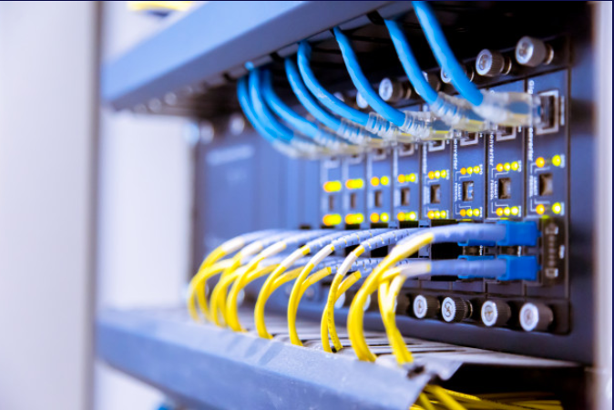
AWS VPC
Think of a VPC as a virtual data centre in the cloud.
Amazon Virtual Private Cloud (Amazon VPC) lets you provision a logically isolated section of the Amazon Web Services (AWS) Cloud where you can launch AWS resources in a virtual network that you define. You have complete control over your virtual networking environment, including selection of your own IP address range, creation of subnets, and configuration of route tables and network gateways.

Slide 3
Additionally, you can create a Hardware Virtual Private Network (VPN)
connection between your corporate datacenter and your VPC and leverage
the AWS cloud as an extension of your corporate datacenter.

Slide 4
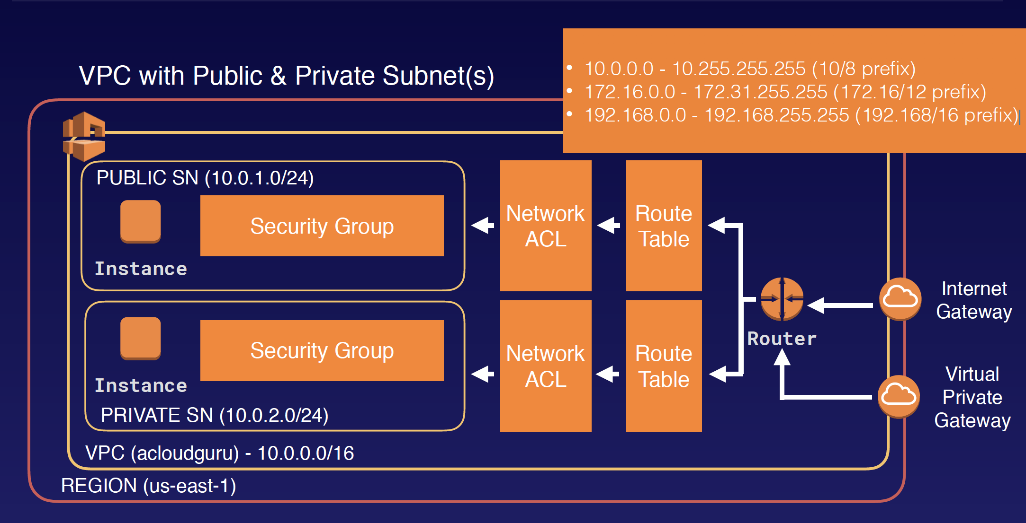
High LEVEL Architecture
Launch instances into a subnet of your choosing
• Assign custom IP address ranges in each subnet
• Configure route tables between subnets
• Create internet gateway and attach it to our VPC
• Much better security control over your AWS resources
• Instance security groups
• Subnet network access control lists (ACLS)

Slide 5
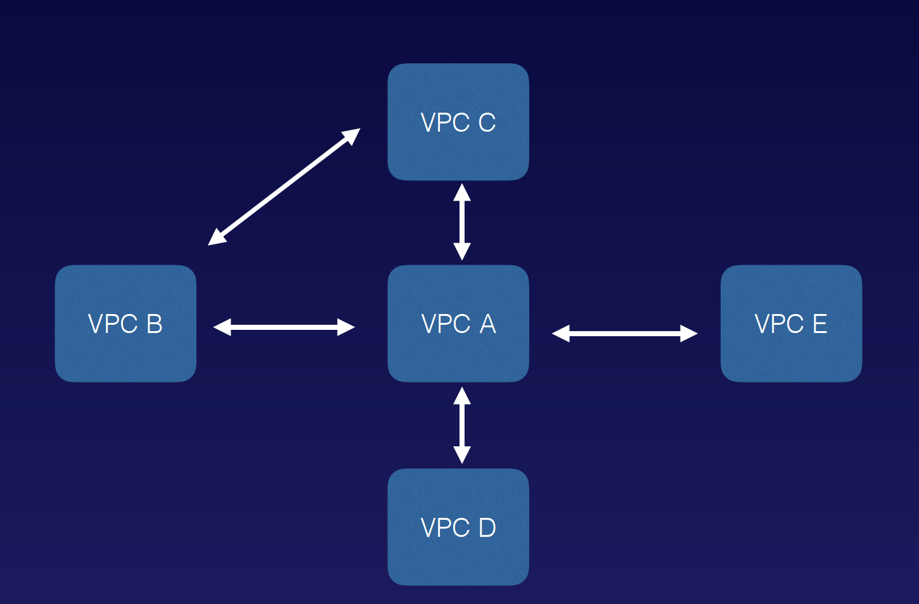
VPC Peering
Allows you to connect one VPC with another via a direct network route using private IP addresses.
Instances behave as if they were on the same private network
You can peer VPC's with other AWS accounts as well as with other VPCs in the same account.
Peering is in a star configuration: ie 1 central VPC peers with 4others.
NO TRANSITIVE PEERING!!!

Slide 6
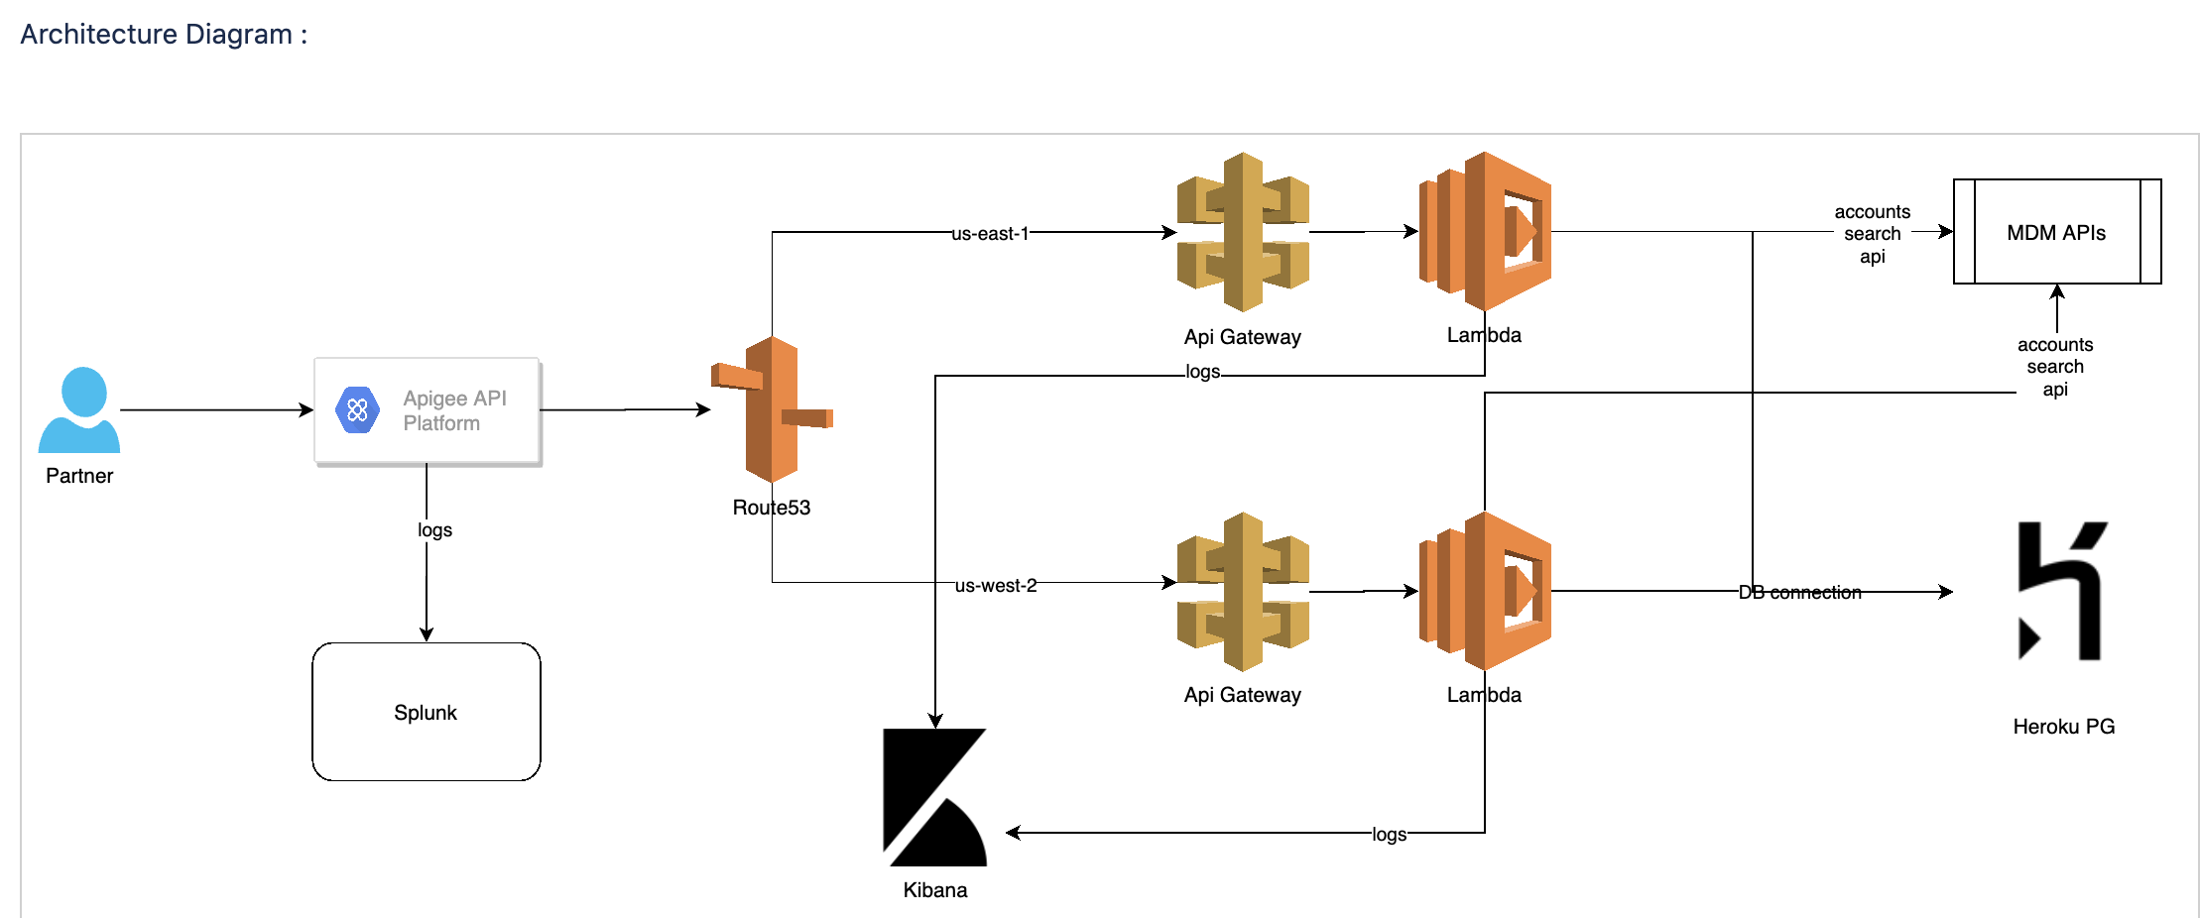
Industry AWS BASED soltuions

Slide 7
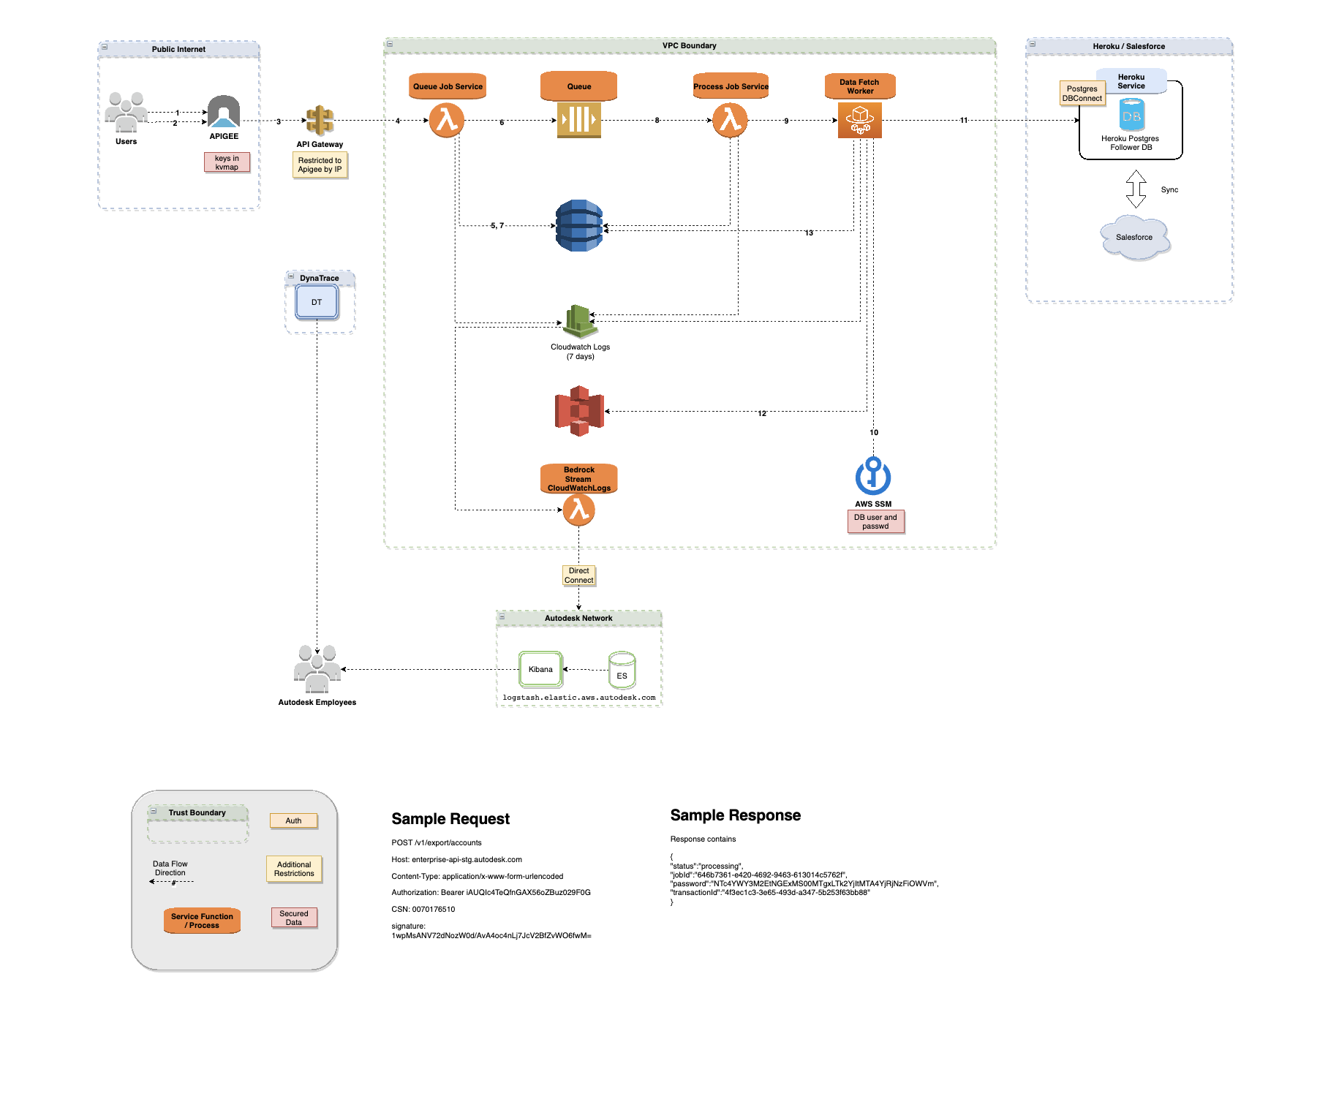
Lambda
SQS
API Gateway
Heroku
DynamoDB
ECS
S3
Cloudwatch

Slide 8
Hands-on lab
Create an API End Point URL using API gateway
React App deployment on AWS – Working session

Slide 9
Thank you
Q & A

