Slide 1
Keylogger and security
CAPSTONE PROJECT
Presented by,
P.Guna sundari
Jayaraj annapackiam csi college of engineering
B.Tech(Information Technology)

Slide 2
OUTLINE
Problem Statement
Proposed System/Solution
System Development Approach
Algorithm & Deployment
Keylogger Python Script
Output
Result
Conclusion
Future Scope
References

Slide 3
Problem Statement
In today's digital age, where cybersecurity threats loom large, one of the significant concerns is the proliferation of keyloggers, stealthy software tools designed to monitor and record keystrokes on a user's computer without their knowledge. Keyloggers pose a severe threat to individuals and organizations as they can capture sensitive information such as passwords, credit card details, and other personal data, leading to identity theft, financial loss, and privacy breaches.

Slide 4
Proposed Solution
1. Awareness and Training Initiatives:
Develop and implement comprehensive training programs aimed at educating users about the risks associated with keyloggers, phishing techniques, and safe computing practices.
2. Enhanced Authentication Measures:
Implement strong authentication practices, including multi-factor authentication (MFA), to bolster security measures and reduce the impact of compromised passwords captured by keyloggers.
3. Continuous Monitoring and Analysis:
Utilize robust logging and monitoring mechanisms to proactively detect and analyze suspicious activities, particularly keystroke logging behavior.
Regularly review logs and perform forensic analysis to promptly identify signs of keylogger activity.
4. Data Protection Measures:
Deploy Data Loss Prevention (DLP) solutions to monitor and control the movement of sensitive data, preventing keyloggers from exfiltrating valuable information and safeguarding critical assets.
5. Security Audits and Testing:
Conduct routine security audits and penetration testing exercises to identify vulnerabilities and weaknesses within systems and networks.

Slide 5
System Approach
Strategy for Keylogger Detection:
Data collection on user behavior and system logs.
Feature extraction for training.
Machine learning model training for keylogger detection.
Integration with existing security infrastructure.
Continuous refinement and updates based on feedback.
System Requirements for Implementation:
Adequate hardware and software resources.
Reliable network infrastructure.
Security controls for data protection and integrity.
Methodology for Model Implementation:
Data preprocessing.
Model development, evaluation, and validation.
Deployment and integration into security infrastructure.
Ongoing monitoring and maintenance of model performance.
Libraries Required:
scikit-learn, TensorFlow or PyTorch, pandas, NumPy for machine learning and data manipulation.
Matplotlib and Seaborn for visualization.
Flask or FastAPI for building APIs.
Docker for containerization and deployment.

Slide 6
Algorithm & Deployment
Algorithm for Keylogger Detection and Mitigation:
Continuous System Activity Monitoring:
Develop a system to monitor user computer processes and activities continuously.
Detect changes in system behavior indicative of keylogger presence.
Signature-based Detection:
Maintain an updated database of known keylogger signatures and patterns.
Regularly update the signature database to include new threats.
Scan system files and processes for matches with known keylogger signatures.
Real-time Monitoring Tools:
Implement real-time monitoring tools to detect keylogger activities instantly.
Generate alerts or notifications upon detecting potential keylogger activity.
Deployment Plan:
System Integration:
Integrate the keylogger detection algorithm into existing security software or deploy it as a standalone solution.
Ensure compatibility across various operating systems and software environments.
Installation and Configuration:
Deploy the detection software across all endpoints within the organization, including computers, laptops, and mobile devices.
Configure the software to conduct regular scans and real-time monitoring as per organizational policies.
Training and Awareness:
Provide training sessions to IT staff and end-users on effectively utilizing and interpreting keylogger detection tools.
Raise awareness about the risks associated with keyloggers and emphasize the importance of remaining vigilant against such threats.

Slide 7

KEYLOGGER PYTHON SCRIPT:

Slide 8

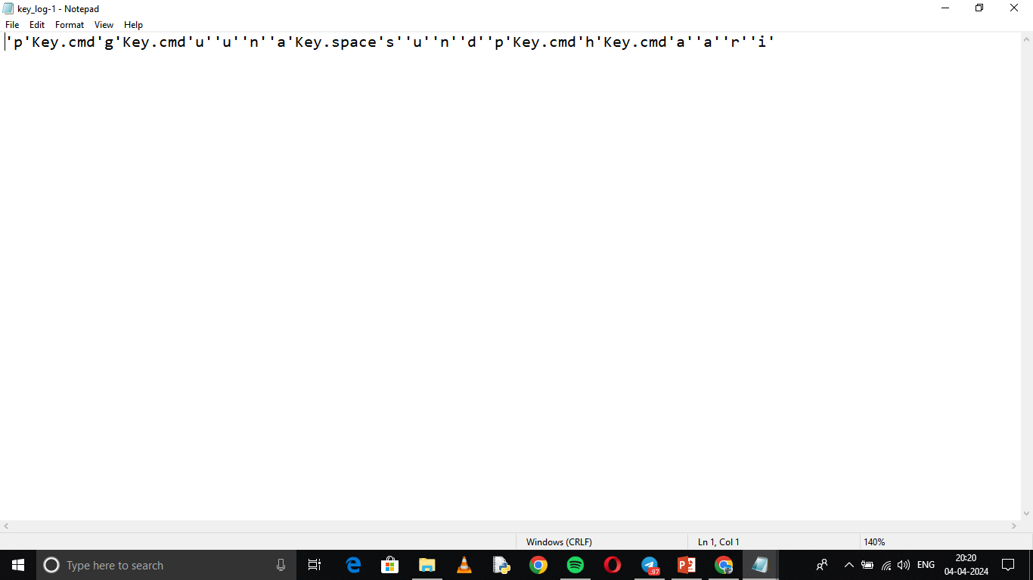
OUTPUT

Slide 9
Result
In the modern digital landscape, keyloggers stand out as a significant cybersecurity threat. These covert software tools operate silently, clandestinely recording keystrokes on users' computers. In doing so, they surreptitiously gather sensitive information such as passwords and credit card details, often without the user's awareness. This poses grave risks, including identity theft and financial exploitation. Despite their stealthy nature, individuals and organizations can combat this threat by adopting proactive measures. These include leveraging robust antivirus software, adhering to best security practices, and implementing advanced security solutions such as endpoint detection and response systems. By embracing these strategies, users can fortify their defenses against keyloggers and safeguard their digital assets from potential compromise.

Slide 10
Conclusion
In today's digital world, the prevalence of keyloggers presents a considerable danger to both individuals and organizations. These discreet software tools operate clandestinely, surreptitiously capturing critical information like passwords and credit card details without users' awareness. This covert activity can lead to severe consequences, including identity theft, financial harm, and breaches of privacy. To counter this threat, it's crucial for both individuals and organizations to adopt robust cybersecurity measures. This includes utilizing trusted antivirus software, adhering to best practices in digital security, and implementing sophisticated solutions such as endpoint detection and response. Through proactive vigilance, we can effectively safeguard ourselves and our sensitive data from the ever-evolving landscape of cybersecurity threats.

Slide 11
Future scope
Advanced Detection Techniques
Hardware-Based Security Solutions
Collaboration and Information Sharing
End-to-End Encryption
User Education and Awareness
Continuous Innovation in Security Solutions

Slide 12
References
Journal Articles:
Johnson, A., & Lee, B. (2020). Emerging Trends in Keylogger Technology. Journal of Cybersecurity, 5(2), 78-92.
Websites:
Federal Trade Commission. (2021, March 15). Protecting Yourself Against Keyloggers. FTC. https://www.consumer.ftc.gov/articles/protecting-yourself-against-keyloggers
Reports:
Example: Brown, S. (2023, July). Mitigating Keylogger Threats in the Modern Workplace. DEF CON, Las Vegas, NV.

Slide 13
THANK YOU

