Slide 1
Banking System
Title of the Project

Slide 2
GROUP MEMBERS
> Gunavanth Reddy
AP23110010505
> Balaji Bhavani Shankar
AP23110010546

Slide 3
TABLE OF CONTENTS
> INTRODUCTION
> OBJECTIVES
> OUTCOMES
> CODE PROGRAM
> OUTPUT
> CONCLUSION

Slide 4
INTRODUCTION
A Banking System is a digital platform that enables Bank User to create account , Deposit ,Withdraw,Balance Enquiry,Transfer efficiently. It serves as a bridge between Bank service providers and Bank User.
Key Features:
User Accounts: Any one can Securely create account in bank.
Deposit and Withdraw: Users can easily Deposit and withdraw their money through this banking system service.
Balance Enquiry : Also Users can easily check the Account Balance.
Transfer : You can Transfer your money to another bank account.

Slide 5
OBJECTIVES
User Account Management:
Allow users to create personal accounts with a unique username .
Deposit :
Enable user to easily deposit their money in their account
Withdraw :
It Enables user to withdraw their money form the account.
Balance Enquiry :
It allows user to check their bank balance that in their account.
Transfer :
Any one can easily transfer their money from account to another account by giving the correct information to the system..

Slide 6
OUTCOMES
User Account Creation:
Users will successfully create accounts with unique usernames.
The system will prevent duplicate usernames.
Deposit :
The system will accurately Deposit the money, by providing users with clear pricing information.
Withdraw:
The system will accurately withdraw the money, by providing users with clear pricing information.
Bank Enquiry :
The system will show the bank balance of the specific user’s bank account balance.
Transfer:
The system will Transfer the amount from one account to another account.
Exit:
The system will stop the program of the banking system service.

Slide 7
Code:
#include <iostream>
#include <vector>
#include <limits>
using namespace std;
class Account {
private:
int accountNumber;
string accountHolderName;
double balance;
public:
Account(int accNum, string name) : accountNumber(accNum), accountHolderName(name), balance(0.0) {}
int getAccountNumber() const {
return accountNumber;
}
string getAccountHolderName() const {
return accountHolderName;
}

Slide 8
double getBalance() const {
return balance;
}
void deposit(double amount) {
if (amount > 0) {
balance += amount;
cout << "Deposited: $" << amount << endl;
} else {
cout << "Invalid deposit amount!" << endl;
}
}
void withdraw(double amount) {
if (amount > 0 && amount <= balance) {
balance -= amount;
cout << "Withdrawn: $" << amount << endl;
} else {
cout << "Invalid withdrawal amount!" << endl;
}
}

Slide 9
void transfer(Account &receiver, double amount) {
if (amount > 0 && amount <= balance) {
balance -= amount;
receiver.deposit(amount);
cout << "Transferred: $" << amount << " to account " << receiver.getAccountNumber() << endl;
} else {
cout << "Invalid transfer amount!" << endl;
}
}
};
class BankingSystem {
private:
vector<Account> accounts;
public:
void createAccount() {
int accNum = accounts.size() + 1; // Auto-increment account number
string name;
cout << "Enter account holder name: ";
cin.ignore(); // Clear the newline character in the input buffer
getline(cin, name);
accounts.emplace_back(accNum, name);
cout << "Account created successfully! Account Number: " << accNum << endl;
}

Slide 10
void deposit() {
int accNum;
double amount;
cout << "Enter account number: ";
cin >> accNum;
cout << "Enter amount to deposit: ";
cin >> amount;
if (accNum > 0 && accNum <= accounts.size()) {
accounts[accNum - 1].deposit(amount);
} else {
cout << "Invalid account number!" << endl;
}
}
void withdraw() {
int accNum;
double amount;
cout << "Enter account number: ";
cin >> accNum;
cout << "Enter amount to withdraw: ";
cin >> amount;
if (accNum > 0 && accNum <= accounts.size()) {
accounts[accNum - 1].withdraw(amount);
} else {
cout << "Invalid account number!" << endl;
}
}

Slide 11
void balanceEnquiry() {
int accNum;
cout << "Enter account number: ";
cin >> accNum;
if (accNum > 0 && accNum <= accounts.size()) {
cout << "Balance for account " << accNum << ": $" << accounts[accNum - 1].getBalance() << endl;
} else {
cout << "Invalid account number!" << endl;
}
}
void transfer() {
int senderAccNum, receiverAccNum;
double amount ;
cout << "Enter sender account number: ";
cin >> senderAccNum;
cout << "Enter receiver account number: ";
cin >> receiverAccNum;
cout << "Enter amount to transfer: ";
cin >> amount;
if (senderAccNum > 0 && senderAccNum <= accounts.size() && receiverAccNum > 0 && receiverAccNum <= accounts.size()) {
accounts[senderAccNum - 1].transfer(accounts[receiverAccNum - 1], amount);
} else {
cout << "Invalid account numbers!" << endl;
}
}

Slide 12
void menu() {
int choice;
do {
cout << "\n--- Banking System Menu ---\n";
cout << "1. Create Account\n";
cout << "2. Deposit\n";
cout << "3. Withdraw\n";
cout << "4. Balance Enquiry\n";
cout << "5. Transfer\n";
cout << "6. Exit\n";
cout << "Enter your choice: ";
cin >> choice;
switch (choice) {
case 1:
createAccount();
break;
case 2:
deposit();
break;
case 3:
withdraw();
break;

Slide 13
case 4:
balanceEnquiry();
break;
case 5:
transfer();
break;
case 6:
cout << "Exiting the Banking System. Goodbye!" << endl;
break;
default:
cout << "Invalid choice! Please try again." << endl;
break;
}
} while (choice != 6);
}
};
int main() {
BankingSystem bankSystem;
bankSystem.menu();
return 0;
}

Slide 14
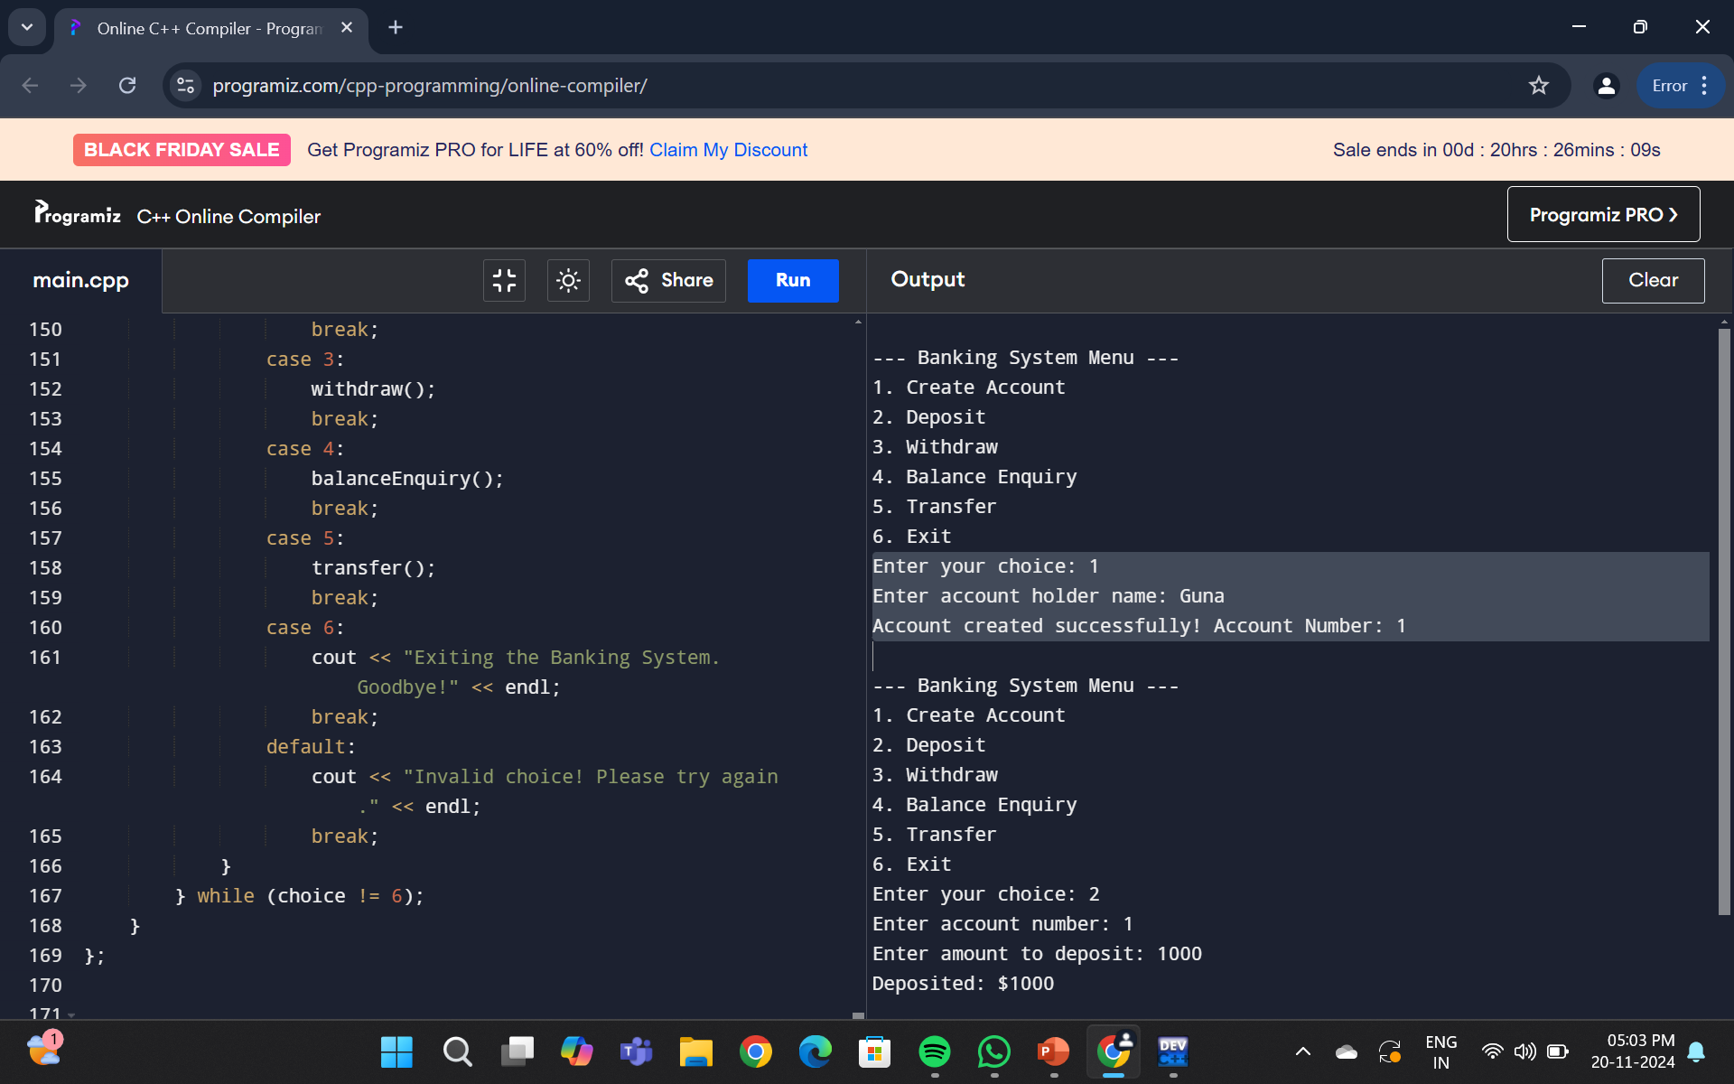

Slide 15
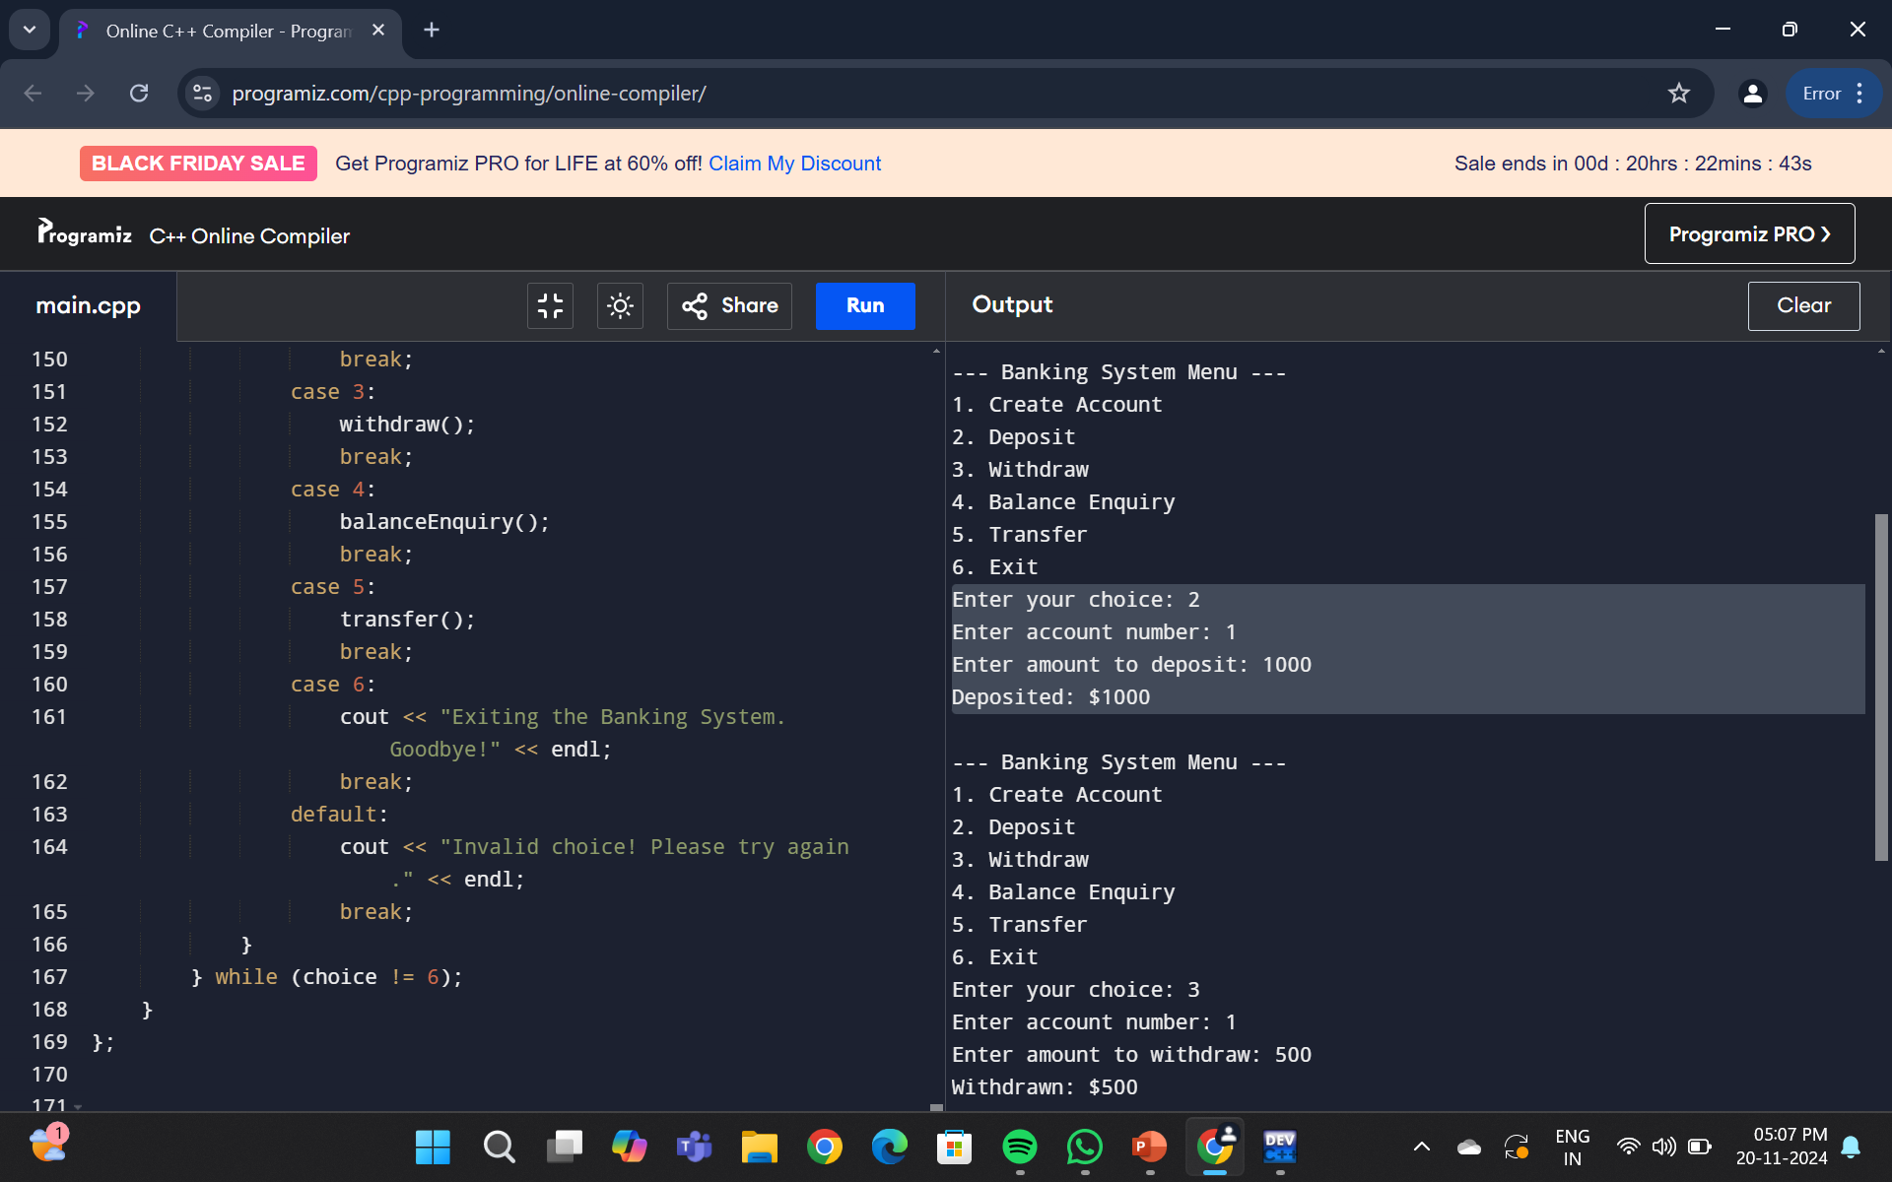

Slide 16
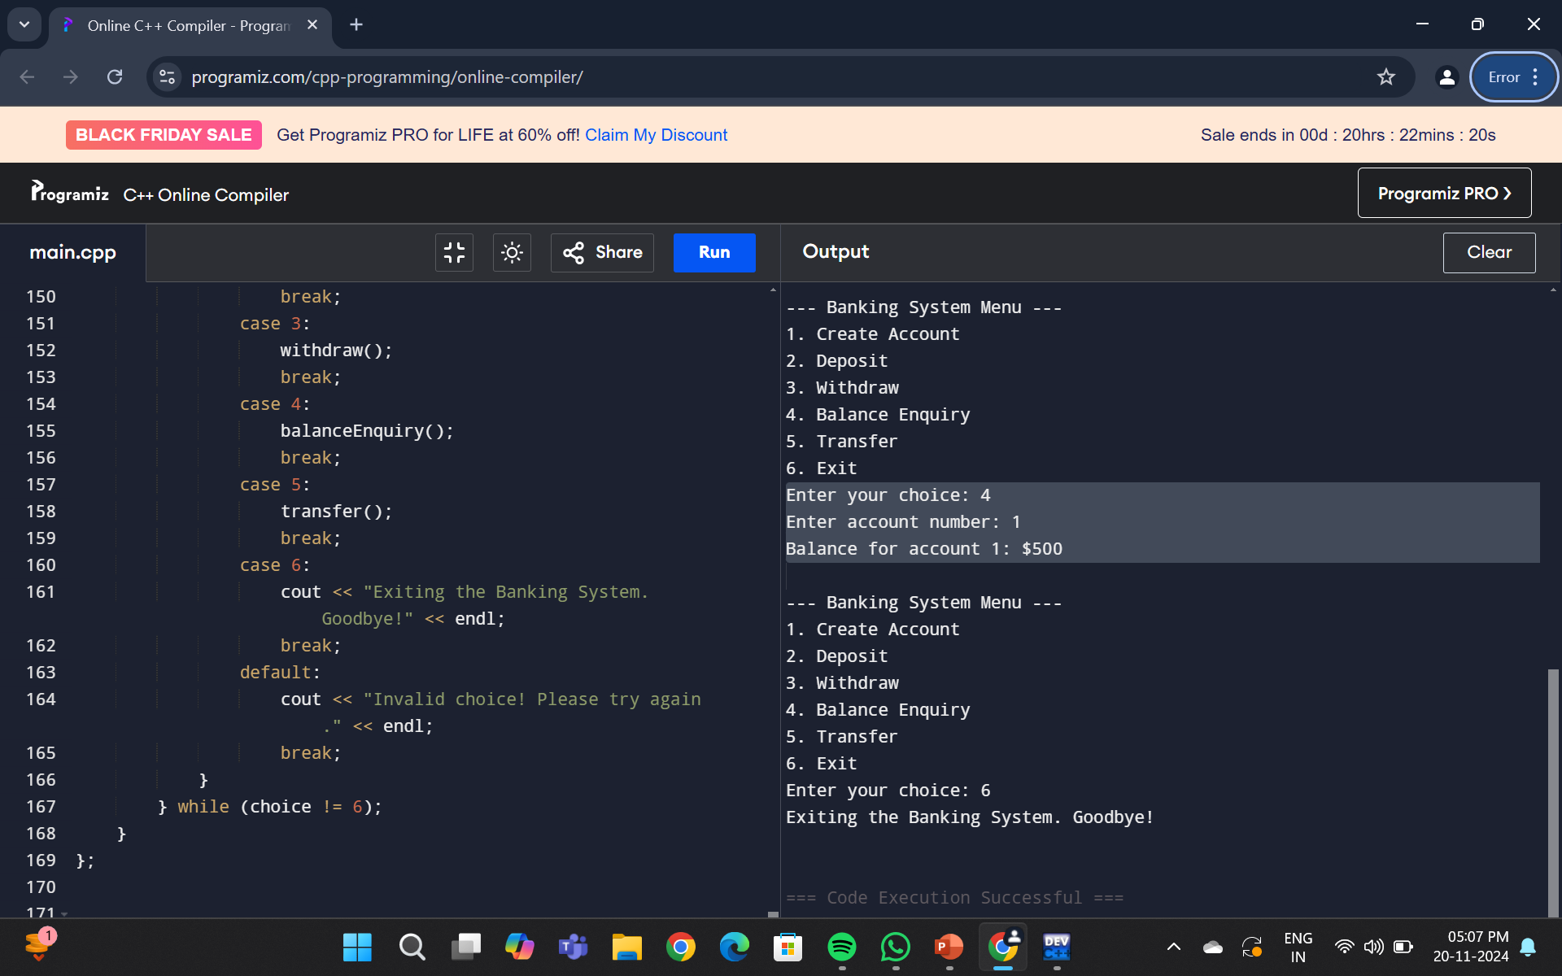

Slide 17
CONCLUSION
The Banking System developed in the provided code effectively addresses fundamental functionalities essential for managing train few banking sector services. Through its structured design utilizing classes for users, the system enables a seamless experience for users by allowing them to create accounts , Deposit, book withdraw, Bank enquiry and Transfer as needed.
.

Slide 18
THANK YOU

