Slide 1

PeerLens
Multi-Agent Reflective Review for Research Drafts
AD23731 – Foundations of Agentic AI · Mini Project
Done by
Submitted to
1. Gunavazhagan B 231501055
2. Jevanandham S 231501069
3. Nimal M G 231501110
Dr.M.Soundarya

Slide 2
PeerLens · Mini Project
Problem Statement
▪ Feedback comes too late – students get detailed criticism only at the final review or from conference reviewers
▪ Self-review misses blind spots – the author is the person least able to see their own mistakes
▪ Single-prompt AI reviews are generic – one pass mixes everything, cannot check literature and does not involve the author
Our goal
Give every author a small, on-demand AI review panel that finds real problems, shows evidence for each one, and lets the author decide – before submission.
2

Slide 3
PeerLens · Mini Project
Objectives
▪ Build a multi-agent review panel – rigor, clarity and novelty reviewers with a meta-reviewer, using LangGraph
▪ Implement agentic RAG – compare it with No-RAG and Basic RAG baselines
▪ Ground every finding – each issue quotes the paper with a page and section
▪ Keep the human in the loop – accept or dispute every issue before the report
▪ Store memory – papers, reviews, decisions and revised versions
▪ Evaluate end to end – across retrieval modes and different Gemini models
3

Slide 4
PeerLens · Mini Project
Proposed Solution – The Agent Panel
Rigor Reviewer
Clarity Reviewer
Novelty Reviewer
Methods, statistics, formulas, data leakage
Terminology, structure, contradictions
Compares claims with arXiv literature (3 modes)
Meta-Reviewer
Reconsideration Agent
Solution Generator
Merges duplicates, finds conflicts, requests re-review
Re-examines issues the author disputes
Three-step fix plan for each issue in the report
4

Slide 5
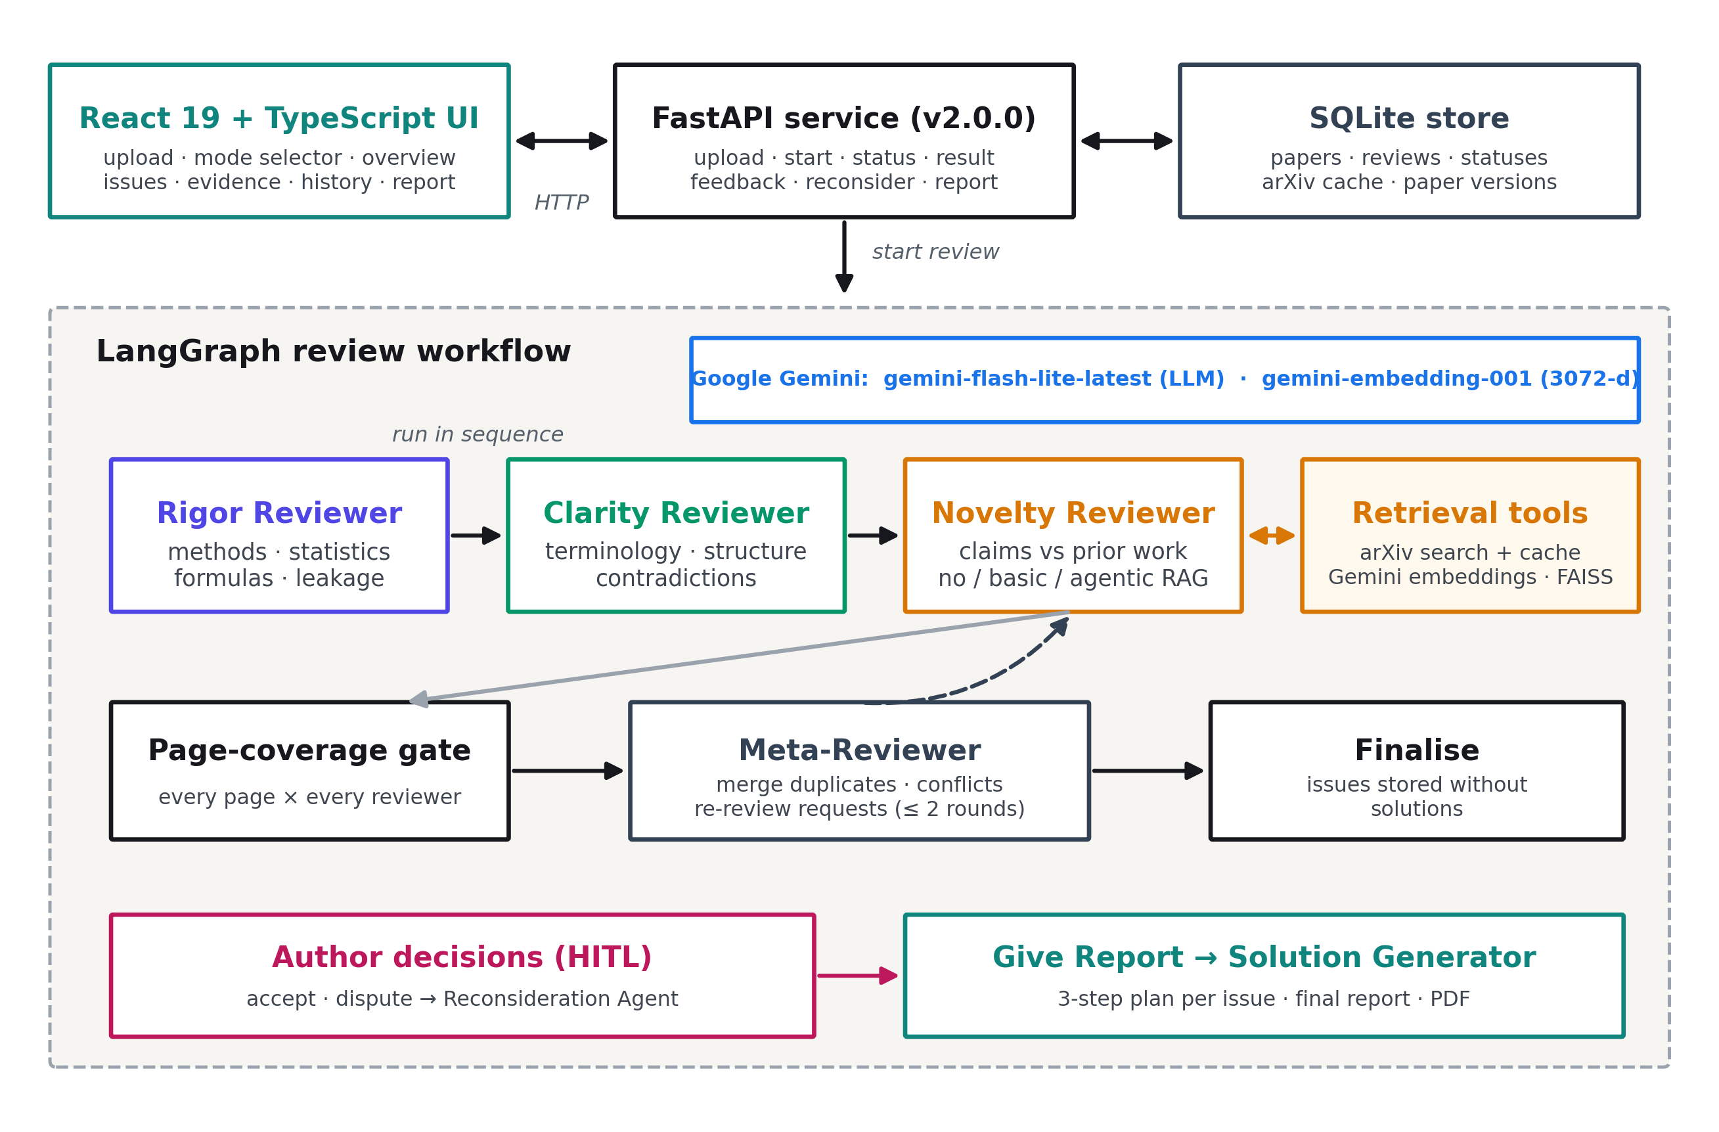
PeerLens · Mini Project
System Architecture
5

Slide 6
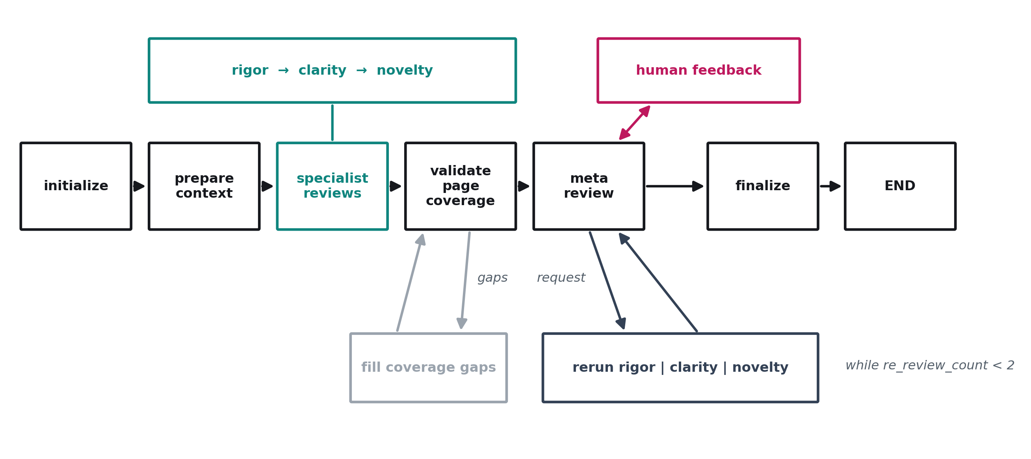
PeerLens · Mini Project
Agent Workflow (LangGraph)
Specialists review in sequence → page-coverage gate → meta-review → optional re-review (max 2) → final review
6

Slide 7
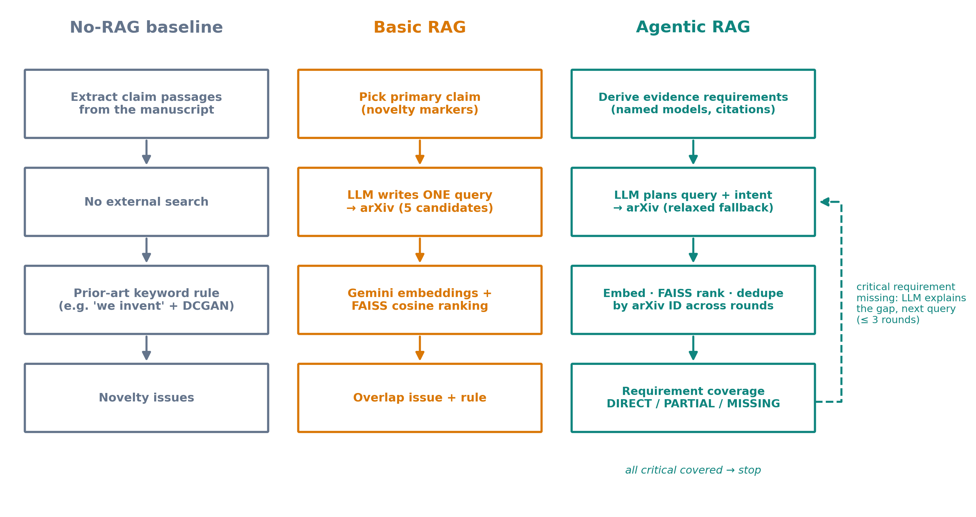
PeerLens · Mini Project
Agentic RAG vs Baselines
▪ arXiv search – with local cache
▪ Gemini embeddings – 3,072-d vectors
▪ FAISS ranking – cosine similarity
▪ Agentic loop – plans queries, tracks missing evidence, up to 3 rounds
7

Slide 8
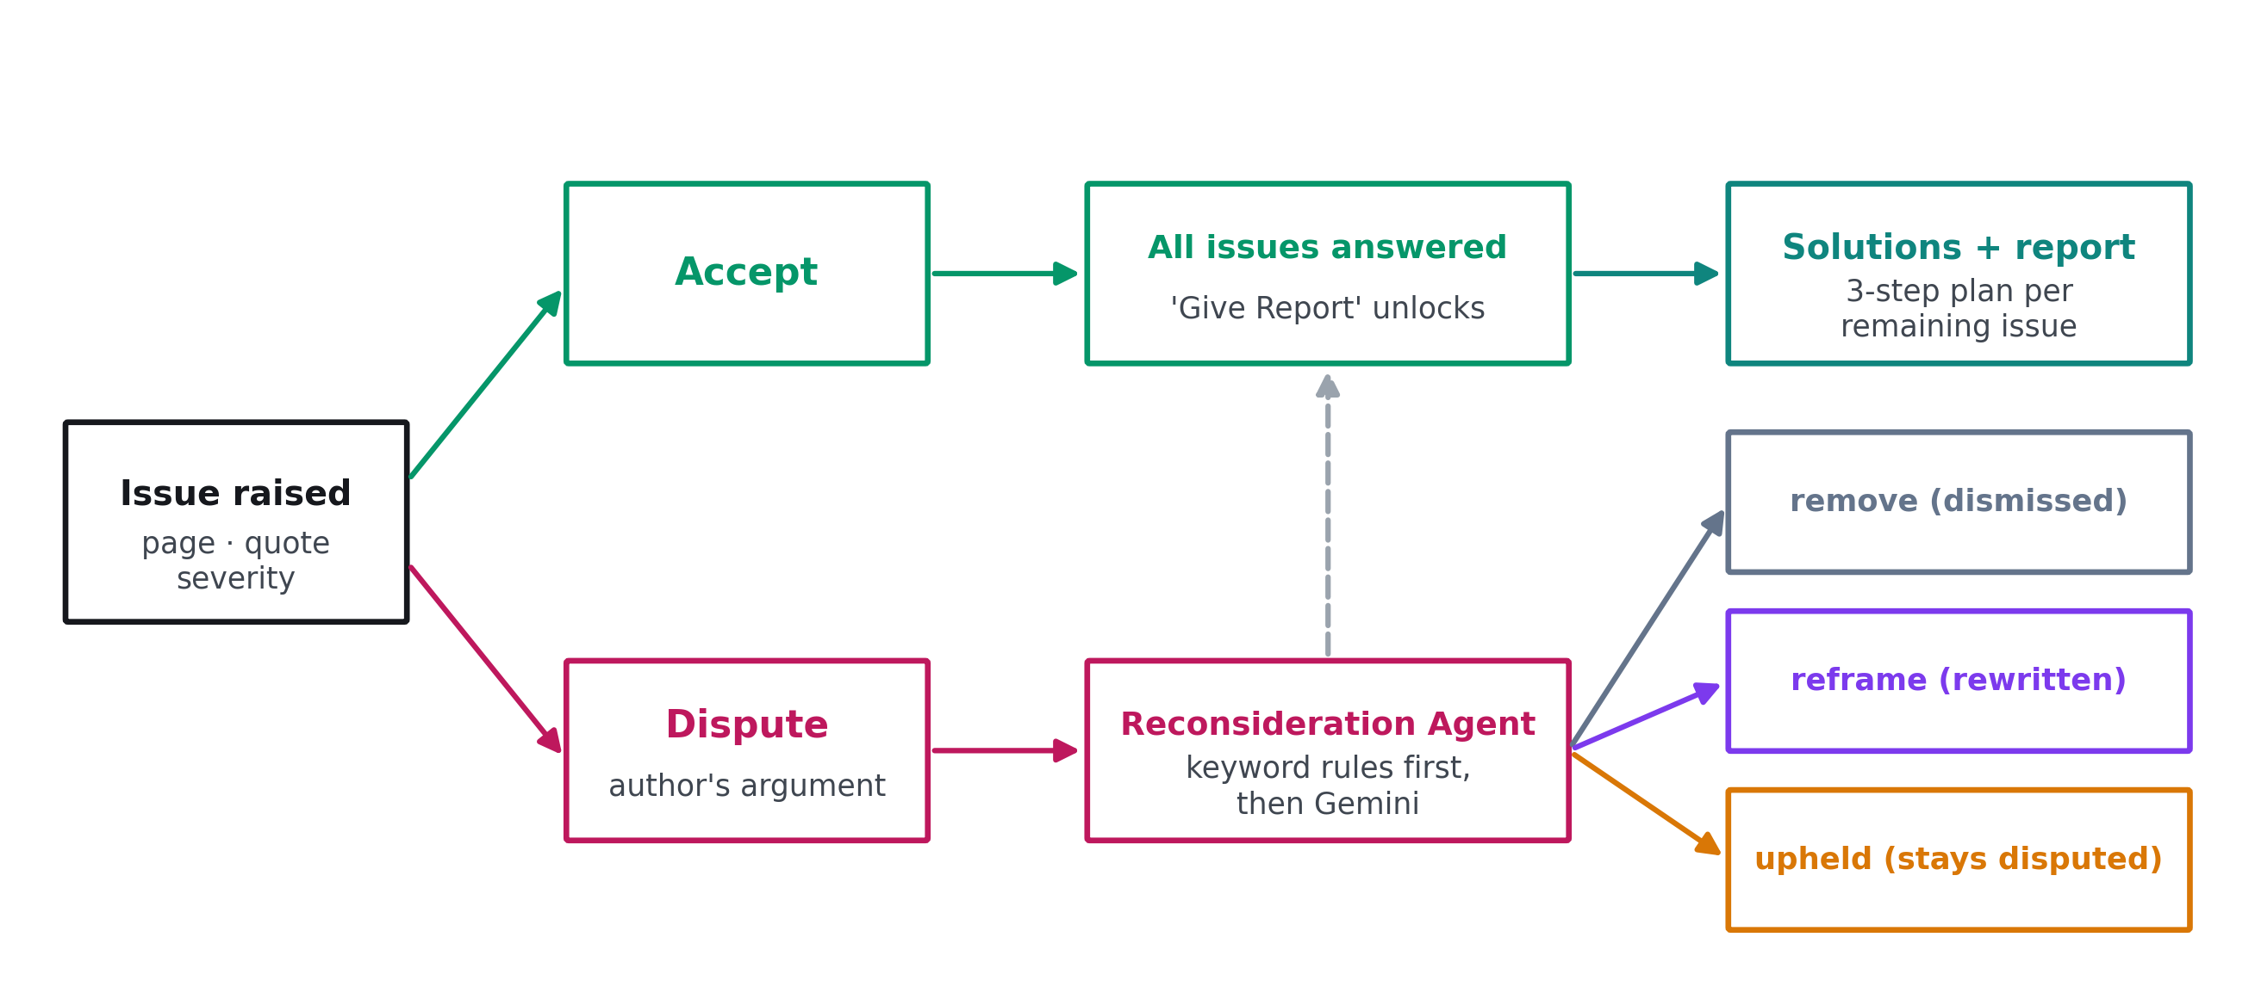
PeerLens · Mini Project
Human-in-the-Loop
The final report unlocks only after the author has answered every issue
8

Slide 9
PeerLens · Mini Project
Tools and Technologies
Agents
LLM
Retrieval
LangGraph · LangChain
Google Gemini (Flash-Lite)
arXiv API · Gemini embeddings · FAISS
Backend
Storage
Frontend
Python · FastAPI · Pydantic
SQLite
React 19 · TypeScript · Tailwind · Vite
9

Slide 10
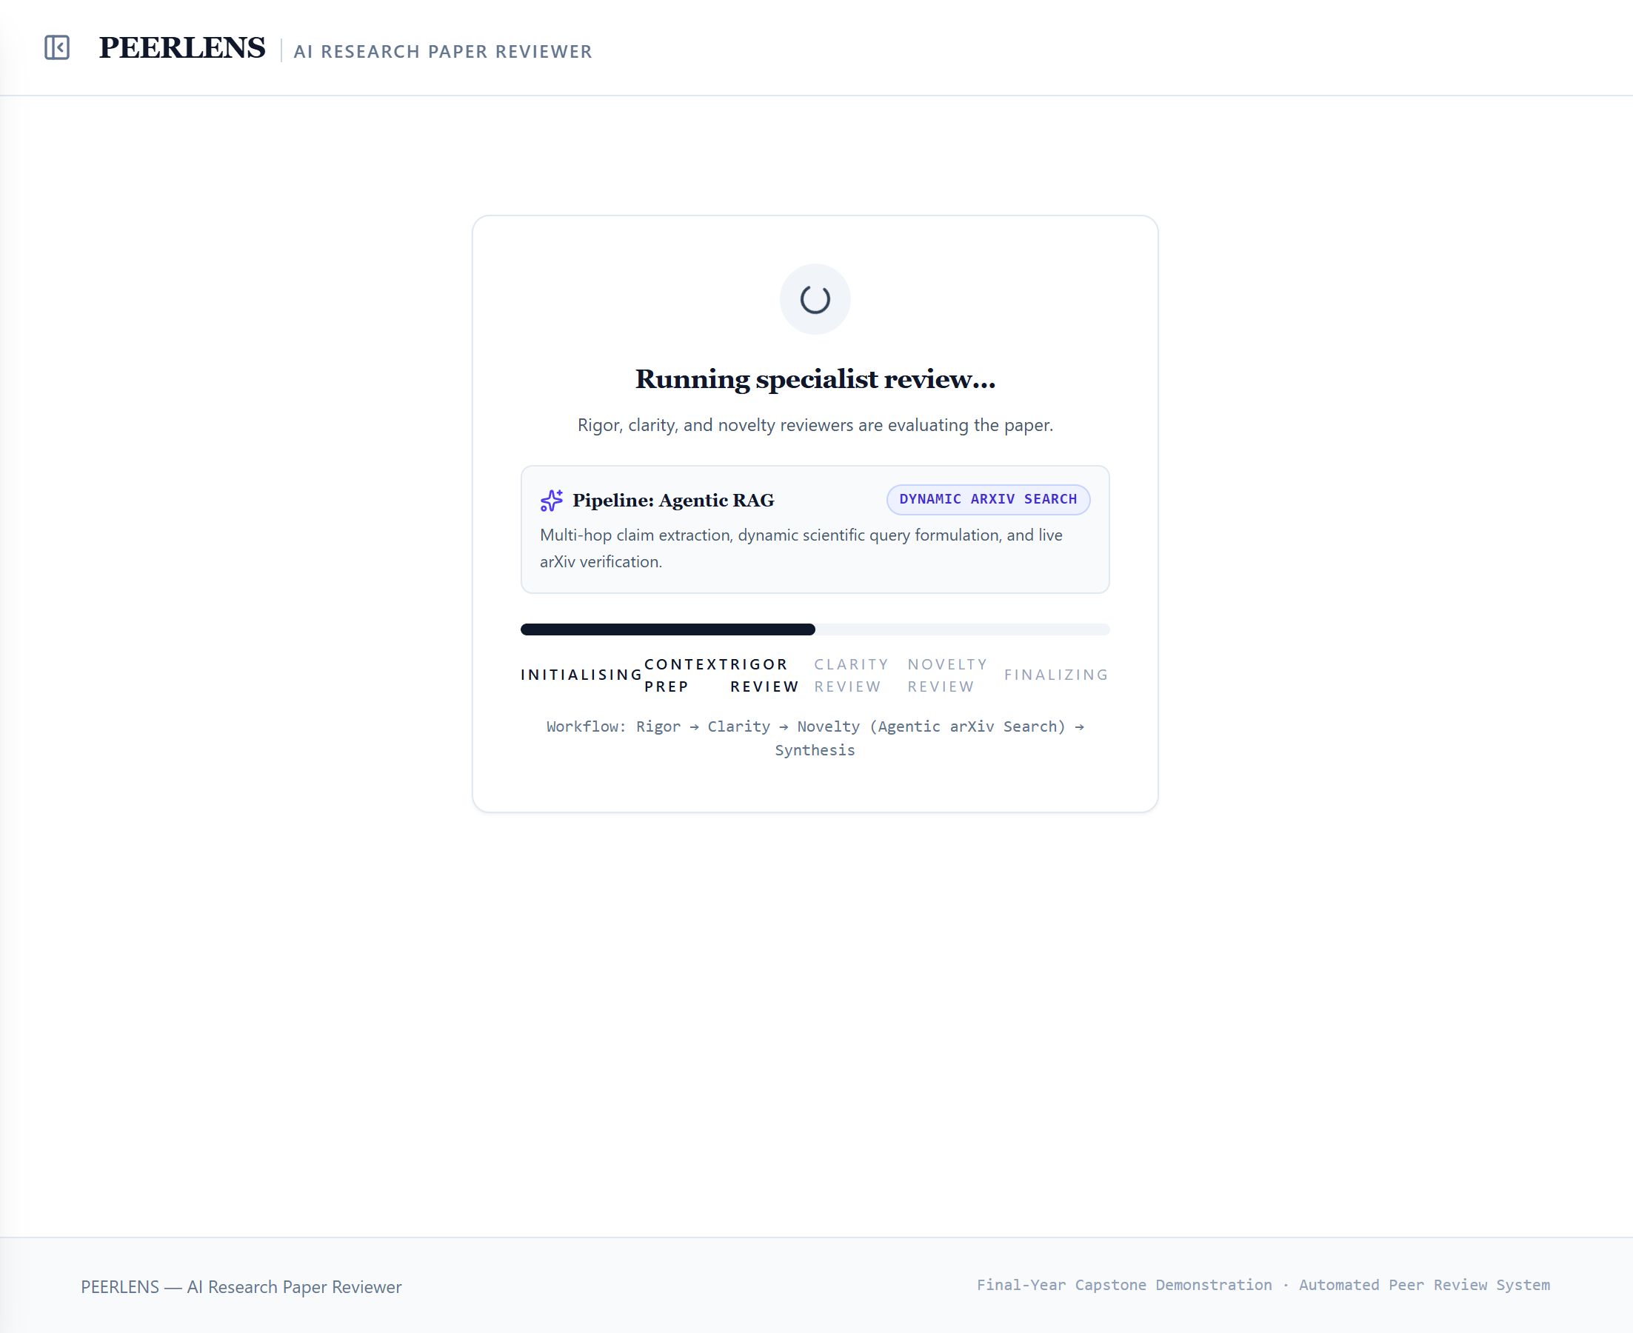
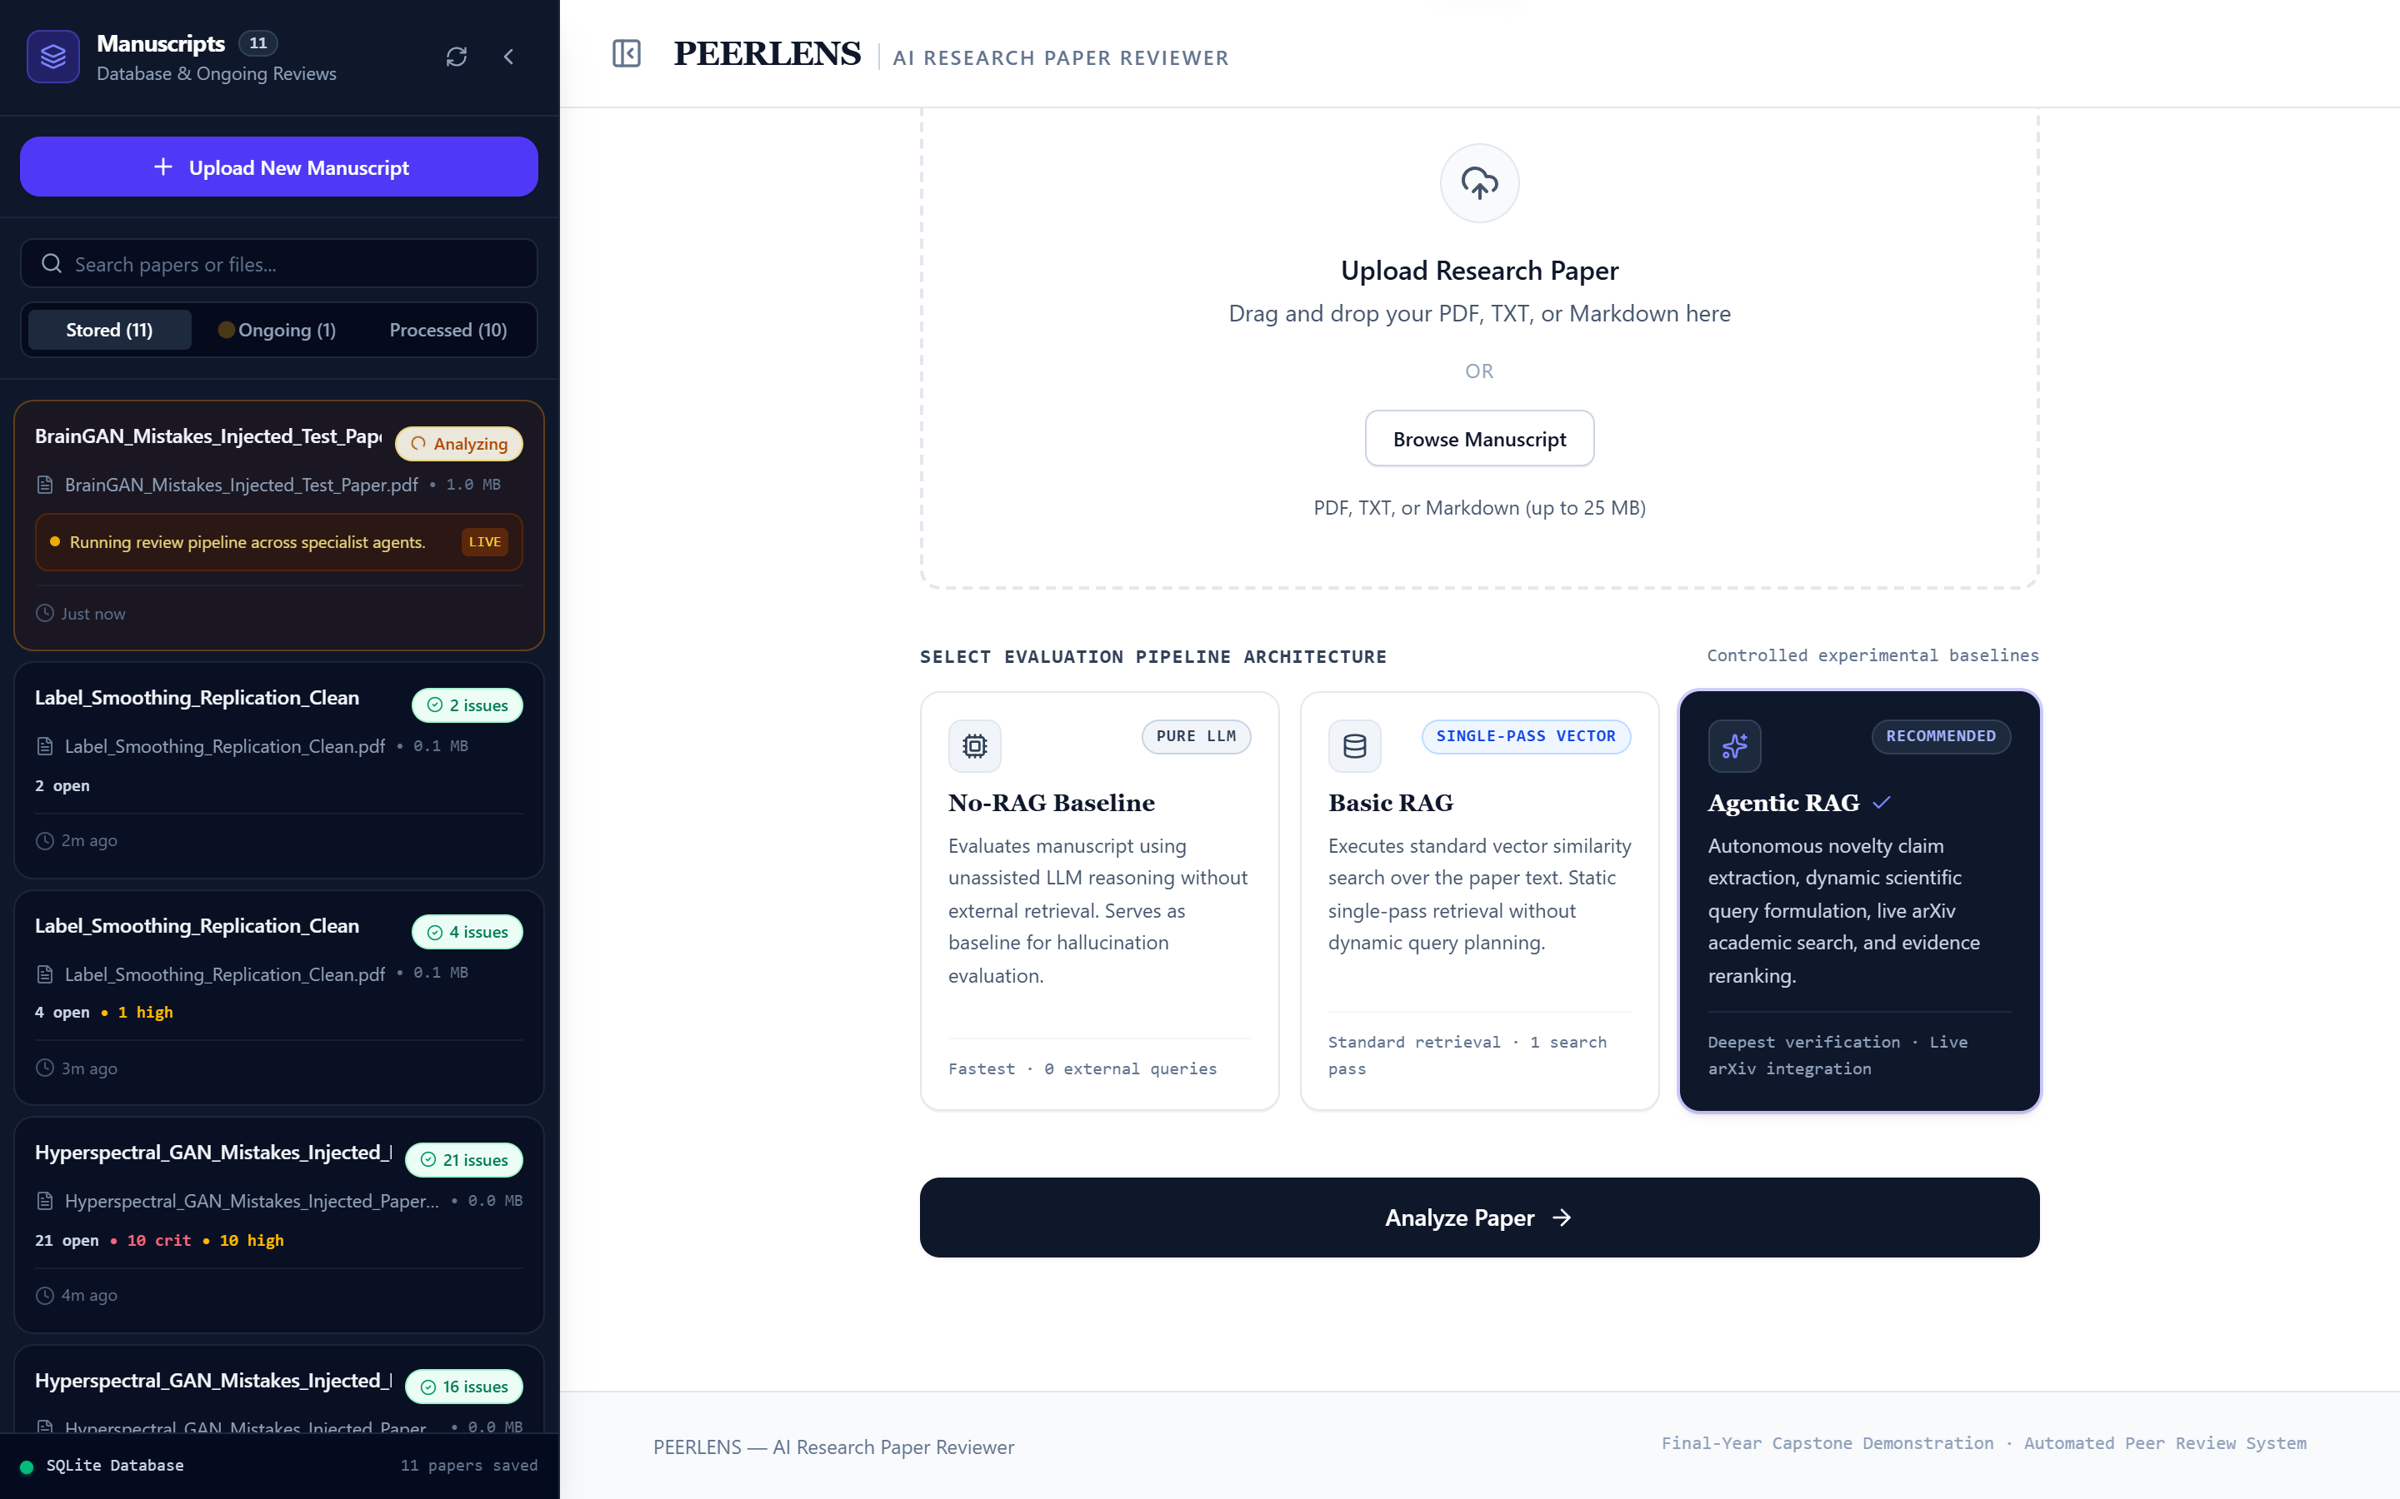
PeerLens · Mini Project
Output – Upload and Live Analysis
Upload a paper and choose the review mode
Reviewers run while progress is shown
10

Slide 11
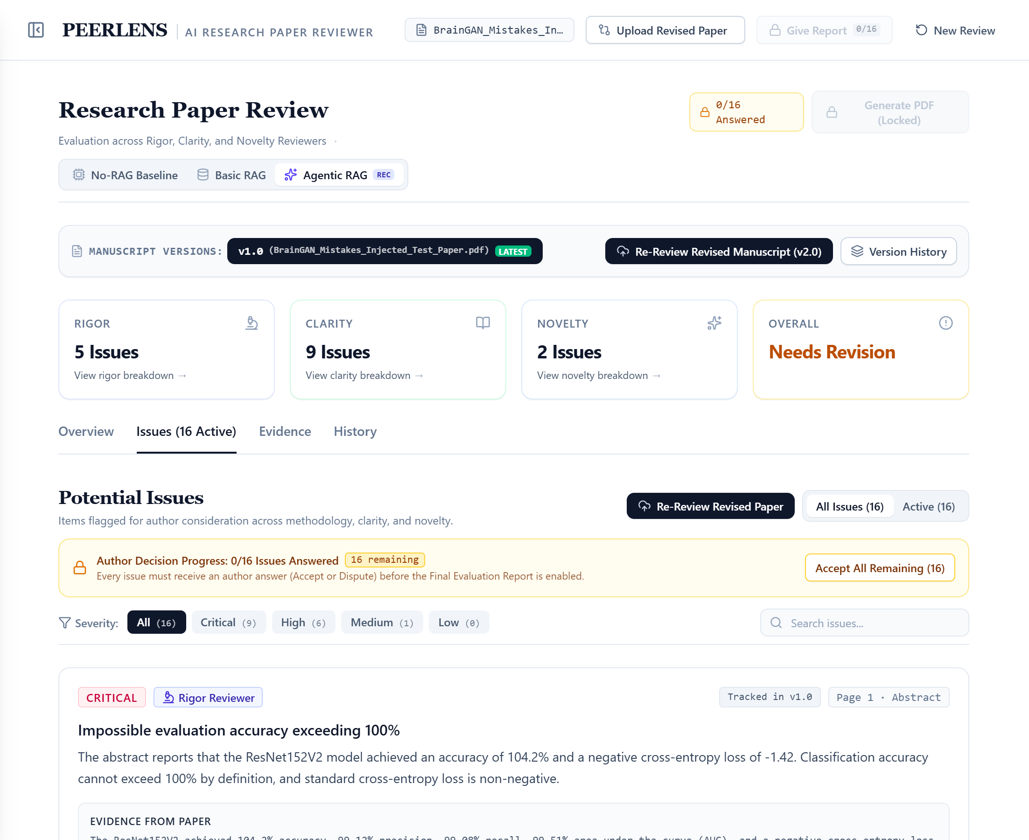
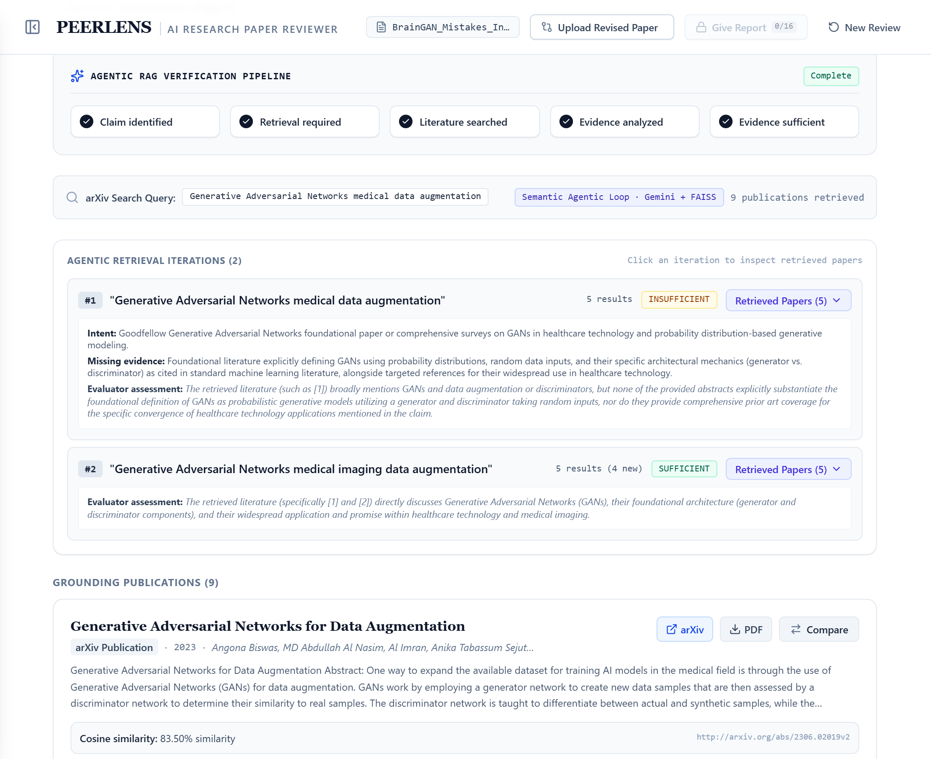
PeerLens · Mini Project
Output – Issues and Evidence
Issues with severity, page and quoted evidence
Agentic RAG rounds with retrieved papers
11

Slide 12
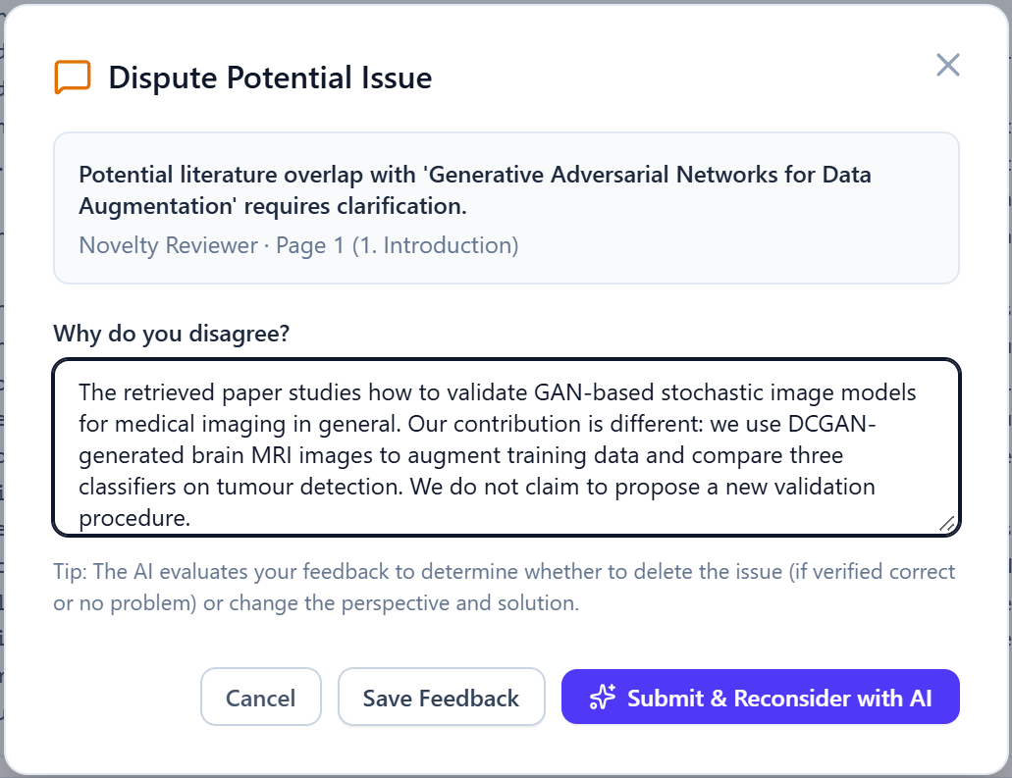
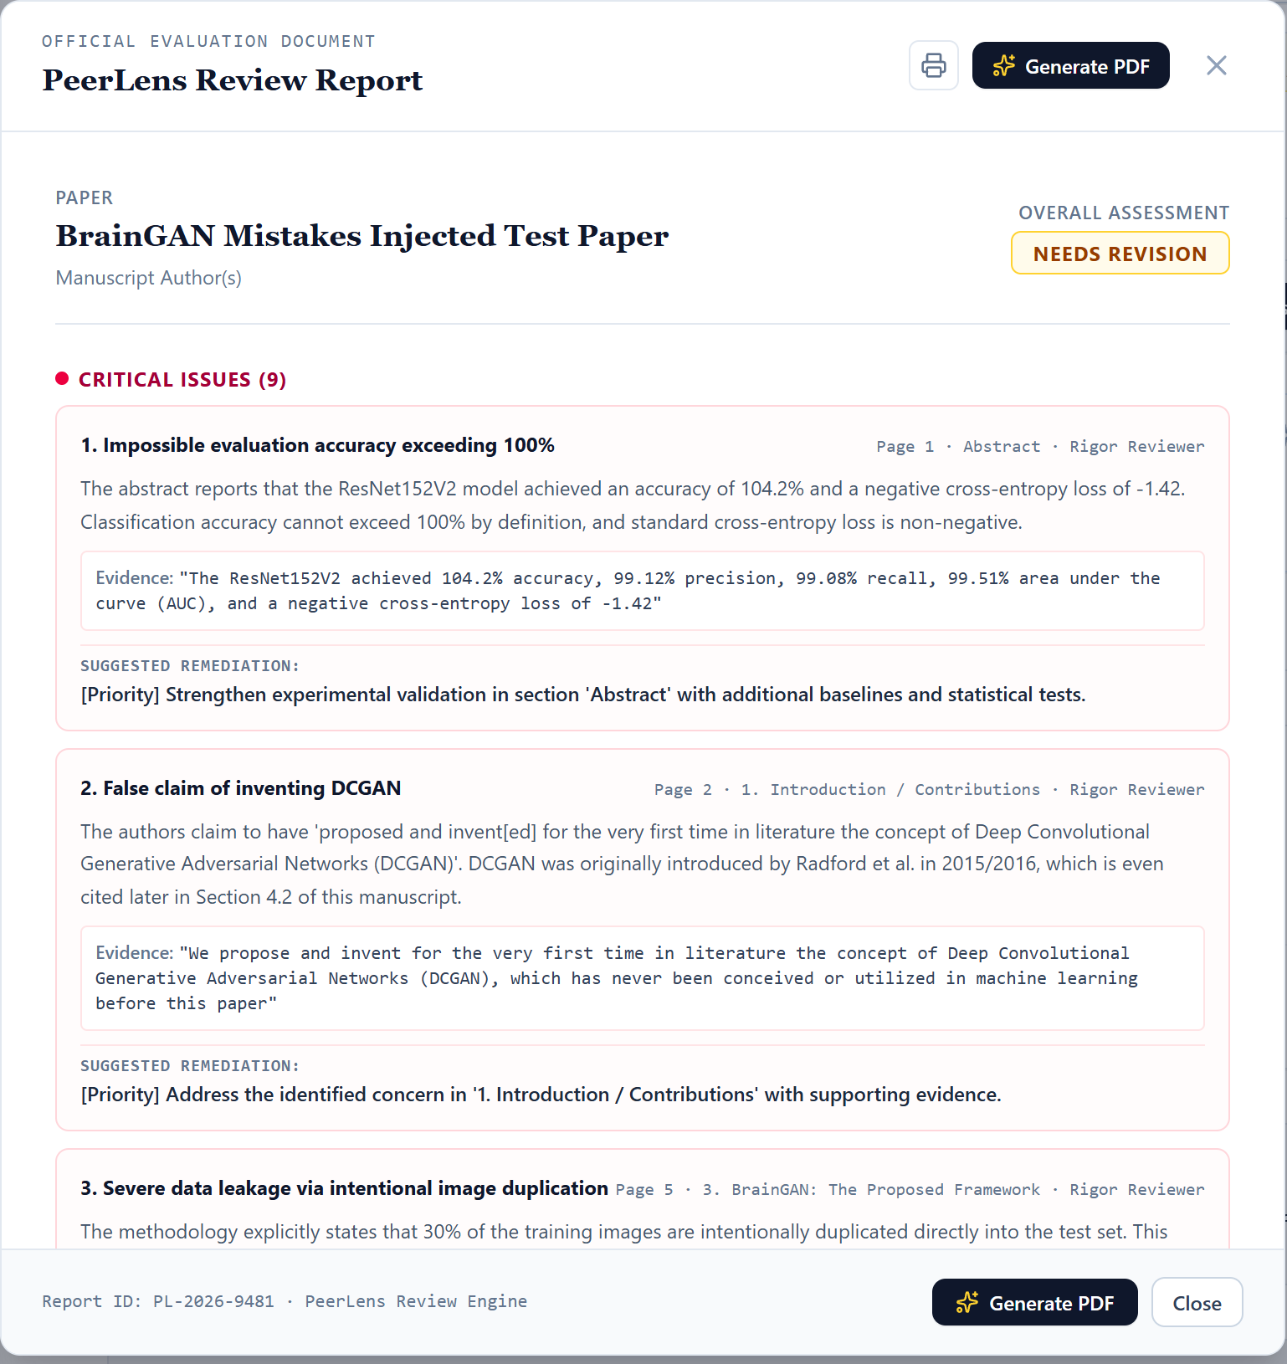
PeerLens · Mini Project
Output – Dispute and Final Report
Author disputes an issue with an argument
Generated review report with remediation
12

Slide 13
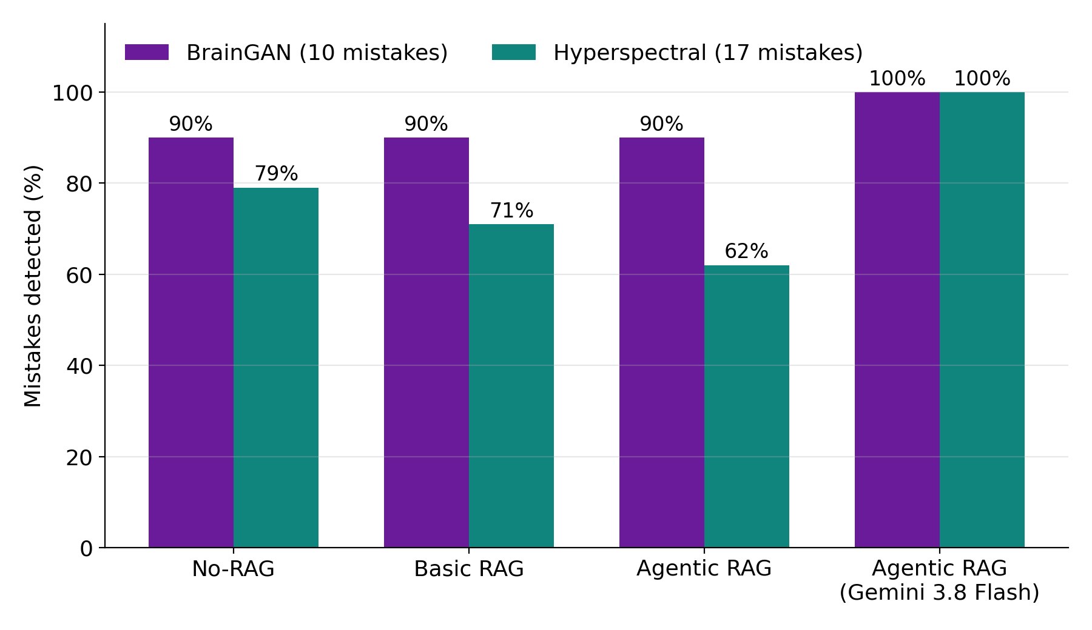
PeerLens · Mini Project
Results
9 / 10
BrainGAN mistakes found in every run
≈ 12 / 17
Hyperspectral mistakes (default model)
17 / 17
found by Gemini 3.8 Flash
175 / 175
automated tests passing
13

Slide 14
PeerLens · Mini Project
Conclusion and Future Work
Conclusion
Future Work
▪ Working multi-agent review system with a web interface
▪ Finds most injected mistakes, each backed by a quote
▪ Three retrieval modes compared, Agentic RAG fully traceable
▪ Author stays in control of every finding
▪ More reviewer agents (ethics, statistics, style)
▪ Wider literature search beyond arXiv
▪ Supervisor and team workspace
▪ Word / LaTeX support and regional languages
▪ Integration with college submission workflow
14

Slide 15
PeerLens · Mini Project
Thank You
15

