Slide 1
Wrapper Classes

Slide 2
In Java, wrapper classes are used to convert primitive data types into objects (also known as reference types) and provide utility methods to work with them. Wrapper classes are part of the Java standard library and are used to represent and manipulate primitive data types in an object-oriented way.
Why Wrapper Classes?
Basically, generic classes only work with objects and don’t support primitives.
As a result, if we want to work with them, we have to convert primitive values into wrapper objects.

Slide 3
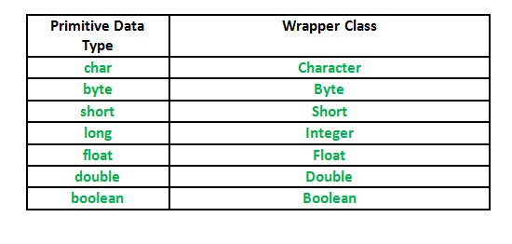

Slide 4
Autoboxing and Unboxing
“Boxing” refers to converting a primitive value into a corresponding wrapper object. Because this can happen automatically, it’s known as autoboxing.
//Converting int into Integer
int a=20;
Integer i=Integer.valueOf(a);//Boxing: converting int into Integer explicitly
Integer j=a;//autoboxing, now compiler will write Integer.valueOf(a) internally
The automatic conversion of primitive data type into its corresponding wrapper class is known as autoboxing, for example, byte to Byte, char to Character, int to Integer, long to Long, float to Float, boolean to Boolean, double to Double, and short to Short.
Since Java 5, we do not need to use the valueOf() method of wrapper classes to convert the primitive into objects.

Slide 5
AutoUnBoxing
The automatic conversion of primitive data type into its corresponding wrapper class is known as autoboxing, for example, byte to Byte, char to Character, int to Integer, long to Long, float to Float, boolean to Boolean, double to Double, and short to Short.
Integer a=new Integer(3);
int i=a.intValue();//unboxing,converting Integer to int explicitly
int j=a;//autounboxing, now compiler will write a.intValue() internally
It is the reverse process of autoboxing.
Since Java 5, we do not need to use the intValue() method of wrapper classes to convert the wrapper type into primitives.

Slide 6
String
the String class is a fundamental class that represents a sequence of characters. It is part of the Java Standard Library
String is a sequence of characters. But in Java, string is an object that represents a sequence of characters. The java.lang.String class is used to create a string object.Strings are immutable in nature
There are two ways to create String object:
By string literal
String s="welcome";
By new keyword
String s1=new String(“Testing”);

Slide 7
String Pool
String Pool in Java is a special storage space in Java Heap memory where string literals are stored.
It is also known by the names - String Constant Pool or String Intern Pool.
Whenever a string literal is created, the JVM first checks the String Constant Pool before creating a new String object corresponding to it.

Slide 8
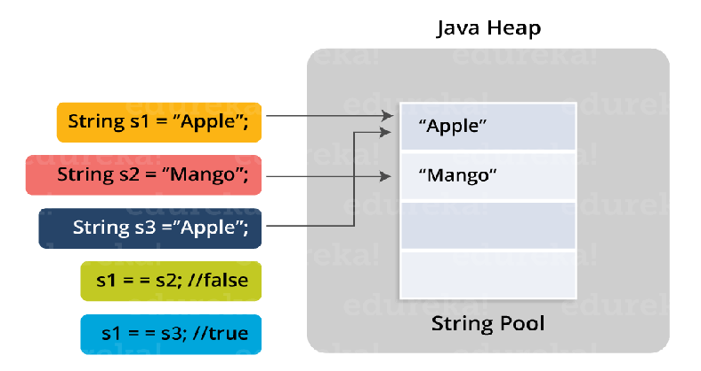
String Pool

Slide 9
String.intern() method
Creating strings using the new keyword allocates memory to the string object in the heap but outside the string constant pool.
When we use the String.intern() method, JVM puts the string literal in the String Pool (if not already present), and its reference is stored in the variable.
However, if the String Constant Pool already contains a string equal to the String object to be created, its reference is returned.
String str = "Java";
String str1 = new String("Java").intern();

Slide 10
String Buffer
StringBuffer is a peer class of String that provides much of the functionality of strings.
The string represents fixed-length, immutable character sequences while StringBuffer represents growable and writable character sequences.
StringBuffer may have characters and substrings inserted in the middle or appended to the end.
StringBuffer str = new StringBuffer("Hello");
StringBuffer is synchronized i.e. thread safe. It means two threads can't call the methods of StringBuffer simultaneously.

Slide 11
StringBuilder
Similar to StringBuffer, the StringBuilder in Java represents a mutable sequence of characters.
The function of StringBuilder is very much similar to the StringBuffer class, as both of them provide an alternative to String Class by making a mutable sequence of characters.
StringBuilder str = new StringBuilder();
StringBuilder is non-synchronized i.e. not thread safe. It means two threads can call the methods of StringBuilder simultaneously.

Slide 12
Enum
An enum is a special "class" that represents a group of constants (unchangeable variables, like final variables).
To create an enum, use the enum keyword (instead of class or interface), and separate the constants with a comma. Note that they should be in uppercase letters:
Why And When To Use Enums?
Use enums when you have values that you know aren't going to change, like month days, days, colors, deck of cards, etc.

Slide 13
Syntax
enum Level {
LOW,
MEDIUM,
HIGH
}
You can access enum constants with the dot syntax:
Level myVar = Level.MEDIUM;
An enum cannot be used to create objects, and it cannot extend other classes (but it can implement interfaces).

