Slide 1
Food_Cleaned_Data
File created on: 6/11/2026 4:03:38 PM

Slide 2
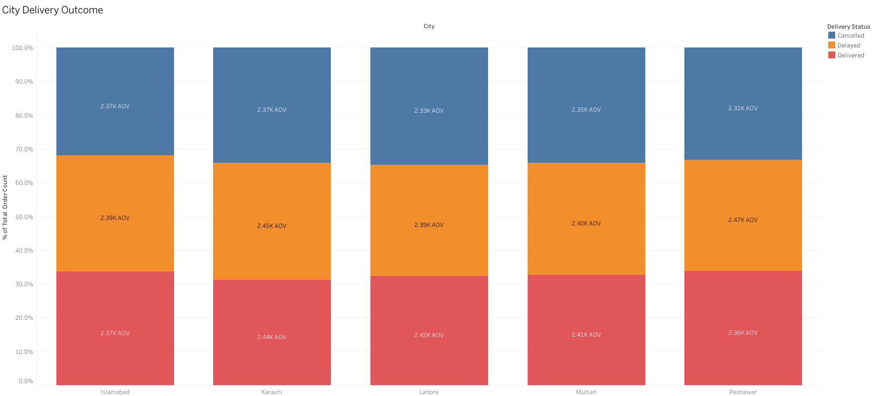

Slide 3
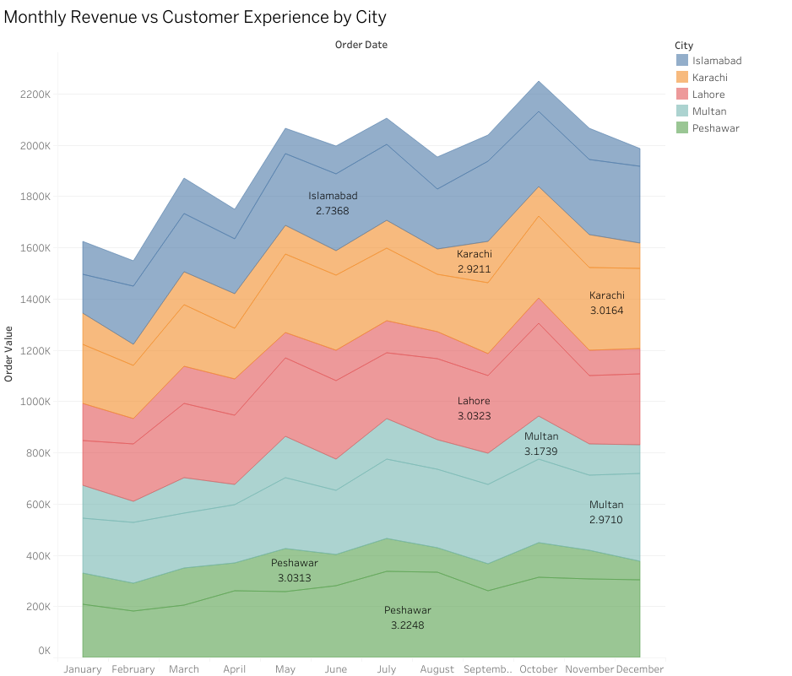

Slide 4
