Slide 1
Food_Price_IND
File created on: 6/11/2026 7:41:57 AM

Slide 2
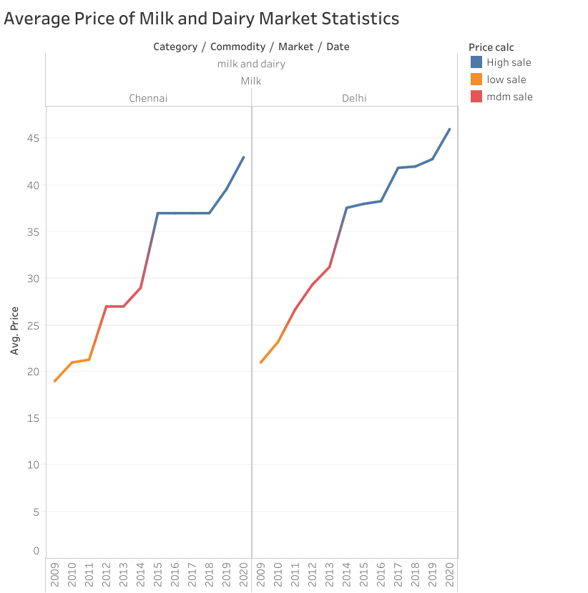

Slide 3
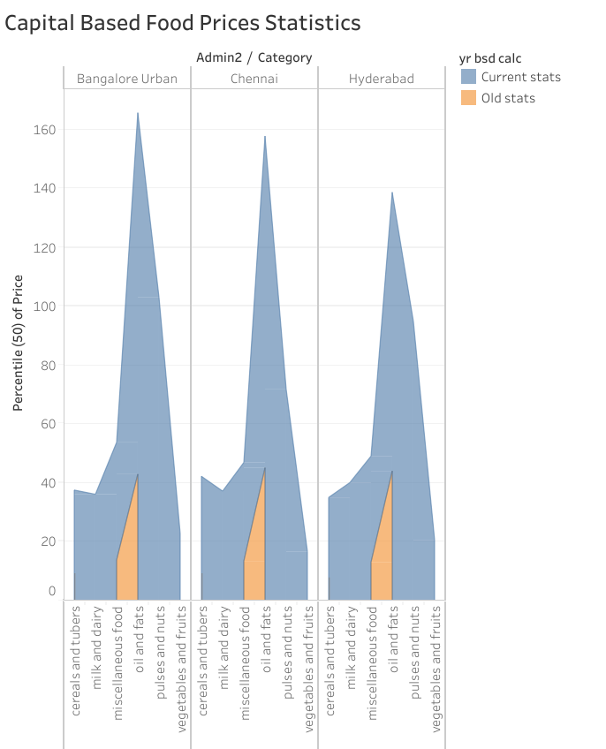

Slide 4
