Slide 1

Team & Project Details
Instructor: Prathusha Ma'am
Team Lead: Gundam Harsha Vardhan Reddy - 2320030157
Team Members:
Bala Karthik Vinay - 2320030144
Gudibanda Sri Vardhan Rao - 2320030141

Slide 2

Cost-of-Living Stress & Affordability Analytics Platform
AI-Powered Financial Insights for Indian Cities
APRIL 2026
FULL-STACK ANALYTICS PROJECT

Slide 3

The Problem: Urban Affordability Is a Blind Spot
No Unified Platform
No single tool combines rent, salary, and cost-of-living data with personalised AI insights for Indian cities.
Raw Data Without Context
Existing tools provide numbers but lack interactivity, city comparisons, and actionable financial guidance.
Our Solution
A full-stack platform with an interactive dashboard, What-If simulator, city comparisons, and an AI chatbot — all in one place.

Slide 4
Project Objectives
Five core goals drive this platform's design.
01
02
03
Interactive Dashboard
Financial Stress Score
City Comparison
Display financial metrics for 50+ Indian cities.
Calculate a Rent-to-Salary ratio to measure affordability at a glance.
Enable side-by-side analysis across all financial parameters.
04
05
What-If Simulator
AI Chatbot
Allow real-time salary and rent adjustments with live metric updates.
Provide personalised, conversational financial guidance via Groq LLM.

Slide 5
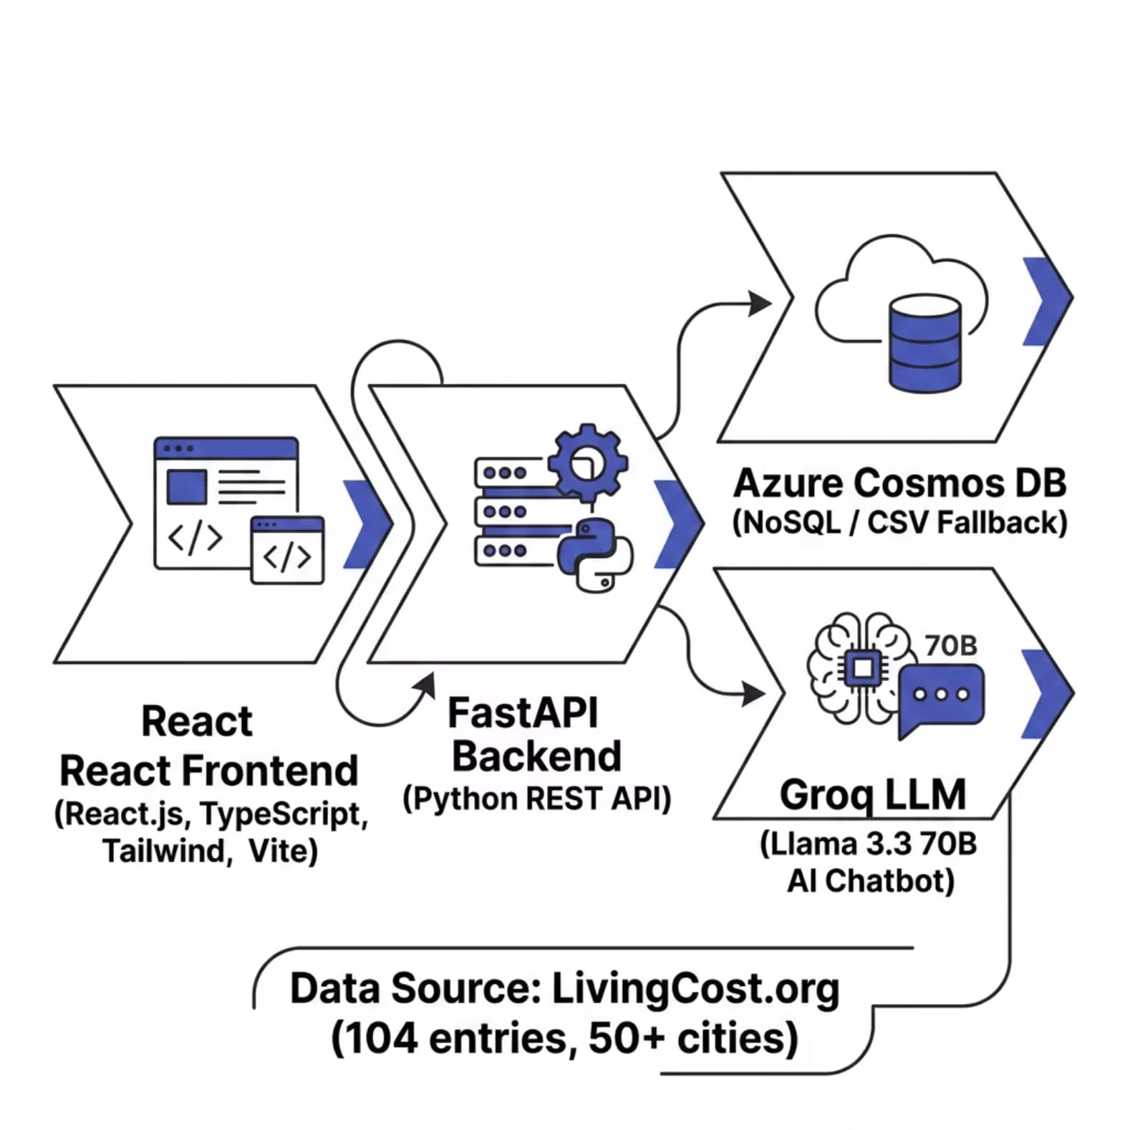

Tech Stack & Architecture
Technology Choices
Frontend
Backend
React.js, TypeScript, Tailwind CSS, Vite
Python, FastAPI
Database
AI / LLM
Azure Cosmos DB (CSV fallback)
Groq API — Llama 3.3 70B
Data Source
LivingCost.org — 104 entries, 50+ cities

Slide 6

Dataset Overview
Source
LivingCost.org — scraped, cleaned, and converted to INR at ₹87.86/USD.
Coverage
104 entries across 50+ Indian cities and states.
Key Fields
Monthly cost of living, 1BHK rent, average salary (after tax), income after rent, and months of salary coverage.

Slide 7

Key Platform Features
Interactive Dashboard
Four metric cards — Cost, Rent, Salary, Disposable Income — plus a live Stress Indicator gauge.
What-If Simulator
Drag sliders to adjust salary (₹10K–₹3L) and rent (₹5K–₹1L). All metrics update instantly.
City Comparison
Side-by-side table comparing two cities across all financial parameters for informed decisions.
AI Chatbot
Context-aware, multi-turn Groq LLM chatbot using real dataset values — not AI guesses.

Slide 8
Financial Stress Score & Key Findings
Stress Score Formula
Key Findings
Stress Score = Rent ÷ Salary (after tax)
Most affordable: Agra, Varanasi, and Meerut — low rent with decent salaries.
Most expensive: Mumbai — rent ₹35,233 vs salary ₹19,506, resulting in negative savings.
~40% of cities have a stress score above 0.50, signalling widespread affordability pressure.
🟢 Below 0.30
🟡 0.30 – 0.50
Low Stress — Affordable
Moderate — Caution Advised
🔴 Above 0.50
High Stress — Unaffordable

Slide 9
Future Enhancements
The platform roadmap targets deeper intelligence, broader data, and wider accessibility.
Predictive Analytics
1
ML-based rent and salary trend forecasting.
2
User Accounts
Save preferences, favourites, and chat history.
Expanded Data
3
Add food, transport, healthcare, and education costs.
4
Mobile App
React Native for on-the-go access.
Regional Languages
5
Hindi, Telugu, and Tamil chatbot responses.

Slide 10

Conclusion
Full-Stack Platform Delivered
Combines data visualisation with AI for 50+ Indian cities — React, FastAPI, Cosmos DB, and Groq LLM integrated end-to-end.
Actionable Affordability Metric
The Stress Score distils complex financial data into a single, interpretable number for quick decision-making.
Empowered User Planning
The Simulator and City Comparison tools give users real control over relocation decisions before they commit.
Accessible AI Guidance
The chatbot makes data conversational and personal — grounded in real numbers, not generic AI responses.

