Slide 1
NETFLIX CONTENT
ANALYSIS
POWER BI PROJECT
Detailed Project Presentation
Submitted By: Gunda Swapthika
Trainer Name: Mangali Rakesh
Tool Used: Microsoft Power BI
Dataset: Netflix Titles Dataset

Slide 2

1. INTRODUCTION
• Netflix is a popular digital streaming platform that provides movies, television shows, documentaries and other entertainment content.
• The Netflix Titles Dataset contains structured information about titles available on Netflix. Important fields include show_id, title, type, director, cast, country, date_added, release_year, rating, duration, listed_in and description.
• In this project, Microsoft Power BI was used to import, clean, transform, analyze and visualize the dataset.
• The final dashboard converts thousands of records into understandable KPI cards, charts and comparisons. It helps users study content types, genres, ratings, countries and time-based trends.

Slide 3

2. PROJECT OBJECTIVES
• The main objectives of this project were to understand the structure of the Netflix Titles Dataset and prepare it for analysis.
• Identify the total number of titles available in the dataset.
• Compare Movies and TV Shows and understand the content mix.
• Analyze genres, ratings, countries and release-year distribution.
• Study the number of titles added to Netflix during different months.
• Review missing values, duplicate records, inconsistent text and incorrect data types.
• Use Power Query, DAX concepts and Power BI visuals to create a professional dashboard.
• Present the findings in a clear and understandable format.

Slide 4
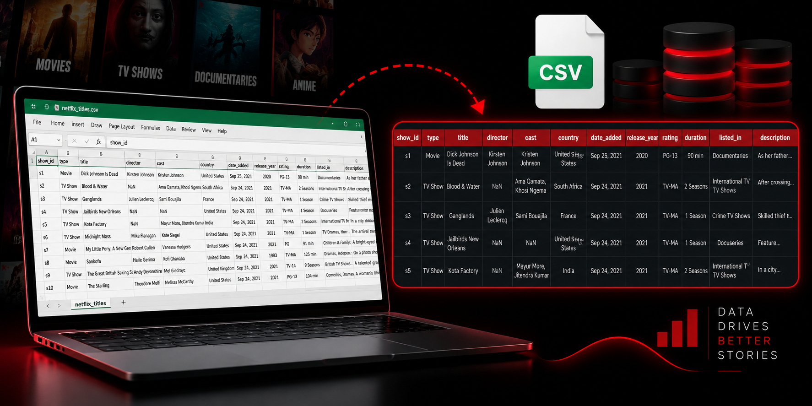
3. DATASET OVERVIEW
• The project uses the Netflix Titles Dataset stored in CSV format. Each row represents one movie or television show, while each column represents an attribute of that title.
• The dataset contains descriptive fields such as title, director, cast and description. It also contains categorical fields such as type, rating and listed_in.
• Country-related fields support country-wise analysis. Time-related fields such as release_year and date_added support trend analysis.
• Because the dataset contains both categorical and time-based information, it is suitable for bar charts, donut charts, treemaps, line charts, area charts, column charts and KPI cards.

Slide 5
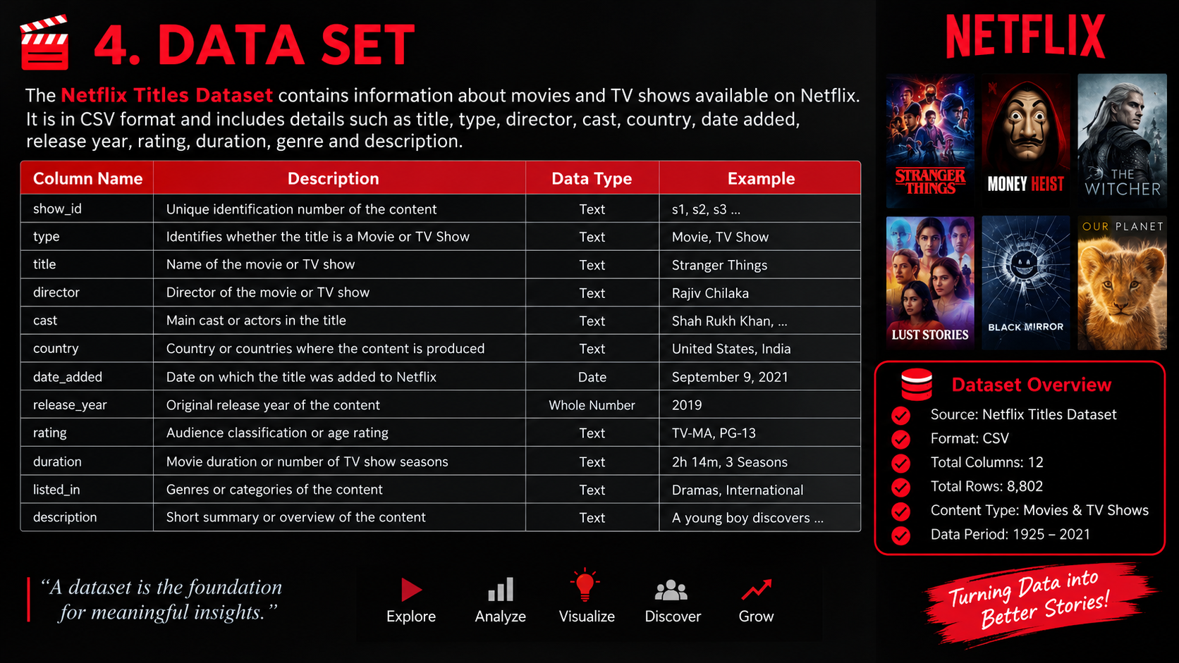
4. DATA SET
• The major dataset columns used in the project are:
• show_id – unique identification number of the title.
• type – identifies whether the title is a Movie or TV Show.
• title – name of the movie or television show.
• director and cast – people connected with the title.
• country – country or countries associated with the content.
• date_added – date on which the title was added to Netflix.
• release_year – original release year.
• rating – audience classification or age rating.
• duration – movie duration or number of TV show seasons.
• listed_in – genres or categories.
• description – short summary of the content.

Slide 6
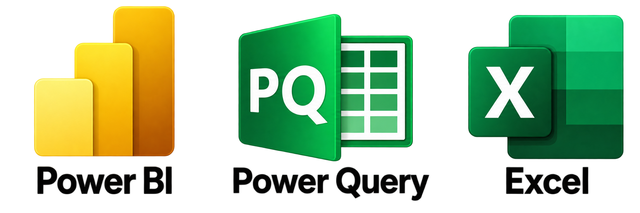
5. TOOLS AND TECHNOLOGIES USED
• Microsoft Power BI Desktop was the main development tool used to import the CSV file, create the data model, build charts, format the report page and present the final dashboard.
• Power Query Editor was used to review columns, inspect missing values, change data types, remove unwanted spaces and prepare the data for analysis.
• DAX, or Data Analysis Expressions, can be used to create calculated columns and measures for totals, counts and summary values.
• The CSV dataset acted as the main source. Microsoft Excel could be used to inspect the source data and validate the structure before importing it into Power BI.
• A computer system was used to develop, save and present the final project.

Slide 7
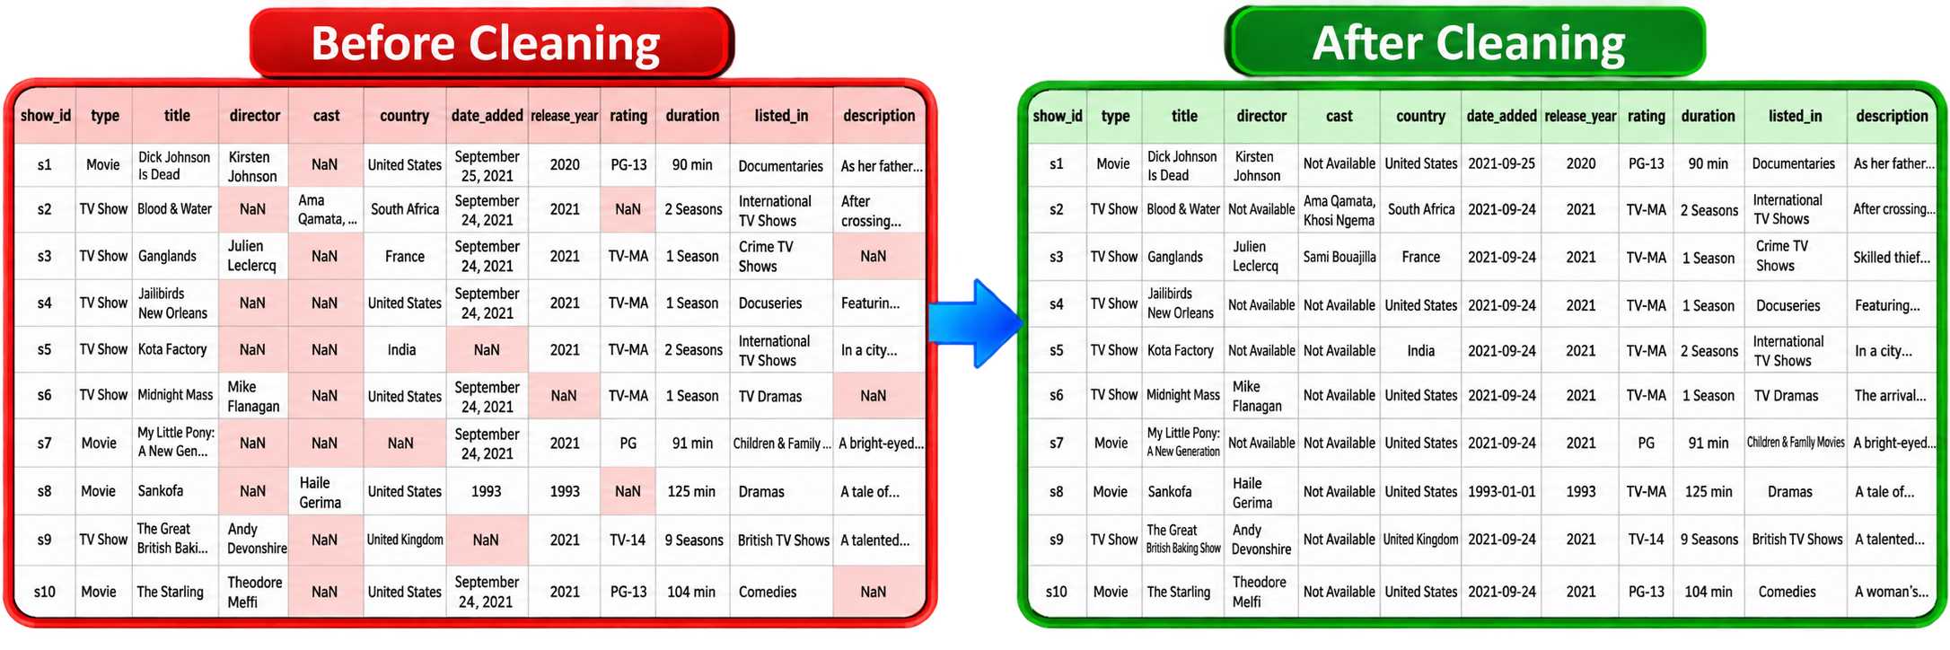
6. DATA CLEANING AND TRANSFORMATION
• Data cleaning prepares raw data for accurate analysis. Raw data may contain missing values, duplicate records, extra spaces, inconsistent text and incorrect data types.
• The Netflix CSV file was imported into Power BI. Column names and data types were reviewed, and missing values in director, cast, country, rating and date_added were checked.
• Duplicate records were reviewed using show_id and title. The release_year and date_added columns were prepared for year and month analysis.
• The listed_in and country columns were reviewed because they may contain multiple values. Unnecessary spaces and inconsistent text values were also checked.
• After cleaning and transformation, the prepared data was loaded into the Power BI data model and used to create charts and the dashboard.

Slide 8
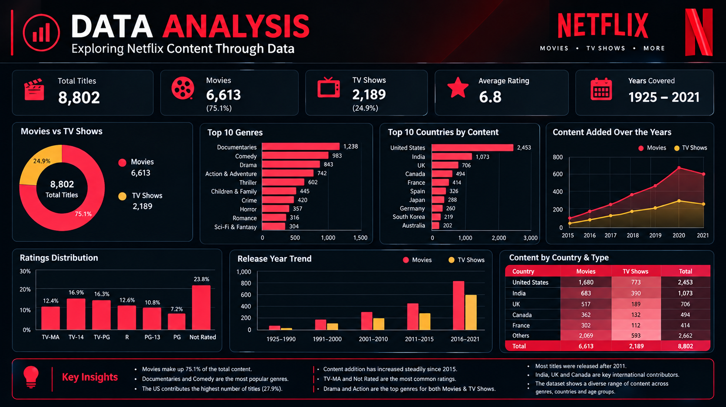
7. DATA ANALYSIS
• After data cleaning and transformation, the dataset was analyzed using Power BI. The analysis focused on content type, genres, ratings, countries, release years and the date on which content was added to Netflix.
• The first analysis compared Movies and TV Shows. A donut chart was used because the size of each section represents the share of each content type.
• Genre analysis identified common categories such as Dramas, International Movies, Documentaries and Stand-Up Comedy.
• Rating analysis studied audience classification, with ratings such as TV-MA and TV-14 visible in the charts.
• Country analysis used a treemap to compare country contribution. Release-year analysis showed the distribution of titles across years.
• Monthly content analysis used date_added to understand variation in titles added during different months.
• All analyses were combined into one dashboard for quick understanding.

Slide 9
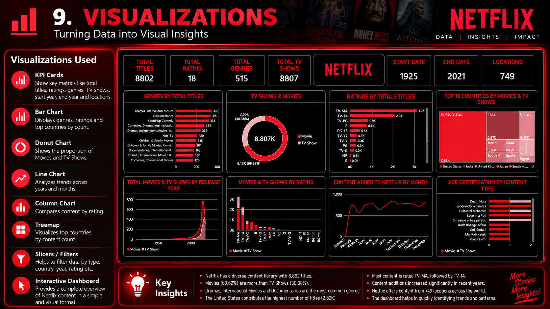
8. VISUALIZATIONS
• Visualizations convert raw data into charts and graphs that are easier to understand. Eight main visualizations were created in this project.
• 1. Genres by Total Titles – bar chart comparing the number of titles across genres.
• 2. TV Shows and Movies – donut chart comparing the two content types.
• 3. Ratings by Total Titles – bar chart showing the number of titles under each rating.
• 4. Top 10 Countries by Movies and TV Shows – treemap comparing country contribution.
• 5. Total Movies and TV Shows by Release Year – area or line chart showing year-wise distribution.
• 6. Movies and TV Shows by Rating – column chart comparing content types under rating categories.
• 7. Content Added to Netflix by Month – line chart showing monthly additions.
• 8. Age Certification by Content Type – bar chart showing audience classification.

Slide 10
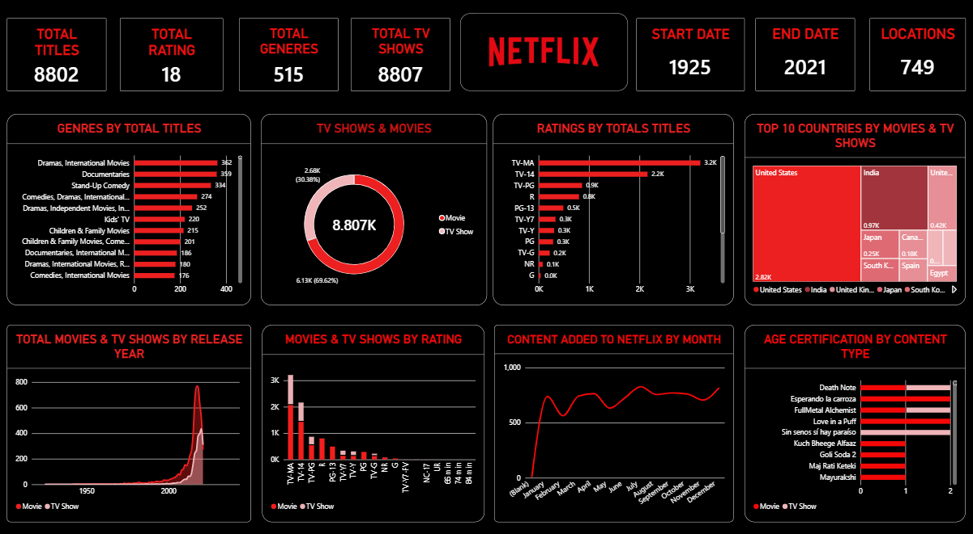
9. POWER BI DASHBOARD

Slide 11
10. KEY INSIGHTS
• The following insights were observed from the KPI cards and charts:
• Movies are more numerous than TV Shows in the displayed comparison.
• The United States contributes the largest number of titles in the Top 10 Countries treemap.
• India is also an important country contributing Netflix content.
• Dramas, International Movies, Documentaries and Stand-Up Comedy are major visible genres.
• TV-MA and TV-14 are among the most common ratings shown.
• Older years contain comparatively fewer titles, while recent years show stronger concentration.
• The number of titles added changes from month to month.
• KPI cards provide a quick summary before detailed analysis begins.

Slide 12
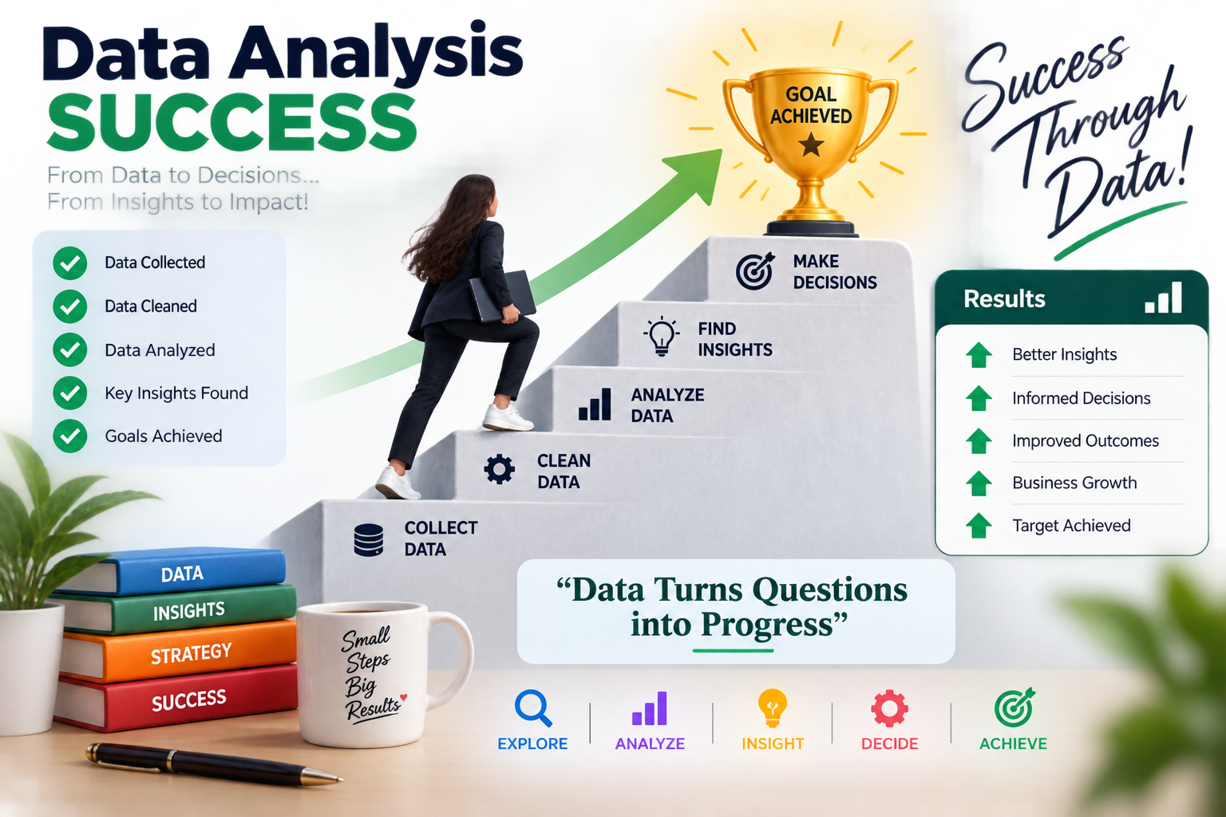
11. CONCLUSION
• This project demonstrates how Microsoft Power BI can be used to analyze a real-world entertainment dataset.
• The Netflix Titles Dataset was imported, reviewed, cleaned, transformed and visualized. Movies and TV Shows were compared, genres and ratings were studied, and country contribution was analyzed.
• Data cleaning was important because missing values, incorrect data types, duplicate records and inconsistent text can affect the accuracy of analysis.
• Power Query helped prepare the data, while KPI cards and charts presented the results in a simple and professional format.
• Overall, the project improved practical knowledge of data preparation, Power Query, DAX concepts, data visualization and dashboard design.

Slide 13
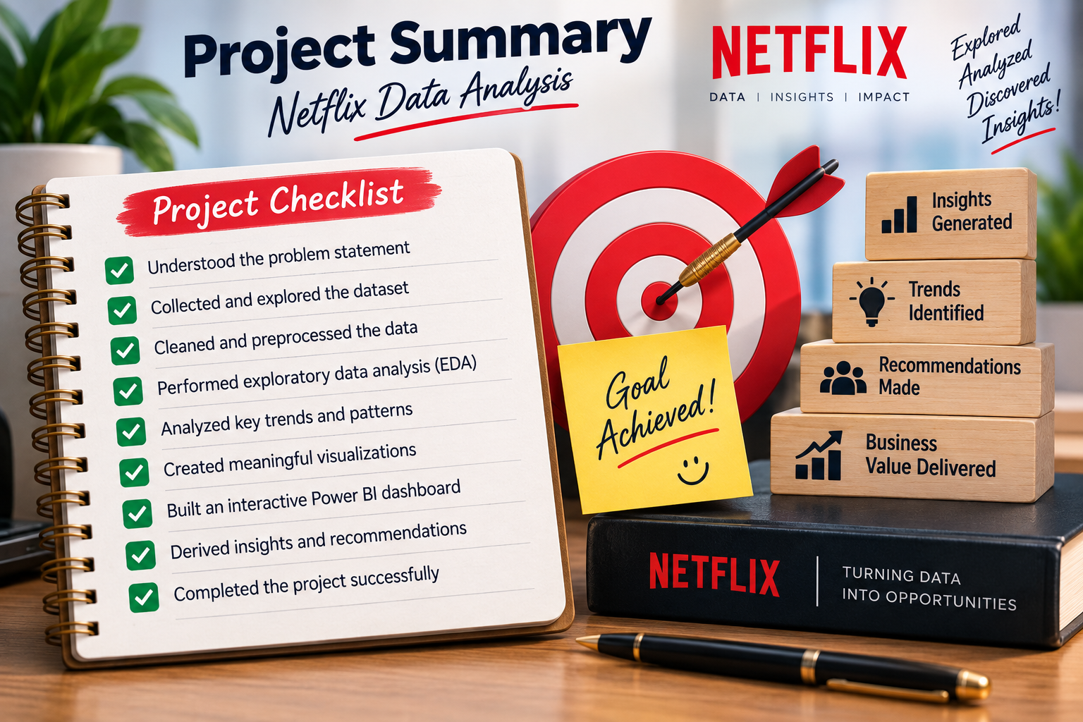
12. PROJECT SUMMARY
• The Netflix Content Analysis project was completed using Microsoft Power BI and the Netflix Titles Dataset.
• Project Title: Netflix Content Analysis
• Tool Used: Microsoft Power BI
• Dataset: Netflix Titles Dataset
• Main Content Types: Movies and TV Shows
• Main Visualizations: Bar chart, donut chart, treemap, area/line chart and column chart
• KPI Cards: Total Titles, Total Rating, Total Genres, Total TV Shows, Start Date, End Date and Locations
• Analysis Areas: Genres, ratings, countries, release years, monthly additions and age certification
• Cleaning Activities: Missing-value review, data-type checking, duplicate review and text/date transformation
• Final Output: Netflix-style Power BI dashboard
• Learning Outcome: Improved knowledge of data cleaning, analysis, visualization and reporting

Slide 14
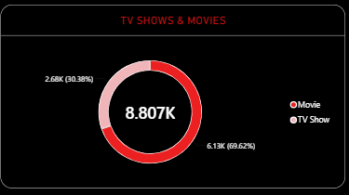
THANK YOU
Questions & Discussion
Netflix Content Analysis

