Slide 1
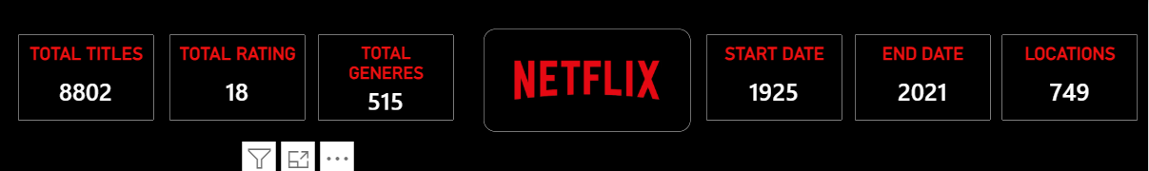
NETFLIX
CONTENT ANALYSIS
POWER BI PROJECT
Dashboard overview
Submitted By: Gunda Swapthika
Trainer Name: Mangali Rakesh
Tool Used: Microsoft Power BI
Dataset: Netflix Titles Dataset
01

Slide 2
AGENDA
A clear story from raw data to dashboard insights
01 Introduction
05 Data Analysis & Visualizations
02 Project Objective
06 Power BI Dashboard
03 Dataset Overview
07 Key Insights
04 Data Cleaning & Transformation
08 Conclusion

Slide 3
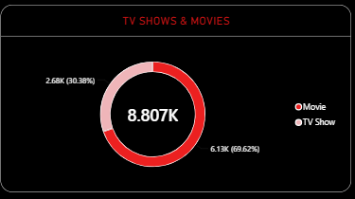
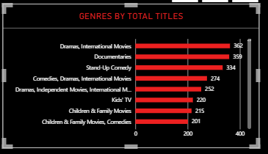
1. INTRODUCTION
Turning Netflix catalog data into an easy-to-understand story
• Netflix provides a large and diverse catalog of movies and TV shows across many countries, ratings and genres.
• This project uses the Netflix Titles dataset to explore the structure and distribution of that catalog.
• Microsoft Power BI is used to prepare, analyze and visualize the data in an interactive dashboard.
• The goal is not only to display numbers, but to identify useful patterns that can be communicated clearly.
• The final dashboard brings the most important measures and comparisons together on one page.
Movies vs TV Shows
Genre analysis

Slide 4
2. PROJECT OBJECTIVE
Questions the analysis is designed to answer
• How much content is represented in the dataset?
• What is the split between Movies and TV Shows?
• Which ratings appear most frequently?
• Which genres or categories have the largest title counts?
• Which countries contribute the most titles?
• How does content vary across release years?
• How can these findings be presented in a professional interactive dashboard?
DATA
→
ANALYSIS
→
VISUALS
→
INSIGHTS

Slide 5
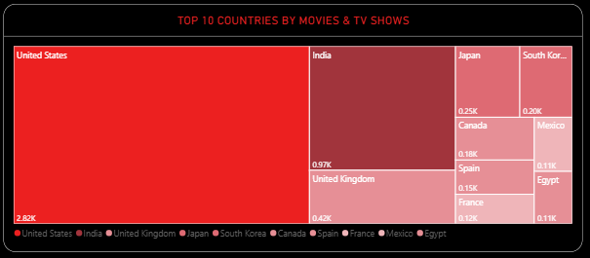
3. DATASET OVERVIEW
Netflix Titles Dataset used for the project
TOTAL RECORDS
8,807
COLUMNS
12
RATINGS
17
COUNTRIES
127
• Core fields include show_id, type, title, director, cast, country, date_added, release_year, rating, duration, listed_in and description.
• The release-year range is 1925 to 2021.
• The dataset contains 6,131 Movies and 2,676 TV Shows.
• The dataset contains both categorical and numeric/date fields, making it suitable for exploratory visual analysis.
Country distribution visual

Slide 6
4. DATA CLEANING & TRANSFORMATION
Preparing the raw data for reliable analysis
Inspect
Checked structure, columns and values.
Validate
Reviewed missing values and data quality.
Prepared visual fields
Transform
Prepared date, numeric and text fields.
Goal
Make the data consistent and analysis-ready.
Split
Prepared multi-value country and genre fields for analysis.
Model
Configured fields for Power BI visuals and measures.

Slide 7
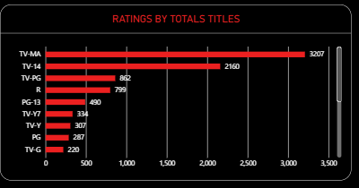
5. DATA ANALYSIS & VISUALIZATIONS
Using different visual types for different analytical questions
CONTENT MIX
GENRES
6,131 Movies 2,676 TV Shows
Compare category title counts
RATINGS
COUNTRIES
Identify the most common ratings
Compare leading country contributions

Slide 8
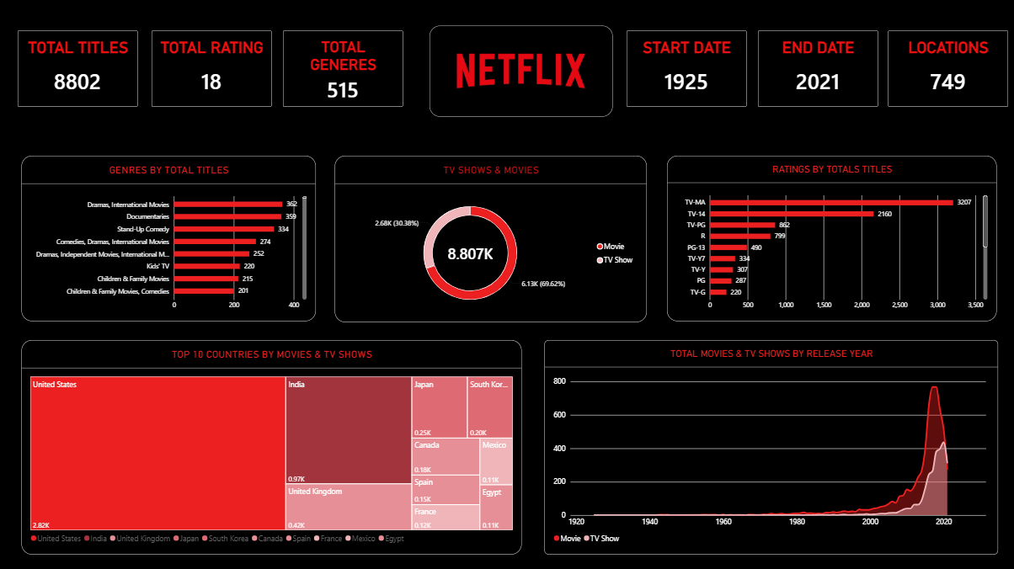
6. POWER BI DASHBOARD
Final interactive dashboard developed in Power BI
Final dashboard
Final Power BI Dashboard

Slide 9
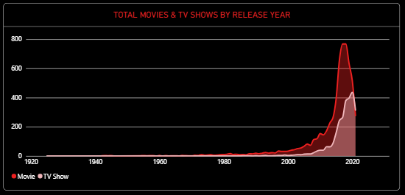
7. KEY INSIGHTS
What the analysis tells us
• Movies account for 69.62% of the catalog, compared with 30.38% for TV Shows.
• TV-MA is the most common rating with 3,207 titles; TV-14 follows with 2,160.
• International Movies is the most frequent individual genre/category value with 2,752 titles.
• The United States has the highest individual country count with 3,689 titles, followed by India with 1,046.
• The dataset spans 1925–2021, and the highest single release-year count is 1,147 titles in 2018.
Ratings pattern
Release-year trend

Slide 10
8. CONCLUSION
From raw records to a clear data story
• The project shows how Power BI can transform a real-world entertainment dataset into a professional analytical dashboard.
• The dashboard combines summary cards with comparisons of content type, genres, ratings, countries and release years.
• The analysis highlights clear differences in content mix and provides a concise way to communicate major patterns.
• The project demonstrates practical skills in data preparation, Power Query, visualization, dashboard design and insight generation.
• The dashboard can be extended in future with advanced DAX, slicers, drill-through pages and additional analysis.
Project KPI summary

Slide 11
THANK YOU
Questions & Discussion
Netflix Content Analysis

