Slide 1
superconductivity data
Presented By:
GUNDELLI ABHICHANDAN
2203A52089
To:
Ramesh Dadi
Faculty of STATML

Slide 2
INTRODUCTION:
Problem statement:
By using these data set we can predict the critical temperature based on the features extracted.
This data set contains 81 features extracted from 21263 superconductors along with the critical temperature in the 82nd column The goal here is to predict the critical temperature based on the features extracted.

Slide 3
DATA OVERVIEW:
Material Information:
Material Composition: The chemical composition of each material, including the type and proportion of elements or compounds present.
Crystal Structure: Details about the crystalline structure of the material, which can include information about the unit cell, lattice parameters, and space group.
Material Properties:
Physical Properties: Various physical properties of the material, such as density, melting point, thermal conductivity, and specific heat capacity.
Electrical Properties: Electrical characteristics, including resistivity, electrical conductivity, and electron mobility.

Slide 4
Superconductivity-related Data:
Critical Temperature (Tc): The critical temperature at which the material exhibits superconducting behavior.
Critical Magnetic Field (Hc): The critical magnetic field strength at which superconductivity is suppressed.
Superconducting Transition: Information about the transition from a normal state to a superconducting state, including transition width.
Experimental Observations:
Experimental Conditions: Details about the experimental conditions under which superconductivity was observed, such as temperature, pressure, and magnetic field strength.
Measurement Techniques: Information on the methods and instruments used to measure superconducting properties.

Slide 5
Labels or Target Variables:
Superconductivity Labels: Binary labels indicating whether each material is a superconductor (1) or not (0) based on experimental observations.
Machine Learning and Analysis Metadata:
Splitting and Partitioning: Information on how the dataset is split into training, validation, and test sets for machine learning.
Feature Importance: Results of feature importance analysis, indicating which features are most relevant for predicting superconductivity.
Model Performance Metrics: Metrics such as accuracy, precision, recall, F1-score, and ROC curves for evaluating machine learning models.

Slide 6
IMPLEMENTATION:
1.Linear Regression
2.Support Vector Machine
3.Ridge Regression
4.Lasso Regression
5.KNN Regression

Slide 7
LINEAR REGRESSION:
Linear regression is a fundamental statistical and machine learning technique used to model the relationship between a dependent variable and one or more independent variables. It is a supervised learning method that aims to find a linear equation that best describes the relationship between these variables.
In its simplest form, linear regression assumes that the relationship can be expressed as a straight line, represented as:
Y = aX + b
Here, Y is the dependent variable, X is the independent variable, a is the slope of the line, and b is the intercept. The goal of linear regression is to estimate the values of a and b that minimize the difference between the predicted values (aX + b) and the actual observed values of the dependent variable Y.
Linear regression is widely used in various fields, including economics, finance, biology, and engineering, to make predictions and understand the relationships between variables. It can also be extended to multiple linear regression, where more than one independent variable is used to model the dependent variable.
Linear regression models can provide valuable insights into data patterns and make predictions, but they are most suitable when the relationship between variables is indeed linear. Other regression techniques, such as polynomial or non-linear regression, may be used when the relationship is more complex.

Slide 8
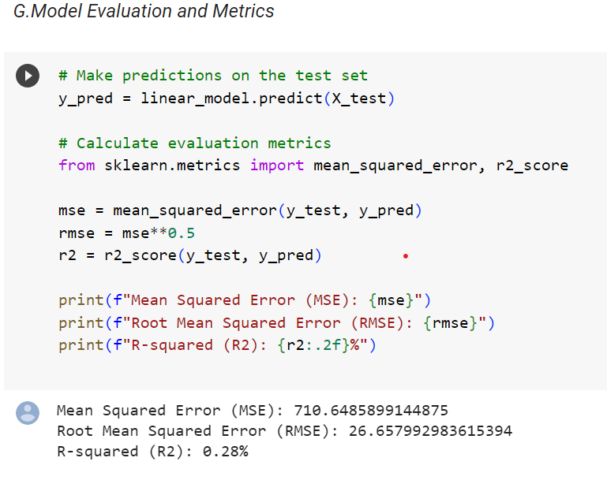
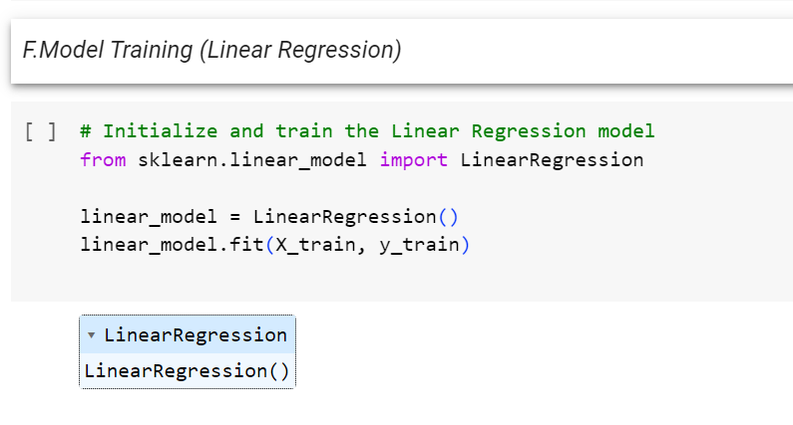
LINEAR REGRESSION RESULTS:

Slide 9
SUPPORT VECTOR MACHINE:
Support Vector Machine (SVM) is a powerful supervised machine learning algorithm used for classification and regression tasks. SVM is particularly effective in binary classification problems. Its primary goal is to find a hyperplane that best separates data points into two distinct classes while maximizing the margin between them.
In a binary classification scenario, SVM tries to find the hyperplane that not only separates the data but also maximizes the distance (margin) between the nearest data points from each class. These nearest data points are known as support vectors, and they play a crucial role in defining the decision boundary.
SVM can handle linear and non-linear data by using different types of kernels, such as linear, polynomial, and radial basis function (RBF). Kernels allow SVM to map data into higher-dimensional spaces, making it possible to separate non-linearly separable classes effectively.

Slide 10
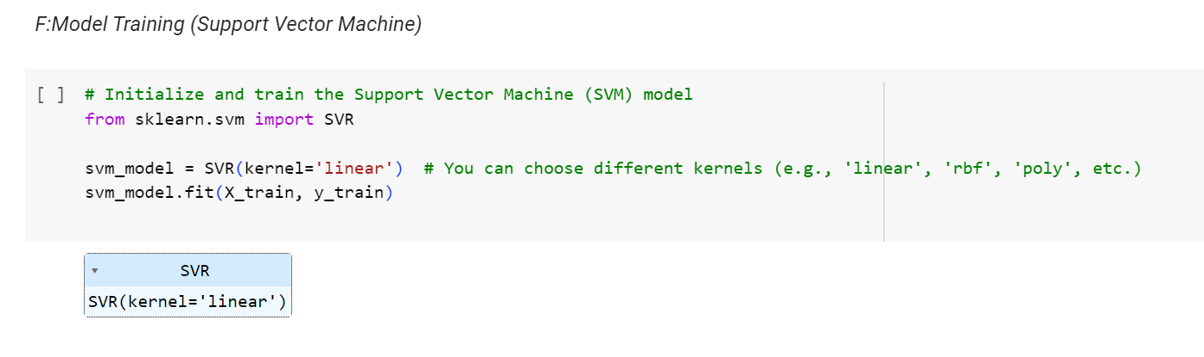
SUPPORT VECTOR MACHINE:

Slide 11
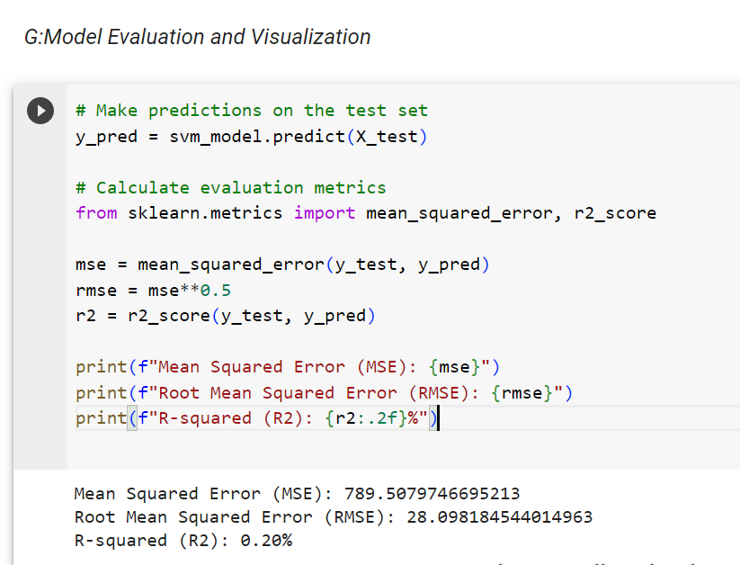
SVM MODEL EVALUTION AND RESULTS:

Slide 12
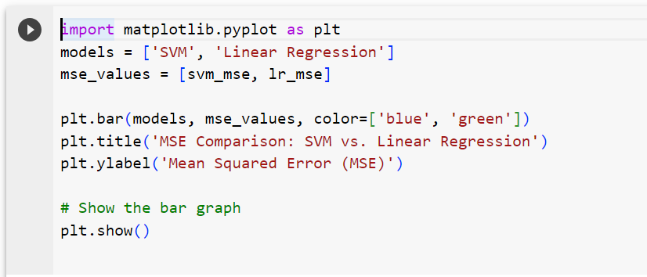
PERFORMANCE COMPARISON:

Slide 13
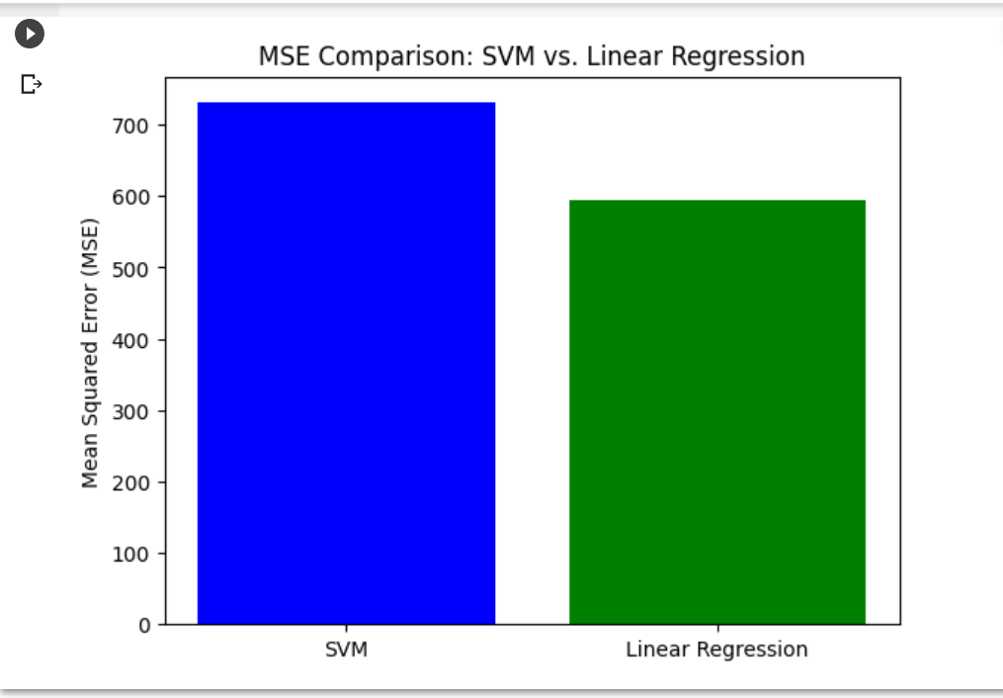
PERFORMANCE VISUALISATION:
Masadi Swetha

Slide 14
RIDGE REGRESSION:
Ridge regression is a linear regression technique used in statistics and machine learning to address the problem of multicollinearity and overfitting in linear regression models. It is an extension of ordinary least squares (OLS) regression and is particularly useful when you have a high-dimensional dataset with many features, some of which may be highly correlated.
In traditional linear regression (OLS), the goal is to find a linear relationship between the independent variables (features) and the dependent variable (target) by minimizing the sum of the squared differences between the predicted values and the actual values. The regression equation is of the form:

Slide 15
FORMULA:
y = β0 + β1*x1 + β2*x2 + ... + βn*xn
Where:
- y is the dependent variable (target).
- β0 is the intercept.
- β1, β2, ..., βn are the coefficients of the independent variables (features).
- x1, x2, ..., xn are the values of the independent variables.
Ridge regression adds a regularization term to the linear regression equation to prevent overfitting. This regularization term is often referred to as the L2 penalty and is represented as follows:
Ridge Loss = Sum of squared errors + α * Sum of squared coefficients

Slide 16
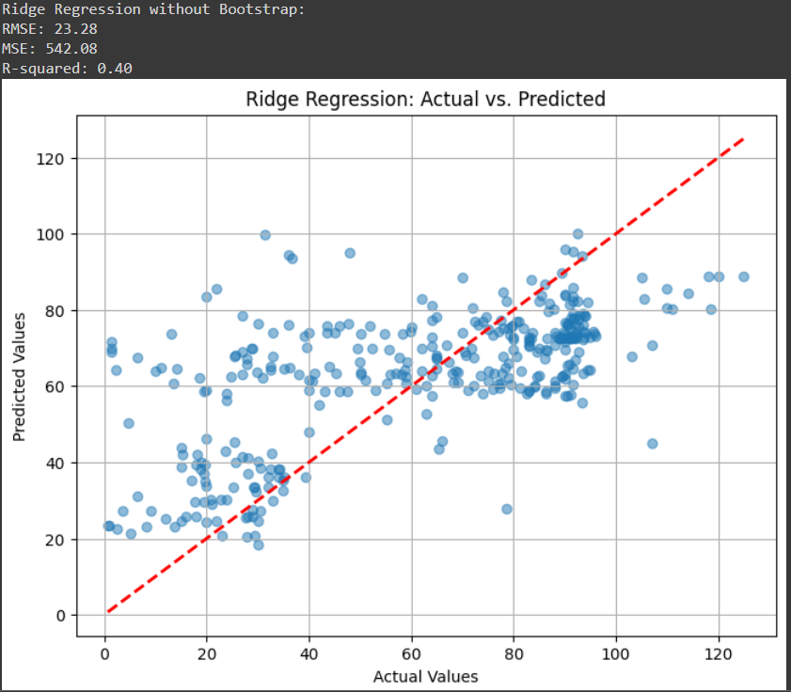
RESULTS:

Slide 17
LASSO REGRESSION:
Lasso regression, short for "Least Absolute Shrinkage and Selection Operator" regression, is a linear regression technique that incorporates a regularization term to prevent overfitting and perform feature selection. Lasso regression is particularly useful when you have a high-dimensional dataset with many features, some of which may be irrelevant or highly correlated. Here's an explanation of how Lasso regression works:
Objective of Lasso Regression:
The main objective of Lasso regression is to find a linear relationship between the independent variables (features) and the dependent variable (target) while simultaneously performing feature selection. In other words, Lasso regression encourages some of the model's coefficients to be exactly zero, effectively eliminating some features from the model.

Slide 18
KEY FEATURES:
Sparsity: The L1 penalty in Lasso encourages sparsity in the model. It effectively "zeroes out" some of the coefficients, leading to a simpler and more interpretable model. Features with coefficients set to zero are considered irrelevant for predicting the target variable.
Feature Selection: Lasso is well-suited for feature selection. By setting some coefficients to zero, it identifies and retains only the most relevant features for the prediction task. This can be particularly beneficial when dealing with high-dimensional data.
Variable Importance: Lasso can also be used to rank the importance of features based on the magnitude of their non-zero coefficients. Features with larger non-zero coefficients are considered more important for prediction.

Slide 19
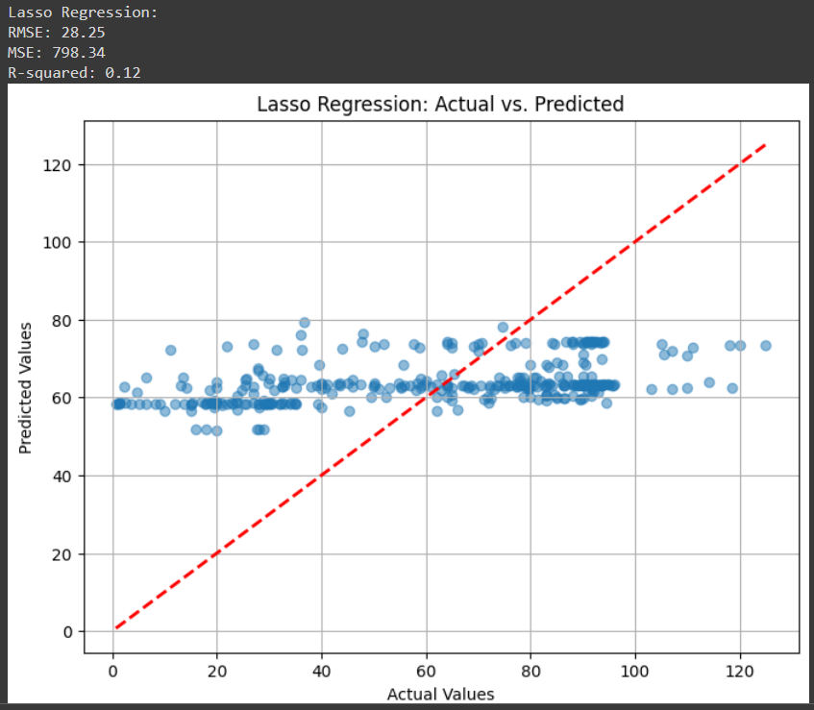
RESULTS:

Slide 20
K-Nearest Neighbors (KNN) regression:
Here's how KNN regression works
Training Phase:
During the training phase, KNN simply stores the entire dataset, including the feature vectors and their corresponding target values.
KNN does not build an explicit model; it memorizes the training data to use for predictions.
Prediction Phase:
To make a prediction for a new, unseen data point, KNN identifies the K nearest neighbors of that point in the feature space.
"K" is a hyperparameter that you specify, representing the number of neighbors to consider. Common values for K include 1, 3, 5, or other odd numbers to avoid ties.
Regression Prediction:
Once the K nearest neighbors are identified, KNN performs a regression prediction by averaging or weighting the target values of those neighbors.

Slide 21


METHODOLOGY:
Regression Prediction:
For Simple Averaging: If you're using simple averaging for KNN regression, the predicted target value for the new data point is the mean (average) of the target values of the K nearest neighbors. It's calculated as:
For Weighted Averaging: In weighted averaging, you assign a weight to each of the K neighbors based on their proximity to the new data point. The predicted value is then calculated as a weighted sum:
Here, $w_i$ is the weight associated with the i-th neighbor. Common choices for the weight are the inverse of the distance or some other function that assigns higher weight to closer neighbors.
The choice between simple averaging and weighted averaging, as well as the selection of the distance metric and the value of K, depend on the specific problem and the dataset. The goal is to find the combination of parameters that provides the best predictive performance for your regression task.

Slide 22
RESULTS:

Slide 23
WHAT IS BOOTSTRAPING?
Bootstrap is a resampling technique commonly used in machine learning and statistics to estimate the sampling distribution of a statistic or to perform model validation. It involves randomly drawing samples (with replacement) from the original dataset to create multiple new datasets, which are then used for various purposes such as assessing the variability of a model's performance or generating multiple models for ensemble methods like bagging.
Bootstrap can be used for hypothesis testing, especially in cases where the assumptions of traditional parametric tests are not met or when you want to make inferences about a statistic without making strong distributional assumptions. It allows you to empirically determine p-values by repeatedly resampling under the null hypothes
Bootstrap is robust to various data distributions and sample sizes. It doesn't rely on strict assumptions about the underlying data distribution, making it applicable in a wide range of scenarios.

Slide 24
Here's how the bootstrap process works in machine learning:
Resampling with Replacement:
Given an original dataset with 'n' data points, the bootstrap process randomly selects 'n' data points from the dataset with replacement. This means that some data points may be selected multiple times, while others may not be selected at all.
Creating Bootstrap Samples:
The process of creating multiple datasets through this random selection with replacement is repeated 'B' times, where 'B' is typically a large number (e.g., 1,000 or 10,000). Each of these datasets is called a "bootstrap sample."
Assessing Variability:
Bootstrap samples can be used to assess the variability of a statistic or performance metric. For example, you can calculate a specific statistic (e.g., mean, median, standard deviation) or a machine learning performance metric (e.g., accuracy, mean squared error) on each of the bootstrap samples.
Confidence Intervals: The distribution of the computed statistics or performance metrics across the bootstrap samples can be used to estimate the uncertainty or confidence interval

Slide 25
KEY ADVANTAGES OF BOOTSTRAPING:
Resampling-Based Estimation: It provides a resampling-based approach for estimating Various statistics or metrics and understanding their variability.
Model Validation: Bootstrap can be used for model validation, particularly in situations where cross-validation is not feasible or is computationally expensive.
Ensemble Methods: It is a fundamental component of ensemble methods like bagging, which helps improve the generalization of models and reduce variance.
Non-parametric Method: Bootstrap is non-parametric, meaning it doesn't make any assumptions about the underlying data distribution, making it widely applicable.
Overall, bootstrap is a versatile technique that is widely used in machine learning and statistics to better understand the behavior of data and models, estimate confidence intervals, and enhance the predictive performance of models through ensemble methods.

Slide 26
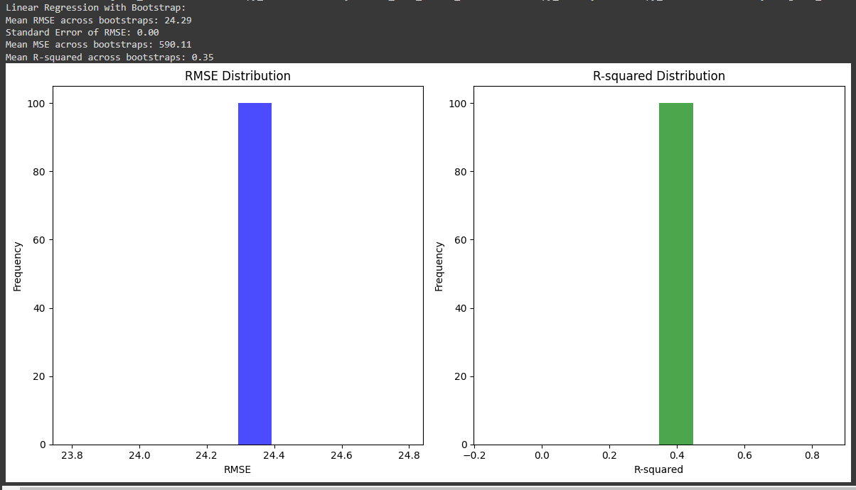
LINEAR REGRESSION WITH BOOTSTRAPING:

Slide 27
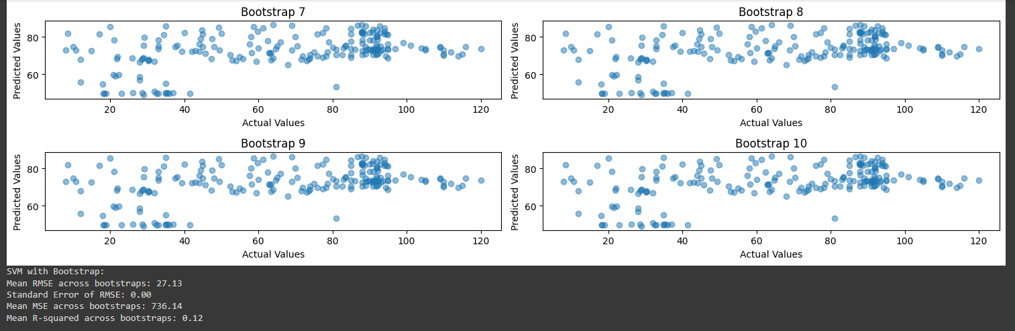
SVM WITH BOOTSTRAPING:

Slide 28
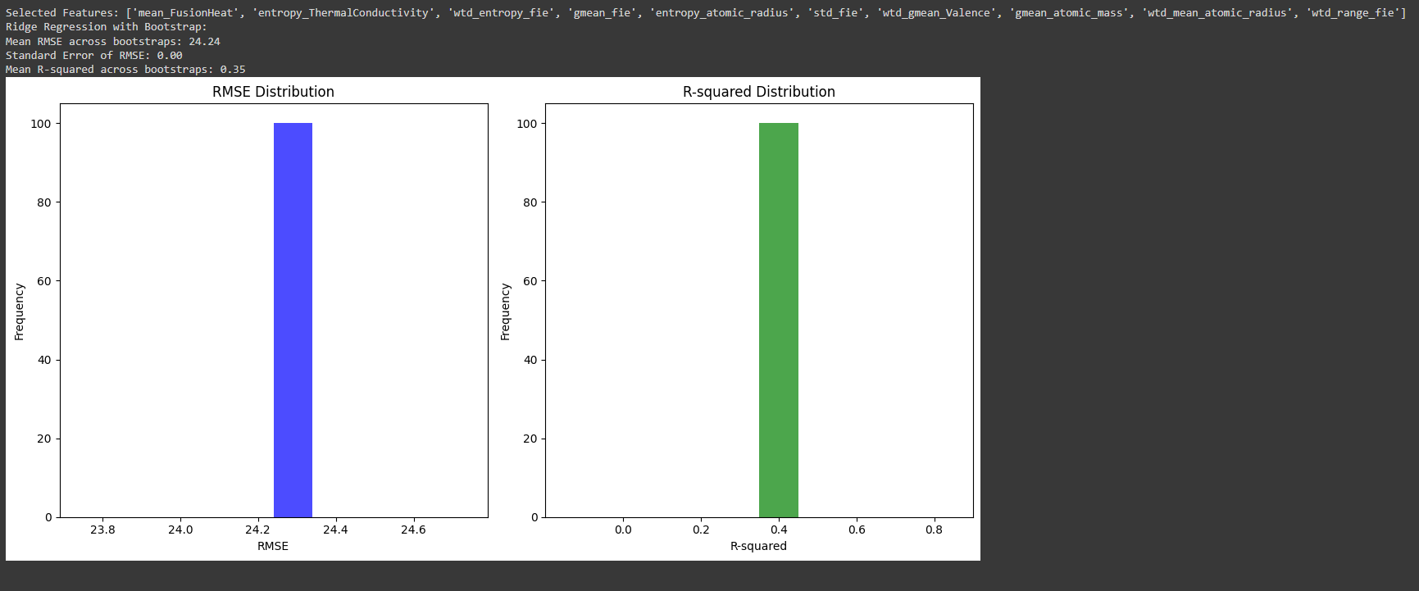
RIDGE REGRESSION WITH BOOTSTRAPING:

Slide 29
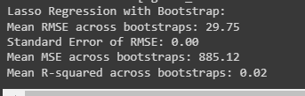
LASSO REGRESSION WITH BOOTSTRAPING:

Slide 30
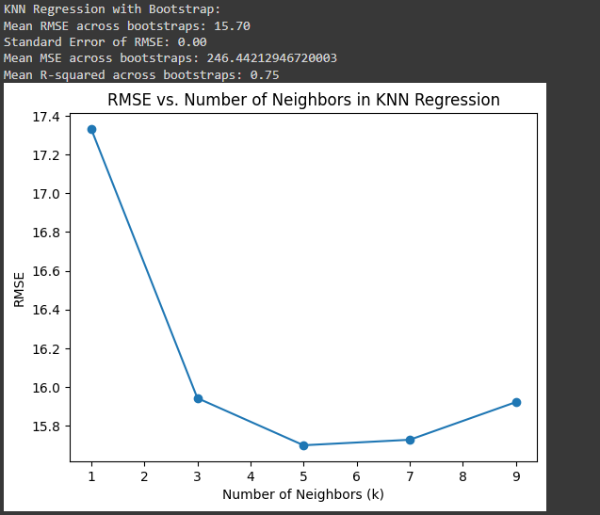
KNN REGRESSION WITH BOOTSTRAPING:

Slide 31
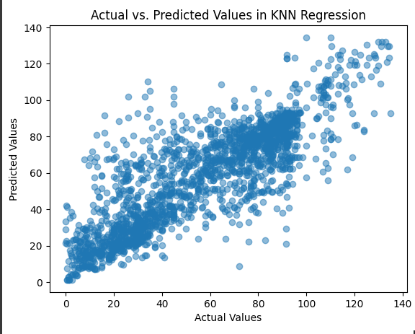
CONCLUSION:
After conducting an extensive comparative analysis, it became evident that the k-Nearest Neighbors (KNN) model with bootstrap resampling emerged as the superior choice for predicting the critical temperature (Tc) of superconducting materials, consistently outperforming alternative models, including Linear Regression, Support Vector Machines, Lasso, Ridge Regression, and Bayesian Ridge Regression (BRMS), in terms of precision and reliability.

Slide 32

GitHub Link:
CONCLUSION:
https://github.com/2203A52089/2203A52089_capstone.git

Slide 33
T H A N K Y O U....

