Slide 1
Bank-Application

Slide 2
Contents:
Abstract
Project Requirements
Implementation
Conclusion

Slide 3
Abstract:
“Internet banking” refers to system that enable bank customers to access accounts and general information on bank products and services through a personal computer and other device.
Aim is to create secure Bank Application.
The Bank Application is a only allow users who have valid login and password.

Slide 4
Project Requirement:
Operating System - Windows Server 2022
Java Development Kit 18.0.1.1

Slide 5
Implementation:
This project is console based project which follows menu driver program.
The series of menus displayed are as follows:
1.Search Account by Account number
2.Deposit the amount
3. Withdraw the amount
4.Prevoius Transition
5.Office work
6.Exit

Slide 6
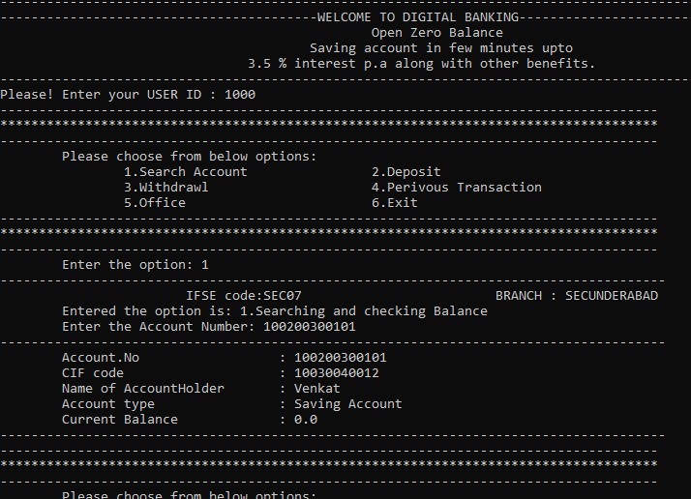
Outputs:
1.Search Account by Account number
Option:1
User id- 1000;
Account number: 100200300101

Slide 7
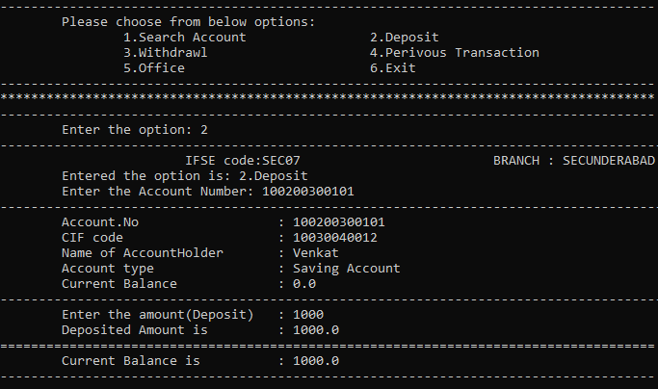
2.Deposit the amount
Option:2
Account number :100200300101;
Deposit Amount-1000.00

Slide 8
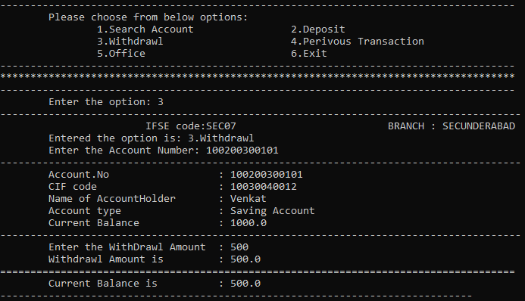
3. Withdraw the amount
Option:3
Account number:100200300101
Withdrawal amount:500.00

Slide 9
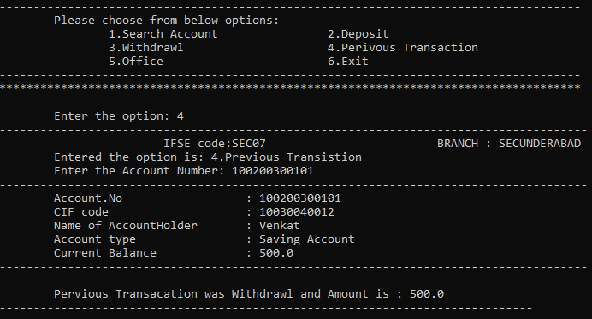
4.Prevoius Transition
Option:4
Account Number: 100200300101;

Slide 10
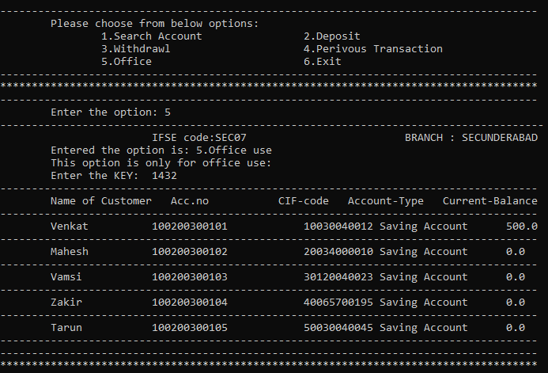
5.Office work
Option:5
Key:1432;

Slide 11
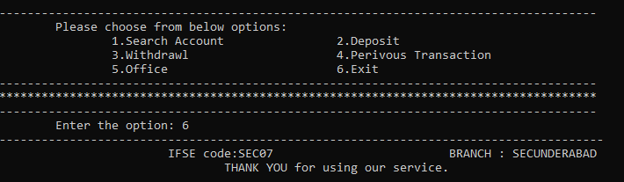
6.Exit
Option:6

Slide 12
Conclusion:
The application demonstrate the way to develop an online banking system by using JDK with more secure way to access.

