Slide 1
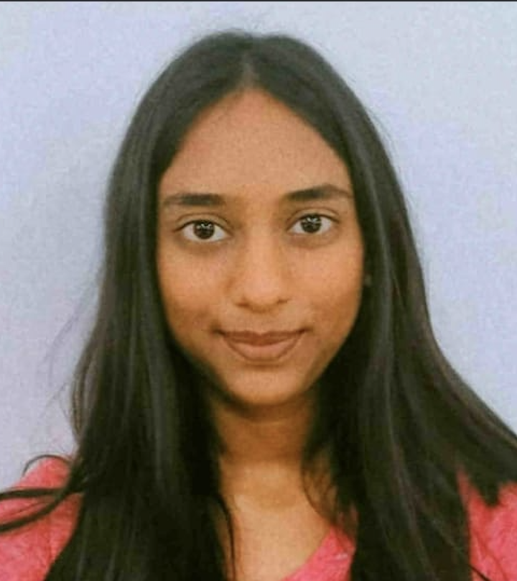


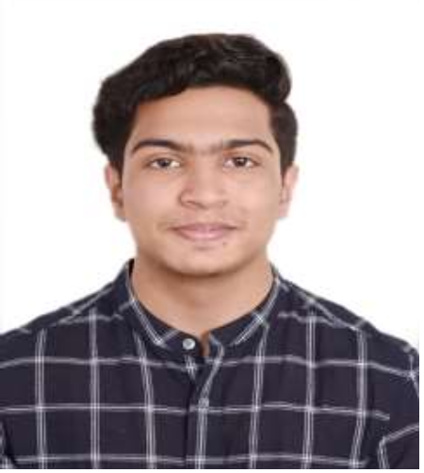

Ishika Sedhu Madhavan
Sujith Antony
KV.Badhrinarayanan
Austin Jaison Jose
Team Name - BIAS
College - SHIV NADAR UNIVERSITY CHENNAI

Slide 2
URL FOR SOURCE CODE
https://github.com/iamneo-production/dec32835-4f55-4cf9-b723-bbda2d4970fe
dec32835-4f55-4cf9-b723-bbda2d4970fe

Slide 3


INFORMATION ON MODEL EVALUATION PARAMETERS
Karim Nagar
Warangal
Khammam
Nizamabad
AVERAGE AME- 1.7294
AVERAGE RMSE- 2.0924
Adilabad
We created separate models for each of the cities and the above mentioned values are the performance values of each of the cities based on their respective models. The overall average performance values across all 5 models have also been mentioned.

Slide 4

INFORMATION ON MODEL EVALUATION PARAMETERS
NIizamabad
Adillabad
Karim Nagar
Khamma
AVERAGE AME - 10.7127687507855732
AVERGAE RMSE- 8.686978443826857
Warangal(MEE_SEVA)
We created separate models for each of the cities and the above mentioned values are the performance values of each of the cities based on their respective models. The overall average performance values across all 5 models have also been mentioned.

Slide 5
PLAN TO STARTUP
We believe our startup can develop a comprehensive plan for addressing climate change through the use of air quality and humidity levels. With a focus on areas as mentioned below our startup can launch successfully and grow to become a leader in the fight against climate change.
1.Research and Development: Conduct research on air quality and humidity, and their impact on climate change.A prototype is being developed and we will test it in various environments.
2.Market Analysis: Identify potential customers, competitors, and pricing strategies.
3.Legal and Regulatory Compliance: Review relevant laws and regulations related to air quality and humidity levels.
4.Business Model: Determine the most appropriate business model and pricing strategy.
5.Marketing and Sales: Develop a marketing and sales plan that targets our ideal customers. Utilize various channels to reach potential customers.
6.Operations and Logistics: Establish processes and systems for manufacturing, shipping, and customer service.
7.Funding: Determine the amount of funding required to launch and grow our startup. Explore various funding options.
8.Launch and Growth: Launch our startup and focus on customer satisfaction and retention. Explore opportunities for growth and expansion

Slide 6
THE PROBLEM AND THE SOLUTION
The problem we have taken up to solve is the increasing frequency, duration, and intensity of heatwaves in Telangana, India, and their significant impacts on human health, causing mortality, heat cramps, exhaustion, and stroke and other related issues. Heatwaves have become a persistent problem with an increase in duration over the past few decades The proposed solution involves developing an AI/ML model that can predict the occurrence of heatwaves and air quality in advance, communicate the risks and dangers with the public, and provide various precautionary measures to mitigate the effects of heatwaves. A "risk map" can help identify vulnerable populations and direct resources to areas with higher risk scores.
HEAT WAVES MODEL
We used an arima time series based model to predict the heat wave occurrence for each month of 2023 .
We initially trained a model with the values from Jan 2018 to Nov 2022, and predicted the heat wave occurrences for the month of December 2022. As heat wave for December 2022 already exists with us , we calculate the accuracy of the model using the prdecting and existing values of december 2022.
Now we create a new model which takes input from jan 2018 dec 2022 and predicts the heat waves occurrences of jan 2023 . Now the Initial dataset from jan 2018 to dec 2022 is updated and jan 2023 dataset is added . Using the new dataset as an input for the new model we predict the heat wave occurrence of jan 2023 . This process keeps getting looped where the predicted dataset gets added to the original dataset to predict the next months data . This is one of the reason why our model is accurate . As it considers the output of the current iteration as the input of the next iteration . the performance metrics and graphs of the dataset are printed throughout the model.
AQI MODEL
We used an arima time series based model to predict the aqi values for each month of 2023.
Our dataset contains aqi values of each month between 2016 and 2022. we predict the values for the year 2022 based on passing the previous years data through an arima model and we use the predicted aqi value and the available value to calculate the performance metrics. The whole dataset is provided as an input for the arima model and we forecast the values for the next 12 months ie.2023 . the performance metrics and graphs of the dataset are printed throughout the model.

Slide 7
HELP FOR STARTUP AND HOW WE WILL USE THE PRIZE MONEY
Help needed
1.Expertise: we need expert advice on the technical aspects of measuring and analyzing air quality and humidity levels, as well as designing and developing a product or service that can address these issues.
2.Funding: Starting a start-up requires some initial investment. we may need to explore different funding sources, such as loans, or venture capital, and develop a solid business plan that outlines our revenue streams, marketing strategies, and growth projections.
3.Mentorship: Finding mentors who have experience in starting and growing a successful start-up can be invaluable
4.Networking: Building a network of partners, collaborators, and customers is essential for the success of any start-up.
5.Legal and regulatory compliance: We may need help in consulting legal and regulatory experts to ensure that we are operating within the legal framework and registering the startup.
Overall, starting a climate change solution start-up requires a multidisciplinary approach, combining technical, financial, business, and legal expertise, and building a strong network of partners and collaborators
We will use the prize money to fund these activities, we can also increase the chances of successfully starting a startup .
1.Conduct market research to identify the potential demand for the product or service.
2.Protect the intellectual property of the solution by filing for patents and trademarks.
3.Build a team to develop the product, conduct further research, and create a marketing strategy.
4.Network and collaborate with investors, and potential partners to identify opportunities and build relationships.
5.Implement sustainable practices to ensure the startup operates ethically and responsibly.
6.Use the money for self improvement

