Slide 1
Phishing Website Detection
Using URL-Based Features and Ensemble Learning Models

Slide 2
Base Paper Reference
Phishing Website Detection Using URL-Based Features and Ensemble Learning Models
Reference:
Barik, K., Misra, S., & Mohan, R. (2025). Web-based phishing URL detection model using deep learning optimization techniques. International Journal of Data Science and Analytics, 20, 4449–4471. https://doi.org/10.1007/s41060-025-00728-9

Slide 3
Abstract
Phishing websites are a significant issue in today's digital world. They deceive users into sharing sensitive personal and financial information through fake links and web pages. This project addresses the problem by developing a phishing website detection system that uses machine learning techniques focused on analysing URL features.
The system allows users to either input extracted feature values or provide a website URL through a web interface. It instantly gives a prediction on whether the site is legitimate or a phishing attempt. Several supervised classification models are tested and compared to evaluate their performance. These include K-Nearest Neighbors, Logistic Regression, Naive Bayes, Decision Tree, Random Forest, Support Vector Machine, and XGBoost.
The models are evaluated using various evaluation metrics, including accuracy, precision, recall, F1-score, ROC-AUC, processing time, memory usage, and robustness. The system allows different machine learning models, including individual classifiers and ensemble methods, to be compared in terms of their detection accuracy and computational efficiency. Overall, this system shows how machine learning can be effectively used for phishing detection and improving online security.

Slide 4
Problem Statement
Phishing websites are a significant issue in today’s digital world. They deceive users into sharing sensitive personal and financial information through fake links and webpages. Traditional detection methods struggle to keep pace with evolving phishing techniques.
Key Challenges
Detection Accuracy
Fast Prediction Response
Evolving Threats
Phishing techniques constantly adapt to bypass security measures
Need for highly accurate classification to minimize false positives and negatives
System should deliver quick and efficient phishing predictions to assist users in making timely security decisions.

Slide 5
The Scale of the Problem
Phishing is not a technical nuisance — it is a global crisis affecting millions every day.
3.4B
Phishing emails sent every single day
36%
Of all data breaches involve phishing
Proofpoint State of the Phish, 2023
Verizon Data Breach Investigations Report, 2023
#1
Most reported cybercrime type globally
1.35M
Unique phishing sites detected in a single year
FBI Internet Crime Report (IC3), 2023
APWG eCrime Report, 2023
Phishing Website Detection System · SASTRA Deemed University

Slide 6
Literature Survey
Author & Year | Title | Methodology | Key Findings & Contributions
Mohammad et al. (2014) | Phishing Website Detection using Machine Learning | Random Forest with URL-based features | Achieved 97% accuracy, demonstrated effectiveness of ensemble methods
Abdelhamid et al. (2014) | Feature Extraction Techniques for Phishing Detection | Feature analysis and selection methods | Identified 30 optimal URL features with high discriminative power
Sahingoz et al. (2019) | XGBoost for Phishing URL Detection | XGBoost with gradient boosting | 98.2% accuracy with faster training and prediction times
Rao & Pais (2019) | Deep Learning Approaches for Phishing Detection | CNN with character-level features | CNN models achieved 97.8% accuracy on URL analysis
Barik, Misra & Mohan (2025) | Web-based phishing URL detection model using deep learning optimization techniques | ML + Deep Learning Based | EGSO-CNN hybrid achieves 99.44% accuracy. This project replicates and extends this benchmark using classical ML classifiers with Streamlit deployment.

Slide 7
Project Objectives
Develop ML-Based Detection System
Create a phishing detection system using URL-based features and machine learning algorithms
Compare Classification Models
Evaluate and compare multiple supervised learning models including KNN, Logistic Regression, Naive Bayes, Decision Tree, Random Forest, SVM, and XGBoost
Implement Web Interface
Build a user-friendly web interface for URL analysis and prediction
Optimize Performance
Evaluate models using accuracy, precision, recall, F1-score, ROC-AUC, processing time, and memory usage to identify the best performing approach

Slide 8
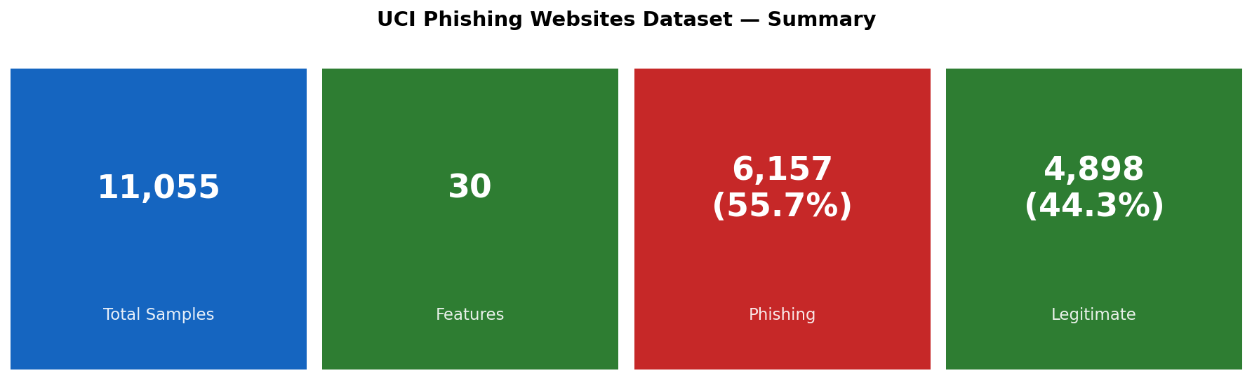
Dataset Information

Slide 9
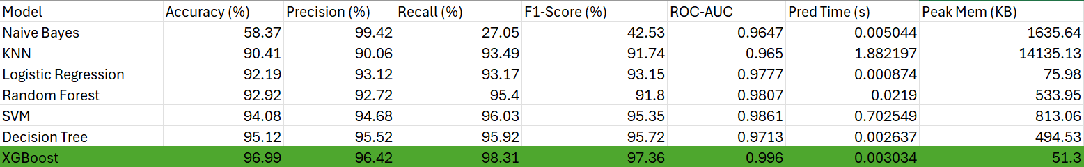
Work Carried Out
Work carried out on 7 supervised ML classifiers (UCI Phishing Dataset — 11,055 samples, 30 features, 70/30 split, StandardScaler) evaluated across Accuracy, Precision, Recall, F1, ROC-AUC, Prediction Time, Peak Memory, and Overfitting analysis.

Slide 10
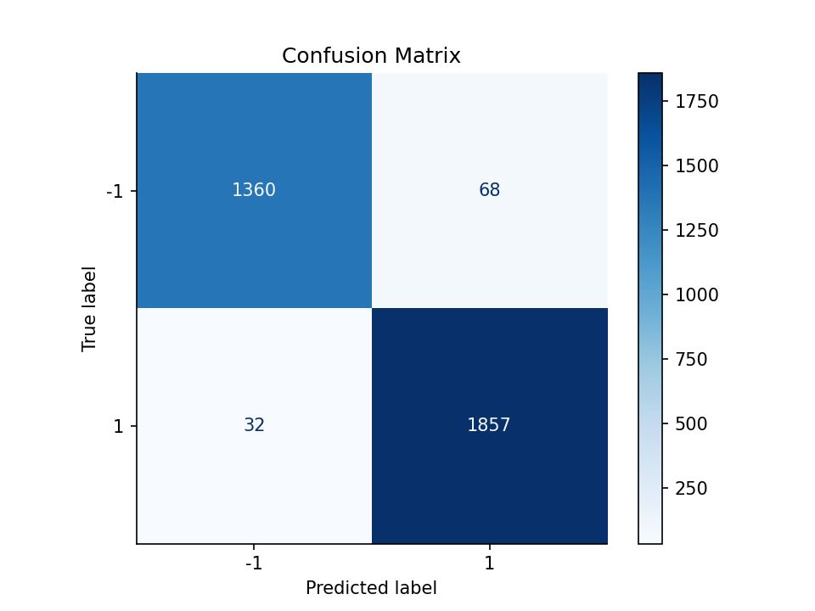
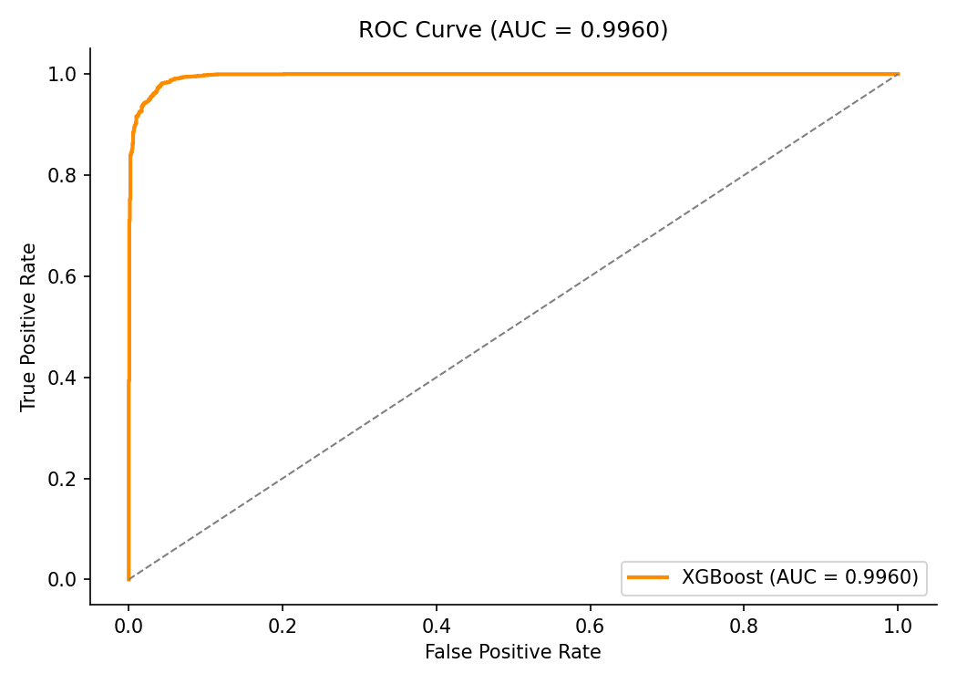
XGBoost

Slide 11
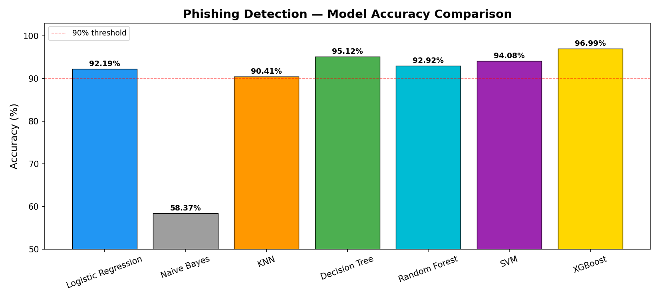
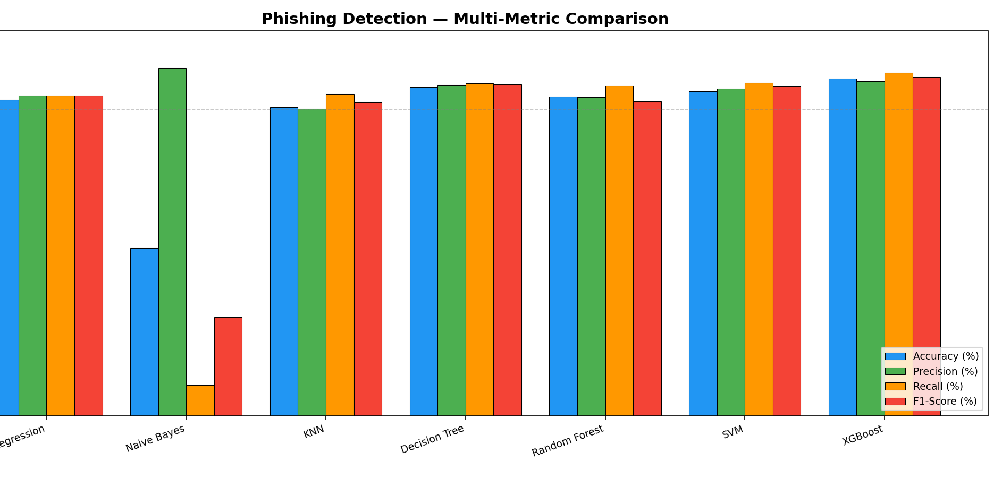
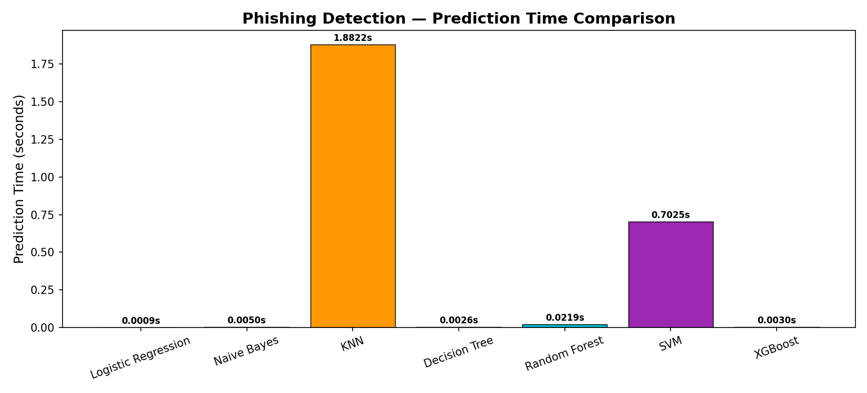
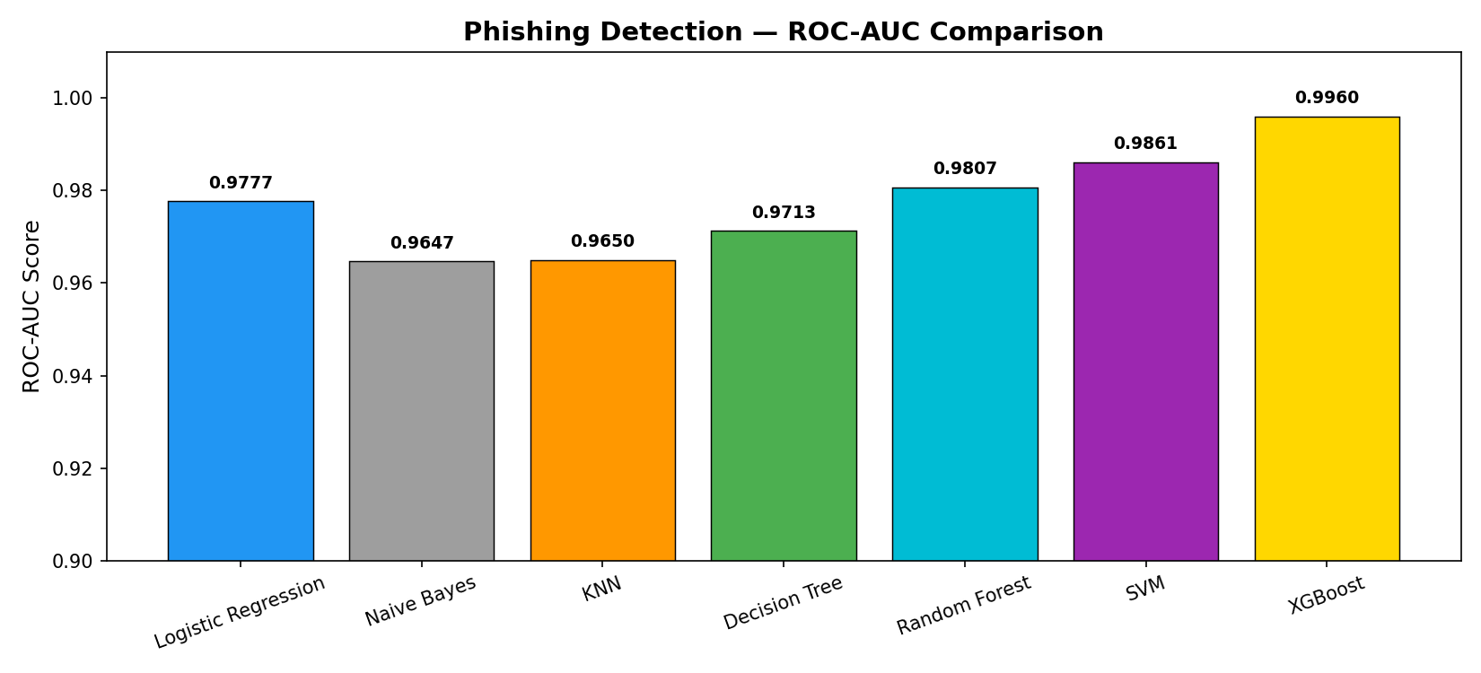
Results

Slide 12

Test Case 1

Slide 13

Test Case 1 (improved)

Slide 14

Test Case 2

Slide 15

Test Case 2 (improved)

Slide 16

Test Case 3

Slide 17

Test Case 3 (improved)

Slide 18

Test Case 4

Slide 19

Test Case 4 (improved)

Slide 20
Conclusions
This project successfully developed a phishing website detection system using seven supervised machine learning classifiers trained on the UCI Phishing Websites Dataset (11,055 samples, 30 URL-based features).
All models were evaluated across eight metrics — Accuracy, Precision, Recall, F1-Score, ROC-AUC, Prediction Time, Peak Memory, and Overfitting analysis.
XGBoost emerged as the best model achieving 96.99% accuracy, 98.31% recall, 0.9960 AUC, 51 KB memory usage, and 3ms prediction time — the highest across every metric simultaneously.
The best model was deployed in a Streamlit web application with a three-layer detection pipeline: PhishTank real-time threat intelligence, typosquatting detection using string similarity, and XGBoost ML classification with live 30-feature extraction via URL parsing, DNS lookup, WHOIS query, and HTML fetch.
The system demonstrates that classical ML with well-engineered URL-based features can achieve near state-of-the-art phishing detection without requiring deep learning or heavy computational resources.

Slide 21
Frameworks, Libraries & Tools
Language & IDE
ML & Data Libraries
Web Application
Python 3.13.2
scikit-learn
Streamlit
Primary programming language
LR · NB · KNN · DT · RF · SVM
Web interface framework
Jupyter Notebook
XGBoost
requests
Model training & experimentation
Best classifier — 96.99% accuracy
Live webpage HTTP fetching
VS Code
NumPy / Pandas
BeautifulSoup4
Application development
Numerical computing & data handling
HTML parsing for feature extraction
Domain Extraction
Model Persistence
Evaluation & Visualization
python-whois
joblib
Matplotlib / Seaborn
Domain registration WHOIS lookup
Save & load .pkl model files
ROC curves · confusion matrix
socket
scaler.pkl
tracemalloc
Live DNS resolution
Pre-fitted StandardScaler
Peak memory profiling
urllib / re
xgbModel.pkl
time module
URL parsing & regex pattern matching
Serialized XGBoost classifier
Prediction time measurement

Slide 22
References
[1] A. Mandadi, S. Boppana, V. Ravella, and R. Kavitha, “Phishing Website Detection Using Machine Learning,” in Proc. 2022 IEEE 7th Int. Conf. Convergence Technol. (I2CT), Pune, India, Apr. 2022, pp. [pages], doi: 10.1109/I2CT54291.2022.9824801.
[2] E. S. Boakai and M. Shabaz, “Deep feature fusion for phishing website detection using URL‑based features,” IEEE Communications Standards Magazine, vol. 9, 2025, doi: 10.1109/MCOMSTD.2025.3626765.
[3] XGBoost Documentation: Extreme Gradient Boosting. https://xgboost.readthedocs.io/
[4] ] scikit-learn Documentation: Machine Learning in Python. https://scikit-learn.org/
[5] UCI Machine Learning Repository: Phishing Websites Dataset: https://archive.ics.uci.edu/dataset/327/phishing+websites
[6] scikit-learn Documentation: Machine Learning in Python. https://scikit-learn.org/
[7] https://www.tutorialspoint.com/machine_learning/index.htm

Slide 23
Thank You

