Slide 1
Evaluation of Green Hydrogen as a Long Duration Storage Solution for Future Energy and Climate Scenarios in the UK
Gunes Sarp Balaban

Slide 2
Aim and Objectives
Aim:
Evaluating green hydrogen production as a form of long-term storage of curtailed wind energy across the UK.
Objectives:
Understanding wind curtailment and geographical distribution
Creating a realistic hydrogen production model
Simulating geographical electrolyser sites
Assessing the results and determining the feasibility

Slide 3
Significance of the Topic
Goal of becoming fully renewable by 2050
Lack of long-term storage options
Sectors that are hard to power by renewable energy
Increasing wind curtailment (1.48 to 10.18TWh)
Increasing investments for wind generation, less for infrastructure

Slide 4
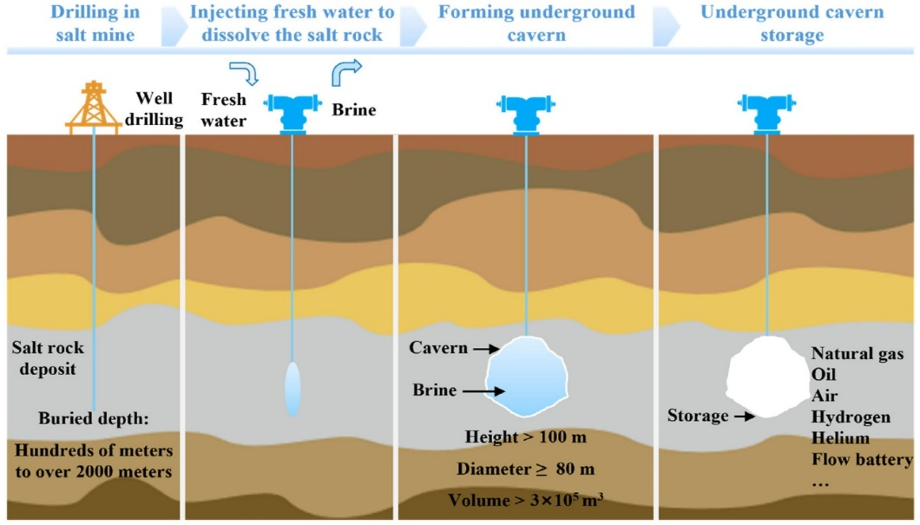
Literature Review
Transportation of energy and role of storage in the grid
Utilising hydrogen as an energy source (petroleum refining 25%, ammonia 55%, and methanol production 10%)
Electrolysis technology (PEM electrolysis)
Hydrogen transportation and storage after production (old pipelines, tube trailers, etc.)

Slide 5
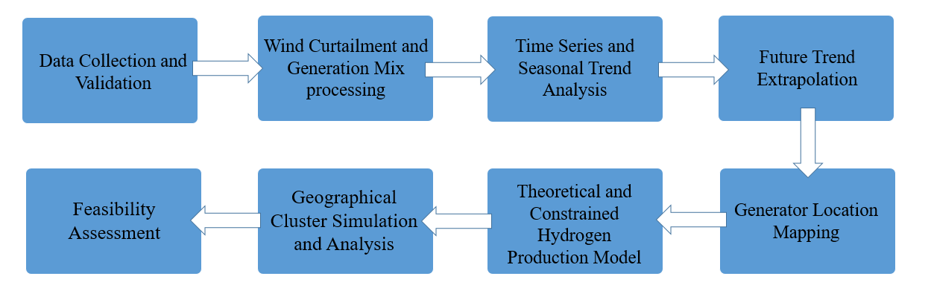
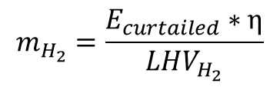
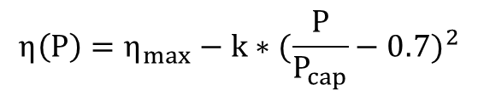
Methodology
$$m_{H_{2}}=\frac{E_{curtailed}∗η}{{LHV}_{H_{2}}}$$
Official NESO data between 2018 and 2026
MATLAB processing and plotting
Hydrogen model creation
System assumptions and constraints
Model simulation and analysis
$$η\left(P\right)=η_{max}−k∗{(\frac{P}{P_{cap}}−0.7)}^{2}$$

Slide 6
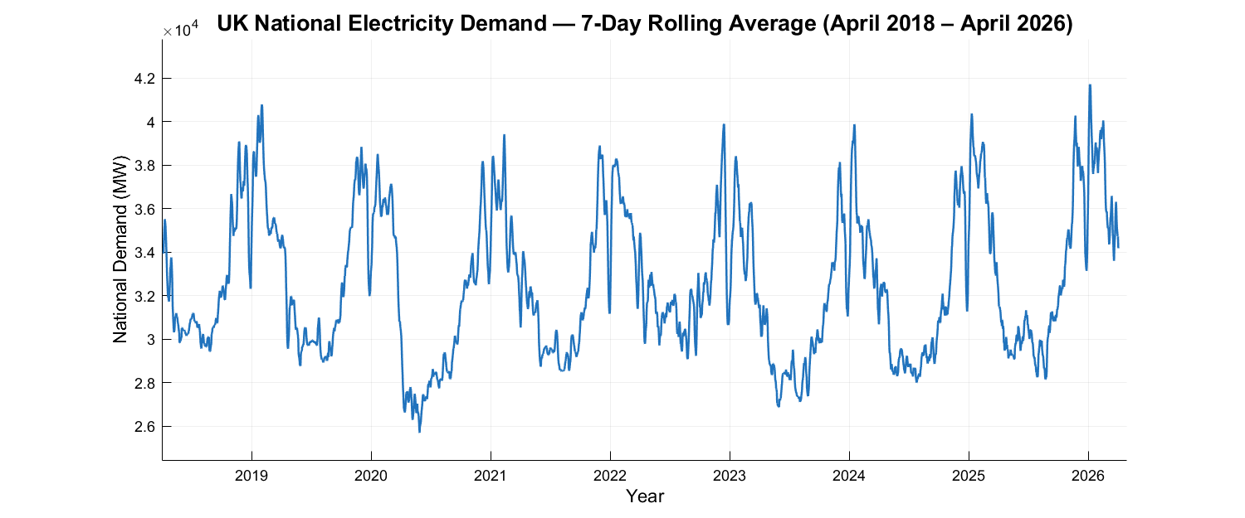
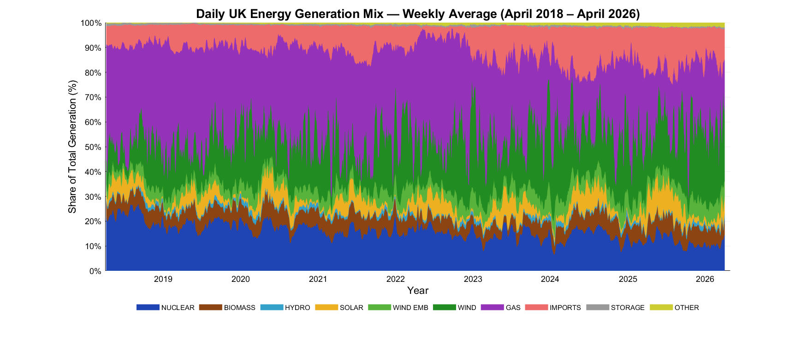
Results – Data Analysis
Demand vs generation analysis

Slide 7
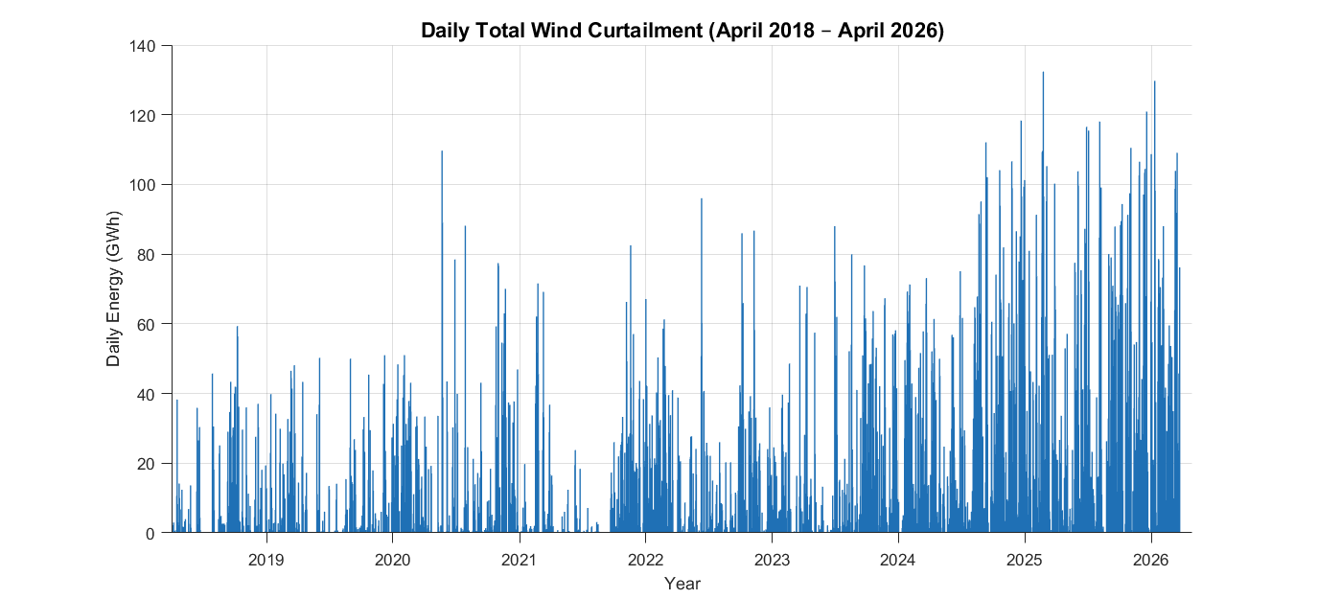
Results – Data Analysis
Daily curtailment and percentage relevance analysis
Period | Average Wind Percentage | Min Wind Percentage | Max Wind Percentage
Apr 2018 – Dec 2018 | 16.54 | 1.96 | 38.28
Jan 2019 – Dec 2019 | 20.1 | 2.94 | 42.92
Jan 2020 – Dec 2020 | 24.61 | 2.19 | 50.13
Jan 2021 – Dec 2021 | 21.57 | 2.16 | 53.53
Jan 2022 – Dec 2022 | 26.48 | 2.06 | 58.92
Jan 2023 – Dec 2023 | 28.42 | 2.16 | 60.87
Jan 2024 – Dec 2024 | 28.95 | 4.29 | 60.8
Jan 2025 – Dec 2025 | 29.34 | 2.16 | 63.92
Jan 2026 – Apr 2026 | 35.59 | 9.17 | 57.03

Slide 8
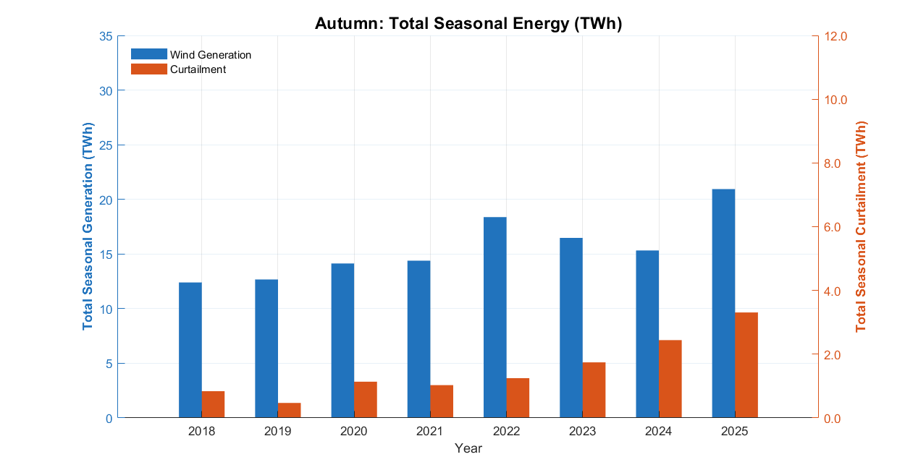
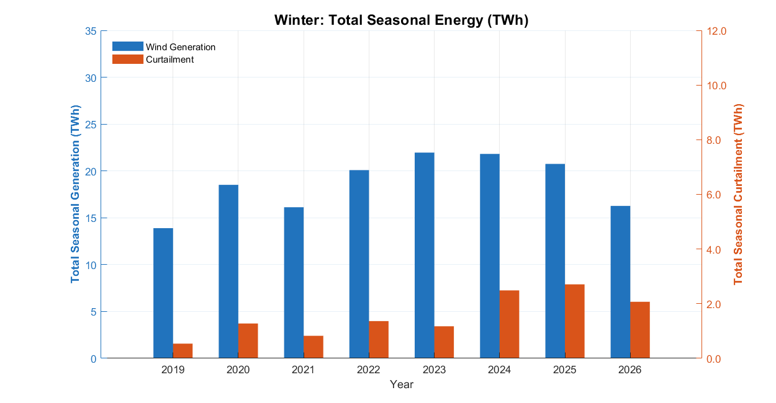
Results – Data Analysis
Seasonal curtailment trends

Slide 9
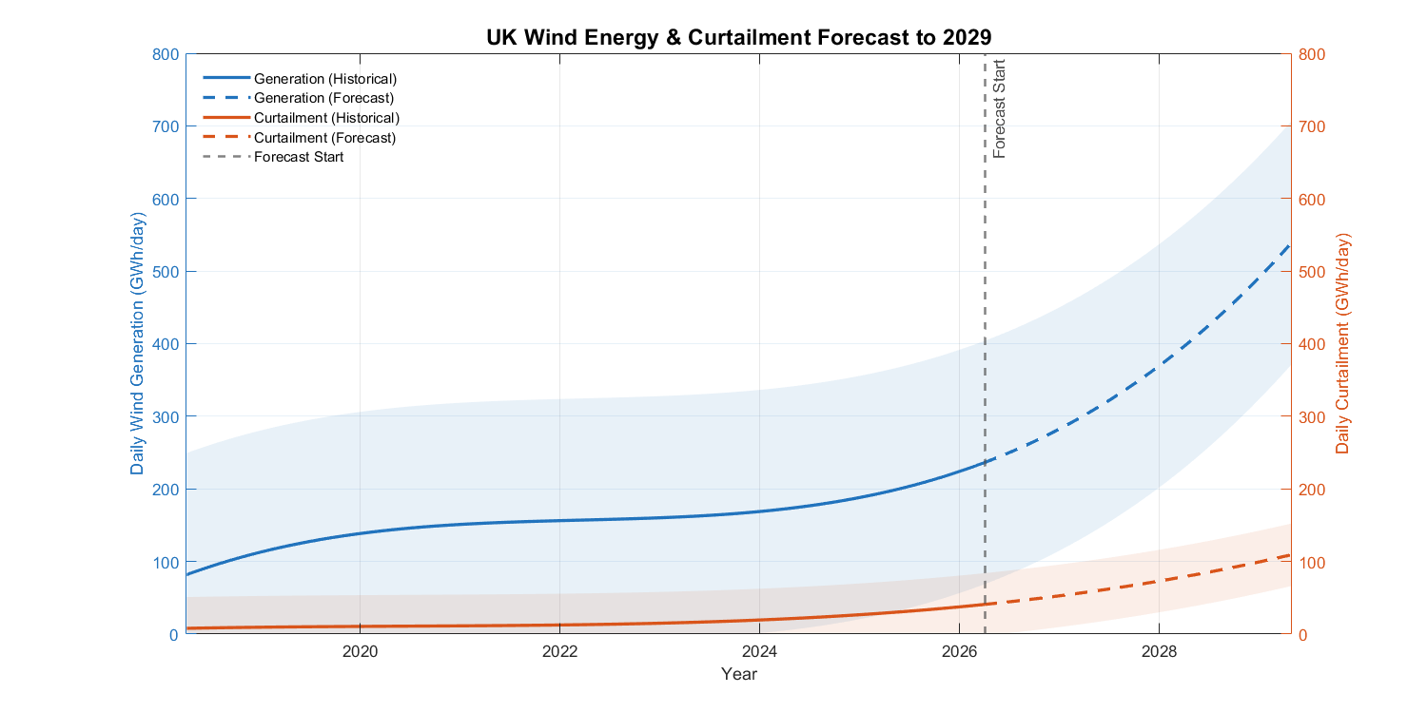
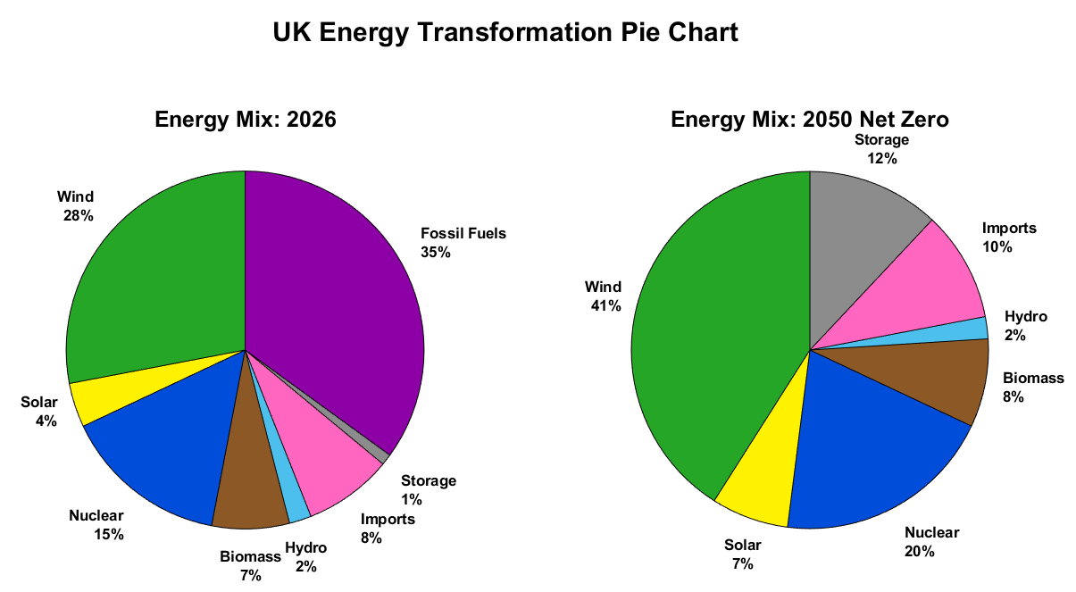
Results – Data Analysis
Future trend extrapolation

Slide 10
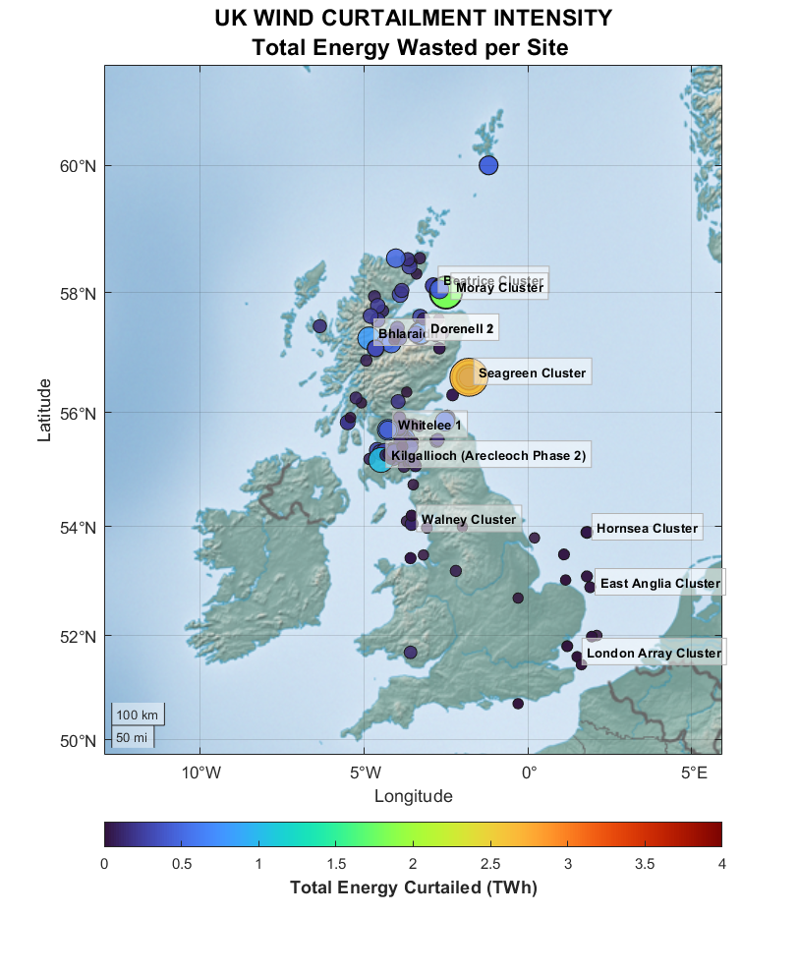
Results – Modelling and Simulation
Generator-based analysis of curtailment
Some generators are overlapping on the
map.
Highlights transmission bottlenecks

Slide 11
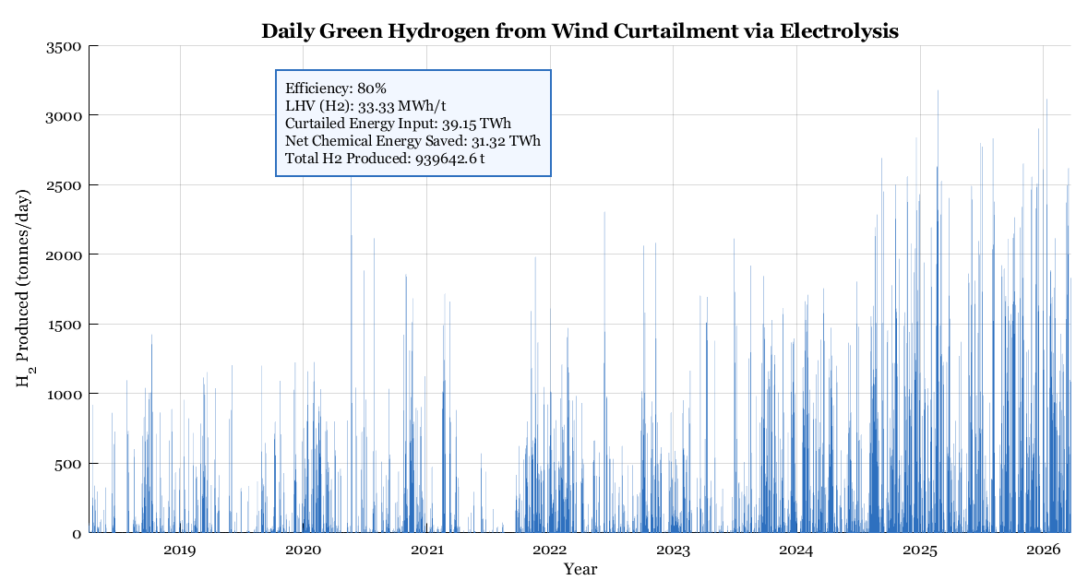
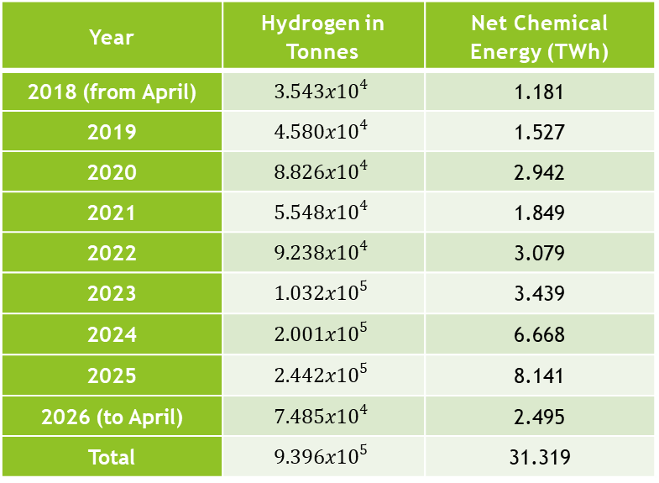
Results – Modelling and Simulation
Theoretical modelling
Year | Hydrogen in Tonnes | Net Chemical Energy (TWh)
2018 (from April) | $$3.543x{10}^{4}$$ | 1.181
2019 | $$4.580x{10}^{4}$$ | 1.527
2020 | $$8.826x{10}^{4}$$ | 2.942
2021 | $$5.548x{10}^{4}$$ | 1.849
2022 | $$9.238x{10}^{4}$$ | 3.079
2023 | $$1.032x{10}^{5}$$ | 3.439
2024 | $$2.001x{10}^{5}$$ | 6.668
2025 | $$2.442x{10}^{5}$$ | 8.141
2026 (to April) | $$7.485x{10}^{4}$$ | 2.495
Total | $$9.396x{10}^{5}$$ | 31.319

Slide 12
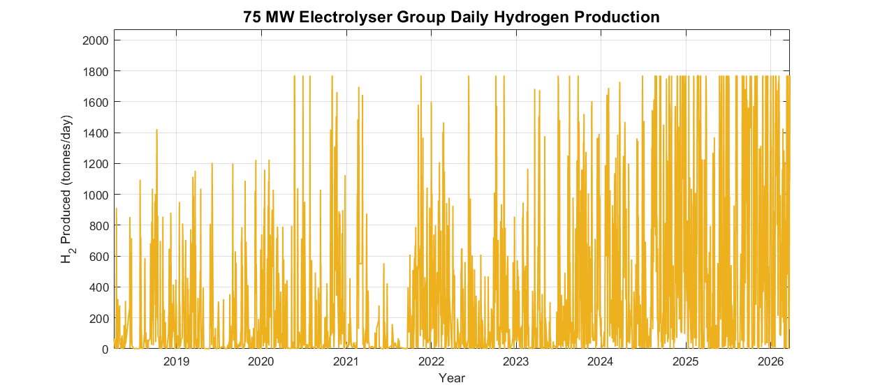
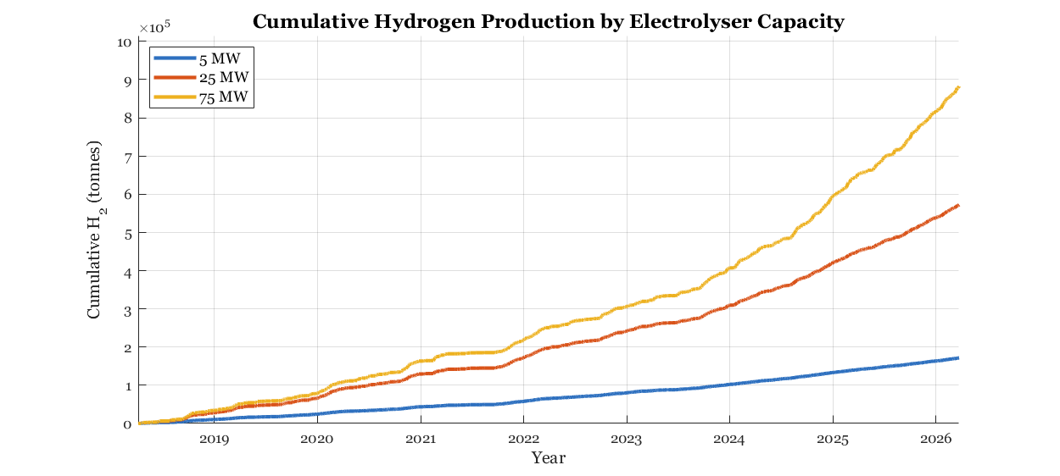
Results – Modelling and Simulation
Realistic modelling (capacity)
All electrolyser groups consist of 40 electrolysers

Slide 13
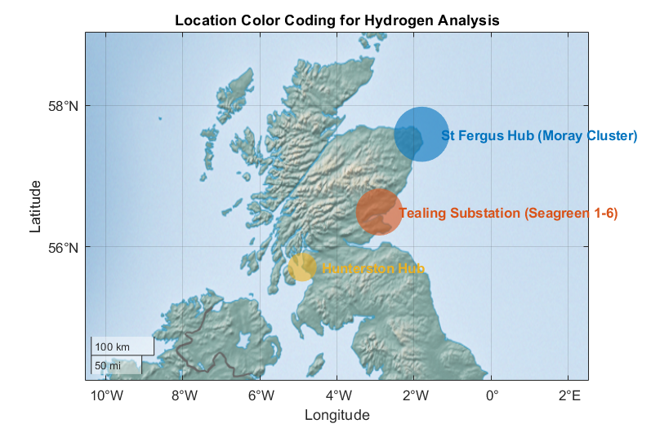
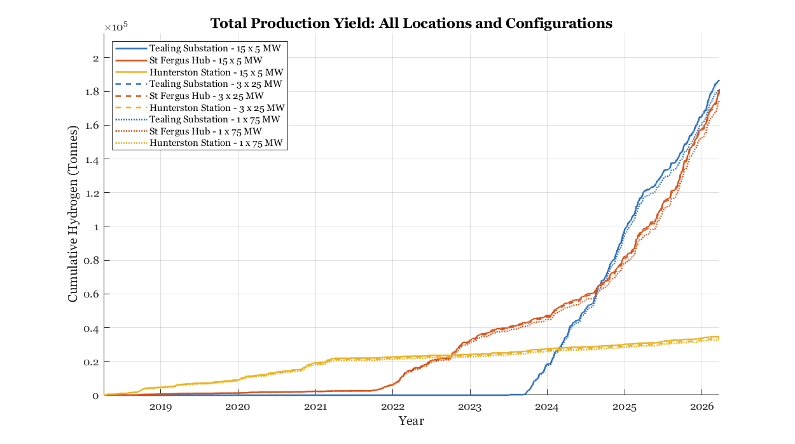
Results – Modelling and Simulation
Location based analysis of hydrogen production and electrolyser efficiency.
Electrolyser efficiency trials (600x5MW - 120x25MW – 40x75MW) (3GW)

Slide 14
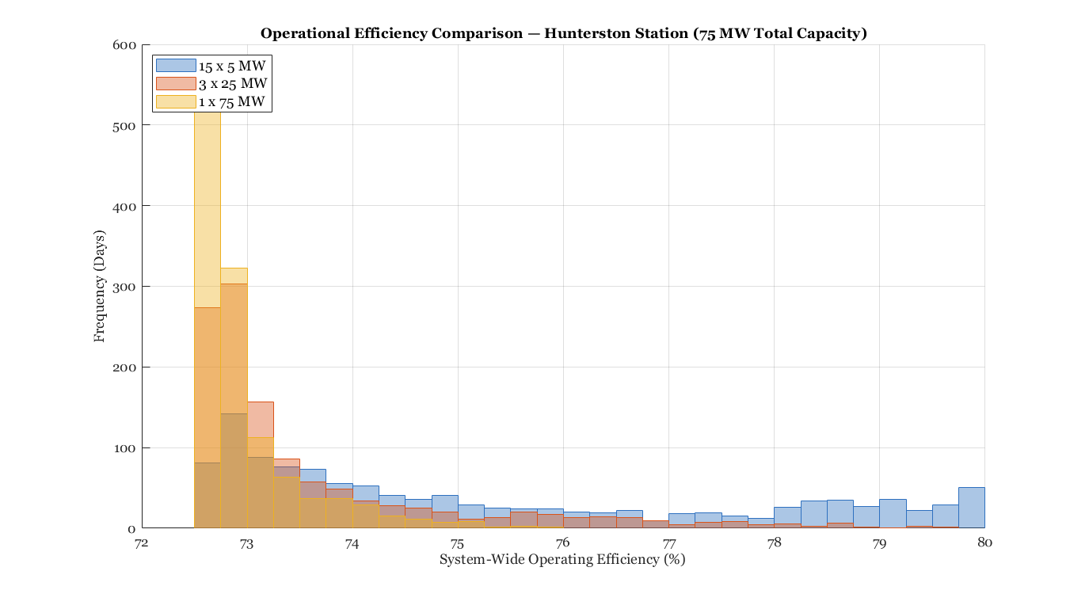
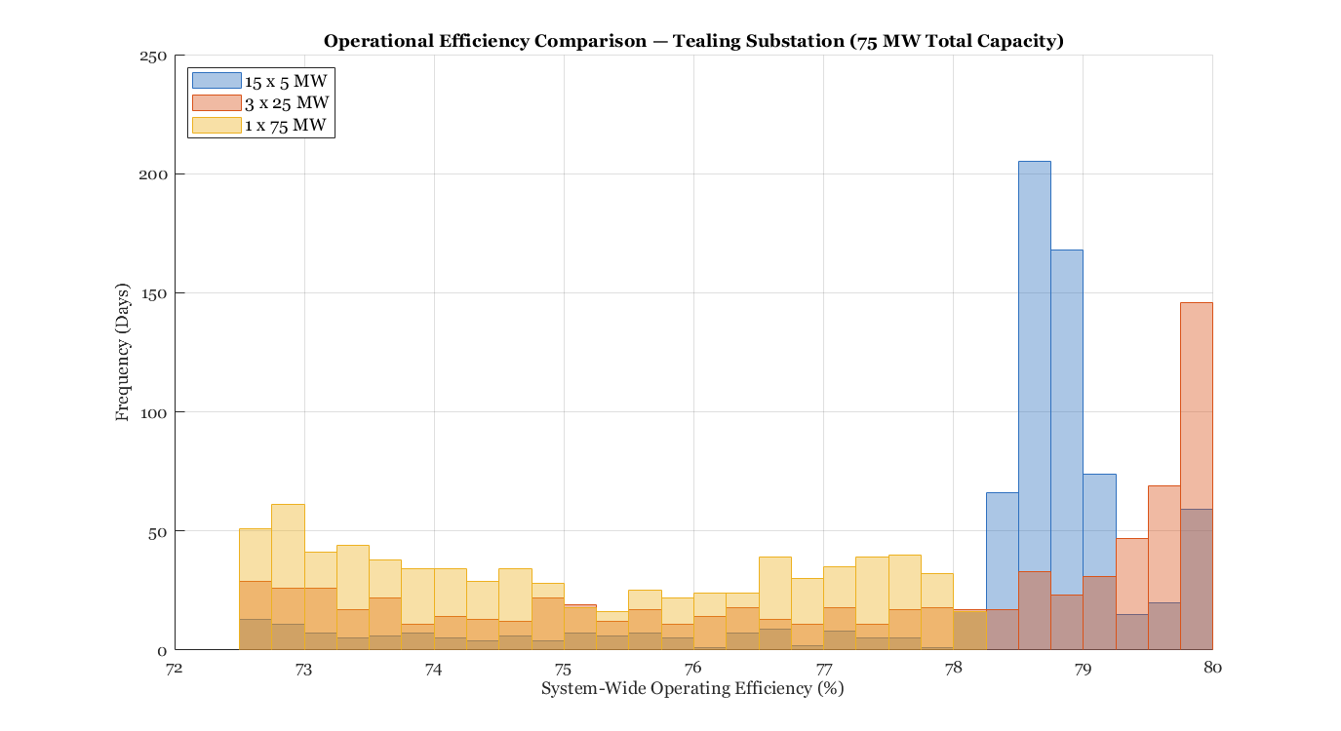
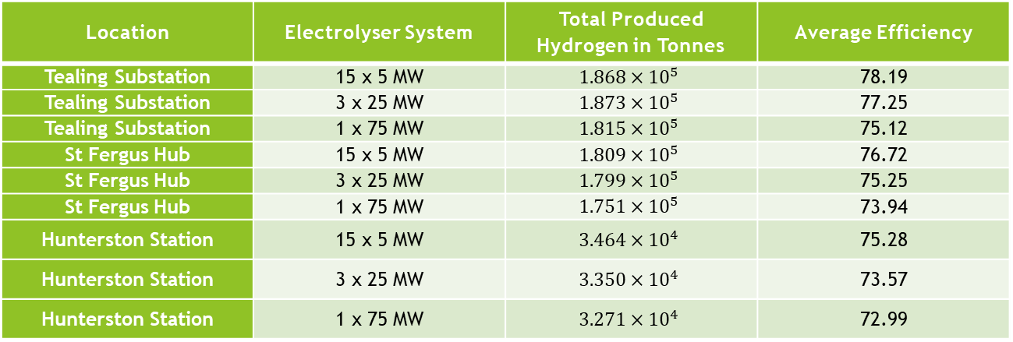
Location | Electrolyser System | Total Produced Hydrogen in Tonnes | Average Efficiency
Tealing Substation | 15 x 5 MW | $$1.868×{10}^{5}$$ | 78.19
Tealing Substation | 3 x 25 MW | $$1.873×{10}^{5}$$ | 77.25
Tealing Substation | 1 x 75 MW | $$1.815×{10}^{5}$$ | 75.12
St Fergus Hub | 15 x 5 MW | $$1.809×{10}^{5}$$ | 76.72
St Fergus Hub | 3 x 25 MW | $$1.799×{10}^{5}$$ | 75.25
St Fergus Hub | 1 x 75 MW | $$1.751×{10}^{5}$$ | 73.94
Hunterston Station | 15 x 5 MW | $$3.464×{10}^{4}$$ | 75.28
Hunterston Station | 3 x 25 MW | $$3.350×{10}^{4}$$ | 73.57
Hunterston Station | 1 x 75 MW | $$3.271×{10}^{4}$$ | 72.99

Slide 15
Discussion
Results suggest curtailment continuously increasing
Scotland to England bottleneck (97% curtailment)
Around 42% of the theoretical maximum production is realistic on a large scale operation. (400 thousand tonnes)
4-5 years curtailment for 1 year hydrogen supply
2.5 years for 48% of realistic production
Operation efficiency around 78-79% with correct systems

Slide 16
Conclusion
Stopping curtailments altogether isn’t realistic
Hydrogen production is limited to curtailment sites due to grid restrictions
Site based analysis and electrolyser system selection is important
Should be acted upon to catch up with existing curtailment levels
Invaluable in a future dependent on renewable energy

Slide 17
Limitations of the Study
Realistic production model assumes around 70% load as the most efficient
The trial capacities were selected based on the available total curtailed energy (Hunterston Hub)
Equal distribution of load between electrolysers in the simulation
Isn’t able to predict the impact of future investments into wind generation

