Slide 1
Honeypot Cybersecurity Project

Slide 2
What Is a Honeypot?
A honeypot is a decoy system designed to attract attackers by mimicking vulnerable or valuable systems.
Acts as a controlled trap, not a production system.
Allows safe observation of malicious activity
Used to study attack behavior and tools

Slide 3
Why Honeypots Matter
Threat intelligence gathering
  Observe real-world attacks
  Collect malware samples
Early Warning
  Identify new threats early
Distraction and Deflection
  Waste attacker time and resources on fake systems
  Provide false information to mislead adversaries

Slide 4
Technical Architecture
Internet Attackers
Cowrie SSH Honeypot
Log Collection
Python Analysis Backend
PostgreSQL Database
Flask Dashboard
→ Simulates vulnerable Linux system
→ JSON logs with attack data
→ Parses, analyzes, geolocates
→ Structured storage
→ Real-time visualization

Slide 5
Technology Stack:
Cowrie: Medium
interaction SSH honeypot
Python
Log parsing and analysis
PostgreSQL
Attack data storage
Flask
Web framework
Chart.js & Leaflet
Visualizations
Ubuntu VPS
Deployment platform

Slide 6
Live Demo: Show Dashboard
Statistics Overview
Total attacks captured
Geographic distribution
Attack Map
Show attack origins worldwide
Attack Timeline
Show attack patterns over time
Unique attackers
Time range of data
Highlight concentration areas (China, Russia, etc.)
Click markers to show details
Point out peak activity periods
Discuss 24/7 automated scanning

Slide 7
Live Demo: Show Dashboard
Credential Analysis
Most common username/password combinations
Command Analysis
Show what attackers try to execute
Show predictability of bot attacks
Discuss password security implications
Explain reconnaissance vs exploitation
Point out malware download attempts

Slide 8
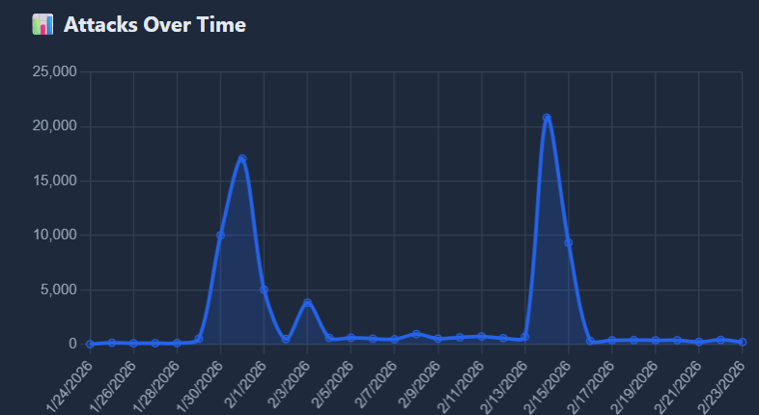
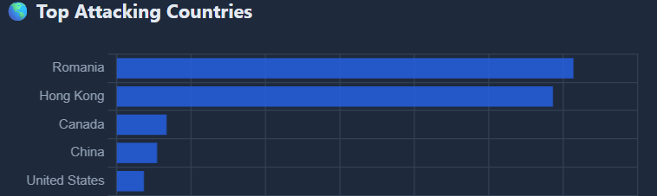
Key Findings
Attack Statistics
  We have captured 76,671 attacks from 105 countries
  In two weeks, we had 39,634 attacks
  Most attacks from: [top 3 countries]
    Romania
    Hongkong
    Canada
  Average of 2470 attacks per day

Slide 9
Key Findings
Attacker Behavior
  Automated bots vs human attackers
  Common attack patterns identified
    1
    2
    3
  Time to first attack after deployment

Slide 10
Key Findings
Top Credentials Tried
  root/root
  admin/admin
  root/password (Show your actual top 5)
    Admin/admin
    Root/P
    Rllot/
    Root/root
    User/user

Slide 11
Key Findings
Malicious Activities Observed
  Cryptocurrency mining attempts
  DDoS botnet recruitment
  Reconnaissance for other targets
  Credential harvesting

Slide 12
Security Insights
Attackers are relentless
Common credentials are dangerous
Real attacker IPs and techniques
Malware samples for analysis
Attacks start within hours of deployment
24/7 automated scanning is constant
No system goes unnoticed on the internet
Layered defense is essential
Threat intelligence is valuable
Default passwords are tried first
Password reuse is heavily exploited
Single security measure is insufficient
Monitoring and detection are crucial
Isolation prevents lateral movement
Understanding TTPs (Tactics, Techniques, Procedures)
Strong, unique passwords are critical

Slide 13
Project Value:
Practical application of cybersecurity concepts
Real-world data collection and analysis
Full-stack development experience
DevOps and infrastructure skills

Slide 14
Future Enhancements:
Machine learning for anomaly detection
Multiple honeypot types (HTTP, database)
Integration with threat intelligence feeds
Automated incident response

