Slide 1
FLex

Slide 2
Overview of Lex
lex is a program (generator) that generates lexical analyzers, (widely used on Unix).
It is mostly used with Yacc parser generator.
Written by Eric Schmidt and Mike Lesk.
It reads the input stream (specifying the lexical analyzer ) and outputs source code implementing the lexical analyzer in the C programming language.
Lex will read patterns (regular expressions); then produces C code for a lexical analyzer that scans for identifiers.

Slide 3
Cont.
Purpose: to construct the scanner
Input: a table of regular expressions and corresponding program fragments
  Used to construct a deterministic finite automaton
Output: a scanner, written in C, which
  Reads an input stream (source language program)
  Partitions input stream into strings which match regular expressions
  Produces an output stream (list of tokens)

Slide 4
Skeleton of a Lex Specification (.l file)
x.l
%{
< C global variables, prototypes, comments >
%}
[DEFINITION SECTION]
%%
[RULES SECTION]
%%
C auxiliary subroutines/code
lex.yy.c is generated after running
> lex x.l
This part will be embedded into lex.yy.c
Define how to scan and what action to take for each token
Any user code.

Slide 5
Lex Source
Lex source is separated into three sections by %% delimiters
definitions
%%
rules
%%
user code
required
optional
Shortest possible legal flex input:
%%

Slide 6
In Context of C
Lex source program
Lex
lex.yy.c
lex.yy.c
C compiler
a.out
input
a.out
tokens

Slide 7
The Shortest Lex program
%%
This program contains no definitions, no rules, and no user subroutines!
It copies the input to the output without change.

Slide 8
Lex Program to Delete White Space at End of Lines
%%
[ \t]+$ ;
\t means “tab”
[ \t] means “either ‘space’ or ‘tab’”
[ \t]+ means “a string of one or more ‘spaces’ or ‘tabs’”
$ means “end of line”
[ \t]+$ means “a string of one or more ‘spaces’ or ‘tabs’ followed by ‘end of line’”
There is no code fragment, so the text which matches the pattern is erased and not replaced with anything.

Slide 9
Lex Program to Compress White Space
%%
[ \t]+$ ;
[ \t]+ printf(" ");

Slide 10
Ex. Identifier in Pascal
Digit [0-9]
Letter [a-zA-Z]
%%
{Letter}({Digit} | {Letter})* printf(“\n The found identifier is = %s“, yytext);

Slide 11
Definition Section
A series of:
  name definitions, each of the form
      name definition
    e.g.:
      DIGIT [0-9]
      CommentStart "/*"
      ID [a-zA-Z][a-zA-Z0-9]
      These definitions can be used in rules section as
      {DIGIT}+ {….
  stuff to be copied verbatim into the flex output (e.g., declarations, #includes):
    enclosed in %{ … }%, or
    indented

Slide 12
Rules Section
The rules portion of the input contains a sequence of rules.
Each rule has the form
  patterns actions
  where:
  Patterns are regular expression which describes a pattern to be matched on the input
  pattern must be un-indented
  actions are either a single C command or a sequence enclosed in braces. It must begin on the same line of patterns.

Slide 13
Count no.of chars and lines
%{
int charcount=0,linecount=0;
%}
%%
. charcount++;
\n {linecount++; charcount++;}
%%
int main()
{
yylex();
printf("There were %d characters in %d lines\n",
charcount,linecount);
return 0;
}

Slide 14
Count no.of chars, words and lines
%{
int charcount=0,linecount=0,wordcount=0;
%}
letter [ˆ \t\n]
%%
{letter}+ {wordcount++; charcount+=yyleng;}
. charcount++;
\n {linecount++; charcount++;}

Slide 15
Patterns
Essentially, extended regular expressions.
  Syntax: similar to grep (see man page)

Slide 16
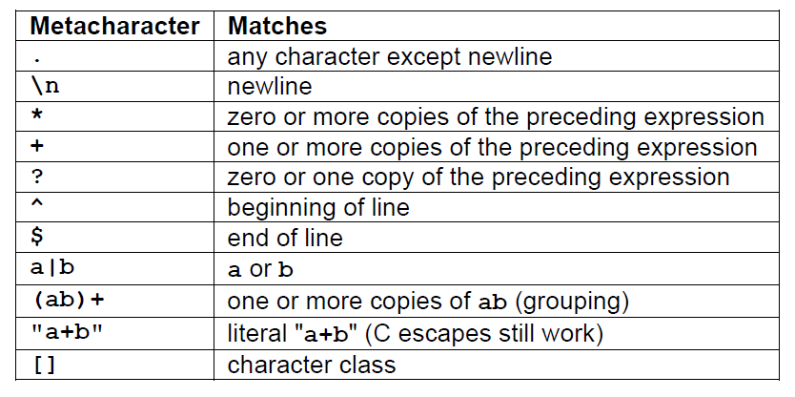
Metacharacters

Slide 17
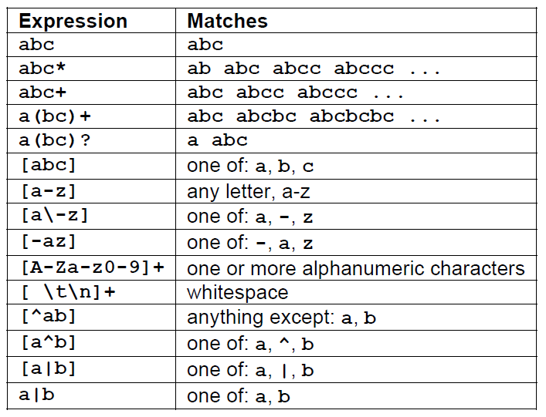
Pattern matching: Examples

Slide 18
Operators
“ \ [ ] ^ - ? . * + | ( ) $ / { } % < >
If they are to be used as text characters, an escape should be used
\$ = “$”
\\ = “\”
Every character except blank, tab (\t), newline (\n) and the list above is always a text character

Slide 19
Precedence of Operators
Level of precedence
  Kleene closure (*), ?, +
  concatenation
  alternation (|)
All operators are left associative.
Ex: a*b|cd* = ((a*)b)|(c(d*))

Slide 20
Regular Expression
x match the character 'x'
. any character (byte) except newline
[xyz] a "character class"; in this case, the pattern
matches either an 'x', a 'y', or a 'z'
[abj-oZ] a "character class" with a range in it; matches
an 'a', a 'b', any letter from 'j' through 'o',
or a 'Z'
[^A-Z] a "negated character class", i.e., any character
but those in the class. In this case, any
character EXCEPT an uppercase letter.
[^A-Z\n] any character EXCEPT an uppercase letter or
a newline

Slide 21
Regular Expression
r* zero or more r's, where r is any regular expression
r+ one or more r's
r? zero or one r's (that is, "an optional r")
r{2,5} anywhere from two to five r's
r{2,} two or more r's
r{4} exactly 4 r's
{name} the expansion of the "name" definition
(see above)
"[xyz]\"foo“ the literal string: [xyz]"foo
\X if X is an 'a', 'b', 'f', 'n', 'r', 't', or 'v',
then the ANSI-C interpretation of \x.
Otherwise, a literal 'X' (used to escape
operators such as '*')

Slide 22
Regular Expression
\0 a NUL character (ASCII code 0)
\123 the character with octal value 123
\x2a the character with hexadecimal value 2a
(r) match an r; parentheses are used to override
precedence (see below)
rs the regular expression r followed by the
regular expression s; called "concatenation"
r|s either an r or an s
^r an r, but only at the beginning of a line (i.e.,
which just starting to scan, or right after a
newline has been scanned).
r$ an r, but only at the end of a line (i.e., just
before a newline). Equivalent to "r/\n".

Slide 23
Two Notes on Using Lex
1. Lex matches token with longest match
Input: abc
Rule: [a-z]+
→ Token: abc (not “a” or “ab”)
2. Lex uses the first applicable rule
Input: post
Rule1: “post” {printf (“Hello,”); }
Rule2: [a-zA-Z]+ {printf (“World!”); }
→ It will print Hello, (not “World!”)

Slide 24
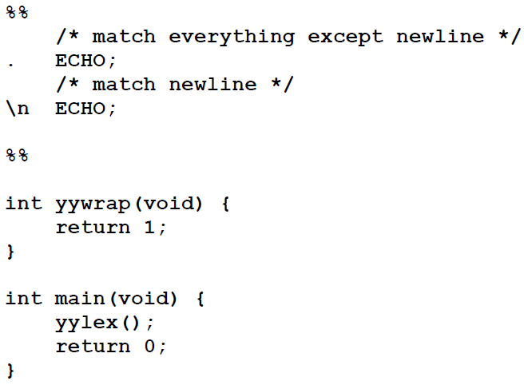
Features
Some limitations, Lex cannot be used to recognize nested structures such as parentheses, since it only has states and transitions between states.
Echo is an action and predefined macro in lex that writes code matched by the pattern.

Slide 25
Features (cont)
Text enclosed by %{ and %} is assumed to be C code and is copied verbatim
Line which begins with white space is assumed to be a comment and is ignored
Other lines are assumed to be definitions
All input characters which are not matched by a lex rule are copied to the output stream (the file lex.yy.c which contains function yylex)
Definitions from the definitions section are physically substituted into the rules

Slide 26
Example
A flex program to read a file of (positive) integers and compute the average:
%{
#include <stdio.h>
#include <stdlib.h>
%}
dgt [0-9]
%%
{dgt}+ return atoi(yytext);
%%
void main()
{
int val, total = 0, n = 0;
while ( (val = yylex()) > 0 ) {
total += val;
n++;
}
if (n > 0) printf(“ave = %d\n”, total/n);
}

Slide 27
Example
A flex program to read a file of (positive) integers and compute the average:
%{
#include <stdio.h>
#include <stdlib.h>
%}
dgt [0-9]
%%
{dgt}+ return atoi(yytext);
%%
void main()
{
int val, total = 0, n = 0;
while ( (val = yylex()) > 0 ) {
total += val;
n++;
}
if (n > 0) printf(“ave = %d\n”, total/n);
}
Definition for a digit
(could have used builtin definition [:digit:] instead)
definitions
Rule to match a number and return its value to the calling routine
rules
Driver code
(could instead have been in a separate file)
user code

Slide 28
Example
A flex program to read a file of (positive) integers and compute the average:
%{
#include <stdio.h>
#include <stdlib.h>
%}
dgt [0-9]
%%
{dgt}+ return atoi(yytext);
%%
void main()
{
int val, total = 0, n = 0;
while ( (val = yylex()) > 0 ) {
total += val;
n++;
}
if (n > 0) printf(“ave = %d\n”, total/n);
}
defining and using a name
definitions
rules
user code

Slide 29
Example
A flex program to read a file of (positive) integers and compute the average:
%{
#include <stdio.h>
#include <stdlib.h>
%}
dgt [0-9]
%%
{dgt}+ return atoi(yytext);
%%
void main()
{
int val, total = 0, n = 0;
while ( (val = yylex()) > 0 ) {
total += val;
n++;
}
if (n > 0) printf(“ave = %d\n”, total/n);
}
defining and using a name
definitions
char * yytext;
  a buffer that holds the input characters that actually match the pattern
rules
user code

Slide 30
Example
A flex program to read a file of (positive) integers and compute the average:
%{
#include <stdio.h>
#include <stdlib.h>
%}
dgt [0-9]
%%
{dgt}+ return atoi(yytext);
%%
void main()
{
int val, total = 0, n = 0;
while ( (val = yylex()) > 0 ) {
total += val;
n++;
}
if (n > 0) printf(“ave = %d\n”, total/n);
}
defining and using a name
definitions
char * yytext;
  a buffer that holds the input characters that actually match the pattern
rules
Invoking the scanner: yylex()
  Each time yylex() is called, the scanner continues processing the input from where it last left off.
  Returns 0 on end-of-file.
user code

Slide 31
Matching the Input
When more than one pattern can match the input, the scanner behaves as follows:
  the longest match is chosen;
  if multiple rules match, the rule listed first in the flex input file is chosen;
  if no rule matches, the default is to copy the next character to stdout.
The text that matched (the “token”) is copied to a buffer yytext.

Slide 32
Matching the Input (cont’d)
Pattern to match C-style comments: /* … */
"/*"(.|\n)*"*/"
Input:
#include <stdio.h> /* definitions */
int main(int argc, char * argv[ ]) {
if (argc <= 1) {
printf(“Error!\n”); /* no arguments */
}
printf(“%d args given\n”, argc);
return 0;
}

Slide 33
Matching the Input (cont’d)
Pattern to match C-style comments: /* … */
"/*"(.|\n)*"*/"
Input:
#include <stdio.h> /* definitions */
int main(int argc, char * argv[ ]) {
if (argc <= 1) {
printf(“Error!\n”); /* no arguments */
}
printf(“%d args given\n”, argc);
return 0;
}
longest match:

Slide 34
Matching the Input (cont’d)
Pattern to match C-style comments: /* … */
"/*"(.|\n)*"*/"
Input:
#include <stdio.h> /* definitions */
int main(int argc, char * argv[ ]) {
if (argc <= 1) {
printf(“Error!\n”); /* no arguments */
}
printf(“%d args given\n”, argc);
return 0;
}
longest match:
Matched text shown in blue

Slide 35
Lex Predefined Variables
yytext -- a string containing the lexeme
yyleng -- the length of the lexeme
yyin -- the input stream pointer
  the default input of default main() is stdin
yyout -- the output stream pointer
  the default output of default main() is stdout.
E.g.
  [a-z]+ printf(“%s”, yytext);
  [a-z]+ ECHO;
  [a-zA-Z]+ {words++; chars += yyleng;}

Slide 36
Lex Library Routines
yylex()
  The default main() contains a call of yylex(), a function of lex.yy.c file generated after using command lex
yymore()
  return the next token
yyless(n)
  retain the first n characters in yytext
yywarp()
  is called whenever Lex reaches an end-of-file
  The default yywarp() always returns 1

Slide 37
Review of Lex Predefined Variables
Name | Function
char *yytext | pointer to matched string
int yyleng | length of matched string
FILE *yyin | input stream pointer
FILE *yyout | output stream pointer
int yylex(void) | call to invoke lexer, returns token
char* yymore(void) | return the next token
int yyless(int n) | retain the first n characters in yytext
int yywrap(void) | wrapup, return 1 if done, 0 if not done
ECHO | write matched string
REJECT | go to the next alternative rule
INITAL | initial start condition
BEGIN | condition switch start condition

Slide 38
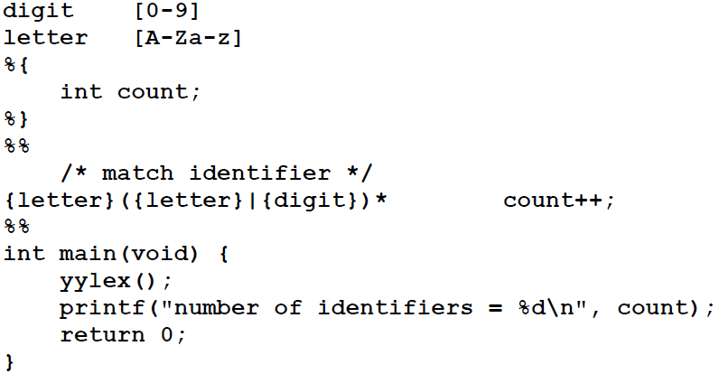
To count no of Identifiers
White space must separate the defining term and the associated expression.
Code in the definitions section is simply copied as-is to the top of the generated C file and must be bracketed with “%{“ and “%}” markers.
substitutions in the rules section are surrounded by braces ({letter}) to distinguish them from literals.

Slide 39
User Subroutines Section
You can use your Lex routines in the same ways you use routines in other programming languages.
%{
void foo();
%}
letter [a-zA-Z]
%%
{letter}+ foo();
%%
…
void foo() {
…
}

Slide 40
User Subroutines Section (cont’d)
The section where main() is placed
%{
int counter = 0;
%}
letter [a-zA-Z]
%%
{letter}+ {printf(“a word\n”); counter++;}
%%
main() {
yylex();
printf(“There are total %d words\n”, counter);
}

Slide 41
Usage
To run Lex on a source file, type
lex scanner.l
It produces a file named lex.yy.c which is a C program for the lexical analyzer.
To compile lex.yy.c, type
cc lex.yy.c –ll
To run the lexical analyzer program, type
./a.out < inputfile

