Slide 1
YACC

Slide 2
YACC
  Tool which will produce a parser for a given grammar.
  YACC (Yet Another Compiler Compiler) is a program designed to compile a LALR(1) grammar and to produce the source code of the syntactic analyzer of the language produced by this grammar
  Input is a grammar (rules) and actions to take upon recognizing a rule
  Output is a C program and optionally a header file of tokens

Slide 3
LEX
  Lex is a scanner generator
  Input is description of patterns and actions
  Output is a C program which contains a function yylex() which, when called, matches patterns and performs actions per input
  Typically, the generated scanner performs lexical analysis and produces tokens for the (YACC-generated) parser

Slide 4
Basic Operational Sequence
- flex and bison are GNU tools
_{Lex}
_{spec}
_{Lex/flex}
_{lex.yy.c}
_{compiler}
_{a.out}
_{YACC}
_{spec}
_{Yacc/bison}
_{y.tab.c}

Slide 5
Lex source
(Lexical Rules)
Yacc source
(Grammar Rules)
Lex
Yacc
lex.yy.c
y.tab.c
call
yylex()
yyparse()
Parsed
Input
Input
return token

Slide 6
How YACC Works
y.tab.h
yacc
YACC source (*.y)
y.tab.c
y.output
(1) Parser generation time
C compiler/linker
y.tab.c
a.out
(2) Compile time
Abstract
Syntax
Tree
a.out
Token stream
(3) Run time

Slide 7
YACC Specification section
  declarations
  %%
  translation rules
  %%
  Additional C/C++ code
  Comments enclosed in /* ... */ may appear in any of the sections.

Slide 8
definitions
%%
rules
%%
user code
required
optional
Shortest possible legal yacc input:
%%

Slide 9
YACC declaration section
Includes:
  Optional C/C++/Java code (%{ … %} ) – copied directly into the output(e.g., declarations, #includes)
  YACC definitions (%token, %start, …) – used to provide additional information
    %token – interface to lex
    %start – start symbol of grammar
    Others: %type, %left, %right, %union …

Slide 10
YACC rules
A rule captures all of the productions for a single non-terminal.
  Left_side : production 1|production 2…..| production n;
Each rule consists of a grammar production and the associated semantic action.
The above would be written in Yacc as:
Left side : production 1 {semantic action 1}
| production 2 {semantic action 2}
……
| production n {semantic action n}
Where Left side is treated as $$, and
suppose production 1 is x+y, then x can be accessed as $1, + as $2 and y as $3

Slide 11
YACC actions
Actions are C/C++/Java code.
Actions can include references to attributes associated with terminals and non-terminals in the productions.
Actions may be put inside a rule – action performed when symbol is pushed on stack
Safest (i.e. most predictable) place to put action is at end of rule.

Slide 12
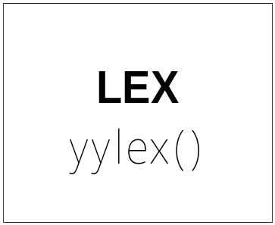
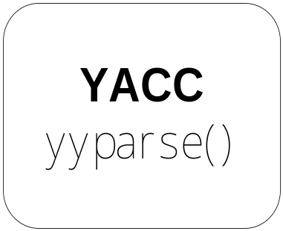
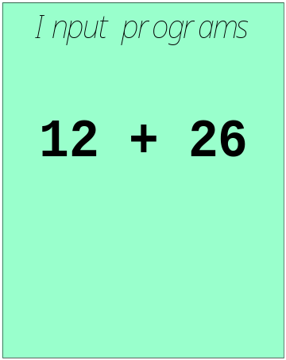
LEX and YACC
How to work ?

Slide 13
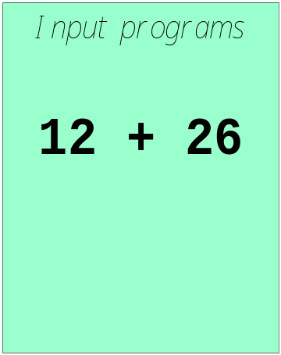
call yylex()
[0-9]+
next token is NUM
NUM ‘+’ NUM

Slide 14
Integration with Lex
yyparse() calls yylex() when it needs a new token. YACC handles the interface details
yylval is used to return attribute information
In the Lexer: | In the Parser:
return(TOKEN) | %token TOKEN TOKEN used in productions
return(‘c’) | ‘c’ used in productions

Slide 15
yyparse() reads a stream of token/value pairs from yylex(), which needs to be supplied
The yylex() as written by Lex reads characters from a FILE * file pointer called yyin. If we do not set yyin, it defaults to standard input. It outputs to yyout, which if unset defaults to stdout.
We can also modify yyin in the yywrap() function which is called at the end of a file. It allows to open another file, and continue parsing. If this is the case, it will return 0. If we want to end parsing at this file, it returns 1.

Slide 16
Each call to yylex() returns an integer value which represents a token type. This tells YACC what kind of token it has read. The token may optionally have a value, which should be placed in the variable yylval.
By default yylval is of type int, but we can override that from the YACC file by re #defining YYSTYPE.
As yylex() needs to return what kind of token it encountered, and put its value in yylval from yytext. When these tokens are defined with the %token command, they are assigned numerical id's, starting from 257. Because of that fact, it is possible to have all ascii characters as a token.

Slide 17
A simple thermostat controller
heat on
Heater on!
heat off
Heater off!
target temperature 22
New temperature set!
The tokens we need to recognize are: heat, on/off (STATE), target, temperature, NUMBER.

Slide 18
thermostat.l
%{
#include <stdio.h>
#include "y.tab.h"
%}
%%
[0−9]+ return NUMBER;
heat return TOKHEAT;
on|off return STATE;
target return TOKTARGET;
temperature return TOKTEMPERATURE;
\n /* ignore end of line */;
[ \t]+ /* ignore whitespace */;
%%

Slide 19
There are two important changes.
First, we include the file 'y.tab.h', and secondly, we no longer print stuff, we return names of tokens. This change is because we are now feeding it all to YACC, which isn't interested in what we output to the screen. y.tab.h has definitions for these tokens.
But where does y.tab.h come from? It is generated by YACC from the grammar file we are about to create.

Slide 20
grammar rules section of thermostat.y
commands: /* empty */
| commands command
;
command:
heat_switch
|
target_set
;
heat_switch:
TOKHEAT STATE
{
printf("\tHeat turned on or off\n");
}
;
target_set:
TOKTARGET TOKTEMPERATURE NUMBER
{
printf("\tTemperature set\n");
}
;

Slide 21
Header section of thermostat.y
The previous section only showed the grammar part of the YACC file, but there is more. This is the header that we omitted:
%{
#include <stdio.h>
#include <string.h>
void yyerror(const char *str)
{
fprintf(stderr,"error: %s\n",str);
}
int yywrap()
{
return 1;
}
main()
{
yyparse();
}
%}
%token NUMBER TOKHEAT STATE TOKTARGET TOKTEMPERATURE

Slide 22
The yyerror() function is called by YACC if it finds an error.
The function yywrap() can be used to continue reading from another file. It is called at EOF and you can then open another file, and return 0. Or you can return 1, indicating that this is truly the end.
Then there is main() function, that does nothing but set everything in motion.
The last line simply defines the tokens we will be using. These are output using y.tab.h if YACC is invoked with the '−d' option. By which yacc writes an extra output file containing macro definitions for the token type names that are defined in the grammar, the semantic value type YYSTYPE, and a few external variable declarations

Slide 23
Compiling & running the thermostat controller
lex thermostat.l
yacc −d thermostat.y
cc lex.yy.c y.tab.c −o thermostat
The Lexer needs to be able to access yylval. In order to do so, it must be declared in the scope of the lexer as an extern variable. The original YACC neglects to do this for you, so we should add the following to the lexter, just beneath #include <y.tab.h>:
extern YYSTYPE yylval;

Slide 24
How to handle parameters
Whenever Lex matches a target, it puts the text of the match in the character string 'yytext'. YACC in turn expects to find a value in the variable 'yylval'.
%{
#include <stdio.h>
#include "y.tab.h“
extern YYSTYPE yylval;
%}
%%
[0−9]+ yylval=atoi(yytext); return NUMBER;
heat return TOKHEAT;
on|off yylval=!strcmp(yytext,"on"); return STATE;
target return TOKTARGET;
temperature return TOKTEMPERATURE;
\n /* ignore end of line */;
[ \t]+ /* ignore whitespace */;
%%

Slide 25
grammar rules section of thermostat.y
commands: /* empty */
| commands command
;
command:
heat_switch
|
target_set
;
target_set:
TOKTARGET TOKTEMPERATURE NUMBER
{
printf("\tTemperature set to %d\n",$3);
}
;
heat_switch:
TOKHEAT STATE {$$ = $1 $2}
{
if($2)
printf("\tHeat turned on\n");
else
printf("\tHeat turned off\n");
}
;

Slide 26
Advanced yylval: %union
Currently, we need to define the type of yylval. This however is not always appropriate.
What if we need to handle multiple data types??
To store only string value to yylval,
typedef char* string;
#define YYSTYPE string

Slide 27
Modified lexer
%{
#include <stdio.h>
#include <string.h>
#include "y.tab.h"
extern YYSTYPE yylval;
%}
%%
[0-9]+ yylval.number=atoi(yytext); return NUMBER;
heater return TOKHEATER;
heat return TOKHEAT;
on|off yylval.number=!strcmp(yytext,"on"); return STATE;
target return TOKTARGET;
temperature return TOKTEMPERATURE;
[a-z0-9]+ yylval.string=strdup(yytext);return WORD;
\n /* ignore end of line */;
[ \t]+ /* ignore whitespace */;
%%

Slide 28
Modified parser
%token TOKHEATER TOKHEAT TOKTARGET TOKTEMPERATURE
%union
{
int number;
char *string;
}
%token <number> STATE
%token <number> NUMBER
%token <string> WORD
%%
/* grammar rules */

Slide 29
heat_switch:
TOKHEAT WORD
{
printf("\tSelected heater '%s'\n",$2);
heater=$2; // just to store copy
};
|
TOKHEAT STATE
{
printf("\tSelected heater '%d'\n",$2);
heater=$2;
};
target_set:
TOKTARGET TOKTEMPERATURE NUMBER
{
printf("\tHeater '%s' temperature set to %d\n",heater,$3);
}
;

Slide 30
Features
Yacc takes a default action when there is a conflict.
For shift-reduce conflicts yacc will shift. For reduce-reduce conflicts it will use the first rule in the listing.
It also issues a warning message whenever a conflict exists. The warnings may be suppressed by making the grammar unambiguous.
You can specify precedence and associativity in YACC, making your grammar simpler.
Associativity: %left, %right, %nonassoc
Precedence : order is important (higher at last)
%left PLUS MINUS
  %left MULT DIV
  %nonassoc UMINUS
Lab Assignment – build calculator which can handle basic operations like +,-,*,/,etc using lex and yacc.

Slide 31
Conflicts
Conflicts arise when there is more than one way to proceed with parsing.
Two types:
  shift-reduce [default action: shift]
  reduce-reduce [default: reduce with the first rule listed]
Removing conflicts:
  specify operator precedence, associativity;
  restructure the grammar
    use y.output to identify reasons for the conflict.

Slide 32
Specifying Operator Properties
Binary operators: %left, %right, %nonassoc:
    %left '+' '-'
    %left '*' '/'
    %right '^‘
Unary operators: %prec
  Changes the precedence of a rule to be that of the token specified. E.g.:
      %left '+' '-'
      %left '*' '/‘
      Expr: expr ‘+’ expr
      | ‘–’ expr %prec ‘*’
      | …
Operators in the same group have the same precedence

Slide 33
Specifying Operator Properties
Binary operators: %left, %right, %nonassoc:
    %left '+' '-'
    %left '*' '/'
    %right '^'
Unary operators: %prec
  Changes the precedence of a rule to be that of the token specified. E.g.:
      %left '+' '-'
      %left '*' '/'
      Expr: expr ‘+’ expr
      | ‘–’ expr %prec ‘*’
      | …
Operators in the same group have the same precedence
Across groups, precedence increases going down.

Slide 34
Specifying Operator Properties
Binary operators: %left, %right, %nonassoc:
    %left '+' '-'
    %left '*' '/'
    %right '^‘
Unary operators: %prec
  Changes the precedence of a rule to be that of the token specified. E.g.:
      %left '+' '-'
      %left '*' '/'
      Expr: expr '+' expr
      | '–' expr %prec '*'
      | …
Operators in the same group have the same precedence
Across groups, precedence increases going down.
The rule for unary ‘–’ has the same (high) precedence as ‘*’

Slide 35
Example
The grammar:
program -> program expr | ε
expr -> expr + expr | expr - expr | id
Program and expr are nonterminals.
id are terminals (tokens returned by lex) .
expression may be :
  sum of two expressions
  product of two expressions
  Or an identifiers

Slide 36
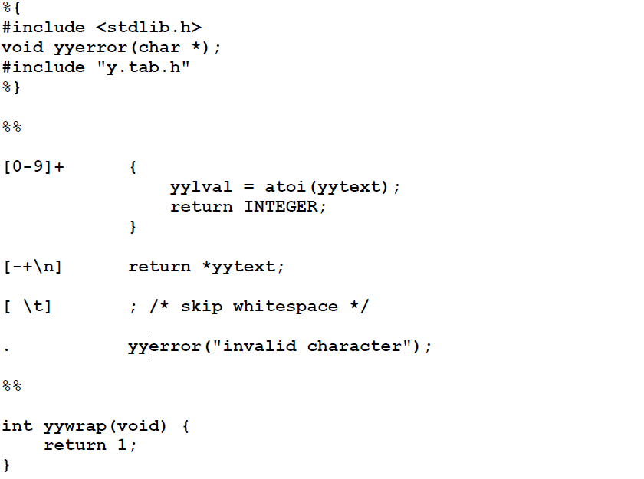
Lex file

Slide 37
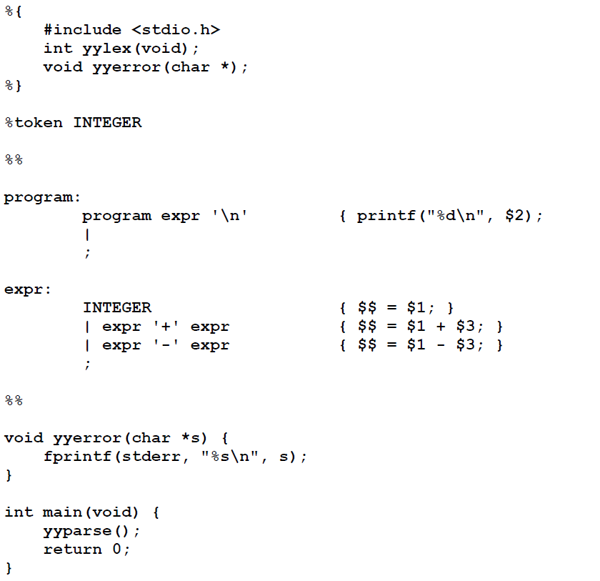
Yacc file

Slide 38
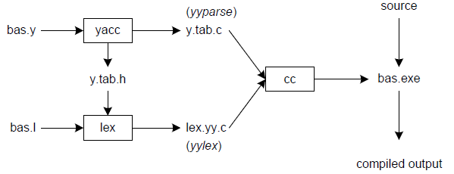
Linking lex & yacc

