Slide 1

RELEVANCE OF GENES ON SURVIVAL OF BREAST CANCER PATIENTS
Gungun Surana, 12th Grade
National Public School, Koramangala, India
Notes:
hello everyone, i am gungun surana from india. today, im going to talk ab the relevance of genes on survival of breast cancer patients.

Slide 2
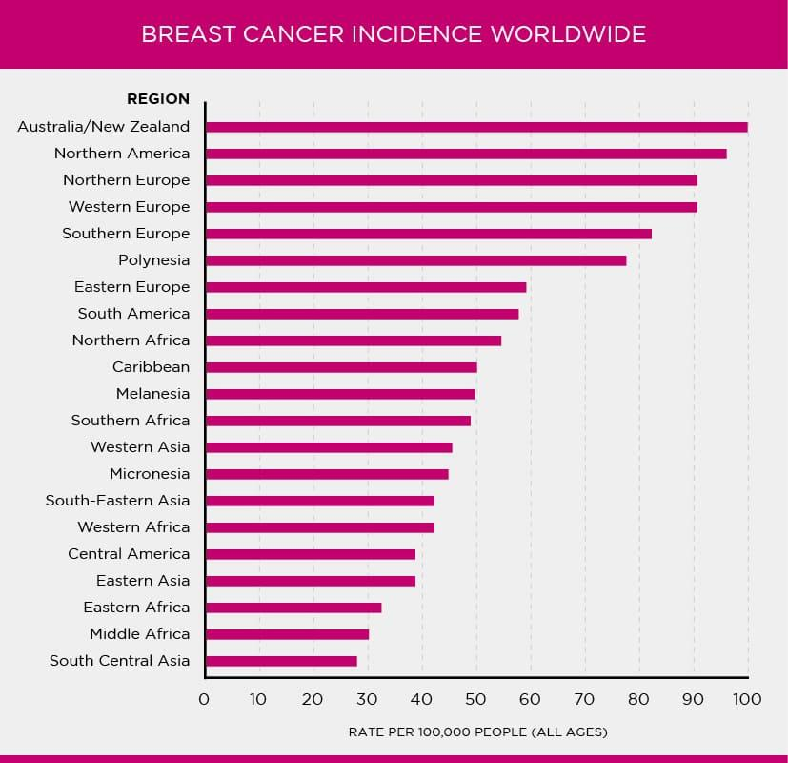
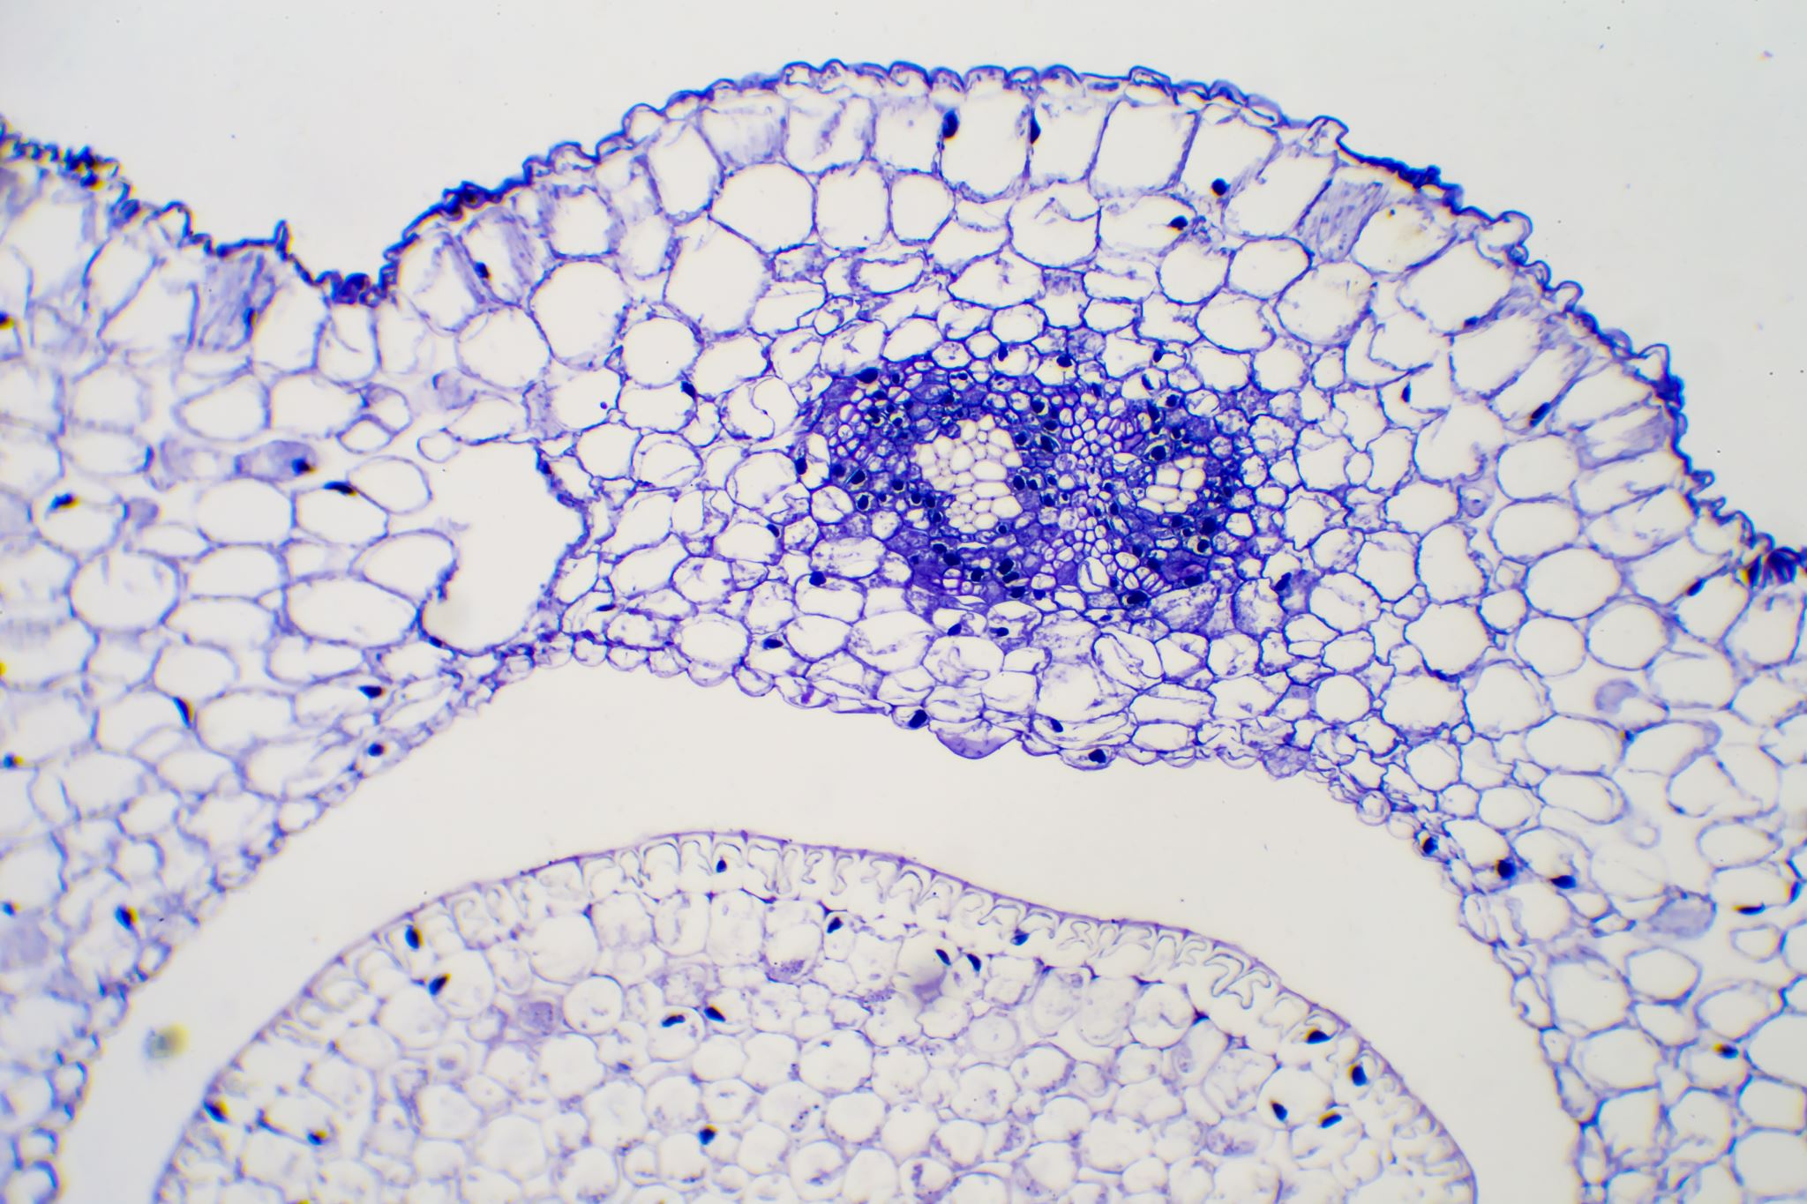
INTRODUCTION TO BRCA
Breast Cancer Prevalence:
One of the most common cancers affecting women globally.
Can also occur in men.
Origin:
In Cells of the breast, primarily in the milk-producing ducts (ductal carcinomas) or the glandular tissue called lobules (lobular carcinomas).
Types:
Ductal Carcinoma In Situ (DCIS): Non-invasive, confined to ducts.
Invasive Ductal Carcinoma (IDC): Most common, spreads beyond ducts.
Invasive Lobular Carcinoma (ILC): Begins in lobules, spreads to tissue.
Statistics:
In 2020, there were 2.3 million new cases of breast cancer globally.
In 2020, approximately 685,000 women died from breast cancer.
Ref
Ref
Notes:
breast cancer is one of the most common cancers affecting women globally. it can also occur in men. it originates in the cells of the breast, primarily in the ductal carcinomas or the lobular carcinomas. there are several types of brca. ductal carcinoma in situ is a non-invasive breast cancer which is confined to the ducts. Invasive ductal carcinoma is the most common, and it spreads beyond ducts. Invasive lobular carcinoma begins in the lobules and spreads to the tissues. In 2020, there were 2.3 mil new cases of breast cancer globally and approximately 685,000 women died frm brca.

Slide 3
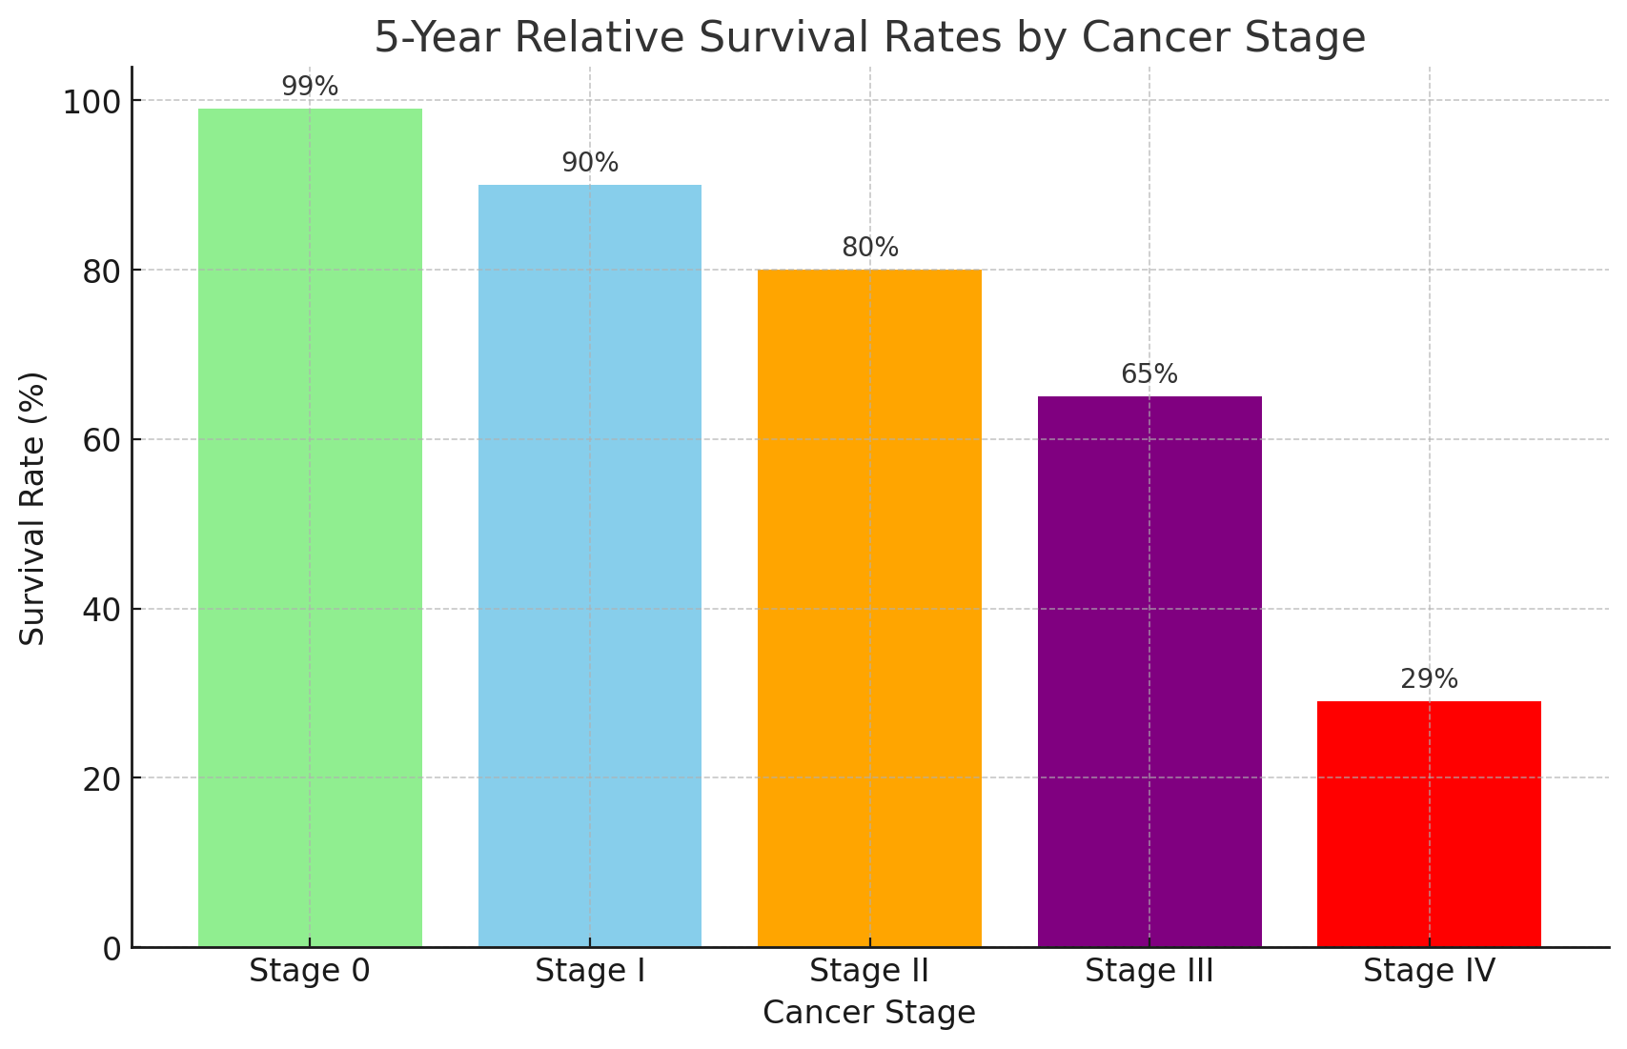
BRCA AND ITS DEBILITATING EFFECTS
Risk Factors:
Age, with most cases diagnosed after age 50.
Family history and genetic mutations (such as BRCA1 and BRCA2).
Reproductive history, including factors such as early menstruation and late menopause.
Hormonal factors, including hormone replacement therapy and birth control.
Lifestyle factors, including alcohol consumption, obesity, and lack of physical activity.
Survival Rates:
The 5-year relative survival rate for:
localized breast cancer (confined to the primary site) ~ 99%.
breast cancer that has spread to regional lymph nodes ~ 86%.
metastatic breast cancer (spread to distant parts of the body) ~ 29%.
Notes:
the risk factors of brca include age, family history and genetic material, reproductive history, hormonal factors and lifestyle factors.

Slide 4
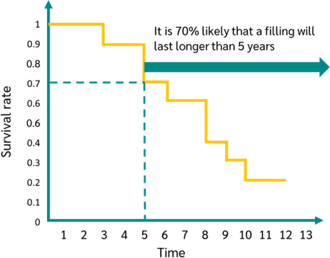

KAPLAN MEIER SURVIVAL ANALYSIS
KM Analysis:
Non-parametric statistic to describe survival function from lifetime data / time-series data.
Survival Function: P (patient surviving or not)
S(t) is probability that life is > t
t_{i} is time when >=1 event happened
d_{i} is number of events (deaths) happened at t_{i}
n_{i} is individuals known to have survived to t_{i}
Ref
Notes:
for my study, i utilised the kaplan meier survival analysis and the univariate cox proportional hazards analysis. In medical research, the kaplan meier survival analysis is often used to measure the fraction of patients living for a certain amount of time after treatment. It constructs a survival curve that visually represents the proportion of subjects surviving over specified time intervals, providing valuable insights into factors influencing outcomes and treatment efficacy.

Slide 5
UNIVARIATE COX PROPORTIONAL HAZARDS ANALYSIS
Each gene is tested in this analysis:
h(t∣X)=h₀​(t)exp(βX)
h(t∣X) is the hazard function at time ttt for a given covariate X.
h₀​(t) is the baseline hazard function.
β is the coefficient for the predictor variable X.
exp(β) represents the hazard ratio for a one-unit increase in X.
Hazard Ratio (HR):HR > 1: Increased hazard (worse survival)
  HR < 1: Decreased hazard (better survival)
  HR = 1: No effect
Confidence Interval (CI):Range of plausible HR values.
Advantages and Applications:
Handles censored data.
Estimates effect of predictors on survival.
Identifies risk factors for diseases.
Evaluates treatment effects.
Predicts patient outcomes based on characteristics.
Ref
Notes:
the univariate cox proportional hazards analysis is A statistical method to explore the relationship between survival time and one predictor variable, assuming the effect is constant over time.
it has quite a few advantages and applications, including
Handling censored data.
Estimating effect of predictors on survival.
Identifying risk factors for diseases, and so on.

Slide 6
METHODOLOGY
Downloaded GSE7390 dataset using GEOparse
Extracted Merged expression and clinical data
KM Survival Curve using covariates
Extracted beta, hazard ratio (HR), Wald test, and p-value for each gene
Univariate Cox proportional hazards analysis for each gene.
Notes:
Now, Let me explain the approach I used in this study. I began by downloading and integrating the GSE7390 dataset using GEOparse. From there, I extracted both merged expression and clinical data, paving the way to construct Kaplan-Meier survival curves based on covariates, followed by performing univariate Cox proportional hazards analysis for each gene. and finally, i extracted beta, hazard ratio, wald test and p value for each gene.

Slide 7
QUESTIONS
What factors does survival of breast cancer patients depend on?
Which genes impact survival differences between the patients?
What pathways are enriched among genes that significantly impact survival differences?
Notes:
here are a few qns which i tried to answer during the course of the project.

Slide 8
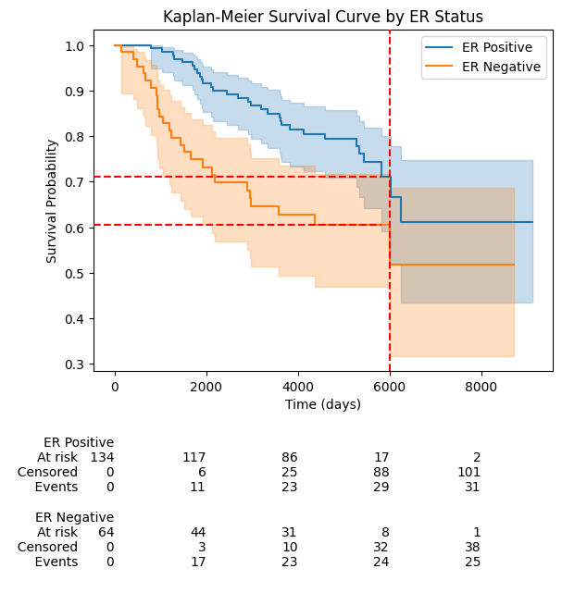
RESULTS
Estrogen Receptor presence (ER+) is associated with better prognosis and survival.
It is often associated with slower growing and less aggressive compared to ER-
Notes:
here are my results. Estrogen receptors (ER) are basically proteins found in some breast cancer cells that bind to estrogen,which is a hormone that can promote the growth of breast cancer cells.

Slide 9
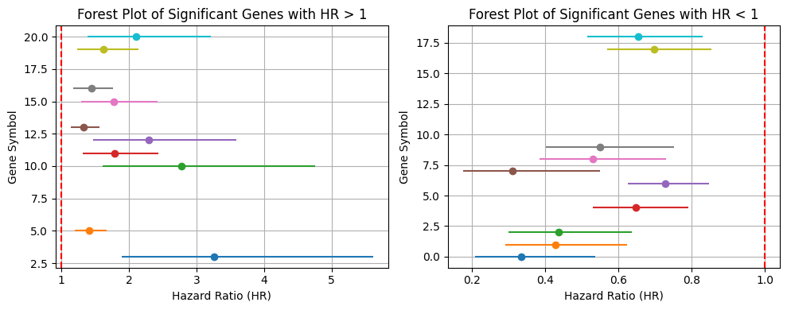
TOP 10 OUT OF 666 TOTAL GENES IMPACTING SURVIVAL
Gene Symbol | p.value | HR
CAND1 | 0.000514 | 2.110083
SCNN1B | 0.000505 | 1.626094
PLCH1 | 0.000414 | 1.442831
GPR56 | 0.000347 | 1.772877
NAT2 | 0.00031 | 1.334235
KATNB1 | 0.000256 | 2.29646
CENPU | 0.000235 | 1.789915
CIAPIN1 | 0.000207 | 2.772696
NPC1L1 | 0.000038 | 1.41416
SLC38A7 | 0.00002 | 3.258757
Notes:
This is a forest plot that summarizes the Hazard ratio across the top 10 genes as shown. Gene CIAPIN1 has the highest hazard ratio at 2.77. This gene is involved in cell growth and survival, and is often reduced in expression in breast cancer

Slide 10
TOP 10 OUT OF 582 TOTAL GENES WITH PROTECTIVE FUNCTION ON SURVIVAL
Gene Symbol | p.value | HR
C9orf156 | 0.000491 | 0.653663
SIK2 | 0.000487 | 0.696943
DFFB | 0.000178 | 0.549663
MGMT | 0.000102 | 0.529302
PAOX | 0.000063 | 0.309853
EPHX2 | 0.00004 | 0.728751
RTN1 | 0.000022 | 0.648152
ZNF589 | 0.000018 | 0.436579
SLC35D2 | 0.000011 | 0.426859
ARL6IP5 | 0.000006 | 0.333449
Notes:
If Hazard ratio is less than 1 then it often has a protective effect. The gene ARL6IP5 is often repressed in some breast cancers and acts as a tumor suppressor.

Slide 11
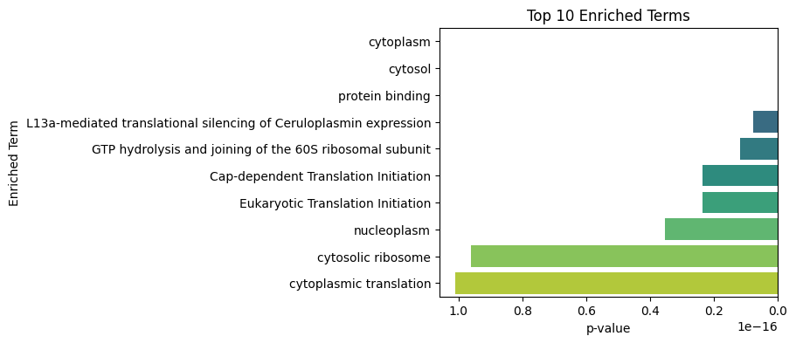
TOP 10 PATHWAYS ENRICHED
Dysregulation of translation processes and ribosome assembly in the cytoplasm can lead to altered protein synthesis, promoting uncontrolled cell growth and cancer.
Changes in the nucleoplasm and abnormal protein interactions disrupt genome integrity and signaling pathways, further contributing to malignancy.
Aberrations in translation initiation and cytosolic composition impact cellular function, metabolism, and survival, driving cancer progression.
Notes:
this graph shows the top 10 enriched terms in this study.

Slide 12
KEY TAKEAWAYS
Disruptions in processes like cytoplasmic translation, cytosolic ribosome function, nucleoplasm integrity, and translation initiation can lead to altered protein synthesis, genome instability, and faulty signaling in breast cancer (BRCA).
These changes contribute to uncontrolled cell growth, tumorigenesis, and cancer progression.
The survival analysis identified key genes associated with overall survival in the GSE7390 dataset.
These genes can potentially serve as biomarkers for breast cancer prognosis.
Future work includes looking at these candidate genes expression profiles and tumor subtyping analysis.
Notes:
these are the key takeaways:

Slide 13
THANK YOU

Slide 14
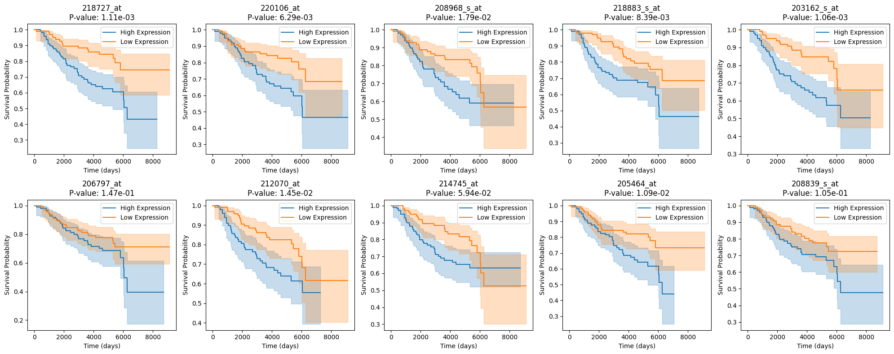

Slide 15
Process | Impact in BRCA
Cytoplasmic Translation | Dysregulation can lead to altered protein synthesis, contributing to uncontrolled cell growth and cancer progression.
Cytosolic Ribosome | Aberrations can affect protein synthesis and quality control, potentially leading to the production of faulty proteins that promote cancer.
Nucleoplasm | Changes can affect the integrity of the genome and the regulation of gene expression, contributing to cancer development.
Eukaryotic Translation Initiation | Dysregulation can lead to the preferential translation of oncogenes or the loss of tumor suppressor protein production.
Cap-dependent Translation Initiation | Malfunctions can result in selective translation of mRNAs that promote tumorigenesis.
GTP Hydrolysis and Joining of the 60S Ribosomal Subunit | Errors can lead to defective ribosome assembly and translation, affecting cellular function and viability.
L13a-mediated Translational Silencing of Ceruloplasmin Expression | Disruption can affect the expression of ceruloplasmin and other genes, potentially altering iron metabolism and contributing to cancer.
Protein Binding | Abnormal protein interactions can disrupt signaling pathways and regulatory mechanisms, promoting cancer.
Cytosol | Changes in cytosolic composition can affect metabolism, signal transduction, and cell survival.
Cytoplasm | Alterations can impact cell structure, signaling, and metabolism, contributing to malignant transformation and progression.

