Slide 1
PROJECT TITLE
CAPSTONE PROJECT
Presented By:
Gunjan Kumari
A.B.R.P.G. College Anpara Sonebhadra Uttar Pradesh
Bachelor Of Computer Application

Slide 2
OUTLINE
Problem Statement (Should not include solution)
Proposed System/Solution
System Development Approach (Technology Used)
Algorithm & Deployment
Result (Output Image)
Conclusion
Future Scope
References

Slide 3
Problem Statement
Example: A Library AI Agent is an intelligent system designed to assist students in finding the right learning materials based on their academic needs. It can autonomously analyze user profiles, study topics, and course syllabi to suggest relevant books and resources. Using natural language processing, it understands student queries and matches them with the most suitable books in the library database. The agent can check real-time book availability, prioritize high-demand titles, and assist with reservation or waitlist actions. It saves time by streamlining the search process and offering personalized recommendations aligned with current academic work. Library AI Agents enhance access, engagement, and resource utilization in educational environments.

Slide 4
Proposed Solution
The proposed system aims to help students easily find the most relevant academic books using intelligent automation. It uses natural language processing, user profiling, and cloud-based services to provide smart, real-time book recommendations.
Data Collection:
• Collect metadata of books including titles, subjects, authors, availability status, and semester relevance
• Capture student information such as course, semester, and subject preferences
• Track high-demand books, reservations, and usage logs to refine suggestions
Data Preprocessing:
• Clean book data (remove duplicates, fill missing values, correct labels)
• Categorize books by subject and academic level
• Extract keywords and tag books for better query matching using NLP techniques
Natural Language Processing & Matching:
• Use NLP (IBM Watson Assistant or IBM Granite) to understand student queries
• Identify subject and semester context from user input
• Match the query with the most relevant books from the library database
Deployment:
• Design a simple chatbot or web-based interface for student interaction
• Deploy the solution on IBM Cloud Lite for reliability, scalability, and easy access
• Integrate real-time book availability and reservation features
Evaluation:
• Evaluate system performance based on user feedback and successful query resolution
• Measure improvement in book accessibility, response time, and accuracy
• Continuously update the book database and NLP model based on usage trends
Result:
• Students get accurate book suggestions instantly
• Library engagement and book utilization improve
• Personalized, AI-driven experience enhances academic learning efficiency

Slide 5
System Approach
System Requirements:
Operating System: Windows 10 / Ubuntu / macOS
Processor: Minimum Intel i3 / AMD Ryzen 3
RAM: 4 GB or higher
Internet: Required for IBM Cloud access
Browser: Chrome / Firefox (latest version)
IBM Cloud Account: Lite plan (Free)
Libraries / Tools Required:
Backend & Logic:
• IBM Watson Assistant – for natural language understanding (NLP)
• IBM Cloud Lite – for hosting and deployment
• Node.js or Python – optional for backend processing (if needed)
Data Handling:
• JSON / Google Sheets – for maintaining book database
• CSV – if using tabular form for data input/output
Frontend (Optional User Interface):
• HTML, CSS, JavaScript – to build a simple chatbot interface
• IBM Watson Web Chat integration – for embedding Watson chatbot on a webpage
Additional Tools:
• IBM Granite (optional) – if using advanced AI/NLP features
• Any text/code editor – VS Code, Sublime, or similar

Slide 6
Algorithm & Deployment
Algorithm Selection:
The system uses Natural Language Processing (NLP) powered by IBM Watson Assistant to understand student queries and suggest suitable books. Unlike numerical prediction models (like ARIMA or LSTM), this system focuses on semantic matching and intent recognition. NLP was chosen due to the unstructured, query-based nature of the input data (e.g., "Suggest a book for DBMS, semester 4").
Data Input:
Student query text
Subject names (e.g., DBMS, OS, CN)
Semester information
Book metadata (title, subject, semester, availability)
Historical query logs (optional for personalization)
Training Process:
Watson Assistant is trained using sample intents and utterances such as “I need a book for Operating Systems, 3rd semester.”
Entity recognition (e.g., @subject, @semester) is used to extract structured information from natural queries.
The assistant is fine-tuned with real or dummy queries to improve accuracy.
Prediction Process:
When a query is received, the system extracts intent and entities using Watson NLP engine.
Based on extracted data, the system matches books from the database and filters by subject and semester.
Availability is checked in real-time, and the best matching book is suggested.
The model continuously improves as more student interactions are recorded.

Slide 7
Result
Students can now find the most suitable books based on subject and semester in just a few seconds using natural language queries.
Real-time availability and suggestions reduce the time spent searching for books manually.
The system improves engagement with library resources and enhances the overall academic experience.
It provides personalized and relevant book recommendations, aligned with students’ academic needs.
Using IBM Watson Assistant and IBM Cloud Lite ensures scalability, easy deployment, and a smooth user experience.

Slide 8
Conclusion
The Library AI Agent is more than just a search tool — it is a personalized academic assistant designed to empower students in their learning journey.
By using AI-powered natural language processing and real-time data, the system understands individual needs and delivers relevant book recommendations with speed and accuracy.
Built on IBM Cloud Lite and Watson Assistant, it simplifies access to academic materials, enhances resource utilization, and makes the library smarter, more accessible, and future-ready.
This project not only saves time and effort but also sets a foundation for transforming how students interact with educational resources in the digital age.

Slide 9
Future scope
Voice-based Search: Enable voice interaction for hands-free and faster book discovery.
Smart Recommendations: Use student history and trending data to suggest new or popular books.
Advanced Analytics: Analyze usage patterns to help librarians manage demand and stock efficiently.
LMS Integration: Link with Learning Management Systems (LMS) to auto-suggest books based on current subjects.
Multilingual Support: Understand and respond to queries in different regional languages.
Mobile App: Develop a responsive app version for students to access the AI agent anytime, anywhere.

Slide 10
References
IBM Cloud Lite Documentation – https://www.ibm.com/cloud/lite
IBM Watson Assistant – https://www.ibm.com/cloud/watson-assistant/
Natural Language Processing – https://en.wikipedia.org/wiki/Natural_language_processing
AI in Education – Research papers and case studies from Google Scholar
Library Management Systems – https://en.wikipedia.org/wiki/Integrated_library_system
Official Course Syllabus and Library Data – (Institution-specific internal documents)

Slide 11
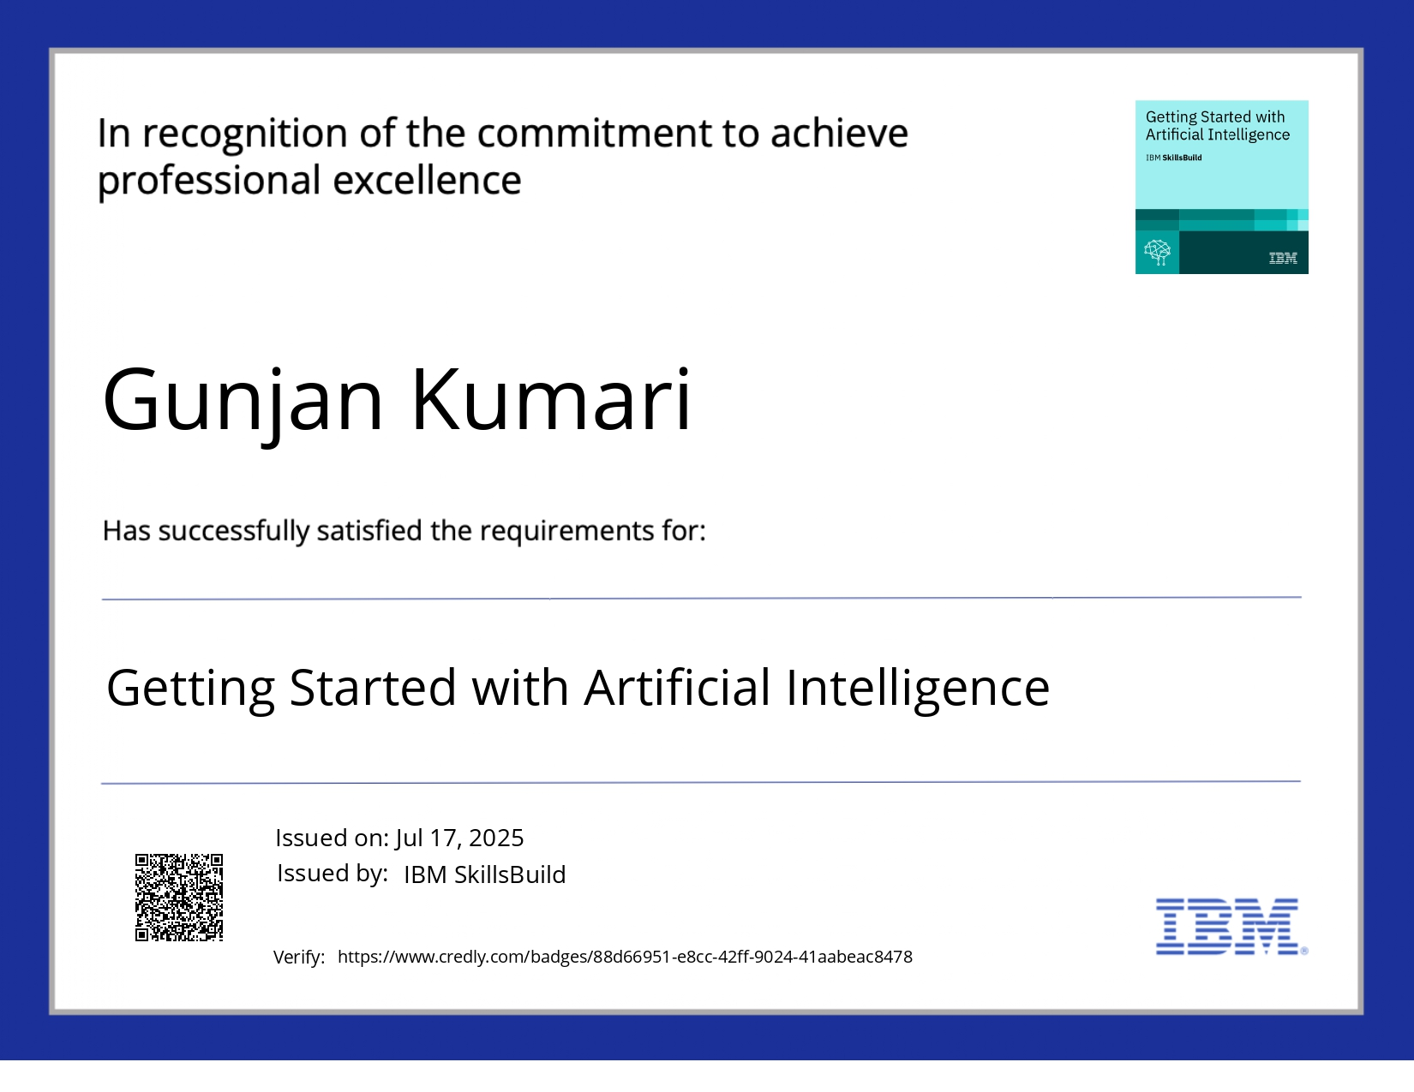
IBM Certifications

Slide 12
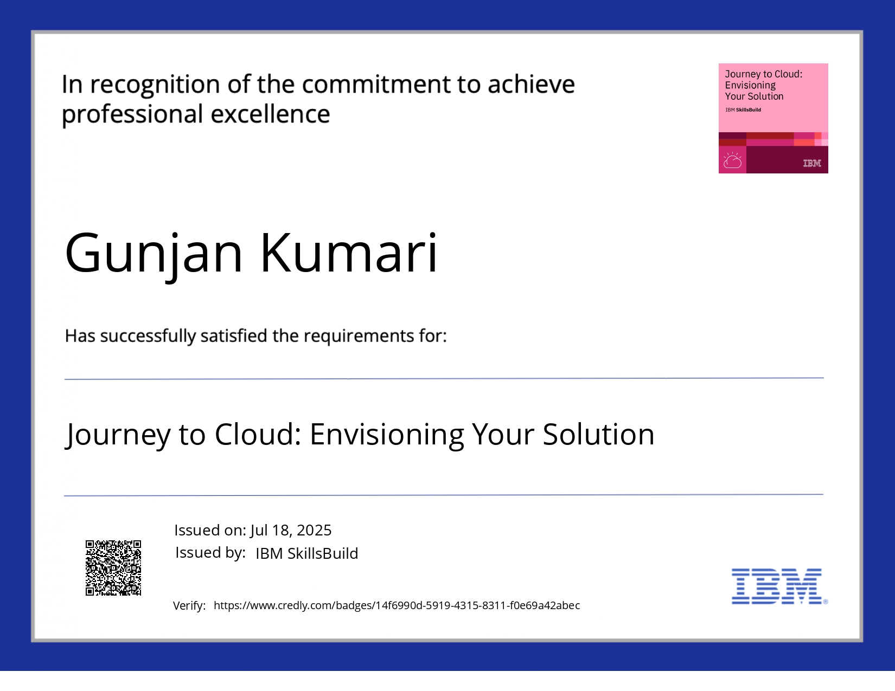
IBM Certifications

Slide 13
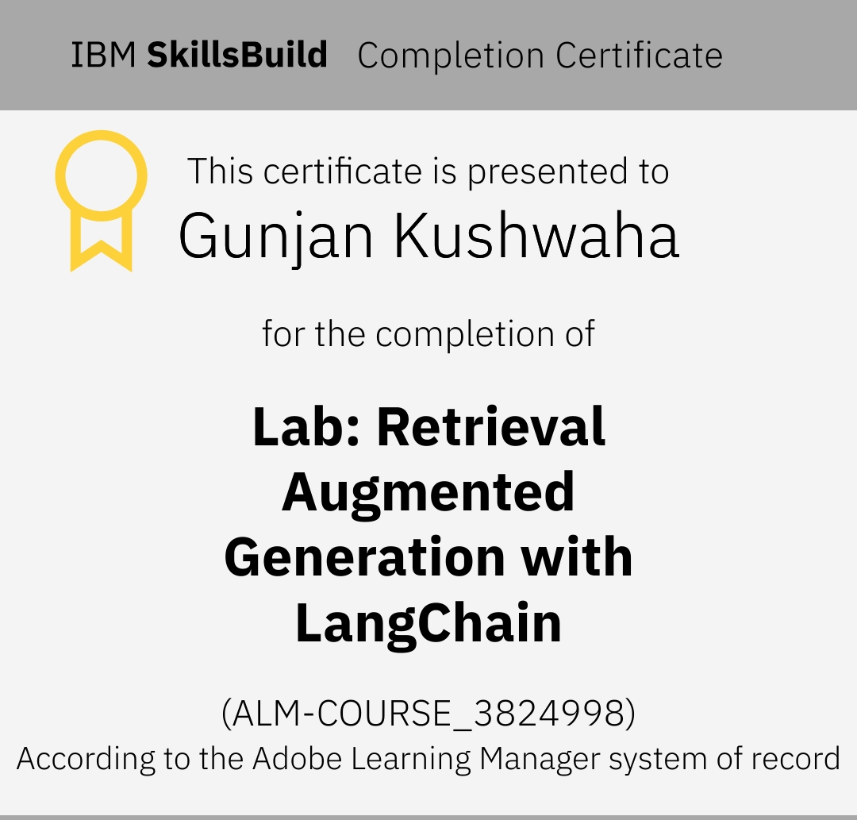
IBM Certifications

Slide 14
THANK YOU

