Slide 1
TIME SERIES ANALYSIS OF GOLD PRICE

Slide 2
Data Description
The data is consisted of two columns which are the date (dd-mm-yyyy) and the monthly average value of gold per gram in Indian rupee. It contains gold price from year 2000 to year 2021. The data is in .csv format.

Slide 3
Objective
The objective of the project is to see whether the price of gold will increase or decrease in future.

Slide 4
Data Analysis
Converted the data into a timeseries data
Imported two library functions (tseries and forecast)
Checked the data for stationarity by acf , pacf and adf-test.
If the data was not stationary then make it stationary.
Then with the forecasted values draw a graph.
Lastly checked the data again with "Ljung-Box" test for validation.

Slide 5
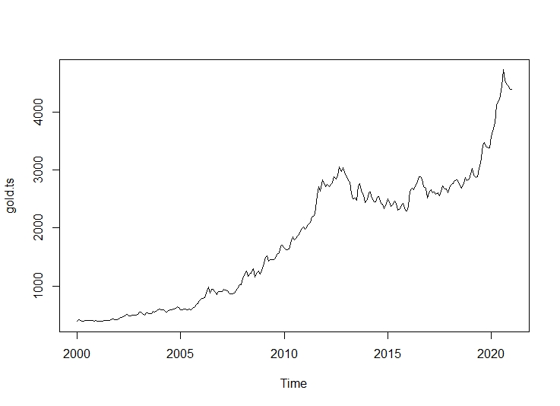
Diagrams
Graph of gold price before forecasting (2000 – 2021)

Slide 6
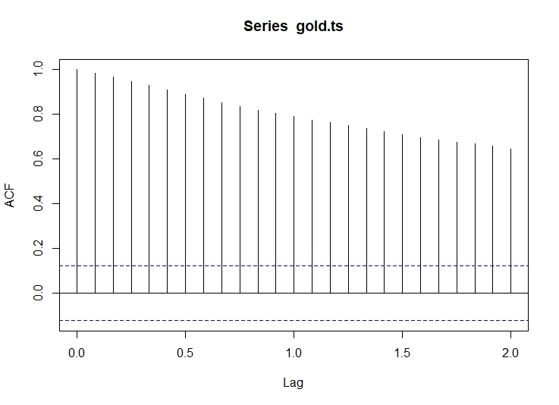
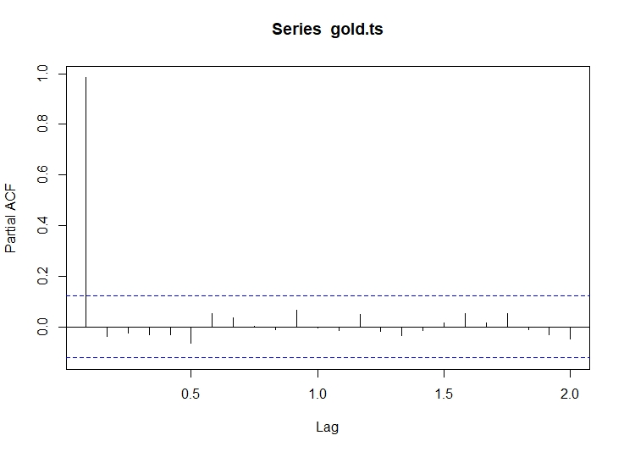
Diagrams
Autocorrelation plot
Partial Autocorrelation plot

Slide 7
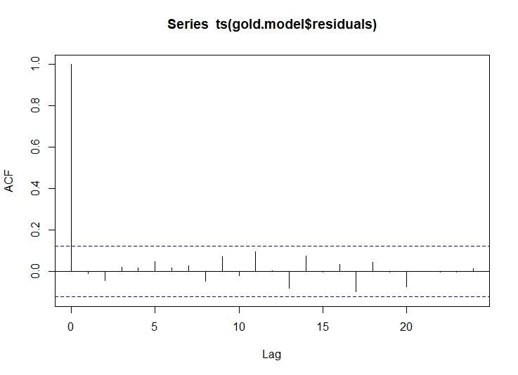
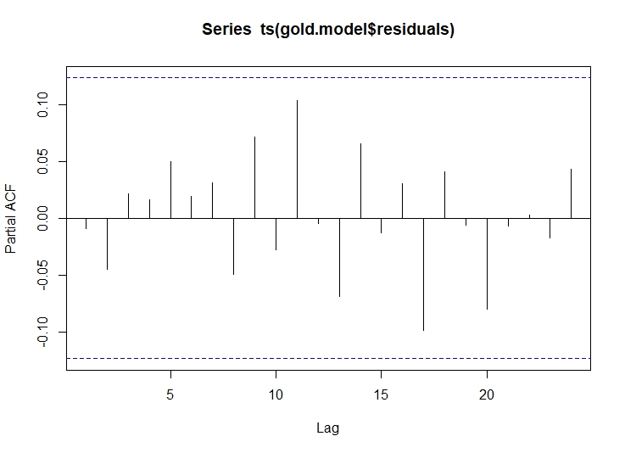
Diagrams
Autocorrelation when stationary
Partial Autocorrelation when stationary

Slide 8
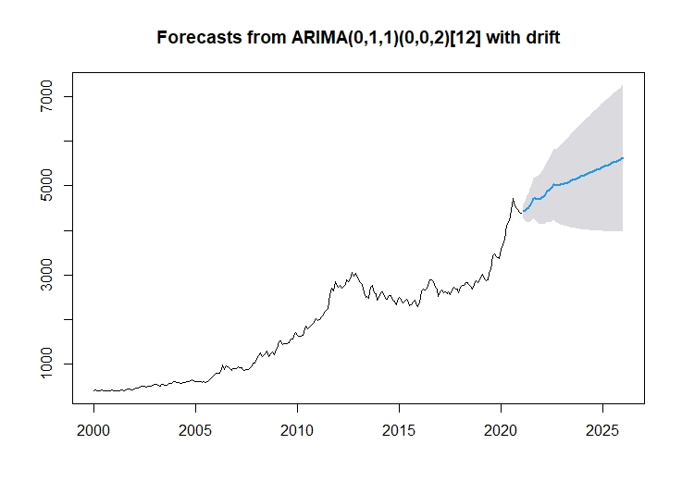
Forecasted Diagram
Forecasting of next 60 months

Slide 9
Conclusion
At first we plotted the data and saw that there was a upward trend. Now, after the analysis we got the predicted values of next 5 years. When we plotted the future prediction values in the graph, it was also giving a upward line. So we conclude that in the future the gold price will increase as it is shown in the graph.

Slide 10
References
Website
https://www.indexmundi.com/commodities/?commodity=gold
https://www.gold.org/goldhub/data/gold-prices
https://www.tutorialspoint.com/r/index.htm
https://en.wikipedia.org/wiki/Gold
Books
Fundamentals of applied statistics –S. C. Gupta , V. K. Kapoor .

Slide 11
THANK YOU

