Slide 1

Loan Default Risk Analysis
A Comprehensive Exploration of Risk Factors
A project by K Mohammed Feroz and Gunjan Singh.
Dated 25 September 2024

Slide 2
Problem Statement
Substantial credit losses arise from lending to high-risk applicants.
'Charged-off' loans serve as indicators of borrower defaults, highlighting the need for better risk assessment.
Identifying risky borrowers is crucial for maintaining financial stability and reducing losses.

Slide 3
Analysis Approach
Exploratory Data Analysis (EDA) to uncover patterns.
Focus on univariate (individual feature) and bivariate (relationship between features) analyses.
Utilized visualizations to highlight insights and trends.

Slide 4
Understanding Loan Default Risks
Loan Offerings: The online marketplace provides personal, business, and medical loans.
Risk of Credit Losses: Significant credit losses occur from lending to high-risk borrowers.
Data Scope: Analysis is based on a dataset of loans issued from 2007 to 2011.

Slide 5
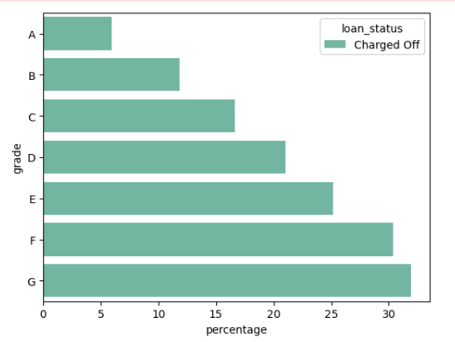
Key Findings on Risk Factors
Prevalence of Charged-Off Loans: Higher rates of charged-off loans are found in lower grades (E, F, G).
Debt Consolidation Risks: Loans for debt consolidation are associated with significantly higher default rates.
Critical Risk Indicators: Unverified income and recent delinquencies are strong predictors of loan defaults.

Slide 6
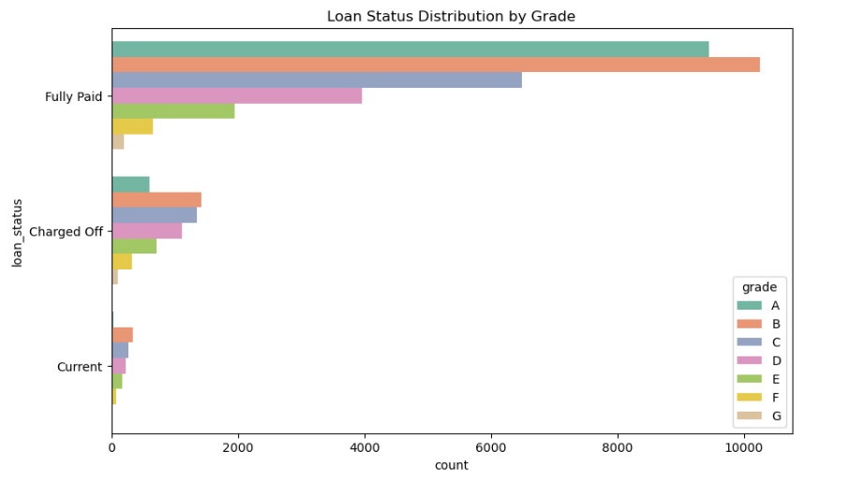
Key Indicators of Loan Default
1. Correlation of Loan Status & Borrower Grade : Strong link indicating higher risk with lower grades.
2. Impact of Home Ownership Status : Homeowners generally present lower default risk.
3. Influence of Verification Status : Verified loans show better grade distribution and reduced risk.

Slide 7
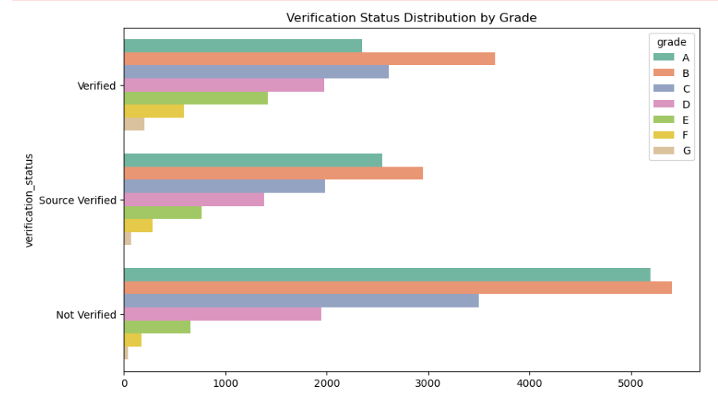
Data-Driven Insights for Risk Mitigation
Stricter Income Verification : Implement for lower-grade loans to reduce default risk.
Link Between Income Verification and Defaults : Unverified income correlates with higher default rates.
Risk-Based Pricing Strategies : Tailor pricing for high-risk borrowers to enhance loan performance.

Slide 8
SUMMARY
Insights from Univariate Analysis
Higher-grade loans show lower interest rates.
Most loans are concentrated in lower amounts, but larger loans are associated with higher risk.
Full homeowners tend to receive higher grades and pose lower risk.

Slide 9
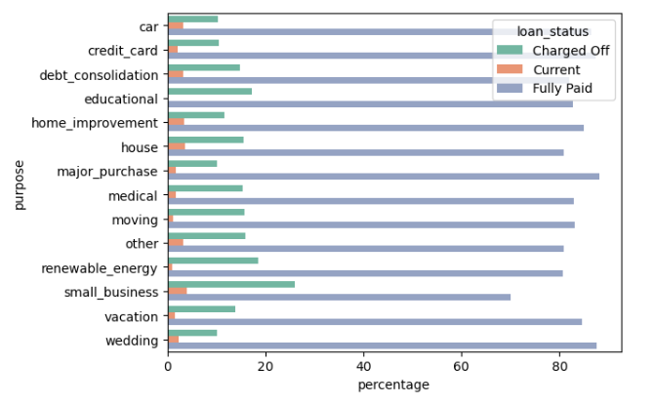
Loan Purpose and Default Risk
Debt Consolidation Loans : Common but associated with a higher risk of default.
Small Business Loans : Show elevated default rates compared to other loan types.
Importance of Understanding Loan Purposes : Insight into loan purposes can inform better lending decisions.

Slide 10
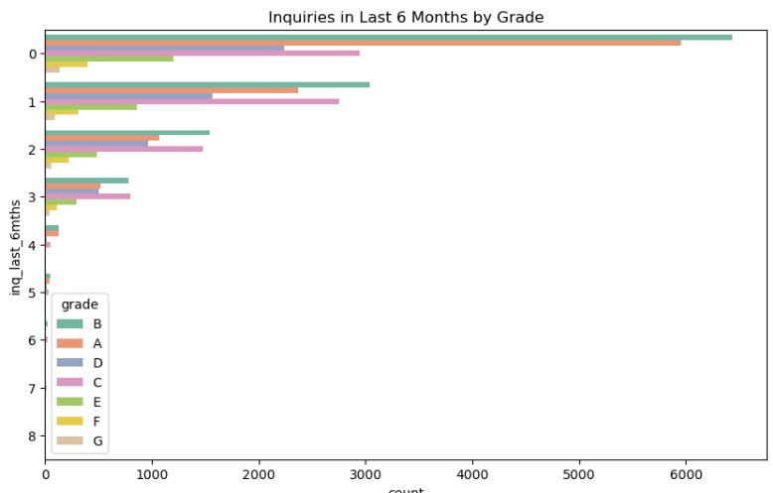
Delinquencies and Credit Inquiries
Higher Delinquency Counts Indicate an increased risk of default.
Delinquent Borrowers Typically fall into lower credit grades.
Monitoring Credit Inquiries Can provide valuable insights to inform lending practices.

Slide 11
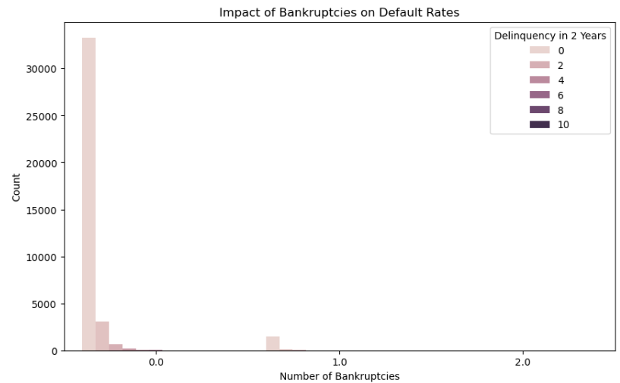
Impact of Public Records on Defaults
Negative Public Records Significantly increase the likelihood of default.
Borrowers with Bankruptcies Typically receive lower credit grades.
Comprehensive Background Checks Are essential for effective risk assessment.

Slide 12
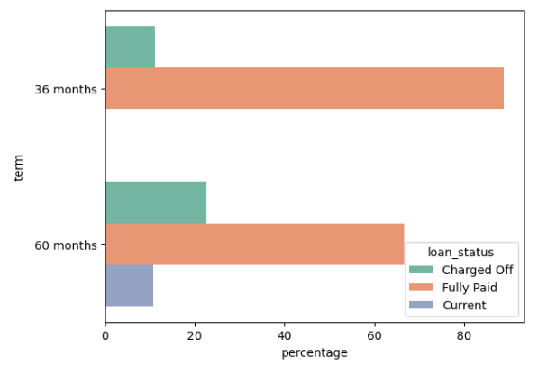
Term Analysis and Default Rates
Longer-Term Loans Have a higher likelihood of default.
Loan Duration and Borrower Risk The relationship is critical to understand.
Incorporating Term Analysis Is vital for effective risk assessment.

Slide 13
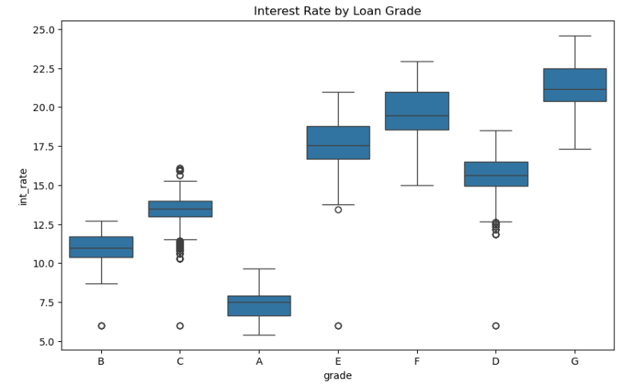
Loan Amounts and Risk Correlation
Higher-grade loans generally have lower average amounts.
Lower grades (E, F, G) often involve larger loans.
Loan amount is a key factor in assessing default risk.

Slide 14
SUMMARY
Key Findings from Bivariate Analysis
1. Charged-Off Loans
Concentrated primarily in lower grades (E, F, G), indicating higher risk.
2. Debt Consolidation Loans
Strongly linked to elevated default rates, highlighting potential risk areas.
3. Delinquency Rates
Directly correlate with lower loan grades, underscoring the importance of monitoring.

Slide 15
Visual Insights
1. Default Rates in Mortgages and Rentals
Higher default rates observed, indicating increased risk.
2. Impact of Unverified Incomes
Linked to lower credit grades and elevated default rates.
3. Loan Term Length
Longer loan terms correlate with increased likelihood of default.

Slide 16
Summary of Insights
Loan Grades: Higher grades have lower rates; lower grades carry higher risk and amounts.
Home Ownership: Mortgaged or rental borrowers often show higher risk; fully-owned homes indicate lower risk.
Verification: Verified incomes align with higher grades; unverified incomes increase default risk.
Loan Purpose: Debt consolidation loans are risky and often low-grade.
Delinquencies: Recent delinquencies correlate with higher defaults and lower grades.
Public Records: Negative records lead to lower grades and increased defaults.

Slide 17
Strategic Recommendations
To enhance risk management, implement stricter income verification processes for lower-grade loans.
Adopt risk-based pricing for borrowers with delinquencies or multiple credit inquiries.
Additionally, introduce targeted financial counseling for high-risk loan applicants to better support their financial stability.

Slide 18
Conclusion
The analysis emphasizes the importance of robust risk assessment strategies.
By understanding key risk factors, lenders can better manage loan portfolios.
Implementing effective strategies is essential to minimize credit losses.

