Slide 1
COMMUNICATION SKILL I

Slide 2

What is communication?
Exchange of information by signs and signals, speaking, writing or using some other medium and meansis called communication.

Slide 3

Learning objectives of effective communication
1. Sending, receiving and understanding the message or information
2. Development of Interpersonal Skills
3. To express effectively with maximum efficiency

Slide 4
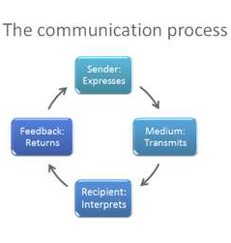
What is Communication Cycle
Communication cycle is the process by which a message is sent by an individual and it passes through a chain of recipients. The timing and effectiveness of a communication cycle is based on how long it takes for feedback to be received by the initial sender.

Slide 5
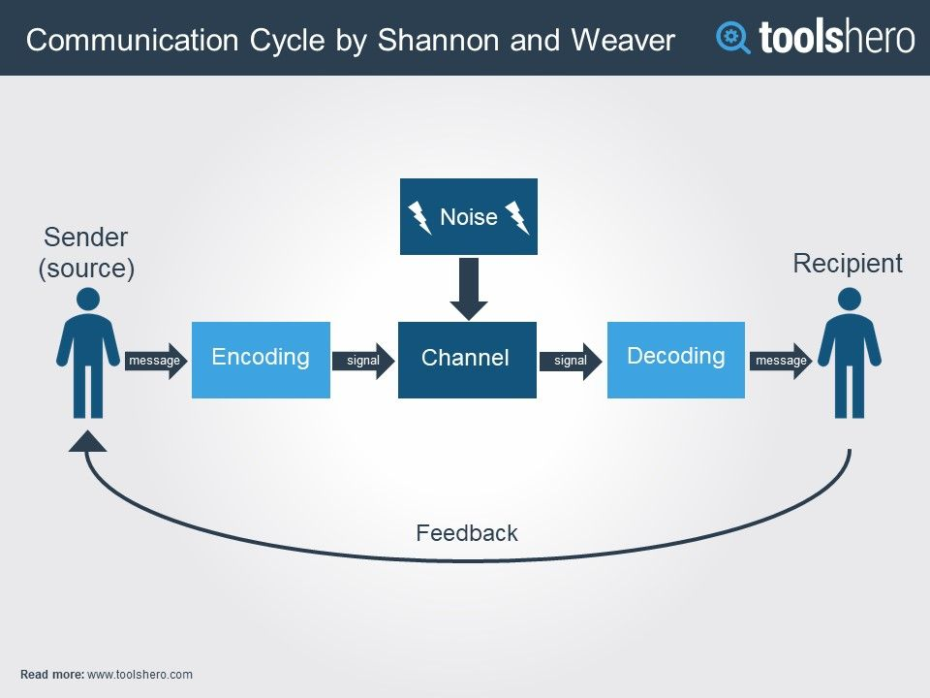
Communication Cycle
Sender: the person or entity originating the communication
Message: the information that the sender wishes to convey
Encoding: how the sender chooses
to bring the message into a form appropriate for sending
Channel: the means by which the message is sent
Receiver: the person or entity to whom the message is sent
Decoding: how the receiver interprets and understands the message
Feedback: the receiver's response to the message

Slide 6
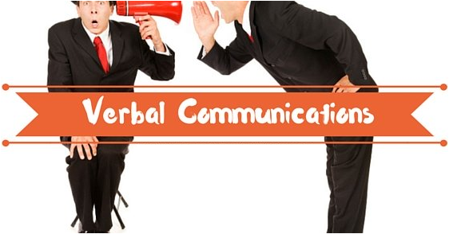

Various Communication Styles
There are four main categories of communication styles including verbal, non - verbal, written and visual:
Verbal : Verbal communication is the use of language to transfer/share information through speaking or sign language. It is one ofthe most common types, often used during presentations, video conferences, phone calls, meetings and one-on-one conversations.
2. Non – verbal : Non - verbal communication is the use of body language, gestures and facial expressions to convey information to others. It intentional or unintentional.
Non - verbal communication is helpful when trying to understand others’ thoughts and feelings.

Slide 7
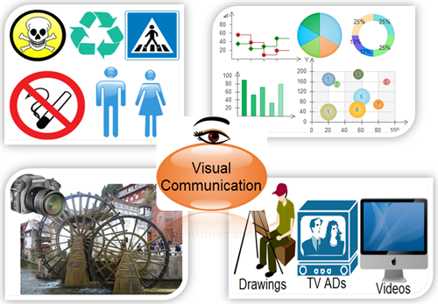
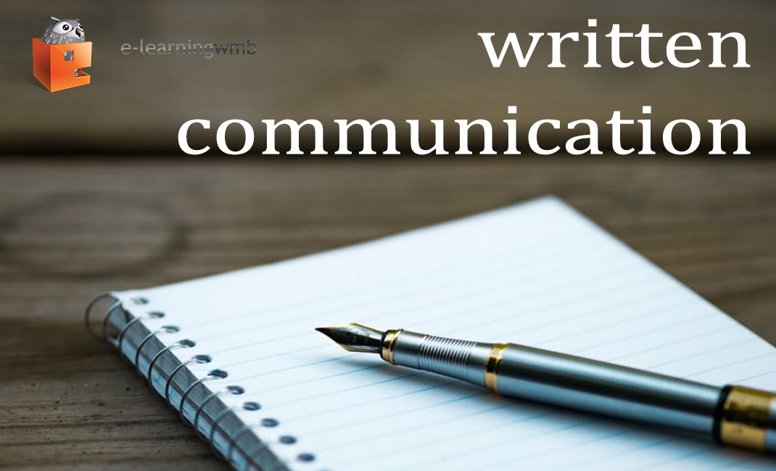
3. Visual :Visual communication is the act of using photographs, videos, art, drawings, sketches, charts and graphs to convey information. Visuals are often used as an aid during presentations to provide helpful context alongside written and/or verbal communication.
4. Written : Written communication is the act of writing, typing or printing symbols like letters and numbers to convey information. It is helpful because it provides a record of information for reference

Slide 8
Advantages of Written Communication
A Permanent Record : A written communication helps to maintain a permanent record of the information exchanged or shared.
2. Meticulous Presentation : As written document is a permanent record, people are very cautious to fulfill all the writing requisites to make the writing perceivable at the other end.
3. Easy Circulation: A written document can easily be circulated in an organisation, unlike the oral communication medium.

Slide 9
Advantages of Written Communication
4. Suitable for Statistical Data: Statistical charts and figures are difficult to be interpreted verbally, thus, circulating a document allow people to examine such intrinsic detail with ease.
5. Promotes Goodwill: When conducting business, a well-crafted written document speaks volumes about the competence of a particular organisation.

Slide 10
Disadvantages of Written Communication
Time Consuming: In order to craft an impeccable piece of document, one has to invest an ample amount of time which is indeed difficult in constrained timelines.
Non-flexible: A written document cannot be altered once circulated. This makes written communication non-flexible as every written word is concrete and final.

Slide 11
Disadvantages of Written Communication
No Scope for Clarification: If the document is not curated keeping the less informed person’s mindset in check, the details cannot be perceived by such people via the formulated written document
Demands Writing Proficiency: In order to deliver the message adequately across the other end, one should have competencies in the writing sector.
Probability of Wrong Interpretation: If there are complex words or difficult sentences included in the written document, one may interpret a wrong/no meaning out of it. Thus, in order to use written communication, one should make use of easy language.

Slide 12
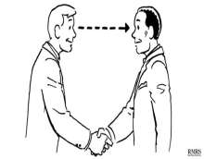

The Do’s and Don’ts of non - verbal messages and body language
Do’S
Make eye contact.
Have a firm handshake

Slide 13
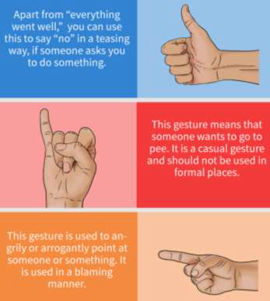
Few hand gestures
• Check your facial expression,it needs to
match with your words. Imagine telling a scary
incident laughing throughout the narration.
• Be natural with your gestures
• Maintain a receptive posture. ...
• Refrain from sending mismatched messages.
• Watch for actions that can be taken for
defensiveness.
• Be engaged and involved.

Slide 14
Don’ts
Rubbing your hands together during an important meet up
Leaning back while meeting with a friend or close colleague.
Crossing your arms during an interesting conversation.
Not making eye contact.
Making too much eye contact.
Fidgeting.
Touching your face too often.

Slide 15
Advantages of Verbal Communication Skill
It saves time:The verbal form of communication helps you to quickly send intended message thus saving time.
It saves you money: No requirement of paper or designing a flyer, spell check etc.
Feedback quickness: The distinct advantage of verbal communication is in the fact that the receiver can ask and clarify his doubt on the spot without any delay.

Slide 16
Advantages of Verbal Communication Skill
Most convenient method: Verbal communication is the most widely adopted means of communication globally. People prefer more of verbal communication due to the convenience factor
Ease of preparation:Oral communication is the easiest way of communication as it does not require preparation of any material.

Slide 17
Disadvantages of Verbal Communication:
Chances of distortion in meaning:Due to the presence of various barriers in effective communication, it may happen that the intended meaning of the message changes for the intended person, causing a lot of problems in the future.
Not convenient for long messages: It is not at all convenient to convey long messages orally as it may happen that by the time message is completed, the receiver may forget the previously spoken important points leading to a chance of ineffective communication.

Slide 18
Disadvantages of Verbal Communication:
Irrelevant information: While having an important discussion, a lot of irrelevant information can creep in during a conversation leading to a waste of time and gap in the relevant information. This leads to unnecessary time waste and sometimes omitting or forgetting to converse on what is really important.
Misunderstanding: Usually, when two individuals are having deep conversations, they can have some misunderstandings during the time. Sometimes subtle hints given or some words spoken with some intention get misinterpreted and a whole new different meaning comes out of it.

Slide 19
Disadvantages of Verbal Communication:
Communication cost: Sometimes verbal communication can be really expensive if you need to communicate in a language that you are not familiar with. You will need another person to play the part of translator for you. With advanced technological services of hologram, translator may not be required but surely cost is involved.

Slide 20
Advantages of non-verbal communication:
Complementary: Non-verbal cues complement a verbal message by adding to its meaning.
Easy presentation: Information can be easily presented in non-verbal communication using visual, audio-visual and silent means of non-verbal communication.
Substituting: Non-verbal messages may substitute for the verbal message especially if it is blocked by noise, interruption, long-distance, language barrier etc.

Slide 21
Advantages of non-verbal communication:
Reducing wastage of time: The message of non-verbal communication reaches the receiver very fast. Non-verbal cues of communication like sign and symbol can also communicate some messages very quickly than written or oral messages.

Slide 22
Disadvantages of non-verbal communication:
Vague and imprecise: Non-verbal communication is quite vague and imprecise. Since in this mode of communication, there is no use of words or language to express clear meaning to the receiver.
Continuous: It is possible to stop talking in verbal communication, but it is generally not possible to stop non – verbal cues.

Slide 23
Disadvantages of non-verbal communication:
Multi-channel: while watching someone’s eyes, you may miss something significant in a hand gesture. Everything is happening at once and therefore it may be confusing to keep up with everything.
Long conversations are not possible: In non-verbal communication, long conversation and necessary explanations are not possible.

Slide 24


Perspectives in Communication
Visual perception: Visual perception is the ability to see and interpret.

Slide 25
Perspectives in Communication
Language-The different perspectives we experience can be with language as well. Few words used in one language may have totally different meaning in another language.
Past Experiences
Prejudices: Prejudices occur when we take an isolated experience with one ‘type’ of person and then act as if all encounters in the future with people of the same ‘type’ or with the same characteristics will result in the same experience.

Slide 26
Perspectives in Communication
Feelings: There are actually two ways in which your feelings can influence your communication with another person.
Environment: The last area of influence on communication is your environment. All of us communicate differently in different Environments.

