Slide 1
SELF –MANAGEMENT SKILL

Slide 2
What is Self-Management
Self-Management refers to management of or by oneself; taking of responsibility for one's own behavior and wellbeing.
It also means managing yourself with the people and resources around you.
A Self-managed person not only manages himself well but also behaves responsibly towards people around.
Self-managed person is like a tree who is taking care of itself and is also helping others to lead a comfortable life.

Slide 3
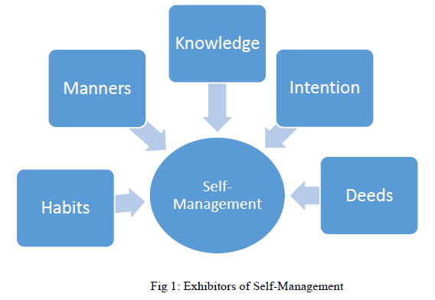
Self-management is exhibitors

Slide 4
Habits :Good habits like brushing teeth, taking bath, eating balanced diet and getting up and sleeping at right time every day, helps us maintain good health and physique.
Manner: Good manners like being kind and friendly, helping others, being a good listener, respecting, sharing, saying please and thank you, are key to maintaining good relations with others.

Slide 5
Self-management is exhibitors
Knowledge : Being responsible for knowledge acquisition and learning increases self-esteem and develops an inquisitive mindset and curious approach. Good intentions guide us to do the right things. They help us identify the right path and right approach to handle situations.
Deed : A good deed done to help others is worth more than a million good words spoken. All these elements together exhibit, how well an individual manages himself.

Slide 6
Self-management skills
Self Confidence: It refers to trusting one capabilities and potentialities to achieve the necessary goals, objectives and challenges in life and being worthy of leading a happy life.
Factors Building SELF-CONFIDENCE
Control over Situation
Belief about our own ability
Self esteem positive feeling about themselves
Self Monitoring
Positive Thinking
Stress Management: It refers to a state of psychological tension and discomfort originating from unforeseen, difficult, confusing and challenging situations.

Slide 7
Self-management skills
Independent Working: This typically means is when an individual is assigned a task(s), he/she takes ownership and doesn't require constant assistance or supervision to complete that task
Team Player : A person who conforms well with norms of a team and contributes to the attainment of the common goals in an efficient and effective way is called as a team player.
Time Management: It is conscious effort to prioritize task according to the time at hand to increase productivity, efficiency and effectiveness.

Slide 8
Self-management skills
Self-Motiv+action: Motivation is defined as a driving force responsible to do something. The students who are motivated to achieve their academic goal, their future is much better than others.
Personality management: General neatness, grooming, appropriate dressing, apt verbal and non-verbal communication are components of good personality

Slide 9
Factors that help in building self confidence
Social: Interactions with family and social environment, like friends, relatives, teachers and media influences self confidence of individuals.
Cultural: Cultural factors comprise of values, beliefs and customs. Indians give higher importance to family values, believe in the philosophy of “Vasudhev Kutumbhkam”.

Slide 10
Factors that help in building self confidence
Physical: Physical self-efficacy, physical activity and social physique anxiety are found to be influencing self confidence of individuals.
Self-confidence building tips
Getting rid of negative thoughts
Thinking positively
Staying happy with small things
Staying clean, hygienic and smart
Chatting with positive people

