Slide 1
Cyclistic Bike Ride
Google Data Analytics: Case Study
By Gunjan Basra

Slide 2
About Cyclistic
Cyclistic, Chicago based company was launched in 2016 with a successful bike-share offering. Since then, the program has grown to a fleet of 5,824 bicycles that are geotracked and locked into a network of 692 stations across the city.
They offer different types of bike like classic, electric and docked. The bikes can be unlocked from one station and returned to any other station in the system anytime.
They also offer flexibility of its pricing plans:
single-ride passes
full-day passes
annual memberships

Slide 3
GOAL
The director of marketing aims to design marketing strategies to convert casual riders into annual members. Also, to better understand how annual members and casual riders differ, why casual riders would buy a membership, and how digital media could affect their marketing tactics.

Slide 4
Ask Phase
To achieve the goal, our team with discussion with all stakeholders come with the following questions to the guide the project:
How do annual members and casual riders use Cyclistic bikes differently
why would casual riders buy Cyclistic annual memberships?
How can we influence casual riders to become members through digital platform ?

Slide 5
Data
The data was taken from here.
The data was made available by Motivate International Inc. under this license. I used 12 months data occurred between May 2022 until April 2023
Each month has a separate csv file and contains 13 rows.
In total the whole dataset have around 5.8 million records.

Slide 6
Preparing & Cleaning the Data
I used R programming language to aggregate and clean the data for analysis
I merged all month's data into a single table.
Removed the missing, incorrect and duplicate records.
Added new columns month, day of week and trip duration for analysis
Also removed the columns that were to required for analysis.
After the above steps the data was reduce approx. 4 million records.

Slide 7
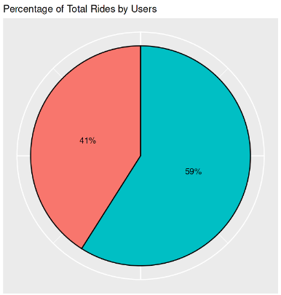
The number of Riders
35%
65%
Casual Riders
1707226
Members
2493229

Slide 8
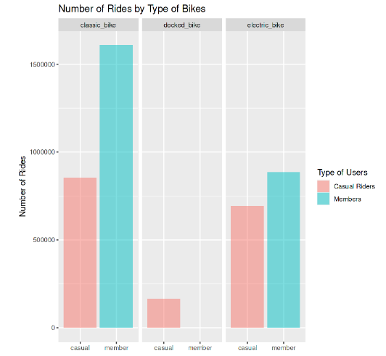
The number of Riders by Bike type
35%
65%
Most of the riders are members and they only prefer classic and electric bikes

Slide 9
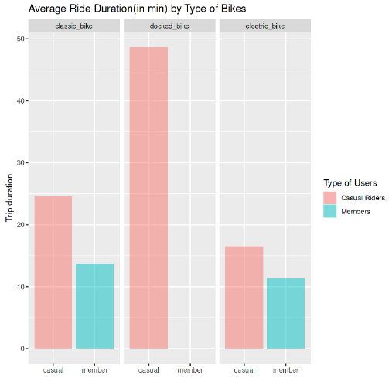
Ride Duration by Bike type
35%
65%
Casual riders spend the most time riding docked bikes

Slide 10
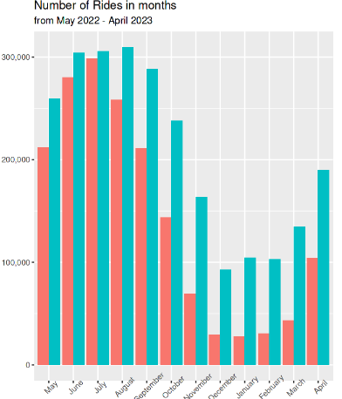
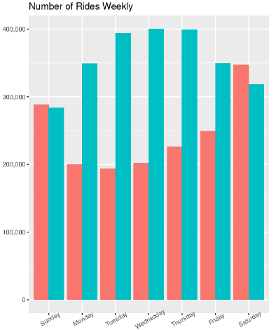
Riders Analysis
Monthly more member riders
Only on weekends there are more causal ride

Slide 11
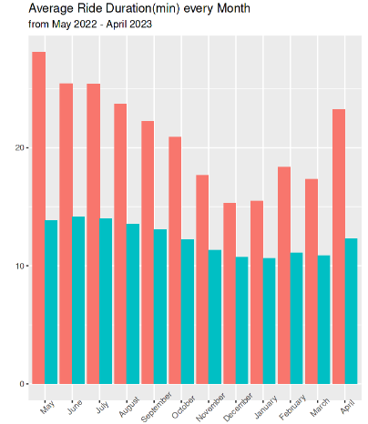
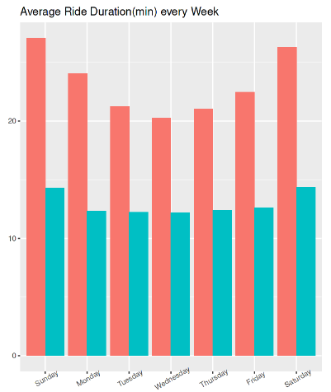
Riders Time Duration Analysis
causal riders spent more time riding the bicycles

Slide 12
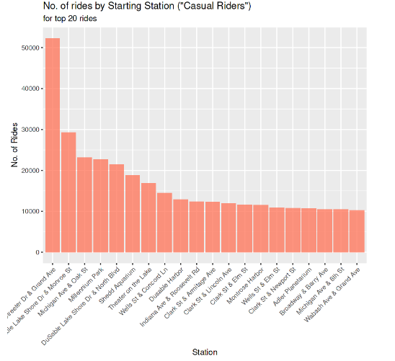
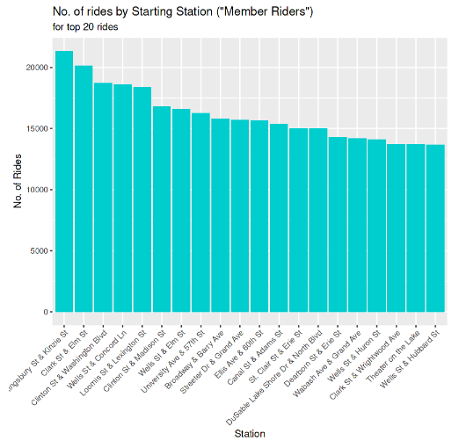
Most Popular Start Station

Slide 13
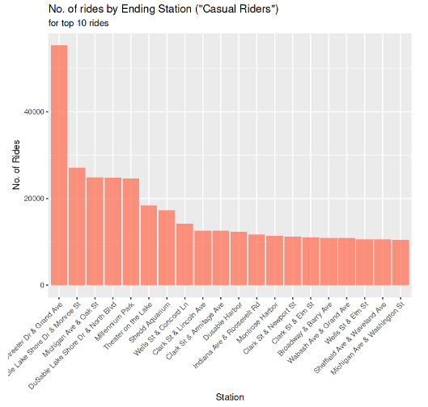
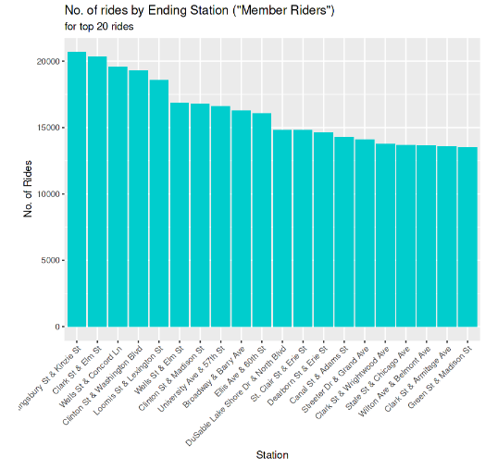
Most Popular End Station

Slide 14
Recommendations
1
Benefits of membership
Casual riders mainly use Cyclistic bikes for leisure purposes. Therefore, they do not use Cyclistic bikes as often, which would make annual memberships seem expensive. One of the solutions is to launch "monthly memberships" that are exclusively for peak riding months.
Adversitment
Using posters and flyers at and around the most popular starting and ending stations areas regarding the benefits for membership and how they can become a member
Discounts/Deals
Offering discounts/deals and advertising on radio/tv during the peak seasons to become a member.

Slide 15
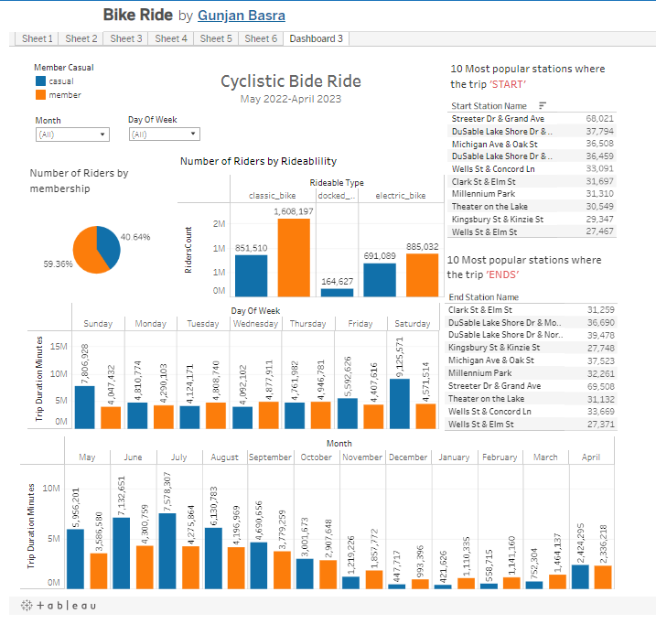
Tableau Dashboard

Slide 16
Thank you!

Slide 17
Alternative resources

