Slide 1
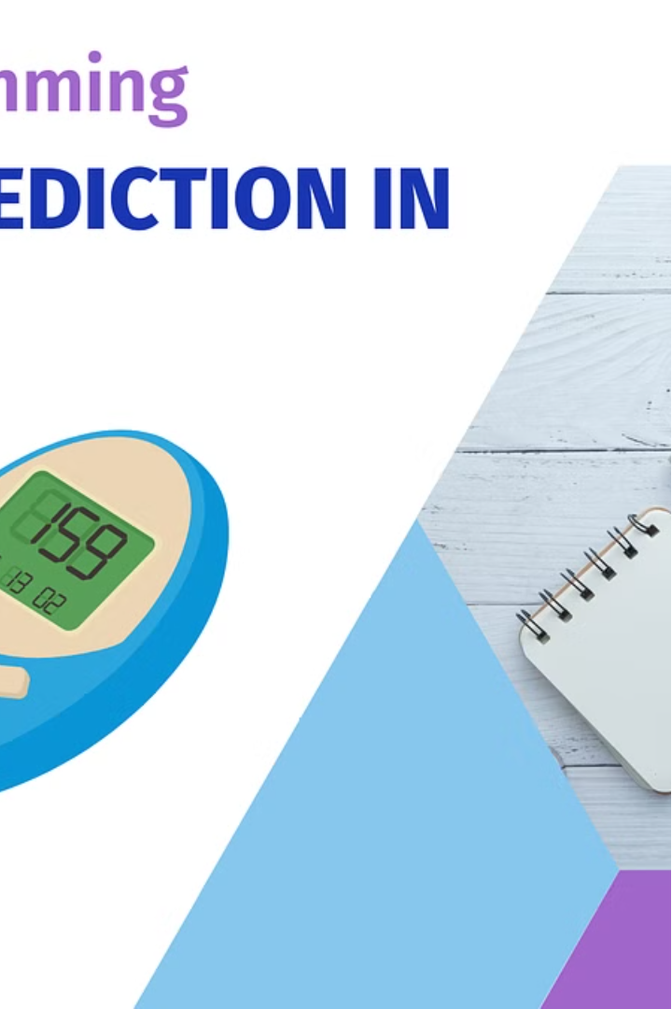

Diabetes
Prediction
Submitted BY: Submitted to:
TEAM:
1)Prachi Sah Ms. Heera Patwal
2)Gunjan Bhanwal
3)Richarani Tarase

Slide 2
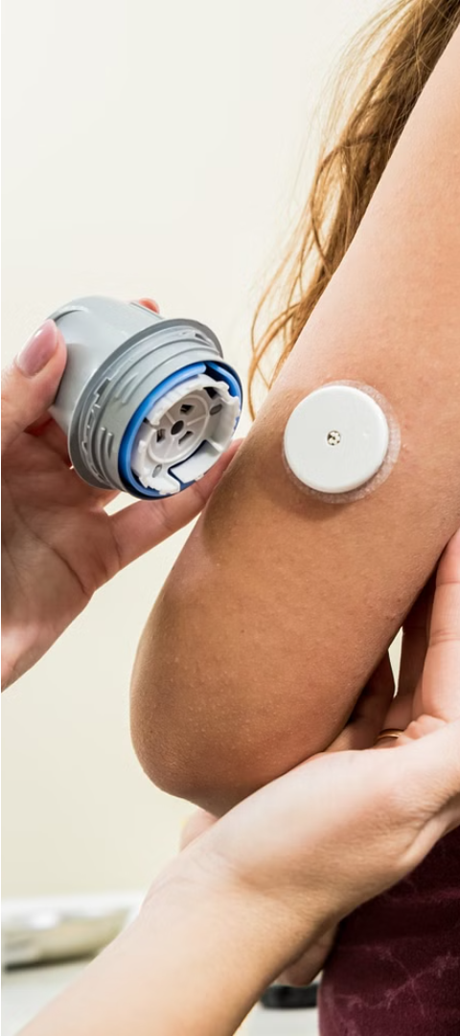
Introduction
1
Understanding Diabetes
2
Early Intervention
Diabetes is a chronic condition characterized by the body's inability to regulate blood sugar levels effectively.
Early detection and management of diabetes can significantly improve patient quality of life and prevent serious complications.
3
Predictive Analytics
Leveraging data-driven techniques can help identify individuals at risk of developing diabetes, enabling proactive interventions.

Slide 3
Project Overview
Objective
Approach
Potential Impact
Develop a predictive model to identify individuals at risk of developing diabetes based on various risk factors.
Utilize machine learning algorithms to analyze patient data and generate accurate diabetes risk predictions.
Early detection and intervention can lead to improved health outcomes and reduced healthcare costs.

Slide 4
Objectives
Risk Factor Analysis
Predictive Modeling
Identify the key demographic, lifestyle, and medical factors that contribute to diabetes risk.
Develop a robust machine learning model to accurately predict the likelihood of an individual developing diabetes.
Early Intervention
Improve Outcomes
Provide healthcare professionals with a tool to identify high-risk individuals and implement preventive measures.
Empower individuals to take proactive steps towards managing their health and reducing the burden of diabetes.

Slide 5

Methodology
1
Data Collection
Use the Pima Indians Diabetes Database for training and testing the model.
2
Data Preprocessing
Handle missing values, normalize the data, and split it into training and testing sets.
3
Model Selection
Experiment with different machine learning algorithms such as Logistic Regression, Decision Trees, Random Forest, and Support Vector Machines
.But Here we have selected SVM.

Slide 6
4
Model Evaluation:
Use metrics like accuracy, precision, recall, and accuracy score to evaluate the performance of the models.
5
Deployment:
Implement a web application using Streamlit for easy interaction with the predictive model.

Slide 7




Implementation
Technologies Used
Python, Scikit-learn, Pandas, Numpy, Streamlit.
Steps:
Data Processing
Model Training
Model Deployment
Monitoring and Refinement
Implement automated data ingestion, cleaning, and feature engineering pipelines.
Train and fine-tune the chosen machine learning algorithm to maximize predictive accuracy.
Integrate the predictive model into a user-friendly application for healthcare professionals.
Continuously monitor model performance and update the system to maintain high accuracy.

Slide 8
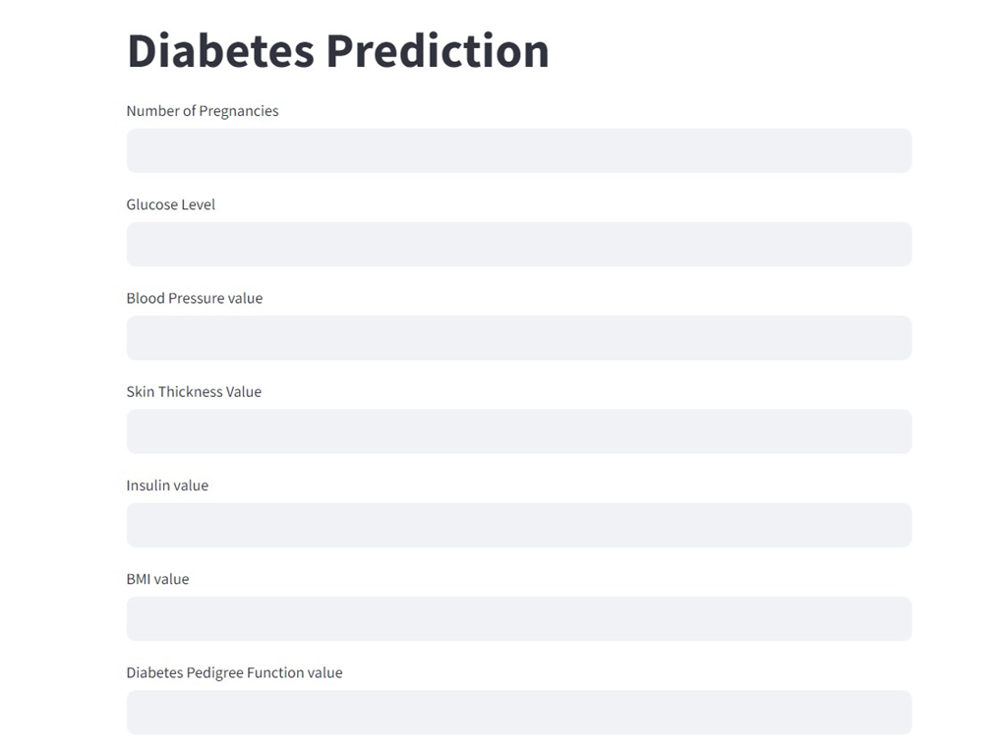
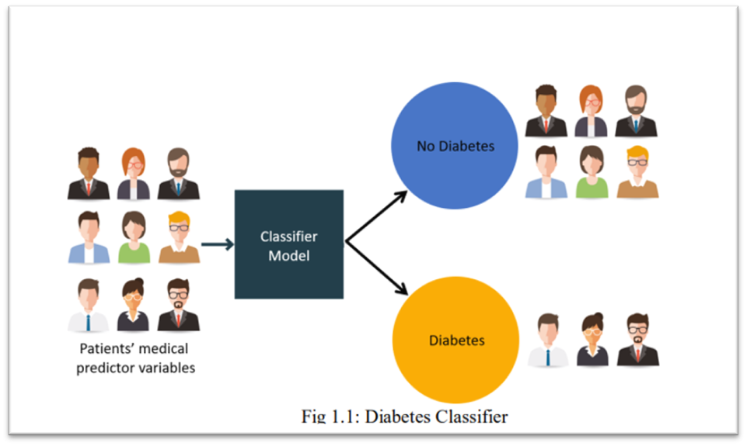
Results
Metric
Value
Accuracy
78%
The developed model demonstrated high predictive accuracy, identifying individuals at risk of developing diabetes with a high degree of reliability.

Slide 9




Challenges Faced
Data Quality
Feature Engineering
Model Optimization
Ensuring the completeness and accuracy of the patient data was a critical challenge.
Identifying the most relevant predictive features from the complex dataset required extensive exploration and testing.
Tuning the hyperparameters of the machine learning algorithms to achieve optimal performance was an iterative process.

Slide 10
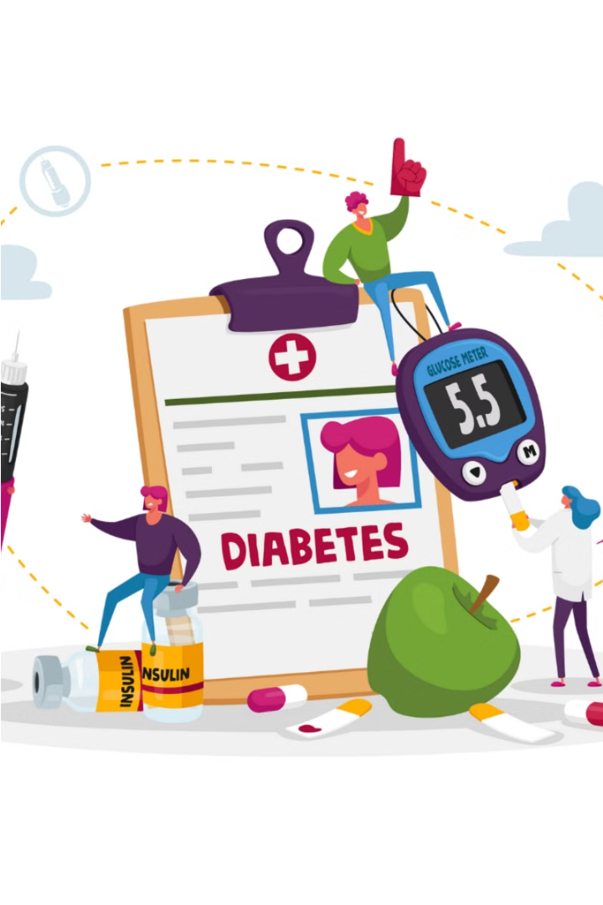
Conclusion
The project successfully developed a machine learning model capable of predicting diabetes with a high degree of accuracy.
The deployed web application provides an accessible tool for healthcare professionals to make informed decisions.
Future work can focus on incorporating additional features and exploring deep learning techniques to further improve prediction accuracy.
The developed model can serve as a valuable tool in the fight against diabetes, paving the way for improved patient outcomes and reduced healthcare costs.

