Slide 1


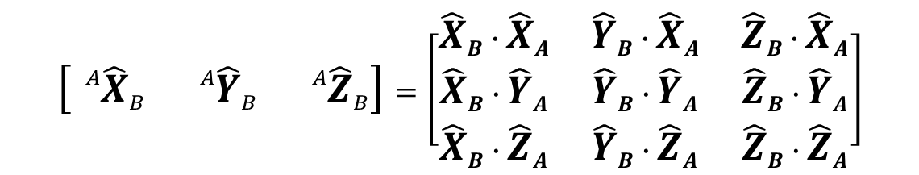









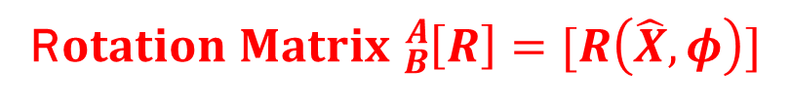


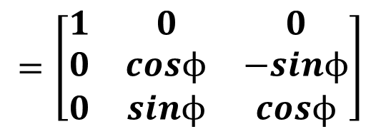
EXAMPLE – Rotation axis is X–axis
$$\{A\}$$
$${\hat{Z}}_{A}$$
$${}_{}^{A}P=\left[\begin{matrix}{}_{}^{A}{{\hat{X}}_{B}} & {}_{}^{A}{{\hat{Y}}_{B}} & {}_{}^{A}{{\hat{Z}}_{B}}\end{matrix}\right]{}_{}^{B}P$$
$${\hat{Z}}_{B}$$
$$\{B\}$$
$$\left[\begin{matrix}{}_{}^{A}{{\hat{X}}_{B}} & {}_{}^{A}{{\hat{Y}}_{B}} & {}_{}^{A}{{\hat{Z}}_{B}}\end{matrix}\right]=\left[\begin{matrix}{\hat{X}}_{B}∙{\hat{X}}_{A} & {\hat{Y}}_{B}∙{\hat{X}}_{A} & {\hat{Z}}_{B}∙{\hat{X}}_{A} \\ {\hat{X}}_{B}∙{\hat{Y}}_{A} & {\hat{Y}}_{B}∙{\hat{Y}}_{A} & {\hat{Z}}_{B}∙{\hat{Y}}_{A} \\ {\hat{X}}_{B}∙{\hat{Z}}_{A} & {\hat{Y}}_{B}∙{\hat{Z}}_{A} & {\hat{Z}}_{B}∙{\hat{Z}}_{A}\end{matrix}\right]$$
$$P$$
$${\hat{Y}}_{B}$$
$$O_{1}$$
$$ϕ$$
$${\hat{Y}}_{A}$$
$$=\left[\begin{matrix}1 & 0 & 0 \\ 0 & cosϕ & −sinϕ \\ 0 & sinϕ & cosϕ\end{matrix}\right]$$
RIGID BODY
$${\hat{X}}_{B}$$
$${\hat{X}}_{A}$$
R$otation Matrix {}_{B}^{A}{\left[R\right]=[R\left(\hat{X},φ\right)]}$
What is rotation matrix for $[R\left(\hat{Y},φ\right)]$ and $[R\left(\hat{Z},φ\right)]$ ??
TRY ON YOUR OWN
SPATIAL DESCRIPTIONS

Slide 2



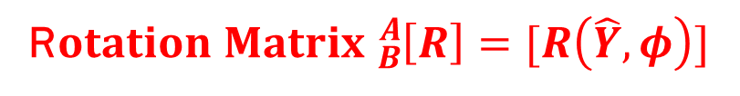
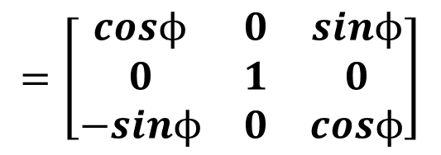
EXAMPLE – Rotation axis is Y–axis
$$\{A\}$$
$${\hat{Z}}_{A}$$
$${}_{}^{A}P=\left[\begin{matrix}{}_{}^{A}{{\hat{X}}_{B}} & {}_{}^{A}{{\hat{Y}}_{B}} & {}_{}^{A}{{\hat{Z}}_{B}}\end{matrix}\right]{}_{}^{B}P$$
$${\hat{Z}}_{B}$$
$$\{B\}$$
$$\left[\begin{matrix}{}_{}^{A}{{\hat{X}}_{B}} & {}_{}^{A}{{\hat{Y}}_{B}} & {}_{}^{A}{{\hat{Z}}_{B}}\end{matrix}\right]=\left[\begin{matrix}{\hat{X}}_{B}∙{\hat{X}}_{A} & {\hat{Y}}_{B}∙{\hat{X}}_{A} & {\hat{Z}}_{B}∙{\hat{X}}_{A} \\ {\hat{X}}_{B}∙{\hat{Y}}_{A} & {\hat{Y}}_{B}∙{\hat{Y}}_{A} & {\hat{Z}}_{B}∙{\hat{Y}}_{A} \\ {\hat{X}}_{B}∙{\hat{Z}}_{A} & {\hat{Y}}_{B}∙{\hat{Z}}_{A} & {\hat{Z}}_{B}∙{\hat{Z}}_{A}\end{matrix}\right]$$
$$P$$
$$O_{1}$$
$${\hat{Y}}_{B}$$
$${\hat{Y}}_{A}$$
$$=\left[\begin{matrix}cosϕ & 0 & sinϕ \\ 0 & 1 & 0 \\ −sinϕ & 0 & cosϕ\end{matrix}\right]$$
RIGID BODY
$$ϕ$$
$${\hat{X}}_{B}$$
$${\hat{X}}_{A}$$
R$otation Matrix {}_{B}^{A}{\left[R\right]=[R\left(\hat{Y},φ\right)]}$
SPATIAL DESCRIPTIONS

Slide 3

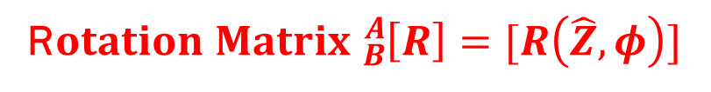
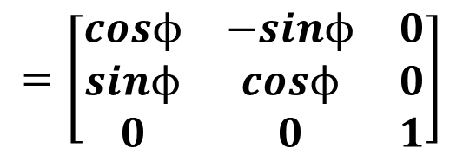


EXAMPLE – Rotation axis is Z–axis
$$\{A\}$$
$${\hat{Z}}_{A}$$
$${}_{}^{A}P=\left[\begin{matrix}{}_{}^{A}{{\hat{X}}_{B}} & {}_{}^{A}{{\hat{Y}}_{B}} & {}_{}^{A}{{\hat{Z}}_{B}}\end{matrix}\right]{}_{}^{B}P$$
$$\{B\}$$
$${\hat{Z}}_{B}$$
$$\left[\begin{matrix}{}_{}^{A}{{\hat{X}}_{B}} & {}_{}^{A}{{\hat{Y}}_{B}} & {}_{}^{A}{{\hat{Z}}_{B}}\end{matrix}\right]=\left[\begin{matrix}{\hat{X}}_{B}∙{\hat{X}}_{A} & {\hat{Y}}_{B}∙{\hat{X}}_{A} & {\hat{Z}}_{B}∙{\hat{X}}_{A} \\ {\hat{X}}_{B}∙{\hat{Y}}_{A} & {\hat{Y}}_{B}∙{\hat{Y}}_{A} & {\hat{Z}}_{B}∙{\hat{Y}}_{A} \\ {\hat{X}}_{B}∙{\hat{Z}}_{A} & {\hat{Y}}_{B}∙{\hat{Z}}_{A} & {\hat{Z}}_{B}∙{\hat{Z}}_{A}\end{matrix}\right]$$
$$P$$
$${\hat{Y}}_{B}$$
$$O_{1}$$
$${\hat{Y}}_{A}$$
$$=\left[\begin{matrix}cosϕ & −sinϕ & 0 \\ sinϕ & cosϕ & 0 \\ 0 & 0 & 1\end{matrix}\right]$$
RIGID BODY
$$ϕ$$
$${\hat{X}}_{B}$$
$${\hat{X}}_{A}$$
R$otation Matrix {}_{B}^{A}{\left[R\right]=[R\left(\hat{Z},φ\right)]}$
SPATIAL DESCRIPTIONS

Slide 4

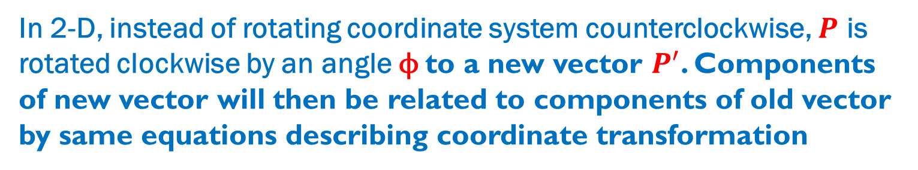






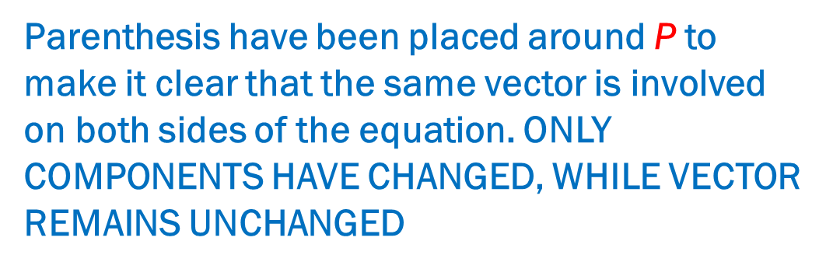

UNDERSTANDING THE ROTATION MATRIX
MATRIX ${}_{B}^{A}{[R] }$can be thought of as an operator that, acting on the fixed system, transforms it into the body system
Symbolically, it may be written as
$${(P)}^{′}=\left[R\right]P$$
Parenthesis have been placed around P to make it clear that the same vector is involved on both sides of the equation. ONLY COMPONENTS HAVE CHANGED, WHILE VECTOR REMAINS UNCHANGED
Matrix [R] operating on the components of a vector in the fixed system yields the components of the vector in the body system
$$y$$
${}_{B}^{A}{[R] }$can also be thought of as an operator acting on vector $P$, changing it to a different vector $P^{′}$, with both vectors expressed in the same coordinate system
$$\{A\}$$
$$P$$
In 2-D, instead of rotating coordinate system counterclockwise, $P$ is rotated clockwise by an angle ϕ to a new vector $P^{′}$. Components of new vector will then be related to components of old vector by same equations describing coordinate transformation
$$P^{′}$$
$$ϕ$$
$$x$$
$$O$$
SPATIAL DESCRIPTIONS

Slide 5
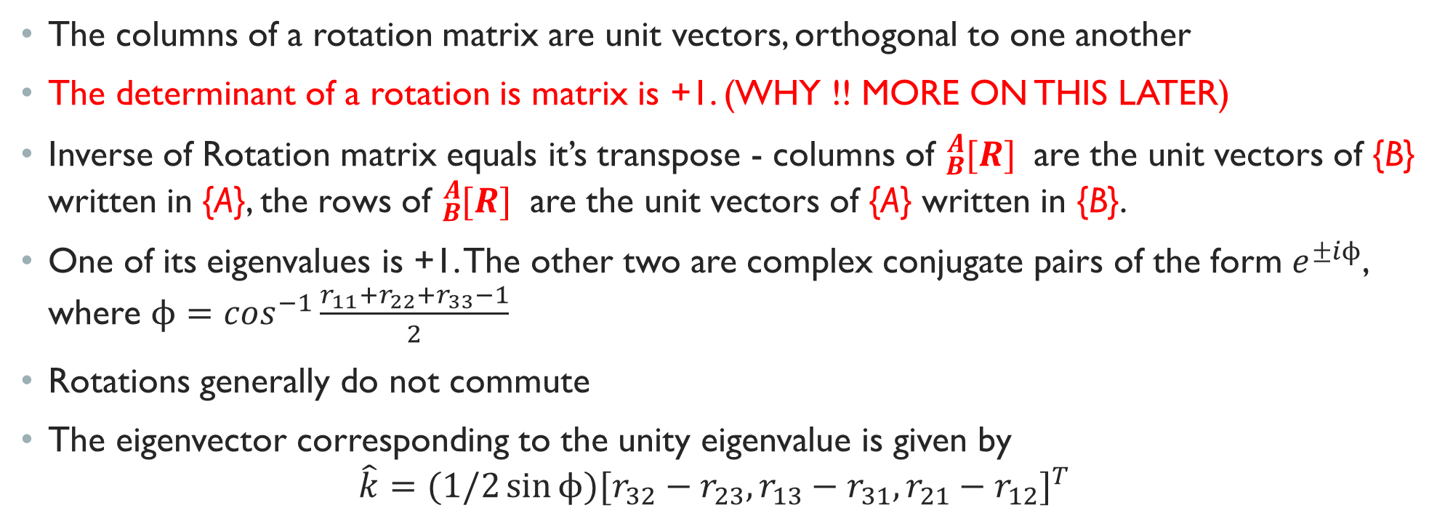
SOME PROPERTIES OF ROTATION MATRICES
The columns of a rotation matrix are unit vectors, orthogonal to one another
The determinant of a rotation is matrix is +1. (WHY !! MORE ON THIS LATER)
Inverse of Rotation matrix equals it’s transpose - columns of ${}_{B}^{A}{[R] }$ are the unit vectors of {B} written in {A}, the rows of ${}_{B}^{A}{[R] }$ are the unit vectors of {A} written in {B}.
One of its eigenvalues is +1. The other two are complex conjugate pairs of the form $e^{±iϕ}$, where $ϕ=\cos^{−1}\frac{r_{11}+r_{22}+r_{33}−1}{2}$
Rotations generally do not commute
The eigenvector corresponding to the unity eigenvalue is given by
$$\hat{k}=(1/2\sin{ϕ){[r_{32}−r_{23},r_{13}−r_{31},r_{21}−r_{12}]}^{T} }$$
SPATIAL DESCRIPTIONS

Slide 6
ANY QUESTIONS SO FAR ???
SPATIAL DESCRIPTIONS

Slide 7
SPATIAL DESCRIPTIONS (Continued….)
MODULE 1 – LECTURE 3
SPATIAL DESCRIPTIONS

Slide 8


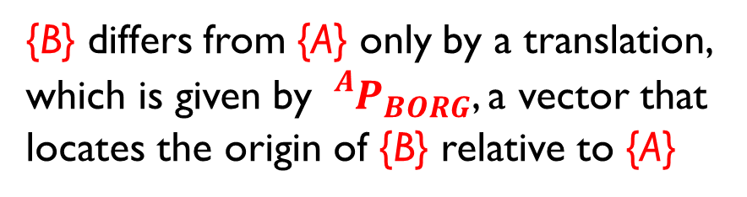








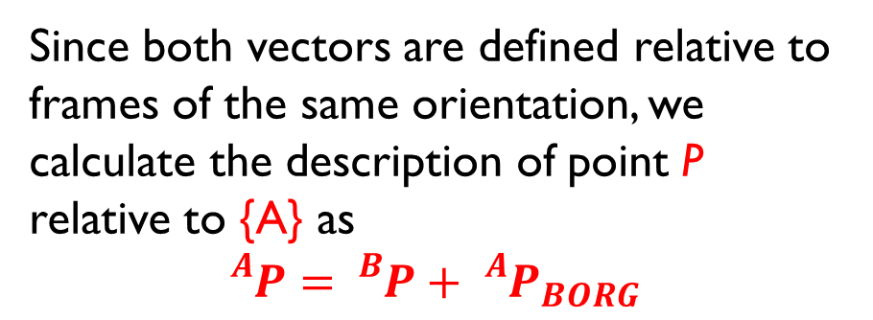
CHANGING DESCRIPTIONS FROM FRAME TO FRAME
PURE TRANSLATION
$${\hat{Z}}_{B}$$
{B} differs from {A} only by a translation, which is given by ${}_{}^{A}{P_{BORG}}$, a vector that locates the origin of {B} relative to {A}
$$\{B\}$$
$${\hat{Z}}_{A}$$
$${}_{}^{B}P$$
$${\hat{Y}}_{B}$$
$$\{A\}$$
Since both vectors are defined relative to frames of the same orientation, we calculate the description of point P relative to {A} as
$${}_{}^{A}{P={}_{}^{B}{P+{}_{}^{A}{P_{BORG}}}}$$
$${}_{}^{A}P$$
$$O_{1}$$
RIGID BODY
$${}_{}^{A}{P_{BORG}}$$
$${\hat{X}}_{B}$$
$$O$$
$${\hat{Y}}_{A}$$
MAPPING changing the description from one frame to another. The quantity itself, namely a point in space is NOT changed.
$${\hat{X}}_{A}$$
SPATIAL DESCRIPTIONS

Slide 9








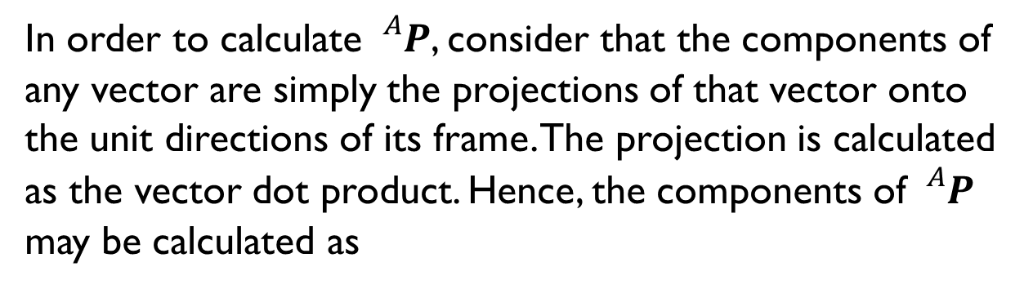


CHANGING DESCRIPTIONS FROM FRAME TO FRAME
PURE ROTATION
$${\hat{Z}}_{A}$$
$$\{A\}$$
$${\hat{Z}}_{B}$$
In order to calculate ${}_{}^{A}P$, consider that the components of any vector are simply the projections of that vector onto the unit directions of its frame. The projection is calculated as the vector dot product. Hence, the components of ${}_{}^{A}P$ may be calculated as
$$\{B\}$$
$${}_{}^{B}P$$
$${\hat{Y}}_{B}$$
$$O_{1}$$
$${\hat{Y}}_{A}$$
RIGID BODY
$${}_{}^{A}{P_{x}={}_{}^{B}{{\hat{X}}_{A}∙{}_{}^{B}P}}$$
$${}_{}^{A}{P_{y}={}_{}^{B}{{\hat{Y}}_{A}∙{}_{}^{B}P}}$$
$${\hat{X}}_{A}$$
$${\hat{X}}_{B}$$
$${}_{}^{A}{P_{z}={}_{}^{B}{{\hat{Z}}_{A}∙{}_{}^{B}P}}$$
$${}_{}^{B}{{\hat{X}}_{A}},{}_{}^{B}{{\hat{Y}}_{A}}.{}_{}^{B}{{\hat{Z}}_{A}} are the rows of {}_{B}^{A}{[R]}$$
$${}_{}^{A}P={}_{B}^{A}{[R]}{}_{}^{B}P$$
SPATIAL DESCRIPTIONS

Slide 10










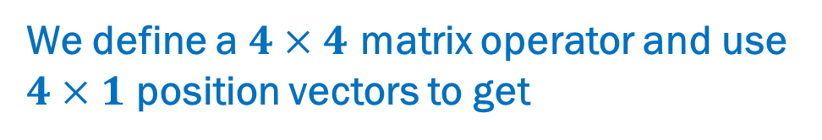
MAPPINGS INVOLVING GENERAL FRAMES
$${\hat{Z}}_{B}$$
$$\{B\}$$
$${}_{}^{A}P={}_{B}^{A}{[R]}{}_{}^{B}P+{}_{}^{A}{P_{BORG}}$$
$${\hat{Z}}_{A}$$
$${}_{}^{B}P$$
$${\hat{Y}}_{B}$$
$$\{A\}$$
$${}_{}^{A}P={}_{B}^{A}{[T]}{}_{}^{B}P$$
$${}_{}^{A}P$$
$$O_{1}$$
We define a $4×4$ matrix operator and use $4×1$ position vectors to get
RIGID BODY
$${}_{}^{A}{P_{BORG}}$$
$$\left[\begin{matrix}{}_{}^{A}P \\ 1\end{matrix}\right]=\left[\begin{matrix}{}_{B}^{A}{[R]} & {}_{}^{A}{P_{BORG}} \\ \begin{matrix}0 & 0 & 0\end{matrix} & 1\end{matrix}\right]\left[\begin{matrix}{}_{}^{B}P \\ 1\end{matrix}\right]$$
$${\hat{X}}_{B}$$
$$O$$
$${\hat{Y}}_{A}$$
$${}_{B}^{A}{[T]}$$
$${\hat{X}}_{A}$$
HOMOGENEOUS TRANSFORMATION
SPATIAL DESCRIPTIONS

Slide 11
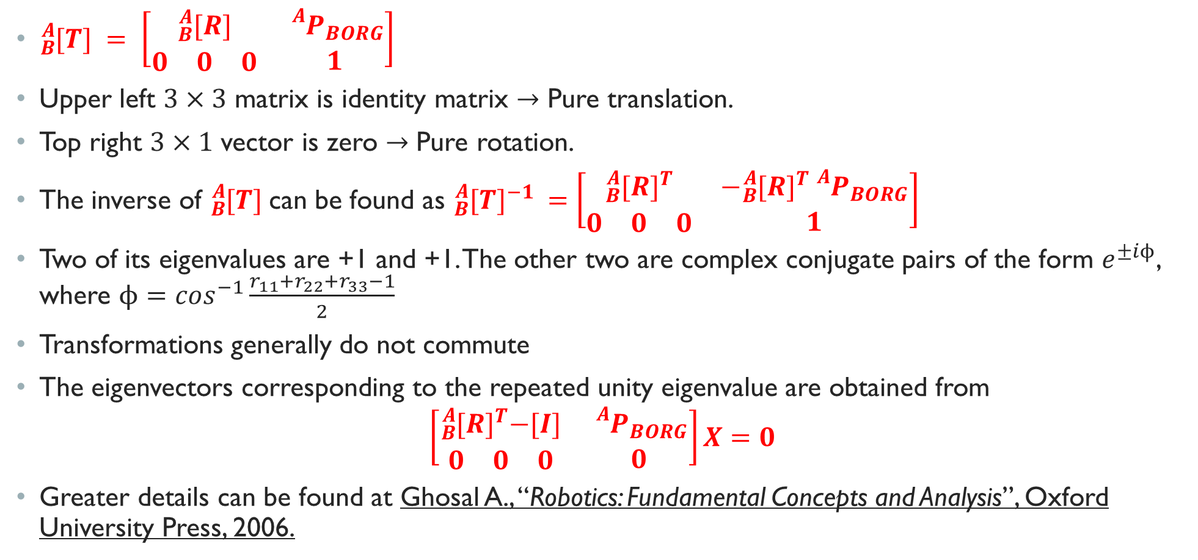
SOME PROPERTIES OF TRANSFORMATION MATRICES
${}_{B}^{A}{[T] }= \left[\begin{matrix}{}_{B}^{A}{[R]} & {}_{}^{A}{P_{BORG}} \\ \begin{matrix}0 & 0 & 0\end{matrix} & 1\end{matrix}\right]$
Upper left $3×3$ matrix is identity matrix $→$ Pure translation.
Top right $3×1$ vector is zero $→$ Pure rotation.
The inverse of ${}_{B}^{A}{[T] }$can be found as ${}_{B}^{A}{{[T]}^{−1}} =\left[\begin{matrix}{}_{B}^{A}{{[R]}^{T}} & −{}_{B}^{A}{{[R]}^{T}}{}_{}^{A}{P_{BORG}} \\ \begin{matrix}0 & 0 & 0\end{matrix} & 1\end{matrix}\right]$
Two of its eigenvalues are +1 and +1. The other two are complex conjugate pairs of the form $e^{±iϕ}$, where $ϕ=\cos^{−1}\frac{r_{11}+r_{22}+r_{33}−1}{2}$
Transformations generally do not commute
The eigenvectors corresponding to the repeated unity eigenvalue are obtained from
$$\left[\begin{matrix}{}_{B}^{A}{{[R]}^{T}−[I]} & {}_{}^{A}{P_{BORG}} \\ \begin{matrix}0 & 0 & 0\end{matrix} & 0\end{matrix}\right]X=0$$
Greater details can be found at Ghosal A., “Robotics: Fundamental Concepts and Analysis”, Oxford University Press, 2006.
SPATIAL DESCRIPTIONS

Slide 12
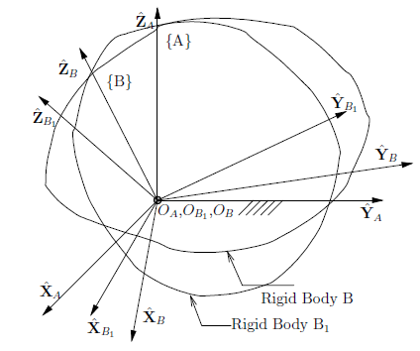
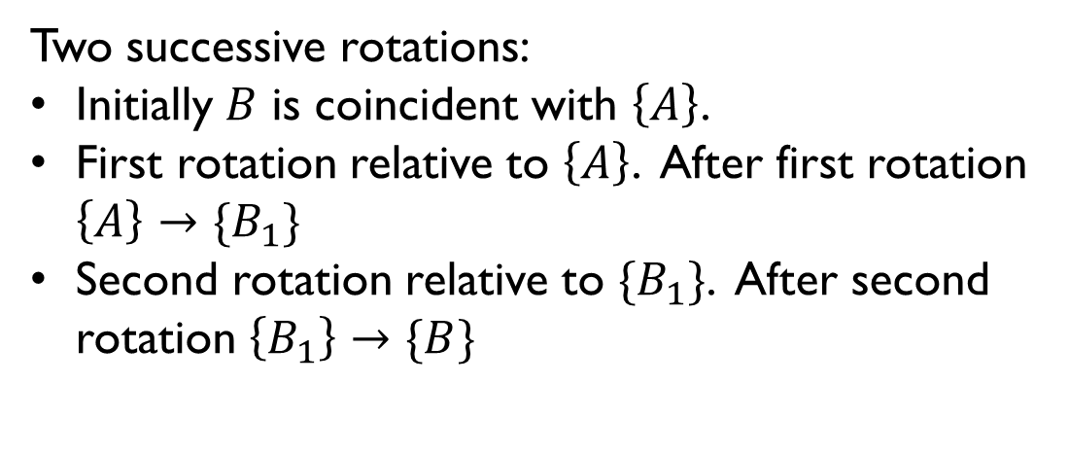
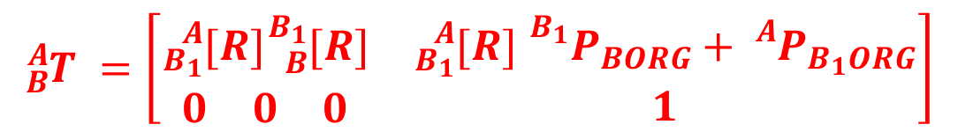
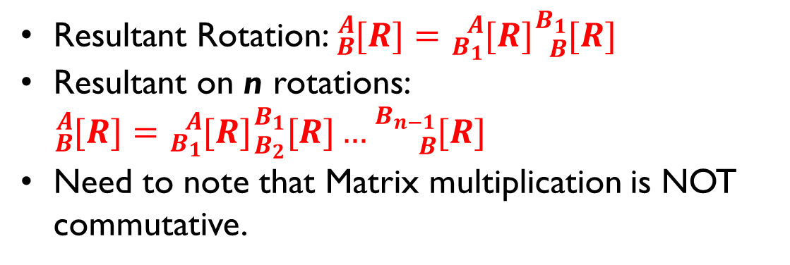
SUCCESSIVE ROTATIONS
Two successive rotations:
Initially $B$ is coincident with $\left\{A\right\}$.
First rotation relative to $\left\{A\right\}$. After first rotation $\left\{A\right\}→\{B_{1}\}$
Second rotation relative to $\{B_{1}\}$. After second rotation $\left\{B_{1}\right\}→\{B\}$
Resultant Rotation: ${}_{B}^{A}{[R]={}_{B_{1}}^{A}{[R]{}_{B}^{B_{1}}{[R]}}}$
Resultant on n rotations: ${}_{B}^{A}{[R]={}_{B_{1}}^{A}{[R]{}_{B_{2}}^{B_{1}}{[R]…}{}_{B}^{B_{n−1}}{[R]}}}$
Need to note that Matrix multiplication is NOT commutative.
Figure from Ghosal, 2006
Can be extended for case of transformation $\left\{A\right\}→\left\{B_{1}\right\}…→\{B\}$.${}_{B}^{A}{[T]={}_{B_{1}}^{A}{[T]{}_{B_{2}}^{B_{1}}{[T]…}{}_{B}^{B_{n−1}}{[T]}}}$
$${}_{B}^{A}{T }=\left[\begin{matrix}{}_{B_{1}}^{A}{[R]{}_{B}^{B_{1}}{[R]}} & {}_{B_{1}}^{A}{[R] }{}_{}^{B_{1}}{P_{BORG}+{}_{}^{A}{P_{B_{1}ORG}}} \\ \begin{matrix}0 & 0 & 0\end{matrix} & 1\end{matrix}\right]$$
SPATIAL DESCRIPTIONS

Slide 13
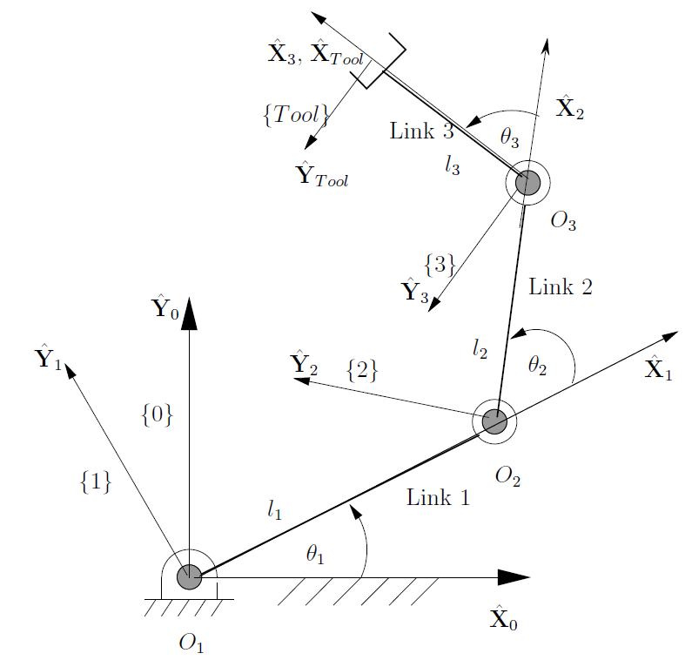

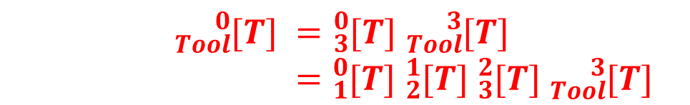
EXAMPLE 1 (TRY IN CLASS)
Find ${}_{Tool}^{0}{[T] }$
$${}_{Tool}^{0}{[T] }={}_{3}^{0}{[T] }{}_{Tool}^{3}{[T] }$$
$$={}_{1}^{0}{[T] }{}_{2}^{1}{[T] }{}_{3}^{2}{[T] }{}_{Tool}^{3}{[T] }$$
3R Manipulator – Figure from Ghosal, 2006
SPATIAL DESCRIPTIONS

Slide 14
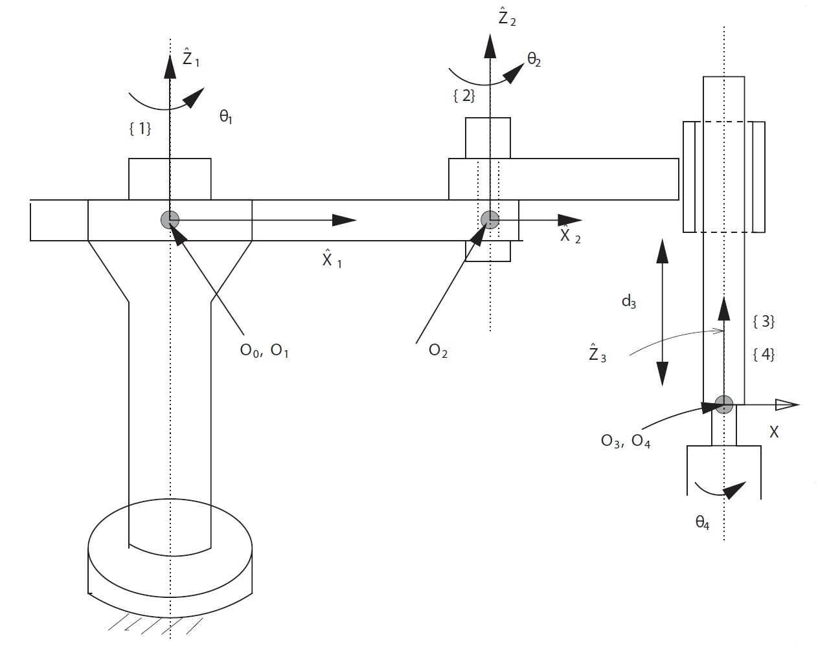


EXAMPLE 2 (IN CLASS)
Find ${}_{4}^{0}{[T] }$
$${}_{4}^{0}{[T] }={}_{1}^{0}{[T] }{}_{2}^{1}{[T] }{}_{3}^{2}{[T] }{}_{4}^{3}{[T] }$$
SCARA MANIPULATOR – Figure from Ghosal, 2006
SPATIAL DESCRIPTIONS

Slide 15
ANY QUESTIONS SO FAR ???
SPATIAL DESCRIPTIONS

Slide 16
DESCRIPTIONS OF ORIENTATION
MODULE 1 – LECTURE 4
DESCRIPTIONS OF ORIENTATION

Slide 17



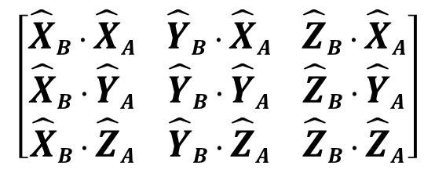




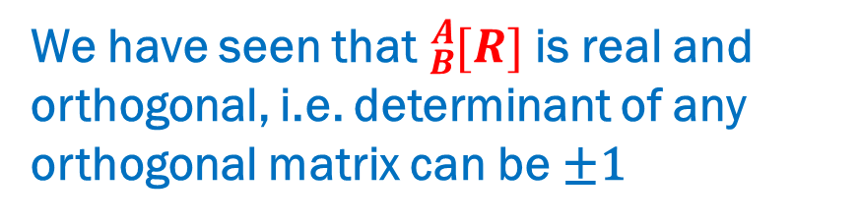
direction cosines – Characterizing motion
$$\left[\begin{matrix}{\hat{X}}_{B}∙{\hat{X}}_{A} & {\hat{Y}}_{B}∙{\hat{X}}_{A} & {\hat{Z}}_{B}∙{\hat{X}}_{A} \\ {\hat{X}}_{B}∙{\hat{Y}}_{A} & {\hat{Y}}_{B}∙{\hat{Y}}_{A} & {\hat{Z}}_{B}∙{\hat{Y}}_{A} \\ {\hat{X}}_{B}∙{\hat{Z}}_{A} & {\hat{Y}}_{B}∙{\hat{Z}}_{A} & {\hat{Z}}_{B}∙{\hat{Z}}_{A}\end{matrix}\right]$$
We have seen that the nine directions cosines are NOT independent quantities.
$$\left|\hat{X}\right|=1$$
$$\hat{X}∙\hat{Y}=0$$
$$\left|\hat{Y}\right|=1$$
$$\hat{X}∙\hat{Z}=0$$
$$\left|\hat{Z}\right|=1$$
$$\hat{Y}∙\hat{Z}=0$$
SIX relations expressing orthogonality conditions reduce independent quantities to three
In order to characterize motion of a rigid body, there is additional requirement matrix elements must satisfy beyond orthogonality
We have seen that ${}_{B}^{A}{[R] }$is real and orthogonal, i.e. determinant of any orthogonal matrix can be ±1
Can determinant of ${}_{B}^{A}{[R] }$be –1 ??
DESCRIPTIONS OF ORIENTATION

Slide 18





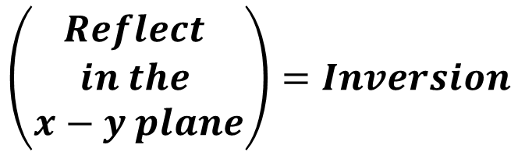


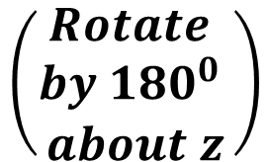
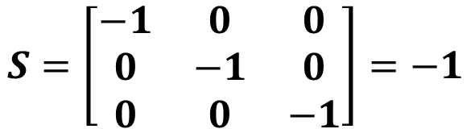

Consider the simplest 3×3 matrix with determinant –1
$$S=\left[\begin{matrix}−1 & 0 & 0 \\ 0 & −1 & 0 \\ 0 & 0 & −1\end{matrix}\right]=−1$$
Transformation S changes the sign of each of the coordinate axes. This is known as Inversion of coordinate axes.
$$\left(\begin{aligned}Rotate \\ by {180}^{0} \\ about z\end{aligned}\right)$$
$$\left(\begin{aligned}Reflect \\ in the \\ x−y plane\end{aligned}\right)=Inversion$$
$$z$$
$$x^{′}$$
$$S$$
$$y$$
$$O$$
$$O$$
$$y^{′}$$
$$x$$
$$z^{′}$$
DESCRIPTIONS OF ORIENTATION

Slide 19
OBSERVATIONS ON IMPLICATIONS OF INVERSION
Inversion of right handed system into left handed one cannot be accomplished by any rigid change in the orientation of the coordinate axes.
“INVERSION” never corresponds to a physical displacement of a rigid body
What is true for “S” is true for any matrix with determinant –1.
Transformations representing rigid body motions must be limited to matrices having determinant +1 (PROPER ROTATION MATRICES).
In order to characterize motion of a rigid body, it is necessary to find three independent parameters that specify orientation of a rigid body in a manner such that the matrix of rotation has determinant +1.
DESCRIPTIONS OF ORIENTATION

Slide 20







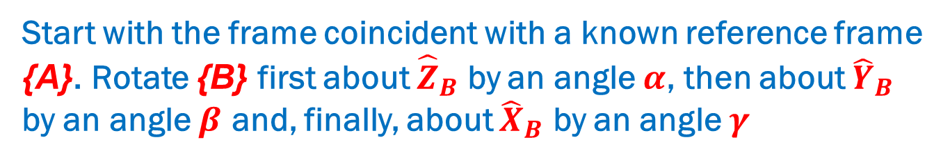














Z–Y–X EULER angles
One method of describing the body frame {B} is
Start with the frame coincident with a known reference frame {A}. Rotate {B} first about ${\hat{Z}}_{B}$ by an angle $α$, then about ${\hat{Y}}_{B}$ by an angle $β$ and, finally, about ${\hat{X}}_{B}$ by an angle $γ$
$${\hat{Z}}_{B}^{′}$$
$${\hat{Z}}_{B}^{′′}$$
$${\hat{Z}}_{B}^{′′}$$
$${\hat{Z}}_{A}$$
$${\hat{Z}}_{B}^{′}$$
$${\hat{Y}}_{B}^{′′′}$$
$${\hat{Y}}_{B}^{′}$$
$${\hat{Y}}_{B}^{′′}$$
$${\hat{Z}}_{B}^{′′′}$$
$$α$$
$$β$$
$${\hat{Y}}_{B}^{′′}$$
$${\hat{Y}}_{B}^{′}$$
$$O_{1}$$
$$γ$$
$$O_{1}$$
$${\hat{Y}}_{A}$$
$$O_{1}$$
$${\hat{X}}_{A}$$
$${\hat{X}}_{B}^{′}$$
$${\hat{X}}_{B}^{′′}$$
$${\hat{X}}_{B}^{′}$$
$${\hat{X}}_{B}^{′′}$$
$${\hat{X}}_{B}^{′′′}$$
Each rotation is performed about an axis of the moving system {B} – hence the term “EULER ANGLES”
Note that each rotation takes place about an axis whose location depends upon the preceding rotations
DESCRIPTIONS OF ORIENTATION

Slide 21
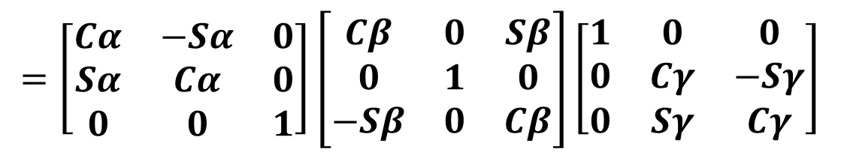

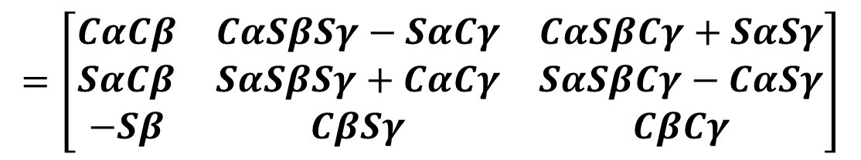
DERIVATION OF Equivalent ROTATION MATRIX
$${}_{B}^{A}{[R]}={}_{B^{′}}^{A}{[R]{}_{B^{′′}}^{B^{′}}{[R]{}_{B^{′′′}}^{B^{′′}}{[R]}}}$$
$${}_{B}^{A}{{\left[R\right]}_{Z^{′}Y^{′}X^{′}}\left(α, β, γ\right)={\left[R\right]}_{Z}\left(α\right) {\left[R\right]}_{Y}\left(β\right) {\left[R\right]}_{X}(γ)}$$
$$=\left[\begin{matrix}Cα & −Sα & 0 \\ Sα & Cα & 0 \\ 0 & 0 & 1\end{matrix}\right]\left[\begin{matrix}Cβ & 0 & Sβ \\ 0 & 1 & 0 \\ −Sβ & 0 & Cβ\end{matrix}\right]\left[\begin{matrix}1 & 0 & 0 \\ 0 & Cγ & −Sγ \\ 0 & Sγ & Cγ\end{matrix}\right]$$
$$=\left[\begin{matrix}CαCβ & CαSβSγ−SαCγ & CαSβCγ+SαSγ \\ SαCβ & SαSβSγ+CαCγ & SαSβCγ−CαSγ \\ −Sβ & CβSγ & CβCγ\end{matrix}\right]$$
DESCRIPTIONS OF ORIENTATION

Slide 22
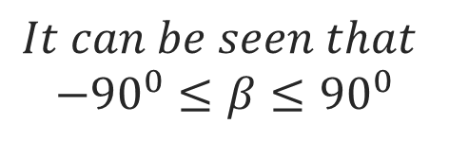
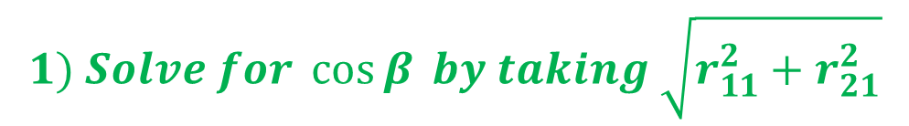
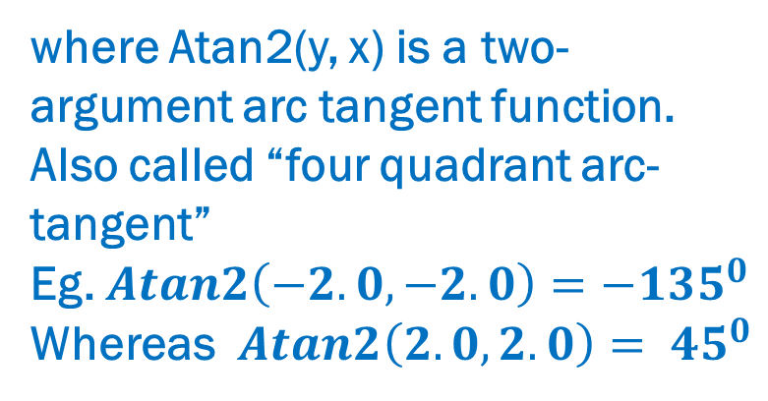

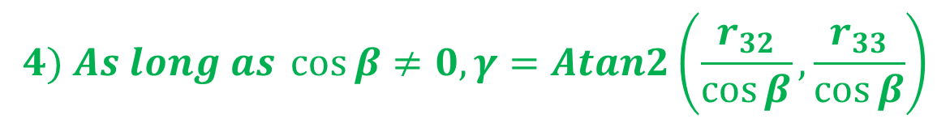
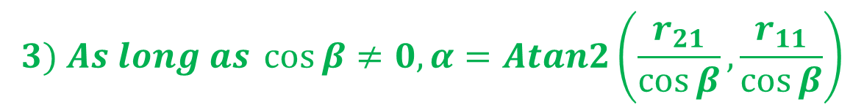
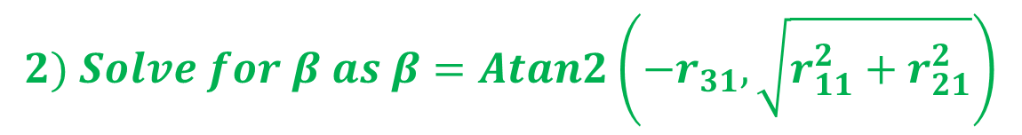
INVERSE PROBLEM – Extracting Z–Y–X EULER angles from rotation matrix
There are nine elements of the rotation matrix and only three independent parameters to describe the rigid body, along with six dependencies
$$Let {}_{B}^{A}{{\left[R\right]}_{XYZ}\left(γ, β, α\right)=}\left[\begin{matrix}r_{11} & r_{12} & r_{13} \\ r_{21} & r_{22} & r_{23} \\ r_{31} & r_{32} & r_{33}\end{matrix}\right]=\left[\begin{matrix}CαCβ & CαSβSγ−SαCγ & CαSβCγ+SαSγ \\ SαCβ & SαSβSγ+CαCγ & SαSβCγ−CαSγ \\ −Sβ & CβSγ & CβCγ\end{matrix}\right]$$
$$1) Solve for \cos{β} by taking \sqrt{r_{11}^{2}+r_{21}^{2}}$$
where Atan2(y, x) is a two-argument arc tangent function. Also called “four quadrant arc-tangent”
Eg. $Atan2\left(−2.0, −2.0\right)=−{135}^{0}$
Whereas $Atan2\left(2.0, 2.0\right)= {45}^{0}$
$$2) Solve for β as β=Atan2\left(−r_{31},\sqrt{r_{11}^{2}+r_{21}^{2}}\right)$$
$$3) As long as \cos{β≠0, α=Atan2\left(\frac{r_{21}}{\cos{β}},\frac{r_{11}}{\cos{β}}\right)}$$
$$4) As long as \cos{β≠0, γ=Atan2\left(\frac{r_{32}}{\cos{β}},\frac{r_{33}}{\cos{β}}\right)}$$
$$It can be seen that$$
$$−{90}^{0}≤β≤{90}^{0}$$
DESCRIPTIONS OF ORIENTATION

Slide 23
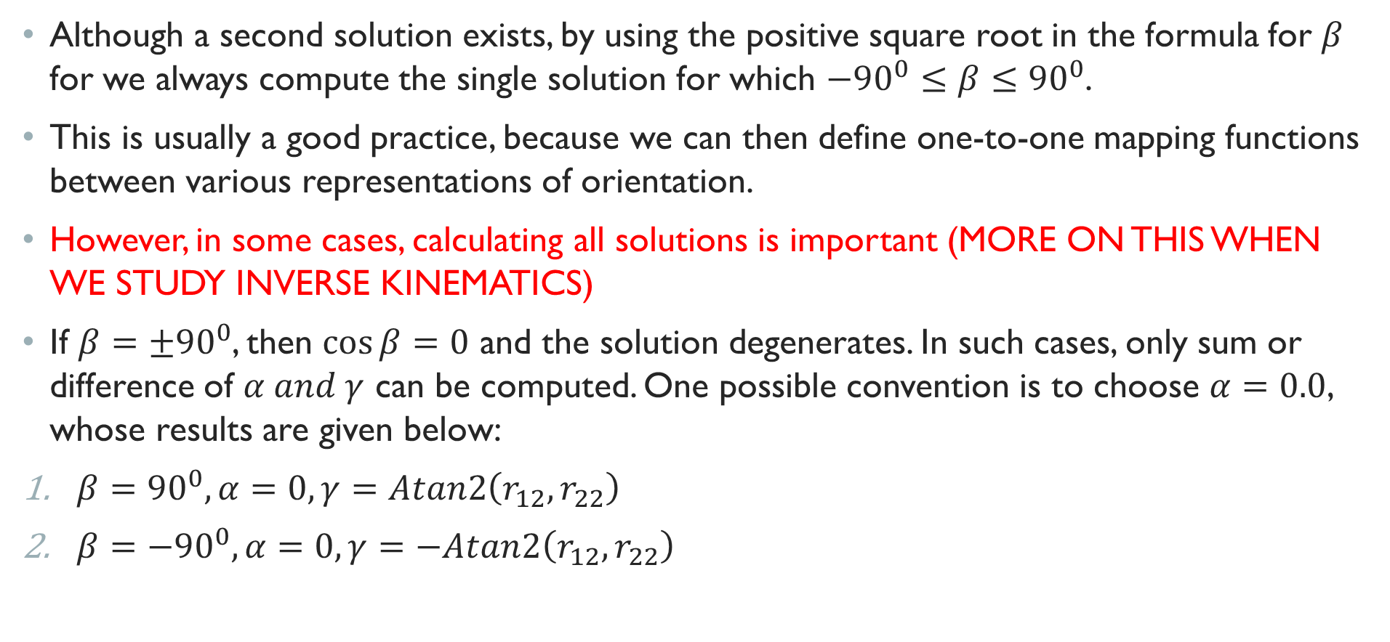
SPECIAL CASE OF $β={90}^{0}$
Although a second solution exists, by using the positive square root in the formula for $β$ for we always compute the single solution for which $−{90}^{0}≤β≤{90}^{0}$.
This is usually a good practice, because we can then define one-to-one mapping functions between various representations of orientation.
However, in some cases, calculating all solutions is important (MORE ON THIS WHEN WE STUDY INVERSE KINEMATICS)
If $β=±{90}^{0}$, then $\cos{β=0}$ and the solution degenerates. In such cases, only sum or difference of $α and γ$ can be computed. One possible convention is to choose $α=0.0$, whose results are given below:
$β={90}^{0}, α=0, γ=Atan2\left(r_{12}, r_{22}\right)$
$β={−90}^{0}, α=0, γ=−Atan2\left(r_{12}, r_{22}\right)$
DESCRIPTIONS OF ORIENTATION

Slide 24





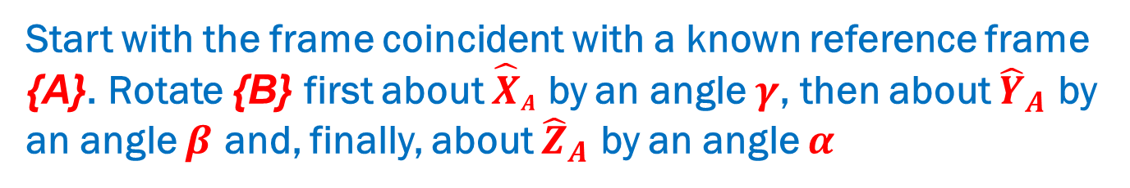









X–Y–Z Fixed angles
Another method of describing the body frame {B} is
Start with the frame coincident with a known reference frame {A}. Rotate {B} first about ${\hat{X}}_{A}$ by an angle $γ$, then about ${\hat{Y}}_{A}$ by an angle $β$ and, finally, about ${\hat{Z}}_{A}$ by an angle $α$
$${\hat{Z}}_{A}$$
$${\hat{Z}}_{B}^{′′}$$
$${\hat{Z}}_{A}$$
$${\hat{Z}}_{B}^{′}$$
$${\hat{Z}}_{A}$$
$$α$$
$${\hat{Y}}_{B}^{′′′}$$
$${\hat{Y}}_{B}^{′′}$$
$${\hat{Z}}_{B}^{′′′}$$
$${\hat{Y}}_{B}^{′}$$
$$γ$$
$$O_{1}$$
$$β$$
$${\hat{Y}}_{A}$$
$${\hat{Y}}_{A}$$
$${\hat{Y}}_{A}$$
$$O_{1}$$
$$O_{1}$$
$${\hat{X}}_{A}$$
$${\hat{X}}_{B}^{′′}$$
$${\hat{X}}_{A}$$
$${\hat{X}}_{B}^{′′′}$$
$${\hat{X}}_{A}$$
$${\hat{X}}_{B}^{′}$$
Each of the three rotations takes place about an axis in the fixed reference frame {A} – hence convention is known as X–Y–Z fixed angles
Sometimes this convention is referred to as roll, pitch, yaw angles – however, one must check proper terminology
DESCRIPTIONS OF ORIENTATION

Slide 25
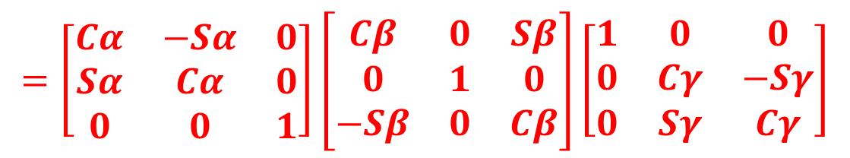
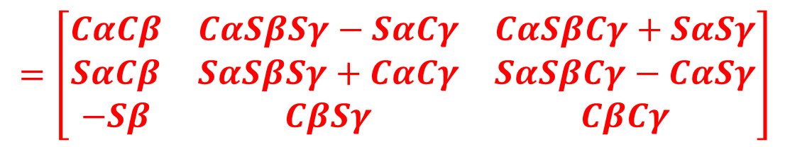
DERIVATION OF Equivalent ROTATION MATRIX
WHAT SHOULD BE THE ORDER OF ROTATIONS ??
IS THIS CORRECT ??
$${}_{B}^{A}{{\left[R\right]}_{XYZ}\left(γ, β, α\right)={\left[R\right]}_{Z}\left(α\right) {\left[R\right]}_{Y}\left(β\right) {\left[R\right]}_{X}(γ)}$$
$$=\left[\begin{matrix}Cα & −Sα & 0 \\ Sα & Cα & 0 \\ 0 & 0 & 1\end{matrix}\right]\left[\begin{matrix}Cβ & 0 & Sβ \\ 0 & 1 & 0 \\ −Sβ & 0 & Cβ\end{matrix}\right]\left[\begin{matrix}1 & 0 & 0 \\ 0 & Cγ & −Sγ \\ 0 & Sγ & Cγ\end{matrix}\right]$$
$$=\left[\begin{matrix}CαCβ & CαSβSγ−SαCγ & CαSβCγ+SαSγ \\ SαCβ & SαSβSγ+CαCγ & SαSβCγ−CαSγ \\ −Sβ & CβSγ & CβCγ\end{matrix}\right]$$
SAME AS FOR Z-Y-X EULER ANGLES
DESCRIPTIONS OF ORIENTATION

Slide 26

Z–Y–Z EULER angles
Another method of describing the body frame {B} is
Start with the frame coincident with a known reference frame {A}. Rotate {B} first about ${\hat{Z}}_{B}$ by an angle $α$, then about ${\hat{Y}}_{B}$ by an angle $β$ and, finally, about ${\hat{Z}}_{B}$ by an angle $γ$
Each rotation is performed about an axis of the moving system {B}
– Hence is EULER ANGLE DESCRIPTION
Note that each rotation takes place about an axis whose location depends upon the preceding rotations
DESCRIPTIONS OF ORIENTATION

Slide 27
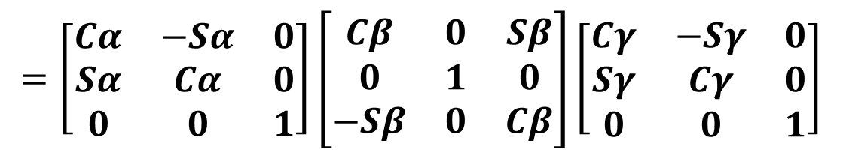
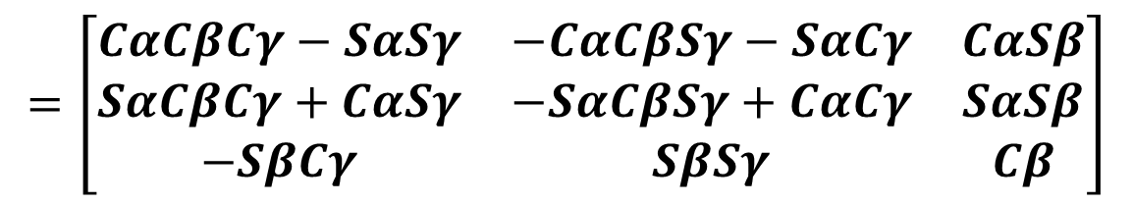
DERIVATION OF Equivalent ROTATION MATRIX
$${}_{B}^{A}{[R]}={}_{B^{′}}^{A}{[R]{}_{B^{′′}}^{B^{′}}{[R]{}_{B^{′′′}}^{B^{′′}}{[R]}}}$$
$${}_{B}^{A}{{\left[R\right]}_{Z^{′}Y^{′}Z^{′}}\left(α, β, γ\right)={\left[R\right]}_{Z}\left(α\right) {\left[R\right]}_{Y}\left(β\right) {\left[R\right]}_{Z}(γ)}$$
$$=\left[\begin{matrix}Cα & −Sα & 0 \\ Sα & Cα & 0 \\ 0 & 0 & 1\end{matrix}\right]\left[\begin{matrix}Cβ & 0 & Sβ \\ 0 & 1 & 0 \\ −Sβ & 0 & Cβ\end{matrix}\right]\left[\begin{matrix}Cγ & −Sγ & 0 \\ Sγ & Cγ & 0 \\ 0 & 0 & 1\end{matrix}\right]$$
$$=\left[\begin{matrix}CαCβCγ−SαSγ & −CαCβSγ−SαCγ & CαSβ \\ SαCβCγ+CαSγ & −SαCβSγ+CαCγ & SαSβ \\ −SβCγ & SβSγ & Cβ\end{matrix}\right]$$
DESCRIPTIONS OF ORIENTATION

Slide 28
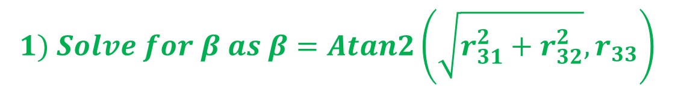
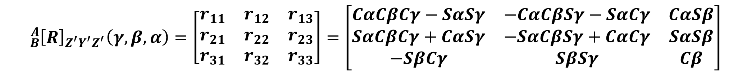
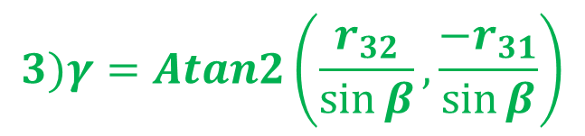

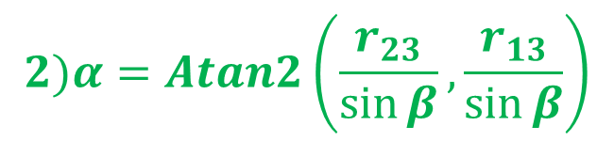
INVERSE PROBLEM – Extracting X–Y–Z Fixed angles from rotation matrix
$${}_{B}^{A}{{\left[R\right]}_{Z^{′}Y^{′}Z^{′}}\left(γ, β, α\right)=}\left[\begin{matrix}r_{11} & r_{12} & r_{13} \\ r_{21} & r_{22} & r_{23} \\ r_{31} & r_{32} & r_{33}\end{matrix}\right]=\left[\begin{matrix}CαCβCγ−SαSγ & −CαCβSγ−SαCγ & CαSβ \\ SαCβCγ+CαSγ & −SαCβSγ+CαCγ & SαSβ \\ −SβCγ & SβSγ & Cβ\end{matrix}\right]$$
$$If \sin{β}≠0$$
$$1) Solve for β as β=Atan2\left(\sqrt{r_{31}^{2}+r_{32}^{2}}, r_{33}\right)$$
$$2)α=Atan2\left(\frac{r_{23}}{\sin{β}},\frac{r_{13}}{\sin{β}}\right)$$
$$3)γ=Atan2\left(\frac{r_{32}}{\sin{β}},\frac{{−r}_{31}}{\sin{β}}\right)$$
DESCRIPTIONS OF ORIENTATION

Slide 29
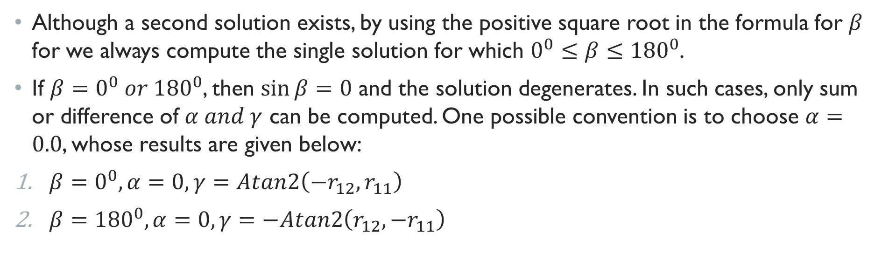
SPECIAL CASE OF $β=0^{0} or {180}^{0}$
Although a second solution exists, by using the positive square root in the formula for $β$ for we always compute the single solution for which $0^{0}≤β≤{180}^{0}$.
If $β=0^{0} or {180}^{0}$, then $\sin{β=0}$ and the solution degenerates. In such cases, only sum or difference of $α and γ$ can be computed. One possible convention is to choose $α=0.0$, whose results are given below:
$β=0^{0}, α=0, γ=Atan2\left({−r}_{12}, r_{11}\right)$
$β={180}^{0}, α=0, γ=−Atan2\left(r_{12}, {−r}_{11}\right)$
DESCRIPTIONS OF ORIENTATION

Slide 30
ANGLE SET CONVENTIONS
Total of 24 angle-set conventions
12 conventions for fixed angle sets and 12 for euler angle sets
No reason to favour one over another, but different authors use different conventions
REFER APPENDIX B of Craig J.J., “Introduction to Robotics: Mechanics and Control” for entire list of angle-set conventions along with corresponding rotation matrices.
DESCRIPTIONS OF ORIENTATION

Slide 31
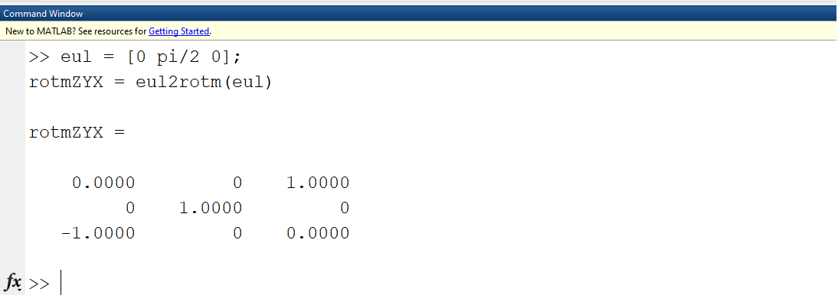
COMPUTING [R] from EULER ANGLES USING MATLAB
SYNTAX –
rotm = eul2rotm(eul)
rotm = eul2rotm(eul,sequence)
eul = [0 pi/2 0];
rotmZYX = eul2rotm(eul)
DESCRIPTIONS OF ORIENTATION

Slide 32
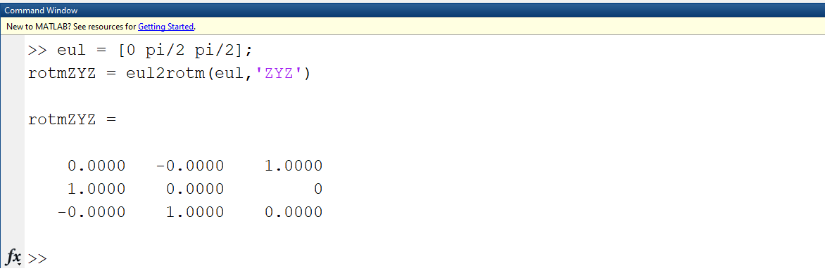
COMPUTING [R] from EULER ANGLES USING MATLAB
rotm = eul2rotm(eul)
Default order of sequence is Z-Y-X
rotm = eul2rotm(eul,sequence)
Specify sequence
eul = [0 pi/2 pi/2];
rotmZYX = eul2rotm(eul, ‘ZYZ’)
DESCRIPTIONS OF ORIENTATION

Slide 33
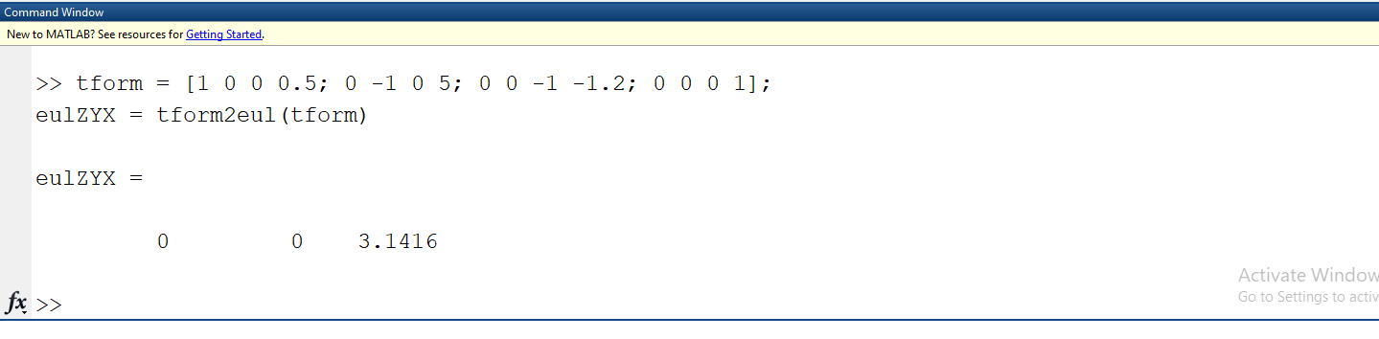

EXTRACTING EULER ANGLES USING MATLAB
SYNTAX –
eul = tform2eul(tform)
eul = tform2eul(tform, sequence)
Eg. – ${}_{B}^{A}{\left[T\right]=}\left[\begin{matrix}\begin{matrix}1 & 0 & 0 \\ 0 & −1 & 0 \\ 0 & 0 & −1\end{matrix} & \begin{matrix}0.5 \\ 5 \\ −1.2\end{matrix} \\ \begin{matrix}0 & 0 & 0\end{matrix} & 1\end{matrix}\right]$
tform = [1 0 0 0.5; 0 -1 0 5; 0 0 -1 -1.2; 0 0 0 1];
eulZYX = tform2eul(tform)
DESCRIPTIONS OF ORIENTATION

Slide 34

EXTRACTING EULER ANGLES USING MATLAB
eul = tform2eul(tform)
Default order of sequence is Z-Y-X
eul = tform2eul(tform, sequence)
Specify sequence
Eg. – ${}_{B}^{A}{\left[T\right]=}\left[\begin{matrix}\begin{matrix}1 & 0 & 0 \\ 0 & −1 & 0 \\ 0 & 0 & −1\end{matrix} & \begin{matrix}0.5 \\ 5 \\ −1.2\end{matrix} \\ \begin{matrix}0 & 0 & 0\end{matrix} & 1\end{matrix}\right]$
tform = [1 0 0 0.5; 0 -1 0 5; 0 0 -1 -1.2; 0 0 0 1];
eulZYX = tform2eul(tform, ‘ZYZ’)
DESCRIPTIONS OF ORIENTATION

