Slide 1




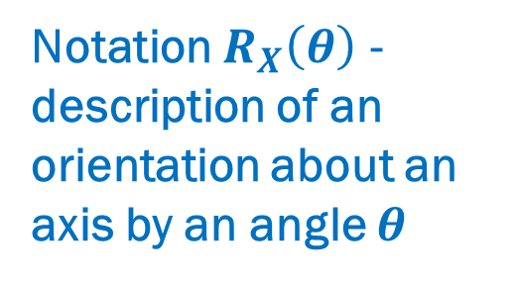




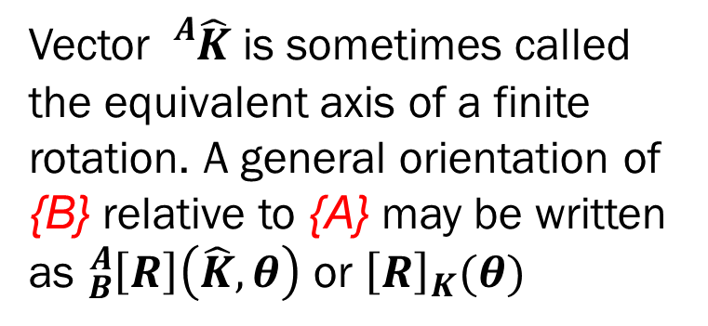



EQUIVALENT ANGLE-AXIS REPRESENTATION
Notation $R_{X}\left(θ\right)$ - description of an orientation about an axis by an angle $θ$
If the axis is a general direction (rather than one of the unit directions) any orientation may be obtained through proper axis and angle selection
$${\hat{Z}}_{A}$$
$${}_{}^{A}{\hat{K}}$$
Vector ${}_{}^{A}{\hat{K}}$ is sometimes called the equivalent axis of a finite rotation. A general orientation of {B} relative to {A} may be written as ${}_{B}^{A}{\left[R\right]\left(\hat{K}, θ\right)}$ or ${\left[R\right]}_{K}(θ)$
$${\hat{Z}}_{B}$$
EQUIVALENT ANGLE-AXIS REPRESENTATION
$$θ$$
$${\hat{Y}}_{B}$$
$$O_{1}$$
$${\hat{Y}}_{A}$$
$${\hat{X}}_{B}$$
$${\hat{X}}_{A}$$
$\hat{K}$ and $θ$ exist for any orientation of {B} relative to {A} – KNOWN RESULT
Start with the frame coincident with a known frame {A}; then rotate {B} about the vector ${}_{}^{A}{\hat{K}}$ by an angle $θ$ according to the right-hand rule.
DESCRIPTIONS OF ORIENTATION

Slide 2
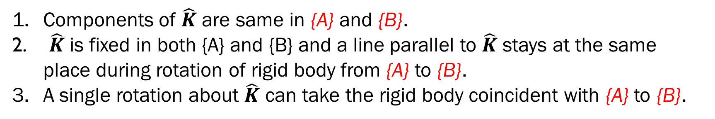
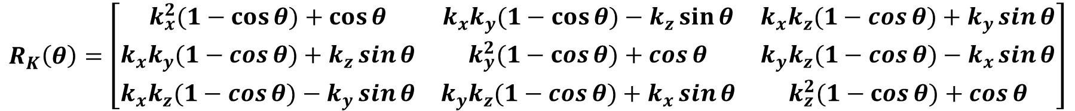
For rotation matrix ${}_{B}^{A}{\left[R\right]}$ and its eigenvector corresponding to +1 eigenvalue, we have ${}_{}^{A}{\hat{K}}={}_{B}^{A}{\left[R\right]{}_{}^{B}{\hat{K}}=1×{}_{}^{B}{\hat{K}}}$
Components of $\hat{K}$ are same in {A} and {B}.
$\hat{K}$ is fixed in both {A} and {B} and a line parallel to $\hat{K}$ stays at the same place during rotation of rigid body from {A} to {B}.
A single rotation about $\hat{K}$ can take the rigid body coincident with {A} to {B}.
$$R_{K}\left(θ\right)=\left[\begin{matrix}k_{x}^{2}(1−\cos{θ)+\cos{θ}} & k_{x}k_{y}(1−\cos{θ)−k_{z}\sin{θ}} & k_{x}k_{z}(1−\cos{θ)+k_{y}\sin{θ}} \\ k_{x}k_{y}(1−\cos{θ)+k_{z}\sin{θ}} & k_{y}^{2}(1−\cos{θ)+\cos{θ}} & k_{y}k_{z}(1−\cos{θ)−k_{x}\sin{θ}} \\ k_{x}k_{z}(1−\cos{θ)−k_{y}\sin{θ}} & k_{y}k_{z}(1−\cos{θ)+k_{x}\sin{θ}} & k_{z}^{2}(1−\cos{θ)+\cos{θ}}\end{matrix}\right]$$
converts from angle—axis representation to rotation-matrix representation
given any axis of rotation and any angular amount, we can easily construct an equivalent rotation matrix
DESCRIPTIONS OF ORIENTATION

Slide 3
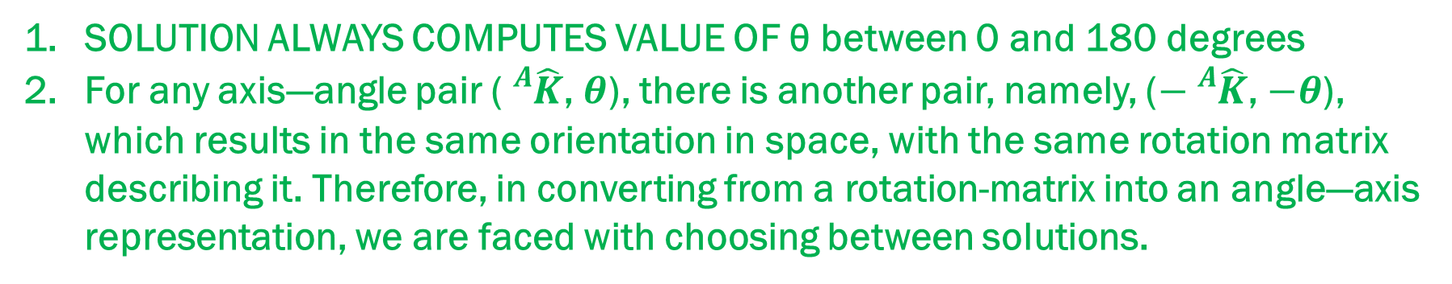
INVERSE PROBLEM
If ${}_{B}^{A}{R_{K}\left(θ\right)=}\left[\begin{matrix}r_{11} & r_{12} & r_{13} \\ r_{21} & r_{22} & r_{23} \\ r_{31} & r_{32} & r_{33}\end{matrix}\right], then θ=Acos\left(\frac{r_{11}+r_{22}+r_{33}−1}{2}\right) and \hat{K}=\frac{1}{2sinθ}\left[\begin{matrix}r_{32}−r_{23} \\ r_{13}−r_{31} \\ r_{21}−r_{12}\end{matrix}\right]$
DOES THIS LOOK FAMILIAR ???
SOLUTION ALWAYS COMPUTES VALUE OF θ between 0 and 180 degrees
For any axis—angle pair (${}_{}^{A}{\hat{K}}$, $θ$), there is another pair, namely, ($−{}_{}^{A}{\hat{K}}$, $−θ$), which results in the same orientation in space, with the same rotation matrix describing it. Therefore, in converting from a rotation-matrix into an angle—axis representation, we are faced with choosing between solutions.
DESCRIPTIONS OF ORIENTATION

Slide 4
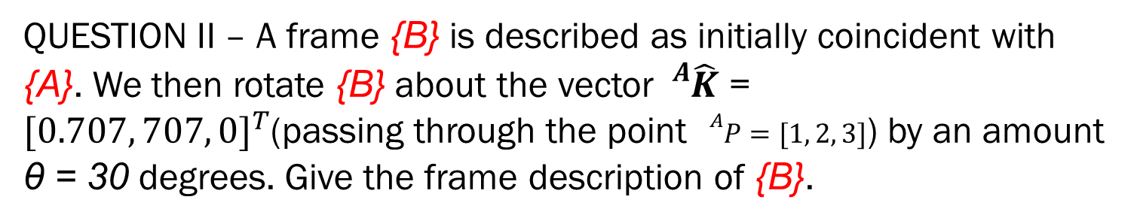
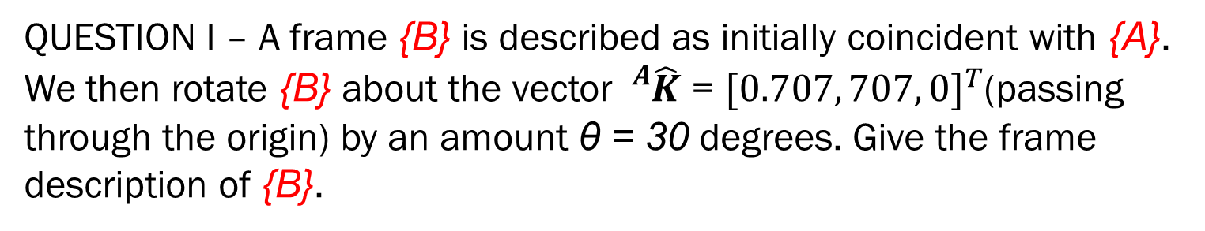
EXAMPLE 3 (TRY IN CLASS)
QUESTION I – A frame {B} is described as initially coincident with {A}. We then rotate {B} about the vector ${}_{}^{A}{\hat{K}}$ = ${[0.707, 707, 0]}^{T}$(passing through the origin) by an amount θ = 30 degrees. Give the frame description of {B}.
QUESTION II – A frame {B} is described as initially coincident with {A}. We then rotate {B} about the vector ${}_{}^{A}{\hat{K}}$ = ${[0.707, 707, 0]}^{T}$(passing through the point ${}_{}^{A}{P=[1, 2, 3]}$) by an amount θ = 30 degrees. Give the frame description of {B}.
DESCRIPTIONS OF ORIENTATION

Slide 5
MODULE 1 – LECTURE 5
DH Parameters
DH PARAMETERS

Slide 6
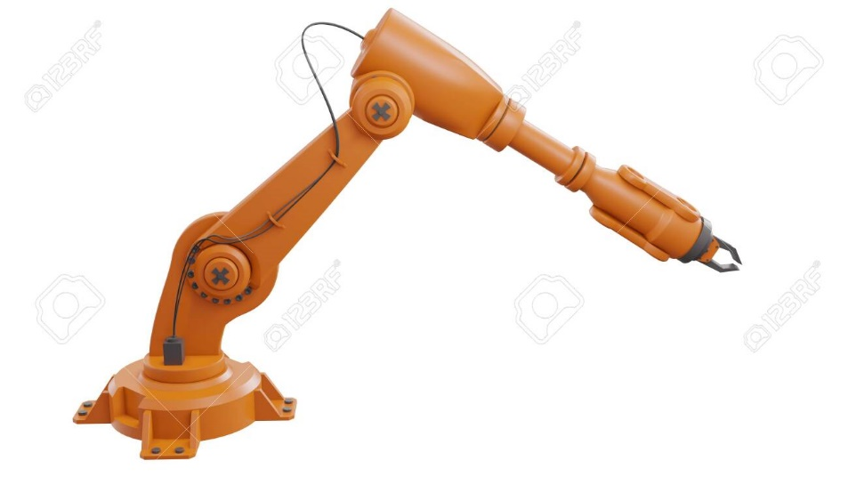
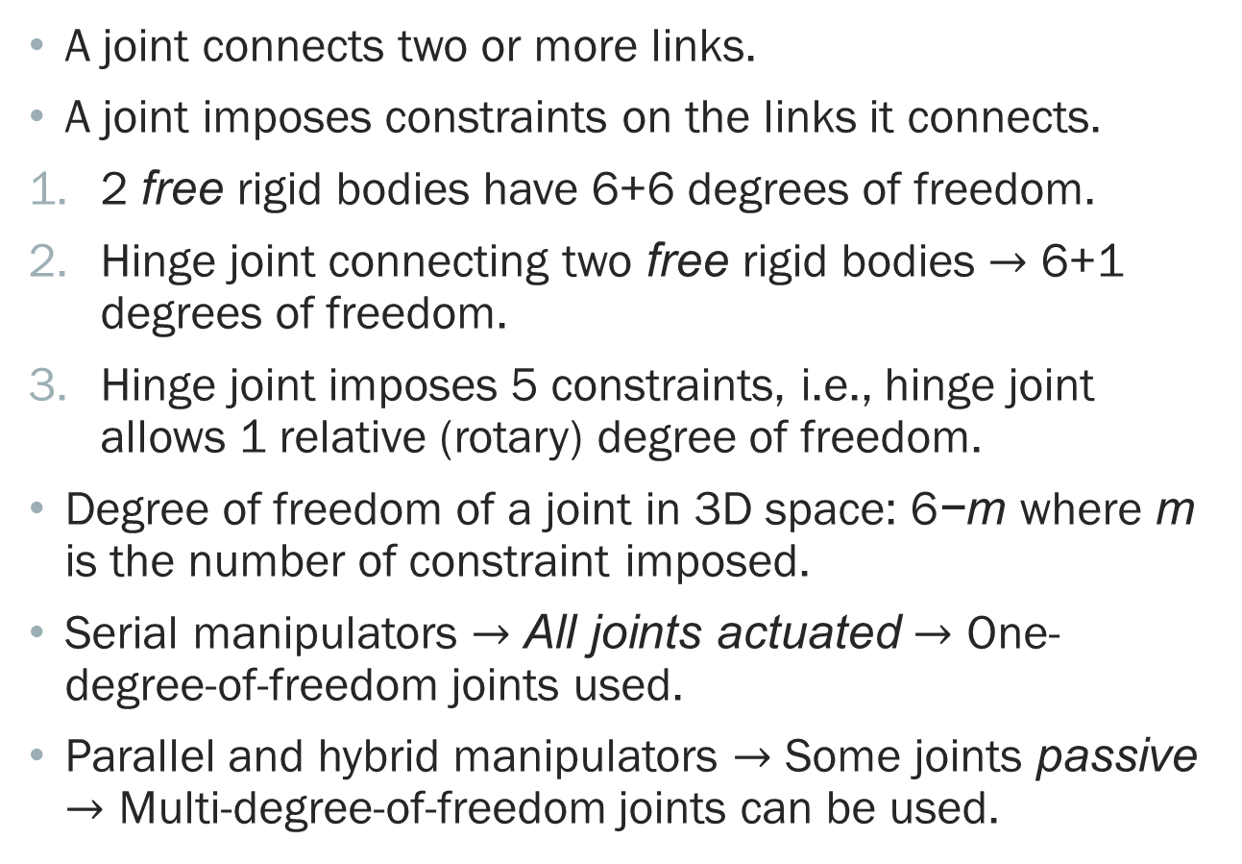
JOINTS (REVIEWED)
A joint connects two or more links.
A joint imposes constraints on the links it connects.
2 free rigid bodies have 6+6 degrees of freedom.
Hinge joint connecting two free rigid bodies $→$ 6+1 degrees of freedom.
Hinge joint imposes 5 constraints, i.e., hinge joint allows 1 relative (rotary) degree of freedom.
Degree of freedom of a joint in 3D space: 6−m where m is the number of constraint imposed.
Serial manipulators $→$ All joints actuated $→$ One-degree-of-freedom joints used.
Parallel and hybrid manipulators $→$ Some joints passive $→$ Multi-degree-of-freedom joints can be used.
DH PARAMETERS

Slide 7
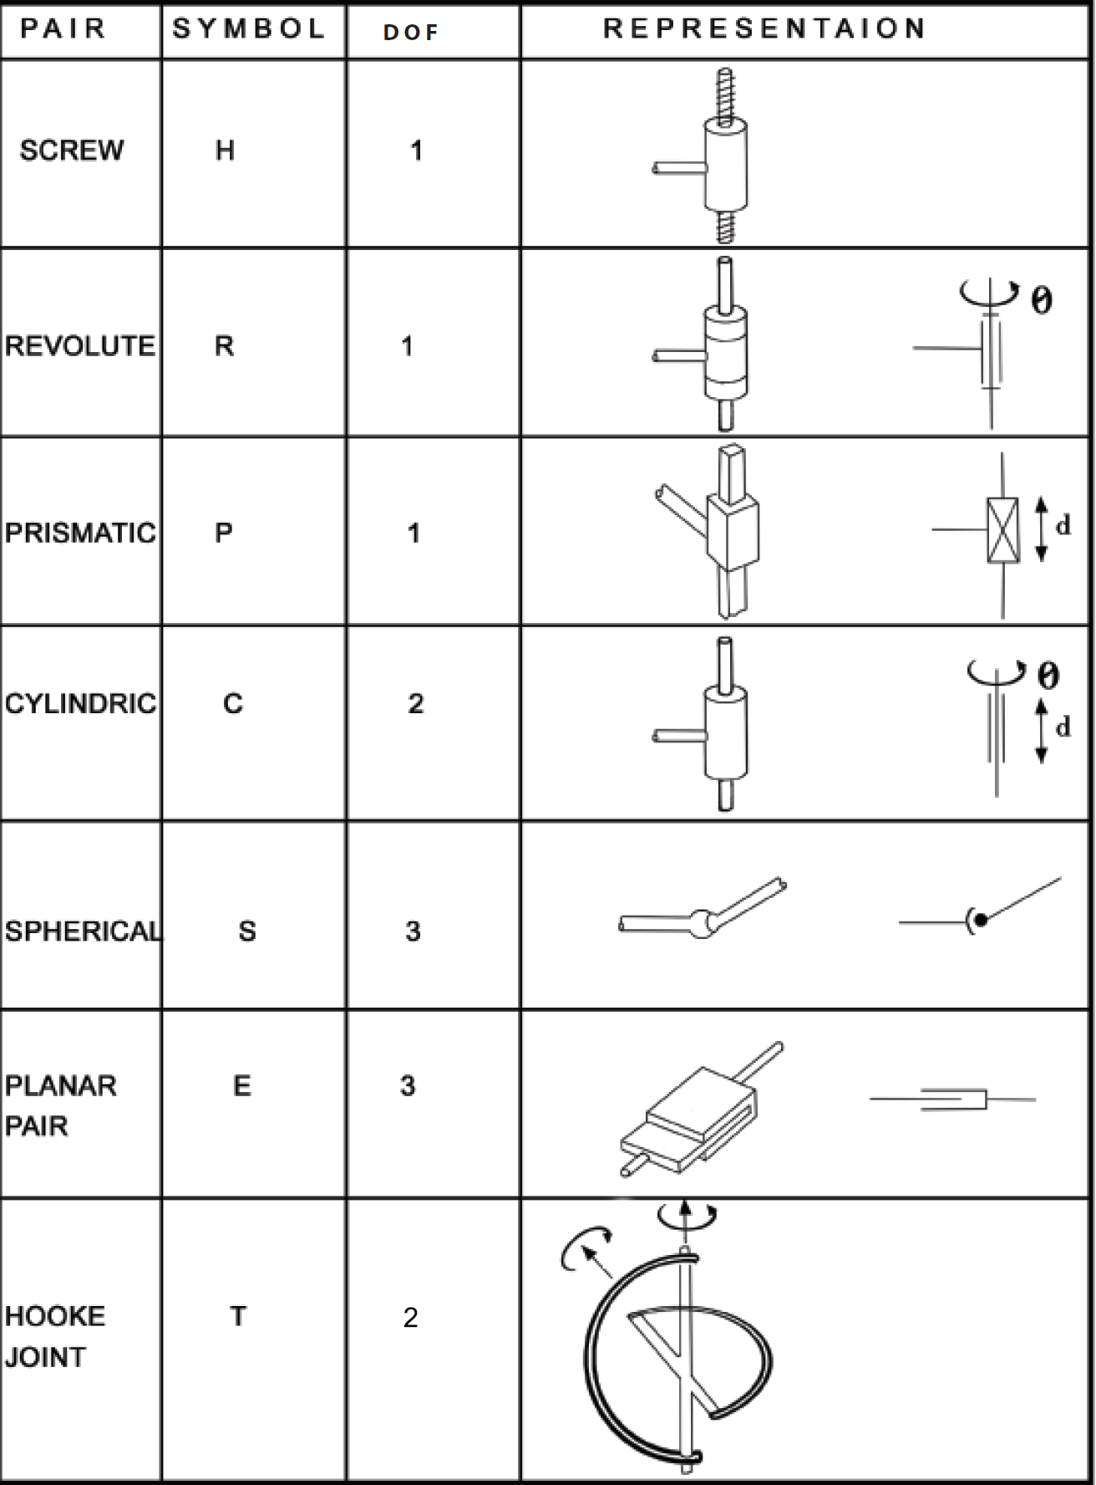
TYPES OF JOINTS (REVIEWED)
To mathematically represent joints, the constraints associated with joints must be studied.
DH PARAMETERS

Slide 8
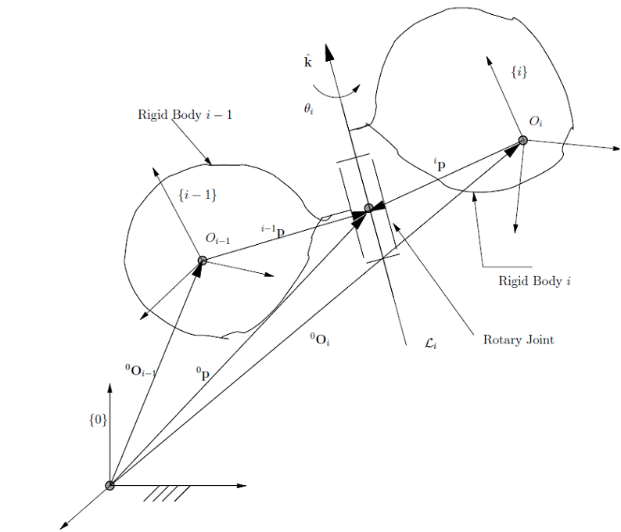
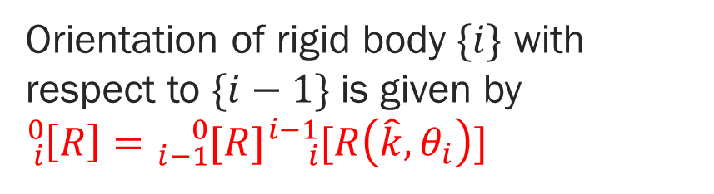
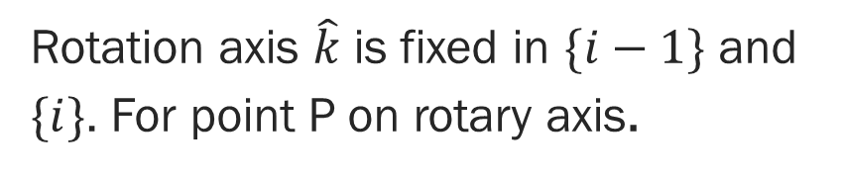

CONSTRAINTS IMPOSED BY A ROTARY (R) JOINT
Unit vector along $L_{i}$
Associated with a rotary joint is a line about which relative rotational motion of two connected bodies is allowed – also called joint axis.
Orientation of rigid body $\{i\}$ with respect to $\{i−1\}$ is given by ${}_{i}^{0}{\left[R\right]={}_{i−1}^{0}{[R]{}_{i}^{i−1}{[R\left(\hat{k}, θ_{i}\right)]}}}$
Rotation axis $\hat{k}$ is fixed in $\{i−1\}$ and $\{i\}$. For point P on rotary axis.
Rotary joint axis.
$${}_{}^{0}p={}_{}^{0}{O_{i−1}+{}_{i−1}^{0}{[R]}{}_{}^{i−1}p={}_{}^{0}{O_{i}+{}_{i}^{0}{[R]}{}_{}^{i}p}}$$
DH PARAMETERS

Slide 9
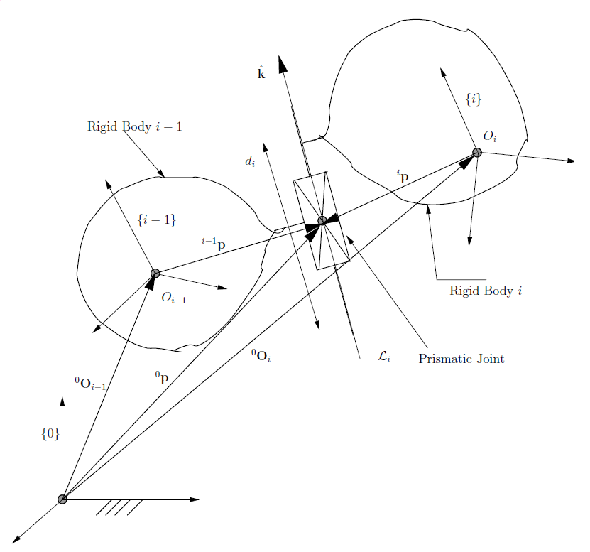
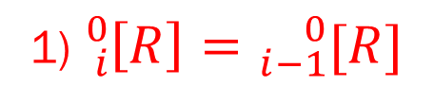
CONSTRAINTS IMPOSED BY A Prismatic (P) JOINT
Associated with a prismatic joint is a line about which relative translational motion of two connected bodies is allowed – also called joint axis.
Since prismatic joint allows only translation, we have
1) ${}_{i}^{0}{\left[R\right]={}_{i−1}^{0}{[R] }}$
2) ${}_{}^{0}{O_{i−1}+{}_{i−1}^{0}{[R]}{}_{}^{i−1}p+d_{i}\hat{k}={}_{}^{0}{O_{i}+{}_{i}^{0}{[R]}{}_{}^{i}p}}$
Prismatic joint axis.
DH PARAMETERS

Slide 10
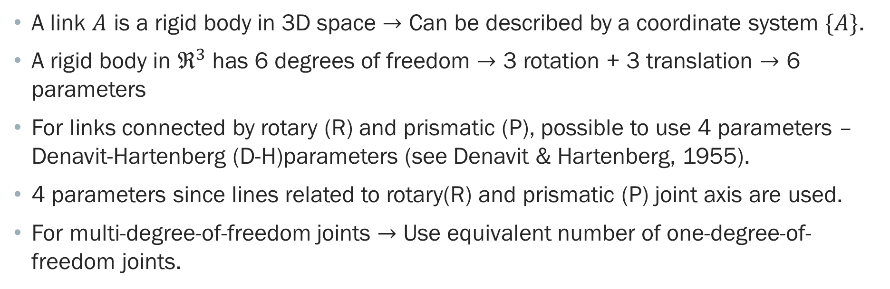
linkS
A link $A$ is a rigid body in 3D space $→$ Can be described by a coordinate system $\{A\}$.
A rigid body in $ℜ^{3}$ has 6 degrees of freedom $→$ 3 rotation + 3 translation $→$ 6 parameters
For links connected by rotary (R) and prismatic (P), possible to use 4 parameters – Denavit-Hartenberg (D-H)parameters (see Denavit & Hartenberg, 1955).
4 parameters since lines related to rotary(R) and prismatic (P) joint axis are used.
For multi-degree-of-freedom joints $→$ Use equivalent number of one-degree-of-freedom joints.
DH PARAMETERS

Slide 11
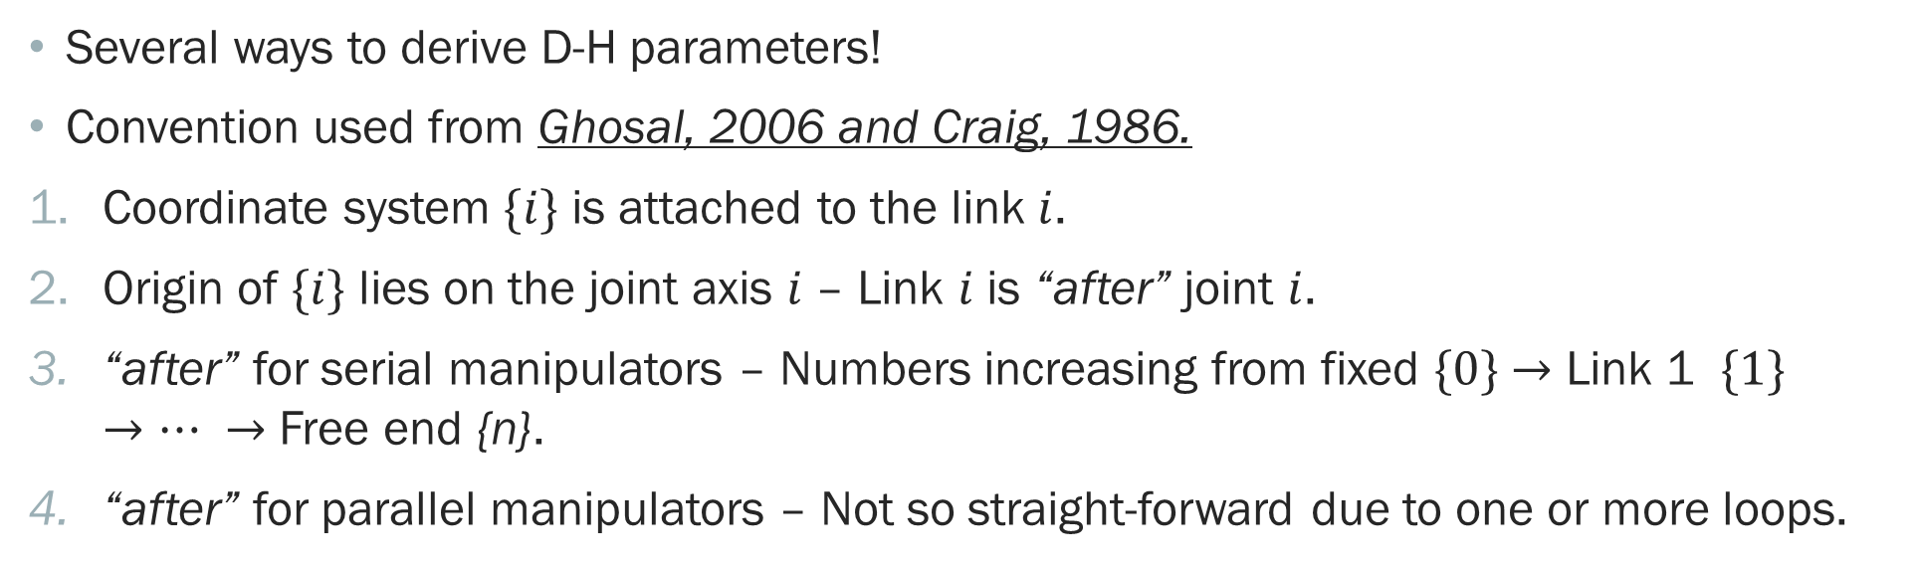
D–H parameters
Several ways to derive D-H parameters!
Convention used from Ghosal, 2006 and Craig, 1986.
Coordinate system $\{i\}$ is attached to the link $i$.
Origin of $\{i\}$ lies on the joint axis $i$ – Link $i$ is “after” joint $i$.
“after” for serial manipulators – Numbers increasing from fixed $\{0\}$ $→$ Link 1 $\{1\}$ $→… →$ Free end {n}.
“after” for parallel manipulators – Not so straight-forward due to one or more loops.
DH PARAMETERS

Slide 12
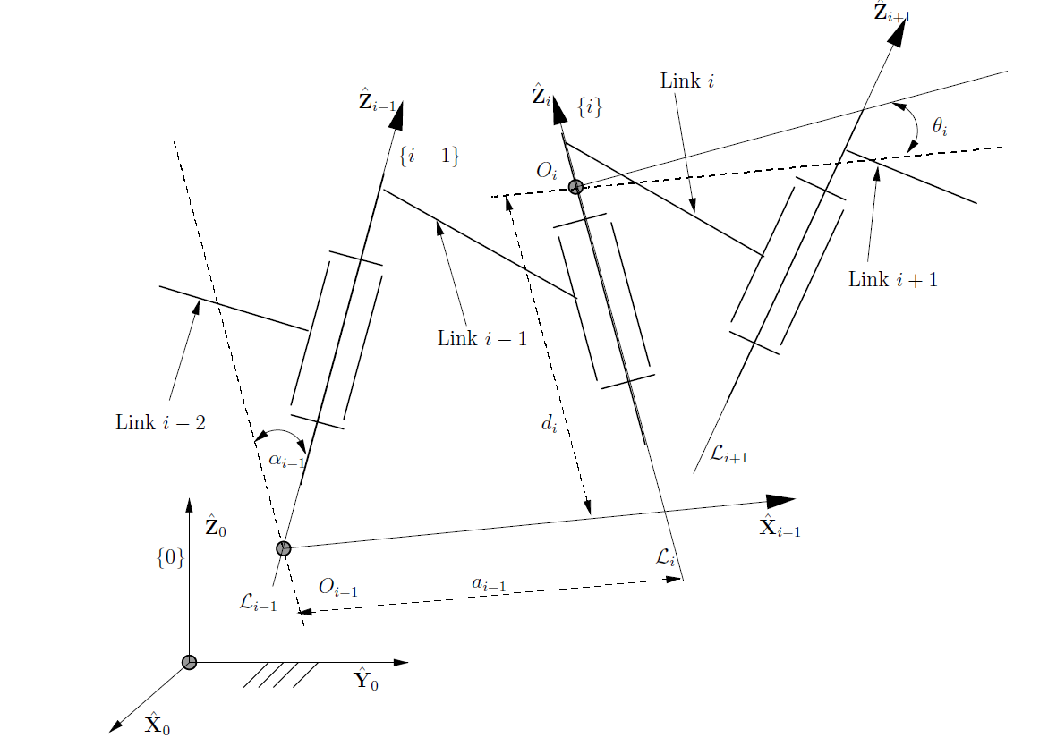
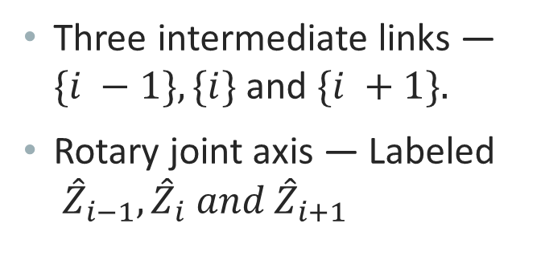
ASSIGNMENT OF Coordinate axes
Three intermediate links — $\{i −1\}, \{i\}$and $\{i +1\}.$
Rotary joint axis — Labeled ${\hat{Z}}_{i−1}, {\hat{Z}}_{i} and {\hat{Z}}_{i+1}$
DH PARAMETERS

Slide 13
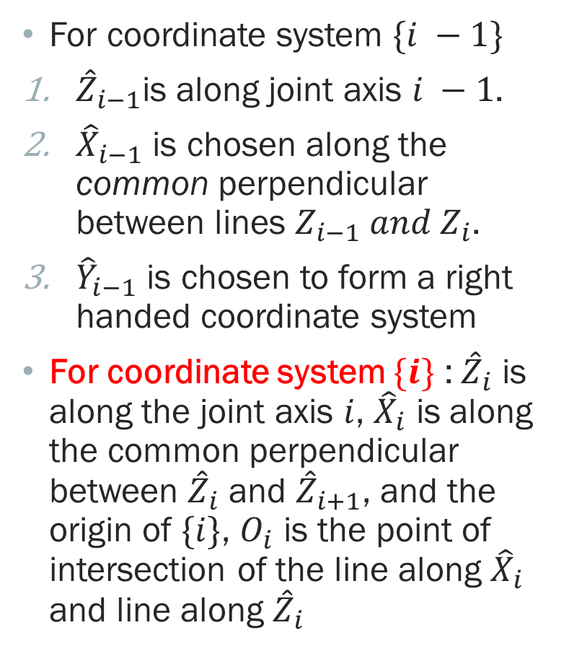
ASSIGNMENT OF Coordinate axes
For coordinate system $\{i −1\}$
${\hat{Z}}_{i−1}$is along joint axis $i −1$.
${\hat{X}}_{i−1}$ is chosen along the common perpendicular between lines $Z_{i−1} and Z_{i}$.
${\hat{Y}}_{i−1}$ is chosen to form a right handed coordinate system
For coordinate system $\{i\}$ : ${\hat{Z}}_{i}$ is along the joint axis $i$, ${\hat{X}}_{i}$ is along the common perpendicular between ${\hat{Z}}_{i}$ and ${\hat{Z}}_{i+1}$, and the origin of $\{i\}$, $O_{i}$ is the point of intersection of the line along ${\hat{X}}_{i}$ and line along ${\hat{Z}}_{i}$
DH PARAMETERS

Slide 14
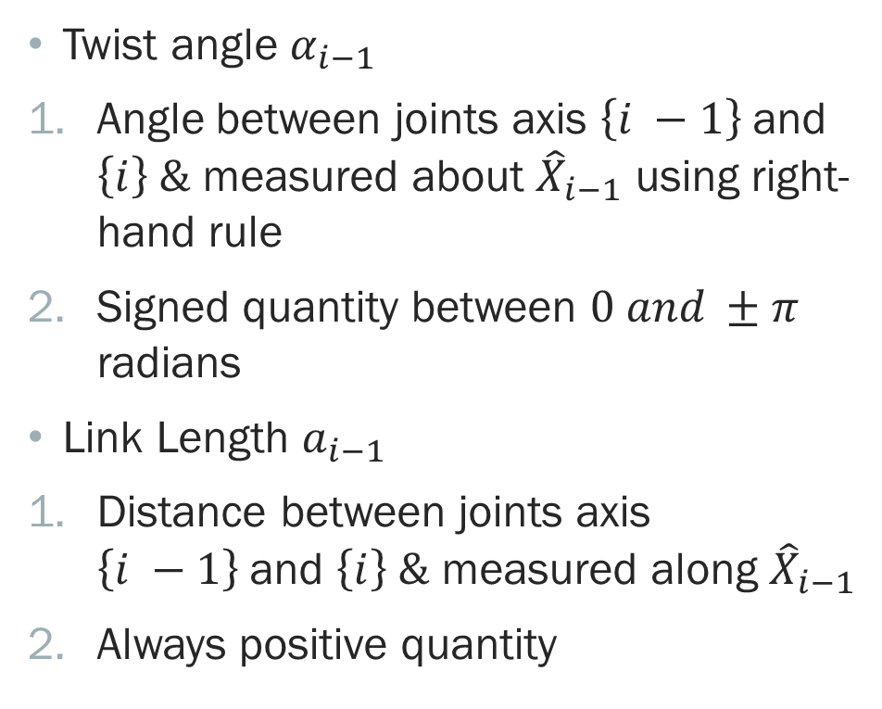

D–H parameters for link $i$
Twist angle $α_{i−1}$
Angle between joints axis $\left\{i −1\right\}$and $\left\{i\right\} \&$ measured about ${\hat{X}}_{i−1}$ using right-hand rule
Signed quantity between $0 and ±π$ radians
Link Length $a_{i−1}$
Distance between joints axis $\left\{i −1\right\}$and $\left\{i\right\} \&$ measured along ${\hat{X}}_{i−1}$
Always positive quantity
DH PARAMETERS

Slide 15
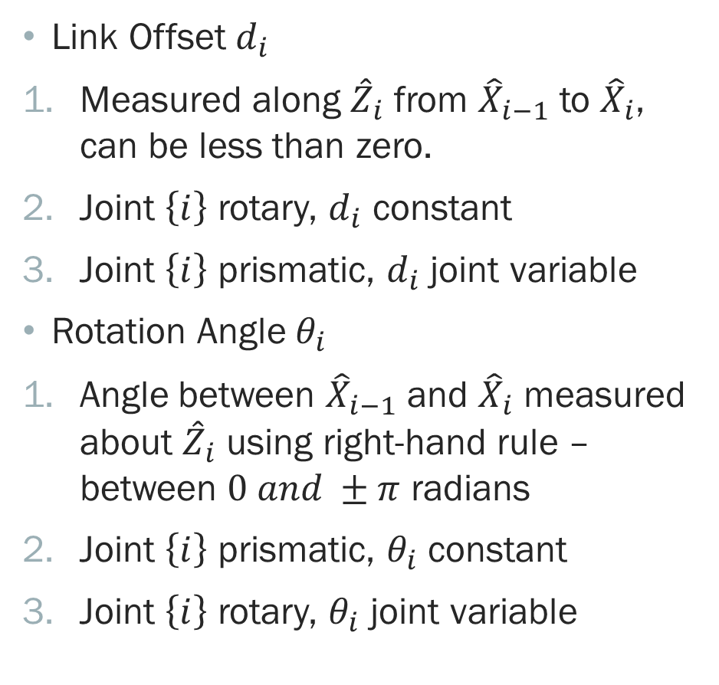

D–H parameters for link $i$
Link Offset $d_{i}$
Measured along ${\hat{Z}}_{i}$ from ${\hat{X}}_{i−1}$ to ${\hat{X}}_{i}$, can be less than zero.
Joint $\left\{i\right\}$ rotary, $d_{i}$ constant
Joint $\left\{i\right\}$ prismatic, $d_{i}$ joint variable
Rotation Angle $θ_{i}$
Angle between ${\hat{X}}_{i−1}$ and ${\hat{X}}_{i}$ measured about ${\hat{Z}}_{i}$ using right-hand rule – between $0 and ±π$ radians
Joint $\left\{i\right\}$ prismatic, $θ_{i}$ constant
Joint $\left\{i\right\}$ rotary, $θ_{i}$ joint variable
DH PARAMETERS

Slide 16
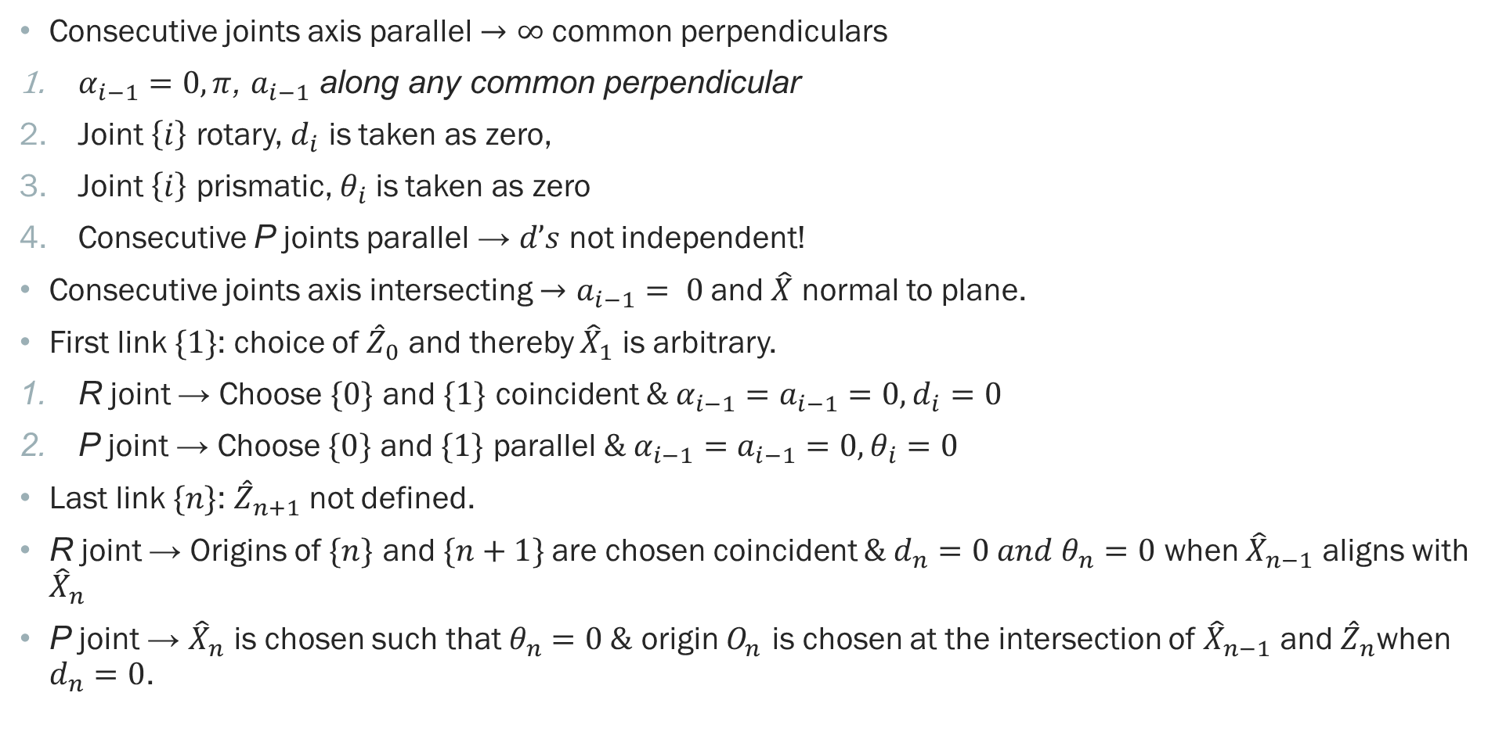
D–H parameters – SPECIAL CASES
Consecutive joints axis parallel $→$ $∞$ common perpendiculars
$α_{i−1}=0,π$, $a_{i−1}$ along any common perpendicular
Joint $\left\{i\right\}$ rotary, $d_{i}$ is taken as zero,
Joint $\left\{i\right\}$ prismatic, $θ_{i}$ is taken as zero
Consecutive P joints parallel → $d’s$ not independent!
Consecutive joints axis intersecting $→a_{i−1}= 0$and $\hat{X}$ normal to plane.
First link $\{1\}$: choice of ${\hat{Z}}_{0}$ and thereby ${\hat{X}}_{1}$ is arbitrary.
R joint → Choose $\{0\}$ and $\{1\}$ coincident $\& α_{i−1}=a_{i−1}=0, d_{i}=0$
P joint → Choose $\{0\}$ and $\{1\}$ parallel $\& α_{i−1}=a_{i−1}=0, θ_{i}=0$
Last link $\{n\}$: ${\hat{Z}}_{n+1}$ not defined.
R joint → Origins of $\{n\}$ and $\{n+1\}$are chosen coincident $\& d_{n}=0 and θ_{n}=0$ when ${\hat{X}}_{n−1}$ aligns with ${\hat{X}}_{n}$
P joint → ${\hat{X}}_{n}$ is chosen such that $θ_{n}=0 \&$ origin $O_{n}$ is chosen at the intersection of ${\hat{X}}_{n−1}$ and ${\hat{Z}}_{n}$when $d_{n}=0$.
DH PARAMETERS

Slide 17
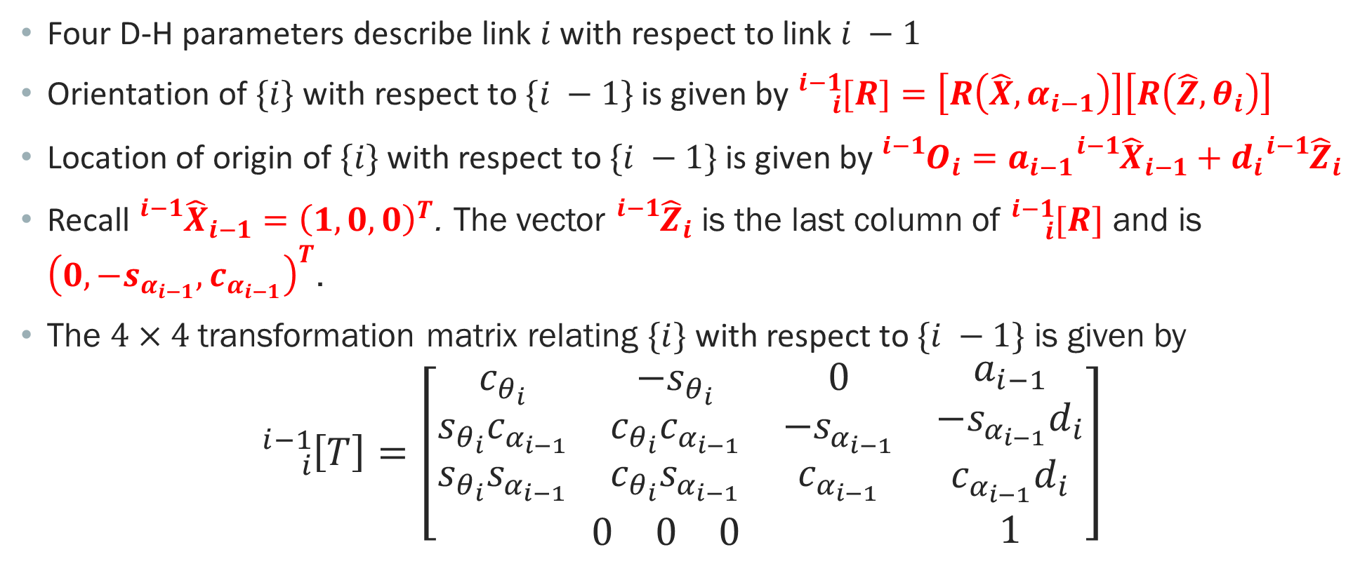
LINK TRANSFORMATION MATRICES
Four D-H parameters describe link $i$ with respect to link $i −1$
Orientation of $\{i\}$ with respect to $\{i −1\}$ is given by ${}_{i}^{i−1}{[R}]=\left[R\left(\hat{X}, α_{i−1}\right)\right]\left[R\left(\hat{Z}, θ_{i}\right)\right]$
Location of origin of $\{i\}$ with respect to $\{i −1\}$ is given by ${}_{}^{i−1}{O_{i}=a_{i−1}{}_{}^{i−1}{{\hat{X}}_{i−1}+d_{i}{}_{}^{i−1}{{\hat{Z}}_{i}}}}$
Recall ${}_{}^{i−1}{{\hat{X}}_{i−1}}={\left(1, 0, 0\right)}^{T}$. The vector ${}_{}^{i−1}{{\hat{Z}}_{i}}$ is the last column of ${}_{i}^{i−1}{[R}]$ and is ${\left(0, −s_{α_{i−1}}, c_{α_{i−1}}\right)}^{T}$.
The $4×4$ transformation matrix relating $\{i\}$ with respect to $\{i −1\}$ is given by
$${}_{i}^{i−1}{\left[T\right]=\left[\begin{matrix}\begin{matrix}c_{θ_{i}} & −s_{θ_{i}} & 0 \\ s_{θ_{i}}c_{α_{i−1}} & c_{θ_{i}}c_{α_{i−1}} & −s_{α_{i−1}} \\ s_{θ_{i}}s_{α_{i−1}} & c_{θ_{i}}s_{α_{i−1}} & c_{α_{i−1}}\end{matrix} & \begin{matrix}a_{i−1} \\ −s_{α_{i−1}}d_{i} \\ c_{α_{i−1}}d_{i}\end{matrix} \\ \begin{matrix}0 & 0 & 0\end{matrix} & 1\end{matrix}\right]}$$
DH PARAMETERS

Slide 18
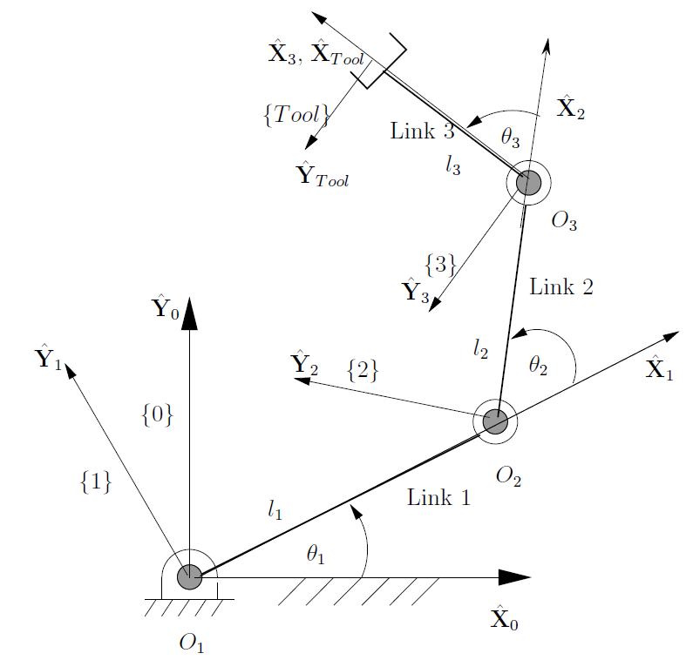
EXAMPLE – I (D-H parameters)
DH PARAMETERS

Slide 19
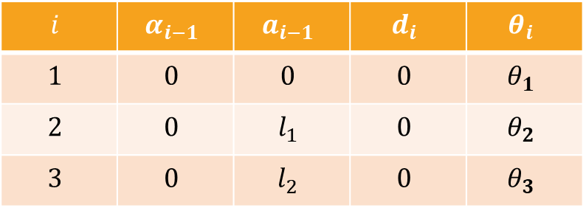
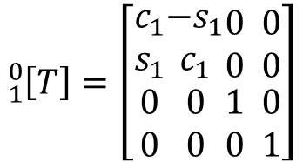

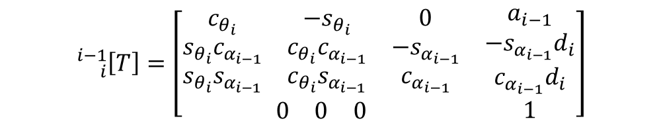
ANSWER
D-H parameters in Tabular form
$$i$$ | $$α_{i−1}$$ | $$a_{i−1}$$ | $$d_{i}$$ | $$θ_{i}$$
$$1$$ | $$0$$ | $$0$$ | $$0$$ | $$θ_{1}$$
$$2$$ | $$0$$ | $$l_{1}$$ | $$0$$ | $$θ_{2}$$
$$3$$ | $$0$$ | $$l_{2}$$ | $$0$$ | $$θ_{3}$$
Substituting $i=1, a_{0}=0, α_{0}=0,d_{1}=0$ in
$${}_{i}^{i−1}{\left[T\right]=\left[\begin{matrix}\begin{matrix}c_{θ_{i}} & −s_{θ_{i}} & 0 \\ s_{θ_{i}}c_{α_{i−1}} & c_{θ_{i}}c_{α_{i−1}} & −s_{α_{i−1}} \\ s_{θ_{i}}s_{α_{i−1}} & c_{θ_{i}}s_{α_{i−1}} & c_{α_{i−1}}\end{matrix} & \begin{matrix}a_{i−1} \\ −s_{α_{i−1}}d_{i} \\ c_{α_{i−1}}d_{i}\end{matrix} \\ \begin{matrix}0 & 0 & 0\end{matrix} & 1\end{matrix}\right]}$$
$${}_{1}^{0}{\left[T\right]=\left[\begin{matrix}c_{1} \\ s_{1} \\ \begin{matrix}0 \\ 0\end{matrix}\end{matrix}\begin{matrix}−s_{1} \\ c_{1} \\ \begin{matrix}0 \\ 0\end{matrix}\end{matrix}\begin{matrix}0 \\ 0 \\ \begin{matrix}1 \\ 0\end{matrix}\end{matrix} \begin{matrix}0 \\ 0 \\ \begin{matrix}0 \\ 1\end{matrix}\end{matrix}\right]}$$
We get
DH PARAMETERS

Slide 20
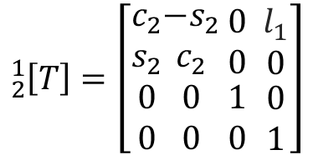
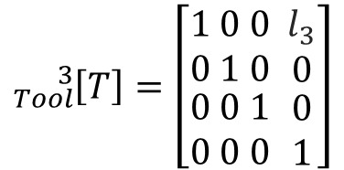
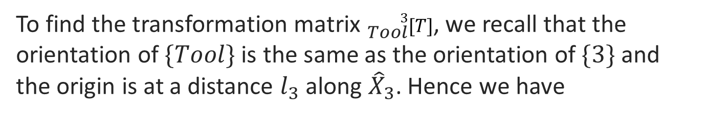
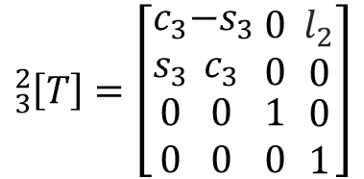
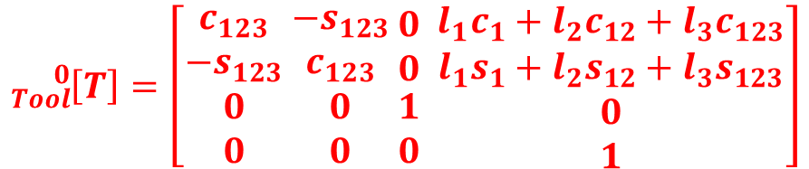

ANSWER (CONTD..)
$${}_{2}^{1}{\left[T\right]=\left[\begin{matrix}c_{2} \\ s_{2} \\ \begin{matrix}0 \\ 0\end{matrix}\end{matrix}\begin{matrix}−s_{2} \\ c_{2} \\ \begin{matrix}0 \\ 0\end{matrix}\end{matrix} \begin{matrix}0 \\ 0 \\ \begin{matrix}1 \\ 0\end{matrix}\end{matrix} \begin{matrix}l_{1} \\ 0 \\ \begin{matrix}0 \\ 1\end{matrix}\end{matrix}\right]}$$
Similarly, substituting $i=2, a_{0}=l_{1}, α_{0}=0,d_{1}=0$, we get
$${}_{3}^{2}{\left[T\right]=\left[\begin{matrix}c_{3} \\ s_{3} \\ \begin{matrix}0 \\ 0\end{matrix}\end{matrix}\begin{matrix}−s_{3} \\ c_{3} \\ \begin{matrix}0 \\ 0\end{matrix}\end{matrix} \begin{matrix}0 \\ 0 \\ \begin{matrix}1 \\ 0\end{matrix}\end{matrix} \begin{matrix}l_{2} \\ 0 \\ \begin{matrix}0 \\ 1\end{matrix}\end{matrix}\right]}$$
Similarly, substituting $i=3, a_{0}=l_{2}, α_{0}=0,d_{1}=0$, we get
To find the transformation matrix ${}_{Tool}^{3}{[T]}$, we recall that the orientation of $\{Tool\}$is the same as the orientation of $\{3\}$ and the origin is at a distance $l_{3}$ along ${\hat{X}}_{3}$. Hence we have
$${}_{Tool}^{3}{\left[T\right]=\left[\begin{matrix}1 \\ 0 \\ \begin{matrix}0 \\ 0\end{matrix}\end{matrix} \begin{matrix}0 \\ 1 \\ \begin{matrix}0 \\ 0\end{matrix}\end{matrix} \begin{matrix}0 \\ 0 \\ \begin{matrix}1 \\ 0\end{matrix}\end{matrix} \begin{matrix}l_{3} \\ 0 \\ \begin{matrix}0 \\ 1\end{matrix}\end{matrix}\right]}$$
To find the transformation matrix ${}_{Tool}^{0}{[T] }$, we have
$${}_{Tool}^{0}{[T] }={}_{3}^{0}{[T] }{}_{Tool}^{3}{[T] }={}_{1}^{0}{[T] }{}_{2}^{1}{[T] }{}_{3}^{2}{[T] }{}_{Tool}^{3}{[T] }$$
$${}_{Tool}^{0}{\left[T\right]=\left[\begin{matrix}c_{123} \\ −s_{123} \\ \begin{matrix}0 \\ 0\end{matrix}\end{matrix} \begin{matrix}−s_{123} \\ c_{123} \\ \begin{matrix}0 \\ 0\end{matrix}\end{matrix} \begin{matrix}0 \\ 0 \\ \begin{matrix}1 \\ 0\end{matrix}\end{matrix} \begin{matrix}{{l_{1}c_{1}+l}_{2}c_{12}+l}_{3}c_{123} \\ {{l_{1}s_{1}+l}_{2}s_{12}+l}_{3}s_{123} \\ \begin{matrix}0 \\ 1\end{matrix}\end{matrix}\right]}$$
DH PARAMETERS

Slide 21
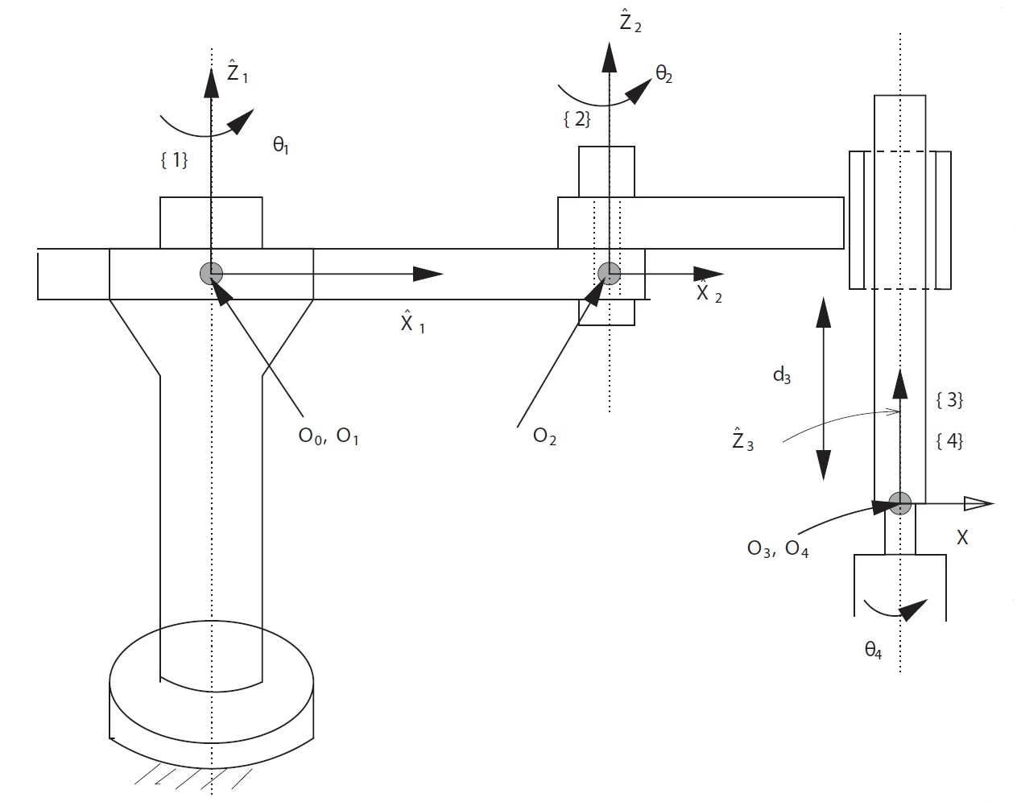
EXAMPLE – II (D-H parameters)
DH PARAMETERS

Slide 22
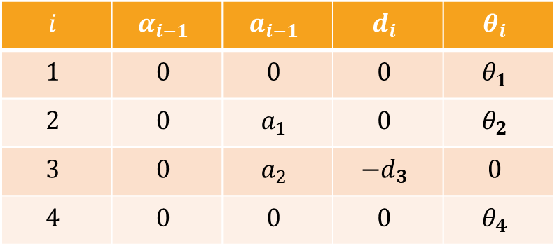


ANSWER
$$a_{2}$$
$$a_{1}$$
D-H parameters in Tabular form
$$i$$ | $$α_{i−1}$$ | $$a_{i−1}$$ | $$d_{i}$$ | $$θ_{i}$$
$$1$$ | $$0$$ | $$0$$ | $$0$$ | $$θ_{1}$$
$$2$$ | $$0$$ | $$a_{1}$$ | $$0$$ | $$θ_{2}$$
$$3$$ | $$0$$ | $$a_{2}$$ | $$−d_{3}$$ | $$0$$
$$4$$ | $$0$$ | $$0$$ | $$0$$ | $$θ_{4}$$
DH PARAMETERS

Slide 23
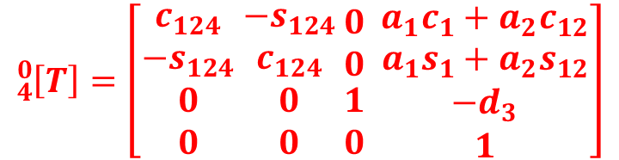
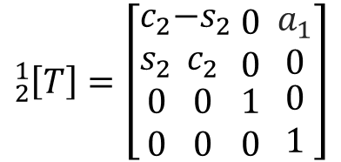

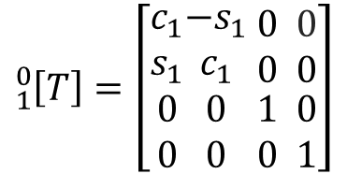

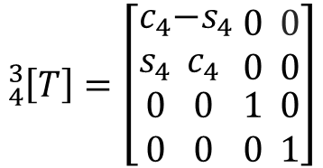
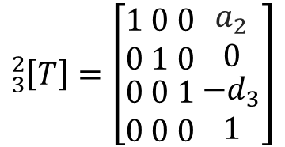
ANSWER (CONTD..)
The link transformation matrices are
$${}_{1}^{0}{\left[T\right]=\left[\begin{matrix}c_{1} \\ s_{1} \\ \begin{matrix}0 \\ 0\end{matrix}\end{matrix}\begin{matrix}−s_{1} \\ c_{1} \\ \begin{matrix}0 \\ 0\end{matrix}\end{matrix} \begin{matrix}0 \\ 0 \\ \begin{matrix}1 \\ 0\end{matrix}\end{matrix} \begin{matrix}0 \\ 0 \\ \begin{matrix}0 \\ 1\end{matrix}\end{matrix}\right]}$$
$${}_{2}^{1}{\left[T\right]=\left[\begin{matrix}c_{2} \\ s_{2} \\ \begin{matrix}0 \\ 0\end{matrix}\end{matrix}\begin{matrix}−s_{2} \\ c_{2} \\ \begin{matrix}0 \\ 0\end{matrix}\end{matrix} \begin{matrix}0 \\ 0 \\ \begin{matrix}1 \\ 0\end{matrix}\end{matrix} \begin{matrix}a_{1} \\ 0 \\ \begin{matrix}0 \\ 1\end{matrix}\end{matrix}\right]}$$
$${}_{3}^{2}{\left[T\right]=\left[\begin{matrix}1 \\ 0 \\ \begin{matrix}0 \\ 0\end{matrix}\end{matrix} \begin{matrix}0 \\ 1 \\ \begin{matrix}0 \\ 0\end{matrix}\end{matrix} \begin{matrix}0 \\ 0 \\ \begin{matrix}1 \\ 0\end{matrix}\end{matrix} \begin{matrix}a_{2} \\ 0 \\ \begin{matrix}−d_{3} \\ 1\end{matrix}\end{matrix}\right]}$$
$${}_{4}^{3}{\left[T\right]=\left[\begin{matrix}c_{4} \\ s_{4} \\ \begin{matrix}0 \\ 0\end{matrix}\end{matrix}\begin{matrix}−s_{4} \\ c_{4} \\ \begin{matrix}0 \\ 0\end{matrix}\end{matrix} \begin{matrix}0 \\ 0 \\ \begin{matrix}1 \\ 0\end{matrix}\end{matrix} \begin{matrix}0 \\ 0 \\ \begin{matrix}0 \\ 1\end{matrix}\end{matrix}\right]}$$
To find the transformation matrix ${}_{4}^{0}{[T] }$, we have
$${}_{4}^{0}{[T] }={}_{1}^{0}{[T] }{}_{2}^{1}{[T] }{}_{3}^{2}{[T] }{}_{4}^{3}{[T] }$$
$${}_{4}^{0}{\left[T\right]=\left[\begin{matrix}c_{124} \\ −s_{124} \\ \begin{matrix}0 \\ 0\end{matrix}\end{matrix} \begin{matrix}−s_{124} \\ c_{124} \\ \begin{matrix}0 \\ 0\end{matrix}\end{matrix} \begin{matrix}0 \\ 0 \\ \begin{matrix}1 \\ 0\end{matrix}\end{matrix} \begin{matrix}{a_{1}c_{1}+a}_{2}c_{12} \\ {a_{1}s_{1}+a}_{2}s_{12} \\ \begin{matrix}−d_{3} \\ 1\end{matrix}\end{matrix}\right]}$$
DH PARAMETERS

Slide 24
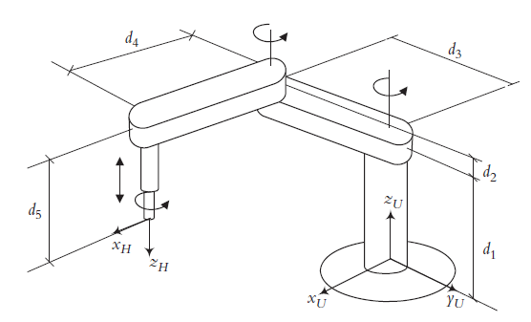
EXAMPLE – III ( CALCULATE D-H parameters)
DH PARAMETERS

Slide 25
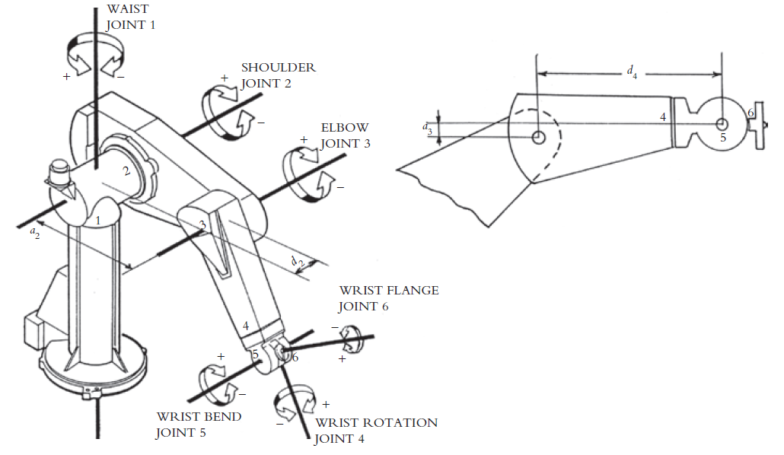
EXAMPLE – IV ( CALCULATE D-H parameters and find ${}_{H}^{R}{[T]}$)
DH PARAMETERS

