Slide 1
WHAT IS A ROBOT ?
Definition - The Robot Institute of America (1969)
a re-programmable, multi-functional manipulator designed to move materials, parts, tools or specialized devices through various programmed motions for the performance of a variety of tasks
Extent of programming distinguishes robot from CNC machine tools
Definition - Current
intelligent agent, physical or virtual, capable of doing a task
autonomously or with guidance
Robot An electro-mechanical machine with sensors, electronics and guided by computers

Slide 2
ANATOMY OF A ROBOT
Links
Joints
Links should be strong and lightweight – Usually die-cast sections
Joints are friction and backlash free to the extent possible
Base

Slide 3
ANATOMY OF A ROBOT
End-Effector
Grippers
Mechanical
Pneumatic
Adhesive
Magnetic
Robot Tools
Spot Welding Gun
Arc Welding Tools
Spray Painting Gun
Drilling Spindle

Slide 4
ANATOMY OF A ROBOT
Sensors – Purposes and Types
Accuracy and Positioning
Reasonable force for gripping
Ensure safety and avoid collisions
Detect position and shape of object
Inspection, monitoring of production
Controller Unit
One or more processors to control motion of actuators
Processor for signal processing and sensing
Processor for user interface, data logging, communication and other activities
Off-line programming system with user friendly GUI to train operator, verify motion and reduce downtime of a robot
Types – Vision sensors, Tactile Sensors, Voice Sensors, Proximity Sensors, etc.

Slide 5
CLASSIFICATION OF ROBOTS
FIXED vs MOBILE
Industrial Robot
Mobile Robot - MARS Rover

Slide 6
CLASSIFICATION OF ROBOTS
SERIAL vs PARALLEL
Parallel Robot
PUMA Robot
A fixed base, links and joints connected sequentially and ending in a end-effector
More than one loop, no natural
end-effector

Slide 7















CLASSIFICATION OF ROBOTS
DEGREE OF FREEDOM
DOF - determines capability of robot, no. of actuated joints
First 3 joints - Revolute, Prismatic, Cylindrical, Spherical, SCARA
Last three joints form a wrist — Orients the end-effector
$$3$$
$$3$$
$$3$$
$$2$$
$$2$$
$$2$$
$$1$$
$$1$$
$$1$$
$$3$$
$$3$$
$$2$$
$$1$$
$$1$$
$$2$$

Slide 8
CLASSIFICATION OF ROBOTS
Rigid vs Flexible
Space shuttle robot arm
PUMA 560 Robot
Industrial Robots – built heavy and rigid for required accuracy
Minimizing weight for space applications - Links and joints are flexible

Slide 9
CLASSIFICATION OF ROBOTS
CONTROL AND MODE OF OPERATION
1. Older industrial robots were teach and playback
Robot is taken (manually) through the tasks and positions recorded
During actual operation, the robot plays back the taught sequence
Very time consuming to teach and robot cannot react to any changes in the environment
2. Computer controlled – Inputs are given from a computer often after
being tried out in an off-line programming system
3. Sensor driven – Sensors are used to avoid obstacles and take decisions
4. Intelligent – Robot can ‘learn’ about the environment using artificial
intelligence (AI) and perform efficiently
Motion planning will be discussed in this course

Slide 10
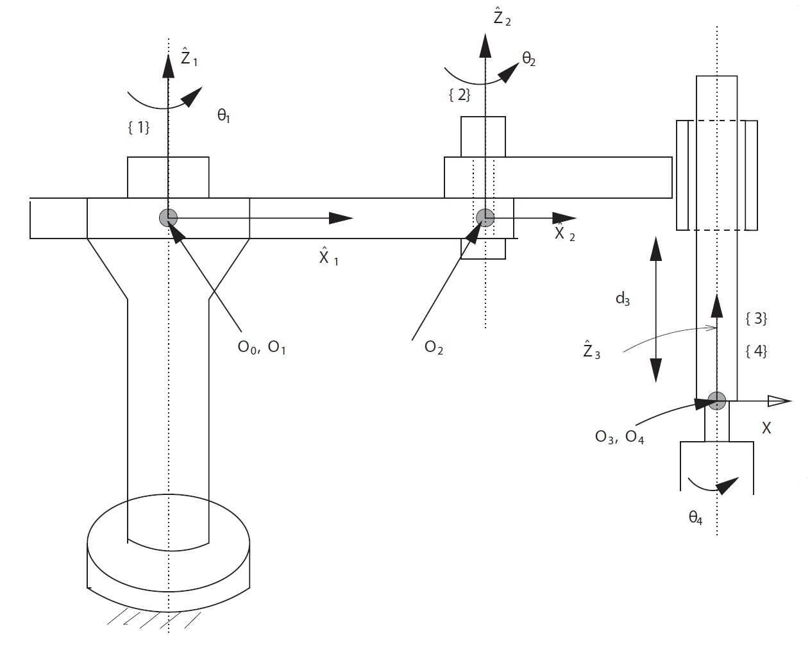
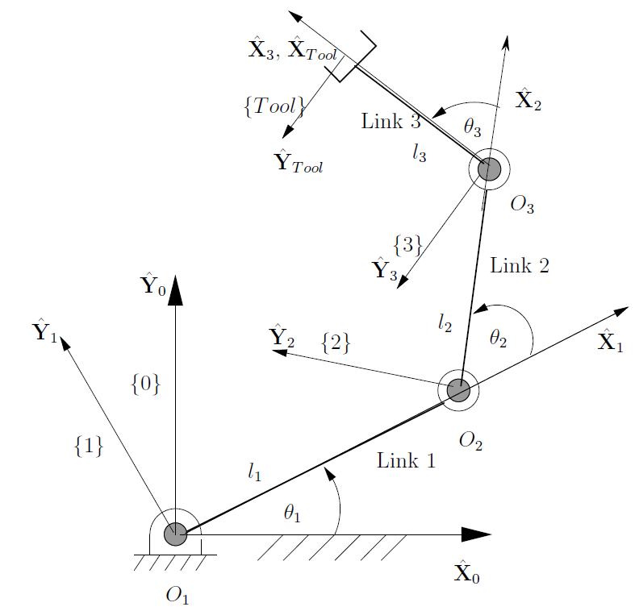
DIRECT KINEMATICS of serial robots
Serial manipulators: One end fixed $→$ Links and joints $→$ Free end with end-effector.
Planar 3R Robot
4 DOF SCARA Robot

Slide 11
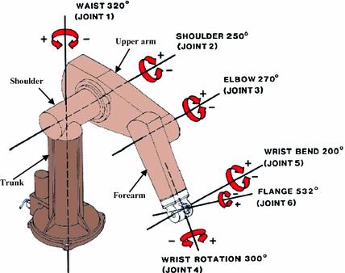
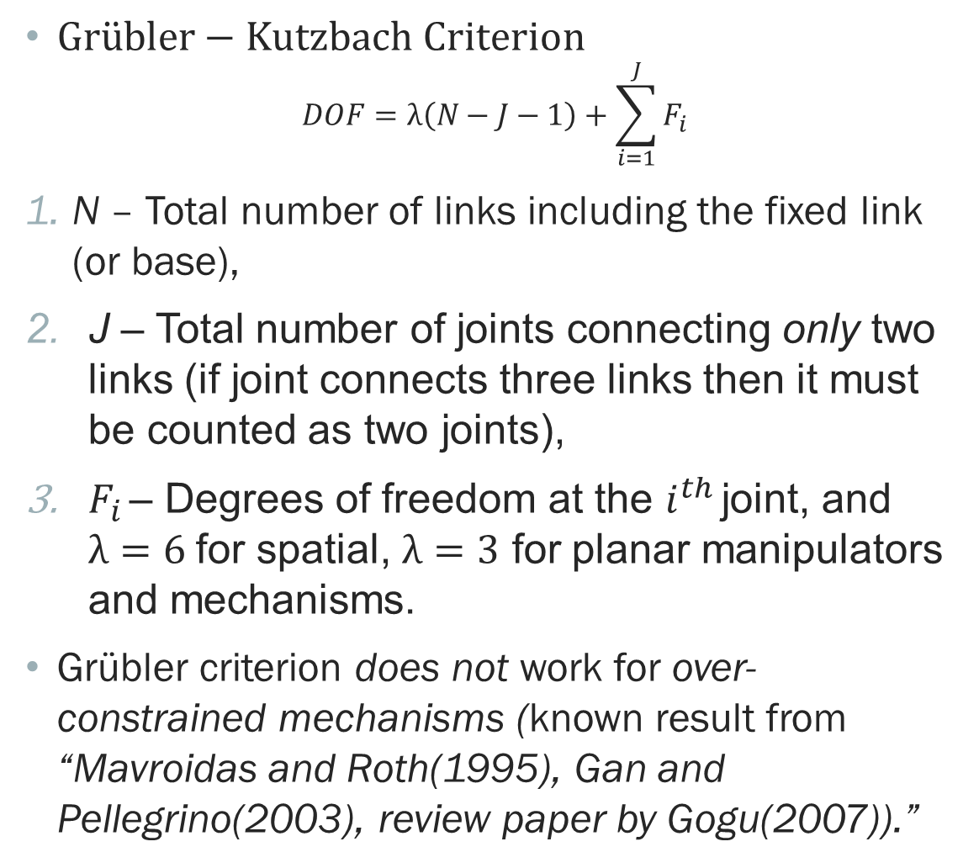
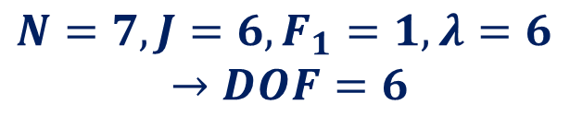
DEGREES OF FREEDOM
$Gr\ddot{u}bler−Kutzbach Criterion$
$$DOF=λ\left(N−J−1\right)+\sum_{i=1}^{J}{F_{i}}$$
N – Total number of links including the fixed link (or base),
J – Total number of joints connecting only two links (if joint connects three links then it must be counted as two joints),
$F_{i}$ – Degrees of freedom at the $i^{th}$ joint, and $λ=6$for spatial, $λ=3$ for planar manipulators and mechanisms.
Grübler criterion does not work for over-constrained mechanisms (known result from “Mavroidas and Roth(1995), Gan and Pellegrino(2003), review paper by Gogu(2007)).”
PUMA 560 Robot
$$N=7, J=6, F_{1}=1, λ=6$$
$$→DOF=6$$

Slide 12
DOF — The number of independent actuators.
DOF — Capability of a manipulator with respect to $λ$.
$DOF =λ$ $→$ End-effector can be positioned and oriented arbitrarily.
$DOF <λ → λ −DOF$relationships containing the position and orientation variables.
$DOF >λ →$Position and orientation of the end-effector in $∞$ ways – Redundant manipulators.
Serial manipulators with a fixed base, a free end-effector and two links connected by a joint — $N = J +1$and $DOF =\sum_{i=1}^{J}{F_{i}}$.
All actuated joints are one DOF joints $→ J = DOF$.
$J > DOF → J −DOF$joints are passive.
$J < DOF →$One or more of the actuated joints are multi-degree-of-freedom joints – Rare in mechanical manipulators but common in biological joints actuated with muscles.

Slide 13
joint variables — $θ_{i}^{′}s or d_{i}^{′}s$ form the joint space.
Position and orientation variables form the task space
For planar motion, $λ = 3$— Task space ($x;y;φ$).
For spatial motion, $λ = 6$— Task space $(x;y; z; [R]).$
Actuator space: due to mechanical linkages, gears, etc. between actuators and joints, joint variables are not identical to actuator variables
Dimension of actuator space is more than $λ —$ Manipulator is redundant.
Dimension of actuator space is less than $λ —$ Manipulator is under-actuated.
Manipulator/robot kinematics — Functional relationship between joint space and task space.

Slide 14
PROBLEMS in kinematics of serial robots
Direct Kinematics Problem:
Given constant D-H link parameters and the joint variable$α_{i−1}, a_{i−1}, d_{i} and θ_{i}, for i=1,2,…n,$find position and orientation of last link in a fixed or reference coordinate system.
Most basic problem in serial manipulator kinematics.
Required to be solved for computer visualization of motion and in off-line prog. systems.
Used in advanced control schemes.
Inverse Kinematics Problem:
Given the constant D-H link parameters and the position and orientation of the end-effector $(\{n\})$ with respect to the fixed frame $\{0\}$, find the joint variables.
Harder than the direct kinematics problem.
Required for computer visualization of motion and used in advanced control schemes.
Leads to the notion of workspace of a robot.

Slide 15
Direct kinematics problem
Planar 3R Robot
The direct kinematics problem can be always solved for any serial manipulator!
The solution procedure is simple – Involves only multiplication of matrices.
Direct kinematics in serial manipulators is unique.
$φ$ represents orientation of tool
From ${}_{Tool}^{0}{[T]}$
$$x=l_{1}c_{1}+l_{2}c_{12}+l_{3}c_{123}$$
$$y=l_{1}s_{1}+l_{2}s_{12}+l_{3}s_{123}$$
$$φ=θ_{1}+θ_{2}+θ_{3}$$

Slide 16
$φ$ represents orientation of $\{4\}$
The position $(x,y,z)$and orientation of $\{4\}$ is
$$x=a_{1}c_{1}+a_{2}c_{12}$$
$$y=a_{1}s_{1}+a_{2}s_{12}$$
$$z=−d_{3}$$
$$φ=θ_{1}+θ_{2}+θ_{4}$$
4 DOF SCARA Robot

Slide 17
Inverse kinematics problem
Inverse Kinematics Problem (restated): Given the constant D-H link parameters and ${}_{n}^{0}{[T]}$, find the joint variables $θ_{i}, i=1, 2, …, n$.
For 3D motion, 6 task space variables $—$ 3 position + 3 orientation in ${}_{n}^{0}{[T]}$.
For planar motion, 3 task space variables $—$ 2 position + 1 orientation in ${}_{n}^{0}{[T]}$.
Following cases possible:
$n = 6$for 3D motion or $n = 3$for planar motion $→$ Same number of equations as unknowns.
$n < 6$for 3D motion or $n < 3$ for planar motion $→$ Number of task space variables larger than number of equations and hence there must be $(6−n)$($(3−n)$for planar) relationships involving the task space variables.
$n> 6$for 3D motion or $n > 3$for planar motion $→$More unknowns than equations and hence infinite number of solutions $—$ Redundant manipulators.

Slide 18
PLANAR 3R manipulator
Direct Kinematics Equations
$$x=l_{1}c_{1}+l_{2}c_{12}+l_{3}c_{123}$$
$$y=l_{1}s_{1}+l_{2}s_{12}+l_{3}s_{123}$$
$$φ=θ_{1}+θ_{2}+θ_{3}$$
Inverse Kinematics: Given $(x, y, φ)$, obtain $θ_{1}, θ_{2}$ and $θ_{3}$
Solution of system of non-linear transcendental equations.
No general methods (as in linear equations) exists — Solution procedure depends on problem.

Slide 19
Inverse kinematic algorithm
Define $X=x−l_{3}c_{ϕ}$ and $Y=y−l_{3}s_{ϕ}$; X and Y are known since $x; y; φ$and $l_{3}$ are known.
Squaring and adding
$$X^{2}+Y^{2}=l_{1}^{2}+l_{2}^{2}+2l_{1}l_{2}c_{2}$$
Thus, we have $θ_{2}=±\cos^{−1}\left(\frac{X^{2}+Y^{2}−l_{1}^{2}−l_{2}^{2}}{2l_{1}l_{2}}\right)$
From the above equation, we can calculate $θ_{1}$ as
$$θ_{1}=atan2\left(Y, X\right)−atan2\left(l_{2}s_{2}, l_{1}+l_{2}c_{2}\right)$$
Finally $θ_{3}$is obtained from
$$θ_{3}=φ−θ_{1}−θ_{2}$$

Slide 20
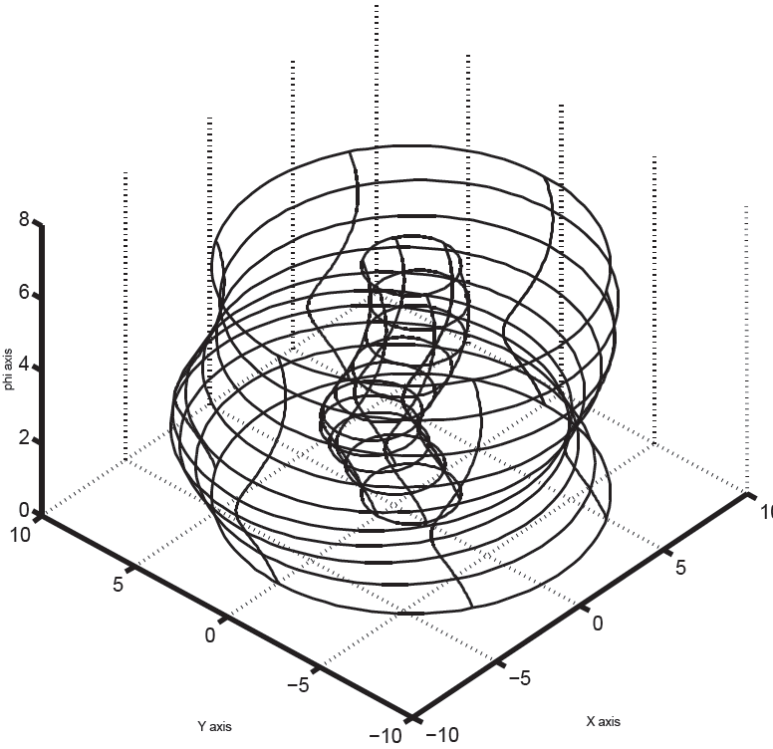
3R manipulator – workspace
All $(x, y, φ)$such that inverse kinematic solution exists.
We have from equation for $θ_{2}$
$$−1≤\frac{X^{2}+Y^{2}−l_{1}^{2}−l_{2}^{2}}{2l_{1}l_{2}}≤+1$$
$$or$$
$${\left(l_{1}−l_{2}\right)}^{2}≤X^{2}+Y^{2}≤{\left(l_{1}+l_{2}\right)}^{2}$$
Figure shows the region in $\{x, y, φ\}$space where the above inequalities are
satisfied and the inverse kinematics solution exists.

Slide 21
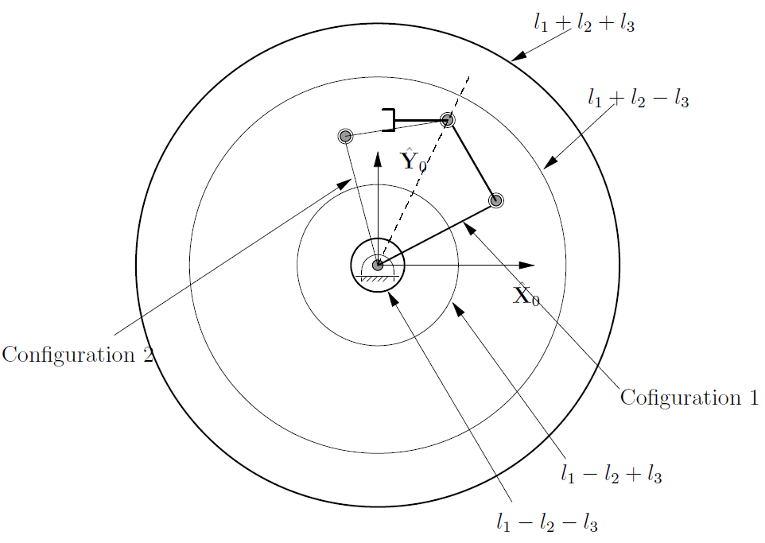
3R manipulator – workspace
Projection of workspace of a planar 3R robot
Projection of the workspace on ${\hat{X}}_{0}−{\hat{Y}}_{0}$ plane for $l_{1}>l_{2}>l_{3} —$
Four circles of radii,
$l_{1}+l_{2}+l_{3}$,
$l_{1}+l_{2}−l_{3}$,
$l_{1}−l_{2}+l_{3}$ and
$l_{1}−l_{2}−l_{3}$.

Slide 22
3R manipulator – workspace
Reachable Workspace: All $(x,y)$between maximum reach $l_{1}+l_{2}+l_{3}$ and minimum reach $l_{1}−l_{2}−l_{3}$.
Dexterous Workspace: All $(x,y)$between radii $l_{1}+l_{2}−l_{3}$ and minimum reach $l_{1}−l_{2}+l_{3}$.
All points inside dexterous workspace can be reached with any $φ$ (Kumar and Waldron, 1980).
As size of end-effector $l_{3}$ increases, reachable workspace increases and dexterous workspace decreases!
Intuitively correct — With a long stick one can reach far but with less freedom in orientation.

Slide 23
3R manipulator – Uniqueness of IK solutions
We have $θ_{2}=±\cos^{−1}\left(\frac{X^{2}+Y^{2}−l_{1}^{2}−l_{2}^{2}}{2l_{1}l_{2}}\right)$
For any $(X, Y )$two values of $θ_{2}$. The two solutions merge at the workspace boundary.
A given $(X, Y )$can be achieved by two configurations as shown in Figure on projection of workspace.
For planar 3R manipulator — $(x,y,φ )$yields two sets of values of $θ_{i}, i=1, 2, 3.$
Inverse kinematics problem does not give unique solution – Compare with direct kinematics!
Existence and uniqueness issues important and non-trivial in solutions of almost all non-linear equations.

Slide 24
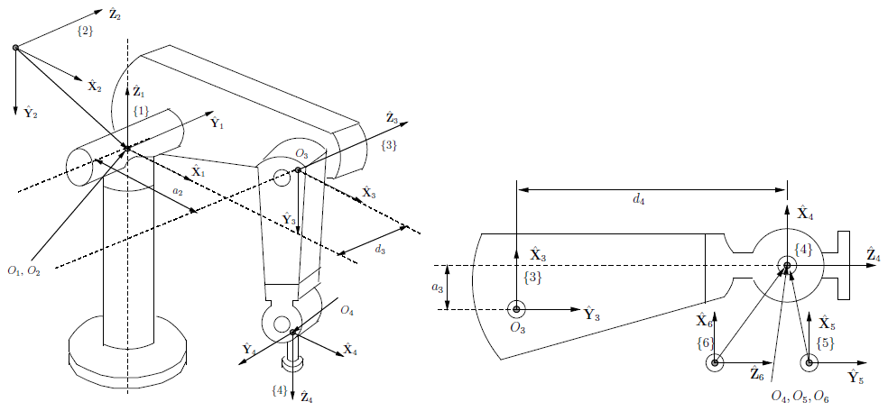
PUMA 560 Manipulator

Slide 25
D-H Parameters

Slide 26
ANY QUESTIONS SO FAR ???

Slide 27
IMPORTANT READINGS
CHAPTER 3 in Ghosal A., “Robotics: Fundamental Concepts and Analysis”, Oxford University Press, 2006.
CHAPTER 4 in Craig J.J., “Introduction to Robotics: Mechanics and Control”, Third Edition, Pearson, Prentice Hall, 2005.

