Slide 1
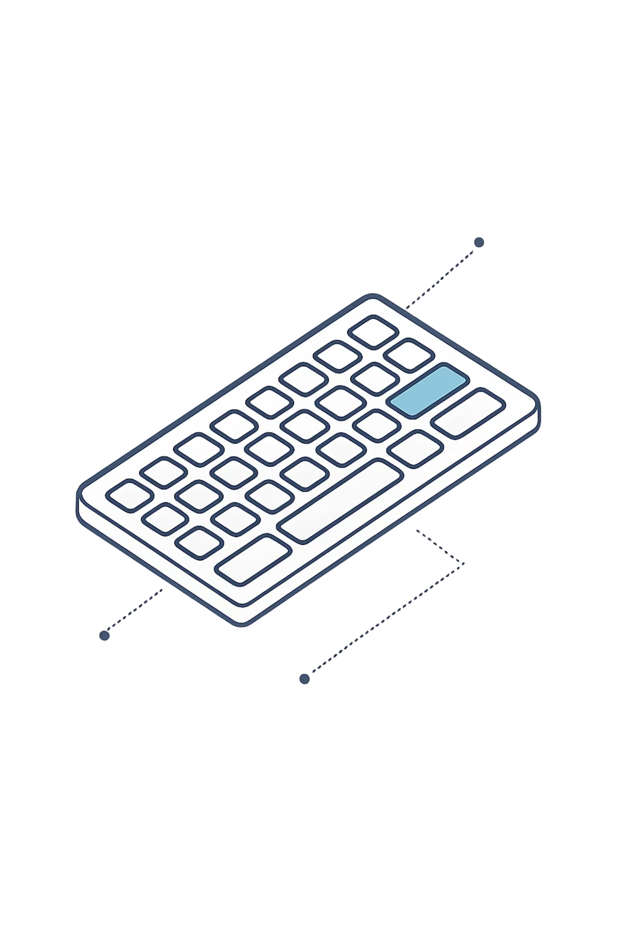
Behavioral Authentication
Deep Learning Mini Project
Submitted To : Prof. Seeja K. R.
Presented by: Gunjan Upadhyay
Rollno : 00502102025
M.Tech CSE-AI, IGDTUW Delhi

Slide 2
Problem Statement
Traditional Authentication
Security Gap
No Continuous Verification
Relies on passwords and OTP, which can be stolen, reused, or intercepted
MFA not always enabled, leaving systems vulnerable to unauthorized access
Users authenticated once at login, with no ongoing behavior monitoring
Research Challenge
Objective
Approach
Develop secure and seamless authentication that detects intruders in real-time without disrupting user experience
Behavioral authentication using typing patterns analyzed through deep learning (use Autoencoder)

Slide 3
Dataset & Preprocessing
Keystroke Dynamics Dataset
Target Encoding
Source: Kaggle
0 = Genuine User
400+ samples per user (51 users)
Multiple subjects with real typing behavior
Continuous data collection
1 = Intruder
Dataset Link : https://www.kaggle.com/datasets/carnegiecylab/keystroke-dynamics-benchmark-data-set
Key Features
Hold time: Key press duration
Flight time: Time between key presses
Key latency: Timing patterns
Dataset Shape: (20400, 34)
Preprocessing Pipeline
Data Cleaning
Label Creation
Normalization
Training Data
Removed unnecessary columns and invalid entries
One user designated as genuine, others as intruders
StandardScaler applied for consistent feature scaling
Only genuine user data used for model training

Slide 4
Methodology
01
02
Data Loading & Preprocessing
Feature Scaling
Dataset preparation
Normalization applied to all input features
03
04
Autoencoder Training
Error Calculation
Model learns patterns from genuine user data
Reconstruction error computed for each sample
05
06
Threshold Selection
Classification
85th percentile used for classification boundary
Normal users vs. anomaly detection

Slide 5
Results & Performance Analysis :
96.25%
96.48%
85th
Accuracy
Intruder Detection Recall
Percentile Threshold
Overall classification performance
Successful identification of unauthorized users
Optimal cutoff point for classification
Key Observations
Clear Separation
Threshold Impact
Real-Time Feasibility
Distinct difference between normal user patterns and intruder behavior observed in reconstruction errors
Percentile-based threshold tuning significantly improved detection performance and reduced false positives
Model demonstrates practical application for continuous authentication without user disruption

Slide 6
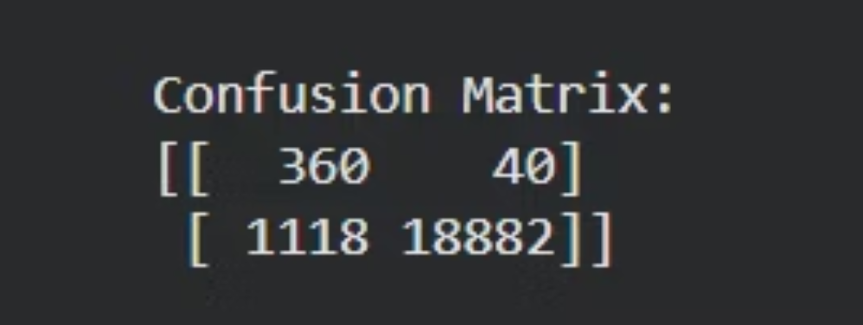
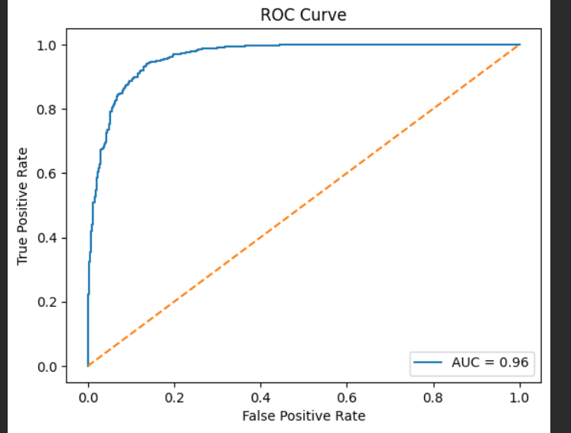
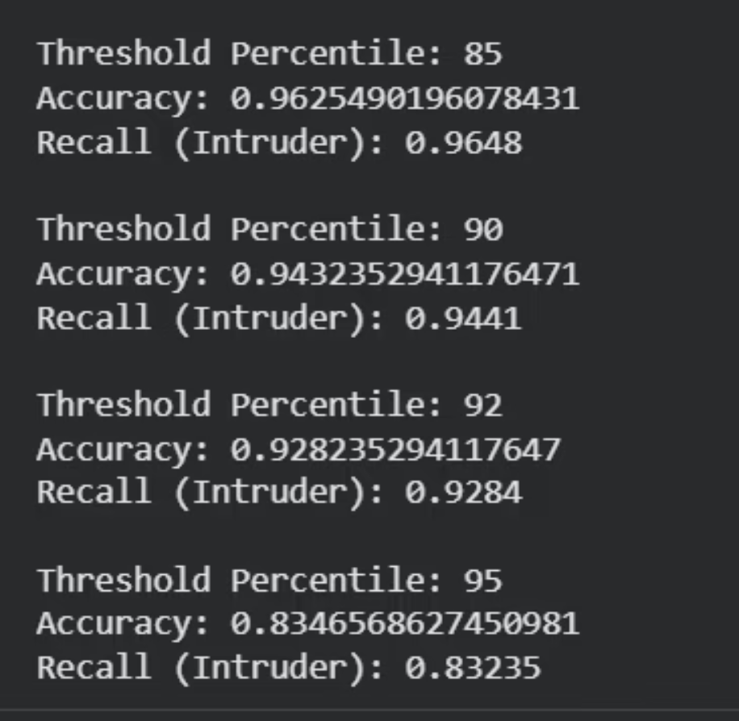
Results
Code Implimentation link :
Google Colab

Slide 7
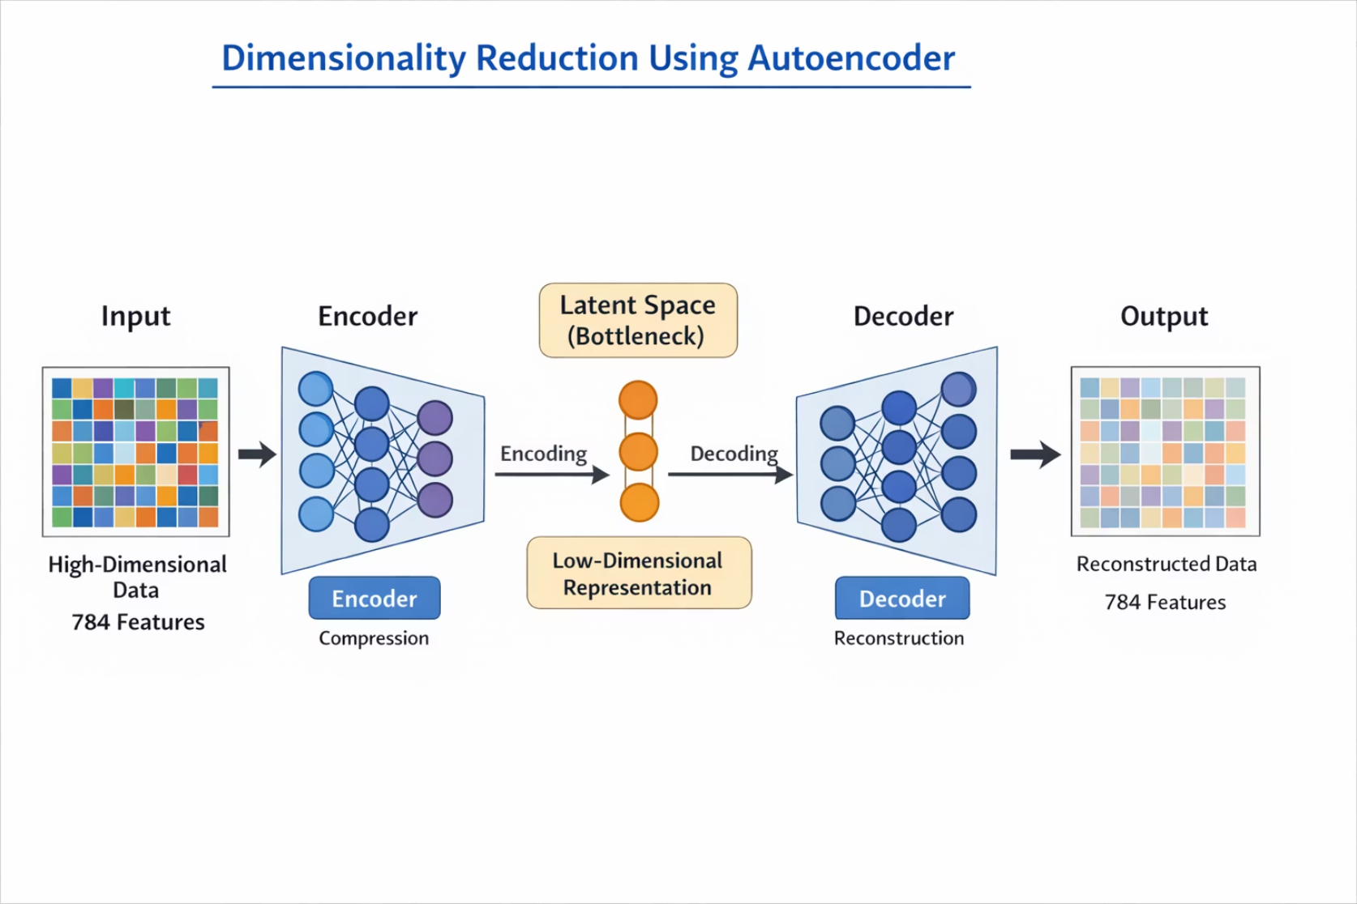
Dimensionality Reduction using Autoencoder
The encoder compresses the input into a lower-dimensional and the decoder reconstructs the original data from this compressed representation.
e.g. Google Photos
The Application: Searching for similar images or compressing large image datasets.
How Dimension Reduction Happens: A convolutional autoencoder compresses an image (thousands of pixels) into a small bottleneck code, or latent representation, that captures essential features like edges, shapes, and colors.

