Slide 1
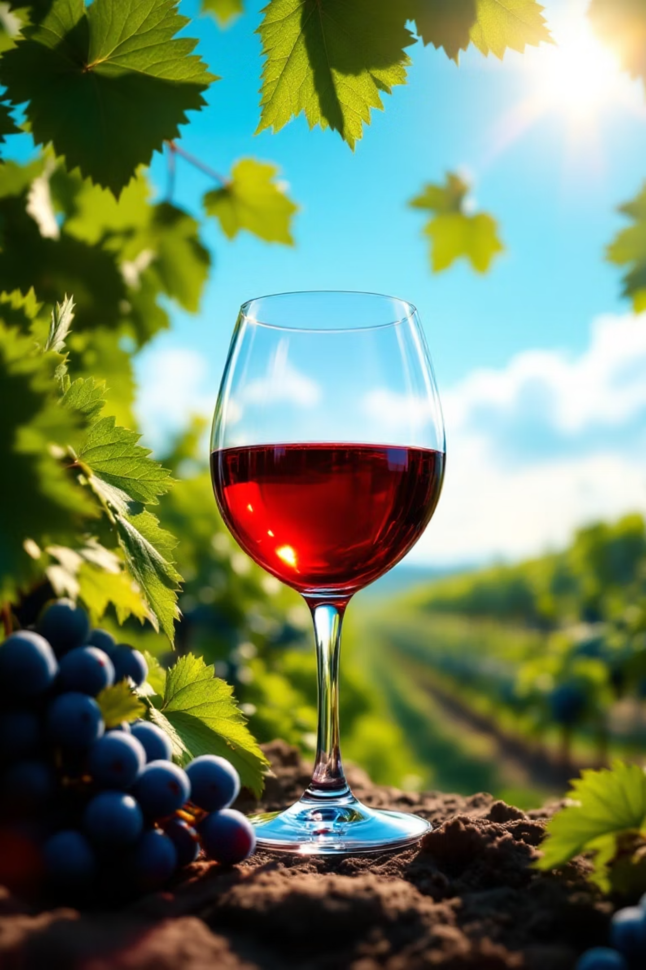
Wine Quality Prediction using Machine Learning
Mini ML Project
Submitted to : Prof. Seeja K.R
Submitted by : Gunjan Upadhyay

Slide 2
Problem Statement
The Challenge
Wine quality depends on multiple chemical properties
Manual testing is slow and subjective
Industry needs objective, automated assessment
My Solution
ML-powered binary classification:
Good Wine vs Bad Wine

Slide 3
Dataset Overview
Dataset link : https://www.kaggle.com/datasets/uciml/red-wine-quality-cortez-et-al-2009
1599
11
0-10
Wine Samples
Chemical Features
Quality Scale
From UCI ML Repository
Acidity, sugar, pH, alcohol
Expert ratings converted to binary
Preprocessing
01
02
Missing Value Check
Analysis
Data integrity validation
Distribution & pattern discovery
03
04
Correlation Study
Label Binarization
Feature relationship heatmap
Good vs Bad classification

Slide 4




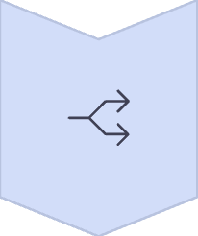


Methodology Workflow
Data Loading
Import wine quality dataset
Data Cleaning
Handle missing values & outliers
Visualization
Correlation heatmap analysis
Label Engineering
Binary classification target
Train-Test Split
80-20 data partition
Model Training
Random Forest Classifier
Evaluation & Testing
Accuracy metrics & predictions

Slide 5
Random Forest Algorithm
Ensemble Learning Powerhouse
Collection of decision trees using bootstrap aggregation (bagging)
How It Works
Key Advantages
Select random data samples
High accuracy on complex data
Build multiple decision trees
Handles non-linear relationships
Aggregate via majority voting
Resistant to overfitting

Slide 6
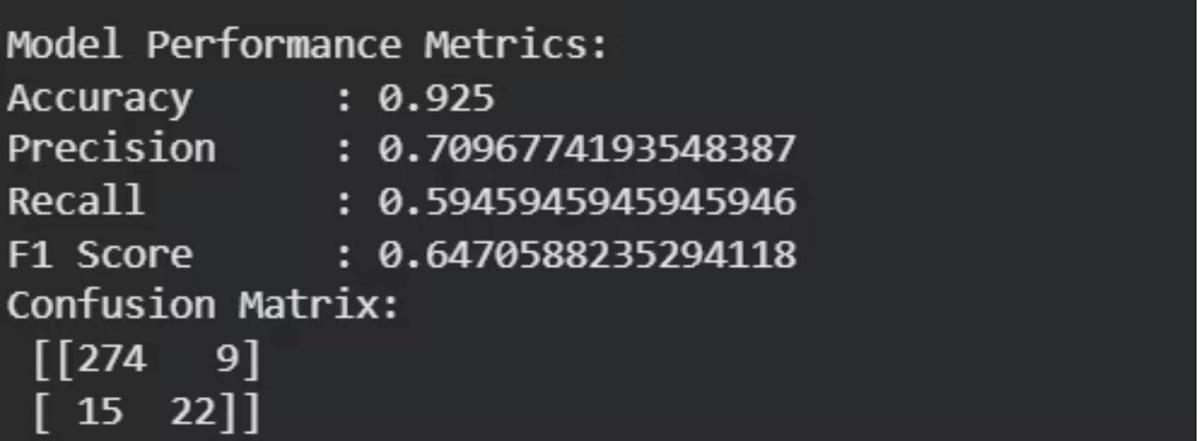
Implementation & Results
Tech Stack
Model Setup
Success
Python · NumPy · Pandas
80% training / 20% testing split
High accuracy achieved
Matplotlib · Seaborn · Scikit-Learn
RandomForestClassifier()
Reliable Good/Bad classification
Result:
Predictive system successfully classifies wine as Good or Bad.

