Slide 1
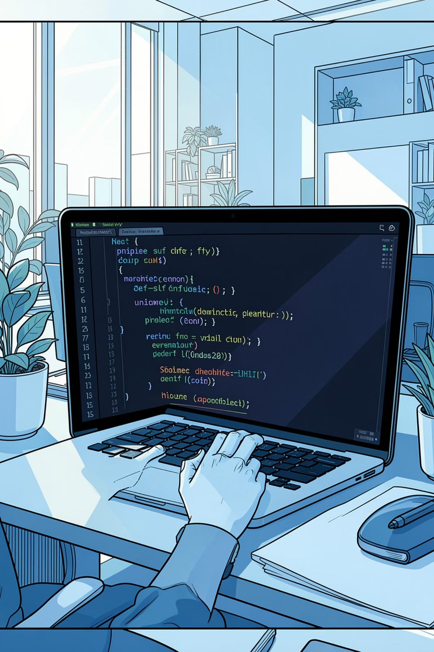
Employee Management System
Python File Handling Project
DATA ANALYTICS
GUNJAN DAHALE
Guided by -
ATHARVA SIR

Slide 2
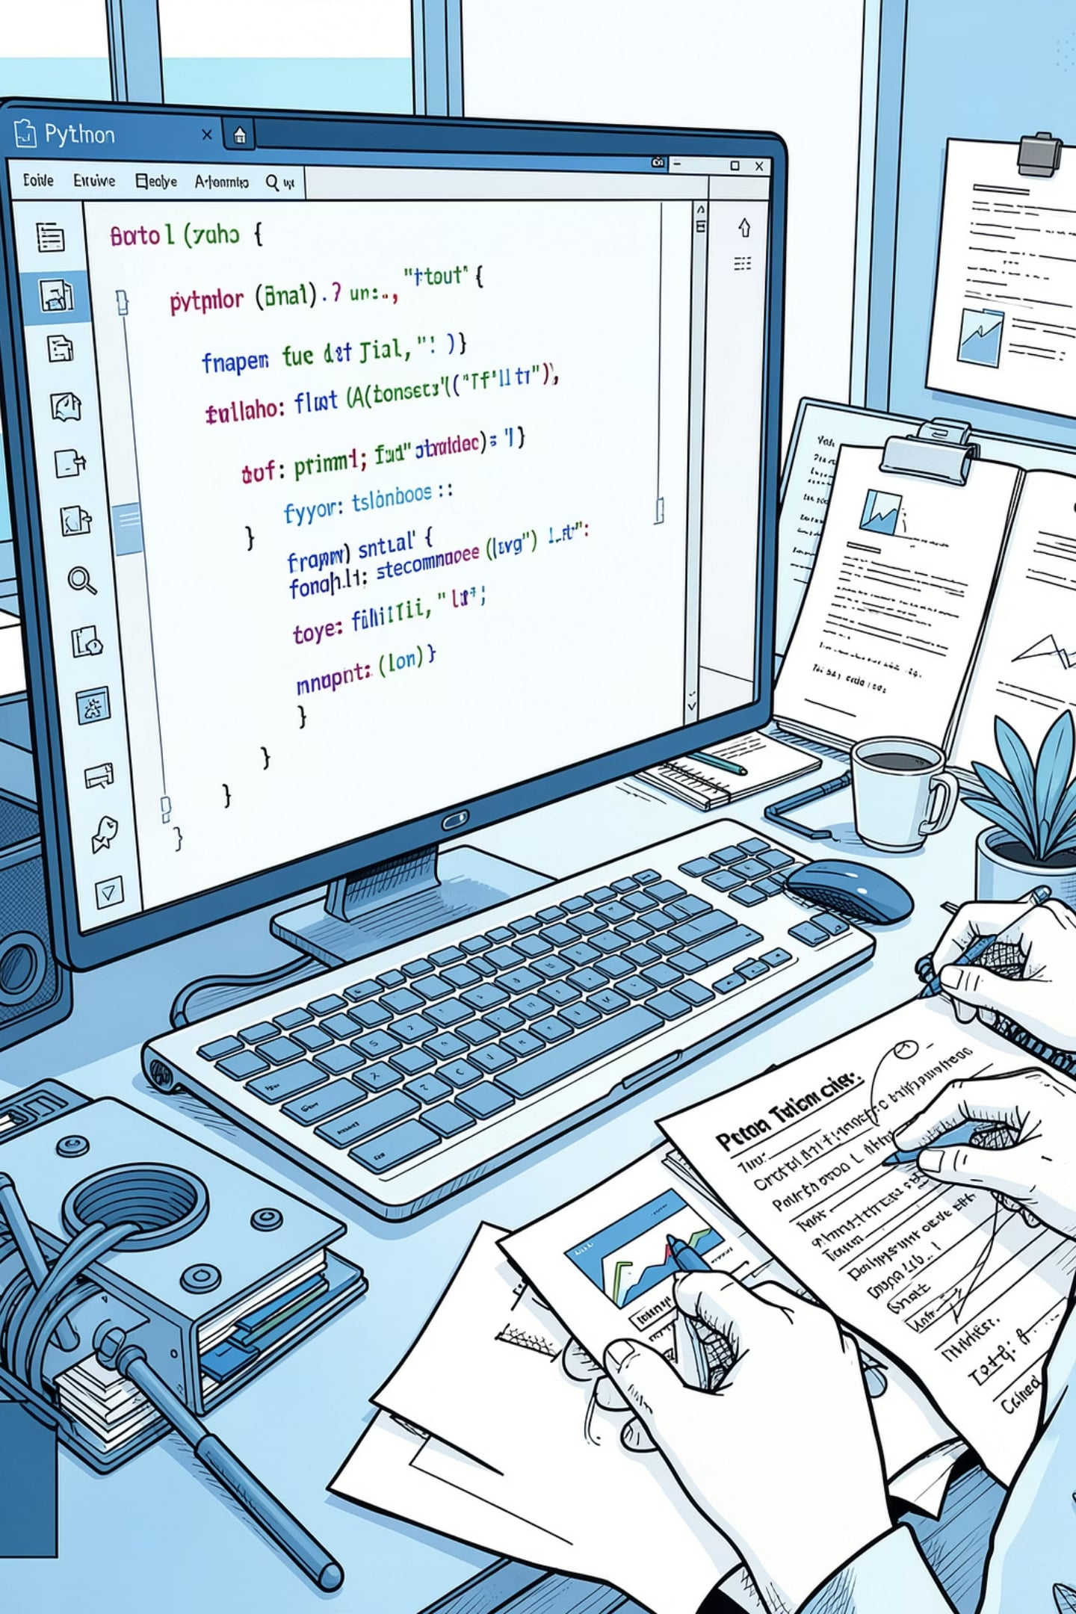
Introduction
The Employee Management System is a console-based Python application designed to help organizations maintain employee records efficiently — without the complexity of a traditional database.
Console-Based
File Storage
Menu-driven interface for intuitive navigation
Data persisted in employees.txt and attendance.txt
Python-Powered
Built entirely with core Python concepts

Slide 3




Project Objectives
This system addresses key data management challenges faced by small organizations, replacing manual paperwork with a structured, automated approach.
Secure Storage
Attendance Tracking
Store employee information reliably in structured text files
Maintain accurate daily attendance records per employee
Salary Reports
CRUD Operations
Generate and calculate total salary expenditure automatically
Search, update, and delete employee records with ease

Slide 4

Technologies Used
Core Language
Python — chosen for its simplicity, readability, and powerful built-in capabilities for file and data manipulation.
Concepts Applied
Functions & Conditional Statements
Loops & Lists
File Handling (Read/Write)
String Operations & OS Module
Data Files
employees.txt — employee records
attendance.txt — attendance logs

Slide 5










System Features
Ten integrated features cover the full employee lifecycle — from onboarding to payroll.
Add Employee
View Employees
Search Employee
Update Employee
Delete Employee
Dept. Wise List
Mark Attendance
View Attendance
Salary Report
Exit System

Slide 6
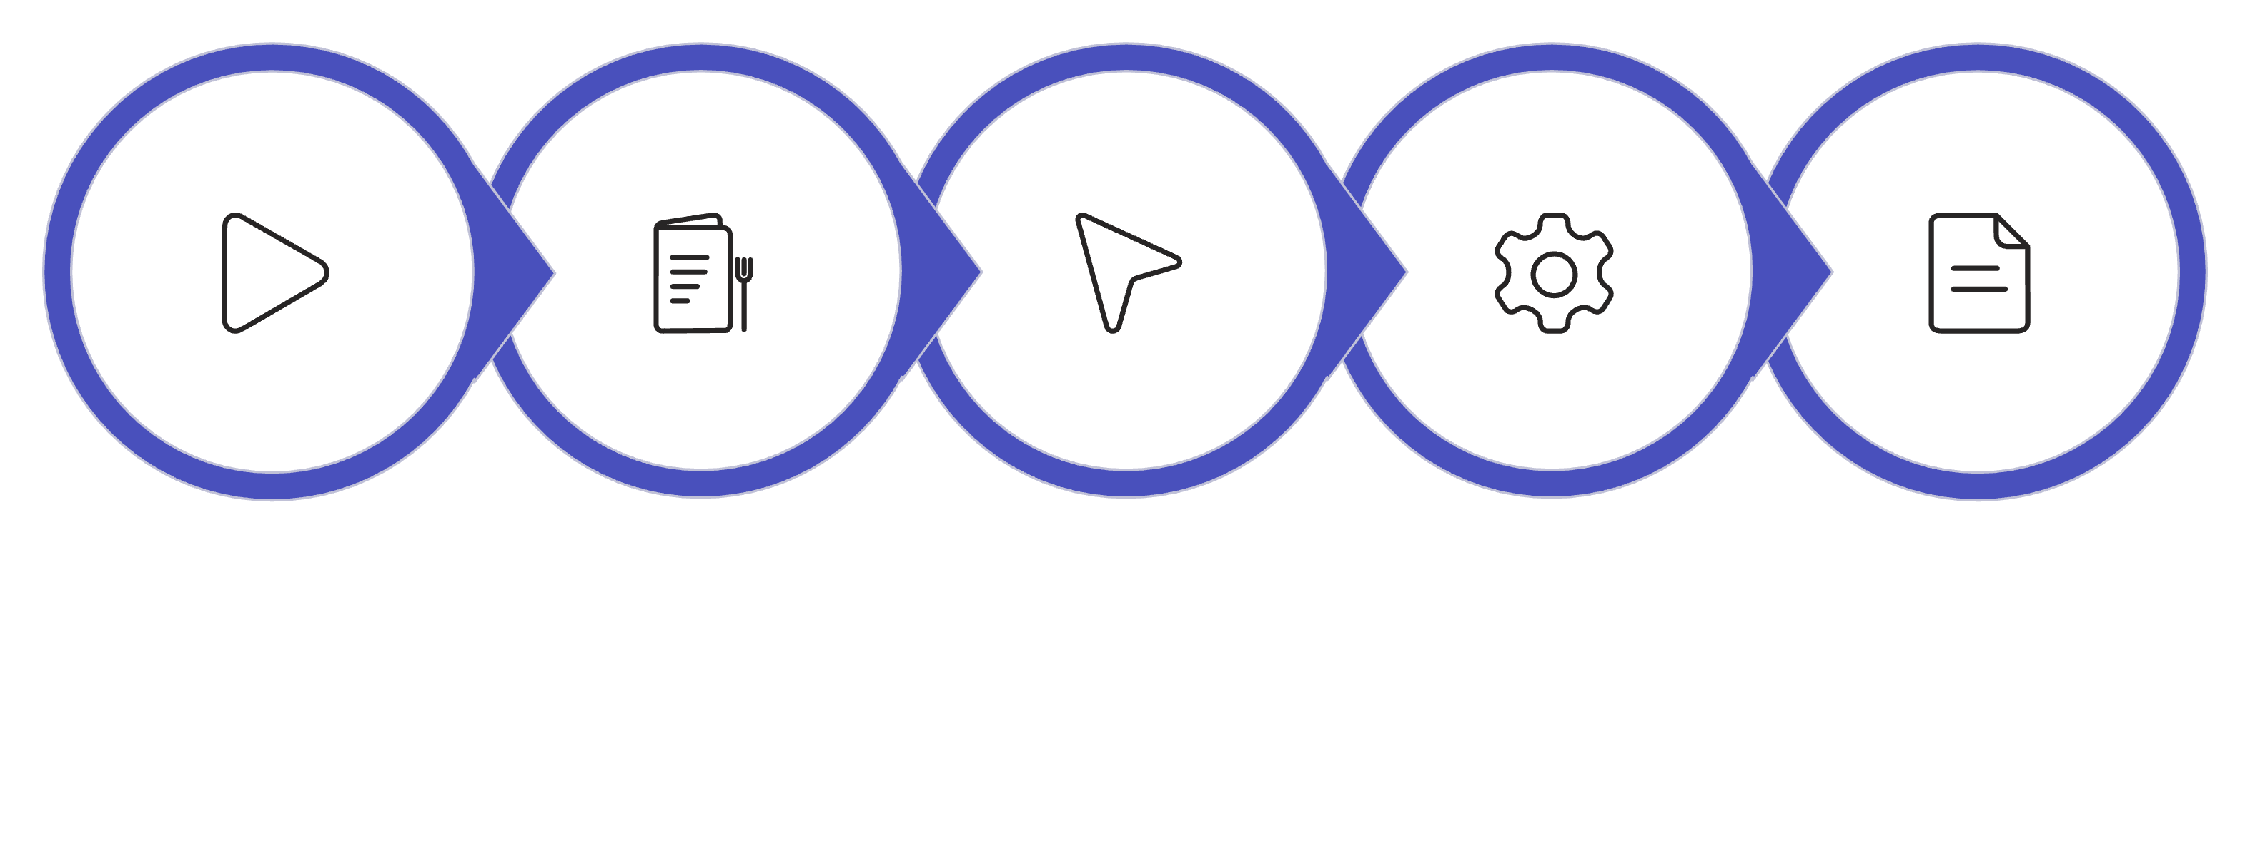
Project Workflow
The application follows a clear, loop-driven menu structure. Each operation reads from or writes to text files before returning control to the main menu.
Select Option
Perform Operation
Read/Write Files
Start
Main Menu
This linear, repeatable flow ensures the system remains responsive and data changes are persisted immediately after each operation.

Slide 7
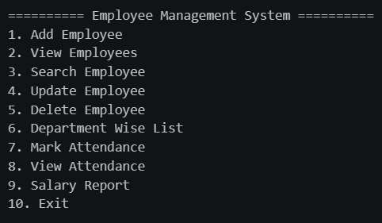
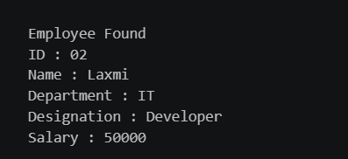
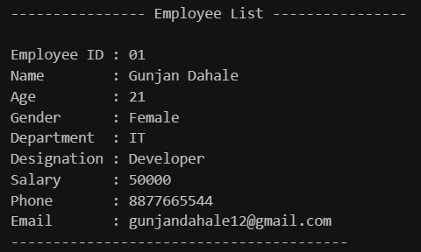
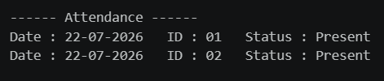
Main Menu of Project :-
Search Employee :-
2) View Employee :-
View Attendance :-

Slide 8
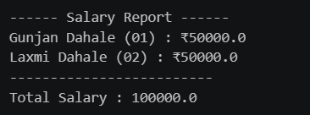
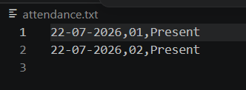
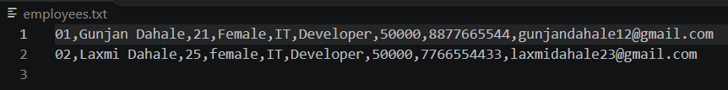
Salary Report :-
Attendance.txt File :-
Employee.txt File :-

Slide 9

Conclusion
The Employee Management System demonstrates practical use of Python — functions, file handling, loops, and the OS module — to manage employee records, attendance, and salary reports through a clean menu-driven interface.
Core Skills Applied
What It Achieves
Functions, file handling, loops, OS module
Efficient records, attendance & salary management
Next Steps
GUI integration and database support for scalability
Thank you! Questions are welcome.

