Slide 1



Energy Consumption Trends Analysis
Name: Gunjan Narendra Kokate
AICTE Stud ID: STU67e005d3e09521742734803
GitHub Repository : https://github.com/Gunjankokate/Energy- Consumption-Week-3

Slide 2

Learning Objectives
To understand the challenges organizations face in tracking and comparing energy usage
(water, electricity, gas) across multiple buildings.
To learn how to leverage Power BI for building interactive dashboards that visualize and
compare energy consumption over time.
To gain hands-on experience in identifying inefficiencies through data-driven visual analysis.
To develop skills in using Power BI tools such as Power Query, DAX, and visual components
to monitor real-time trends and support cost-saving decisions.
To apply data visualization best practices for presenting actionable insights that improve
operational efficiency and resource management.
GOAL
Source :
www.freepik.com/

Slide 3
Tools and Technology used
Microsoft Excel –
Used for initial data entry, formatting, and cleaning of raw energy consumption data.
Power BI Desktop –
Primary tool for creating dynamic and interactive dashboards to visualize energy trends.
Power Query Editor –
Utilized for data transformation, cleansing, and shaping before visualization.
DAX (Data Analysis Expressions) –
Employed for creating custom measures and calculated columns to enhance analysis.
Power BI Visuals –
Line charts, bar graphs, KPI cards, and slicers used to compare resource consumption across time and buildings.
Data Modeling –
Relationships were built between different data tables (e.g., buildings, utility types, weekly usage) to ensure accurate analysis.

Slide 4
Methodology
Data Collection Collected weekly energy consumption data (Electricity, Water, Gas) across multiple buildings using structured Excel files.
Data Preparation & Cleaning Imported the data into Power BI and used Power Query Editor to clean, transform, and standardize the dataset—handling nulls,
duplicates, and format issues.
Data Modeling Established relationships between tables (e.g., buildings, energy types, time periods) to enable accurate cross-filtering and
drill-down analysis.
Dashboard Design Created an interactive Power BI dashboard featuring bar charts, line graphs, line chart, stacked area chart, scatter chart, KPI cards,
and slicers for weekly filtering and comparison.
Insight Generation Analyzed trends, anomalies, and consumption patterns to identify high-usage zones, inefficiencies, and potential cost-saving opportunities.

Slide 5
Problem Statement:
Organizations often operate across multiple facilities, utilizing resources such as water, electricity, and gas. However, they frequently lack a centralized and transparent system to monitor and compare consumption across these locations over time.
As a result:
High-usage buildings may go unnoticed.
Sudden spikes or drops in resource consumption may not be promptly detected.
Data-driven decisions to improve efficiency and reduce costs become difficult to make.
This absence of clear and actionable insights can lead to inefficient resource utilization, increased operational expenses, and suboptimal facility management.

Slide 6
Solution:
To address the lack of visibility and control over energy consumption across multiple buildings, a comprehensive Power BI dashboard can be developed.
This dashboard serves as a centralized, interactive platform that allows organizations to track, monitor, and compare the usage of water, electricity, and gas over time, on a building-by-building basis.
Using Power BI, raw energy data collected from Excel or other data sources can be cleaned, transformed, and modeled efficiently.
The dashboard includes –
Dynamic charts and graphs:
that display weekly or monthly usage trends for each utility (water, electricity, gas).
Building-wise comparisons:
to identify which locations are consuming more resources.
KPI cards:
that highlight peak usage, sudden changes, or outliers in energy consumption.
Slicers and filters:
that allow users to view data by week, building, or utility type for deeper insights
Price Per unit consumption:
to understand how each building uses the utility type and to easily figure out the price per unit.

Slide 7
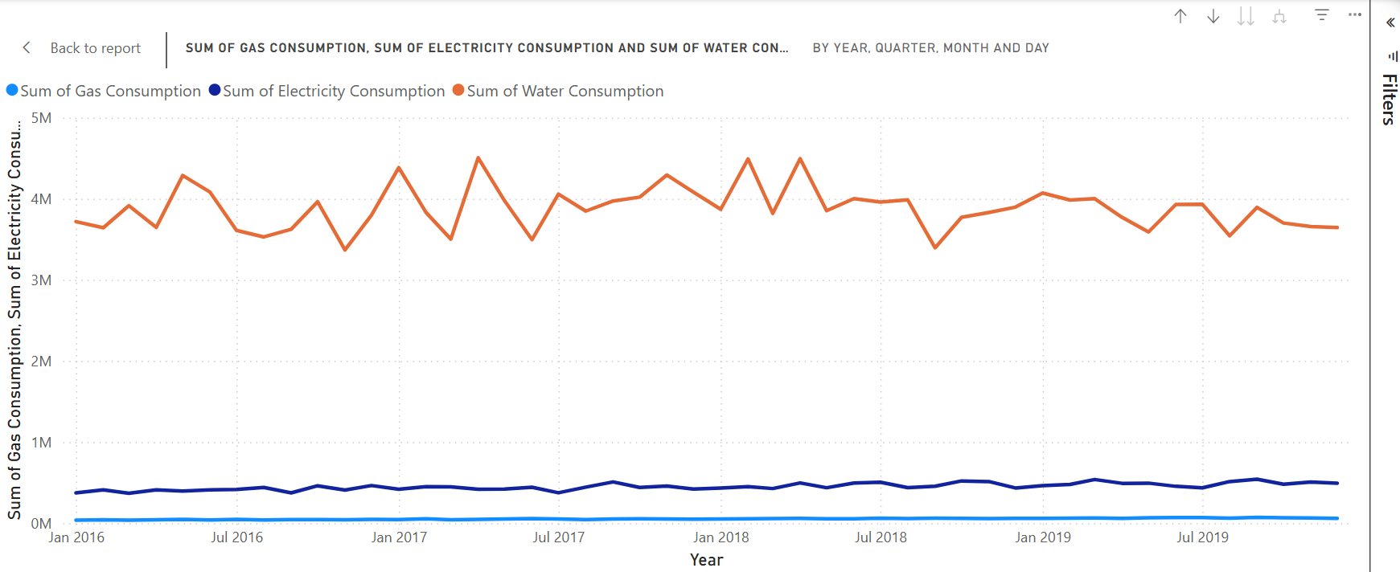
Screenshot of Output:
Short Summary:
From Jan 2016 to late 2019:
Water consumption (orange) is the highest with seasonal fluctuations.
Electricity consumption (dark blue) is moderate and shows a slight upward trend.
Gas consumption (light blue) is the lowest and remains nearly constant.
Overall, water shows cyclical use, while electricity and gas remain steady.

Slide 8
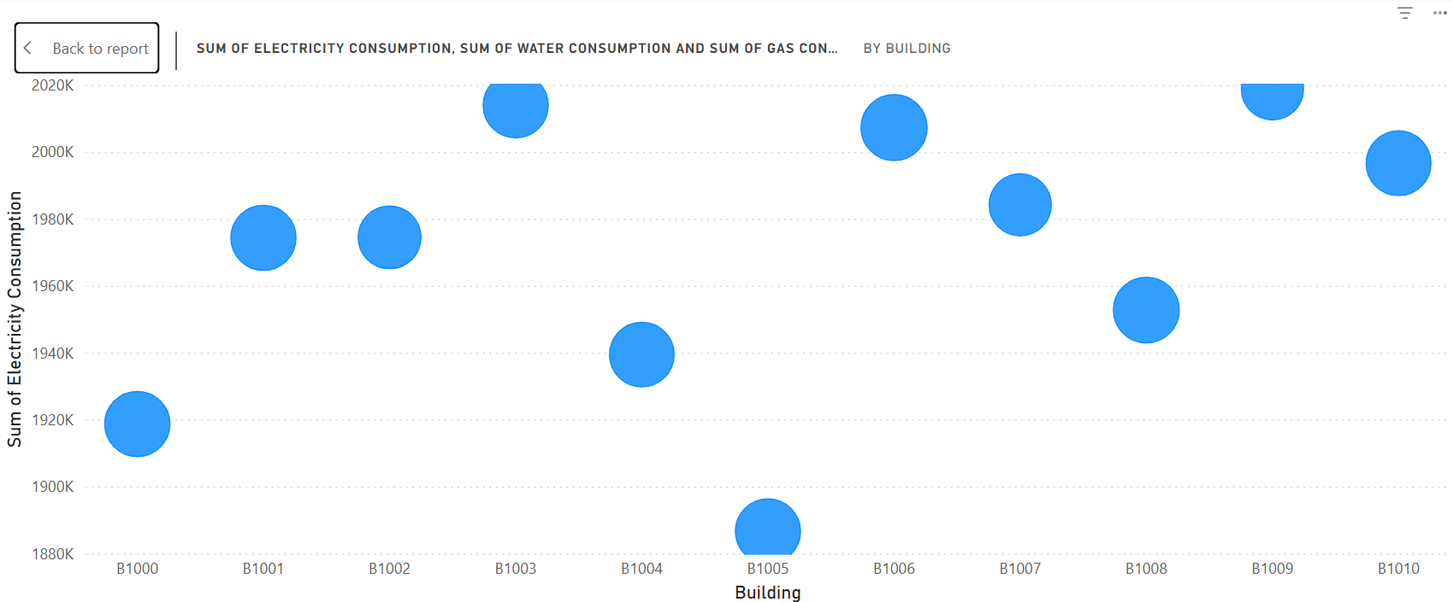
Screenshot of Output:
Short Summary:
This bubble chart shows electricity consumption by building:
Y-axis: Sum of Electricity Consumption (in thousands).
X-axis: Building codes (e.g., B1000 to B1010).
Bubble size: Likely represents total utility consumption (electricity, water, gas combined).
Key Points:
Buildings B1006 and B1009 show the highest electricity use (~2020K).
Building B1005 has the lowest consumption (~1880K).
Bubble sizes are similar, meaning total utility use is fairly uniform across buildings.

Slide 9
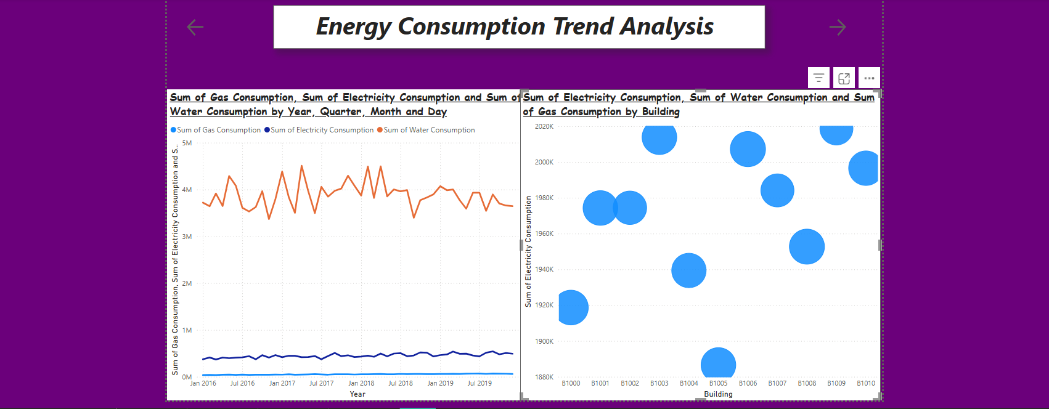
Screenshot of Output:

Slide 10
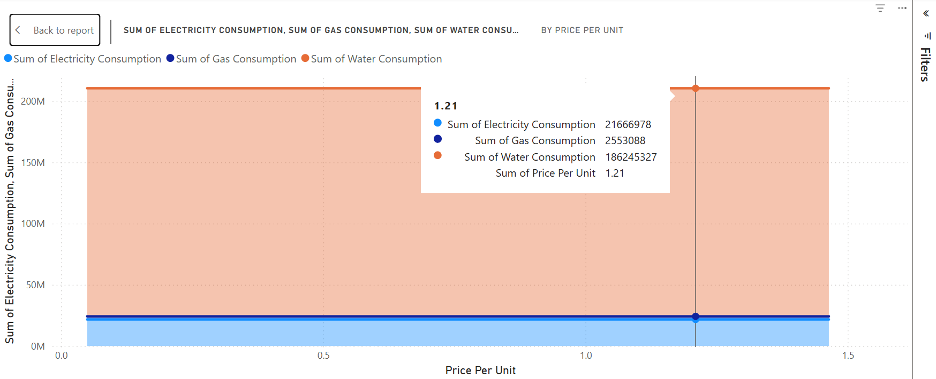
Screenshot of Output:
Short Explanation:
The chart shows electricity consumption per building:
Highest consumption: B1006 and B1009 (~2020K).
Lowest consumption: B1005 (~1880K).
Bubble size: Indicates total utility use (all buildings have similar overall usage).

Slide 11
Conclusion:
The Power BI dashboard developed for analyzing energy consumption across multiple buildings provides a powerful and insightful solution to a common organizational challenge—lack of visibility into resource usage.
By integrating data from different utilities (electricity, water, and gas) and presenting it in a dynamic, interactive format, the dashboard enables users to:
Monitor and compare usage trends over time
Identify inefficiencies and high-consumption areas
Detect anomalies such as sudden spikes or drops in usage
Make informed, data-driven decisions to reduce operational costs
This project demonstrates how advanced data visualization tools like Power BI can transform raw utility data into meaningful insights.
Ultimately, the solution supports improved energy efficiency, cost savings, and sustainability efforts—empowering organizations to manage resources more effectively and responsibly.

