Slide 1

Text-to-Speech and Voice Generation using Machine Learning
Using Python and speech synthesis to convert written text into natural speech. A mini project focused on voice assistant development.
Notes:
1

Slide 2




What is Text-to-Speech?
Core Function
Technology Blend
Converts written text into spoken audio output
Combines NLP and speech synthesis techniques
Applications
User Experience
Used in voice assistants and accessibility systems
Enables natural human-computer interaction
Notes:
2

Slide 3

Problem Statement
Current Limitations
Key Challenge: Existing basic TTS systems produce monotonic, robotic speech that lacks expressiveness and natural flow.
Heavy reliance on text-based interaction
Lack of natural, human-like communication
Accessibility barriers for visually impaired users
Robotic and unnatural speech output
Need for efficient speech generation
Notes:
3

Slide 4
Existing System Limitations
Rule-Based Systems
Robotic Output
Limited voice quality and expressiveness due to hardcoded rules
Monotonic speech lacking natural intonation and emotion
Internet Dependency
Performance Issues
Many implementations require constant internet connectivity
Not optimized for real-time or flexible usage scenarios
Notes:
4

Slide 5

Proposed Python-Based System
1
Python Core
Built using Python programming language for flexibility
2
Natural Speech
Converts input text into natural-sounding speech
3
Library Options
Uses gTTS and pyttsx3 for online and offline synthesis
4
Voice Assistant
Can function as a simple, responsive voice assistant
5
User-Friendly
Focus on ease of use and clarity of output
Notes:
5

Slide 6
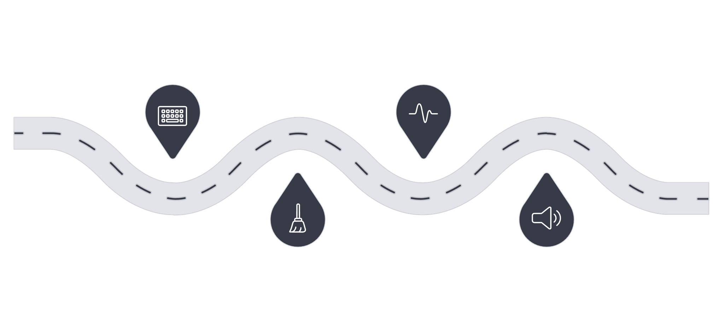




System Architecture & Workflow
TTS Processing
User Input
Convert text to phonemes
Provide text or prompt
Preprocessing
Speech Output
Clean and normalize text
Generate and export audio
The system follows a sequential pipeline from text input to audio output, ensuring efficient processing and natural speech generation.
Notes:
6

Slide 7





Technologies & Libraries Used
Python
gTTS
pyttsx3
Core programming language providing flexibility and extensive library support
Google Text-to-Speech for online synthesis with high-quality voices
Offline speech generation library for platform-independent operation
TensorFlow
NLP Concepts
Machine learning framework for advanced deep learning extensions
Basic natural language processing for text preprocessing and formatting
Notes:
7

Slide 8
System Requirements
Hardware
Software
Computer or laptop with speakers
Minimum dual-core processor
At least 4 GB RAM
Python 3.x installed
gTTS library
pyttsx3 library
TensorFlow (optional for ML extensions)
Notes:
8

Slide 9
Applications & Use Cases
Voice Assistants
Accessibility
E-Learning
Chatbots and intelligent assistants for customer service and automation
Assistive technology for visually impaired users
Audiobook systems and educational content delivery
Announcements
Customer Support
Automated announcement systems for public spaces
Interactive Voice Response (IVR) systems
Notes:
9

Slide 10





Conclusion & Future Scope
Current Success
Successfully converts text into understandable, natural speech
Implementation
Simple and efficient Python-based implementation
Impact
Enhances accessibility and user interaction
Future Enhancements
More natural voices using deep learning and neural networks
Expansion
Support for multiple languages and voice customization
Notes:
10

